Slide 1
The Policy File
14 February 2014
Notes:
Guidewire training materials contain Guidewire proprietary information that is subject to confidentiality and non-disclosure agreements. You agree to use the information in this manual solely for the purpose of training to implement Guidewire software solutions. You also agree not to disclose the information in this manual to third parties or copy this manual without prior written consent from Guidewire. Guidewire training may be given only by Guidewire employees or certified Guidewire partners under the appropriate agreement with Guidewire.

Slide 2
Lesson objectives
By the end of this lesson, you should be able to:
  Define the primary entities of the PolicyCenter data model
  Search for policies
  View the primary entities of the policy file
  This lesson uses the notes section for additional explanation and information.
  To view the notes in PowerPoint, choose View→Normal or View→Notes Page.
  If you choose to print the notes for the lesson, be sure to select “Print hidden slides.”

Slide 3
Lesson outline
PolicyCenter data model
Searching for policies
Policy contract data

Slide 4
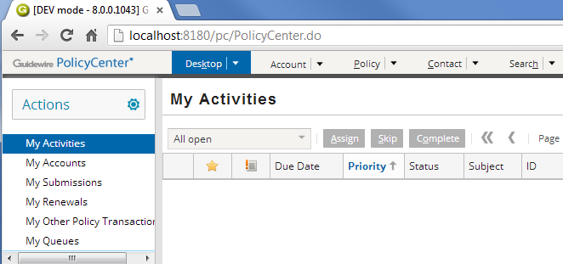
PolicyCenter data model
An entity is a type of object which PolicyCenter needs to create, modify, or otherwise manage
  Examples: policy, coverage, user
Base application data model has over 500 entities
  Only a small number are central to overall process
Notes:
The data model is the collection of:
Entities used by PolicyCenter, along with the associated data types
Typelists (which are sets of hard-coded values typically used for drop-down lists)
Field validators (which are patterns that can be applied to field to ensure the data meets a given format, such as a 5- or 9-digit requirement for a zip code)
Only 15-20 that are central

Slide 5
Policies and coverages
A policy is a contract between the carrier and the insured in which the carrier promises to cover the insured for specific types of losses
A coverage is protection from a specific risk and is always attached to a coverable such as vehicle or a building
policy
coverage
Notes:
Coverages are always attached to a coverable. (Coverables are discussed later in this section.)

Slide 6
Accounts
An account is a single person or organization which has or may have one or more policies
  Account could have many, one, or zero policies
account
policy
Notes:
The account is really a collection of information, and includes the account holder, the policies (each of which has a policy holder or holders who may or may not be the same as the account holder), Once an account has at least one policy, the account holder or the policy holder (primary named insured) is referred to as the insured.

Slide 7
Contacts and locations
A contact is a person or organization which includes but is not limited to the Named Insured(s)
A location is a physical location which may be referenced on a policy
Contacts and locations can be:
  Created on account and reused on policy
  Created on policy
account
policy
contact
location
Notes:
A named insured is an individual, business or organization that is specified in the declarations by name as the insured(s) under a policy. The named insured is responsible for premium payments, receipt of notices, and adjustment of losses.

Slide 8
Coverables
account
A coverable is an exposure to risk that can be protected by the policy, such as:
  Tangible property item such as a building
  Vehicle
  Jurisdiction
  The policy itself
policy
contact
location
coverable
Notes:
Coverages are attached only to coverables. Within PolicyCenter, Guidewire makes the policy line a coverable to represent the named insureds. A policy line is the type of insurance that the insured is buying such as personal auto or business owners insurance and so on.

Slide 9
Coverages
account
Coverages can be at policy level or for specific coverable
Two basic types:
  Property
  Liability
coverage
policy
contact
location
coverable
Notes:
In some cases, the coverage specifies not only the type of loss but the cause. For example, collision coverage covers damage to a car from auto accidents. Comprehensive coverage covers damage from incidents other than auto accidents (weather, fire, theft). If a given car is covered for collision but not comprehensive and the windshield is damaged, the cause of loss is relevant to determining whether the loss is covered.
Be aware that within the insurance industry, the term coverage is not used in exactly the same way from carrier to carrier.

Slide 10
Coverage terminology
Property coverages cover tangible assets belonging to the insured, such as a vehicle, home, or the body of the insured
property coverages
collision
comprehensive
insured
med. pay
Liability coverages cover the liability of the insured when damage is done to a third party
liability coverages
liability - vehicle
third
party
liability - injury
Notes:
The term insured refers to the person, group of people, or business covered on the policy. The term third party refers to a person who suffers a loss for which the insured is responsible. (The first party is the insured, and the second party is the carrier.)
A property coverage is a coverage in which a tangible asset (a physical object, a real estate location, or the body of the insured) of the insured is covered. The coverage exists to repair or replace the asset if it is lost, damaged, or otherwise rendered unusable. (For example, an auto policy has collision coverage which covers the car in the event that it is damaged due to a collision. Comprehensive coverage covers the car in the event that it is lost or damaged due to a non-collision event (such as a hail storm or theft). Medical payment coverage covers medical payments (damage done to the body of the insured) that results from use of the car.)
When a claim is filed, the money from losses covered by property coverages goes to the insured. (In some cases, it may go to a business which provided service to the insured, such as an auto shop which repaired the car of the insured. But from a logical standpoint, the money is still going to the insured.
A liability coverage is a coverage in which the liability of the insured is covered. The coverage exists to provide financial remuneration if a third party suffers a loss for which the insured is liable. (For example, an auto policy has the liability - vehicle damage coverage that covers damage done to a car of the third party for which the insured is responsible for. Liability - injury covers damage done to the body of the third party which occurred as the result of the insured operating a vehicle.)
When a claim is filed, the money from losses covered by liability coverages goes to the third party.
(continued)

Slide 11
(Notes only slide)
Notes:
Some policies may cover only property exposures (such as a business property policy), some may cover only liability exposures (such as a workers’ comp policy), and some may cover both (such as an auto policy).
There are several different categories of insurance. Guidewire currently focuses on the property and casualty category. The name property and casualty involves policies with property exposure and liability exposures. (Casualty is the issue of who was the cause of the incident, and therefore who is liable for financial remuneration.)

Slide 12
Coverage terms
A coverage term is a value that further limits or defines the coverage
account
coverage
policy
coverage term
contact
location
coverable
Notes:
The two most common coverage terms are deductibles and limits.
A deductible is an amount of money that the insured must pay out of pocket for a loss. The carrier provides payment only for the amount above and beyond the deductible.
Some deductibles are per incident (such as when the insured pays the first $1000 for each accident) and some are aggregate (such as when the insured pays the first $1000 within a year, and then the carrier covers losses above that, regardless of how many accidents occurred). Aggregate deductibles are also used in health insurance, where the insured may be responsible for the first $1000 in costs in a given year and then insurance covers amounts above that.
Deductibles can be found associated to property and liability exposures. However, deductibles are more commonly found with property exposures.
A limit is a maximum amount of money that will be provided for a covered loss (above and beyond the deductible).
Similar to deductibles, some limits are per incident (such as when the carrier pays up to $10,000 for any given accident) and some are aggregate (such as when the carrier pays a maximum of $10,000 per year, regardless of the number of accidents).
Deductibles and limits work together to define the range of financial responsibility that the carrier has. The deductible identifies the minimum amount of loss. The limit specifies the maximum amount of loss.

Slide 13
Forms
A form is a physical
document detailing some aspect of policy
account
coverage
policy
coverage term
contact
location
form
coverable
Notes:
Forms (also known as endorsement forms) commonly include, but are not limited to, the following:
Declaration sheets - A declaration sheet is an index or summary of all exposures, coverages, and in some cases forms.
Policy definition forms - These forms get attached regardless of what coverages or exposure units are selected. They have language defining, from a legal perspective, who is the insured, who is the insurer and so on. They typically have a set of standard coverages which additional forms will either amend or remove.
Coverage endorsements - These forms add additional coverage. (For example, a Hired Auto Coverage Form might add hired auto coverage to a base form that did not originally specify this.)
Exclusion forms - These forms limit coverages. (For example, a Mold and Fungus Exclusion Form might limit coverage on the policy of a homeowner such that damage due to mold and fungus was not covered or covered only to a certain amount.)
Manuscript forms - These forms are blank forms with space for free form text where the carrier can type one off legal terms for the policy.

Slide 14
Premium
The premium is the money the account pays for the policy
account
coverage
policy
coverage term
contact
location
form
coverable
premium
Notes:
A premium is an amount of money paid by the account for the policy. The payment can be made in full at the start of the policy or can be made in installments
At a high level, one could say that the premium is derived by evaluating all the coverages on the policy and the terms of those coverages (such as deductibles and limits), adding them up, and then adding administrative costs of the policy. In practice, determining the amount of the premium (also known as pricing) is much more complicated. A premium could be increased or decreased because of the nature of the insured. (For example, homeowners in Florida who purchase hurricane insurance will pay a higher premium than homeowners in Maine who purchase the exact same type of policy. Similarly, a business auto policy might have a lower premium for a business with no history of on-the-job driving accidents.)

Slide 15
Policy “tools”
Policy tools are used to complete the work of policy management
account
coverage
policy
coverage term
contact
location
form
coverable
premium
“tools”

Slide 16
Policy “tools”
policy
Billing
Contact
Policy Transaction
Note
Document
Risk Analysis
Reinsurance
Notes:
Billing allows you to view overall balance and balances for individual policy periods.
Contact is a person whom the carrier may need to contact but who is not part of the policy contract (such as a billing manager for a company which has a business owner’s policy).
Policy transaction displays summary information about all policy transactions that have occurred on the policy. This list includes jobs that have modified the policy, as well as jobs that are in-progress, withdrawn, not taken, or non-renewed.
Note is a record of a user of PolicyCenter thinking or strategy when working on a policy.
Document is an electronic or physical file associated to a policy (other than a form).
Risk Analysis displays issues that may affect the policy. It includes underwriting issues which is a note of an issue which is relevant to the creation or renewal of a policy and may cause the carrier to deny the policy or raise the premium. It also displays claims, prior policies, or prior losses. A claim is an event in which a potentially covered loss occurred.
Reinsurance is insurance risk transferred to another insurance company for all or part of an assumed liability.

Slide 17
Groups and users
account
group & user
coverage
policy
coverage term
contact
location
form
coverable
premium
“tools”
Notes:
Each policy is usually managed by several users. Every user assigned to a policy has a role on that policy, such as underwriter, customer service representative, or producer.
Users belong to one or more groups. Group membership influences several PolicyCenter aspects of functionality. For example, once a policy is assigned to a group, the assignment engine can automatically assign roles on the policy to one of the users in the group using the round robin selection.

Slide 18
Lesson outline
PolicyCenter data model
Searching for policies
Policy contract data

Slide 19
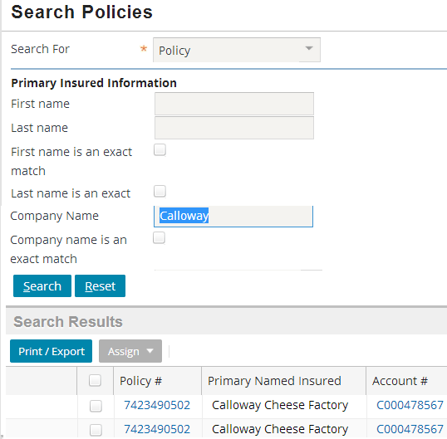
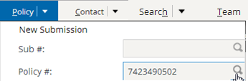
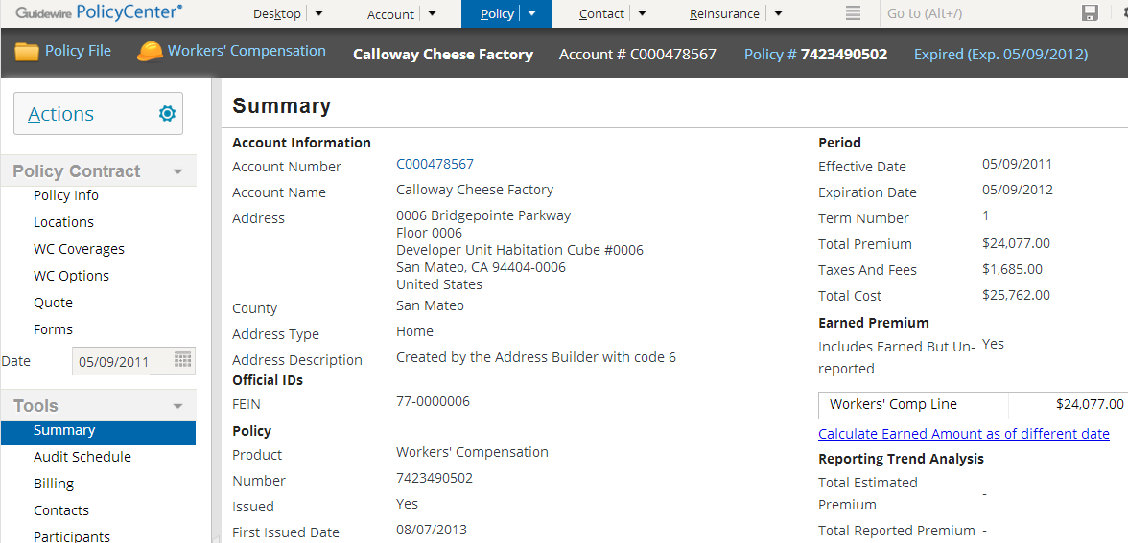
Searching for policies
Search tab
Policy search widget in Policy menu on tab bar

Slide 20
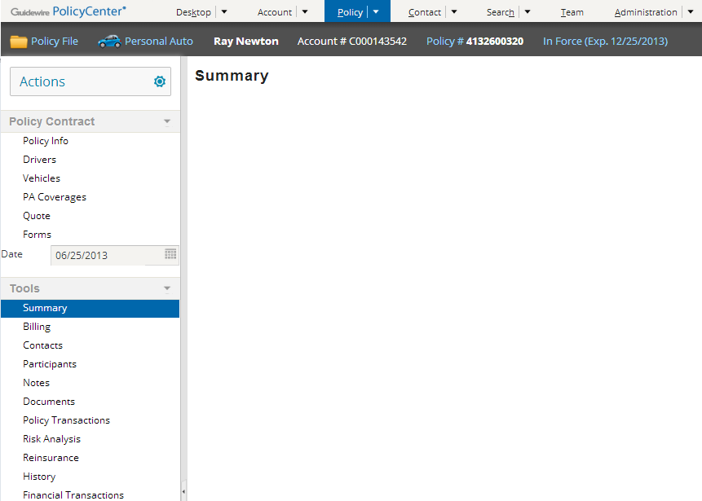
Policy file
Policy Contract
  Information which is part of legally binding policy contract
Policy Tools
  Information about policy processing and history
Notes:
Note: Audit Schedule is not listed in Policy Tools for Personal Auto policies.

Slide 21
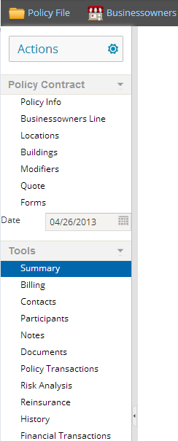
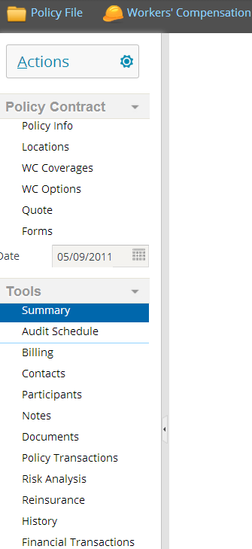
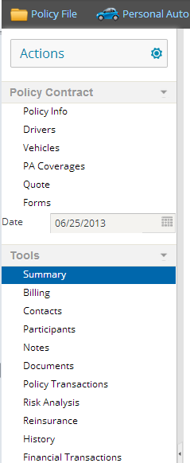
Policy file side bars
varies by type of product
identical for all types of product
Notes:
Audit Schedule link only shows up for LOBs that are defined to support Audit.

Slide 22
Lesson outline
PolicyCenter data model
Searching for policies
Policy contract data

Slide 23
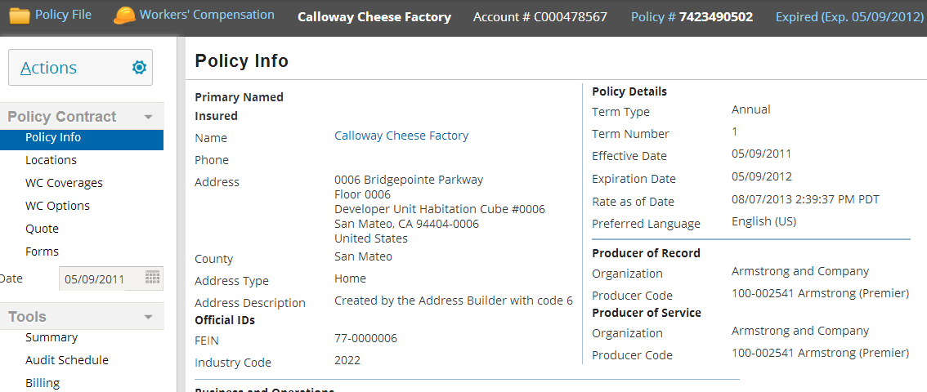
Policy Info
Policy information
Notes:
The Policy Info screen captures basic information about the policy. It contains information about primary named insured, producer information, and policy details such as effective date and expiration date.

Slide 24
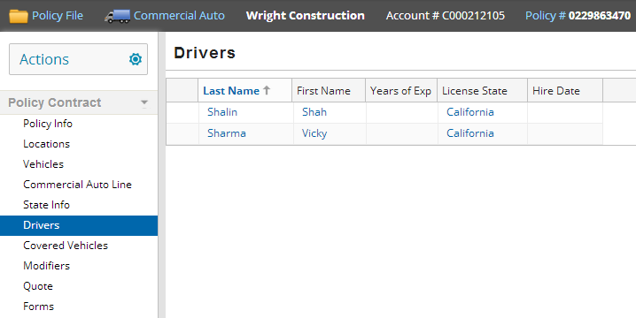
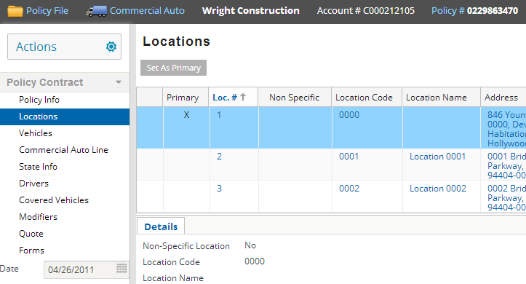
Locations and contract-level contacts
Contract-level contacts are not common to all lines of business
Notes:
The contact roles that are needed for each line of business are different for example, Drivers only occur on Personal or Commercial Auto line of business.
Contract-level contacts include only for those contacts whose role is part of the policy contract. The full set of contacts (in all roles) would show in the Policy Tools Contacts link.

Slide 25
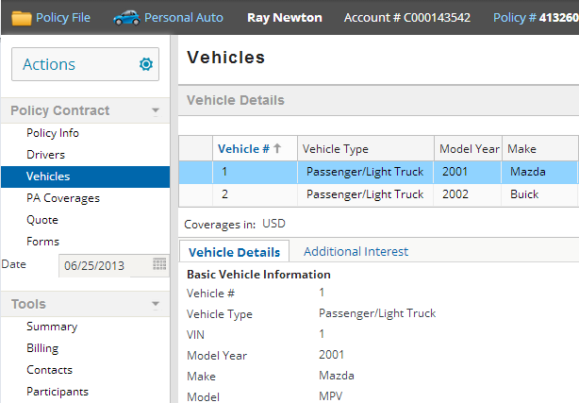
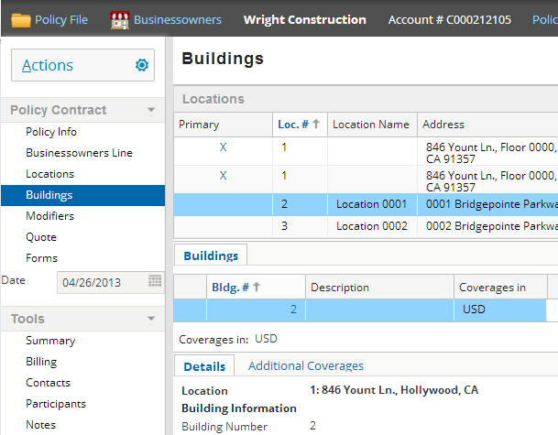
Coverables
Notes:
The vehicle in a personal auto policy or a building on a businessowners policy can be a coverable. The policy itself can also be a coverable.

Slide 26
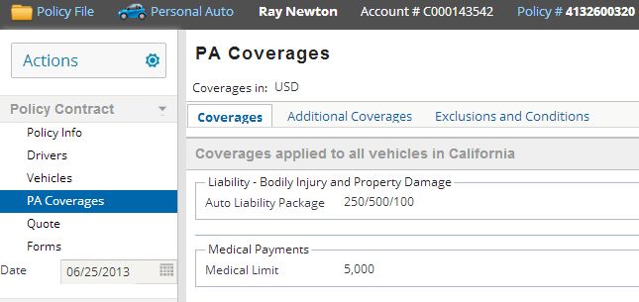
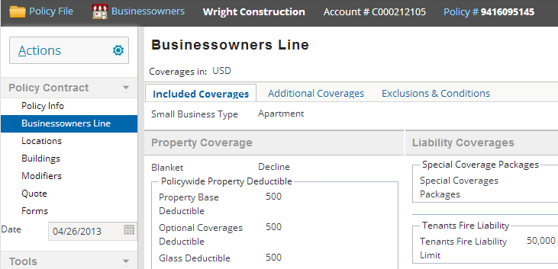
Line-level coverages

Slide 27
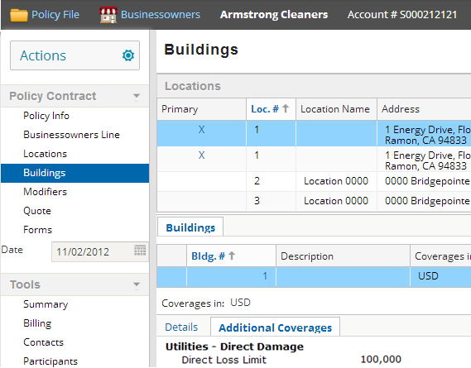
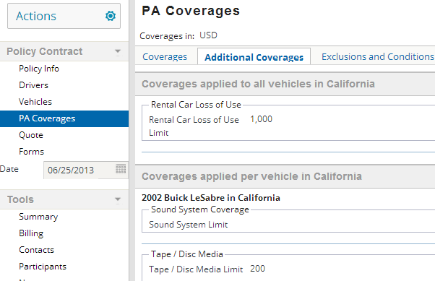
Coverable-level coverages

Slide 28
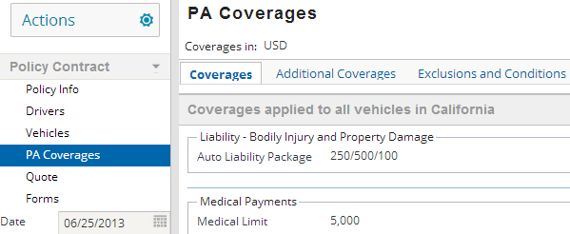
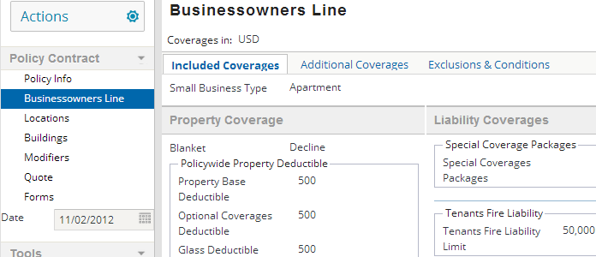
Coverage terms

Slide 29
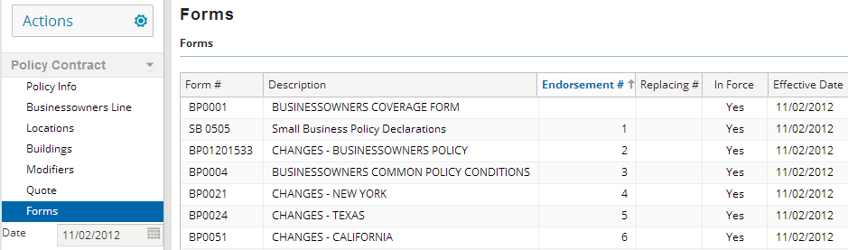
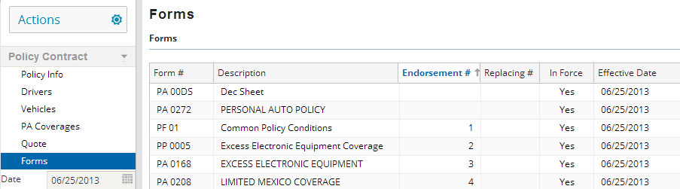
Forms
Notes:
Users cannot view the actual forms in PolicyCenter.

Slide 30
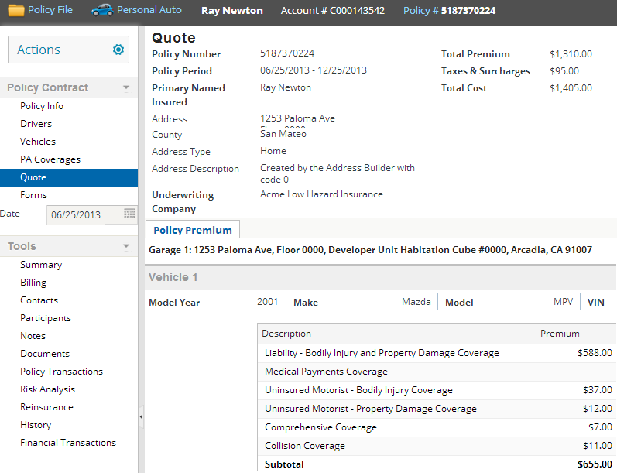
Premium
Policy Premium tab displays all the costs on the premium
Notes:
The total premium on a policy is a total of all the costs on the policy. The above Quote page has Vehicle 1 and Vehicle 2 as the two coverables on the policy. The Quote page screenshot above cannot display the cost details for Vehicle 2 since it is too big to fit on the slide above.

Slide 31
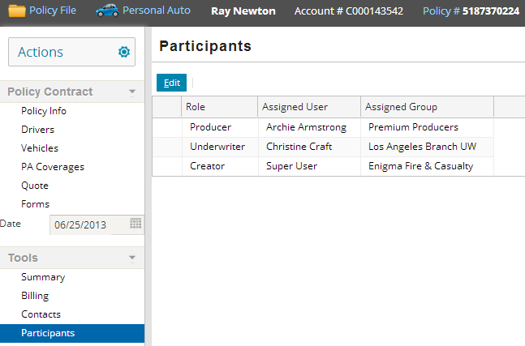
Groups and users

Slide 32
Lesson objectives review
You should now be able to:
  Define the primary entities of the PolicyCenter data model
  Search for policies
  View the primary entities of the policy file

Slide 33
Review questions
Of the primary entities discussed in this lesson (other than policy), which entity:
  Is the money the account pays for the policy?
  Is an exposure to risk that can be protected by the policy?
  Is a physical document detailing some aspect of policy?
  Can either be created on the policy or created on the account and reused on the policy? (Two possible answers)
  Is a value that further limits or defines the coverage?
What is the difference between policy contract data and policy tool data?
While a policy is in force, is there only one PolicyCenter user associated to the policy?
Notes:
Answers
1.
Premium
Coverable
Form
Contact or Location
Coverage Term
2. Policy contract data is part of the legal contract itself. Policy tools data is information about policy processing and history, but it is not legally part of the policy.
3. Typically no. There are usually several users associated to a policy, each with a different role on the policy.

Slide 34
Notices
Copyright © 2001-2014 Guidewire Software, Inc. All rights reserved.
Guidewire, Guidewire Software, Guidewire ClaimCenter, Guidewire PolicyCenter, Guidewire BillingCenter, Guidewire Reinsurance Management, Guidewire ContactManager, Guidewire Vendor Data Management, Guidewire Client Data Management, Guidewire Rating Management, Guidewire InsuranceSuite, Guidewire ContactCenter, Guidewire Studio, Guidewire Product Designer, Guidewire Live, Guidewire DataHub, Guidewire InfoCenter, Guidewire Standard Reporting, Guidewire ExampleCenter, Guidewire Account Manager Portal, Guidewire Claim Portal, Guidewire Policyholder Portal, ClaimCenter, BillingCenter, PolicyCenter, InsuranceSuite, Gosu, Deliver Insurance Your Way, and the Guidewire logo are trademarks, service marks, or registered trademarks of Guidewire Software, Inc. in the United States and/or other countries.
All other trademarks are the property of their respective owners.
This material is confidential and proprietary to Guidewire and subject to the confidentiality terms in the applicable license agreement and/or separate nondisclosure agreement.
This file and the contents herein are the property of Guidewire Software, Inc. Use of this course material is restricted to students officially registered in this specific Guidewire-instructed course, or for other use expressly authorized by Guidewire. Replication or distribution of this course material in electronic, paper, or other format is prohibited without express permission from Guidewire.
Guidewire products are protected by one or more United States patents.
Notes:
The Policy File - 34

