Slide 1
Accounts
21 April 2014
Notes:
Guidewire training materials contain Guidewire proprietary information that is subject to confidentiality and non-disclosure agreements. You agree to use the information in this manual solely for the purpose of training to implement Guidewire software solutions. You also agree not to disclose the information in this manual to third parties or copy this manual without prior written consent from Guidewire. Guidewire training may be given only by Guidewire employees or certified Guidewire partners under the appropriate agreement with Guidewire.

Slide 2
Lesson objectives
By the end of this lesson, you should be able to:
Describe the functionality of accounts in PolicyCenter
Search for and view account information
Create and modify accounts
Assign users to accounts
Create account contacts
Create account locations
This lesson uses the notes section for additional explanation and information. To view the notes in PowerPoint, choose View→Normal or View→Notes Page. If you choose to print the notes for the lesson, be sure to select “Print hidden slides.”

Slide 3
Lesson outline
Account basics
Viewing account data
Working with accounts
Account participants
Account contacts
Account locations

Slide 4
Review: Accounts
An account is a person or organization which has or may have one or more policies
Single person can be associated to multiple accounts
Account could have many, one, or zero policies
Notes:
Once an account has at least one policy, it is often referred to as the "insured".
The account may have many separate and distinct “insureds” aggregated within or below it. For example, General Motors could be an account with separate insureds (including Chevy, Buick, GMC, and Pontiac) and separate policies for each.

Slide 5
Producers
carrier
producer
Producer is a generic term for a third party who brings business to the carrier
May work with multiple carriers and know which one is best for applicant's needs
Can pre-qualify applicant to ensure it makes sense for underwriter to offer quote
Notes:
A producer makes his or her living from commissions. The commissions are paid by the carrier whenever a policy goes into effect. Therefore, the producer cares about connecting applicants who are as likely as possible to get a policy issued with underwriters who have policies with commissions as high as possible.
A carrier is a company that provides insurance to applicants. An underwriter is an employee of the carrier. It is his or her job to assess applicants to determine if it's economically advisable to insure an applicant and if so at what cost.
A single account may have relations with multiple producers and/or multiple carriers to meet all of its insurance requirements. For example, a delivery company might want to get policies from one carrier for business auto insurance because the carrier rates are extremely competitive, but that carrier does not write workers' compensation policies. So the delivery company would need to engage a second carrier for workers' compensation.
In Policy Center, a single account may have relations with multiple producers. And an “account” in a more abstract sense may have relationships with multiple carriers – but in a policy center sense, an account is only associated with one carrier.

Slide 6
Participants
A participant is any PolicyCenter user that interacts with the policy
Participant can have role one or many roles such as:
Creator
Underwriter
Auditor
producer
participant
Notes:
When a user is assigned to an account, that user may get activities assigned to him or her based on the role he or she has with the account. Their role or context, and the assigned group that the user belongs to is displayed in PolicyCenter.

Slide 7
Contacts
A contact is a person or a company
A contact:
May need to be contacted for policy information
May be named on one or more policies
producer
participant
contact
Notes:
PolicyCenter stores contact information on policies and accounts; this gives user the flexibility to manage, group, and reuse contact information throughout the application. Users can define and maintain contacts at the account level and use them across policies. A user can have policy specific contact role information added at the policy level. Users can also enter and edit contact information on a policy, and have it update the account and unbound policies in the account.

Slide 8
Locations
A location is a physical location relevant to account's insurance needs
May or may not have buildings or other structures on it
May be referenced on one or more policies
producer
participant
contact
location

Slide 9
Policies and underwriting files
Account may have one or more policies
An underwriting file is a collection of policies which may require processing as a group
producer
participant
contact
location
policy (and UW file)
Notes:
An underwriting file is a collection of policies which may require information from one another during the processing of their transactions. For example, if the quote for the renewal of the business owner policy of an account requires information from the workers’ comp policy of that same account, users can simplify the processing by having the two policies belong to the same underwriting file.

Slide 10
Transactions
Transactions include:
Submissions which did not or have not yet resulted in policies
Submissions for policies held by account
Other transactions which have modified account policies (changes, renewals, cancellations, and so on)
producer
participant
contact
location
policy (and UW file)
trans- actions

Slide 11
Activities
An activity is a task required to manage the account (or complete a transaction for the account)
producer
participant
contact
location
policy (and UW file)
trans- actions
activity
Notes:
Every activity is ultimately assigned to a participant, who is responsible for completing the task. The activity identifies when the task is expected to be done by and whether it has been done or not.

Slide 12
Documents
A document is an electronic or physical file which contains information relevant to the account or its policies
producer
participant
contact
location
policy (and UW file)
trans- actions
activity
document

Slide 13
Notes
A note is a detailed record of the actions or thinking of a PolicyCenter user
producer
participant
contact
location
policy (and UW file)
trans- actions
activity
document
note

Slide 14
Review: Account data model
producer
account
participant
contact
location
policy (and UW file)
trans- actions
activity
document
note

Slide 15
Lesson outline
Account basics
Viewing account data
Working with accounts
Account participants
Account contacts
Account locations

Slide 16
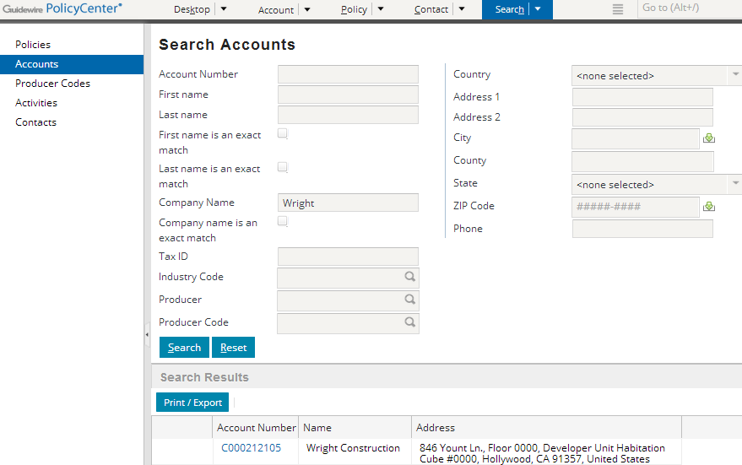
Searching for accounts
Notes:
To search for an account, click the Search tab and then click the Accounts menu link. Enter the appropriate criteria and click the Search button.

Slide 17
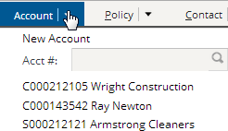
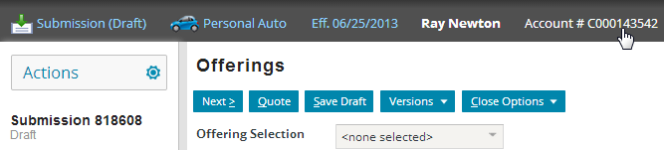
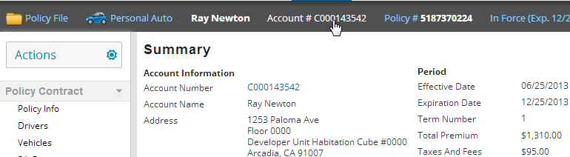
Fast ways of getting to an account
Account tab's menu has - account search widget (by number) - recently visited accounts
Policy and transaction info bar has links
Notes:
Also a user can click directly on the “Account” tab itself and will be taken to the most recently visited account.

Slide 18
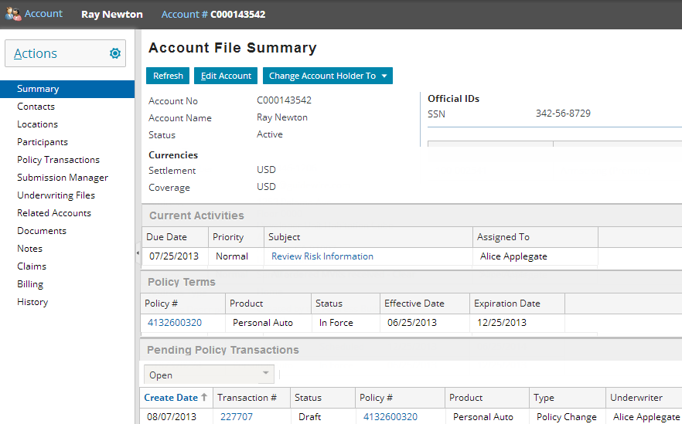
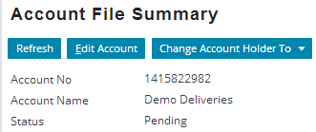
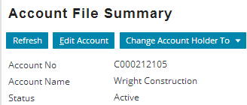
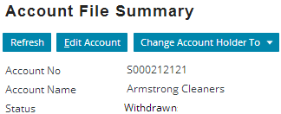
Account summary and status
Notes:
An account can have one of three statuses:
Pending - The account is ready for data entry, but data entry is still ongoing and the account is not considered fully open. All new accounts begin with a status of pending.
Active - The account is fully ready and submissions have been created for it.
Withdrawn - The account has been withdrawn from consideration for business with the carrier.

Slide 19
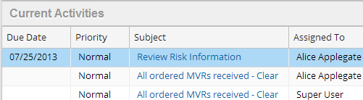
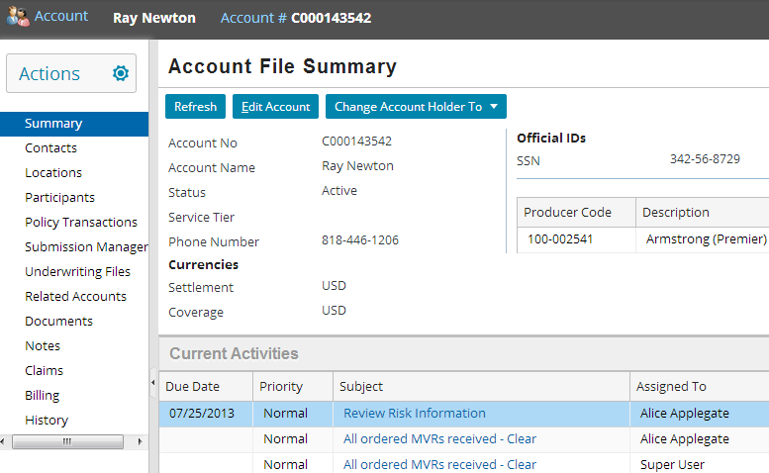
Activities
On Summary screen
Notes:
The Current Activities list view lists all open activities associated to the account or to any policy transaction (such as a submission or renewal) associated to the account.

Slide 20
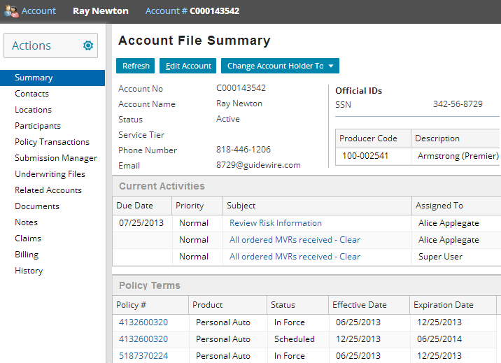
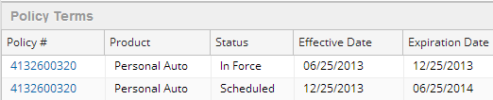
Policy Terms
On Summary screen
Notes:
The Policy Terms list view on the Account Summary page lists all in force, cancelled, and expired policies owned by the account.

Slide 21

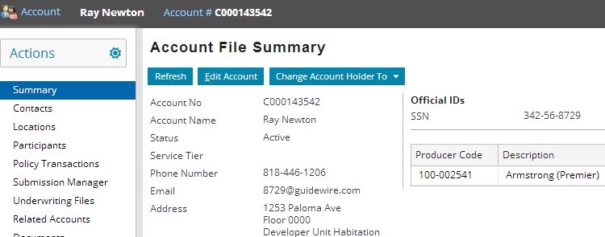
Producer Code
On Account File Summary screen
Account Producer Code is used to control access to the account
Notes:
When an account is initially created, only one producer code can be associated to the account. However, an account can have multiple producer codes associated with it when different policies on the same account use different producer codes thus adding those producer codes to the account.

Slide 22
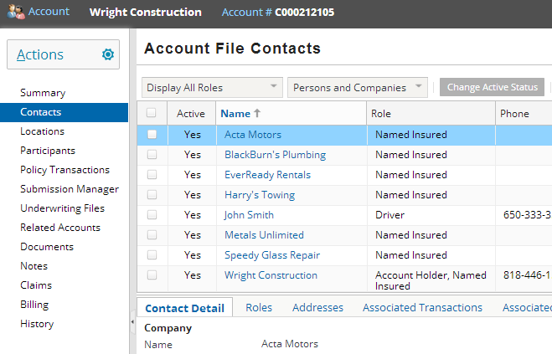
Contacts
Notes:
A contact that is set up from the Account File can be used by all policies within the account. One contact can play multiple roles on the account and on the policy. Take a personal auto policy for example. A contact can be the holder of the account, the primary named insured on the policy, and a driver of a vehicle insured by the policy.
Users can access contacts through accounts and policies, which provide a centralized view of all contacts on the account and policy files. Some contact information is shared across policies. An update to the shared information propagates across all unbound usages of a contact. Other information is policy or usage specific, and does not propagate to other policies.
In the screenshot above, the contact Wright Constructions has two roles: Account Holder and Named Insured.

Slide 23
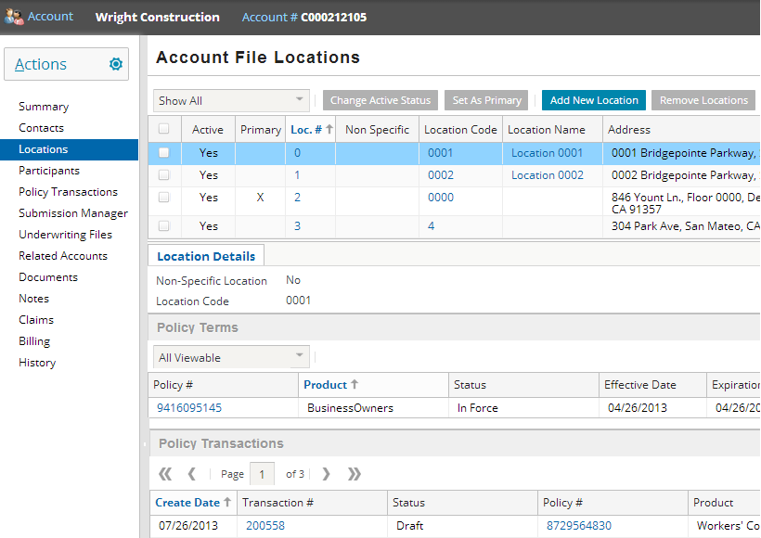
Locations
Policies and transactions that reference selected location

Slide 24
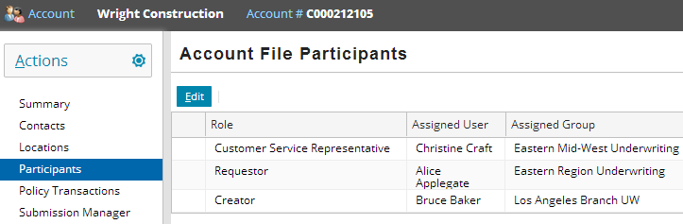
Participants
Participants screen lists each user associated to account with his or her role

Slide 25
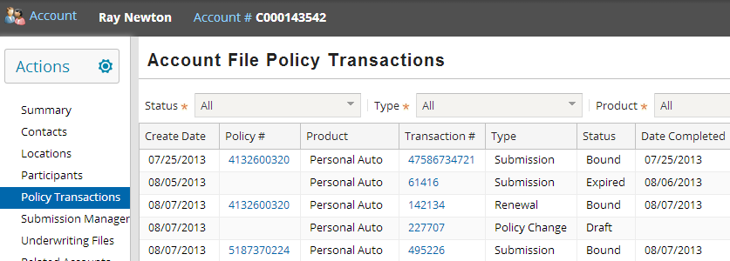
Policy Transactions
Notes:
The Account File Policy Transactions list view lists all transactions. The user can see all policy transactions, just open ones or just completed ones, depending on what they choose in the first filter. The results can also be filtered based on Product or Transaction Type.

Slide 26
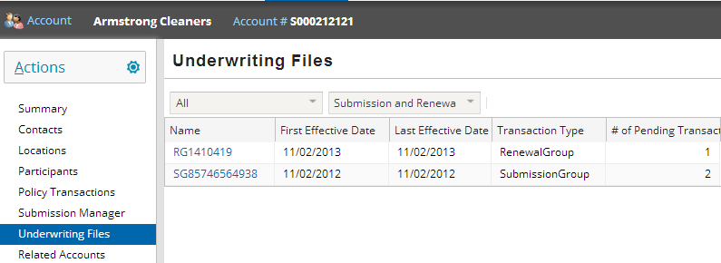
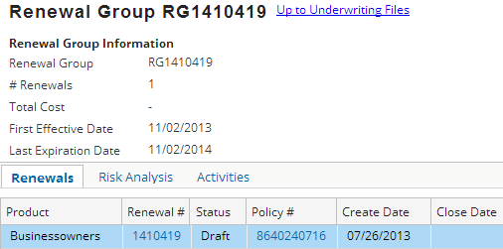
Underwriting Files
JobGroups
Notes:
The Underwriting Files list identifies all underwriting files. Underwriting Files allow customers to view risk information by grouping. The base configuration of PolicyCenter, puts submissions in one group and all renewals in another group but this behavior is configurable.
A user could click on a RenewalsGroup and that lists three tabs – Renewals, Risk Analysis, and Activities.
These are called JobGroups in PolicyCenter as they are grouped based on the job.

Slide 27
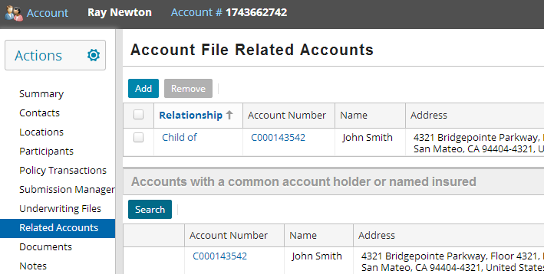
Related Accounts
Accounts are related when another account has some of the same contacts with Account Holder or Named Insureds roles
Notes:
To find related accounts, click Search button on the Related Accounts screen. A list of accounts is displayed where there is a contact with an appropriate role on both the accounts. By default, it is defined to include Account Holders and Named Insureds.

Slide 28
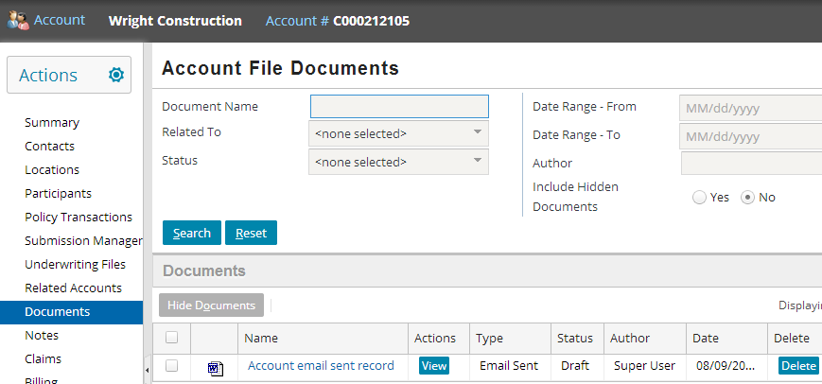
Documents
The Account File Documents screen lists documents associated to the account
Notes:
A document is a basic operating system file (such as a text file or image file) which is stored by PolicyCenter and whose contents can be viewed through the account. By default, PolicyCenter stores documents as files in your local file system. Users can manage these files with directory and files commands. Users can also integrate documents with an external document management system.

Slide 29
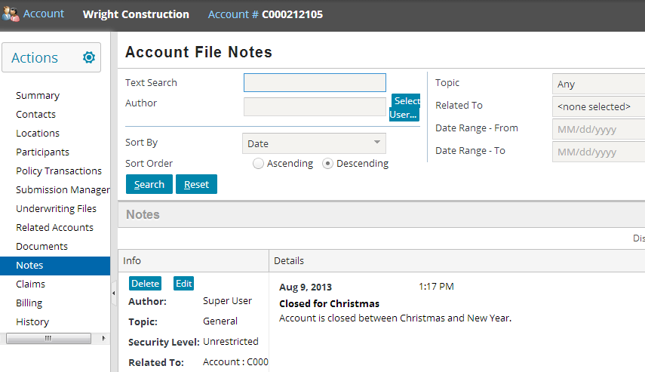
Notes
A user can view notes that have been associated directly with the account and with any policy or transaction associated with the account
Notes:
The “Related To” field allow a user to be more specific about what notes they want to view.
This is information a user wishes to record about his or her thinking or strategy regarding the account (such as the detailed reason why a billing issue occurred).

Slide 30
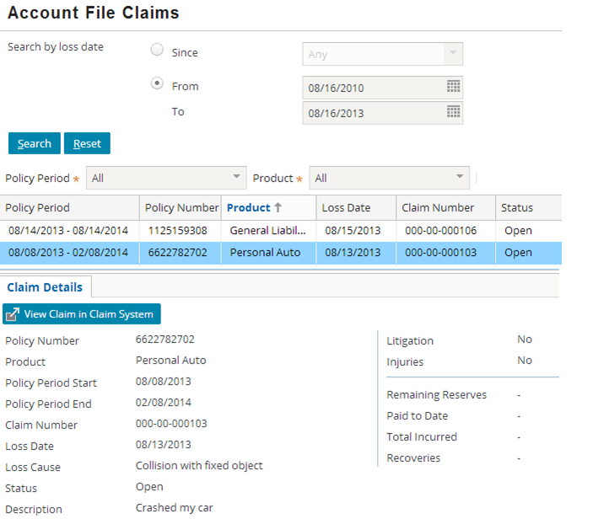
Claims
Claims screen in an account lets a user view claims associated with the account
Appears only if you are integrated with a Claim System
Notes:
A user can see claims for which they have view permission on the policy. A user can view this screen by navigating to an account then clicking Claims in the left sidebar. This screen is similar to the Claims screen for policies except that it retrieves claims for all policies in the account. In addition, the account Claims screen displays Product and Policy Number in the account claim list and Claim Details.
The Claim Details has a View Claim in Claim System button. This button appears if the ClaimCenter integration or integration with a claim system is enabled and the user has the permissions to view claims in the system. This button opens a window to the claim system.

Slide 31
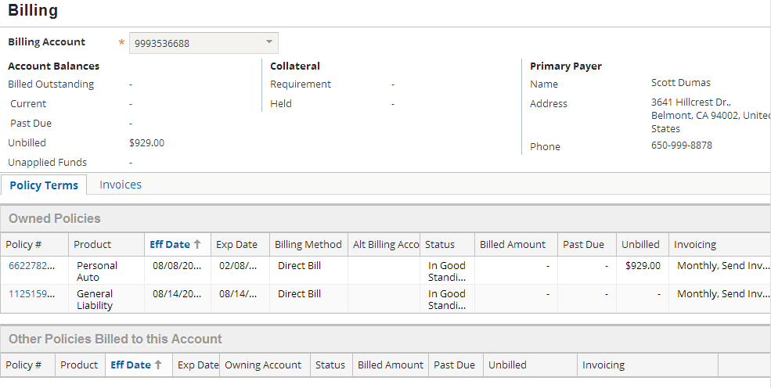
Billing
Billing link provides detailed Billing information on an account

Slide 32
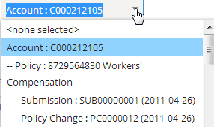
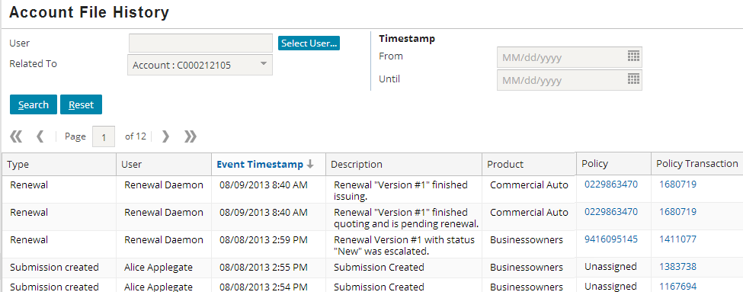
History
Account history captures all account events such as name or address change, jobs on account and so on
Account → History (on the sidebar)
Notes:
The results can be filtered by “Related To”. The options in the dropdown are policies on the account and within a policy its jobs are listed. You can search on account, policy, or job for its history. (Policy and Job history are available on the policy and transaction files as well). The jobs within a policy are ordered by policy term (descending) and within the policy term by the job type (alphabetical). When a user selects Account search, results include all job history events for all policies.
Some use cases where the account history might be needed is: merging an account into another account, splitting an account off from a current account, or transferring a policy between accounts. Account history may also be viewed while adding or removing contacts from the account, when they were granted roles or the roles were removed.

Slide 33
Lesson outline
Account basics
Viewing account data
Working with accounts
Account participants
Account contacts
Account locations

Slide 34
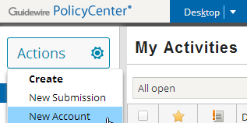

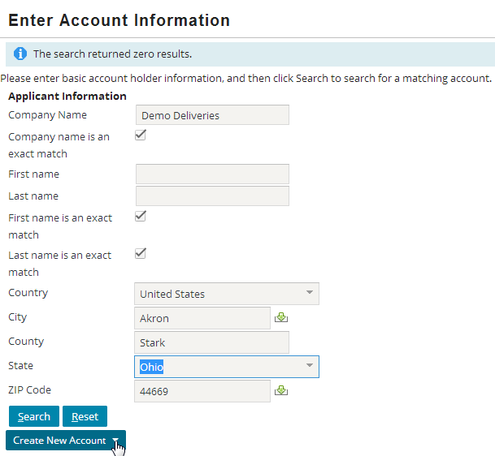
Creating accounts
Before you can create account, you must search to verify it doesn't exist
If the account search finds no match, then Create New Account button becomes visible
Notes:
PolicyCenter requires you to search for an account first. If the account does not exist, then you can create a new account using information from the search criteria. (The new account can be created as a company or as a person.) This is shown in detail on the next page.
Within the insurance industry, there is a concept known as "name clearance". Name clearance is the process of determining if a given account is a new account or if the account is already known to the carrier. This is a relevant issue when the same account requests quotes or policies at different times and may not provide exactly the same name (such as a company known as "Demo Deliveries", "Demo Deliveries Inc.", and "Demo Delivers"). This screen executes name clearance. A search is always executed to see if the named account exists, and the end user must either choose an existing account or identify that the applicant is in fact a new account.

Slide 35
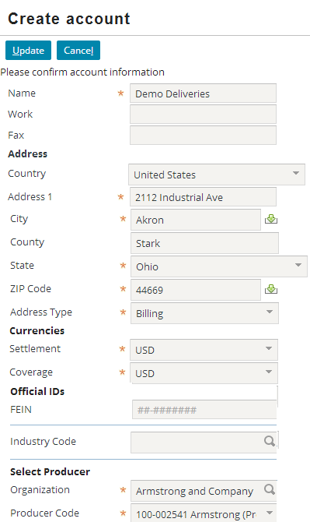

Create Account screen
Information from search is carried over to Create Account screen
Note Producer and Producer Code are required fields
Notes:
Some fields have been removed to fit the screenshot on the slide.

Slide 36
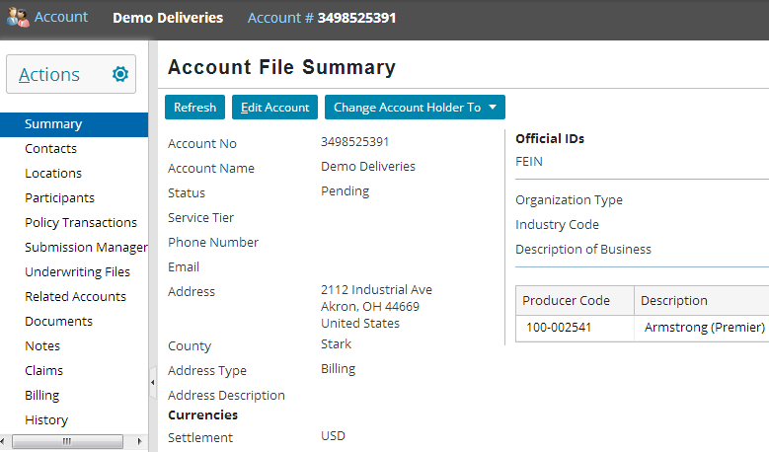
Editing accounts
To edit account information, locate the Edit Account button on the Account File Summary screen
Notes:
Clicking this button puts you in edit mode. Make the necessary modifications and click the Update button.

Slide 37
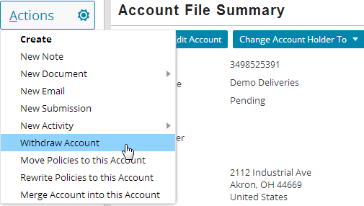
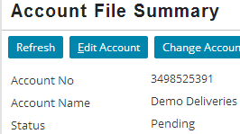

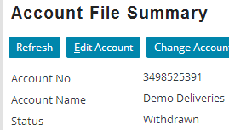
Withdrawing accounts
Notes:
Only pending accounts can be withdrawn. The Actions menu is context-sensitive and displays the Withdraw Account menu option for pending accounts only. When a user withdraws account, that account is withdrawn from consideration for business with the carrier and the Account Status changes to Withdrawn. However, the user can request to Re-open the account. The account status then changes from Withdrawn to Pending. A Pending account becomes active automatically when a submission is created for it.

Slide 38
Lesson outline
Account basics
Viewing account data
Working with accounts
Account participants
Account contacts
Account locations

Slide 39
Account participants
A participant is a PolicyCenter user who works directly or indirectly (producer) for the carrier and is assigned to account with given role
Participants can be assigned manually or automatically
Notes:
Participants often work for the carrier and there can be “External” users also that are Participants. An external user is a person outside the company who needs to access PolicyCenter data. Typically they are producers.
“Internal” users are those that work directly for the carrier. When creating a user, an administrator can define whether they are external or internal.

Slide 40
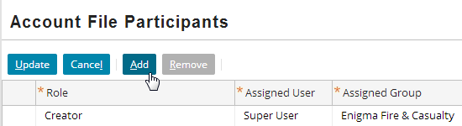
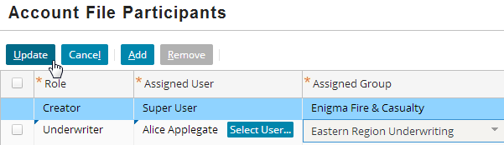
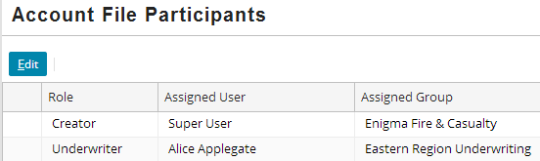
Adding participants manually

Slide 41
Lesson outline
Account basics
Viewing account data
Working with accounts
Account participants
Account contacts
Account locations

Slide 42
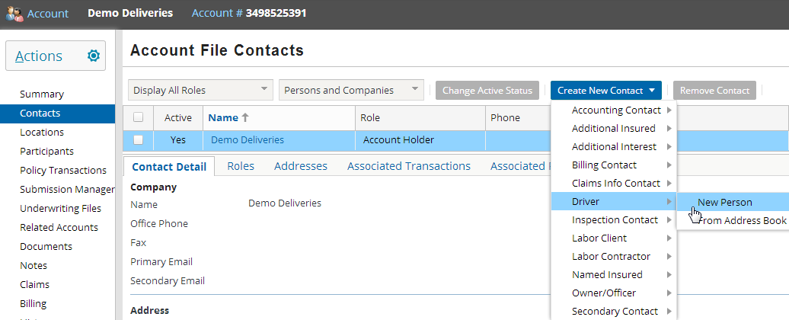
Creating a new contact
Contact will be created with a role (such as “Driver") based on which menu is used to create it
Contact can be created or retrieved from address book (see slide 44)

Slide 43
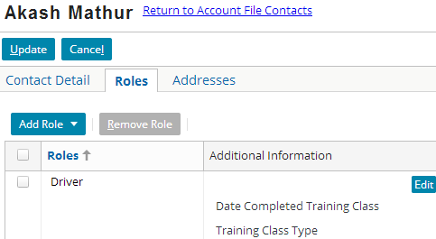
Viewing and adding contact roles
Contact roles are listed under the Roles tab
Add or change roles
Edit additional role information
Notes:
Additional roles can be added to a contact from within the above New Contact screen.

Slide 44
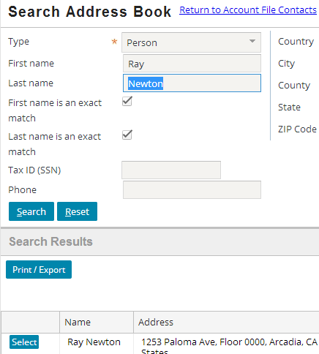
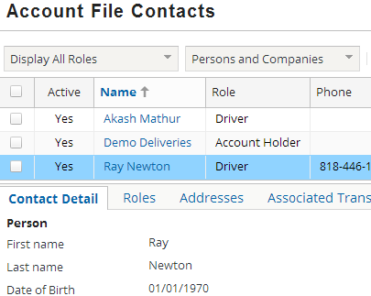
Adding contact from Address Book
Enter exact first and last name

Slide 45
Lesson outline
Account basics
Viewing account data
Working with accounts
Account participants
Account contacts
Account locations

Slide 46
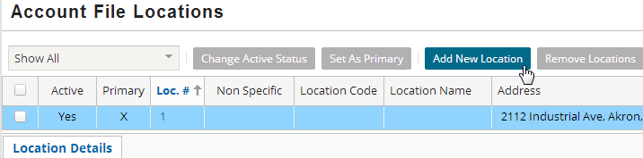
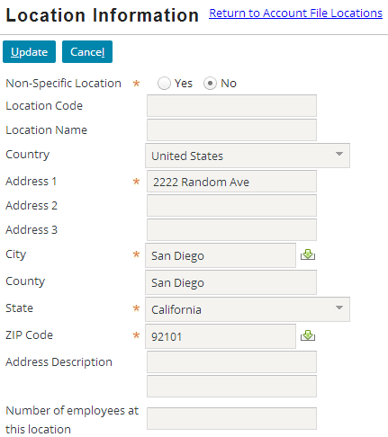
Adding new locations
Create locations on the account using Add New Location button
Transactions created on the account can use these account locations
Notes:
For example, you can access account location information when creating a submission or modifying a policy.

Slide 47
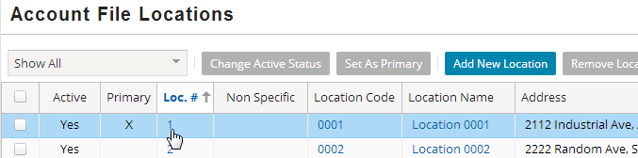
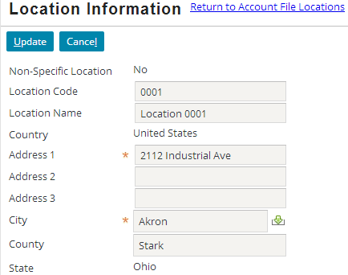
Editing locations
Any clickable blue text in list view displays the location in detail and in edit mode

Slide 48
Lesson objectives review
You should now be able to:
Describe the functionality of accounts in PolicyCenter
Search for and view account information
Create and modify accounts
Assign users to accounts
Create account contacts
Create account locations

Slide 49
Review questions
What is the cardinality between account and policy?
How could you navigate to the following accounts? For each, name the fastest method.
The account named Big Lake Bakery.
Anna Delfino's account, which is number 5673211.
The Wright Construction account, which you were looking at five minutes ago.
The account for the policy you're currently looking at.
What three statuses can an account have?
What is the difference between an account participant and an account contact?
Notes:
Answers
1. Account to policy is a 1-0 (one account with zero policies) or 1-to-many (one account with one or more policies) relationship. (One account can have many policies. A policy can belong to only one account.)
2. a) Navigate to the Account Search screen and execute a search for Big Lake Bakery.
b) From the Account tab menu, enter the account number into the account search widget.
c) Two ways:
From the Account tab menu, click the Wright Construction account link. (Presumably, it will be listed there as a recently visited account.)
Click the Account tab, which takes you to the account you most recently visited
d) From the navigation panel, click the Account menu link. (If the Summary page is visible, you can also click the Account number there.)
3. Pending, active, and withdrawn
4. A participant can be someone who works for the carrier or can be external agents and they are people who have responsibility for the account. A contact is a person or a company on the account or related policies, whereas the participants have responsibility for maintenance of the account or policies. They may be named insureds, they may be drivers etc.

Slide 50
Notices
Copyright © 2001-2014 Guidewire Software, Inc. All rights reserved.
Guidewire, Guidewire Software, Guidewire ClaimCenter, Guidewire PolicyCenter, Guidewire BillingCenter, Guidewire Reinsurance Management, Guidewire ContactManager, Guidewire Vendor Data Management, Guidewire Client Data Management, Guidewire Rating Management, Guidewire InsuranceSuite, Guidewire ContactCenter, Guidewire Studio, Guidewire Product Designer, Guidewire Live, Guidewire DataHub, Guidewire InfoCenter, Guidewire Standard Reporting, Guidewire ExampleCenter, Guidewire Account Manager Portal, Guidewire Claim Portal, Guidewire Policyholder Portal, ClaimCenter, BillingCenter, PolicyCenter, InsuranceSuite, Gosu, Deliver Insurance Your Way, and the Guidewire logo are trademarks, service marks, or registered trademarks of Guidewire Software, Inc. in the United States and/or other countries.
All other trademarks are the property of their respective owners.
This material is confidential and proprietary to Guidewire and subject to the confidentiality terms in the applicable license agreement and/or separate nondisclosure agreement.
This file and the contents herein are the property of Guidewire Software, Inc. Use of this course material is restricted to students officially registered in this specific Guidewire-instructed course, or for other use expressly authorized by Guidewire. Replication or distribution of this course material in electronic, paper, or other format is prohibited without express permission from Guidewire.
Guidewire products are protected by one or more United States patents.
Notes:
Accounts - 50

