Slide 1
Typelists
December 9, 2013
Notes:
Guidewire training materials contain Guidewire proprietary information that is subject to confidentiality and non-disclosure agreements. You agree to use the information in this manual solely for the purpose of training to implement Guidewire software solutions. You also agree not to disclose the information in this manual to third parties or copy this manual without prior written consent from Guidewire. Guidewire training may be given only by Guidewire employees or certified Guidewire partners under the appropriate agreement with Guidewire.

Slide 2
Describe the functionality of a typelist
Create a typelist and typelist extension
Create a typekey field
Create a typekey field that references a typelist filter

Slide 3
Typelist basics
Create a typelist
Create a typelist extension
Defining typekey fields

Slide 4
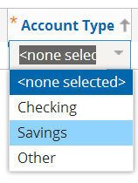
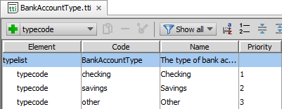
What is a typelist?
A typelist is a list of defined values
Defined values often used to constrain user input
When rendered in UI, typically appears as dropdown list
BankAccountType typelist defines values in Account Type cell

Slide 5
Locations of typelist files
…\Metadata\Typelist
…\Extensions\Typelist
Typelist
Internal Typelist Extension
Typelist
Typelist Extension
Most platform and base application typelists
All files are read-only
Some files marked as final
Some base application typelists and typelist extensions
Customer custom typelists and typelist extensions
All files are editable

Slide 6
Kinds of typelists
Internal
Internal base application logic
Cannot modify or extend
Read-only
Some virtual
Extendable
Base application
Can modify typelist or typelist extension
Custom
Customer creates as part of custom configuration
Virtual Typelist
Typelist
Internal Typelist Extension
Typelist Extension
Typelist
Typelist Extension
Notes:
In some cases, an internal typelist does not have a physical file that is exposed in Guidewire Studio. One type of virtual typelist is a typelist of subtypes for a given supertype. In Guidewire Studio, using Class Name Search (CTRL+N) , you can find and view a virtual typelists in the Typelist Editor. However, there is no file path and no XML file view for virtual typelists. One example is the ABContact typelist which is a typelist of all ABContact subtypes.
Typelists with the final="true" attribute defined in the <typelist /> element cannot be extended. An internal typelist extension (TIX) file can only be found in the …\modules\configuration\config\metadata\typelist\ folder.
You can always determine to base configuration for a Guidewire application by looking at the <installDirectory>\modules\base.zip file.

Slide 7
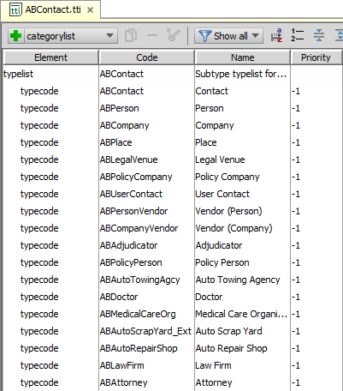
Internally managed (virtual) typelists
Some typelists are not exposed
No physical file exposed
Typelist Editor file tab shows yellow for virtual status
Typelist Editor XML tab shows empty file
Studio navigation bar is blank
Example: Subtype typelist
Shows all subtypes a specific subtyped parent entity
New subtypes entities automatically added
Virtual Typelist

Slide 8
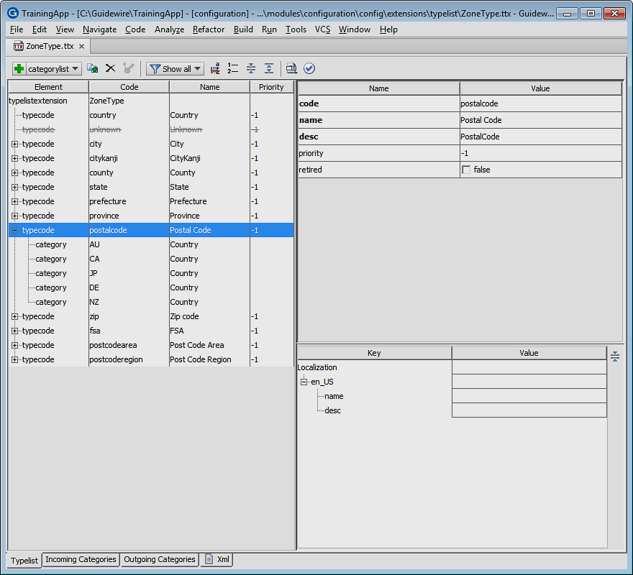
Typelist editor
View, define and edit a typelist, typelist extension, or internal typelist extension
/extensions/typelist/
TTI and TTX files
/metadata/typelist/
TTI and TIX files
Consists of
Editor toolbar
Element tree pane
Attribute pane
Localization pane
Metadata Editor is base editor
Notes:
With the Typelist editor, you define a typelist and any associated typecodes, typefilters, and categorylists. With the Typelist editor, you can view all (but not edit all) typelists: extendable, internal, internally exposed (typelist of subtypes, for example), and custom typelists.
You can define and edit an typelist and typelist extension located in the …\configuration\config\extensions\typelist folder. The Typelist editor also allows you to view an typelist or internal typelist extension located in the …\configuration\config\metadata\typelist folder. Files in the metadata folder are read-only.

Slide 9
Typelist editor: Toolbar reference
 |  | Icon | Description
Actions | Edit |  | Add an element; Dropdown list is schema aware
 |  |  | Duplicate selected element
 |  |  | Delete selected element
 |  |  | Override selected element
 | View |  | Filter elements by file
 |  |  | Persist sort order
 |  |  | Reassign priorities
 |  |  | Collapse nested elements; Expand nested elements
 | Navigate |  | Navigate to supertype and/or subtype
 |  |  | Click link to navigate to extension
 | Validate |  | Validate typelist
Notes:
When you define and edit a typelist or typelist extension located in the /configuration/config/extensions/typelist folder, the Typelist editor toolbar is fully enabled. Typelists and internal typelist extensions in the /configuration/config/metadata/entity folder are read-only and all Edit actions are disabled.
The Typelist editor toolbar is also context sensitive based on the kind of typelist (internal, internally exposed, extendable, or custom). For internal typelists, there are no edit actions in the toolbar.
The Typelist editor toolbar is also context sensitive based on the bottom tab selection. For both the Incoming Categories and Outgoing Categories bottom tabs, the toolbar consists only of the Add Category/Typecode, Remove, Filter, Collapse, Expand, and Validate commands.

Slide 10
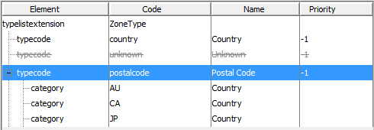
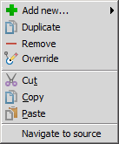
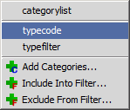
Typelist editor: Element tree pane
Displays hierarchy of XML elements
Elements merged from underlying base typelists are read-only
Sortable columns
Context menu is schema aware
Add new elements as siblings and children
Cut, Copy, and Paste elements
Notes:
View actions in the Typelist editor toolbar influence the display of the Element tree pane. Bottom tab selection also changes the columns of the Element tree pane for the Typelist editor. For instance, Incoming Categories and Outgoing Categories changes the columns to Category/Typecode and Typelist. By default, the Element tree pane displays the hierarchy of nested elements, including any inherited elements from base typelists. You can use the toolbar to change how the editor display the various elements: Show all, This file only, Typecodes only, and Typefilters only. The toolbar and the context menu for the element tree pane is schema aware.

Slide 11
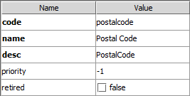
Typelist editor: Attribute pane
For selected element, define attributes
Name is the attribute
Value is the attribute value
Attribute styling
Bold for required and black for editable
Grayed-out for non-editable
Overridden, Inherited, Internal and Default
<typecode code="postalcode"
name="Postal Code
desc="PostalCode">

Slide 12
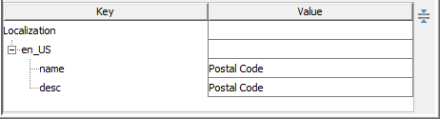
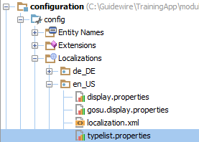

Localization pane
Localize a specific typecode
Name
Description
New or edited values modified in the typelist.properties file, example
/locale/en_US/ typelist.properties
Notes:
Use the Localization pane to select a specific locale for a given typecode. Then, create or edit a translation string for both the typecode name and description. The name and description that you specify is created in the typelists.properties file for the locale. Guidewire stores typelist typekey localizations in typelist.properties files, one file for each locale. Guidewire Studio stores typelist typekey localizations using the following format for name and description respectively:
TypeKey.typelist.typekey = localized_name TypeKeyDescription.typelist.typekey = localized_description You can edit typecode name and descriptions in the Typelist editor Localization pane or in the Typelist Localization editor.

Slide 13
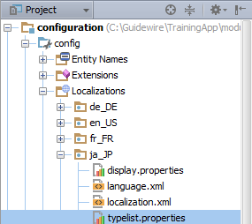
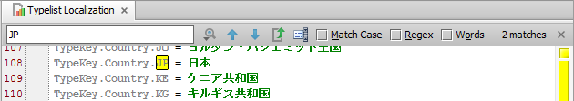

Typelist Localization text editor
For a given locale, edit typelist.properties
Define TypeKey and/or TypeKeyDescription
In file search
CTRL+F
Remove and sort
ALT+ENTER
Notes:
Guidewire stores typelist typekey localizations in typelist.properties files, one file for each locale. Guidewire Studio stores typelist typekey localizations using the following format for name and description respectively:
TypeKey.typelist.typekey = localized_name
TypeKeyDescription.typelist.typekey = localized_description You can edit typecode name and descriptions in the Typelist editor Localization pane or in the Typelist Localization editor.
There are several ways to view localized typekey properties:
typekey.Code = String that represents the typecode
typekey.DisplayName = Localized language version of the entity name
typekey.UnlocalizedName = Name listed in the data model

Slide 14
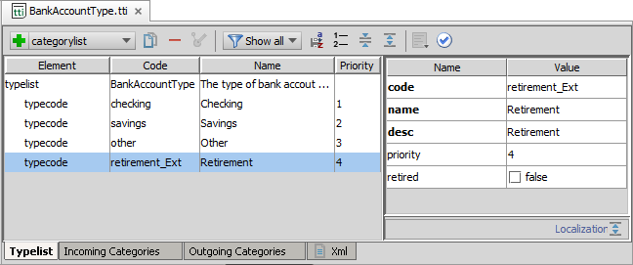
Typecodes for base application typelists
When extending base application typelists or typelist extensions in the …\Extensions\Typelist\ folder, create new typecodes with codes that end in _Ext
Notes:
The BankAccountType.tti is an application typelist found in the …\modules\configuration\config\extensions\typelist\ folder.
For TTI and TTX files that are extendable (not marked as final) and editable in the \extensions\typelist\ folder that are part of the base application, use the _Ext naming convention by adding _Ext to the name of the typecode.

Slide 15
Typelist basics
Create a typelist
Create a typelist extension
Defining typekey fields

Slide 16
Steps to create a typelist
Create the typelist file
Define typecodes
Optionally Localize typecode descriptions
Optionally regenerate the dictionary
Deploy the typelist
Create file
Define variables
Code Default return value
Create additional names
Restart Server
Code return values
Notes:
To create an typelist, in Project view, navigate to the /configuration/config/Extensions/Typelist folder. Open the folder context menu. Select Typelist. In the Typelist dialog, name the typelist. Click OK.

Slide 17
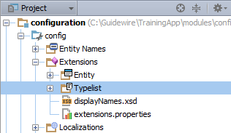
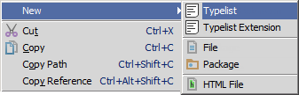
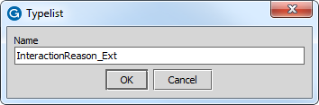
Step 1: Create the typelist file
In Project View, select .../config/Extensions/Typelists
Context menu → New → Typelist
Typelist dialog
Naming convention is for custom typelists to end in _Ext
Example: InteractionReason_Ext
Notes:
The maximum length for a typelist name is 25 characters.
By default, Guidewire uses xxtl_<typelist name> as the name of the typelist table (where "xx" is the application's code). If you want a different table name, you can override the default value by specifying a value in the "Table name" field in Studio. If you override the default value, the table name becomes xxtl_<table name>.
Guidewire restricts the typelist table name to ASCII letters, digits, and the underscore character. Guidewire also places limits on the length of the name.
Guidewire imposes these restrictions because of the restrictions imposed by the various relational database management systems (RDBMS) with which Guidewire applications interact. If you choose, however, you can override the name of the typelist and thus the table name stored in the database.
A "final" typelist is a typelist to which no additional typecodes can be added. All custom typelists are non-final.

Slide 18
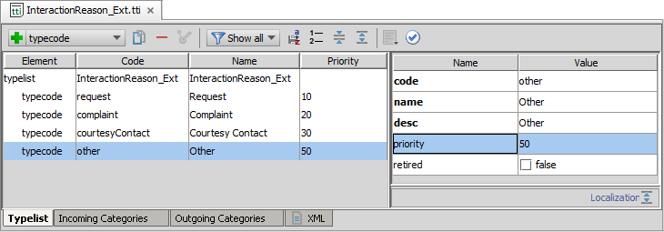
Step 2: Define typecodes
Add new typecodes with toolbar or context menu and define typecode attributes in the Name Value pane
Code is internal reference, must be unique within typelist, <=50 characters and contain alphanumeric values
Name is the default for when displayed in the user interface and Desc for the data dictionary
Priority is the sort order
Retired is to preserve typecode from perm
Notes:
Use the Typelist Editor to add typecode, categories, and filters. If a list view is sorted based on a typekey field, then the rows are sorted using standard typecode sorting. Standard typecode sorting is first by priority and then by name, and items with a priority of -1 appearing at the beginning of the list.
In a production environment, you should never delete a typecode or modify the typecode's "code" value. Either of these behaviors can cause problems because there could be existing objects that reference the altered or deleted typecode. In situations like this, you should mark the typecode's "retired" value as true.
Retired=true preserves the typecode for objects that already make use of the typecode, and prevents the use of the typecode by new objects or by existing objects that don't already use the typecode.
For example, assume you have a Color typelist that is used by the Vehicle entity and you retire the typecode brown. Any existing vehicle with the color brown will be unaffected. But new vehicles cannot be set to brown and existing vehicles that are not brown cannot be changed to brown.

Slide 19
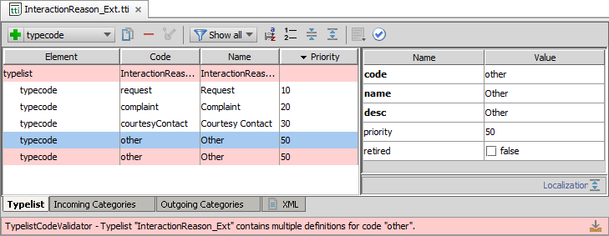
Validate the schema
Click Validate in the toolbar
Red highlight indicates schema violation warning
Schema violations explained in pane below editor

Slide 20
Step 3: Optionally regenerate dictionary
gwXX regen-dictionary
Process builds entire entity model including base and custom typelists
Identifies errors in the data model beyond Typelist Editor schema validation
C:\Guidewire\TrainingApp\bin>gwta regen-dictionary regen-entity-model-xml: ==================================================== = Running main class: com.guidewire.tools.dictionary.data.EntityModelXmlTool [java] --- Guidewire Entity Model In Xml --- … ERROR Errors found in DoctorSpecialtyType ERROR TypelistCategoriesValidator - Typecode DoctorSpecialtyType.Critical Care Medicine refers to a non-existent category
Notes:
Regenerating the data dictionary is not required, but doing so can identify flawed XML in the data model that go beyond schema validation. For example, a deleted typecode that is referenced by other typelists or entities will throw an error.

Slide 21
Step 4: Deploy the typelist
Restart Server
bin command window
gwXX dev-stop
gwXX dev-start
Or, Guidewire Studio
Run → Stop
Run 'Server' or Debug 'Server'
During start-up
If autoupgrade=true in database-config.xml, then Guidewire attempts to upgrade the database according to the changes in the data model
Typelist
Typelist
Notes:
In Studio, the newly created typelist is available to reference immediately. However, the typelist is not available to the application server until the server is restarted.

Slide 22
Typelist basics
Create a typelist
Create a typelist extension
Defining typekey fields

Slide 23
Steps to create a typelist extension
Navigate to the typelist
Create a typelist extension file
Define typecodes
Optionally Localize typecode descriptions
Optionally regenerate the dictionary
Deploy the typelist extension
Create file
Define variables
Code Default return value
Create additional names
Restart Server
Code return values

Slide 24
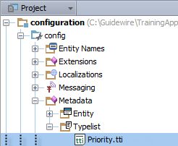

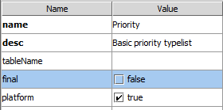
Step 1: Navigate to a typelist
Navigate to a typelist in …\Metadata\Typelist\
Project View or using CTRL+N
Studio will open an existing extension first!
If an existing extension already exists, STOP
Do NOT create a new extension; edit existing extension instead!
Typelist (TTI) file must NOT be final=true

Slide 25
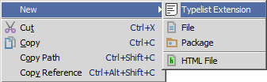
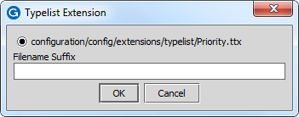
Step 2: Create a typelist extension file
Project View → Context menu → New → Typelist Extension
Do NOT enter filename suffix; Click OK

Slide 26
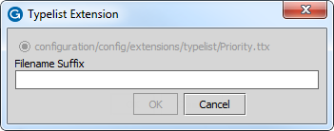
Step 2: Create a typelist extension file (2)
Unable to click OK? Click Cancel
Grayed out path shows that a typelist extension (TTX) file already exists!
Navigate to the typelist (CTRL+N)
Studio automatically opens the extension file first!
Edit the extension in the Typelist Editor

Slide 27

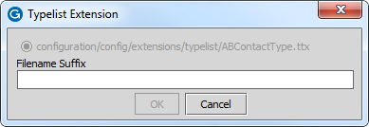
Step 2: Create a typelist extension file (3)
For a typelist (TTI) in …\Extensions\Typelist\
NOT possible to create typelist extension (TTX)
Edit the TTI file directly in the Typelist Editor
For a typelist extension (TTX) in …\Extensions\Typelist\
Do NOT create an extension for an extension
Click Cancel
Edit the TTX file directly in the Typelist Editor
Notes:
It is not possible to create a typelist extension (TTX) for a typelist (TTI) that already exists in the /Extensions/typelist/ folder. Simply edit the existing TTI file.

Slide 28
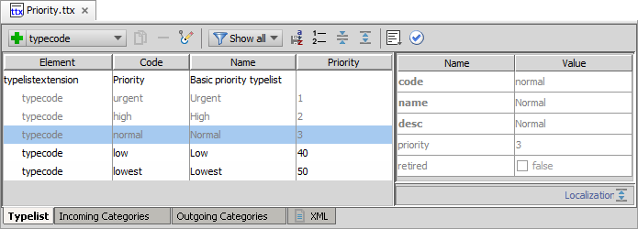
Step 3: Define typecodes
Typelist (TTI) typecodes are in grey
Can change with from Show all to This file only
Add new typecodes with toolbar or context menu to
To change or remove typecodes, override element
Font color for overridden elements turn from grey to black
Notes:
In the slide example, the low typecode has been overridden.

Slide 29
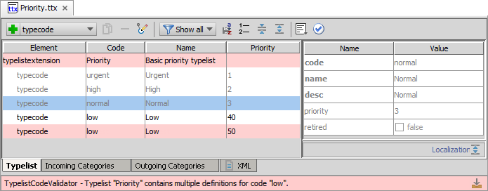
Validate the schema
Click Validate in the toolbar
Red highlight indicates schema violation warning
Schema violations explained in pane below editor

Slide 30
Step 4: Optionally regenerate dictionary
gwXX regen-dictionary
Process builds entire entity model including base and custom typelists
Identifies errors in the data model beyond Typelist Editor schema validation
C:\Guidewire\TrainingApp\bin>gwta regen-dictionary regen-entity-model-xml: ==================================================== = Running main class: com.guidewire.tools.dictionary.data.EntityModelXmlTool [java] --- Guidewire Entity Model In Xml --- … ERROR Errors found in Priority ERROR TypelistCategoriesValidator - Typecode "Priority" contains multiple definitions for code "low".
Notes:
Regenerating the data dictionary is not required, but doing so can identify flawed XML in the data model that go beyond schema validation. For example, a deleted typecode that is referenced by other typelists or entities will throw an error.

Slide 31
Step 5: Deploy the typelist extension
Restart Server
bin command window
gwXX dev-stop
gwXX dev-start
Or, Guidewire Studio
Run → Stop
Run 'Server' or Debug 'Server'
During start-up
If autoupgrade=true in database-config.xml, then Guidewire attempts to upgrade the database according to the changes in the data model
Typelist extension
Typelist Extension
Notes:
In Studio, the newly created typelist extension is available to reference immediately. However, the typelist extension is not available to the application server until the server is restarted.

Slide 32
Typelist basics
Create a typelist
Create a typelist extension
Defining typekey fields

Slide 33
Typekey fields
A typekey field is an entity defined field associated with a specific typelist
Referenced typelist contains typecodes whose values are the only possible value for the typekey field
BuildingType_Ext Residential - single Residential - multi Office Industrial Hotel Other

Slide 34
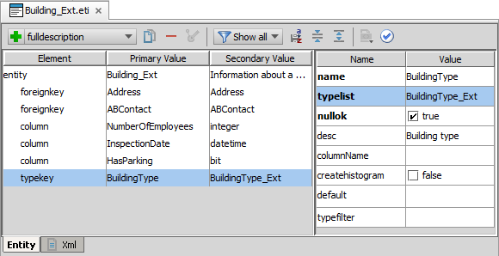
Entity configuration: typekey
Add the typekey element to entity or entity extension
Define the typelist attribute with specified typelist

Slide 35
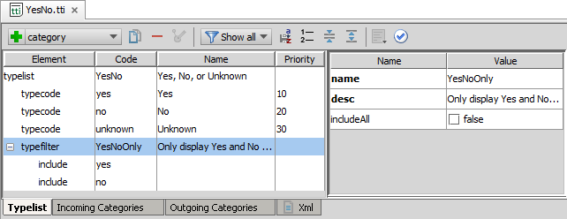
Typelist filters
A typelist filter defines a subset of typecodes in the typelist
Configure filters for typelists to filter available typecodes
Example: YesNoOnly typefilter
Notes:
It is possible to configure a typelist so that a Guidewire application can filter the typelist values so that they do not all appear in the drop-down list (typelist) in the application user interface.
A typelist filter causes the typelist to display only a subset of the typecodes for that typelist. A filter narrows the list of typecodes to show in the typelist view in the application.

Slide 36

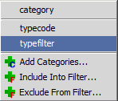
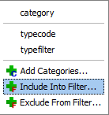
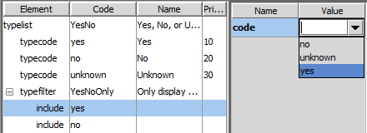
Create a typelist filter
Add typefilter element
Add Include Into Filter typecodes
Specify code attribute values
Notes:
You define a typelist filter at the level of the typelist. Use the Typelist Editor to define a filter for a particular typelist.

Slide 37
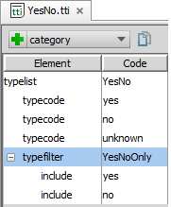
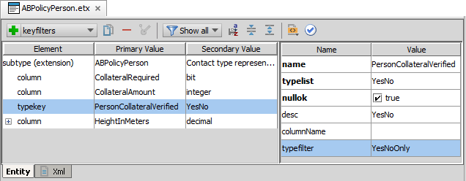
Referencing a typelist filter
For the typekey element in the entity file, specify the typefilter attribute
Only values in the typefilter are specified (included or excluded)

Slide 38
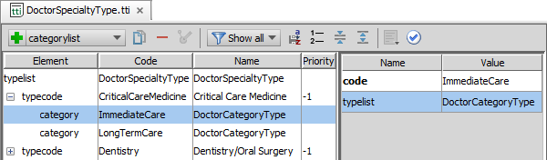
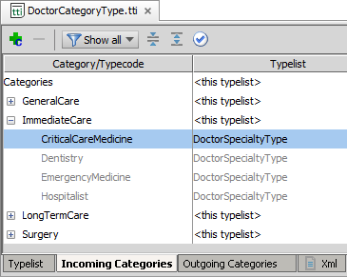
Typecode category
Category
Associate one or more typecodes on a parent typelist with one or more typecodes on a child typelist
Incoming Categories tab in parent typelist shows child typecodes
Notes:
A typecode filter uses categories and category lists at the typecode level to restrict or filter a typelist.

Slide 39
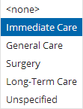
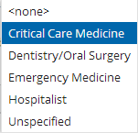
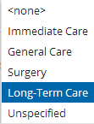
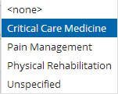
Dependent Drop-down lists
Category
Specialty
Use categories and category lists at the typecode level to restrict or filter dependent drop-down lists
Example
Doctor Category filters Doctor Specialty
Parent filters can share children typecode
Category
Specialty
Notes:
The entity ABDoctor specifies that the DoctorSpecialtyType typekey has a keyfilter for the DoctorCategoryType typekey.
Later lessons discuss how to configure the user interface with Page Configuration Files and the Input widgets.

Slide 40
Describe the functionality of a typelist
Create a typelist and typelist extension
Create a typekey field
Create a typekey field that references a typelist filter

Slide 41
Describe some of the differences between the files in the …\metadata\typelist\ and …\extensions\typelist\ folders.
Which is a valid code value for a typecode in a food coloring typelist?
RedDye#1
YellowDye40
OrangeDye:10
Which typecode attribute determines the order in which typecodes are listed in the user interface?
What is the key difference between a typekey and a typekey with a defined typefilter attribute?
Notes:
Answers
1) Files under metadata are read-only are specific to the base configuration. You cannot create typelist files in the metadata directory but can create typelist files in the extensions directory. Only internal typelist extension files (TIX) are in the metedata directory. Only external typelist files (TTX) are in the extensions directory. Both directories contain typelist (TTI) files. 2) The typecode must be unique within the typelist and must have 50 characters or fewer. The value for the code must be an alphanumeric value.
2a) Not valid
2b) Valid
2c) Not valid
3) The priority attribute determines the sort order in the User Interface for a typelist. After priority, the name (not code) determines the sort order. Entries with priority -1 appear at the end of the list
4) A typekey is only limited by the values in the typelist. A typekey with a defined typefilter attribute is limited to the named subset of values as defined by the typekey filter in the typelist.

