Slide 1
The User Interface Architecture
January 20, 2014
Notes:
Guidewire training materials contain Guidewire proprietary information that is subject to confidentiality and non-disclosure agreements. You agree to use the information in this manual solely for the purpose of training to implement Guidewire software solutions. You also agree not to disclose the information in this manual to third parties or copy this manual without prior written consent from Guidewire. Guidewire training may be given only by Guidewire employees or certified Guidewire partners under the appropriate agreement with Guidewire.

Slide 2
Describe the user interface architecture for Guidewire applications
Describe the kinds of Page Configuration Files (PCF)
Create new PCF folders and files
Open and edit PCF files
Deploy PCF files

Slide 3
User interface architecture
PCF files
Create and open PCF files
Modify PCF files
Deploy PCF files

Slide 4
Guidewire application UI framework
PCF Element
Widget
Location
Displayable elements of the user interface rendered into HTML
Navigable places in application that a user or the application itself can navigate to
The PCF (Page Configuration File) object model is a proprietary application framework used to create all Guidewire end-user interfaces
Widget and Location are high-level categories for PCF elements
Notes:
A widget is a PCF element that can be converted into HTML and displayed.
A location is a PCF element that a user (or the application itself) can navigate to. It is used to define how users move from one area of user interface to the next.
Both Widget and Location are conceptual representations in this diagram. There are no <Widget /> or <Location /> elements.

Slide 5
Atom widgets
PCF Element
Widget
Location
Atomic Widget
An atomic widget is an atomic piece of the user interface
Display individual data values
OR executes individual actions
Input
Cell
Button
Notes:
Atomic widgets are individual field items such as inputs, cells, or buttons. They will always be defined within a container widget or location.
Both Widget and Location are conceptual representations in this diagram. There are no <Widget /> or <Location /> elements. Atomic Widget is also a conceptual representation. There is no <Atomic Widget /> element.
The PCF object model is container-based. Each screen element is modeled as an object, which may contain other objects. The hierarchical structure simplifies the task of locating and modifying visual elements. Furthermore, each element can be declared as an independent and therefore reusable element.

Slide 6
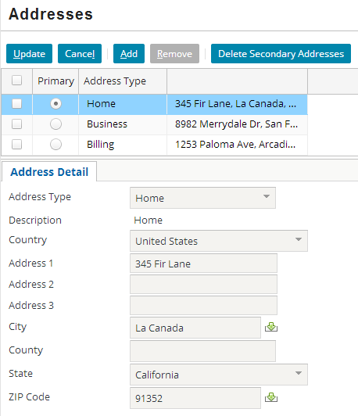
Atomic widgets: examples
Button
Cell
Input

Slide 7
Container widgets
PCF Element
Widget
Location
Atomic Widget
Container Widget
A container widget is a collection of atomic widgets and/or other container widgets
Organizes data and functionality into logical groups
Screen
Input Set
Card View Panel
Detail View Panel
List Detail Panel
List View Panel
Notes:
Container widgets hold other widgets. Each one can be defined either in its own file or as a child container within some other PCF element file.
Both Widget and Location are conceptual representations in this diagram. There are no <Widget /> or <Location /> elements. Similarly, both Atomic Widget and Container Widget are conceptual representations. There are no <Atomic Widget /> or <Container Widget /> elements.
The PCF object model is container-based. Each screen element is modeled as an object, which may contain other objects. The hierarchical structure simplifies the task of locating and modifying visual elements. Furthermore, each element can be declared as an independent and therefore reusable element.

Slide 8
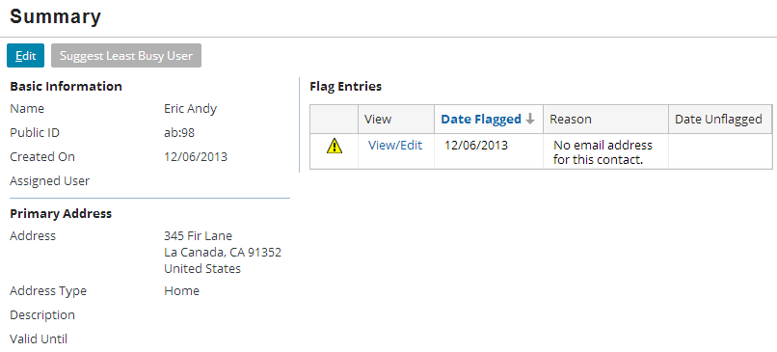
Primary views
A primary view is a reusable panel such as a detail view panel or list view panel that organizes atomic widgets.
An Input Set is a reusable collection of atomic widgets for detail view panels
Detail View Panel
List View Panel
Input Set

Slide 9
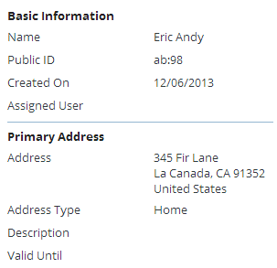
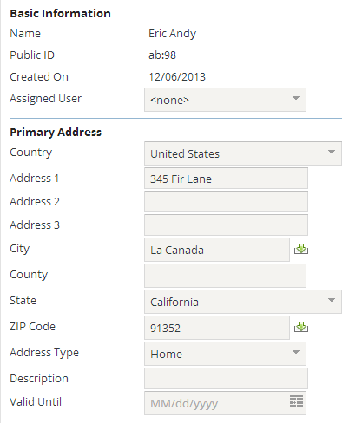
Container widgets: detail view panels
Focus on a single record
Typically, but can be more than one
Allow the user to…
View an existing record
Create a new record
Edit a record
Columns help organize atomic widgets to display a related information
Screens and secondary views can reference
Often referred to as "Detail View"
View
Edit
Notes:
Detail view panels are generally designed to use widgets to organize and manage a collection of related pieces of information that constitute a single record. The most obvious example is the set of individual fields of an instance of an entity such as User, Claim, or Policy. There are no constraints imposed by the system as to what information can be displayed by a detail view, however; the view could present information from multiple entities that do not even have to be related to one another, in addition to information that does not derive from an entity at all (such as calculated or static values).
The purpose of a detail view panel, however, and the recommended practice behind their use, is to present the user with all of the detailed information that is relevant to that interface, and no information that is irrelevant. In general this means displaying information about the fields of a particular entity and possibly fields from a small number of closely related entities.
Detail view panels must contain at least one column and can contain as many columns as necessary to present the widgets in the most effective way for the user.

Slide 10
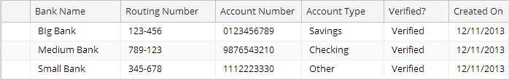
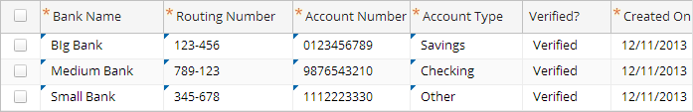
Container widgets: list view panels
View
Edit
Table organizes information that allows the user to view information about multiple records at the same time
Uses a small number of atomic widgets to display the most relevant information
Screens and secondary views can reference
Often referred to as "List View"
Notes:
Just as a detail view panel is designed to allow the user to view detailed information about a single record, a list view panel is designed to allow the user to view summary information about a collection of records.

Slide 11
Container widgets: Input Sets
Can contain atomic widgets
Can be reused by detail view panels
Cannot be referenced by secondary views
Cannot have a toolbar directly associated with them
Input Set

Slide 12
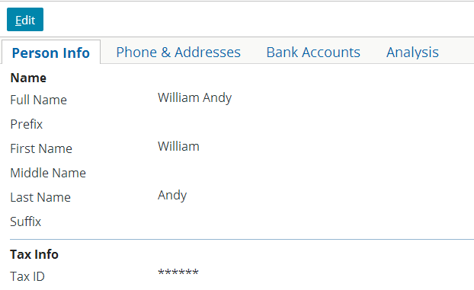
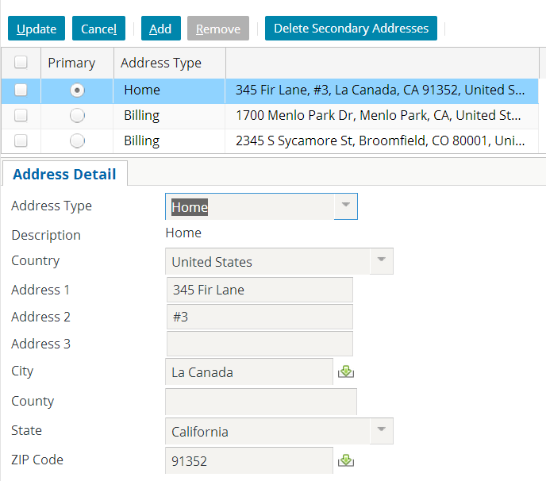
Secondary views
A secondary view organizes primary views
A Card View Panel is a collection of cards, with each card containing detail view panels or list view panels
A List Detail Panel contains a top list view panel and a bottom view panel that display data about the selected list item
Card View Panel
List Detail Panel
Notes:
A Card View Panel is often referred to as a Card View. A List Detail Panel is often referred to as a List-Detail View.

Slide 13
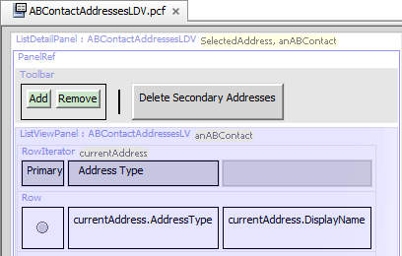
Panels
Container Widget
Card View Panel
Detail View Panel
List Detail Panel
List View Panel
A panel is a container which has a structured UI layout, shares a common placement on a PCF page, and can be rendered with a Toolbar and/or a Title bar that controls the panel behavior
Toolbar and Title bar require a containing PanelRef
Notes:
All panels share the common placement on a PCF page, for example, when defined directly on a Screen, Card, or Panel Set.
A panel and can be rendered with an associated Toolbar and/or Title Bar. Edit Buttons are typically associated with a Toolbar defined in a Screen.
Often, panels are placed within a Screen using a PanelRef widget. Although not a defining characteristic of panels, panel placement using a Panel Ref helps illustrate the distinction between primary views and secondary views.

Slide 14
Container widgets: screens
Screens are top-level containers
Every atomic widget, primary view, and secondary view is contained (directly or indirectly) in a screen
Screen

Slide 15
Container widget hierarchy
Screen
Screen
a top-level container one can navigate to
Secondary views
collections of primary views organized for usability
Primary views
a single object (and its related data) or set of objects
Atomic widgets
individual elements of data and/or functionality
Card View Panel / List Detail Panel
Detail View Panel
List View Panel
Input Set
Atomic Widgets
Notes:
Container widgets can be classified in four categories:
The lowest level is comprised of atomic widgets.
Atomic widgets can be directly contained only by primary views (detail view panels and list view panels). The purpose of a primary view is to organize atomic widgets into logical groups.
Secondary views (card view panels and list detail panels) organize primary views. Secondary views cannot directly contain most atomic widgets.
Screens are the top-level containers. Screens are used to connect what is displayed in the user interface with how users navigate through the user interface. A screen can directly contain both primary views and secondary views, but it cannot directly contain most atomic widgets.
Input sets do not readily fall into any of these categories. Input sets fit some of the attributes of primary views. They can contain atomic widgets and organize them into logical groups. Input sets cannot be referenced directly by secondary views or screens. Input set must be embedded into detail view panels and cannot have toolbars directly associated with them.

Slide 16
Locations
PCF Element
Widget
Location
Atomic Widget
Container Widget
Location Group
Page
A location is a PCF element that a user can navigate to
Define how user navigates from one UI to the next UI
Locations lesson discusses in detail
Wizard
Popup
Worksheet
Forward
Exit Point
Notes:
Both Widget and Location are conceptual representations in this diagram. There are no <Widget /> or <Location /> elements.

Slide 17
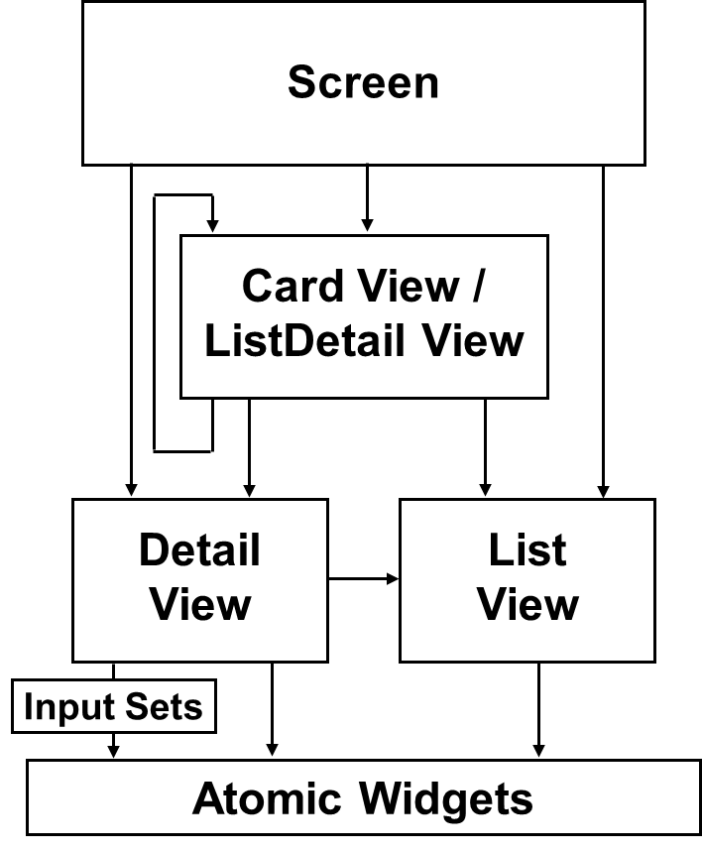
Container widgets and locations
Page
Screen
A location references a specific screen
Screens form the bridge between what the application displays and how users work and navigate in the application
Wizard
Popup
Worksheet
Card View Panel / List Detail Panel
Detail View Panel
List View Panel
Input Set
Atomic Widgets
Notes:
Notice that only a subset of locations reference screens:
LocationGroups reference a collection of Page locations, which then reference screens
Forwards redirect to any other location types, which may contain screens
Exit Points reference external URLs, which define non-application screens

Slide 18
PCF hierarchy review
PCF Element
Atomic Widget
Input
Container Widget
Cell
Button
Widget
Screen
Input Set
Card View Panel
Detail View Panel
List Detail Panel
List View Panel
Location
Location Group
Page
Wizard
Popup
Forward
Exit Point
Worksheet
Notes:
At the top level, PCF elements are split between widgets and locations. This lesson only addresses the high-level classifications of widgets (both atomic and container) and locations. Discussions of specific widgets and locations will follow in future lessons.

Slide 19
User interface architecture
PCF files
Create and open PCF files
Modify PCF files
Deploy PCF files

Slide 20
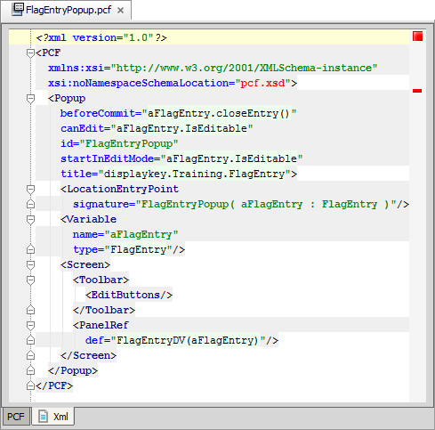
Page Configuration File (PCF)
A PCF file is an XML file that defines a location or container widget
May also:
Define child containers
Reference other containers
Include atomic widgets
Notes:
A PCF is an XSD-validated XML document containing elements that describe the structure, layout, and behavior of the web user interface. The majority of this content is defined at the application level, though some is defined at the platform level.

Slide 21
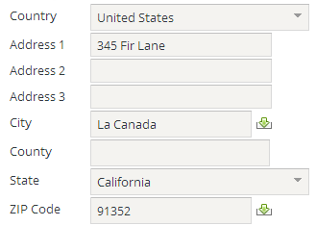
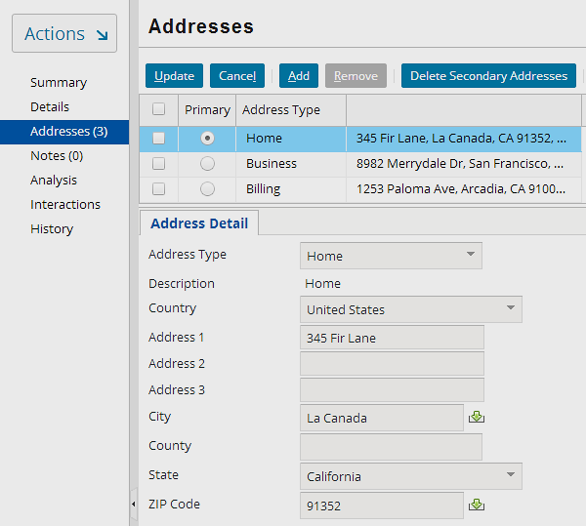
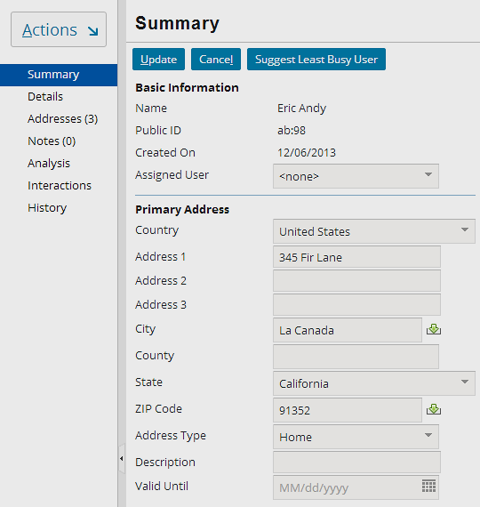
PCF files enable reusability of containers
ABContactAddressesLDV
GlobalAddressInputSet .default
ABContactSummaryDV
Notes:
GlobalAddressInputSet is a globalization input set and is modal. Modal widgets are discussed in greater detail later in this course. It is not a requirement for a PCF to be modal in order for it to be reused.

Slide 22
Valid parent objects for PCF files
PCF Element
Atomic Widget
Input
Container Widget
Cell
Button
Widget
Screen
Input Set
Card View Panel
Detail View Panel
List Detail Panel
List View Panel
Location
Location Group
Page
Wizard
Popup
Forward
Exit Point
Worksheet
Elements in blue can be a parent object in a PCF.
Notes:
Every PCF file declares either a container widget or a location. It is not possible to create a PCF file that declares only a single isolated atomic widget.

Slide 23
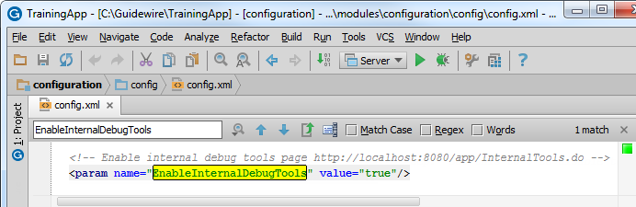
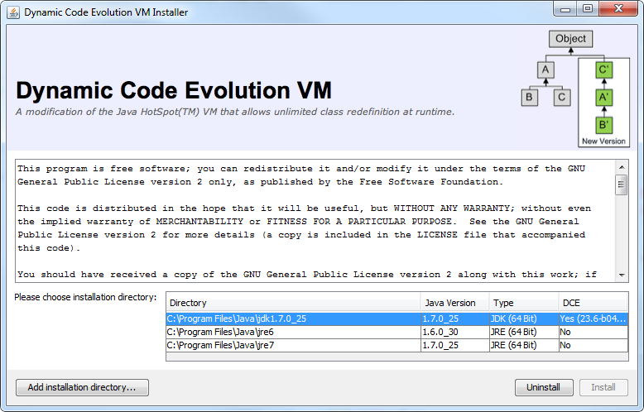
Internal Debug Tools for PCFs
config.xml parameter
EnableInternalDebugTools
value="true"
Install and enable DCEVM for JDK
Developer environments ONLY!
Notes:
You can use the internal debug tools to identify the PCF structure, associated widgets, PCF related GOSU code, and even open the PCF in Studio. It is optional to install the DCEVM for the JDK in order to use the internal debug tools.
Guidewire recommends that you install the DCEVM in development environments for a more efficient development experience. The DCEVM allows for "hot swapping" of classes. The DCEVM should NOT be installed in production environments.

Slide 24
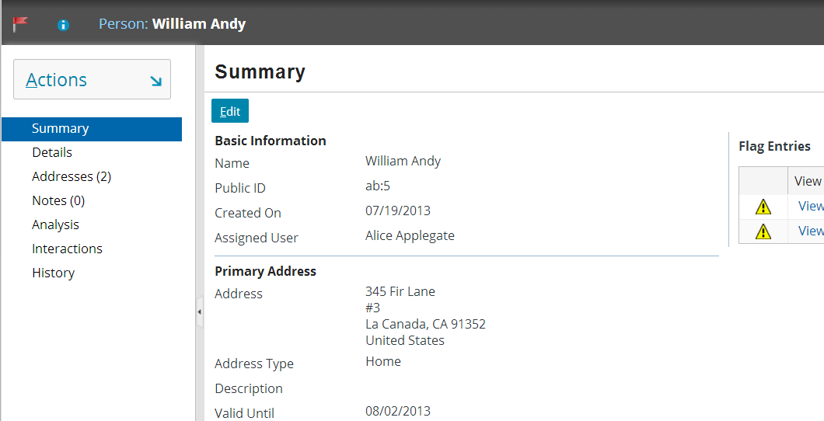
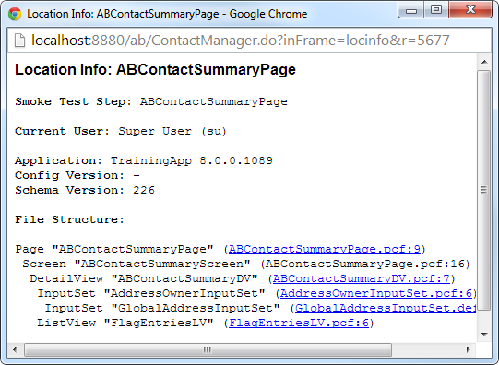
Internal debug tools: Location info ALT+SHIFT+I
ALT+SHIFT+I
Shows PCF structure and details file names
Helps identify widgets and containers
Notes:
If you are running an application project with internal tools enabled, you can view the location information with ALT+SHIFT+I in a separate browser window.
The window details the file structure and details the hierarchy of the location, screen, and any child container widgets. For each location and container widget, the name of the file in which it is referenced is listed.
Location Info is also useful when Studio is not running or if you are viewing a modal file. Location Info identifies the mode currently displayed. Going directly to the PCF editor shows you the "first" mode until you choose another.
Location Info also shows the workspace PCF if it is defined.

Slide 25
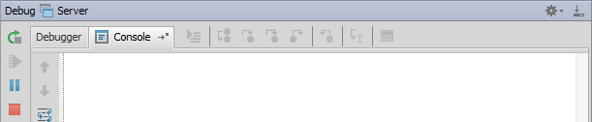
Internal debug tools: Reload PCFs ALT+SHIFT+L
ALT+SHIFT+L
2013-12-13 15:16:06,573 INFO PCFs reloaded.
Reloads all Page Configuration Files
Command window or Guidewire Studio Console window (Debug / Run) details output
Notes:
If you are running an open application project in Guidewire Studio and if internal tools are enabled, you can reload all the page configuration files and display keys for the server.
If you reload PCF files while in edit mode, you may experience unpredictable results. For the current location, where there is a data modification in progress, the new PCFs may not be reloaded. Therefore, Guidewire recommends reloading PCF files while in read-only mode as it provides for more predictable results.

Slide 26
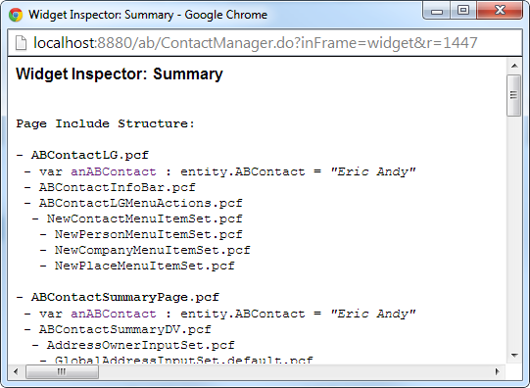
Internal debug tools: Widget Inspector ALT+SHIFT+W
ALT+SHIFT+W
Shows PCF structure and details file names
Helps identify widgets and containers
Notes:
If you are running an application project with internal tools enabled, you can view the widget information with ALT+SHIFT+W in a separate browser window.
The widget inspector shows all the PCF files and widgets referenced in the active application browser window except for the workspace area. To view the widget inspector, press ALT+SHIFT+W in the application.

Slide 27
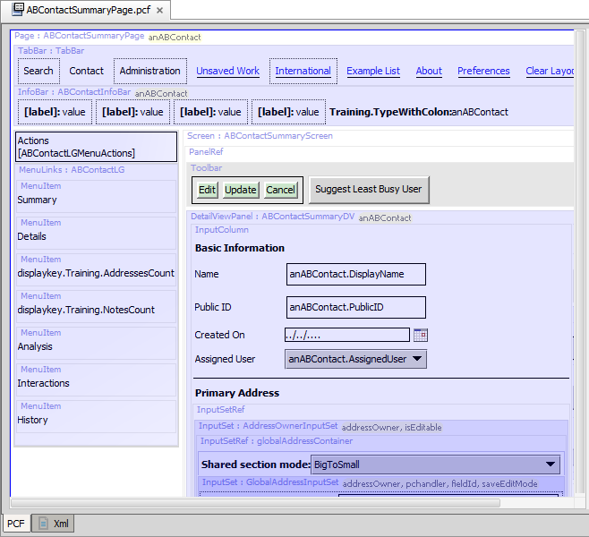
Internal debug tools: Open PCF in Studio ALT+SHIFT+E
ALT+SHIFT+E
Opens location in Studio
In Studio, navigate to container and widgets to edit
Notes:
If you are running an open application project in Guidewire Studio and if internal tools are enabled, you can automatically open the location being viewed in the application. Non-wizard locations typically reference a single screen. From the screen, you can navigate in Studio to the file you wish to edit.
This technique is useful for most UI configuration in ClaimCenter and BillingCenter, where the majority of the UI configuration is done outside of wizards.
The ALT+SHIFT+E shortcut is considered experimental. While there may be circumstances where the shortcut does not function, there should never be any negative consequences in attempting to use it.

Slide 28
User interface architecture
PCF files
Create and open PCF files
Modify PCF files
Deploy PCF files

Slide 29
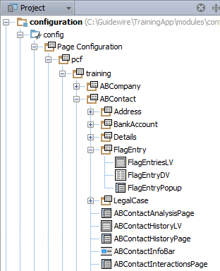
Project view
PCF folders
Group PCF files and folders
PCF files
Container widgets
Locations
PCF file suffix examples:
DV – detail view panel
LV – list view panel
InputSet – input set
CV – card view panel
LDV – list detail panel
Screen – screen
LG – location group
Wizard – wizard
Notes:
Any PCF file in any folder can reference content in another PCF file in any other PCF folder. Developers often logically group related PCF files in PCF Folders.
Guidewire recommends that suffixes be used with PCF file names to indicate the contents of the file. In some cases, the suffix is required. If you create the PCF using Guidewire Studio, Studio will automatically append the file suffix for you.
Common suffixes include:
DV – detail view panel (detail view)
LV – list view panel (list view)
InputSet – input set
CV – card view panel (card view)
LDV – list detail panel (list-detail view)
Screen – screen
LG – location group
Wizard – wizard

Slide 30
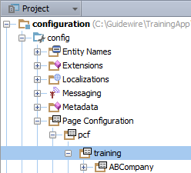
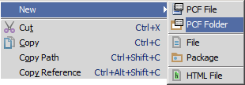
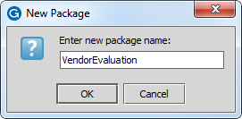
Optionally create a PCF Folder
In Project View, select a PCF Folder in ...\config\Page Configuration\pcf\
Context menu → New → PCF Folder
Specify folder name in New Package dialog
Notes:
PCF Folders organize PCF files. Consider organizing PCF Files into PCF Folders.
In the physical folders for the application, there is no Page Configuration Folder. The physical folder is "web". The Page Configuration Folder in the Project View is an alias for the physical web folder in the file system.

Slide 31
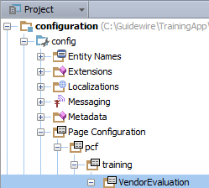
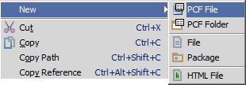
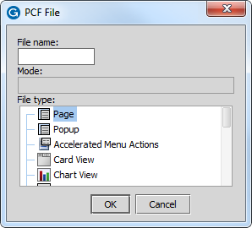
Create a PCF File (1)
In Project View, select a PCF Folder in …\config\ Page Configuration\pcf\
Context menu → New → PCF File
Opens PCF File dialog

Slide 32
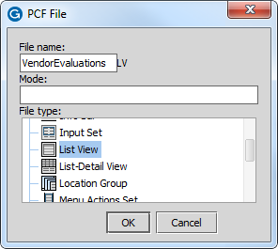
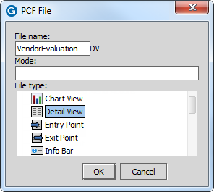
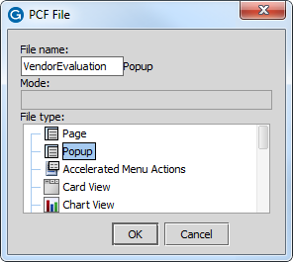
Create a PCF File (2)
PCF File dialog appends suffix in most cases
File name + File Type selection
Adds suffix to File Name
Examples
VendorEvaluationsLV, VendorEvaluationDV, VendorEvaluationPopup
Notes:
Specify the name of the file in the dialog and the file type. The dialog automatically appends the suffix to the file name when necessary.

Slide 33


Open a PCF in Studio
CTRL+N
Find Class…
CTRL+SHIFT+N
Find File…

Slide 34
User interface architecture
PCF files
Create and open PCF files
Modify PCF files
Deploy PCF files

Slide 35
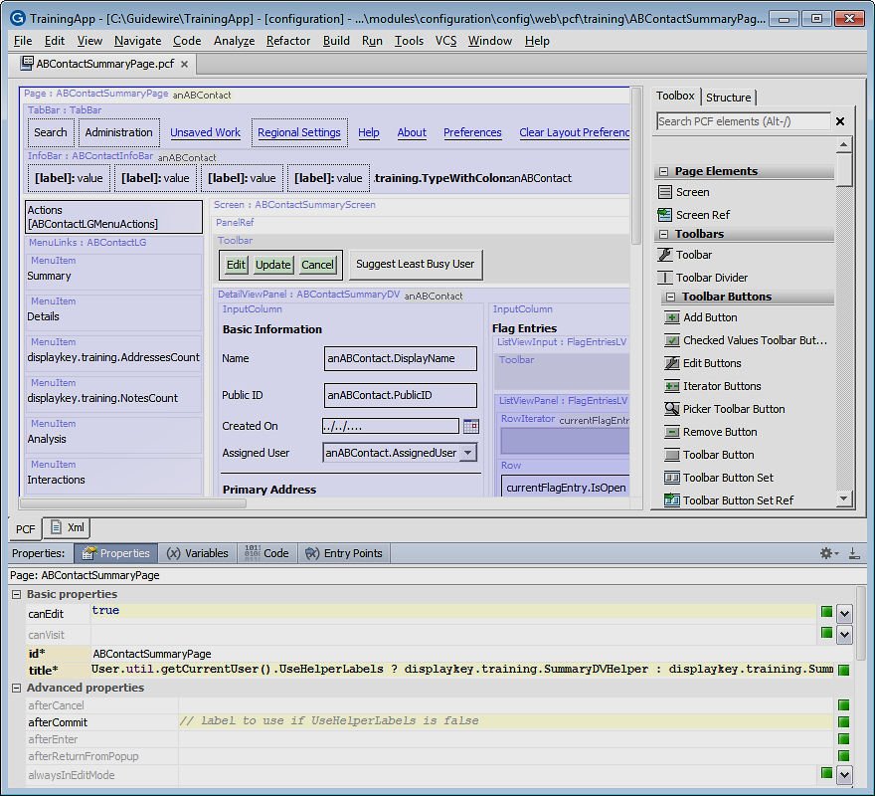
Page Configuration (PCF) editor
View and edit page configuration files (PCF)
…\config\web\pcf\
View file as read-only XML
Consists of
PCF canvas
Toolbox tab
Structure tab
Properties Window
Notes:
Guidewire applications use a page configuration format (PCF) files to render the application user interface. Use the Page Configuration File (PCF) editor to edit PCF files. The PCF Editor supports drag-and-drop composition of PCF pages using graphical elements, PCF page grouping views, Gosu code, display key creation, and much more.

Slide 36
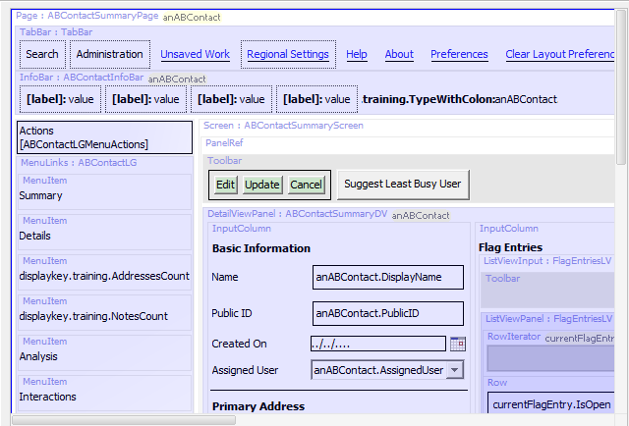
PCF editor: Canvas
Graphical representation of PCF elements (widgets):
Content
Container
Gosu symbol
Conditionally visible
Iterator
RowIterator
Colors
Hierarchy
Warnings
Placement
Supports drag-and-drop from toolbox
Context menu commands
Notes:
The PCF editor contains a canvas that provides a graphic display of the contents of the file. From the canvas, you can select an item to display and edit its properties. You can also move and delete existing items. In addition, the canvas in the Studio center pane provides a drag-and-drop capability for working with the PCF elements (widgets) on the PCF page. On the canvas, Studio displays:
Elements that represent actual screen content (inputs, and similar items) as a simplified version of how they appear within ClaimCenter.
Elements that function primarily as containers (data view panels, for example) as light gray boxes, with a header indicating the element type and ID.
Elements that define or expose additional Gosu symbols to their descendants as light gray boxes, with a list of symbols at the top. If you move your mouse over a symbol, Studio shows a tooltip with the name, type, and initial value of the symbol.
If the symbol represents a Require, the tooltip indicates this as well.
If you click a symbol name, Studio selects the containing element, and then opens the appropriate properties tab for editing whatever is providing the symbol. Finally, if necessary, Studio selects the symbol in the Properties tab.
Elements that are conditionally visible with a dotted border.
Elements that iterate over a set of data and produce their contents once for each element in the data by a single copy of the contents. It follows this with an ellipsis to indicate iteration.
RowIterator widgets with inferred header and footer cells in the position in which they appear.
The Canvas also allows for you to view all the nested elements. Files can be nested as deep as necessary, in which case the color of the shaded area will be progressively deeper, for example:
White - defined in this file
Light blue -defined in other file that is referenced by this file
Dark blue - defined in file referenced by referenced file
Double-clicking at any level will open the selected PCF directly.

Slide 37
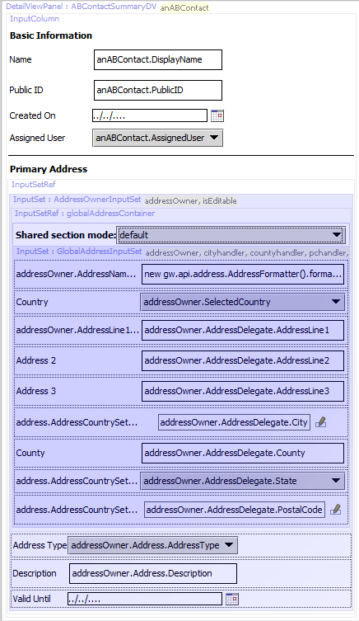
Included sections
White
In this file
Light purple
Reference to another file
Darker purple
Reference to a file that includes another reference to a file
Color darkens with additional nesting of included sections
Notes:
Files can be nested as deep as necessary, in which case the color of the shaded area will be progressively deeper. Double-clicking at any level will open the selected file directly. You can toggle the visibility of child files embedded in a parent PCF file. If you disable the representation of the included files, Studio displays the text of the reference expression instead.

Slide 38
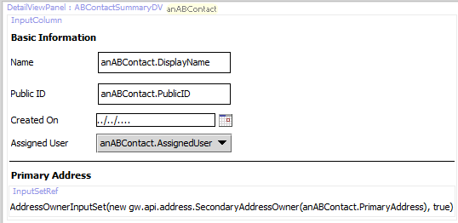
Show / Hide included sections
Toggle the visibility with PCF canvas context menu command
Hide included sections
Show included sections
Hide
Show
Notes:
Show/Hide included sections: Toggle the visibility of child files embedded in a parent PCF file. If you disable the representation of the included files, Studio displays the text of the reference expression instead.

Slide 39
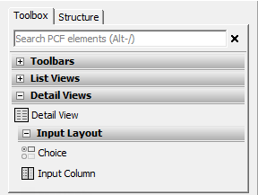
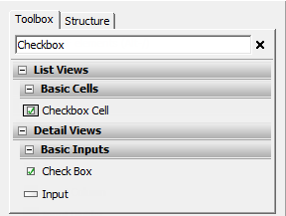
PCF Editor: Toolbox
Categories
Search box
Expand and collapse
Categories
Subcategories
Matches results by
Category name
Widget description or name
Xml element name
ALT+/ keystroke
Notes:
The Toolbox tab is a list of widgets. To add elements to a PCF file, you select the corresponding tool in the toolbox and drag it onto the canvas. The Toolbox tab contains a search box and a list widgets organized into specific categories and subcategories.
Clicking on a category name expands or collapses that category. Clicking on a subcategory name expands or collapses that subcategory as well. Guidewire Studio only displays widget categories containing widgets that are valid and available for use in the current PCF file. Guidewire Studio displays a description of that widget in a tooltip when you hover over the widget with your mouse.
You use the search box to filter the full set of widgets. As you type a search term into the search box, the toolbox filters the results by:
Any widgets whose category name matches the typed text
Any widgets whose name matches the typed text
Any widgets whose actual name in the XML matches the typed text
Any widgets whose description contains the typed text
Clicking the X icon by the search box clears text from the box and stops filtering the widget list. Keyboard shortcut ALT+/ gives focus to the search box.

Slide 40
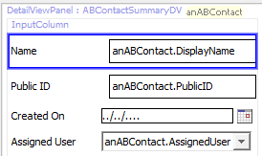
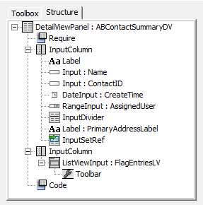
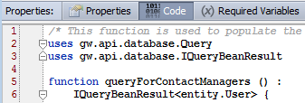
PCF Editor: Structure tab
Shows hierarchal structure of PCF file of elements
Concrete element highlighted in canvas
Non-concrete selects parent element in canvas and opens Properties Window related tab
Notes:
The Structure tab shows the hierarchical structure of the PCF file as a tree. Each node in the tree represents a PCF element. Any children of the node are children of that element.
If you click an element that represents a concrete element on the canvas, Studio selects that element on the canvas.
If you click on an element that does not represent a concrete element on the canvas, then Studio first selects the containing element on the canvas. It then selects the appropriate properties tab with which to edit the clicked element. Finally, if necessary, Studio selects the clicked element in the properties tab (at the bottom of the screen).

Slide 41
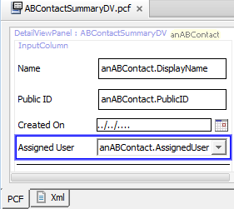
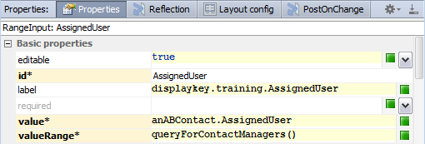
PCF Editor: Properties Window
Select element in
Structure tab or canvas
View and/or edit element properties
Schema aware tabs
Property validation
Notes:
All PCF elements have definable properties in the Properties window. To view properties of a PCF file, click its title link in the upper-left corner. To view properties of any element, click that element.
The Properties window contains multiple property tabs. Click a tab to edit the associated properties. Some properties are not editable. Other properties are required. Required properties have an asterisk and the property name appears against a yellow background.
If you select a property, variable, or entry point, an "X" icon appears on the right-hand side of the cell for that property, variable, or entry point. You can click the "X" to restore the selected property, variable, or entry point to its default value.
The Properties window validates each property expression and/or and value.

Slide 42
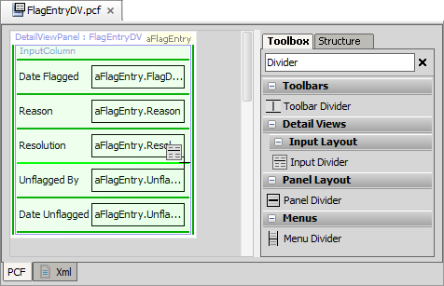
Adding PCF elements
Light green line - new widget will be placed here
Dark green line - new widget could be placed here
Notes:
To add a new widget to a PCF file, select the appropriate tool from the toolbox and drag the widget onto the canvas. As soon as you drag onto the canvas, a series of green lines appear.
Dark green lines indicate places where the widget can legally be placed. A single light green line indicates the place where the widget will be placed if you release the mouse.

Slide 43
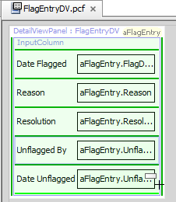
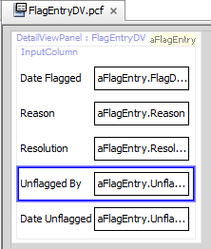
Moving PCF elements
Select element to move and drag to valid location
Light green line - new widget will be placed here
Dark green line - new widget could be placed here
Notes:
Dark green lines indicate places where the widget can legally be placed. A single light green line indicates the place where the widget will be placed if you release the mouse.

Slide 44
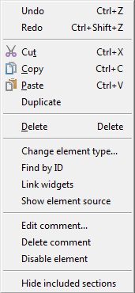
Element context menu commands
Standard editing commands
Change element type…
Opens dialog of possible substitutes
Find by ID
Opens dialog to available elements
Link widgets
Create explicit iterator references
Show element source
Opens window with read-only XML
Edit comment… / Delete Comment
Disable element
Show/Hide included sections
Notes:
The canvas element context menu has many menu actions as explained below:
Enable element: Enable a previously disabled element. This action removes the surrounding comment tags from the element.
Disable element: Disable an element by commenting out the widget. This prevents ClaimCenter from rendering the widget in the interface.
Delete comment: Remove a comment from an element.
Edit comment...:Attach a comment to any element on the canvas
Link widgets: Link widgets on a parent page that spans multiple child PCF files. You use this particularly for explicit iterator references.
Show/Hide included sections: Toggle the visibility of child files embedded in a parent PCF file. If you disable the representation of the included files, Studio displays the text of the reference expression instead.
Show element source: View the XML code for an element. Studio displays the XML code in a pop-up window.
Find by ID: Find an element by its ID. The dialog contains a filter text field. The dialog lists all elements on the canvas that have their id attribute set.

Slide 45

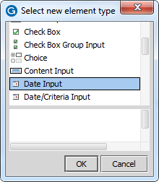
Change element type
Select widget element in canvass
Right click to open context menu
Change element type…
Opens dialog of possible substitutes
Make change selection in dialog
Notes:
"Change element type…" context menu command substitutes a different element for the selected element. The dialog contains a list of element types that you can substitute for the selected element within the constraints of the PCF schema.

Slide 46
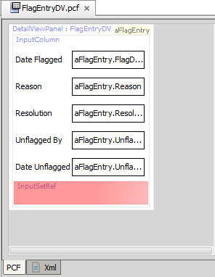

Error messaging
Editor red highlights the widget element with an error
Misconfiguration
Missing configuration
Mouse over element to see Error Message
Notes:
The PCF editor canvas highlights elements with errors.

Slide 47

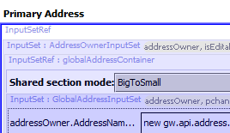
Refresh PCF
Refresh the display of the current PCF file
Main toolbar → Refresh PCF
Helps with widgets that include another widget by reference
Examples
InputSetRef
PanelRef
ScreenRef
Notes:
When you add a PCF widget or edit a PCF widget that includes by reference another widget, you can Refresh the PCF to display the referenced widget.

Slide 48
User interface architecture
PCF files
Create and open PCF files
Modify PCF files
Deploy PCFs

Slide 49
Deploy PCFs
Restart Server
Reload PCFs
PCFs read at server startup
ALT+SHIFT+L
Internal debug tools enabled
Internal Tools
Reload → Reload PCF Files
Page Configuration File
Page Configuration File
Notes:
It is also possible to reload PCF files using the Guidewire API and/or internal server tools. The Reload PCF command can be found on the Reload page in Internal Tools. To access Internal Tools, you must log in as an administrator user, e.g., su/gw. Then, use ALT+SHIFT+T. In the tab bar, select Internal Tools → Reload. On the Reload page, click the Reload PCF Files button. The Reload PCF Files button calls the static method gw.api.tools.InternalToolsUtil.reloadPCFs().

Slide 50
Describe the user interface architecture for Guidewire applications
Describe the kinds of Page Configuration Files (PCF)
Create new PCF folders and files
Open and edit PCF files
Deploy PCF files

Slide 51
Define the broad purpose for each element category:
Atomic widgets
Container widgets
Locations
What does a PCF file define?
What does each PCF editor convention mean?
A container widget shaded light blue
A container widget shaded dark blue
A light green line
A dark green line
A red background
How do you deploy PCF changes?
Notes:
Answers
1a) Atomic widgets display individual elements of data and/or functionality.
1b) Container widgets group atomic widgets into logical groups.
1c) Locations define how users move from one place in the application to the next.
2) A PCF file defines a container widget or location and its contents.
3a) The container widget is referenced by the current PCF file and Its contents are contained in another file
3b) The container widget is referenced by some container widget referenced by the current PCF file. It is in a "grandchild" file.
3c) For the currently selected widget tool, a new widget of that type will be placed in the current location.
3d) For the currently selected widget tool, a new widget of that type could be placed in the current location.
3e) The PCF file has an error in it.
4) You can Restart the server. Restarting the server reloads PCF files at startup. A more efficient approach for development is to Reload the PCF files. With internal tools enabled, you can use the ALT+SHIFT+L keystroke to reload the PCF files. You can also log in with an administrator user account and reload PCF files from the Internal Tools Reload page.

