Slide 1
Dependent Dropdowns
9 December 2013
Notes:
Guidewire training materials contain Guidewire proprietary information that is subject to confidentiality and non-disclosure agreements. You agree to use the information in this manual solely for the purpose of training to implement Guidewire software solutions. You also agree not to disclose the information in this manual to third parties or copy this manual without prior written consent from Guidewire. Guidewire training may be given only by Guidewire employees or certified Guidewire partners under the appropriate agreement with Guidewire.

Slide 2
Lesson objectives
By the end of this lesson, you should be able to:
Create dependent dropdowns
This lesson uses the notes section for additional explanation and information. To view the notes in PowerPoint, choose View→Normal or View→Notes Page. If you choose to print the notes for the lesson, be sure to select “Print hidden slides.”

Slide 3
Lesson outline
Dependent dropdowns

Slide 4
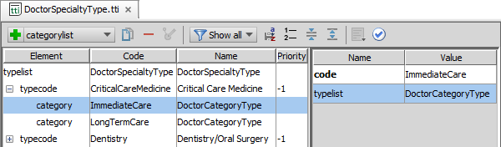
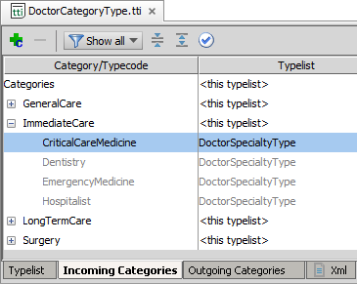
Review: Typecode category
Category
Associate one or more typecodes on a parent typelist with one or more typecodes on a child typelist
Incoming Categories tab in parent typelist shows child typecodes
Notes:
A typecode filter uses categories and category lists at the typecode level to restrict or filter a typelist.

Slide 5
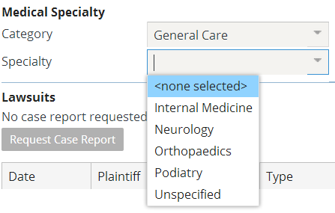
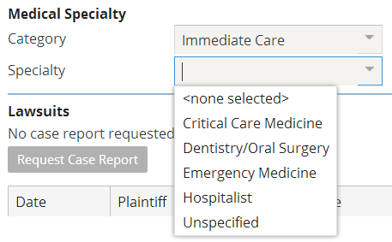
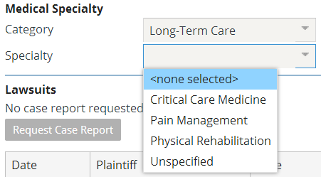
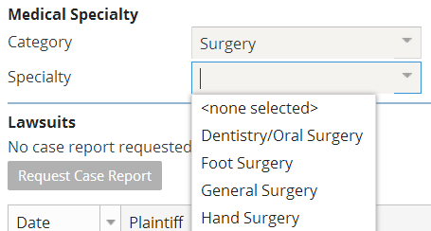
Dependent dropdowns
Typecode categories "group" typecodes into categories
Categories are displayed as "parent" field to a dropdown
Value of category constrains which typecodes may be chosen

Slide 6
UI requirements for dependent dropdowns
To work correctly:
The category dropdown and the child dropdown must be declared in the same PCF file
The typecode dropdown must come after the category dropdown
It does not need to be immediately after the parent
It does not need to be in the same input column
Notes:
The parent and child dropdowns must be on the same screen or location. Because the built-in reflection is not dynamic, the two must be rendered at the same time.

Slide 7
Steps to implement dependent dropdowns
Select a typecode
Select category(s)
Add to an entity
Add to UI

Slide 8
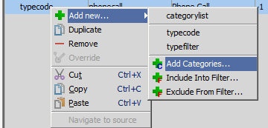
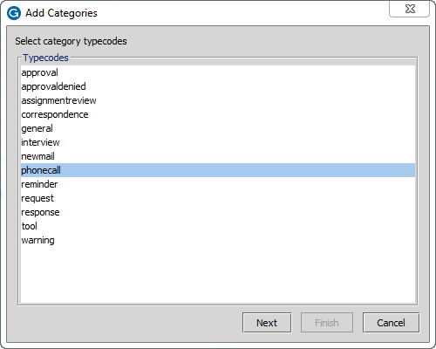
1. Select a typecode
Select a typecode to associate with a category and right-click it
Select Add new… → Add Categories…
The "Add Categories" dialog lists the typecodes in the child typelist
The one you right- clicked is preselected
Click "Next"
Notes:
More than one child typecode can be selected (using shift-click or control-click).

Slide 9
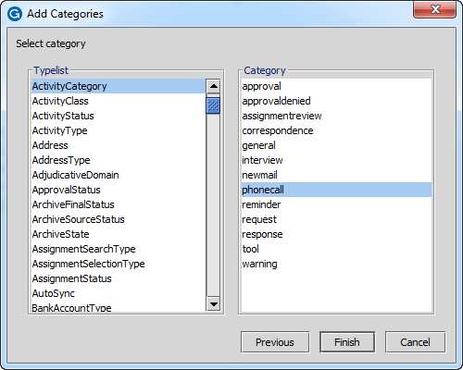

2. Select category(s)
The second "Add Categories" dialog lists the typecodes in the parent typelist
In the left-hand pane, select the parent typelist
In the right-hand pane, select the category
Click "Finish"
Notes:
Only one parent value/category can be selected.

Slide 10
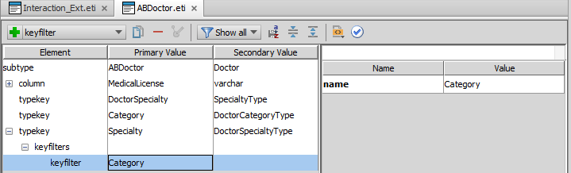
3. Add to an entity
Add both parent and child typelists to the entity
On the child typelist, right-click and select Add new… → keyfilter
This creates a node called "keyfilters"
Right-click "keyfilters" and select Add new → keyfilter
In the Name property, select the name of the parent typelist

Slide 11
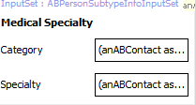
4. Add to UI
The parent and child typelists must appear on the same screen or location
The child typelist must appear after the parent typelist
Parent typelist
Child typelist

Slide 12
Review: Deploying data model extensions
Optionally regenerate Data Dictionary and check for validation errors
gwXX regen-dictionary
Restart the application server
gwXX dev-stop, and then
gwXX dev-start

Slide 13
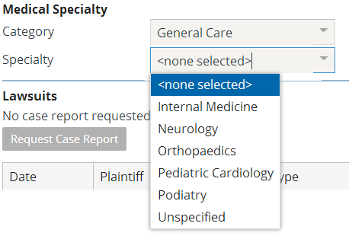
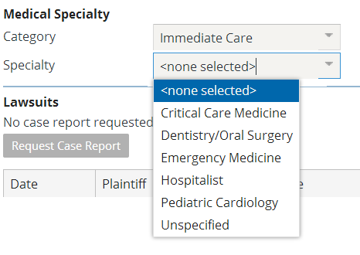
The deployed dependent dropdown

Slide 14
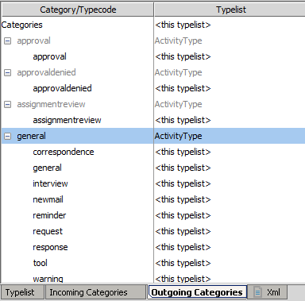
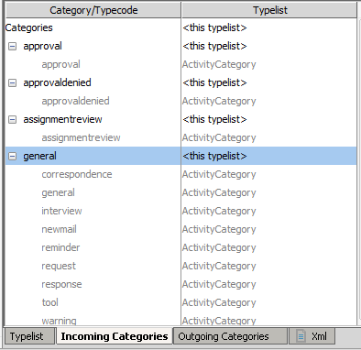
Incoming and Outgoing categories
The outgoing categories tab on the child typelist shows the categories associated with that typelist, and which typecodes belong to them
The incoming categories tab on the parent typelist shows the categories derived from that typelist, and which typecodes belong to them

Slide 15
Lesson objectives review
You should now be able to:
Create dependent dropdowns

Slide 16
Notices
Copyright © 2001-2013 Guidewire Software, Inc. All rights reserved. Guidewire, Guidewire Software, Guidewire ClaimCenter, Guidewire PolicyCenter, Guidewire BillingCenter, Guidewire Reinsurance Management, Guidewire ContactManager, Guidewire Vendor Data Management, Guidewire Client Data Management, Guidewire Rating Management, Guidewire InsuranceSuite, Guidewire ContactCenter, Guidewire Studio, Guidewire Product Designer, Guidewire Live, Guidewire DataHub, Guidewire InfoCenter, Guidewire Standard Reporting, Guidewire ExampleCenter, Gosu, Deliver Insurance Your Way, and the Guidewire logo are trademarks, service marks, or registered trademarks of Guidewire Software, Inc. in the United States and/or other countries.
Guidewire products are protected by one or more United States patents.

