Slide 1
Partial Page Update
October 14, 2013
Notes:
Guidewire training materials contain Guidewire proprietary information that is subject to confidentiality and non-disclosure agreements. You agree to use the information in this manual solely for the purpose of training to implement Guidewire software solutions. You also agree not to disclose the information in this manual to third parties or copy this manual without prior written consent from Guidewire. Guidewire training may be given only by Guidewire employees or certified Guidewire partners under the appropriate agreement with Guidewire.

Slide 2
Identify common ways to configure a partial page update
Enable targeted Post On Change for an input and define properties that are best performing
Differentiate between targeted Post On Change and client reflection
Replace client reflection with targeted Post On Change

Slide 3
Partial page update
Configuring targeted Post On Change
Replacing client reflection

Slide 4
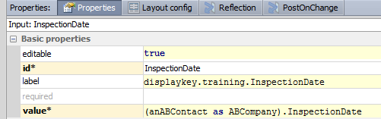

Static and dynamic widget properties
Some widget properties must be set to static values
They define aspects of widget that never change
Some widget properties can be set to Gosu expressions
They define dynamic behaviors
Notes:
In the example above, the "id" property of a widget is a static property. The widget always has the same ID, regardless of the state of the application or the values of any business data. However, the "visible" property is a dynamic property. It evaluates to either true (if the InspectionRequired field is true) or false (if the InspectionRequired field is false).
Theoretically, the visible condition could be set to "(ABContact as ABCompany).InspectionRequired". The "== true" has been added only to clarify to students that the InspectionRequired field is a boolean.

Slide 5
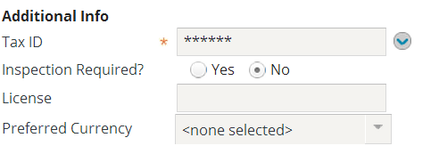
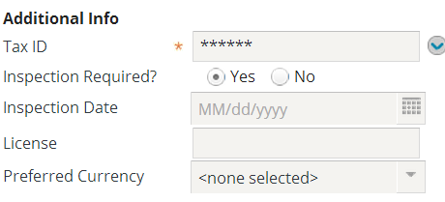
Dynamic widget behavior
Dynamic widget behavior refers to widget behavior that responds to changes in business data
Examples:
Notes:
In the example above, the Company Info card has both an Inspection Required? field and Inspection Date field. However, the Inspection Date field is visible only if the Inspection Required? field is set to Yes.

Slide 6
Why implement dynamic widget behavior?
To hide (or show) widgets and containers irrelevant (or relevant) to current business process
To conditionally prevent (or allow) widget values from being modified
To conditionally make a widget's value required (or optional)
To update data immediately after a user changes a given widget's value
Notes:
Widgets have properties that can be controlled by dynamic values. The examples in the slide reference the widget properties (respectively):
Visible, Available
Editable, Available
Required
onChange

Slide 7
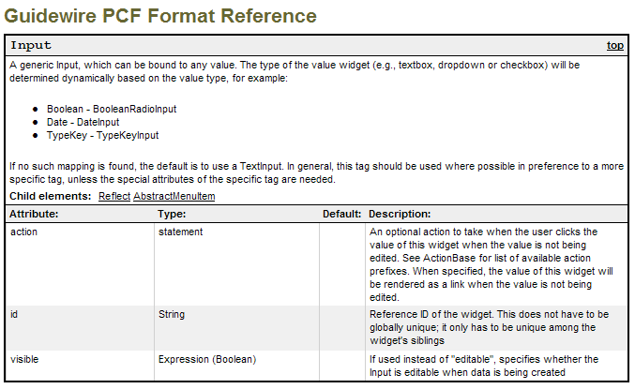
Identifying properties that are Gosu expressions
Notes:
Recall that the PCF Format Reference defines the properties for every widget, including the type of value the property takes. The example above is an abbreviated portion of the Input section that shows the "id" property takes a static string, but the "visible" property takes a dynamic expression (which must return a boolean value). Note that the PCF Format Reference refers to widget properties as "attributes".
The PCF Format Reference is located in <ApplicationRootDirectory>\modules. It is called "pcf.htm".

Slide 8
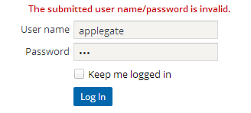


How does processing occur?
Client
AJAX
JSON
Server
Client makes AJAX server request and server responds to client with JSON
Client JavaScript libraries process JSON to update page data and layout
Reduced network traffic
Content length = 1479 octets
JSON
{"cmd":"replaceItems", "items":[{ "id":"Login:LoginScreen:0",
"frame":false, "xtype":"gcontainer", "html":"The submitted user name/password is invalid.", "border":false }] }
Notes:
AJAX is an acronym for Asynchronous JavaScript and XML. The term generically describes how an application send data to and retrieve data from a server either asynchronously (in the background) or synchronously. XML is not a required format. Guidewire applications use JSON instead of XML for AJAX requests. JSON stands for JavaScript Object Notation. JSON is a text-data interchange format that is language independent and self-describing. JSON is like XML in that it is plain text, self-describing, hierarchal, and can be transported using AJAX. JSON is unlike XML in that it uses arrays, has no reserved keywords, and is quicker to read and parse.
In this example, it is important to observe that to display a simple error message to the user requires little server side processing and low levels of network traffic. This example is from the Emerald version of TrainingApp. Server-side processing involves the client making a HTTP Post or HTTP Get request to the Guidewire application server, the server renders a complete HTML page and responds to the client with the complete HTML, and the client browser then parses the document object model for the HTML and renders the resulting page.

Slide 9
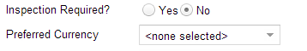

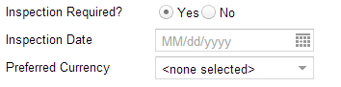
Partial page update type: Layout re-render
No data committed
Applies to following widget properties
Visibility
Editability
Availability
Required
Layout re-rendered for the page
Value Changed
Layout re-rendered
Notes:
There are two general and non-exclusive categories for a partial page update: DATA_ONLY and a layout re-render.
In the layout re-render example above, whenever the value of the InspectionRequired field is changed, all user editable data is sent from the client to the application server via AJAX. No data is committed. The server process the request and returns the user editable data to the client in JSON format. The client renders a partial page update that shows an Inspection Date calendar input.

Slide 10


Partial page update: DATA_ONLY
No data committed
Applies to only one widget property:
Value
Data is updated for the page
Value Changed
Data updated
Notes:
There are two general and non-exclusive categories for a partial page update: DATA_ONLY and a layout re-render.
In the DATA_ONLY example, whenever the value of the Resolution field is changed, all user editable data is sent from the client to the application server via AJAX. No data is committed. The server processes the request and returns the user editable data to the client in JSON format. The client renders a partial page update that shows new data for the Unflagged By and Date Unflagged fields.
DATA_ONLY applies to the value property of a widget. Examples include refreshing an input group and refreshing a set of fields on a cell change in a list view.

Slide 11
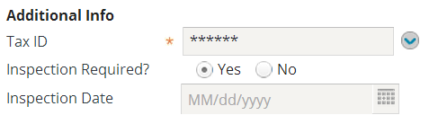


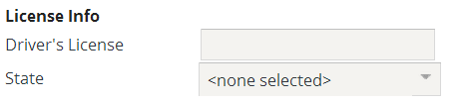
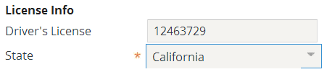
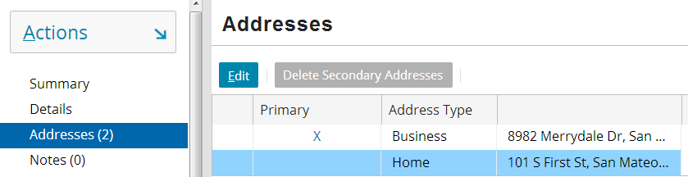
Properties that use expressions
Visible
Editable
Required
Label
null
null
Notes:
The visible property is used to dynamically control whether a widget is displayed.
The editable property is used to dynamically control whether a widget can be edited.
The required property is used to dynamically control whether a widget value is required.
The label property is used to dynamically control either which label is used or what is displayed in the label.
The properties listed above are not the only properties that use expressions, but they are properties that are commonly used with expressions.

Slide 12
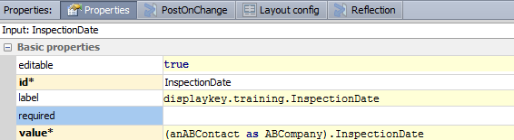
Example 1: Conditionally visible
Display "Inspection Date" only if inspection is required
Notes:
In the example above, the visible property resolves to true only if the contact's InspectionRequired field is true. (Theoretically, the visible condition could be set to simply "(ABContact as ABCompany).InspectionRequired". The "== true" has been added only to clarify to students that the InspectionRequired field is a boolean.)

Slide 13


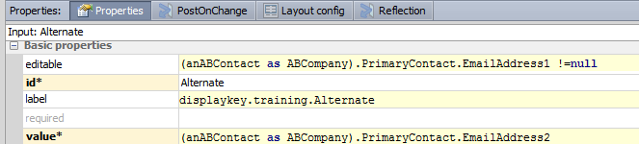
Example 2: Conditionally editable
Alternate email can be added only if main email exists
If the condition in the editable property is met, then the value for the Alternate Email field is added
Notes:
In the example above, the editable property resolves to true only if the contact's EmailAddress1 field has a non-null value. This example is not implemented in TrainingApp and only serves as a possible scenario.

Slide 14
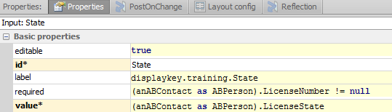
Example 3: Conditionally required
null
State is not required unless a driver's license number is provided
Notes:
In the example above, the required property resolves to true only if the contact's license number field has a non-null value.

Slide 15
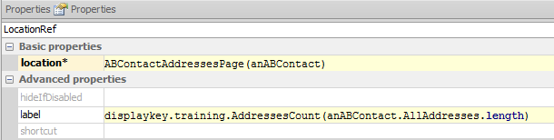

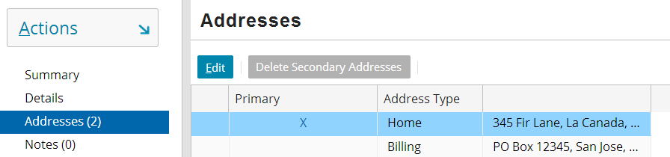
Example 4: Label with argument
Label should be "Addresses" plus the number of addresses in parenthesis
Display key
Notes:
In the example above, the label property specifies a display key with an argument. It also passes in a value, specifically the length of the AllAddresses array. The label is rendered using the named display key with the argument is the designated location. Recall that a display key argument is noted by "{X}", where X is an integer. If there is only one argument, then the integer should be 0. If there are multiple arguments, then the arguments should be numbered starting with 0. When there are multiple arguments, the first argument listed in the label property is assigned to the {0} position, the second to the {1} position, and so on.

Slide 16
Partial page update
Configuring targeted Post On Change
Replacing client reflection

Slide 17
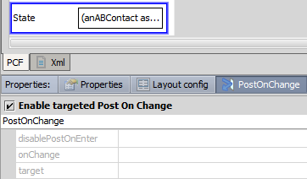
PostOnChange tab property
PostOnChange tab property
Mark the Enable targeted Post On Change checkbox
Configurable widgets
Cell
Input
InputGroup
See pcf.xsd for schema support
Three (3) configurable properties
disablePostOnEnter
onChange
target
Notes:
In order to improve data entry efficiency and reduce page refresh, you can configure input widgets and cell widgets to dynamically react to user input using targeted Post On Change. With targeted Post On Change enabled, it is possible to updated field values on the page and/or re-render the entire layout or a partial page layout.
Post On Change is a Boolean tab property in Guidewire Studio and allows you to define three additional properties: disablePostOnEnter, onChange, and target.
The PostOnChange property tab contains the Enable targeted Post On Change checkbox. When checked, the three additional properties are editable.
You can determine which widgets support targeted Post On Change. In the pcf.xsd file, you can see if a specific widgets has the following element:
<xsd:element ref="PostOnChange" …/>. The pcf.xsd file is in the parent directory of the Guidewire application project for Guidewire Studio.

Slide 18
<PostOnChange /> XML example
1 <Input
2 editable="true"
3 id="DriversLicense"
4 label="displaykey.training.DriversLicense"
5 value="(anABContact as ABPerson).LicenseNumber">
6 <PostOnChange/>
7 </Input>
<PostOnChange/> is an XML element in PCF
Properties in Guidewire Studio are XML attributes
disablePostOnEnter
onChange
target
Notes:
In the example above, Line 6 details the <PostOnChange /> element with no defined attributes.
PostOnChange is an XML element in PCF files for specific input and cell widgets. The XML element is the equivalent to a checked “Enable targeted Post On Change” checkbox for a given widget. The defined onChange attribute is equivalent to a specified onChange property in the Post On Change properties tab.
When upgrading previous applications, the upgrade tools will create the <PostOnChange/> XML element for widgets where the PostOnChange property equals true.

Slide 19
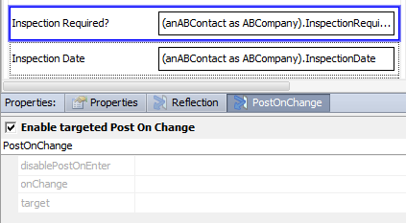
Targeted Post On Change
Enable targeted Post On Change
NO defined properties
Data Behavior
Refresh of user-editable data
No data committed
Layout Behavior
Entire page layout re-rendered
northPanel, westPanel, centerPanel, and southPanel
Notes:
If targeted Post On Change is enabled, the target property defines the scope and behavior of a page update, even if unspecified. Three types of values are accepted: No Value, specific Widget ID, and DATA_ONLY.
When no value is specified, the entire page is re-rendered and all user-editable data is refreshed. There is a high performance cost for implementing targeted Post On Change without specifying a target and any other properties. An unspecified value (no value) provides backwards compatibility for upgraded Guidewire applications.
A page layout in Guidewire 8.0 applications consist of four defined panels: northPanel, westPanel, centerPanel, and SouthPanel. In this example, the application server renders the InspectionDate widget because the visible property of the InspectionDate widget is based on the boolean evaluation of anABContact’s InspectionRequired property.

Slide 20
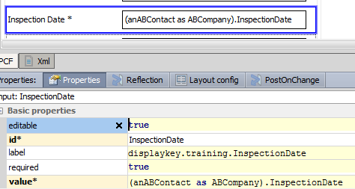
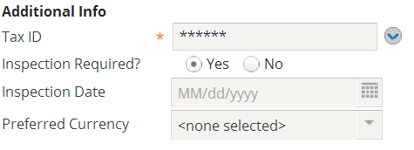
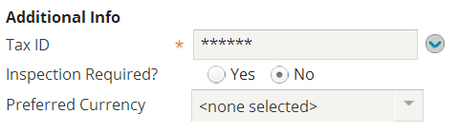
postOnChange: No target property
Advanced property required
Notes:
In this example, InspectionRequired's postOnChange property is enabled but no value (disablePostOnEnter, onChange, nor target) is defined. Therefore, whenever the widget value changes, the change is announced to all other widgets. This is not optimal. The InspectionDate's visible property is based on the InspectionRequired value (An advanced property). Consequently, whenever the InspectionRequired field is changed, the InspectionDate visibility is immediately updated.

Slide 21
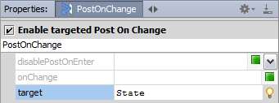

Target property (preferred)
Target widget re-rendered
Refreshes all user-editable page data
Example:
DriversLicense widget specifies State as target
Partial page update causes re-renderfor target widget
State widget’s required property enabled
Input: DriversLicense
Validation enabled with layout re-render
Notes:
The target property defines the scope and behavior of a page update. Three types of values are accepted: No Value, specific Widget ID, and DATA_ONLY. Triggering refreshes all user-editable data, but only the target widget is re-rendered with a new layout. The following widget types are supported targets:
• inline input widget (individual input)
• inline input set
• inline input panel (DV panel or LV panel)
• included panel (Panel ref)
• exposed panel or input set
• label widget
In the slide example, targeted Post On Change is enabled for the DriversLicense input widget. The target is the State widget. When a user edits the Driver’s License field, the change is announced to the State field. Only the layout of the State field is updated, causing the validation expression to equal to true as it is dependent on the existence of a value in the Driver’s License field. All other user-editable data is also refreshed.

Slide 22
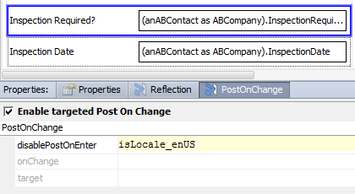
Property: disableOnEnter
Default is false
If evaluated to true, not triggered when page is rendered
Value Changed
Notes:
In certain cases, you may want to toggle (disable or enable) targeted Post On Change behavior for a specific widget.
In the layout example above, targeted Post On Change is enabled for the InspectionRequired input widget. However, the disablePostOnEnter property is set to the isLocale_enUS variable. A variable evaluation of true disables the targeted Post On Change behavior for the InspectionRequired widget. When the disablePostOnEnter property is true, the InspectionRequired widget will not announce a change in its value; data will not make a round-trip between client and the application server; the page will not be re-rendered; and unless the InspectionRequired field is already true for the given ABContact, the InspectionDate widget will not be visible.

Slide 23
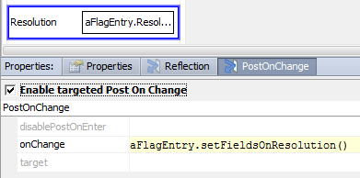
Property: onChange
Defines the Gosu expression to invoke
Applicable when user changes the editable value of a widget
Causes immediate post back to server
High cost to server-side processing in PCF configuration, especially if complex
Upgrade support for onChange widget property
Notes:
In the slide example, the Gosu expression defined for the onChange property invokes the setFieldsOnResolution() function. The function is defined in the entity enhancement, FlagEntryEnhancement.gsx.
16 /* This function is called when a FlagEntry's resolution field 17 is set. This function sets the UnflagDate and UnflagUser
18 fields. This serves the role of a "FlagEntry Pre-Update"
19 rule set.
20 */
21 function setFieldsOnResolution() : void {
22 this.UnflagDate = gw.api.util.DateUtil.currentDate()
23 this.UnflagUser = User.util.getCurrentUser()
24 } // end of function

Slide 24
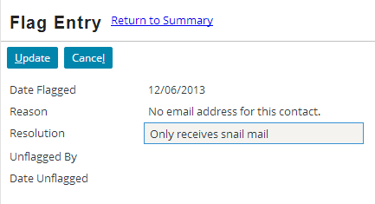
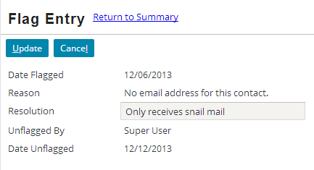
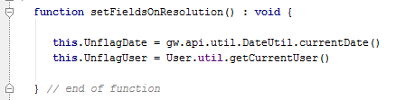
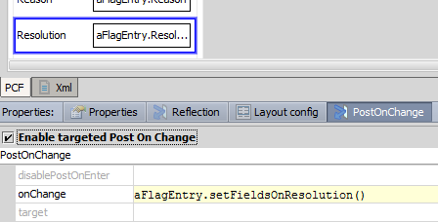
Example: onChange
Enabled
Notes:
In the example above, whenever the value of the Resolution field changes and the user makes some other widget active, the setFieldsOnResolution function executes.
If the code executed by onChange modifies any field values, these modifications are done to the run-time objects only . In other words, the new values will be displayed in the user interface, but the values are not yet committed to the database. In fact, the changed values will never be committed unless something else explicitly commits the data (such as being in Edit mode and then clicking the Update button).

Slide 25
Complex reactions to widget changes
Some widget behavior cannot be implemented with the visible/editable/ required properties and postOnChange
For example, setting fields to current date and user
When Resolution field changes, immediately set values for read-only user and date field
Notes:
Gosu expression properties and postOnChange are useful when you want to toggle boolean widget properties, such as visible or required, between true and false. However, they cannot be used to provide more open-ended functionality, such as setting a given field to the current date when a given event occurs.

Slide 26
onChange property
onChange is a widget property that executes code whenever widget's value changes
postOnChange must be true for onChange to trigger
onChange: UnflagUser = current user UnflagDate = current date
Notes:
The onChange property is also discussed in the "PCF Methods" lesson.

Slide 27
Partial page update
Configuring targeted Post On Change
Replacing client reflection

Slide 28
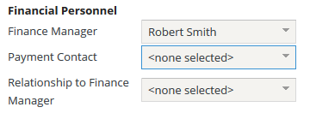
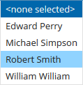
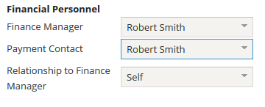
Reflection
Two or more widgets
One or more triggers
One or more listening
Trigger widget changes value
Listening widget(s) reflects change
Value
Availability
Trigger widget changes value
Listening widget reflects change
Notes:
In the example above, whenever a change is made to the either the Finance Manager or Payment Contact, the Relationship to Finance Manager field reflects the change.

Slide 29
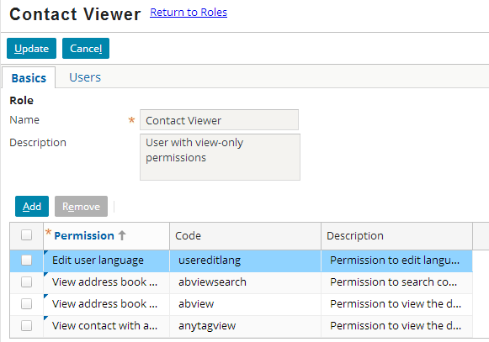
Reflection capabilities
Reflection can be used to set listening widget's:
Value, Availability (and indirectly its Editability)
Change this field…
…and these fields reflect the change
Reflection cannot be used to set listening widget's:
Visibility, Requiredness, Label

Slide 30
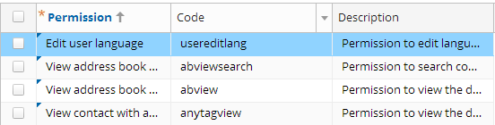
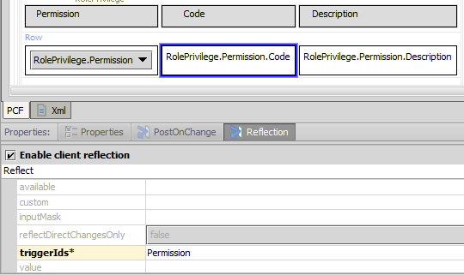
Reflection tab
Reflection is configured on listening widget's Reflection tab

Slide 31
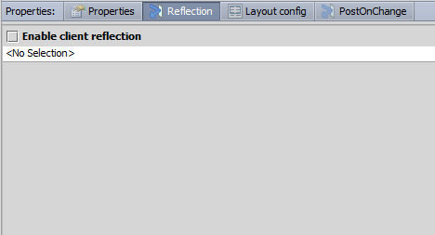
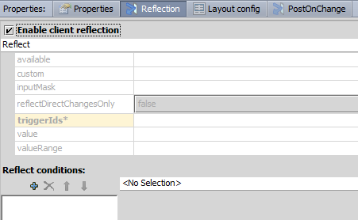
Enabling reflection
To enable reflection, first select "Enable client reflection" checkbox on listening widget

Slide 32
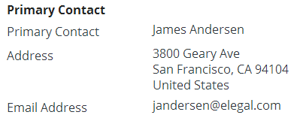
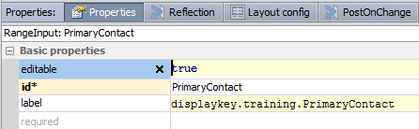
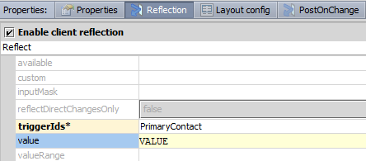
Configuring value reflection
Listening widget must identify:
Triggering widget(s)
Widget value
triggering widget
listening widget
"VALUE" is token that contains value of triggering widget
Notes:
The VALUE token represents the value of the widget that is referenced by the triggerIds property.
It is possible for a single widget to reflect changes from multiple triggering widgets. Each argument becomes a numbered token as in VALUE1, VALUE2, VALUE3, etc. The value field for the listening widget can be a Gosu expression.
There is one circumstance where the value property on the Reflection tab is optional. If the listening widget is a property on an object and the triggering widget is a foreign key to that object, then the value property on the Reflection tab is not required. In this situation, a Guidewire application can infer the value from the value property on the Properties tab. For example, if the listening widget is the EmailAddress1 field on a contact object, and the triggering widget PrimaryContact points to that same object, then a Guidewire application can infer that the Reflection value should be PrimaryContact.EmailAddress1. However, including the value property does not cause problems and may make the configuration more readable.
The value field is required if:
The triggering widget is not a foreign key field pointing to an object, or
The triggering widget is a foreign key field pointing to an object, but the reflecting widget reflects a value that is not a field on that object
Note that the example shown on this and the next slide is not representative of what is actually configured in TrainingApp, but has been configured to demonstrate value reflection.

Slide 33
Value reflection in action
selected PrimaryContact is Richard Madison
Displayed email is VALUE.EmailAddress1, which is Richard Madison's Email Address 1
selected PrimaryContact is William Andy
Displayed email is VALUE.EmailAddress1, which is William Andy's Email Address 1
Notes:
In the example above, the Email Address widget's client reflection has been enabled with the following properties set as stated:
triggerIds is set to "PrimaryContact"
value is set to "VALUE"
Changes made to the primary contact widget are immediately reflected in the EmailAddress widget.
Keep in mind that the example shows the selected value of Primary Contact and the displayed email address. Because these changes are occurring in Edit mode, the values of Primary Contact and Email Address remain null until the Update button is clicked and changes are committed.
Note that the example shown on this and the previous slide is not representative of what is actually configured in TrainingApp, but has been configured to demonstrate value reflection.

Slide 34

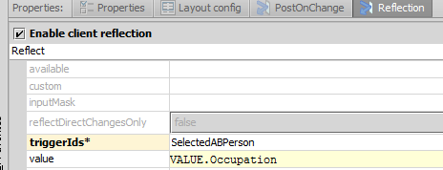
Value reflection: additional information
If the value of a VALUE token has properties, they can be accessed by using standard dot notation (VALUE.property)

Slide 35
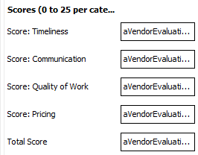
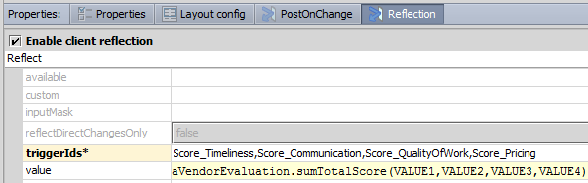

Complex value reflection
If more than one triggerId is specified, the tokens for their values are VALUE1, VALUE2, etc.
The "value" property of a widget's Reflection tab may be a complex statement, such as a Gosu function
Notes:
In the example shown, the Total Score widget listens to four other widgets. A change to any of these triggering widgets causes the value of the listening widget to update using the sumTotalScore function from VendorEvaluationEnhancement.gsx.

Slide 36
Basic implementation comparison
Client Reflection
Targeted Post On Change
On listening widget
Reflection tab
Define triggerIds property
One widget ID
Specify Value property
References specific triggerId field
Optional VALUE token
On triggering widget
PostOnChange tab
Define target property
One widget ID
Assign value with onChange
Variable

Slide 37
Advanced implementation comparison
Client Reflection
Targeted Post On Change
On listening widget
Reflection tab
Define triggerIds property
Comma delimited list of widget IDs
Specify Value property
VALUEx tokens
References specific TriggerId field value
On triggering widget
PostOnChange tab
Define target property
InputSet, InputGroup, ListViewPanel, or Ref id
Assign value with onChange
Expression
Method

Slide 38
Deprecated server-side client reflection
Two kinds of client reflection
Client-side
Server-side
Client-side still supported as partial page update option
Targeted post onChange is easier to manage and configure in most cases
Client reflection with server-side expressions are deprecated
Replace with targeted post on change

Slide 39
Replacing reflection with targeted Post On Change
Identify the listening widgets configured for client reflection
Identify the announcing widgets, e.g., the triggerIds, for client reflection
Enable targeted Post On Change for announcing widgets
Specify required properties for best performance
disableOnEnter
onChange
Target
Disable client reflection for listening widgets
Test and verify behavior

Slide 40
Identify common ways to configure a partial page update
Enable targeted Post On Change for an input and define properties that are best performing
Differentiate between targeted Post On Change and client reflection
Replace client reflection with targeted Post On Change

Slide 41
How is a partial page update implemented?
What are the three properties that you can configure for a widget with targeted Post On Change enabled?
What are the three possibilities for the target property? Which is the best performing? Why?
What is the primary configuration difference between client reflection and targeted Post On Change?
How can you most effectively refresh of layout of several related widgets by enabling targeted Post on Change on one trigger widget?
Notes:
1) A partial page update response is typically a JSON response to an AJAX request.
2) disableOnEnter, onChange, and target.
3) No value (unspecified value), DATA_ONLY, or a specific id? DATA_ONLY refreshes only the user-editable data and is often the best performing.
4) You configure client reflection on listening widgets. You configure targeted Post On Change on the trigger widget.
5) If there are several widgets that for which you need to refresh the layout or update the data, consider wrapping the related widgets into an Input Set widget.

