Slide 1
Enhancements
16 September 2013
Notes:
Guidewire training materials contain Guidewire proprietary information that is subject to confidentiality and non-disclosure agreements. You agree to use the information in this manual solely for the purpose of training to implement Guidewire software solutions. You also agree not to disclose the information in this manual to third parties or copy this manual without prior written consent from Guidewire. Guidewire training may be given only by Guidewire employees or certified Guidewire partners under the appropriate agreement with Guidewire.

Slide 2
Lesson objectives
By the end of this lesson, you should be able to:
Describe the purpose and functionality of Gosu enhancements
Write entity enhancements
Reference properties and methods in an entity enhancement
Write static methods in Java class enhancements
Debug enhancements
This lesson uses the notes section for additional explanation and information. To view the notes in PowerPoint, choose View→Normal or View→Notes Page. If you choose to print the notes for the lesson, be sure to select “Print hidden slides.”

Slide 3
Lesson outline
Entity enhancement basics
Working with entity enhancements
Working with Java class enhancements
Debugging enhancements

Slide 4
Gosu enhancements
A Gosu enhancement is a set of code that enhances the functionality of an existing Guidewire type
For configuration developers, nearly all enhancement work involves enhancing either:
Guidewire entities
Java classes
Therefore, this lesson focuses on these types of enhancements
Notes:
Guidewire types that can be enhanced include entities, classes, PCF files, permissions, SOAP entities, and typekeys.
Gosu enhancements can also be used to enhance types where subclassing is impractical or not possible.

Slide 5
Elements of an enhancement
Enhancements can have any number of the following:
Getter properties, which calculate derived values
Setter properties, which set field values in situations where additional logic is needed
Methods, which:
Take input parameters, and/or
Modify other objects, and/or
Create objects

Slide 6
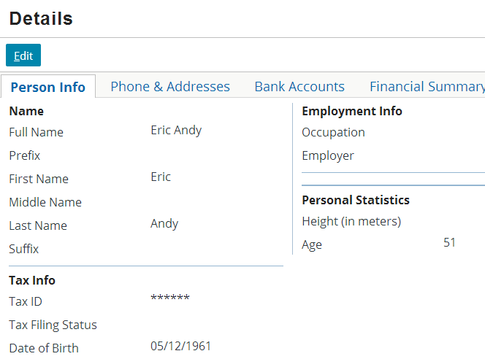
Using logic to calculate ("get") values
Some data does not need to be stored in the database because it can be derived from other data

Slide 7
Getter properties
A getter property is used to calculate a derived value
Property not declared at data model level
Value not stored in database
Code cannot receive input parameters
Code can only return value
Should not be used to alter any data
Null safe
Example
ABPerson.Age
Derive value by calculating number of years between date of birth and current date (or returning "Unknown" if date of birth is null)
Storing value in database would be redundant

Slide 8
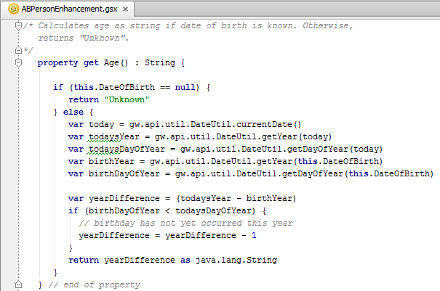
Example getter: ABPerson.Age
Enhancement declaration identifies type it enhances
"this" represents object from which getter was called
Notes:
For all enhancement logic, the keyword "this" represents the object from which the getter, setter, or method is called.

Slide 9
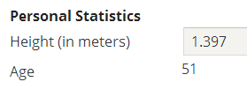
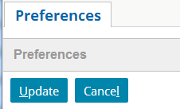
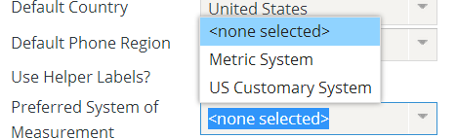
Using logic to "set" values
If user's preference is metric, display and save value as normal
In some cases, logic is needed to display and modify values
For example, the database stores all heights in meters, but users have the option to see and enter heights in inches
If user's preference is US Customary, convert value to inches before displaying and before saving

Slide 10
Setter properties
A setter property takes a single input value and uses it to modify the associated object
Property not declared at data model level
Value given to setter may or may not be stored in database
Values manipulated by setter are typically stored in database
Code must receive exactly one input parameter
Should not be used to alter other objects
Example
ABPolicyPerson.HeightInInches
Getter takes height from database (in meters) and converts it to inches (so, for example, it can be displayed in UI)
Setter takes height (in inches) and converts it to meters before saving it to database
Notes:
Typically, an implementation of any Guidewire application will have a small number of setters. This is because of the unusual number of circumstances that must be true for a setter to be an appropriate choice. A getter is appropriate any time a needed value can be derived and therefore should not be stored in the database. A method is appropriate any time you need to modify values in an open-ended way. Both of these circumstances come up frequently. But a setter is appropriate only when you need to set one or more fields based on a single input value and—if there is a single field to be set—it is a field that cannot be set by simply assigning the input value to the field.
Possible use cases for setters could include:
Adding a value to one field out of several possible fields (such as adding a new phone number to either Work Phone, Home Phone, or Cell Phone).
Adding an object to an array and making that value the primary object (such as adding a new employee to an ABCompany and making that employee the primary contact).
Adding a value to a field that must be converted to a different unit (such as receiving a dollar amount in Euros but needing to store that amount as dollars).
Converting an integer value to a typekey value (such as receiving an integer that represents the number of employees and using that to set a CompanySize typekey value which could be: Under 100, 101 to 500, 501 to 1000, Over 1000).

Slide 11
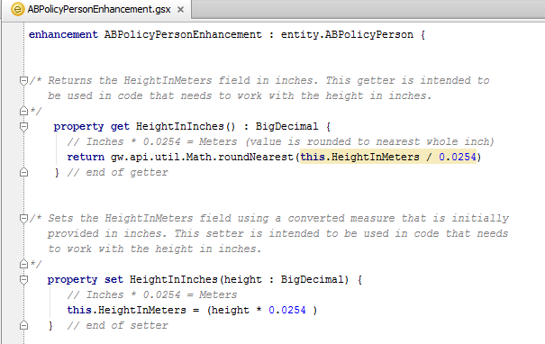
Example setter
Must receive exactly one value, which is value to set
Notes:
For all enhancement logic, the keyword "this" represents the object from which the getter, setter, or method is called.

Slide 12
Enhancement methods
A method is a set of statements that executes a logical unit of work
Can receive any number of input parameters
Can optionally return a value
Should be used when code:
Requires multiple input parameters, and/or
Modifies multiple unrelated fields on given object, and/or
Creates or modifies other objects, and/or
Does not "feel like" a setter
Example
ABPerson.assignDefaultOccupation
Uses information known about object to generate default occupation
Notes:
There are two elements that alter data: setters and methods. Each is appropriate under different circumstances.
A setter is appropriate when you are making a change to the object and:
The change "feels like" you are setting a field,
A single input value is used to determine how to set the value, and
No other objects get changed. (Example: Contact.PrimaryAddress(anAddress), which adds anAddress to the contact's array of addresses (if necessary) and then sets that address to be the primary address.)
A method is appropriate when you need to make a change and either:
The change doesn't feel like you are setting a field, or
You need parameters, or
Changes are made beyond the object in question. (Example: Contact.CreateFraudCase(Reason), which creates an activity associated to the contact and creates a note associated to the activity that includes Reason in the body).

Slide 13
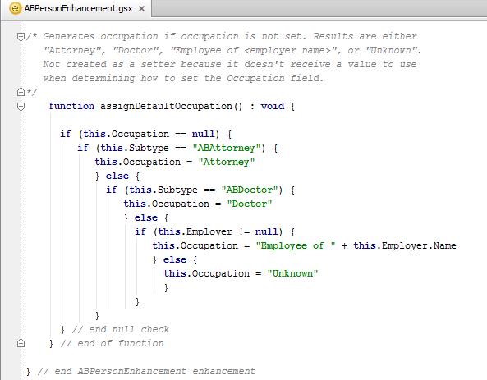
Example method 1: AssignDefaultOccupation
Notes:
For all enhancement logic, the keyword "this" represents the object from which the getter, setter, or method is called.

Slide 14
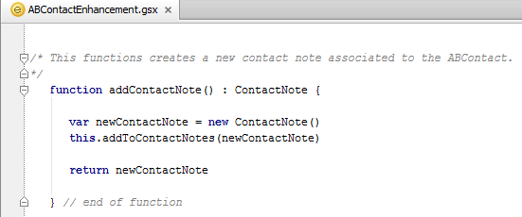
Example method 2: Creating new objects
When you need to create a new object in code, you typically also need to relate the object to some existing object, either by:
Setting one object's foreign key to the other object, or
Adding the new object to an existing array

Slide 15


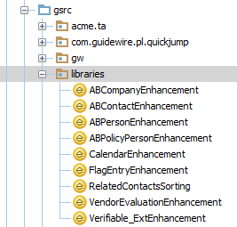
Enhancement files
Enhancements are:
Declared in .gsx files ( )
Organized into packages ( )
Listed under the Classes resource in Studio
package
.gsx file
.gsx file
.gsx file
Notes:
A package is an aspect of object oriented programming languages. It is a collection of classes gathered together for convenience (typically because the classes have a similar purpose). Because enhancements extend the functionality of an entity class, enhancements are also stored in packages.
A package can contain any number of enhancements (and/or Gosu classes).
In ClaimCenter, BillingCenter, ContactManager, and TrainingApp, the base file enhancements are declared in the libraries package. In PolicyCenter, they are declared in sub-packages of the gw package.

Slide 16
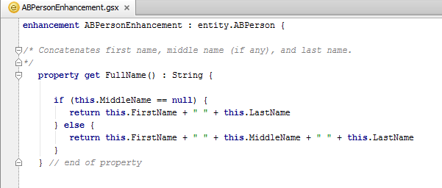
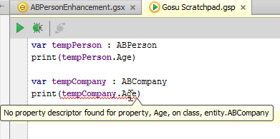
Enhancements enhance a given type
"Age" is available only to ABPerson (and its subtypes)
Enhancement elements are available only to type it enhances (and its subtypes, when relevant)
Notes:
In the example above, the ABPerson entity is extended to include an Age property. This property is available to any ABPerson or any object that is a subtype of ABPerson (such as ABDoctor). However, it is not available to any other entity (such as ABCompany, as shown in the screenshot).

Slide 17
Lesson outline
Entity enhancement basics
Working with entity enhancements
Working with Java class enhancements
Debugging enhancements

Slide 18
Implementing enhancements
Create a new enhancement file (or add to an existing enhancement file)
Write the code for the properties and/or methods
Test and debug the properties and/or methods
Reference the properties and/or methods as appropriate

Slide 19

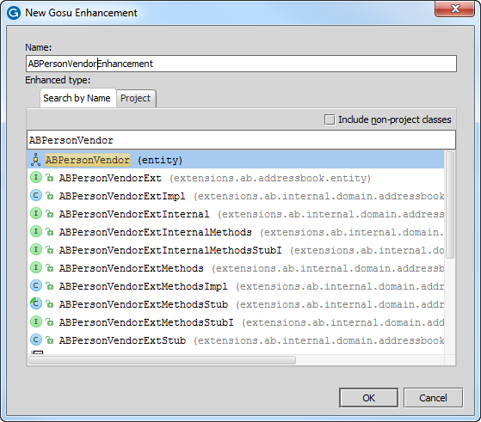
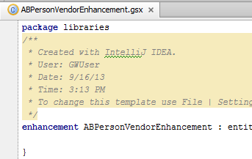
Creating new enhancement files
Right-click desired package and select New → Gosu Enhancement
Enter entity name, then select entity and optionally modify enhancement name
Studio automatically generates code shell
Notes:
Guidewire recommends that all enhancements that you create should be in a custom package named after your company. For example, if you were implementing an application for Acme Insurance, then all custom enhancements should be in a package named Acme (or in sub-packages of an Acme package).
The recommended naming convention for enhancements is <EntityName> + <AdditionalTextWhenNeeded> + Enhancement. In some cases, you may need to have multiple enhancements for a single entity. In this case, the "AdditionalTextWhenNeeded" should be used to clarify the difference between the enhancements.

Slide 20
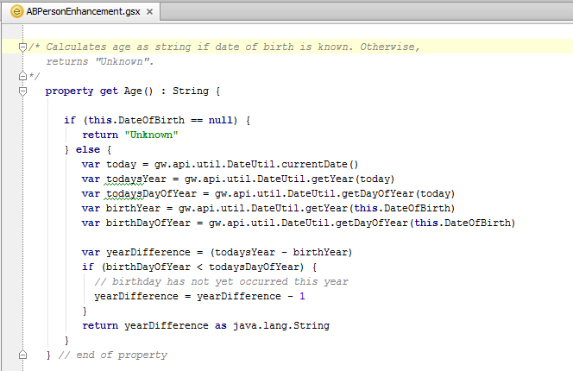
Getter syntax
Syntax:
property get PropertyName() : returnType {
// code to derive property, using "this" to reference root object return propertyValue
}
Notes:
The recommended capitalization convention for properties is to use camelcase with an initial upper-case letter (such as IsFlagged, FundsRemaining, or BackupUser).
You can precede the property keyword with one or more modifier keywords. Guidewire modifiers include public and private, which are access modifiers. A property is public by default, meaning that it can be referenced from anywhere in a Guidewire application that uses Gosu. In contrast, a private property can be referenced only within the library in which it is defined. The property shown in the slide will be called from a business rule and from a PCF. Therefore, it must be public. Because the public keyword is optional, it has been omitted in the example.
For more information about modifiers, see the Gosu Reference Guide.

Slide 21
Setter syntax
Syntax:
property set PropertyName( parameter : dataType ) {
// code to set appropriate property, using "this" to // reference root object
}
When used with a getter, both getter and setter should use the same property name
Notes:
The recommended capitalization convention for properties is to use camelcase with an initial upper-case letter (such as IsFlagged, FundsRemaining, or BackupUser).
You can precede the property keyword with one or more modifier keywords. Guidewire modifiers include public and private, which are access modifiers. A property is public by default, meaning that it can be referenced from anywhere in a Guidewire application that uses Gosu. In contrast, a private property can be referenced only within the library in which it is defined. The property shown in the slide will be called from a business rule and from a PCF. Therefore, it must be public. Because the public keyword is optional, it has been omitted in the example.
For more information about modifiers, see the Gosu Reference Guide.

Slide 22
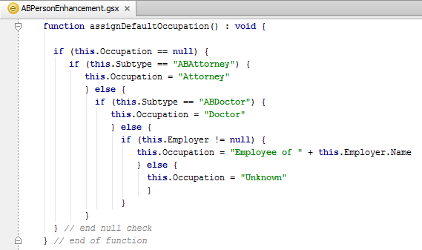
Method syntax
Syntax:
function functionName( parameter : dataType ) : returnType {
// code to execute method, using "this" to reference // root object
return returnValue // if returnType not void
}
Notes:
The recommended capitalization convention for methods is to use camelcase with an initial lower-case letter (such as popupButtonText, calculateAvailability, or assignToNextAvailableUser).
A method can return any type of value found in Gosu, including:
Boolean
String
Integer
Like the property keyword, you can precede the function keyword with one or more modifier keywords. Guidewire modifiers include public and private, which are access modifiers. A method is public by default, meaning that it can be referenced from anywhere in a Guidewire application that uses Gosu. In contrast, a private method can be referenced only within the library in which it is defined. The method shown in the slide will be called from a business rule and from a PCF. Therefore, it must be public. Because the public keyword is optional, it has been omitted in the example. For more information about modifiers, see the Gosu Reference Guide.
In object-oriented languages such as Gosu, you can create multiple methods with the same name provided that each method declaration has a different number of input parameters and/or different datatypes for the input parameters. This is known as "overloading" a method. For example, you could overload a theoretical "upgradeContact()" method by creating one declaration that takes an ABPerson and one that takes an ABCompany. You can also theoretically use enhancements to overload existing base application methods. For example, you could overload the existing makePrimaryAddress() method on the ABContact entity by creating a second declaration that takes additional arguments. However, this is not recommended and could cause problems during future upgrades. Customers should use entity enhancements only to create new methods and not to overload existing methods.
Object from the data model
Arrays
Void (no value returned)

Slide 23
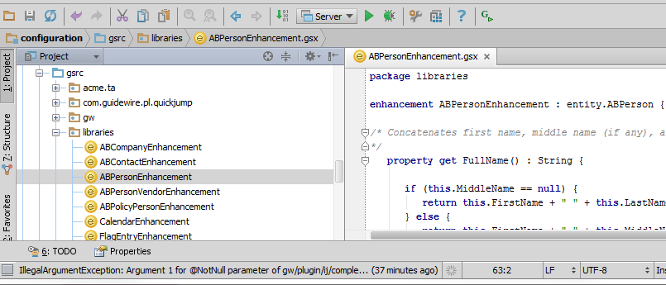
Deploying enhancements
Once saved, enhancements require no special action to deploy them
If Studio is connected to application server, then they are immediately available to application upon save

Slide 24
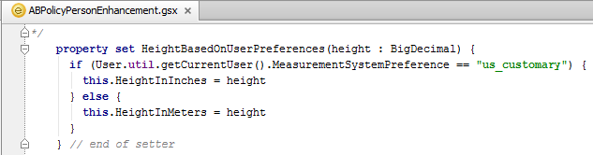
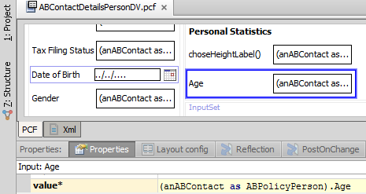
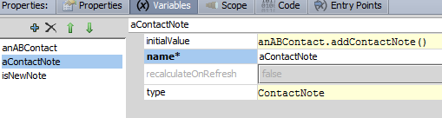
No special syntax to reference enhancements
setter: rootObj.setter = inputValue
getter: rootObj.getter
method: rootObj.function(inputParams)
Notes:
Entity enhancement elements are referenced using the same syntax as base application entity elements.
In the examples above:
The Age getter is used to specify the value of the Age widget.
The HeightInInches setter is used in code that determines if the input value—height—should be converted to inches and saved (using the HeightInInches setter) or if it should be saved directly to the database field (HeightInMeters).
The addContactNote method is used to create a new, empty contact note related to anABContact.

Slide 25
Lesson outline
Entity enhancement basics
Working with entity enhancements
Working with Java class enhancements
Debugging enhancements

Slide 26
Enhancing Java classes
Gosu enhancements can also add methods to Java classes
Typically, configuration resources enhance Java classes using only static methods (methods that can be called from the class itself as opposed to from an instance of the class)
This is useful when you want to create a generic method (such as a date, string, or math method) that doesn't relate to any specific entity
Notes:
Gosu enhancements can add more than just static methods to Java classes. However, configuration developers typically only add static methods to Java classes. The further capabilities of Gosu enhancements of Java classes are usually more relevant to integration work and are discussed in the integration courses.

Slide 27
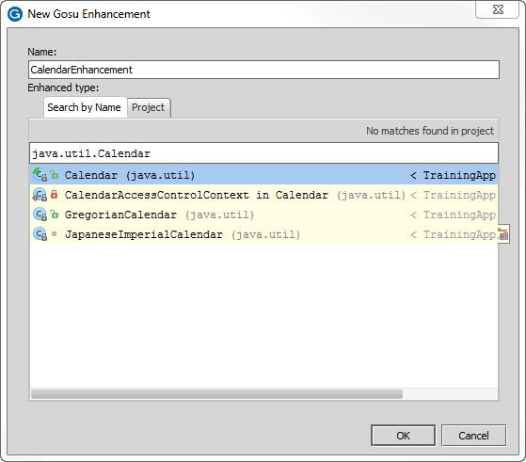

Creating Java class enhancements
For "Type to Enhance", specify Java class
Notes:
Because a static method can be called without having any instances, you can theoretically put any static method in any class. (For example, you could put a string method in java.util.Math.) However, it is considered good programming practice to put static methods in the class they most logically relate to, as this makes it easier for developers to find the class and it makes code that makes use of the class more readable.

Slide 28
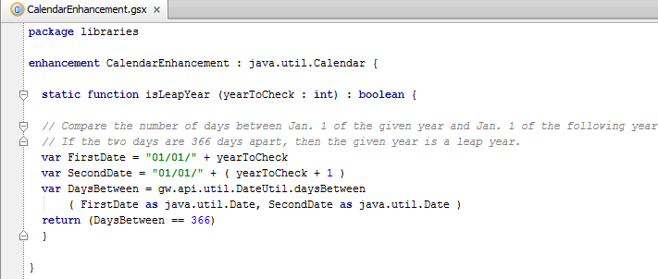
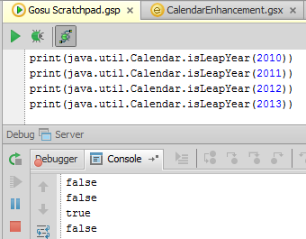
Creating and referencing static methods
Method preceded by keyword static
Reference the method explicitly (not working from an instance)
Notes:
Because static methods do not work off an instance, you typically do not see the keyword "this" in a static Gosu method. The keyword "this" is used to reference the instance from which the method is being called, but static methods are not called from instances.

Slide 29
Lesson outline
Entity enhancement basics
Working with entity enhancements
Working with Java class enhancements
Debugging enhancements

Slide 30


Studio debugger
The Studio debugger is a set of tools that shows how code managed by Studio is executed
Helps you debug code that does not execute as expected
Useful for determining how rules are being executed
Available for most code managed by Studio, including:
Rules
Enhancements
Classes

Slide 31
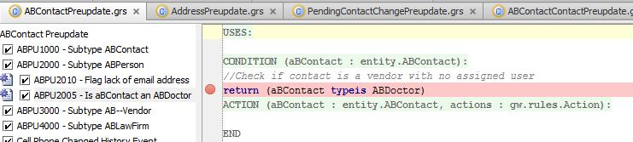
Setting breakpoints
A breakpoint indicates a place in code where execution should be suspended
After execution is suspended, you can step through code and observe:
Code that is executed
Variable and object values
To add breakpoint, click in area immediately left of line number
Notes:
When the debugger is on and a breakpoint is reached, normal execution of code is halted until you resume it. Because you can step through lines, you normally need only one breakpoint for each section of code you want to investigate. There is no advantage to having breakpoints on multiple consecutive lines because the first breakpoint suspends normal execution and normal execution does not resume until you request it to.
When the debugger is stopped, breakpoints are ignored and code is executed as normal.
Setting a Breakpoint
You can set a breakpoint by clicking in the gray area next to the line where the breakpoint symbol would appear. Alternatively, you can set breakpoints in one of the following ways:
On a particular line of code: Click in that line, and then select Debug →Toggle Line Breakpoint
On a particular rule: Click on or in the rule, and then select Debug → Toggle Rule Breakpoint. The debugger places a breakpoint on the rule condition, which is the first line of code executed in a rule.
Removing a Breakpoint
You can remove a breakpoint from your code by one of the following methods:
Click the breakpoint symbol (a red sphere)
Select Debug > Remove All Breakpoints
Position the cursor on line with a breakpoint and select Debug →Toggle Line Breakpoint
Position the cursor in a rule that is breakpointed and select Debug → Toggle Rule Breakpoint

Slide 32
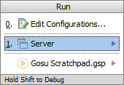
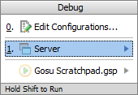
Run and debug server
Run Server (Alt + Shift + F10 )
Debug Server (Alt + Shift + F9)
Errors in Messages window
Console information and generated output in Run window
View running instance on jetty socket and port
Errors in Messages window
Debug window contains
Debugger and Console tabs
Console information and generated output to Console tab in Debug window
View running instance on jetty socket and port
Remember to set your breakpoints!
Notes:
In Guidewire Studio, you can run, debug (and test) your Guidewire application without leaving Guidewire Studio. You can run or debug your project by selecting the Run Server and/or Debug Server menu commands. In certain cases, you can use the Shift + F10 keystroke to Run Server and Shift + F9 keystroke to Debug Server. However, if you are actively working in Gosu Scratchpad (run/debug/stop), these keystrokes will run and debug, respectively, the code in Gosu Scratchpad! For this reason, you may want to use Alt + Shift + F10 and Alt + Shift + F9 to open the respective dialogs to run and debug the server instance for your project.
The console information and the generated output are displayed in the Run tool window or the Debug tool window in the Console tab.
The debugger enables you to execute your application step by step, examine program information related to variables, watches, or threads, and change your program without leaving Guidewire Studio. Prior to launching the debugger session, it makes sense to set breakpoints that cause the debugger to suspend the application or take some other actions when breakpoints are reached in code. There is no requirement for an explicit connection to running server. The same functionality supported by starting server in debug mode or by remote debugging,
No authentication is required to start debugging, however, debugging of production servers is not possible because they are not running in debug mode.

Slide 33
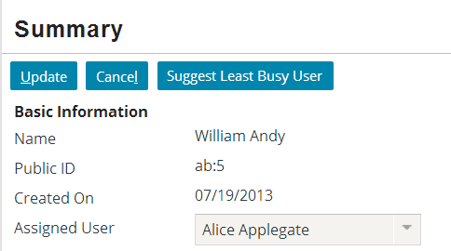
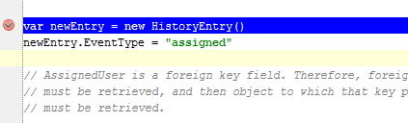
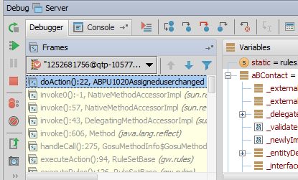
Suspending execution
When application executes code with breakpoint
Execution is suspended
Studio is automatically displayed with current line in blue
Frame tab shows current values of root and related objects
Notes:
The Frame tab lists the object passed to the code (for business rules, this is the root entity). Variable values at the breakpoint are visible in the Variables window. Frames shows the sequence of actions executed until the breakpoint, inclusive.

Slide 34
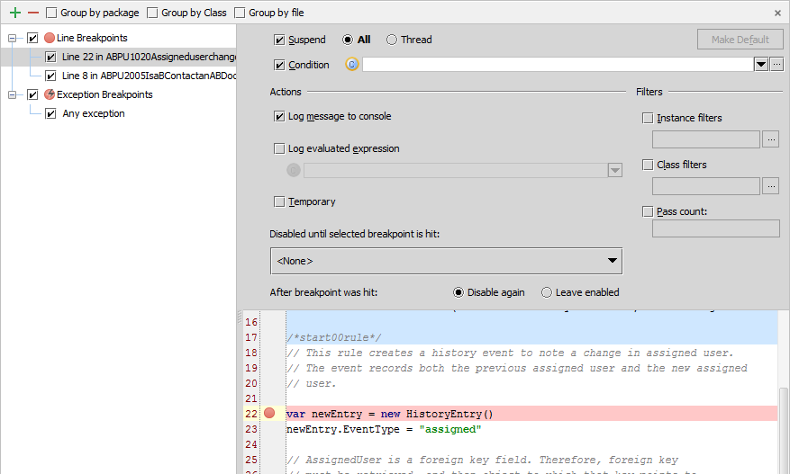
Breakpoint details
Run → View Breakpoints…
Ctrl +Shift + F8
Enable, disable, define action and conditions
Notes:
In addition to Ctrl-Shift-F8, right-clicking on the breakpoint also displays a menu with choices to Edit, Disable, Remove, or View Breakpoints. This screen shows the Edit breakpoint options.
The Breakpoint options dialog allows you to review all breakpoints. In the Toolbar, you can add a breakpoint, remove a breakpoint, display breakpoints under their respective packages rather than under their types, display breakpoints under their respective classes, and display breakpoints under their respective files. There are various Breakpoint options to set. You can enable a suspend policy for a breakpoint. For example, for a Thread policy the thread where the breakpoint is hit is suspended. You can also specify a condition in either Gosu or Java. You can also specify actions, such as logging the evaluated expression.

Slide 35
Stepping through code
Several step tools are available to help in debugging
Step over (F8) advances you to the next line in the file
Step into (F7) advances you to the next line executed
Force step into (Alt+Shift+F7) steps into, ignore stepping filters for libraries, constructors, etc.
Step out(Shift+F8) step to the first line executed after returning from this method
Notes:
Once the debugger pauses execution, you can step through the code in one of several ways. The most basic, stepping through code one line at a time, is achieved using Step Over (F8).

Slide 36

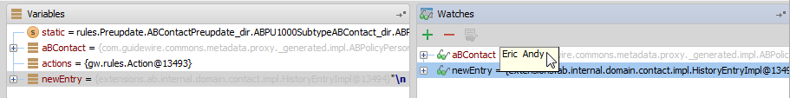
Watches
A watch is an expression whose value you wish to observe
To add a watch:
On Watches tab, right-click and select Add Watch
Drag the variables you want to watch from the Variables window to the Watches window
Notes:
The easiest way to populate the Watches window is to run the code to a desired point, then drag the variable over to the Watches window.

Slide 37
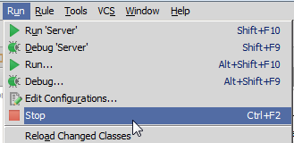
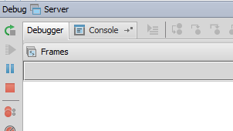
Stopping debugger
To stop debugger, click the stop button from the Run menu item, or within the debugger itself

Slide 38
Lesson objectives review
You should now be able to:
Describe the purpose and functionality of Gosu enhancements
Write entity enhancements
Reference properties and methods in an entity enhancement
Write static methods in Java class enhancements
Debug enhancements

Slide 39
Review questions
In Studio, enhancements are declared under what node?
What type of logic should be implemented as a getter? A setter? A method?
When you create a new enhancement, what code does Studio add for you automatically?
For an enhancement on the ABContact entity, what code would you write to reference the given ABContact's AssignedUser field?
How do you create an enhancement method that returns no value?
How do you reference enhancement properties and methods?
Notes:
Answers
1. The gsrc node
2. Getter: Logic that returns a derived value and does not take parameters or change other data. Setter: Logic that takes a single input value and uses that to modify some other field (or set of fields) on the given object. Method: Logic that requires parameters, changes data, or otherwise does more than simply deriving or setting a value.
3. Studio automatically creates the package statement and the enhancement declaration statement.
4. this.AssignedUser
5. You would create the method and specify a return value of "void".
6. You reference enhancement properties and methods using the same syntax as base application entity properties and methods: object.propertyOrMethodName.

