Slide 1
Policy Transactions
05 November 2013
Notes:
Guidewire training materials contain Guidewire proprietary information that is subject to confidentiality and non-disclosure agreements. You agree to use the information in this manual solely for the purpose of training to implement Guidewire software solutions. You also agree not to disclose the information in this manual to third parties or copy this manual without prior written consent from Guidewire. Guidewire training may be given only by Guidewire employees or certified Guidewire partners under the appropriate agreement with Guidewire.

Slide 2
Lesson objectives
By the end of this lesson, you should be able to:
Describe the types of transactions used to maintain policies
Explain the relationship between transactions and jobs
Describe how PolicyCenter represents policies
Interpret policy transaction graphs
This lesson uses the notes section for additional explanation and information. To view the notes in PowerPoint, choose View→Normal or View→Notes Page. If you choose to print the notes for the lesson, be sure to select “Print hidden slides.”

Slide 3
Lesson outline
Policy transactions
Jobs
Representing policies
Policy transaction graphs

Slide 4
Life span of a policy
effective date
expiration date
expiration date
policy term
renewal term
Length of time policy is in force determined by effective date (start date) and expiration date (end date)
Period between these two dates is policy term
During life of the policy, one or more transactions can occur that change the policy
Policy term is not the same as policy period
Notes:
The question "When does a policy end?" does not have a universal answer in the insurance industry. Personal lines carriers are more likely to view successive policy terms as a single policy; and Commercial Lines carriers are likely to view each term as a “policy”.
Assume for a moment that a given policy has a one-year term, and at renewal time a new policy number is not generated. (This is often the case, but not always the case with every insurance company.) At the end of that year, the policy is renewed, and the policy has the same policy number. Did the original policy end?
Some would say yes, that when the expiration date is reached, the policy ends. A new policy with the same number is created, but it is a different policy.
Others would say no, if the two time periods are governed by a document with the same policy number, then it is in fact the same policy.

Slide 5
Policy lifecycle transactions
Changes
Renewals
Non renewals
Submissions
Policy
Expiration
Policy created
Cancellations
Policy ends
Reinstatements
Rewrites
Notes:
The core of PolicyCenter revolves around the policy. Examples of policy changes are: creation of a new policy, renewal of a policy for a new term, or cancellation of a policy. The only transaction not included in the slide above is Audit. Audits can occur at any time during a policy term. A final audit can happen at the end of each policy term. Each of the above transactions are discussed in the slides to follow.

Slide 6
Submissions
submission
policy term
A submission is a transaction that creates a policy
Qualifying candidate
Getting one or more quotes
Binding and issuing policy when acceptable quote is found
Most do not end with policy being issued because
Applicant may not qualify
May not be any acceptable quote
Notes:
All transactions (including submissions) have an create date, an effective date and close date.
The create date is the date that the transaction was initiated.
transaction close date or close date - the date the job was completed.
Effective date - the date that the information in the job becomes legal and binding. The effective date is the date that the transaction becomes effective. For example, you could create and complete a submission today for an auto policy that will not take effect until Monday of next week. Today would be the written date, but Monday of next week is the effective date.
In some cases, the transaction close date comes before the effective date. For example, a submission job is typically completed before the policy goes into effect.
In other cases, the transaction close date comes after the effective date. For example, a rewrite job that corrects a clerical error may be run several weeks after the policy has become effective, but the rewrite is effective at the start of the policy.
Issuance job: An issuance job always occurs with a submission job if necessary. There are times that a user may choose to bind a submission without issuing it. Perhaps you need to collect additional information that binding does not require but issuing the final policy contract requires, such as verification of eligibility for discounts in an auto policy. To start an issuance job, the policy must already be bound (submission), but not issued. In addition, there must be no other open jobs on the policy.

Slide 7
Policy change
policy change
policy term
A policy change changes policy prior to expiration date
Some of the changes can be
Coverables added to or removed from policy
Coverages added to or removed from coverables
Coverage terms modified
Notes:
A change transaction is also referred to as a "policy change". A "material change" is a change to a policy that affects what is covered. Policy changes typically involve material changes. Policy changes almost always involve a change to the policy's premium.

Slide 8
Renewals
renewal
Yes
policy term
renewal term
No (expires)
A renewal creates a new policy for another term, at the end of policy term
May involve changes to coverables, coverages, or premium
If not renewed, policy simply expires
Notes:
An insured might choose to not renew a policy because he or she found a better-priced policy elsewhere, or because the policy premium has changed (perhaps because of changes in the industry or because of claims made against the original policy) and the insured does not wish to pay the new premium.
A carrier might choose to not renew a policy because the policy is considered financially unfavorable (perhaps because too many claims were filed against the policy).
Renewals can be highly regulated from state to state. There are restrictions in some states relating to non-renewal because of losses. There are also restrictions in many states relating to rate increases on renewals in excess of a given percent. And, there are restrictions in essentially all states relating to the carrier non-renewing without providing a specified amount of prior notice. Renewal regulation at a state level is largely a consumer protection issue. It is focused principally on personal lines (homeowners, personal auto) and harder to place on commercial lines.

Slide 9
Cancellations
cancellation
policy term
A cancellation ends policy before its expiration date
Could be initiated by insured
They found better price elsewhere
Could be initiated by carrier
Insured may have not paid premiums
Notes:
Cancellations are more easily executed by the insured than they are by the insurer. In many cases, the insured can choose to discontinue a policy and not need to have any reason for it. However, an insurer cannot discontinue a policy unless they can demonstrate some just cause, such as non-payment of premiums, purposefully inaccurate information provided at the time of submission, or fraud.

Slide 10
Reinstatements
cancellation
reinstatement
policy term
effective date
A reinstatement reinstates cancelled policy with original terms
Cancellation and reinstatement always have same effective date
No lapse in coverage
Can happen when issue causing cancellation has been rectified
For example, insured pays overdue premiums

Slide 11
Rewrites
cancellation
rewrite
policy term
new policy term
A rewrite creates new policy from existing policy
Typically done when an error occurred during initial and original policy does not reflect original intent of policy and
New set of policy forms showing correct information is required
Can have a lapse in coverage
Rewrites are carrier specific and there is no universal definition of what might cause a rewrite
Notes:
A rewrite involves a change to a policy that is significant enough that it cannot be captured with a policy change. Although there is no absolute rule in the insurance industry that dictates when something must be done as a rewrite versus as a policy change, there is at least one common use cases for this type of transaction:
People who work for the carrier may make clerical errors when entering policy information. For example, during a discussion with an applicant, the underwriter might have agreed to provide a certain type of coverage but forget to enter it into the policy system. The forms issued from the submission job are wrong, and the insured may prefer to have a new set of forms drafted so that they have physical proof of exactly what was covered. In this case, a rewrite is required because the customer wants a full set of policy forms showing the correct information. If the requirement was to just make the change then a policy change could have handled this. This rewrite must have an effective date as of the start of the policy.
Rewrite feature allows you to do the following:
Full-Term Rewrite: A full-term rewrite replaces the original policy for the complete policy term. A full-term rewrite can have a lapse in coverage.

Slide 12
Mid-term rewrites
cancellation
rewrite
policy term
new policy term
A mid-term rewrite replaces a portion of the original term and allows you to rewrite the policy till the original policy end date or to a new end date
Can create a lapse in coverage
Notes:
Mid-Term Rewrite: A mid-term rewrite replaces a portion of the original term and allows you to rewrite the policy to the original policy end date or to a new end date.
Every transaction has two different dates:
transaction close date or close date - the date the job was completed.
effective date - the date that the information in the job becomes legal and binding.
In some cases, the transaction close date comes before the effective date. For example, a submission job is typically completed before the policy goes into effect.
In other cases, the transaction close date comes after the effective date. For example, a rewrite job that corrects a clerical error may be run several weeks after the policy has become effective, but the rewrite is effective at the start of the policy.

Slide 13
Rewrite new account
rewrite
Source acct
policy term
Rewritten to target acct
new policy term
Rewrites policy to a new target account
Takes data from an existing policy and creates a new policy with a new policy number in new account
Rewrites only canceled or expired policies to new account
Policy terms can have a gap between them
Notes:
Rewriting a policy to another account means moving the policy going forward to another account, but the policy history including earlier policy terms stay with its current account. For example, a young adult has a policy in his parent’s personal auto account. He graduates from college, and wants to move his policy to his own account. The insurer cancels his policy, and rewrites it to his new account.
When the user chooses to rewrite a policy to a new account, a rewrite new account job is created on the new account. This job takes data from an existing policy and creates a new policy with a new policy number in the new account. The policies on the new and old accounts cannot overlap. Because of this, no policy transaction can be created on the source policy for a date later than the rewrite date (effective date of the rewritten policy). The policy does not exist on the source account after that date.
Unlike a rewrite job, a rewrite new policy job can have qualification questions. Qualification questions are discussed later in this course.

Slide 14
Audits / final audits
audit
audit
final audit
policy term
(estimate → actual)
Audits are policy line (LOB) specific
A submission creates a policy with premium based on estimated information (such as the insured's revenue)
An audit updates policy by adjusting estimated amounts with actual data
Can change policy premium
A final audit may happen at end of term to ensure policy reflects no estimated data
Notes:
Audits are unlike the other transactions for the following reasons:
Audits utilize the policy information and are tied to the policy periods but they cannot alter the policy contract.
Audits don’t have an edit effective date associated with them and do not get “issued”.
They can be executed at any time within the policy term. (The only other job which typically executes on a recurring basis is a renewal, and even that technically occurs only once per term.)
They are initiated and are viewable in a separate place in the PolicyCenter interface.
In case of workers' compensation line of business the premium is typically based on the payroll of the insured workers. One usually cannot say for certain how many workers will be employed during the policy term or what their salaries will be. Consequently, the payroll is estimated. Hence an audit is required to convert this estimated amounts to actual data which in turn is reflected on the policy premium. Sometimes, an LOB which does not appear to be based on estimates may be subject to a Final Audit (for example Business Auto). Final Audits or other audit ‘reporting’ can be applied to several lines of businesses.
Premium Reports are available for workers’ compensation line of business. Final Audits are available for worker’s compensation and general liability LOBs.
Premium Reports: Premium reports are a subtype for audit that are created for interim periods within a policy period. Premium reporting audits adjust estimated data, such as payroll, inventory, and course of construction reports. The primary distinction between the two types of activities is that an "audit" is executed by the carrier whereas a “premium report" is prepared exclusively by the policyholder (or their representative) and are not typically verified by the carrier. A premium report or a final audit is created using any of the available audit methods (voluntary, phone, physical or estimate).

Slide 15
Lesson outline
Policy transactions
Jobs
Representing policies
Policy transaction graphs

Slide 16
Jobs
submission transaction
submission job
Policy Transactions are represented in PolicyCenter by Jobs
Essentially "job" and "policy transaction" are synonymous
“Policy Transaction” and “Transaction” are used in the user interface, while “Job” is used throughout the configuration
Jobs coordinate all of the work associated with creating a new policy and modifying the policy
Notes:
The term "policy transaction" is more typical in the industry and is used in the user interface. The term "job" is used in the data model, in user interface configuration, and in business rules.
All jobs have an issue date and an effective date. For example, you could create a submission job today and issue it tomorrow, that will not take effect until Monday of next week. Tomorrow would be the issue date, but Monday of next week is the effective date. Also referred to as the “Transaction Close Date” in the Transactions list.
A policy transaction is used to execute a transaction. Once it completes, it becomes a transaction on the policy but has an associated policy transaction number.

Slide 17

Things that define job logic
1
2
3
Job Processes
Workflows
Wizards
Product model
Business rules
External systems
Notes:
Job Processes control the job flow and may use workflows. Workflows can be invoked by a job process class as appropriate for asynchronous processes. User actions in the user interface directly invoke methods on the job process. The other places where logic could be defined that could impact how a job is executed, include functions called by business rules and/or changes to the Guidewire’s default Java class model. But the majority of the configuration work occurs in the above listed six categories.
With the exception of the Product model, none of the features are unique to PolicyCenter. They are platform-level features that are also used in ClaimCenter and BillingCenter. Because policy processing involves more complex business processes than claims processing, PolicyCenter makes more extensive use of wizards and workflow.
The categories listed above are defined in the next few slides.

Slide 18

Job processes
Submission process snippet
Full app quote
Start submission
Edit submission
Bind and Issue
Save draft
Withdrawn
A job process controls the flow of a job by using:
Gosu classes such as SubmissionProcess.gs
Wizard actions that can directly interact with the job and policy revisions
Workflows
Job processes are flexible for user driven logic
Notes:
PolicyCenter uses both workflows and job process. Job processes are editable. The JobProcess.gs Gosu class contains methods that are common to all jobs and can be viewed in Studio. For example, consider the above job process steps involved in a submission job process. The SubmissionProcess.gs class exists in Guidewire Studio and has the actions taken within a submission job.

Slide 19
Workflows
Workflow is a component for executing custom business processes asynchronously
The building blocks for a workflow process are:
Start
Auto Step
Manual Step
Activity Step
Message Step
Outcome
Finish
Notes:
Workflow is recommended for automation and coordination of activities (including manual activities) between PolicyCenter and external systems. Workflows are used for asynchronous steps and for automated processes. The workflow is called by the job code and by rules in the rule sets. In some cases, the wizard calls the workflow and sends control back to the wizard.
In the default installation, only renewal and cancellation jobs have workflows. Cancellation has a workflow that handles the potential waiting period between the time the cancellation is scheduled or issued and completed.

Slide 20
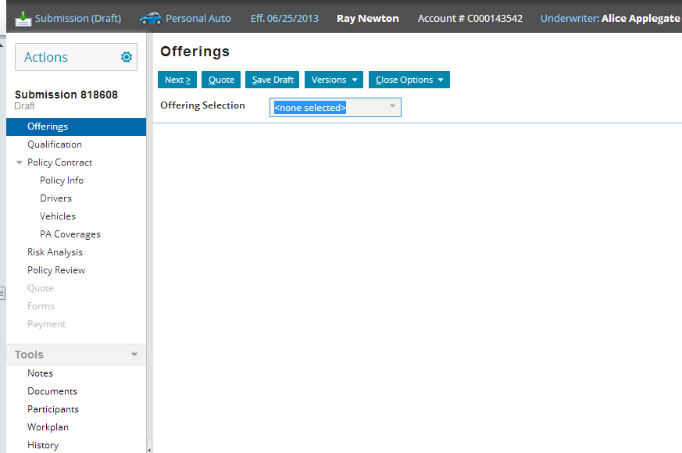
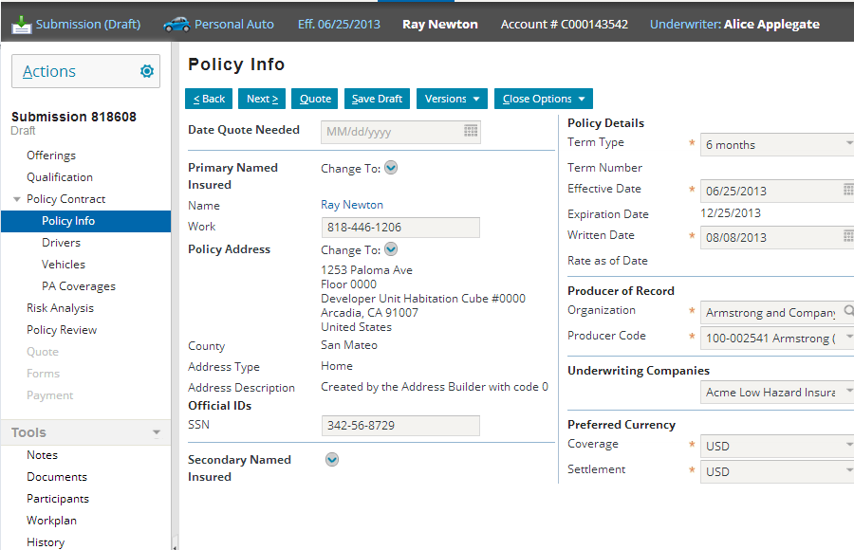
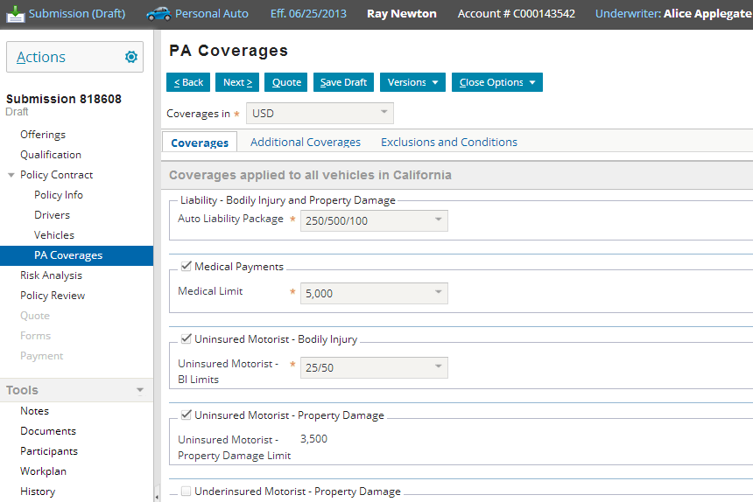
Wizards
A job wizard is a series of screens that collect information during a job
Information varies based on job type and line of business
1
2
3

Slide 21
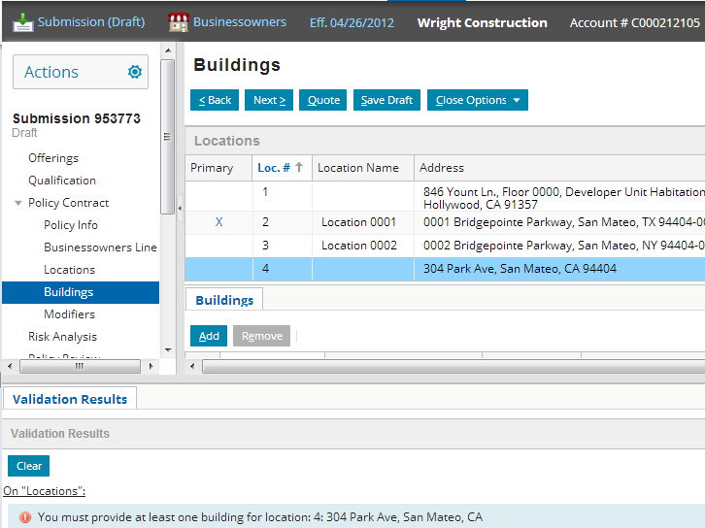
Business rules
Notes:
The job code and workflows access the rule sets. Business rules are often implemented and executed within Gosu classes. Inserting logic in the job code allows for a more centralized job flow and is easier to debug. The default application puts most of the business logic in the Gosu job process code. Rules can be used to check for a simple set of conditions and then follow with a set of simple actions. Rules are grouped by function for the purpose of customizing a process, such as a submission, to follow established business procedures.

Slide 22
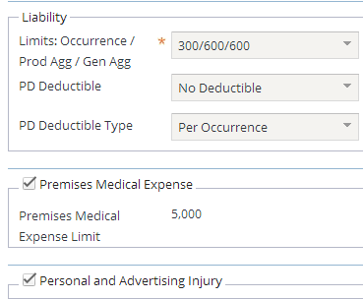
Product model
These coverages are added automatically
coverage is required
coverage limit can be set to one of eight values
coverage can be declined
Notes:
The product model is basically a product configurator. It specifies the structure of each product (what coverages are available, what terms are available for those coverages, what questions are asked during submission to establish qualification, and so on). You can configure the product model using Product Designer. Configuration of the product model is covered in a separate PolicyCenter 8.0 Product Designer course. Product Designer is a web based tool that is included in PolicyCenter.
The above screenshot has been taken from a BusinessOwners Line page on a BOP submission.

Slide 23

External systems
information about policy draft
quote
rating engine
PolicyCenter periodically calls external systems during job processing
For example, during submission, typically call to external rating engine to get a quote for given draft
Notes:
External systems are not discussed in detail in this course. For further information, refer to the PolicyCenter Documentation.

Slide 24
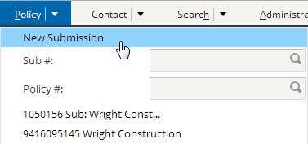
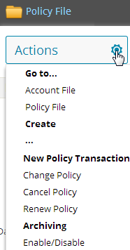
Initiating jobs
no policy is in focus
submission
change
cancellation
Through menu actions, external systems, or automatically by PolicyCenter
Notes:
The jobs that can be executed depend on the state of the policy. For example, you cannot initiate a reinstatement job against a policy that hasn't been cancelled.
Submission, policy change, cancellation, reinstatement, rewrite, and audit jobs are typically initiated by the end user through menu actions.
Renewal jobs are typically initiated automatically by a PolicyCenter batch process.
Also cancellation jobs might be initiated automatically by a billing application due to non-payment.

Slide 25
Lesson outline
Policy transactions
Jobs
Representing policies
Policy transaction graphs

Slide 26
History of a policy
policy created 04/20/08
second auto added 07/20/08
teen driver added 10/20/08
renewal (premium changed) 04/20/09
$270
$450
$920
$990
Policies often change over time
Coverables and coverages are added or removed
When a policy is renewed, rates (and therefore premiums) may change
Policy may be canceled (and possibly reinstated)
Notes:
If a policy is created, not modified, and then either canceled before the renewal date or not renewed at the expiration date, then the policy never changed over time. In all other circumstances, the policy changes over time.

Slide 27
PolicyPeriods
A PolicyPeriod is one "version" of the policy
Has an effective date and an expiration date
Model time is the actual real-world time when policies are created or jobs are bound
Model time
4/20/08
7/20/08
10/20/08
04/20/09
policy created $270
+ second auto $450
+ teen driver $920
3 versions, so 3 PolicyPeriods: 04/20/08 – 04/20/09
Renewal $990
1 PP and 1 PT : 04/20/09 – 04/20/10
1 PolicyTerm: 04/20/08 – 04/20/09
Notes:
Policy Transactions - 27
The PolicyPeriod entity contains information about all effective dates within a single PolicyTerm or period. Thus, every change in policy is represented by a PolicyPeriod entity at the root of a complex graph of sub-objects such as policy lines, vehicles, coverages, and many others. This entire hierarchy of entities is cloned in the database into new rows during policy changes, renewals, or other jobs. The cloned branch is updated with the changes. The changes made to this branch will be visible only when a user views policy from that branch’s effective date. This cloned branch becomes the base for future changes and so forth. (In contrast, a submission job’s branch is not cloned from another branch.)
PolicyPeriod
The PolicyPeriod entity stores information for a specific revision of the contractual period of a policy. A revision occurs when a job occurs on a policy. Submission creates the first revision. Each additional transaction on the policy creates a new revision. Therefore, a policy usually has multiple revisions, with one PolicyPeriod entity for each revision. During the contractual period, only one PolicyPeriod entity is in effect at a time. A new revision is created when you process a policy change that adds a car to the policy. The EffectiveDate for the car is several months into contractual period, and the ExpirationDate extends to the end of the period. PolicyCenter clones a new PolicyPeriod entity and its sub-entities and adds an entity for the new car. The contractual period now has two PolicyPeriods. The new PolicyPeriod entity is in effect. The old PolicyPeriod entity is preserved as a historical record of the policy.
(continued)

Slide 28
(Notes only slide)
Notes:
PolicyTerm
A new PolicyTerm is created whenever the policy contract is completely recreated. This occurs with a new policy (submission), a renewal, or a rewrite of an existing contract. A new PolicyTerm is not created when you amend a policy contract with a policy change job.
The terms “policy period” and “policy term” are used pretty much synonymously throughout the industry. The PolicyPeriod entity represents one historical version of a particular “policy period” or “policy term”, but there can be many PolicyPeriods for one “policy period” or “policy term”, all representing what the policy looked like at different points in model time. Thus “PolicyPeriod” is somewhat different than “policy period”. In order to avoid confusion about which we are talking about at any given time, throughout this course we will use the term “policy term” to refer to a “policy period” or “policy term”, and use “PolicyPeriod” only to refer to the entity, that is, a specific version of a “policy term”.

Slide 29
Applying jobs to policies
4/20/08
8/20/08
12/20/08
4/20/09
sub-mission
$270
policy change
$450
policy change
$920
renewal
$990
policy term: 04/20/09 – 04/20/10
policy term: 04/20/08 – 04/20/09
When job becomes effective, it changes nature of policy
Each job has a transaction effective date
Transaction generally applies until end of the policy term
Notes:
In a simple world, only one job would be run against a policy at a given time, and every job would be executed in the order in which it was supposed to take effect. In practice, this is not always the case.
"Preemption" is a policy transaction phenomenon that occurs when two or more jobs are running on a policy at a given time. This can cause a problem because both jobs are based off of the same version of the policy. When one job finishes, the state of the policy changes, and this could cause conflicts for the other job. (For example, an auto policy could have one car on it. Then, a change job is executed to add a motorcycle to it, and a second change job is executed to add a truck to it. If the motorcycle job finishes first, then the car policy becomes a car + motorcycle policy. However, the truck job was started on a policy that had just a car on it. When that job finishes, the motorcycle cannot be discarded. Somehow, the results of the motorcycle change job and the truck change job must be reconciled.)
An "out of sequence transaction" (also referred to in the industry as an "out of sequence endorsement") is a policy transaction which is executed after some other policy transaction but becomes effective before that policy transaction. The second job changes the state of the policy which could impact how the first job should be executed. (For example, in January, an auto policy could have one car on it. Then, a change job is executed to add a motorcycle to the policy as of June. After that, a change job is executed to add a truck to the policy as of March. The second job must be treated in two pieces: March to June (in which only a truck is being added) and June forward (in which a car and a truck are being added).
Preemptions and out-of-sequence transactions are discussed later in this course in the Out-Of-Sequence Transactions lesson under Policy Transactions.

Slide 30
Transaction effective dates within a policy term
4/20/08
8/20/08
12/20/08
4/20/09
sub-mission
transaction effective 4/20/08 (superseded)
policy change
transaction effective 8/20/08 (superseded)
policy change
transaction effective 12/20/08
new policy term effective 4/20/09
Every transaction has effective date that identifies when it goes into effect
Every transaction within a policy term supersedes the transaction effective before it
Notes:
Policy Transactions - 30
Recall that the effective date of a policy is the date the policy is in effect. The expiration date is the date the policy expires. The diagram above represents the effective dates of each job, not the date the job was actually run.
For example, a renewal job often takes several weeks (or even months) to run. Therefore, it must be executed well in advance of the expiration date. The "renewal" label shown above indicates when the job became effective. The date the job was started would be well in advance of the date indicated by the "renewal" arrow. The data model uses the term “Edit Effective Date” for job policy periods so that it is not confused with the policy term dates. Although they both show up as Effective Date on the user interface.
For the example above, the policy term has the following dates effective date 4/20/08 and an expiration date of 4/20/09. But the renewal job has an edit effective date of 4/20/09 and expiration date of 4/20/10. The policy term dates are different from the job dates.

Slide 31
Lesson outline
Policy transactions
Jobs
Representing policies
Policy transaction graphs
Notes:
Policy Transactions - 31

Slide 32
Policy transaction graphs
policy comes into effect
policy renewed or expires
submission
subsequent transactions
Guidewire curriculum uses this graphic convention to represent how transactions change policies over time
Horizontal axis represents policy term ("real time")
Vertical axis represents policy as modeled in PolicyCenter ("model time")
Notes:
The conventions for policy transaction graphs are discussed on the next set of slides.
Policy transaction graphs are useful for depicting the nature and behavior of complex transaction interactions, including reinstatements, rewrites, preemptions, and out-of-sequence transaction.

Slide 33
Sample scenario: Submission
policy comes into effect
policy renewed or expires
submission
A
Submission creates PolicyPeriod which starts on effective date and ends on the expiration date
Policy term is the period of the policy from the effective date until the expiration date
Notes:
In policy transaction graphs, each PolicyPeriod is represented as a horizontal bar. Each PolicyPeriod is also given a unique letter (such as the "A" above) which corresponds to the transaction that created it.
Recall that PolicyPeriod is “one version” of a particular policy term at any given time.

Slide 34
Sample scenario: The first change
policy comes into effect
policy renewed or expires
submission
A
change 1
B
Policy change creates second version of policy term
This period (B) is initially based on first policy period (A)
First PolicyPeriod still exists in database as created, and is superseded by this policy change
Notes:
Information about the every PolicyPeriod is kept in its entirety inside the PolicyCenter database. This is done to facilitate any queries which seek to know what the policy looked like at previous points in its own history. For example, an audit job may want to know what the projected payroll was on the first PolicyPeriod and compare it to what it looks like as of the policy change.

Slide 35
Sample scenario: Subsequent changes
policy comes into effect
policy renewed or expires
submission
A
change 1
B
change 2
C
Subsequent changes create additional versions
Each new version (such as C) is based on some other version , typically the last version to be bound (B in the diagram above)

Slide 36
Sample scenario: Renewals
policy comes into effect
policy renewed or expires
submission
A
change 1
B
change 2
C
...
renewal
D
Renewals create new policy term
Once again, new PolicyPeriod (D) is based on some previous PolicyPeriod (C in the diagram above)
Notes:
For convenience sake, the bar representing PolicyPeriod D has been truncated. If the graph were completely drawn, the length of PolicyPeriod D would be identical to that of PolicyPeriod A. D is going to be based on what C looks like at the end of the policy term.
The most recent PolicyPeriod within a policy period or policy term is the period in force. In example above, C is the period in force.

Slide 37
Transaction dates
policy comes into effect
policy renewed or expires
bound: 1/20 eff: 1/20
A
bound: 3/07 eff: 4/01
B
bound: 5/18 eff: 5/10
C
bound: 7/01 eff: 7/20
...
D
Every transaction has two dates relevant to these graphs
Bind date - when was transaction processing completed
Effective date - when do transaction results come into effect
Notes:
Note that the effective date can come before, on, or after the bind date. For example:
The submission job (A) created a policy which became effective the same day the submission was completed. (The policy goes into effect immediately.)
The first change (B) created a change which became effective after the change was bound. (This could be a change in which the insured plans to move but has not done so yet.)
The second change (C) created a change which became effective as of a date before the change was bound. (This could be a change in which the insured purchased a new car but neglected to inform the carrier immediately.)
For any policy, the completed and pending policy transactions are listed on the Summary page. On Summary > Completed / Pending Policy Transactions list view in the user interface the policy bind date shows up as “Trans Close Date” and the effective date of the change is called the “Trans Eff Date”.

Slide 38
Simple scenarios
policy comes into effect
policy renewed or expires
bound: 1/20 eff: 1/20
A
bound: 3/07 eff: 4/01
B
bound: 5/18 eff: 5/10
C
bound: 7/01 eff: 7/20
...
D
Scenarios remain simple when:
Transactions executed in series
Transaction B starts only after Transaction A finishes
Transactions become effective in series
Transaction B becomes effective after Transaction A

Slide 39
Lesson objectives review
You should now be able to:
Describe the types of transactions used to maintain policies
Explain the relationship between transactions and jobs
Describe how PolicyCenter represents policies
Interpret policy transaction graphs

Slide 40
Review questions
What are the two things that can occur when a policy reaches its expiration date?
Name three transactions that can become effective in between a policy's effective and expiration dates.
A submission makes a policy effective as of Monday. A policy change makes a change that is effective as of Wednesday. As of Friday, how many policy terms exist? How many PolicyPeriods exist?
If a policy becomes effective as of March 1, 2006, what happens if you attempt to view the policy as of February 1, 2006?
Notes:
Answers
1. The policy could be renewed, or the policy could simply expire.
2. Possible answers: policy change, cancellation, reinstatement, rewrite. (Audits don’t really become “effective” like the other jobs.)
3. In a business sense there is just one “policy term” or “policy period”. However, in PolicyCenter, there are two PolicyPeriod entity instances created . The second PolicyPeriod entity instance (created as a consequence of the “Policy Change” transaction) supersedes the first one (created as a consequence the original “Submission” transaction). Most importantly, both PolicyPeriod entity instances cover the entire duration of the policy term, from Monday to the expiration date of the policy. So there are two PolicyPeriods. The second policy period supersedes the first one. Both PolicyPeriods cover the entire time of the term, from Monday to the expiration date of the policy.
4. The user interface states that there is no policy in effect as of the given date.

Slide 41
Notices
Copyright © 2001-2013 Guidewire Software, Inc. All rights reserved.
Guidewire, Guidewire Software, Guidewire ClaimCenter, Guidewire PolicyCenter, Guidewire BillingCenter, Guidewire Reinsurance Management, Guidewire ContactManager, Guidewire Vendor Data Management, Guidewire Client Data Management, Guidewire Rating Management, Guidewire InsuranceSuite, Guidewire ContactCenter, Guidewire Studio, Guidewire Product Designer, Guidewire Live, Guidewire ExampleCenter, Gosu, Deliver Insurance Your Way, and the Guidewire logo are trademarks, service marks, or registered trademarks of Guidewire Software, Inc. in the United States and/or other countries.
This material is Guidewire proprietary and confidential. The contents of this material, including product architecture details and APIs, are considered confidential and are fully protected by customer licensing confidentiality agreements and signed Non-Disclosure Agreements (NDAs).
This file and the contents herein are the property of Guidewire Software, Inc. Use of this course material is restricted to students officially registered in this specific Guidewire-instructed course, or for other use expressly authorized by Guidewire. Replication or distribution of this course material in electronic, paper, or other format is prohibited without express permission from Guidewire.
Guidewire products are protected by one or more United States patents.

