Slide 1
Introduction to PolicyCenter Configuration
22 November 2013
Notes:
Guidewire training materials contain Guidewire proprietary information that is subject to confidentiality and non-disclosure agreements. You agree to use the information in this manual solely for the purpose of training to implement Guidewire software solutions. You also agree not to disclose the information in this manual to third parties or copy this manual without prior written consent from Guidewire. Guidewire training may be given only by Guidewire employees or certified Guidewire partners under the appropriate agreement with Guidewire.

Slide 2
Lesson objectives
By the end of this lesson, you should be able to:
List examples of user interface elements unique to PolicyCenter
Describe the role of business rules in PolicyCenter
Identify what should not be done while working in different modes in PolicyCenter
This lesson uses the notes section for additional explanation and information. To view the notes in PowerPoint, choose View→Normal or View→Notes Page. If you choose to print the notes for the lesson, be sure to select “Print hidden slides.”

Slide 3
Lesson outline
PolicyCenter user interface
PolicyCenter rules
PolicyCenter development mode

Slide 4
PolicyCenter user interface
User interface in PolicyCenter base application is built almost entirely from functionality at platform level
However, there are UI elements unique to PolicyCenter
They have special functionality needed for policy processing
PolicyCenter
Data Model
User Inter.
Bus. Rules
Int. APIs
Guidewire Platform, with a common technology for configuring...
Data Model
User Interface
Business Rules
Integration APIs

Slide 5
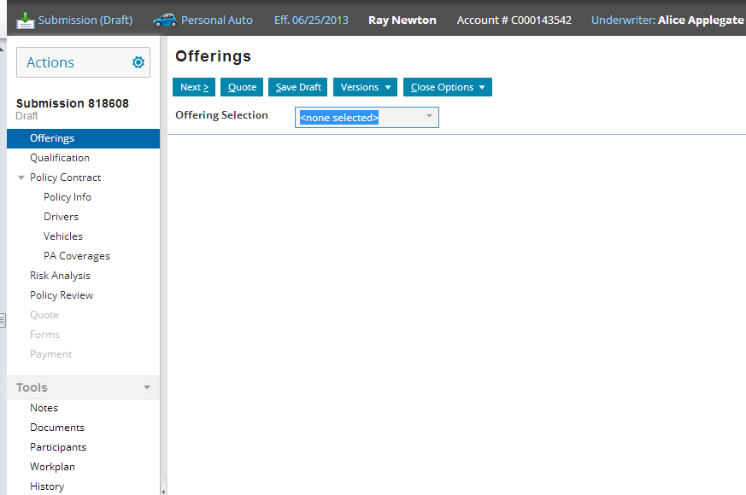
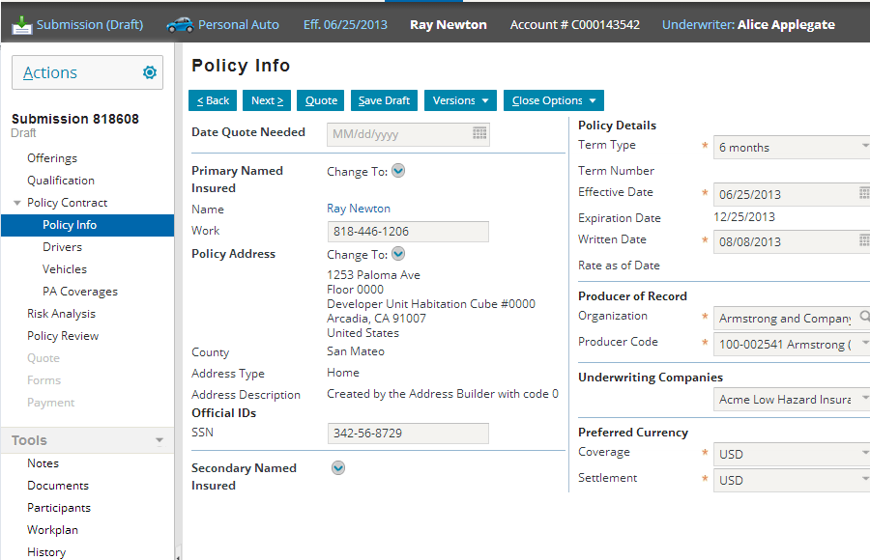
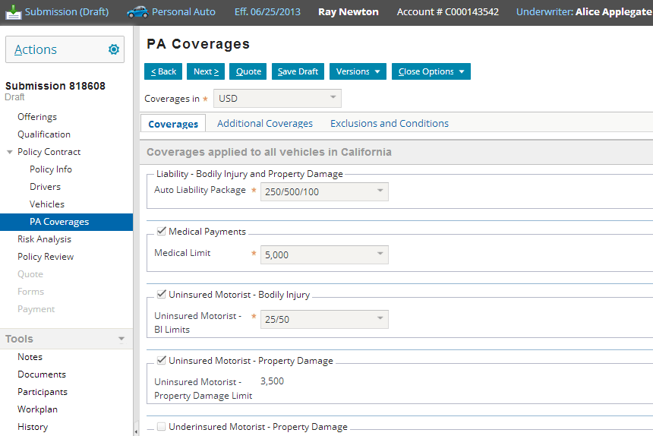
PolicyCenter job wizards
1
2
3
Notes:
The PolicyCenter base application has one wizard for every policy transaction. Each of these wizards has job-specific functionality. For example, the reinstatement wizard automatically retrieves and displays information about the cancellation.

Slide 6
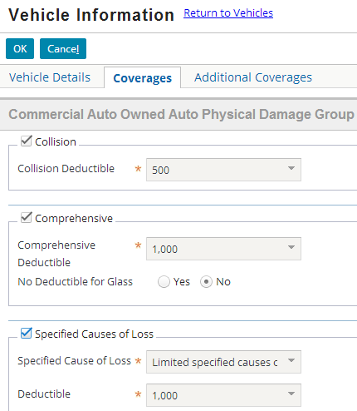
Product-model-specific widgets (examples)
Coverage Input
CovTerm Input
Notes:
There are a small set of widgets unique to PolicyCenter with functionality specific to elements of the Product Model (such as coverages, coverage terms, and modifiers.) These widgets are often used inside iterators. The iterator receives an array of all elements (all coverage, all coverage terms, all modifiers) for a given policy in a given context and then iterates through the array, using a given type of widget to render each element in the user interface. Product model is configured using Product Designer.

Slide 7
Lesson outline
PolicyCenter user interface
PolicyCenter rules
PolicyCenter development mode

Slide 8
PolicyCenter business rules
PolicyCenter business rules execute business logic required for policy processing
Written in Gosu (Guidewire's proprietary scripting language)
PolicyCenter
Data Model
User Inter.
Bus. Rules
Int. APIs
Guidewire Platform, with a common technology for configuring...
Data Model
User Interface
Business Rules
Integration APIs

Slide 9
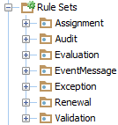
Business rule sets (1)
A business rule set is a set of rules which execute a specific type of business logic
Rule sets:
Assignment – Determines party responsible for an assignable activity
Audit – generate activities related to audits
EventMessage – Execute logic when event occurs which is relevant to integration point (such as data being sent to or received from external system)
Exception – Specifies an action to take if an Activity or Job is overdue and enters the escalated state
Notes:
Users who are familiar with Guidewire ClaimCenter and want to use pre-update functionality can do so using the pre-update classes. Guidewire expects you to implement any necessary pre-update functionality using the Guidewire-provided pre-update classes and your own custom classes. See PolicyCenter documentation for more information.

Slide 10
Business rule sets (2)
Renewal – Govern behavior at decision points in the Renewal job flow, for example, accepting or rejecting a renewal request
Validation – Check for missing information or invalid data on non-policy related objects

Slide 11
Lesson outline
PolicyCenter user interface
PolicyCenter rules
PolicyCenter development
Notes:
Introduction to PolicyCenter Configuration - 11

Slide 12
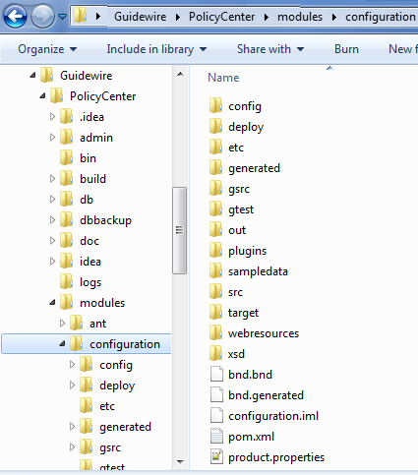
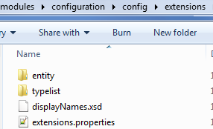

Resource files edited in PolicyCenter
Configuration files reside in the configuration module
After configuration
After install
Gosu resources
Notes:
Once you make configuration changes using Guidewire Studio, the folders within the configuration folder get updated as necessary and files with configuration changes get added in their respective folders. For example, the Gosu resources are stored within the gsrc folder and data model extensions are stored under configuration → config → extensions and so on.
If files in any module except configuration are edited Studio or PolicyCenter application may not start.
Introduction to PolicyCenter Configuration - 12

Slide 13
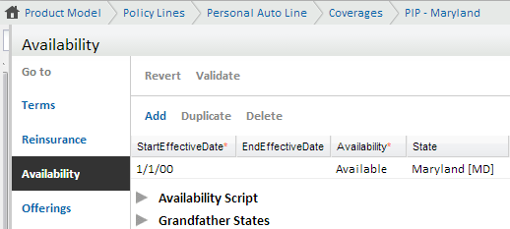
Do not do these in production mode
Drop database using gwpc dev-dropdb command
Delete typecodes using the typelist editor
Delete product model patterns created in dev mode
You may have data referring these product model patterns
Instead set end effective date for Availability of the product model pattern using Product Designer once you do not plan to use them

Slide 14
Dev mode vs. production mode
Tasks | Development mode | Production mode
QuickStart server | Yes (always runs) | No (App never runs)
Internal tools | Yes | No
Server tools | Yes | Yes
Deploy product model changes to running server | Yes | No (One exception is that availability can be reloaded in production mode)
Notes:
Deploying product model changes: You modify the product model using Product Designer. You work on the local configuration files, package the configured application into a .war/.ear file, and deploy it to a local or remote application server. For instructions on deploying product model changes to a specific server, refer to the PolicyCenter Installation Guide.
Note: The only server available in dev mode is QuickStart. In production mode you could be running JBoss, TomCat, WebSphere or WebLogic servers.
Introduction to PolicyCenter Configuration - 14

Slide 15
Viewing Studio configuration changes
All data may not be available in the application immediately
Some of the changes within Studio require server restart
The following table lists some of the changes that do or do not require server restart to take effect:
Restart server | Do not restart server
Changes to typelists | Edits to PCFs
Data model changes | Reload Gosu classes using Run → Reload Changed Classes (in debug mode)
Logging | Reload Rules using Run → Reload Changed Classes
Create a new rule
Notes:
The server should be running in debug mode meaning it was started using Run → Debug Server menu command in Studio to be able to reload Gosu classes or rules.

Slide 16
Setting server modes
You can change server mode using any application server type except QuickStart
QuickStart server always runs PolicyCenter in dev mode
Control server mode through system parameter:
-Dgw.server.mode=(dev|prod|test)
Steps to change the mode:
Restart the server
Set value to dev, prod, or test for system parameter for server mode using –Dgw.server.mode=dev
Notes:
PolicyCenter ignores the server mode parameter on QuickStart server.
Introduction to PolicyCenter Configuration - 16

Slide 17
Lesson objectives review
You should now be able to:
List examples of user interface elements unique to PolicyCenter
Describe the role of business rules in PolicyCenter
Identifies what should not be done while working in different modes in PolicyCenter

Slide 18
Notices
Copyright © 2001-2013 Guidewire Software, Inc. All rights reserved.
Guidewire, Guidewire Software, Guidewire ClaimCenter, Guidewire PolicyCenter, Guidewire BillingCenter, Guidewire Reinsurance Management, Guidewire ContactManager, Guidewire Vendor Data Management, Guidewire Client Data Management, Guidewire Rating Management, Guidewire InsuranceSuite, Guidewire ContactCenter, Guidewire Studio, Guidewire Product Designer, Guidewire Live, Guidewire DataHub, Guidewire InfoCenter, Guidewire Standard Reporting, Guidewire ExampleCenter, Gosu, Deliver Insurance Your Way, and the Guidewire logo are trademarks, service marks, or registered trademarks of Guidewire Software, Inc. in the United States and/or other countries.
This material is Guidewire proprietary and confidential. The contents of this material, including product architecture details and APIs, are considered confidential and are fully protected by customer licensing confidentiality agreements and signed Non-Disclosure Agreements (NDAs).
This file and the contents herein are the property of Guidewire Software, Inc. Use of this course material is restricted to students officially registered in this specific Guidewire-instructed course, or for other use expressly authorized by Guidewire. Replication or distribution of this course material in electronic, paper, or other format is prohibited without express permission from Guidewire.
Guidewire products are protected by one or more United States patents.

