Slide 1
Configuring Location Groups and Pages
08 November 2013
Notes:
Guidewire training materials contain Guidewire proprietary information that is subject to confidentiality and non-disclosure agreements. You agree to use the information in this manual solely for the purpose of training to implement Guidewire software solutions. You also agree not to disclose the information in this manual to third parties or copy this manual without prior written consent from Guidewire. Guidewire training may be given only by Guidewire employees or certified Guidewire partners under the appropriate agreement with Guidewire.

Slide 2
Lesson objectives
By the end of this lesson, you should be able to:
Describe the architecture of a location group
Configure existing location groups
Create and modify pages
This lesson uses the notes section for additional explanation and information. To view the notes in PowerPoint, choose View→Normal or View→Notes Page. If you choose to print the notes for the lesson, be sure to select “Print hidden slides.”

Slide 3
Lesson outline
Location group and page basics
Location group configuration
Page configuration

Slide 4
Locations
PCF Element
Widget
Location
Atomic Widget
Container Widget
Location Group
Page
A location is a PCF element that a user can navigate to
Used to define how user moves from one area of user interface to the next
Wizard
Popup
Worksheet
Forward
Exit Point
Notes:
Locations are used primarily to provide a hierarchical organization of the interface elements, and to assist with navigation.
You can define the following types of locations:
Page - Location with exactly one screen. The majority of locations defined in PolicyCenter are wizards.
Wizard - A location with one or more screens, in which only one screen is active at a time.
Worksheet – A page that can be shown in the workspace, the bottom panel of the web interface. The main advantage of worksheets is that they can be viewed at the same time as regular pages. This makes them appropriate for certain kinds of detail pages such as creating a new note.
Popup - A page that appears on top of another page, and that returns a value to its invoking page. Popups allow users to perform an interim action without leaving the context of the original task. For example, a page that requires the user to specify a contact person could provide a popup to search for the contact. After the popup closes, PolicyCenter returns the contact to the invoking page.
Forward - A location with zero screens. Since it has no screens, it has no visual content, and so a Forward must immediately forward the user to some other location. Forwards are useful as placeholders and for indirect navigation. For example, you might want to link to the generic Desktop location. This would then forward the user directly to the specific Desktop page (for example, Desktop Activities) most appropriate for that kind of user.
Location Group - A collection of locations. Typically a location group is used to provide the structure and navigation for a group of related pages. PolicyCenter can automatically display the appropriate menus and other interface elements that allow users to navigate among these pages.

Slide 5
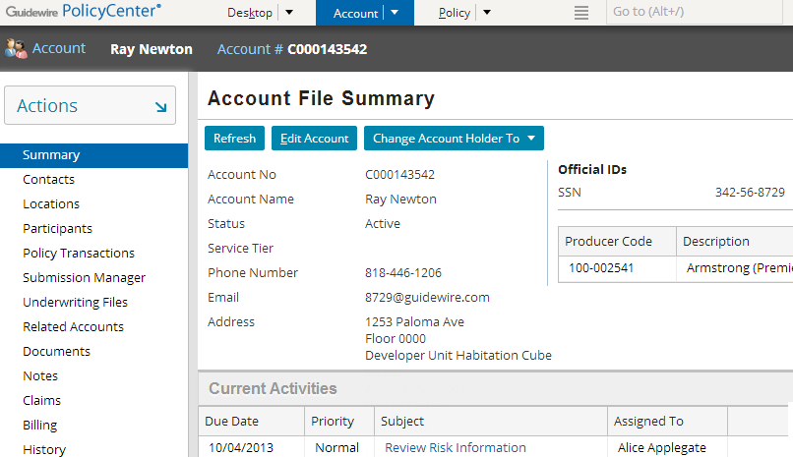
Location groups
A location group is a collection of locations used to provide structure and navigation for a group of related pages through menus or other interface elements
Info bar
Location group
Menu actions
Menu links
Notes:
The menu links are the set of clickable labels in the side bar (such as "Summary" or “Contacts").
The info bar is the set of widgets that appear below the tabs but above the screen area. (In other words, they are the widgets in the horizontal gray strip just above the "Summary" label.) Some location groups do not have info bars, in which case the gray strip is not visible.
The menu actions are collapsed inside the Actions menu.
As the user navigates between locations in a location group, the menu links, menu actions, and info bar remain the same.

Slide 6
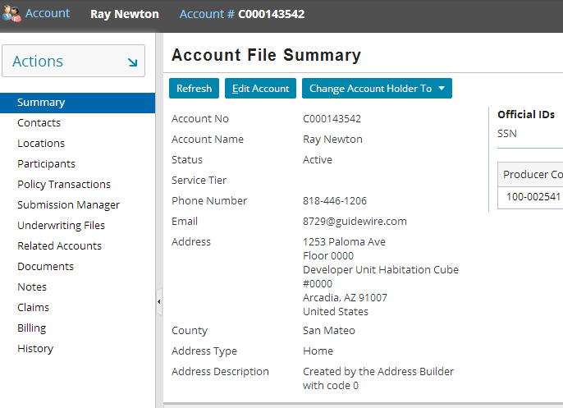
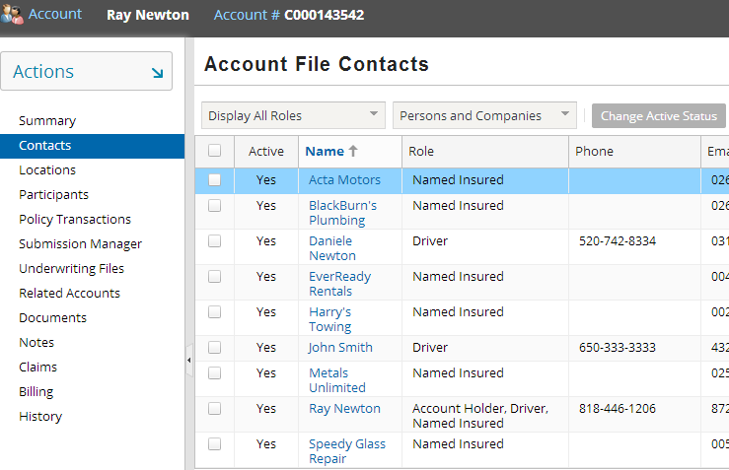
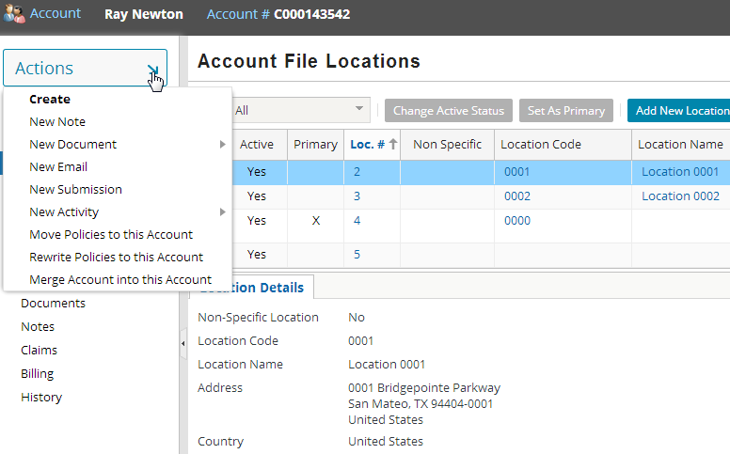
Navigating within the location group
Unchanged
Unchanged
Changed
Unchanged
Notes:
When you navigate from one location within the location group to another location within that same group, the contents of the screen area changes. However, the menu links, menu actions, and info bar remain the same.

Slide 7
Pages
A page is a location that contains a single screen in the main frame
Used exclusively within location groups
Notes:
Pages are the most common location.
Ultimately, the "groups" inside location groups are groups of pages. The contents of a location group consist of pages, child location groups, or both. A child location group is simply a sub-group of pages.

Slide 8
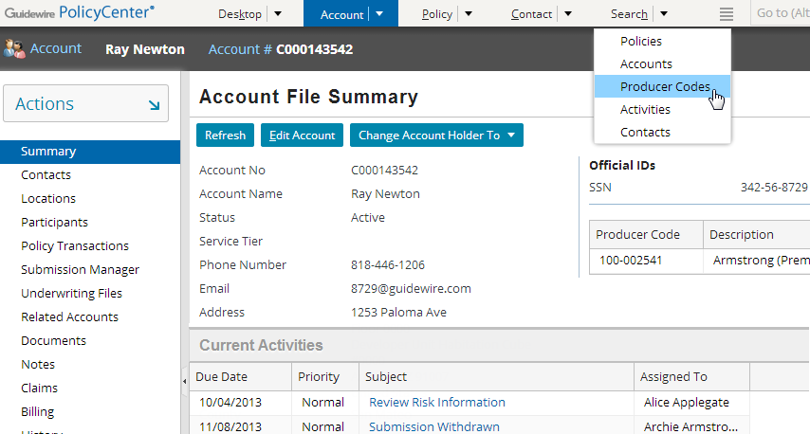
Navigation and navigation elements
Navigation is the process of moving from one place in a Guidewire application interface to another
Tab bar
Tabs
Tab menu items
Menu actions
Menu links
Sidebar
Notes:
When you click on a link, you “navigate” to another location specified by the link. The following types of navigation elements can be defined:
Tab bar - Set of tabs that run across the top of the application.
Tab - Items in the tab bar that navigate to particular locations or show a drop-down list menu.
Tab menu items - Set of links shown in the drop-down list menu of a tab.
Menu link - Links in the sidebar that take you to other locations, typically within the context of the current tab.
Menu action - Links under the Actions menu in the sidebar that perform actions that are typically related to what you can do on the current tab.

Slide 9
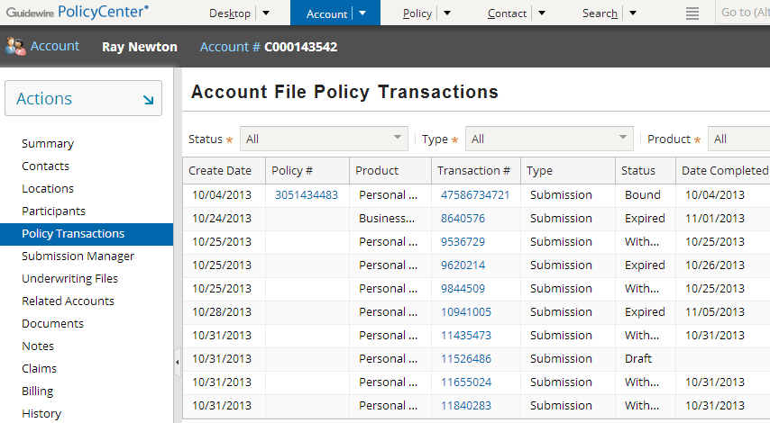
Navigation hierarchy
1st level - tab bar
2nd level - menu links
location ref

Slide 10
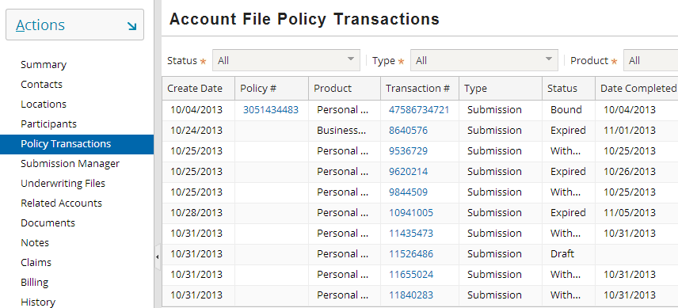
Location ref can point to a page
Menu link location ref (in sidebar) pointing to a page
Notes:
A menu link location ref (a "second level navigation") can point to either another page or a location group. In the above example, the menu link points to a page and the screen contained by the page is rendered alone in the screen area. In PolicyCenter a location ref mostly points to another page or screen.

Slide 11
Architecture of a location group
Tab
Location Group
Location Ref
Page
screen
Location Ref
Location Group
Page
Location Ref
screen
Page
Location Ref
screen
Notes:
In the base application, location groups consist of tabs in the tab bar (First-level navigations) and menu links (Second-level navigations).
A first-level navigation location group is a location group that a tab points to (either directly or through a forward). This type of location group is a "parent-level" group. If it has an info bar and menu actions, those elements are displayed. A second-level navigation location group can contain pages and other location groups.
A second-level navigation location group is a location group that some other location group contains. This type of location group is a "child-level" group. It typically does not have an info bar or menu actions. A second-level navigation location group typically contains only pages or child location groups.
A location group contains location refs. Each location ref points to either a page or another location group. When a location ref points to a page, clicking the label of the location ref (the menu link) renders the page, which renders the associated screen. When a location ref points to a location group, clicking the label of the location ref (the menu link) renders the location group as a set of menu links. The first location ref's page is also rendered.

Slide 12
Location groups in the base application
Team.pcf
Admin.pcf
Desktop.pcf
PolicySearch.pcf PolicyForward.pcf
(Visible if user has permission to view team or admin screen resp.)
AccountFile.pcf AccountSearch.pcf AccountForward.pcf AccountFileForward.pcf
ContactSearch.pcf ContactForward.pcf
Search.pcf
Note: Blue indicates forwards to search a location group
Notes:
PolicyCenter has extra behavior for the Account and Policy tabs so that user can be taken to one of two different location groups:
If user clicks the tab name, user is taken to location group of a previously saved account or policy if it exists. (This is implemented by forwards within the AccountForward.pcf and AccountFileForward.pcf.) If a previously saved account or policy do not exist, user is taken to Search Accounts menu links under the Search tab. This is specified using the AccountSearch.pcf. The same is true for Policy and Contact tabs.
If user clicks a link to a specific account or policy using the tab menu items, you navigate to a typical location group specified through that link.

Slide 13
Location group and page configuration
Two levels of configuration
Location-group-level
Entry point and navigation to location group
Permissions to visit
Location refs
Page-level
Screen that a page renders
Page logic (visibility, editability)
Page labels
Location Group
Location Ref
Location Group
Page
Location Ref
screen
Notes:
The next section of this lesson discusses location group-level configuration. The section after that discusses page-level configuration.

Slide 14
Lesson outline
Location group and page basics
Location group configuration
Page configuration

Slide 15
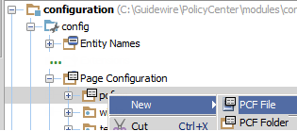
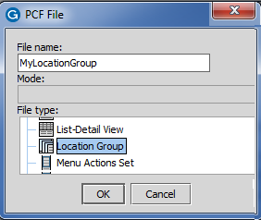
Define a location group
Right click on configuration → config → Page Configuration → pcf
Select New → PCF File
Enter location group name and select type Location Group
Notes:
A location group must contain one or more references to another location. Any time that you navigate to the location group, PolicyCenter uses the locations defined within it to determine what page and surrounding navigation to display.

Slide 16
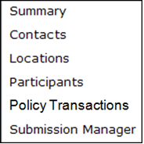
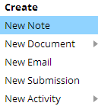
Information in location group PCF
AccountFile.pcf
Info bar
Entry Point
Menu actions
…
Location refs
Entry point and required objects
"Location refs" that point to pages or child location groups
Attributes that point to separate files for info bar and menu actions

Slide 17
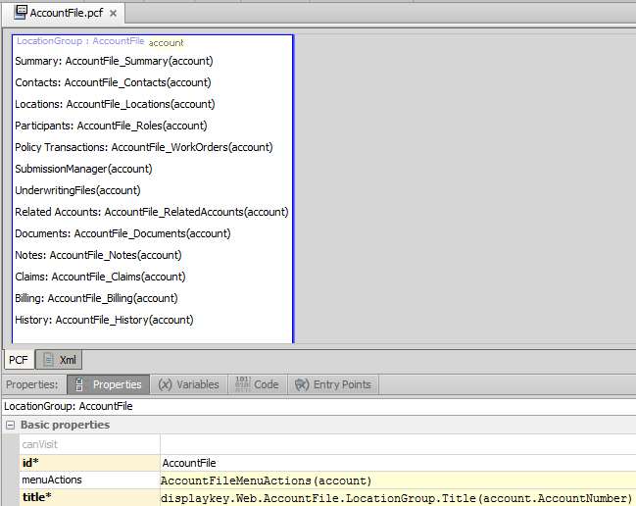
Example PCF: AccountFile
Location refs declared in top pane
PCF tab includes: Properties (menu actions, info bar and tab bar) Entry Points (entry points)
Notes:
The PCF file for a location group consists of location refs. Each location ref points to a page or a child location group. The location group attributes are specified on the tabs at the bottom.

Slide 18
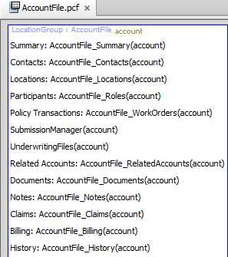
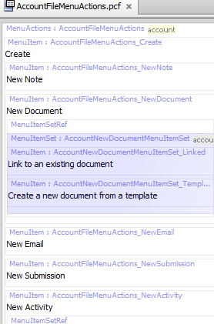
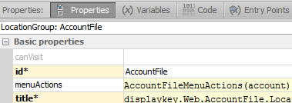
Location group property: menuActions
AccountFileMenuActions.pcf
Notes:
The location group's menuActions property specifies the file to use for contents of the Actions menu. Ctrl + Click on the menuActions value opens the file link.

Slide 19

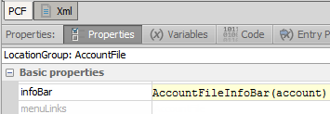
Location group property: infoBar
Notes:
The location group's infoBar property specifies the file to use for contents of the info bar..

Slide 20

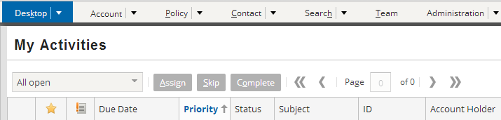
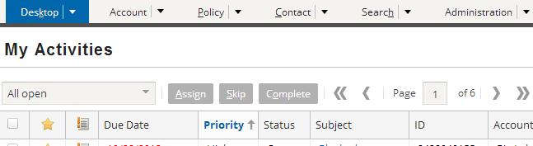
Location group property: canVisit
true
false
Notes:
The canVisit attribute determines whether a user can visit the location group. If blank, the canVisit attribute evaluates to true. When the attribute evaluates to false, the tab is not rendered in the user interface. For example, if the above canVisit expression (perm.User.viewteam) returns false the user does not have permissions to view any team screen and the Team tab is not rendered for that user.
canEdit: In addition to the canVisit property, single-screen locations and wizards also have a canEdit attribute. Location groups do not have the canEdit property. Editability for location groups is controlled at the level of each page.
In the example above, aapplegate does not have access to the Team tab whereas su (Superuser) has access to the Team tab. Team tab is useful for admin or supervisors.

Slide 21

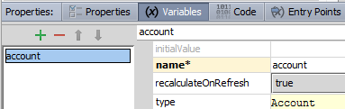
Define entry points for location group
Define the entry point, which is used by navigation widgets
Define each object in entry point as a variable on Variables tab
Entry point name
Object name
Object type
Notes:
In the example above, the AccountFile location group has an entry point named AccountFile. It expects a single object of type Account, which is referred to within the PCF page as “account".
Location groups can have multiple entry points. This is useful when a single location is referenced from different places with different known pieces of information. (For example, the Admin location group has 3 entry points:
Admin() - This means it is called without any arguments.
Admin(group : GroupBase) – If the Admin tab is viewed for a group then it needs the group object passed.
Admin(org : OrganizationBase) - If the Administration tab is viewed for an organization it needs the organization object passed.

Slide 22
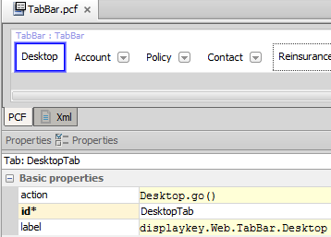
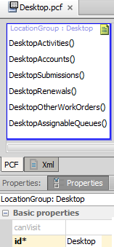
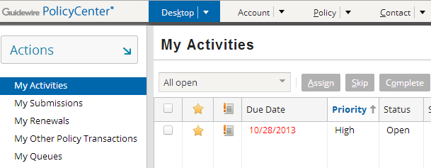
Navigating to a location group
Navigation uses "go()"
Syntax:
EntryPointOfLocation.go(objectsToPass)
Notes:
Most navigation widgets have an action attribute, which defines where to navigate when the widget is clicked. The syntax for an action attribute that navigates to a location is:
pcf.LocationEntryPoint.method(objectList), where
LocationEntryPoint is (one of) the location entry point(s) defined on the destination location's Entry Points tab.
method is the method used to navigate to the location (either "push" or "go"). For location groups, this is almost always "go".
objectList is a comma-delimited list of zero to many objects. This list must match the number of objects and the type which are expected by the location entry point.

Slide 23
Lesson outline
Location group basics
Location group configuration
Page configuration

Slide 24
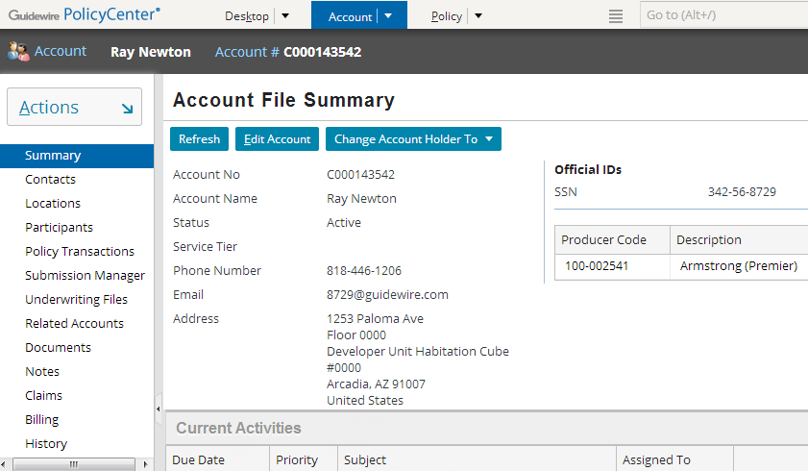
Pages
A page is a location that contains a single screen in the main frame
Used exclusively within location groups
Notes:
Pages are the most common location. Ultimately, the "groups" inside location groups are groups of pages. The contents of a location group consist of pages, child location groups, or both. A child location group is simply a sub-group of pages.

Slide 25
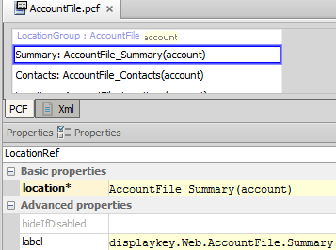
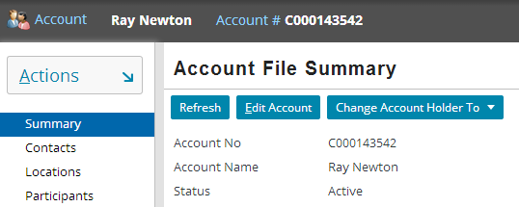
Pages are referenced by location refs
Location group's location ref
When clicked, where do I navigate to?
Notes:
Each location ref has a location attribute which specifies the location which the location ref points to. The location is typically a child location group or a page. If the destination location group or page requires one or more objects, then the location attribute must specify which objects to pass.

Slide 26
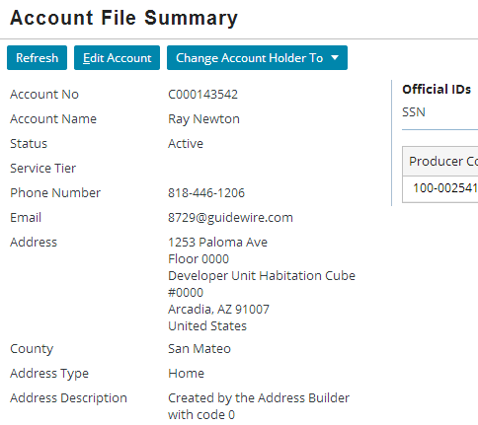
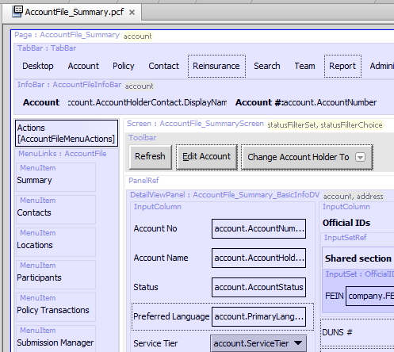
Page PCFs
Page PCF file contains references to all embedded content
Notes:
A page is actually very simple, as it typically contains just a screen with panel references to the views to embed within it. However, the rendering of the page in Studio can look somewhat complex, as all the embedded elements are visible in the page.

Slide 27
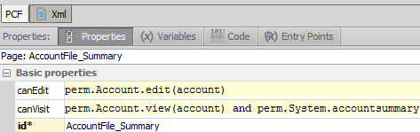
Page property: canVisit
Notes:
Similar to a location group's canVisit attribute, a user can see links to (and therefore can navigate to) a page only if canVisit evaluates to true.

Slide 28
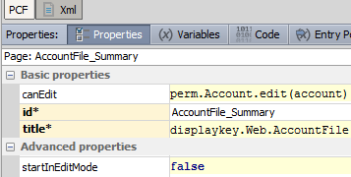
Page edit properties: canEdit and startInEditMode
A page is either in read-only or edit mode
If canEdit evaluates to true, the page has Edit/Update buttons
If startInEditMode is true, then page renders in Edit mode
Notes:
If canEdit mode for a page evaluates to false, then the page appears only in readonly mode, even if startInEditMode is set to true.

Slide 29
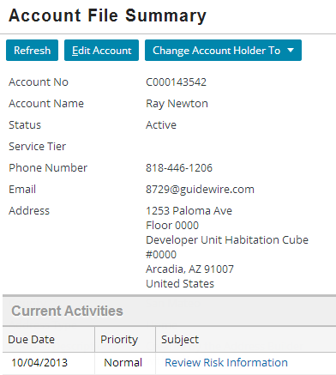
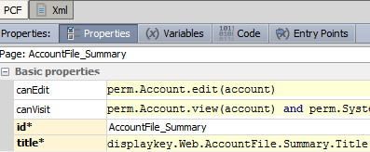
Page property: title
Title bar label comes from page's title property

Slide 30
Lesson objectives review
You should now be able to:
Describe the architecture of a location group
Configure existing location groups
Create and modify pages

Slide 31
Review questions
When you navigate between locations in a location group:
What changes?
What remains the same?
What two things can a location ref point to?
What happens if a location group's canVisit attribute evaluates to false?
When viewing a location group PCF file in Studio, which Studio tab specifies how to navigate to a particular location group?
Notes:
Answers
Answers:
The contents of the screen area changes.
The menu links, menu actions, and info bar remain the same.
A child location group or a page.
When a location group's canVisit attribute is false, the location group is not rendered in the user interface. For example, if the location group appears on a tab, the tab is not rendered at all.
The Entry Points tab. This identifies the "navigation name" of the location group as well as any objects needed when navigating to it.

Slide 32
Notices
Copyright © 2001-2013 Guidewire Software, Inc. All rights reserved.
Guidewire, Guidewire Software, Guidewire ClaimCenter, Guidewire PolicyCenter, Guidewire BillingCenter, Guidewire Reinsurance Management, Guidewire ContactManager, Guidewire Vendor Data Management, Guidewire Client Data Management, Guidewire Rating Management, Guidewire InsuranceSuite, Guidewire ContactCenter, Guidewire Studio, Guidewire Product Designer, Guidewire Live, Guidewire ExampleCenter, Gosu, Deliver Insurance Your Way, and the Guidewire logo are trademarks, service marks, or registered trademarks of Guidewire Software, Inc. in the United States and/or other countries.
This material is Guidewire proprietary and confidential. The contents of this material, including product architecture details and APIs, are considered confidential and are fully protected by customer licensing confidentiality agreements and signed Non-Disclosure Agreements (NDAs).
This file and the contents herein are the property of Guidewire Software, Inc. Use of this course material is restricted to students officially registered in this specific Guidewire-instructed course, or for other use expressly authorized by Guidewire. Replication or distribution of this course material in electronic, paper, or other format is prohibited without express permission from Guidewire.
Guidewire products are protected by one or more United States patents.

