Slide 1
Configuring JobWizards
08 November 2013
Notes:
Guidewire training materials contain Guidewire proprietary information that is subject to confidentiality and non-disclosure agreements. You agree to use the information in this manual solely for the purpose of training to implement Guidewire software solutions. You also agree not to disclose the information in this manual to third parties or copy this manual without prior written consent from Guidewire. Guidewire training may be given only by Guidewire employees or certified Guidewire partners under the appropriate agreement with Guidewire.

Slide 2
Lesson objectives
By the end of this lesson, you should be able to:
Describe the architecture of a job wizard
Configure existing job wizard
Create and modify job wizard steps
This lesson uses the notes section for additional explanation and information. To view the notes in PowerPoint, choose View→Normal or View→Notes Page. If you choose to print the notes for the lesson, be sure to select “Print hidden slides.”
Notes:
Note: This lesson discusses PolicyCenter job wizards. If you need to configure wizards refer to the Configuring Wizards lesson in the Configuration fundamentals training.

Slide 3
Lesson outline
Job wizard basics
JobWizard configuration
JobWizardStep configuration

Slide 4
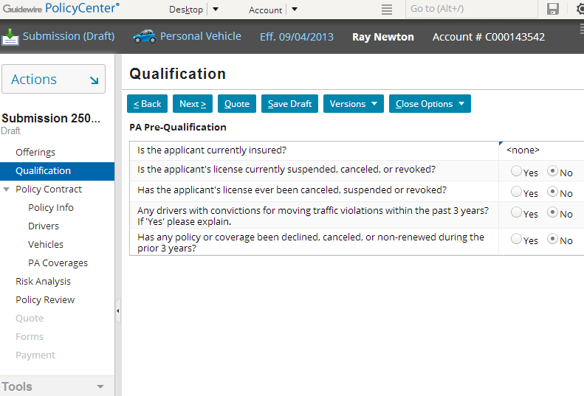
Job wizards
1
2
3
A job wizard is a location with one or more screens, in which only one screen is active at a time
Submission wizard
Notes:
A job wizard has multiple screens, but only one screen is displayed at a time. The screens in a job wizard have an order (though it may be possible for a user to traverse the screens out of order). Job wizards collect information and perform operations while guiding the user through a complex business transaction. job wizards are defined as a PCF; The Job process is usually a Gosu class. So, SubmissionWizard is a PCF, but SubmissionProcess is Gosu.

Slide 5
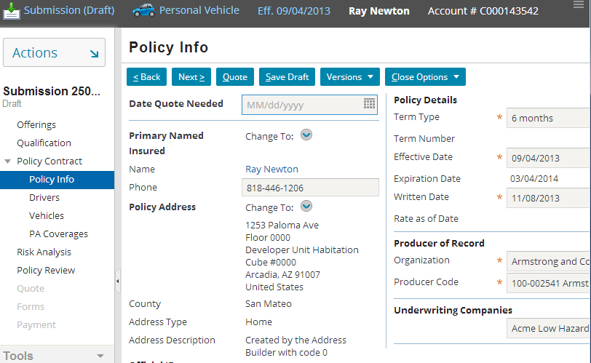
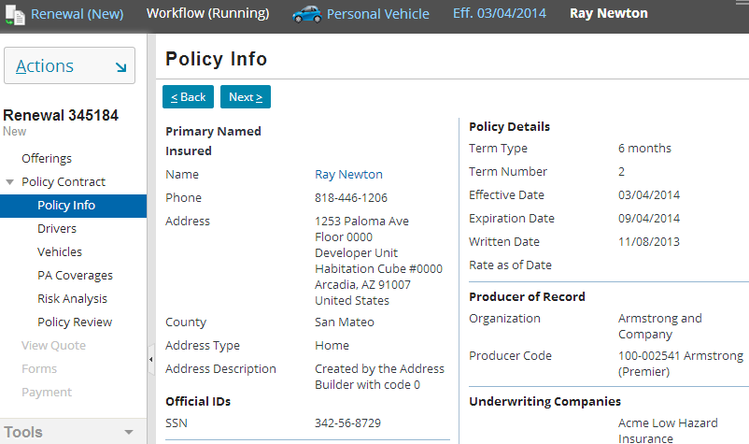
Job wizards in the base application
SubmissionWizard
RenewalWizard
1
2
3
1
2
3
Notes:
In PolicyCenter each job has a job wizard associated with it. For example, the most frequently used job wizard is the submission job wizard which has the SubmissionWizard.pcf file that contains the steps for collecting information about a submission. The wizard prequalifies the applicant, collects policy information, performs risk analysis, reviews the policy, views a quote, prints forms, and sets up billing. Each wizard step has a screen such as the New Submission, Qualification, Policy Info, Quote, and Submission Bound screens. Each screen is a set of PCF files that defines the screen and its component parts.
Some other wizards included in the base application are:
Renewal Wizard
Reinstatement Wizard
Policy Change Wizard
Audit Wizard
Cancellation Wizard
Rewrite Wizard
Issuance Wizard

Slide 6
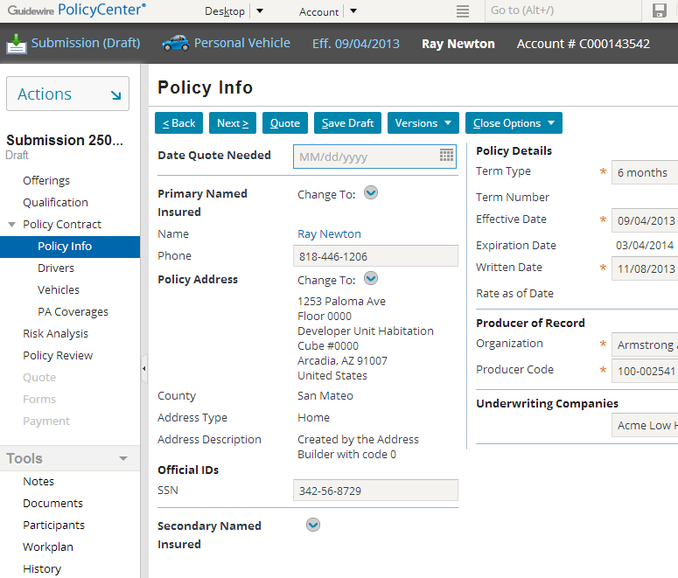
Comparing job wizards and location groups
info bar
location group
side bar
Both are assigned to a single tab
Both reference multiple screens
Both can have a set of screens that have no inherent order
Both have a shared info bar, actions menu, and side bar
wizard

Slide 7
Contrasting job wizards and location groups
Jobwizard Steps
Wizards have a toolbar specifically for navigating through the screens
Wizard access screens directly (as opposed to using pages)
Wizards have a set of screens which have an inherent order
Wizard screen availability can be tied to where you are in the wizard
1 2 3 4 5
.
.
.
Notes:
Wizard is a Location and it has no pages, but only screens.
The independent screens (such as the Policy Info, Drivers, and Vehicles screen in the example above) are accessible regardless of what step you are at in the wizard.
A distinction needs to be made between job wizardStep’s available property and job wizardStep’s visible property. The visible property controls whether a job wizardStep appears or not. This functionality is available to both wizard and non-wizard menu links. The available property controls whether a visible job wizardStep can be clicked on or not. This functionality is also available to both wizard and non-wizard menu links. However, availability for a job wizardStep is sometimes based on where a user is within the wizard. Location within a wizard does not typically change a job wizardStep’s visibility.

Slide 8
Job wizard's UI components
Actions menu
Job wizard infobar
Job wizard toolbar
Dependent steps
Independent steps
Screen (which defines the UI contents of one step)
Notes:
The following UI elements can be thought of as "building blocks" that are used to render a job wizard:
Actions menu
Dependent steps, which are an ordered set of labels, each of which represents a single job wizard step and maps to a single screen. Some steps may not be accessible until a given step is complete.
Independent steps, which are a set of labels, each of which maps to a single screen. Independent steps do not have a logical order and can be accessed at any time, regardless of what steps have been completed in the job wizard.
job wizard infobar, which lists information about the policy, the Account, or the Line of Business.
job wizard toolbar, which contains Back and Next buttons to navigate through the job wizard as well as other buttons relevant to the current step.
Screens (for each step of the job wizard).

Slide 9
Internal architecture
Policy Tab
job wizard
job wizardStep
screen
WizardStepGroup
Steps vary based on LOB
job wizardStep
screen
First and last step(s) are same for all lines
WizardStepSetRef / WizardStepSet
job wizardStep
screen
job wizardStep
screen
job wizardStep
screen
Notes:
The architecture of a job wizard is more simple than that of a location group. A job wizard's architecture consists of job wizard steps, and each job wizard step points directly to a screen. Often, job wizard steps are grouped together into wizard step sets or wizard step groups. job wizard step sets let developers specify logic which is identical for multiple steps based on the lines of businesses. For example, the submission wizard is often said to have a "sandwich-like" structure. The first and last steps are the same across all lines of business which are like the bread of a sandwich - remaining constant regardless of the type of sandwich. The interior steps vary dramatically depending on the line of business. A job wizard is a part of the entire job process.

Slide 10
Job wizard configuration levels
Three levels of configuration:
JobWizard level
Entry point and navigation to wizard
Permissions to visit and edit
WizardStepGroup
Group label if applicable
WizardStepSet level
Visibility and mode for grouping
JobWizardStep level
Screen that a step renders
Step logic (visibility, editability, next step)
Step order
Independent steps
JobWizard
JobWizardStep
screen
WizardStepGroup
WizardStepSetRef / WizardStepSet
JobWizardStep
screen
JobWizardStep
screen
JobWizardStep
screen
Notes:
The next section of this lesson discusses job wizard level configuration. The section after that discusses job wizard step level configuration.

Slide 11
Lesson outline
Job wizard basics
JobWizard configuration
JobWizardStep configuration

Slide 12
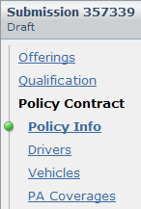
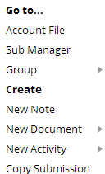
Information in job wizard PCF file
SubmissionWizard.pcf
Info bar
Entry point
Menu actions
Job wizard PCF file contains:
Entry point and required objects
Steps which point to screens
Properties that point to separate files for info bar and menu actions
Notes:
Each job wizard step has a screen such as the New Submissions, Qualification, Policy Info, Quote, Forms and Payment screens. Each screen is a PCF file that defines the screen and its component parts.

Slide 13
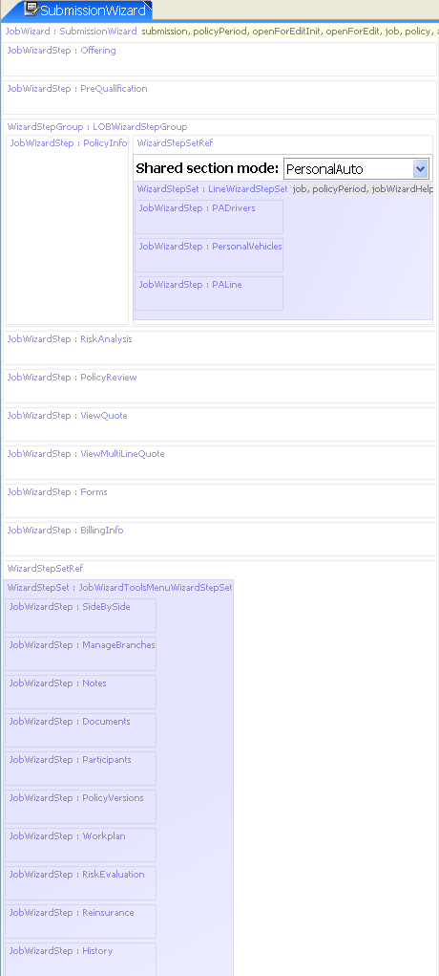
Example PCF file: SubmissionWizard
Dependent steps for job wizard:
Has WizardStepSets which have JobWizardSteps in them
JobWizardSteps can be accessed out of order if available
Independent step set for independent steps
Notes:
The PCF file for a job wizard consists of steps (either on their own or in step sets). Each step points to a screen. The job wizard properties are specified on the tabs at the bottom.
The steps of a job wizard are listed in the following order:
Dependent steps (and which screens they navigate to) for full wizards
Independent steps (and which screens they navigate to)

Slide 14
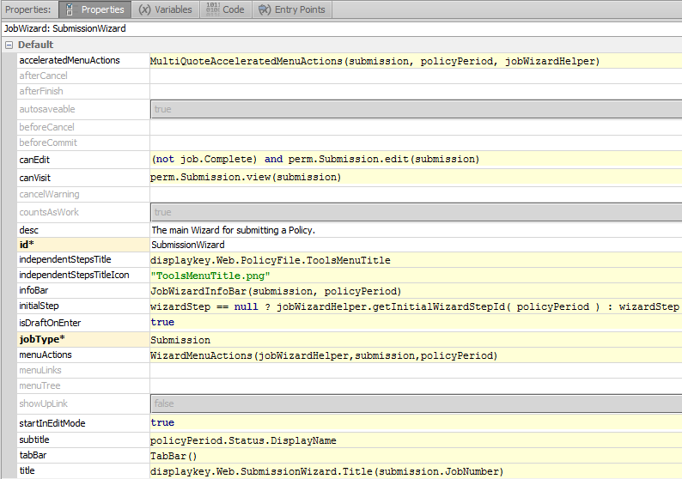
Example PCF file: SubmissionWizard properties
Tabs, including: Properties (menu actions, info bar, tab bar) Entry Points (entry points)

Slide 15
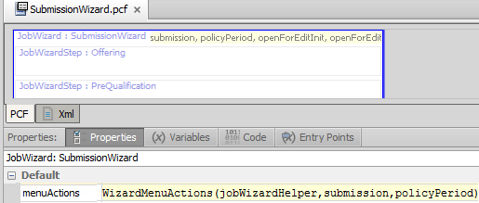
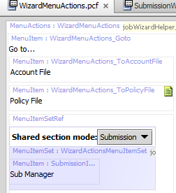
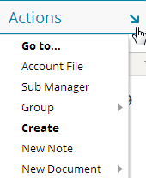
Job wizard menu actions
Notes:
The menuActions property of the job wizard specifies the file to use for contents of the Actions menu.

Slide 16
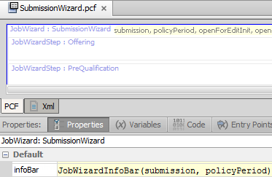

Job wizard info bar
Notes:
The infoBar property of the job wizard specifies the file to use for contents of the info bar.

Slide 17
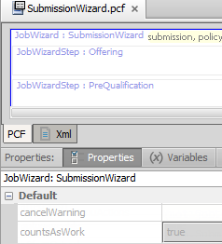
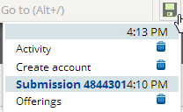
Job wizard properties: countsAsWork
Allows a user to resume working in a wizard after leaving the wizard without finishing
If set to true and user exits before finishing a wizard, wizard step is listed as Unsaved Work
countAsWork is true for a submission wizard
Notes:
If the save property for job step = false, then that screen does not count as work.

Slide 18
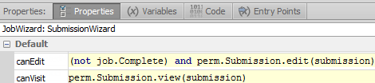
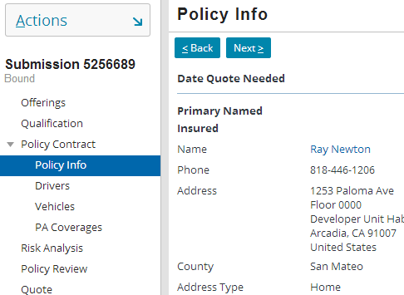
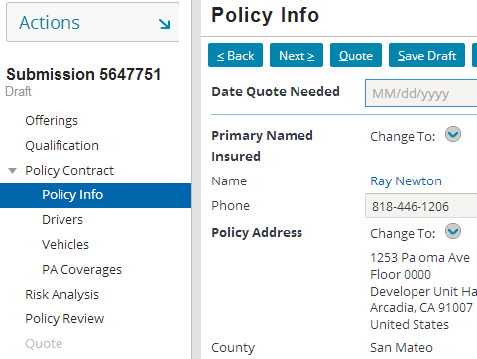
Job wizard properties: canVisit and canEdit
false
true
Notes:
The canEdit property determines whether a user can edit the information in the job wizard. In some situations, you may want to let a user review the information entered in a job wizard at some previous point in time without being able to edit that information.
The canVisit property determines whether a user can visit the job wizard.
As shown in the above example, you would want a canEdit condition which returned false under the circumstance when an underwriter wants to view a policy submission that is bound. A bound submission cannot be edited because this would mean that a job is complete.
The canVisit property gives only view permission in case of submissions that are complete. Hence you do not see the edit buttons for a submission that is Bound but the edit submission buttons are available to a submission in Draft state.

Slide 19

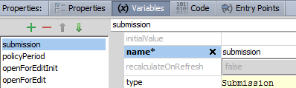
Job wizard entry points and variables tabs
Review that entry point is name for location used by navigation widgets
Entry point name
Object name
Object type
Each object expected in each entry points must be declared on Variables tab
Notes:
In the example above, the SubmissionWizard has one entry point. It expects a two objects - one of type Submission which is referred to within the PCF page as “submission“ and one of type PolicyPeriod which is referred as “policyPeriod” within the PCF page.
Locations can have multiple entry points. This is useful when a single location can be referenced from different places with different known pieces of information.

Slide 20
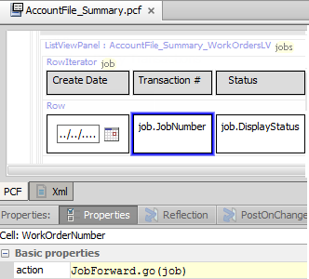
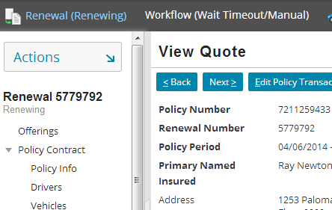
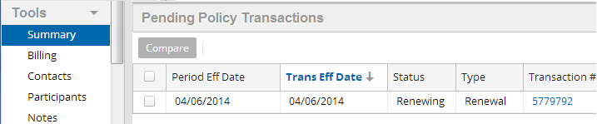
Navigating to wizards (1)
Syntax:
LocationEntryPoint.go(objectList)
Renewal wizard
Navigation can use push() or go()
Notes:
Most navigation widgets have an action property, which defines where to navigate to when the widget is clicked. The syntax for an action property which navigates to a location is:
pcf.LocationEntryPoint.method(objectList), where
LocationEntryPoint is (one of) the location entry point(s) defined on the destination location's Entry Points tab.
method is the method used to navigate to the location (either "push" or "go"). Use “go” if you want the user to decide where to go after the wizard is finished. The syntax for “push” is the same as that for “go”.
objectList is a comma-delimited list of zero to many objects. This list must match the number of objects and the type which are expected by the location entry point.
In the example above, the Policy Summary under tools lists the Pending Policy Transactions. The Transaction# has an action of “JobForward.go(job)”. The go method indicates that clicking the cell item should navigate the user to that location. The job type is passed into the parenthesis which in this case is Renewal. (You can also leave the parenthesis empty depending on the number of arguments.) The location to navigate to is the one that has an entry point of “JobForward(Job:Job)".

Slide 21
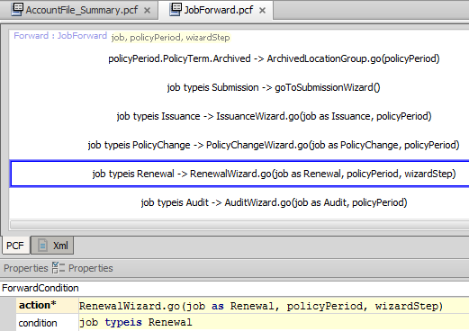
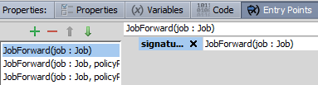
Navigating to wizards (2)
Notes:
On the previous slide, the command JobForward.go(Job) navigates to the JobForward.PCF file.
Forward files consist of pairs of conditions and actions. They evaluate the conditions in order, and for the first condition that is met, take the associated action. In the example above, when the type of the Job is “Renewal,” it navigates (.go) to the RenewalWizard.PCF file.
The user never sees the Forward file.
The JobForward PCF has an Entry Points tab. From this tab, three entry points have been defined, including one which is “JobForward" with one argument. Because this corresponds to the renewal wizard, this is the location to which the user will navigate to when the user clicks the cell link.

Slide 22
Lesson outline
Job wizard basics
JobWizard configuration
JobWizardStep configuration

Slide 23
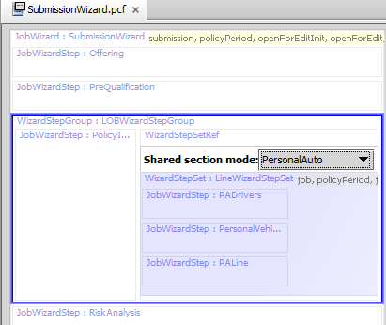
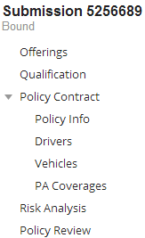
WizardStepGroup
A WizardStepGroup is a set of wizard steps which:
are indented
have a single parent label
Group label
Indented child steps
Notes:
Wizard step groups have a visible property, but they do not have an available property. Wizard step groups are intended for creating a collection of "child" steps or "sub" steps, as opposed to wizard step sets, which are intended to gather a set of steps which should be treated as a logic unit.

Slide 24
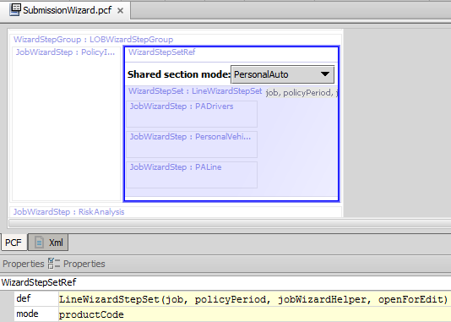
WizardStepSetRef
Reference to the PCF where the step set is stored
Reference to WizardStepSet PCF
Boolean
LOB
Job
PolicyPeriod
job wizardHelper
Notes:
The mode can be chosen in situations where only certain steps within a wizard change. The PolicyCenter SubmissionWizard is used to create submissions for different policy lines. The policy line specific information changes for each LOB but the rest of the steps remain the same such as Policy Review, RiskAnalysis etc. The mode in the WizardStepSetRef specifies the LOB.

Slide 25
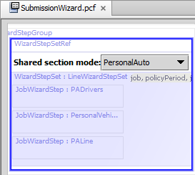
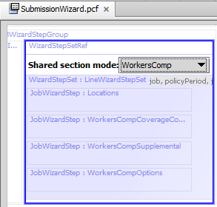
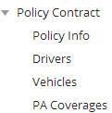
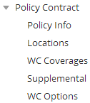
WizardStepSets
A WizardStepSet is a set of wizard steps which have shared logic (visible, available, mode) and can be inserted into a wizard as a group
Personal auto step set
Workers comp step set
Notes:
In the base application, there are set of wizard steps for the submission wizard which change depending upon the line of business. For example, one set of wizard steps are used for personal auto submission and a different set of wizard steps for the workers comp submission.
The availability and visibility logic for a wizard step set is accessible in the properties window. The step set shown above uses mode property to select the line of business for the submission.

Slide 26
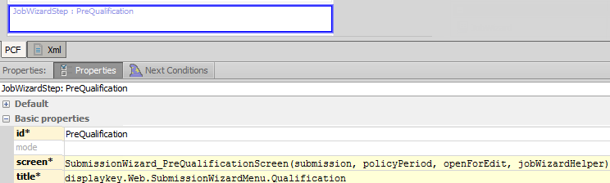
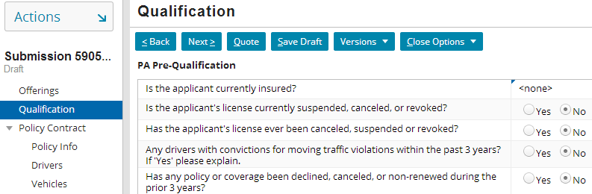
Screens are referenced by wizard steps
When clicked, what screen is displayed?
Notes:
Each job wizard step has a screen property. This specifies the screen which the step points to. If the destination screen requires one or more objects, then the screen property must specify which objects to pass.

Slide 27
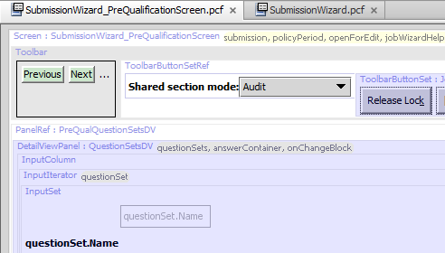
Screen PCFs
A screen PCF contains references to all embedded content

Slide 28
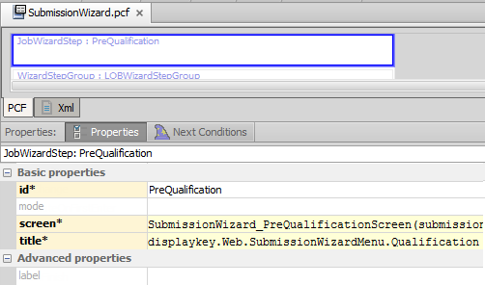
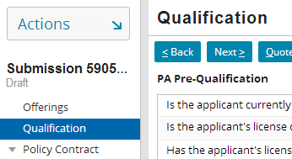
Screen-related labels
Empty label defaults to title
Title determines the text displayed in the title bar
Label determines the text displayed in the sidebar

Slide 29
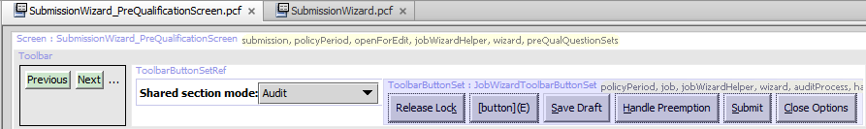

job wizard buttons
After you create a new screen PCF:
Add a toolbar
Add WizardButtons widget
Wizard button behavior is handled automatically
Buttons are visible based on the visibility property in job wizard step

Slide 30
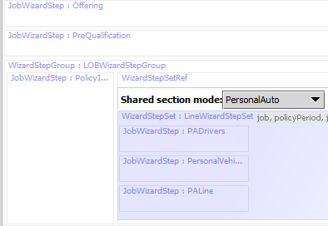
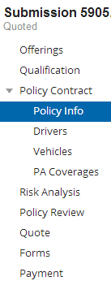
Order of job wizard steps
Determined by order in which they appear in PCF
job wizard displays all visible steps in order declared
Dependent steps are always in top box
Independent steps are always in bottom box
Notes:
Independent steps are discussed in the next slide.

Slide 31
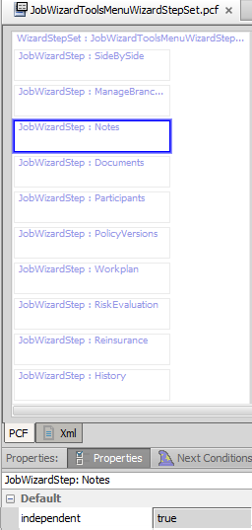
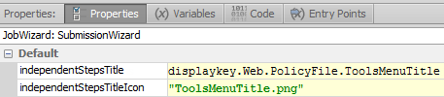
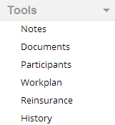
Independent job wizard steps
Independent steps appear in the bottom box
To make a step independent, set its independent attribute to true
The independent steps’ title and title icon are set in the job wizard

Slide 32
Lesson objectives review
You should now be able to:
Describe the architecture of a job wizard
Configure existing job wizards
Create and modify job wizard steps

Slide 33
Review questions
Name three things that are true of a job wizard that are not true of a location group.
Why would you want to put job wizard steps into a step group? A step set?
What attribute controls the order of appearance of job wizard steps in the user interface?
How does a step behave differently if you set its independent attribute to true?
What is a job wizard's entry point? What other elements of the user interface reference a job wizard's entry point?
Notes:
Answers
Possible answers:
job wizard screens are ordered.
job wizards have toolbars used to navigate through the ordered screens.
job wizard screens can have conditional availability tied to where you are at in the job wizard.
You might put steps into a step set when you want to control the visibility or availability of multiple steps with a single condition. You might put steps into a step group when you want the steps to be indented with a single label displayed over all of them.
There is no attribute that controls the order of appearance. Order of appearance is based on the order in which the wizard steps are listed in the PCF file.
Setting a step’s independent attribute to true will list it at the bottom of the sidebar and it cannot be navigated to using the Back/Next toolbar buttons.
A job wizard's entry point is the internal name for the job wizard. It is used by navigation widgets which navigate to the job wizard when clicked.

Slide 34
Notices
Copyright © 2001-2013 Guidewire Software, Inc. All rights reserved.
Guidewire, Guidewire Software, Guidewire ClaimCenter, Guidewire PolicyCenter, Guidewire BillingCenter, Guidewire Reinsurance Management, Guidewire ContactManager, Guidewire Vendor Data Management, Guidewire Client Data Management, Guidewire Rating Management, Guidewire InsuranceSuite, Guidewire ContactCenter, Guidewire Studio, Guidewire Product Designer, Guidewire Live, Guidewire ExampleCenter, Gosu, Deliver Insurance Your Way, and the Guidewire logo are trademarks, service marks, or registered trademarks of Guidewire Software, Inc. in the United States and/or other countries.
This material is Guidewire proprietary and confidential. The contents of this material, including product architecture details and APIs, are considered confidential and are fully protected by customer licensing confidentiality agreements and signed Non-Disclosure Agreements (NDAs).
This file and the contents herein are the property of Guidewire Software, Inc. Use of this course material is restricted to students officially registered in this specific Guidewire-instructed course, or for other use expressly authorized by Guidewire. Replication or distribution of this course material in electronic, paper, or other format is prohibited without express permission from Guidewire.
Guidewire products are protected by one or more United States patents.

