Slide 1
Contacts and Locations
29 April 2014
Notes:
Guidewire training materials contain Guidewire proprietary information that is subject to confidentiality and non-disclosure agreements. You agree to use the information in this manual solely for the purpose of training to implement Guidewire software solutions. You also agree not to disclose the information in this manual to third parties or copy this manual without prior written consent from Guidewire. Guidewire training may be given only by Guidewire employees or certified Guidewire partners under the appropriate agreement with Guidewire.

Slide 2
Lesson objectives
By the end of this lesson, you should be able to:
Understand contacts and locations
Configure contact roles
This lesson uses the notes section for additional explanation and information. To view the notes in PowerPoint, choose View→Normal or View→Notes Page. If you choose to print the notes for the lesson, be sure to select “Print hidden slides.”

Slide 3
Lesson outline
Contacts overview
Extending the contact data model
Adding a new contact role
Locations overview

Slide 4
Review: Account data model
producer
account
participant
contact
location
policy (and UW file)
trans- actions
activity
document
note

Slide 5
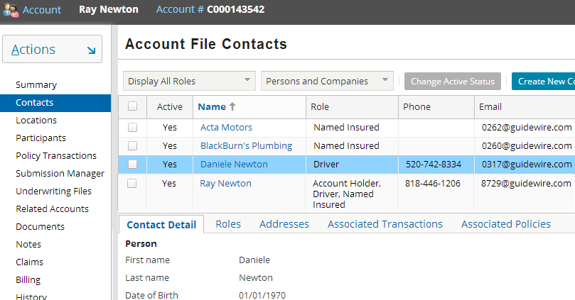
Contacts on an account
Account File Contacts page lists all contacts on an account
Contacts list
Tabs display related details
Detail view of contact selected at the top
Notes:
A list-detail view lists all the information on the contacts on the account on the Account File Contacts screen. Separate tabs list details of contact, roles of the contact, associated work orders, addresses and the policies the contact is associated with. The details view at the bottom with tabs is refreshed when you select a different contact from the list view on top to show details of that contact.
A contact that is set up from the Account File can be used by all policies within the account. One contact can play multiple roles on the account and on the policy. Take a personal auto policy for example. A contact can be the holder of the account, the primary named insured on the policy, and a driver of a vehicle insured by the policy.
You can access contacts through accounts and policies, which provide a centralized view of all contacts on the account and policy files. Some contact information is shared across policies. An update to the shared information propagates across all unbound usages of a contact. Other information is policy or usage specific, and does not propagate to other policies.
In the screenshot above, the contact Ray Newton has three roles: Account Holder, Driver and Named Insured.

Slide 6
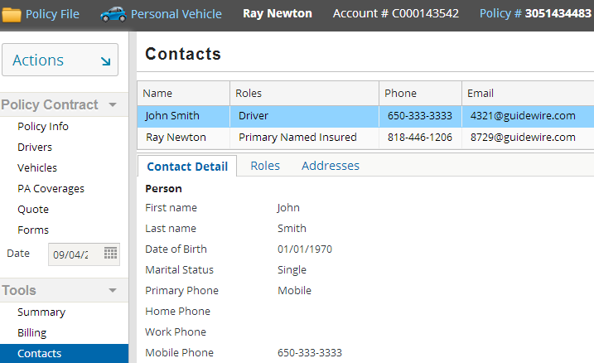
Contacts on a policy
Policy may have some or all of the Account contacts
Two contacts from account are on this policy
Notes:
All contacts are listed on an account. Contacts on an account can be added on any new policies or other transactions created on the account.

Slide 7
Lesson outline
Contacts overview
Extending the contact data model
Adding a new contact role
Locations overview

Slide 8
Extending the contact data model
Contacts are identified by the role they play
You can define roles for:
Person or
Company or
Both
Roles can be disabled when not needed
Contacts entities that are extendable include:
PolicyContactRole and AccountContactRole
All other roles in the default configuration
Notes:
Generally, you define new contact roles by defining new subtypes of PolicyContactRole and AccountContactRole. It is also possible to extend any of the specific roles in the default configuration. Accompanied by appropriate account and policy level user interfaces, the new contact roles are automatically integrated into the contact scheme of the application.

Slide 9
Strategy to configure a new contact role
For a contact role that does not exist in base application:
Add a new contact role and
Configure it to follow the implementation of an existing contact role
Compare desired behavior of contact to roles in base application and find role with most similar behavior:
How many of them can be created?
How the match attaches to other roles or objects?
Notes:
Guidewire recommends that you should find a contact role in the base application that best matches the behavior you want to implement in your new contact role. Then you can review the implementation of this role in the base application and utilize that behavior in implementing your new role.

Slide 10
Contact role behavior patterns in PolicyCenter
Normal
Array connected to an entity, simple properties (additionalNamedInsured)
Singleton
One and only one connected to an entity (BillingContact)
Simple Details
One contact, array of detail entities (AdditionalInsured)
Join Details
Details join contact to another entity (Driver)
These patterns are only patterns of contact behavior, not something that would be automatically configured
Notes:
There are a number of contact role behavior patterns that we see consistently in PolicyCenter. When configuring new contact roles, you should take into consideration what behavior pattern you want that contact role to have and then you can use one of the existing contact roles with that behavior as an example for configuration of your new contact role. These patterns are truly only patterns of contact behavior, not something that would be automatically configured.
Contact role patterns in the base configuration include:
Normal: This pattern can be used when you have an array of contacts that play this role (and those contacts potentially have some fields specific to that role but those fields are a simple set of fields.) Note, the pattern does not specify where this array is attached. The example given, additional named insureds, attach at the PolicyPeriod level – but you could have an array of entities with simple properties that attached at the vehicle level or the location level.
Singleton: Use this pattern when there is only ever one of this particular contact role at any given time. Note, this is again at whatever level it attaches to. The BillingContact attaches at the PolicyPeriod level so there is only ever one on the policy at any given time because it is a singleton. However, you could have another contact role – say LocationBillingContact – that is also a singleton, but attaches at the Location level. In that case, there could be one-and-only-one LocationBillingContact attached to each Location – but that could result in multiple LocationBillingContacts on the policy as a whole.
Simple Details: This pattern refers to contact roles where the contact can play the role in multiple different ways, so you need an array of details. Like the other patterns, this doesn’t say where the contact role attaches. In the base configuration, both AdditionalInsured and AdditionalInterest are of the simple details pattern.
(continued)

Slide 11
(Notes only slide)
Notes:
Join Details refers to contact roles where there is a many-to-many relationship between the role and another entity on the policy. Driver is the classic example of this -- there may be two drivers on a policy. There is a policydriver record for each of those drivers. But there are three vehicles on the policy, and those two drivers can be drivers on each of those three vehicles, so a join table is used to represent that relationship – but each of the drivers is only represented by a single PolicyDriver record.

Slide 12
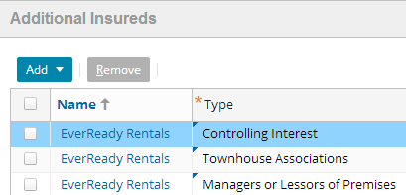
Example policy contact role pattern
Additional Insured contact uses a Simple Details pattern
Contact is multiple types of additionalInsureds
Notes:
As shown in the example above, on a BusinessOwners policy for Wright construction, the AdditionalInsured for the same contact EverReady Rentals can be multiple types of additionalInsureds such as a controlling interest, a Townhouse Association, etc. So, in this case, you need one PolicyContactRole (subtyped for the AdditionalInsured) but an array of detail records that record all of the additionalInsured “types”.

Slide 13
Policy contact roles in default configuration
Policy Contact Role | Data Model Pattern | Attaches To
Named Insured | Normal | Period
Primary Named Insured | Singleton | Period
Secondary Named Insured | Singleton | Period
Location Named Insured* | Join Details | Period
Additional Insured | Simple Details | Line
Billing Contact | Singleton | Period
Driver | Join Details | PA Line
Additional Interest | Join Details | Period
Owner Officer | Normal | WC Line
Labor Client | Simple Details | WC Line
Labor Contractor | Simple Details | WC Line
Notes:
“Attaches to” is specifying how the role is associated with a policy in the data model. You can check that using the Data Dictionary. For example, Named Insured is attached to the Policy Period with the PrimaryNamedInsured column. Same thing with Driver (attached as PolicyDrivers to the Personal Auto Line.
All Roles attach to policy period and then some roles have special foreign keys that attach them to other entities like Driver to PALine.
Named insureds must exist at the policy level (hence are attached to the policy period). You can’t have a policy that has different named insureds for different lines on the policy.
However, there are other roles that either only make sense on certain lines (Driver on PA, for example) or can vary by line even within a package policy (Additional Insureds). Or roles that are attached at even a more granular level – you have an array of additional interests for a specific building, for example, thus they are attached directly to that building.
The secondary named insured one is a bit different, as is not attached at the Policy Period level but is PA specific so it got attached to the PA Line.
When you configure a new policy contact role, you can base its configuration on an existing role from the list in the table on this slide.
Location Named Insureds have a single * because it actually has implicit records and is not actually a defined role but instead a join table between Named Insureds and locations.

Slide 14
ContactRoles for Accounts and Policies in PolicyCenter
Contact Roles
Primary subtypes
AccountContactRole
PolicyContactRole
AccountHolder
NamedInsured
PolicyNamedInsured
AccountingContact
Driver
PolicyDriver
SecondaryContact
BillingContact
PolicyBillingContact
ClaimsInfoContact
AdditionalInsured
PolicyAddInsured
InspectionContact
AdditionalInterest
PolicyAddlInterest
SuppliedEmployee
PolicySuppliedEmployee
MiscContact
PolicyMiscContact
No correspondence with PolicyContactRole
AccountContactRole can correspond to many PolicyContactRole
Notes:
The above are the contact roles in the PolicyCenter base application that are defined at the account and policy levels. These roles are subtypes of the AccountContactRole and PolicyContactRole entities. The AccountContactRole entity represents a contact filling a role on the account, such as Sue Lee as a driver on the account. The PolicyContactRole represents a contact filling a role on the policy, such as Sue Lee as the primary named insured on the policy.
The roles in the first column are subtypes of AccountContactRole which can be added to the account level. If there is no corresponding role in the PolicyContactRole column, the account contact role can only be associated with a contact that is added to the account. These roles represent people or company contacts that play roles that are associated with the account but not to individual policies.
In some cases, a policy contact role is associated with an account level contact role, such as PolicyDriver and Driver. A policy contact role can be added to any of the policies within that account. (Many roles only apply to certain lines of business.) A contact role can contain fields that are shared across policies and other fields that are different across policies.
For some lines of business, line-of-business specific PolicyContactRole exist and subtypes can be created from there. For example the Workers comp line of business has WCPolicyContactRole and PolicyOwnerOfficer subtype is created from it. A list can be obtained from the data dictionary.
Note: The above is not a complete list. Refer to the PolicyCenter Application Guide or data dictionary for a complete corresponding list.

Slide 15
Contact configuration plugin
ContactConfigPlugin configures the Contact entity
Maps PolicyContactRole to AccountContactRole
Controls contact subtypes allowed for each role
Disables roles by setting first argument to false
Syntax: new ContactConfig( enable, { contactRoleType }, AccountContactRole , { PolicyContactRole1, PolicyContactRole2, … } )
Default configuration:
Can be configured as:
AccountContactRole
PolicyContactRole
AccountContactRole
PolicyContactRole
Notes:
Arguments are:
Boolean – true or false to enable or disable roles
{ contactRoleType } – { “company” } or { “person” } or {“company”, “person”}
AccountContactRole
{ PolicyContactRole1, PolicyContactRole2, … } – Include only if role exists at policy level.
The ContactConfigPlugin maps the PolicyContactRole to the corresponding AccountContactRole. For example, the code maps PolicyNamedInsured to NamedInsured. The code also controls which Contact subtypes (Person or Company) are allowed for each role. For example, it specifies that an AccountHolder can be a Person or a Company, but a Driver or a PolicyDriver can only be a Person.
The ContactConfigPlugin can also disable roles. You disable roles by setting first argument in the line configuring the contact to false:
new ContactConfig(false, {"company", "person"}, "AuditContact", {"PolicyAuditContact"}),
In the default configuration, each PolicyContactRole references one AccountContactRole. However, you can configure several PolicyContactRoles to reference one AccountContactRole.
The third and fourth arguments map AccountContactRole to PolicyContactRole. If there are additional policy contact roles that map to AccountContact they are added to this line as a comma separated list.
If you create a role that only exists at the account level, include an empty fourth argument.

Slide 16
Lesson outline
Contacts overview
Extending the contact data model
Adding a new contact role
Locations overview

Slide 17
Adding new contact role
New contact roles can be configured by defining new subtypes of PolicyContactRole or AccountContactRole
Following are the steps to extend these entities:
Add extension file (*.eti) that defines the new subtype
Modify ContactConfigPlugin file to map new subtypes to each other
Add display keys as needed
Create entity name for new contact role
Reference display name as needed
Modify PCFs and Gosu classes as needed
Notes:
The example role used in this training lesson is AuditContact. The following slides have steps to add this new role for use on policies. As a result, the role appears automatically on the AccountFileContacts and PolicyFileContacts PCF pages. You can select this role on the Roles tab of the Contacts screen in the account and the policy.

Slide 18

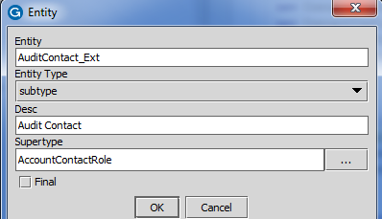
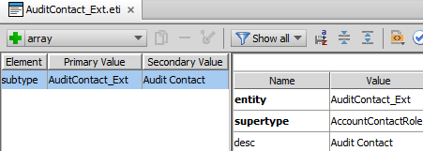
1. Add extension files (*.eti)
Add the subtypes that create the contact role
In Studio, config → Extensions → Right click Entity → New → Entity
Define two new entities – AuditContact_Ext.eti and PolicyAuditContact_Ext.eti for account and policy
Notes:
Entities defined:
a. AuditContact_Ext.eti: <?xml version="1.0"?> <subtype entity="AuditContact_Ext" supertype="AccountContactRole" displayName=“Audit Contact" />
b. PolicyAuditContact_Ext.eti: <?xml version="1.0"?> <subtype entity="PolicyAuditContact_Ext" supertype="PolicyContactRole“ desc=“Audit”/>
There must be subtypes of AuditContactRole at both the account level (a subtype of AccountContactRole) and at the policy level (a subtype of PolicyContactRole).
If this role is only applied at the account level, such as AccountHolder, then you do not need the second subtype, PolicyAuditContact.
In this example, these contacts are defined to have no extra properties beyond the standard contact properties.
If you need additional properties, define these in the extension (eti) files that reside under the extensions folder.
Use the account contact subtype, AuditContact_Ext, to define any properties beyond the standard contact properties that you want to be the same across policies.
Use the policy contact subtype, PolicyAuditContact_Ext, to define any properties that change across policies.
In either case, the properties can change across policy revisions. If at any given time you want the value of the property to be different on two different policies, then configure the property at the policy level.
Note that you will have to restart the server for the above data model changes to take effect. You can restart after step 5 to start server only once.
Restart Studio for these entities to be available in Studio.

Slide 19
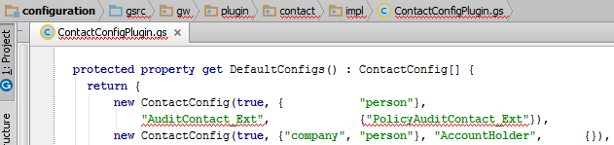
2. Modify the ContactConfigPlugin
Go to ../gsrc/gw/plugin/contact/impl/ContactConfigPlugin.gs
In the DefaultConfigs() property, add code to map the new AccountContactRole to PolicyContactRole
Notes:
The third and fourth arguments map the account contact role - AuditContact_Ext to the corresponding policy contact role - PolicyAuditContact_Ext. If there are additional policy contact roles that map to AuditContact_Ext, they are added as a comma separated list in the fourth argument. If you create a role that only exists at the account level, then add an empty fourth argument.
For this example, we added,
new ContactConfig(true, { “person"}, "AuditContact_Ext", { "PolicyAuditContact_Ext"})

Slide 20
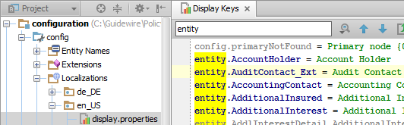
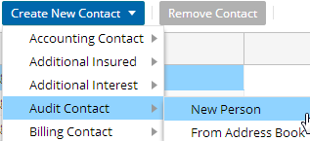
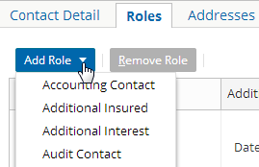
3. Add a display key
Add display key under Localizations → en_US → display.properties
Result in the Add Role and
Create new Contact drop-down lists in the UI:
Notes:
From the Accounts File Contacts page the Audit Contact roles is displayed on the Create New Contact drop-down list. It is also displayed in the Roles tab for Contacts screen for a contact in the list view of the account contacts. The Add Role drop-down list and the Create New Contact drop-down lists are shown in the screenshots in the slide above.
The Add Role drop-down list calls a plugin which has a function that calls the contact role Entity Name. The Entity Name retrieves the display key value which is created in the step shown above.
Note: The above step is required to create an EntityName, which is done in the next step. The EntityName has to be implemented using a displaykey.

Slide 21
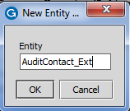

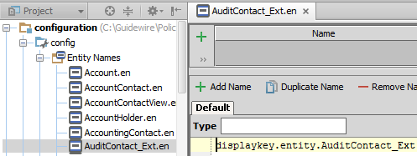
4. Create entity name for new contact role
When the object’s display name is used in user interface
If entity name is not created, PolicyCenter displays an error at runtime in the UI
You must name an existing entity
Notes:
To create a new entity name:
Right-click the Entity Names node and select New → Entity Name.
In the New Entity Name dialog box, enter the name of an existing entity. (Studio prevents you from advancing if the named entity doesn't exist.)
For the example above, we are pointing the entity to the displaykey we already created with the value we want to be displayed.
Recommended practice: Create an entity name for every entity whose objects will have their display names used in the user interface. If an object has no entity name, then the application displays a comma-delimited list of all object fields and their values. The display name used for an entity with no entity name is not user-friendly.

Slide 22
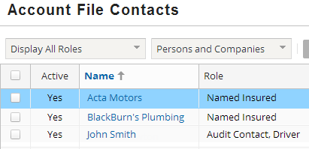
5. Reference display name as needed
Account File Contacts page displays the newly added role
A contact can have many roles
Roles are displayed as a comma-separated list sorted alphabetically
Method sortBy uses entity name created in step 4
Restart the server to load entity names
Notes:
If you have an object named "x", then any UI display reference to "x" is equivalent to "x.DisplayName". However, Guidewire recommends explicitly adding DisplayName to improve readability of the code.
The list view in the Account File Contacts screen has a Role cell that displays contact’s display name. The entity editor references the same display key. Theoretically, this could reference anything but in practice it is easy to reference what we already have.
The code to compute an entity name gets loaded at startup. The result of the code is not computed until runtime. Hence a user needs to restart server after they create entity names.

Slide 23
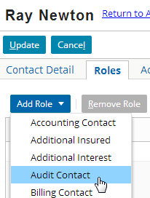
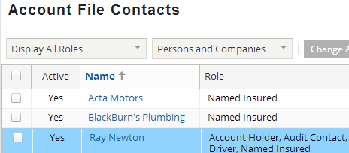
Result: New contact role at account level
User can add new role Audit Contact to contacts through the Accounts File Contacts Screen
Open an account
Select contact to edit on the account
Add a new role to the contact
Contact role added at account level
Notes:
You can change PCF files to allow users to set these roles on submissions. You will also probably need to add some methods in the Gosu classes that are used by buttons on the PCF pages for adding and removing contacts. Exactly how and where you change the PCF files and Gosu classes depends on what you want to do with the contacts. You can examine how the existing contact roles are added in a submission and follow those patterns.
Note: Configuring AuditContact PCF and Gosu is out of scope of this course so the next few slides show you a matching role BillingContact’s configuration. For more information on how to configure PCF files, see the PolicyCenter Configuration Guide.

Slide 24
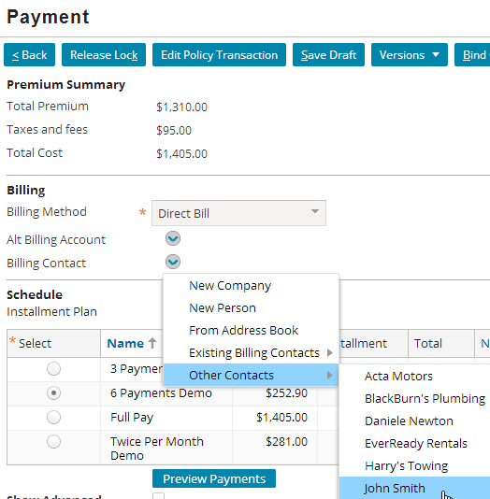
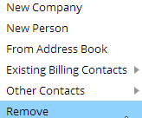
6. Modify PCFs and Gosu classes as needed a. Find best matching contact role
BillingContact (Singleton) best matches AuditContact
BillingContact in the User Interface
OR
Menu changes after a contact is added
Notes:
BillingContact is added in the Payment step of the Submission wizard. AuditContact seems to best match the role of BillingContact in the base application. This slide and the following slides show you how BillingContact is configured in Studio.
Singleton data pattern means that you can have only one BillingContact at a time. If you want to choose another contact Ray Newton as the BillingContact then you can do so directly in the user interface and behind the scenes John Smith is removed as the BillingContact and Ray Newton will be added as the BillingContact. This is configured in Guidewire Studio.

Slide 25
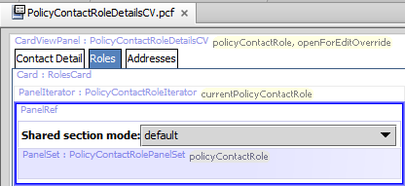
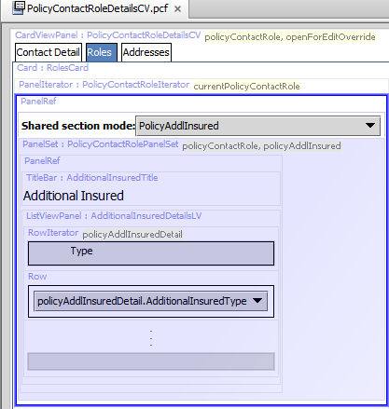
6b. BillingContact configuration in Studio
Contact roles are configured using modal PCF PolicyContactRoleDetailsCV
BillingContact role uses default modal
AdditionalInsured role has one field

Slide 26
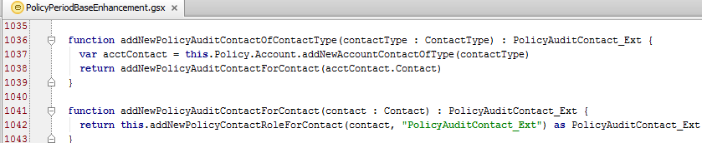
6c. Add/edit code in PolicyPeriodBaseEnhancement
Add or edit the code to meet your requirement
Notes:
The PolicyPeriodBaseEnhancement has all the methods that have the functionality to add or remove the contact roles in the base application. You can copy-paste and modify the code according to your requirement for a role such as AuditContact for example. Or if you cannot find a best match then you can write your own implementation of the contact role you want to define here.

Slide 27
Lesson outline
Contacts overview
Extending the contact data model
Adding a new contact role
Locations overview

Slide 28
Review: Locations
A location is a physical location which may be referenced on a policy
Locations can be:
Created on account and reused on policy
Created on policy
account
policy
contact
location
Notes:
When locations are created on a policy, they are the available on the account and can be reused on other policies.

Slide 29
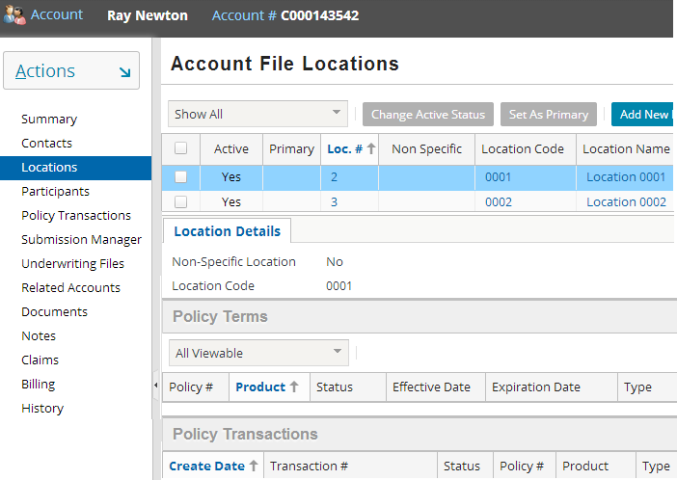
Locations on an account
Locations link on sidebar opens the Account File Locations
All locations on account
Details of location selected at the top
Policies with selected location
Transactions using selected location
Notes:
A list-detail view lists all the information on the locations on the account on the Account File Locations screen. These are stored in the AccountLocation entity.

Slide 30
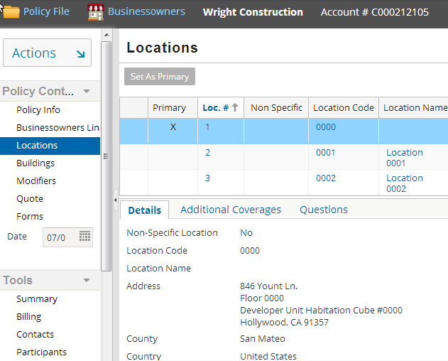
Locations on a policy
Locations on a policy
Details of location selected at the top
Notes:
The detail view at the bottom lists details of the location selected in the top list view. The detail view tabs may or may not appear depending on whether the questions set or additional coverages exist on the location selected at the top. The above is an example of BusinessOwners Policy’s locations screen. These are stored in the PolicyLocation entity. The Questions tab appears only for those LOBs for which question sets are configured.
All LOB’s do not have a separate listing of locations and correspondingly, do not have a Locations link.

Slide 31
Location numbering
System assigns each location a sequential number
AccountLocation and PolicyLocation are numbered separately
Stored in LocationNum field
LocationNum can be configured based on how a carrier wants to number and renumber locations within policies
AccountLoc
PolicyLoc
01/01/08 Submission with account LocationNum 1, 3, 5
LocationNum 1, 2, 3, 4, 5
Locations renumbered LocationNum 1, 2, 3
Notes:
The autonumbering algorithm is configurable and can be changed, based on how a particular carrier wants to number and renumber locations within policies.
User can modify how the application numbers locations, if they do not want to use the default autonumbering.

Slide 32
Location numbering example
AccountLocation
Model time
PolicyLocation
Submission Acct LocationNum 1, 3, 5
01/01/08
LocationNum 1, 2, 3, 4, 5
LocationNum 1, 2, 3
03/01/08
Change (remove 2) LocationNum 1, 3
06/01/08
Renewal renumbers LocationNum 1, 2
LocationNum 1, 2, 3, 4, 5
Notes:
The numbering of locations as shown in the above example works as follows:
If you have five locations on an account, and use locations 1, 3, and 5 in a policy, the locations are numbered 1, 2, and 3 in the policy.
If, during a submission, you remove location 2 before binding the policy, the remaining locations are renumbered 1 and 2.
Note that if you have locations numbered 1, 2, and 3 in an issued policy, and remove location 2 through a policy change, then the remaining locations are numbered 1 and 3.
At renewal, the location numbers will be revised to 1 and 2.

Slide 33
LOB specific location types
Subtypes of PolicyLine entity have associated location type
LOB location types have foreign key Location, that point to PolicyLocation
Associated Location has foreign key to PolicyLine subtype
BusinessOwnersLine
BOPLocation
CommercialPropertyLine
CPLocation
InlandMarineLine
IMLocation
Notes:
There are only a few LOB specific location types. The above are the LOB specific location types and their respective policy lines in the base configuration. You often need LOB specific locations when either coverages or other coverables (like buildings) need to be attached to a location.
In general there are a couple of reasons you might need line-specific locations:
When the location itself is a coverable, that is coverages, modifiers, etc. are associated directly with the location
When you have other coverables that exist at the location (generally, buildings – IM, CP and BOP all have buildings)
Note, this is distinct from “garaging” locations because the vehicles could be garaged anywhere so though they are linked to a location, they don’t exist at that location
It is important to note that even if you do have line specific locations for a particular line, you still will be using the PolicyLocations. They do not replace PolicyLocations and their behavior; they provide additional functionality.

Slide 34
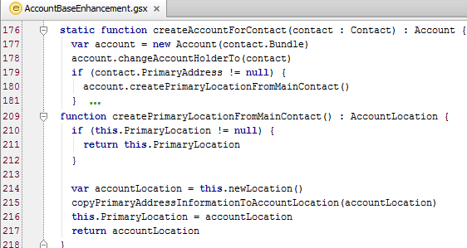
Creating a new account location
To add a new AccountLocation to the account, call newLocation() method on Account
Returns the AccountLocation created
Notes:
The above example show the use of account.newLocation() to create a new AccountLocation when the primary location on the account is null. The primary address on the account is checked and if it is not null the createPrimaryLocationFromMainContact() function checks if a primary location exists on the account. If it is does not exist, then the newLocation() method is called to create a new AccountLocation.

Slide 35
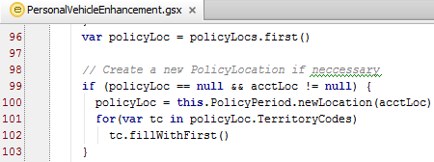
Creating a new policy location
Add a new PolicyLocation using newLocation method on PolicyPeriod
newLocation() or
newLocation(AccountLocation acctLoc) where: acctLoc - existing AccountLocation to which the new policy location is associated with
Notes:
If the associated account location is not yet defined on the account:
A new account level location is created on the account, and a new associated policy level location is created on the policy.
The policy level location has a foreign key to the account level location.
If the associated account location is already defined on the account:
A new associated policy level location is created on the policy.
To add a new PolicyLocation from a policy period, call one of the methods in the PolicyPeriod class:
newLocation()
or
newLocation(AccountLocation accLoc)
The first method creates a new PolicyLocation as well as a new AccountLocation. The second method creates a new PolicyLocation that is linked to the existing AccountLocation passed into the method.

Slide 36
Lesson objectives review
By the end of this lesson, you should be able to:
Understand contacts and locations
Configure contact roles
This lesson uses the notes section for additional explanation and information. To view the notes in PowerPoint, choose View→Normal or View→Notes Page. If you choose to print the notes for the lesson, be sure to select “Print hidden slides.”

Slide 37
Review questions
Name the plugin that maps the AccountContactRole to the PolicyContactRole.
Name the types of contact patterns available that occur in the base configuration of PolicyCenter.
What is LocationNum?
How are locations numbered between accounts and policies?
Which lines of business in the base configuration have extendable location related entities?
Notes:
Answers
ContactConfigPlugin
Normal, Singleton, Simple Details, Join Details
LocationNum is the field that stores the sequential location number for account and policies.
Locations are numbered separately between accounts and policies using LocationNum field.
IM, CP and BOP

Slide 38
Notices
Copyright © 2001-2014 Guidewire Software, Inc. All rights reserved.
Guidewire, Guidewire Software, Guidewire ClaimCenter, Guidewire PolicyCenter, Guidewire BillingCenter, Guidewire Reinsurance Management, Guidewire ContactManager, Guidewire Vendor Data Management, Guidewire Client Data Management, Guidewire Rating Management, Guidewire InsuranceSuite, Guidewire ContactCenter, Guidewire Studio, Guidewire Product Designer, Guidewire Live, Guidewire DataHub, Guidewire InfoCenter, Guidewire Standard Reporting, Guidewire ExampleCenter, Guidewire Account Manager Portal, Guidewire Claim Portal, Guidewire Policyholder Portal, ClaimCenter, BillingCenter, PolicyCenter, InsuranceSuite, Gosu, Deliver Insurance Your Way, and the Guidewire logo are trademarks, service marks, or registered trademarks of Guidewire Software, Inc. in the United States and/or other countries.
All other trademarks are the property of their respective owners.
This material is confidential and proprietary to Guidewire and subject to the confidentiality terms in the applicable license agreement and/or separate nondisclosure agreement.
This file and the contents herein are the property of Guidewire Software, Inc. Use of this course material is restricted to students officially registered in this specific Guidewire-instructed course, or for other use expressly authorized by Guidewire. Replication or distribution of this course material in electronic, paper, or other format is prohibited without express permission from Guidewire.
Guidewire products are protected by one or more United States patents.
Notes:
Contacts and Locations - 38

