Slide 1
Concepts of Revisioning
28 February 2014
Notes:
Guidewire training materials contain Guidewire proprietary information that is subject to confidentiality and non-disclosure agreements. You agree to use the information in this manual solely for the purpose of training to implement Guidewire software solutions. You also agree not to disclose the information in this manual to third parties or copy this manual without prior written consent from Guidewire. Guidewire training may be given only by Guidewire employees or certified Guidewire partners under the appropriate agreement with Guidewire.

Slide 2
Lesson objectives
By the end of this lesson, you should be able to:
  Describe policy revisioning and EffDated entities
  Describe window mode and slice mode
  Access a policy in window and slice mode using Gosu
  This lesson uses the notes section for additional explanation and information.
  To view the notes in PowerPoint, choose View→Normal or View→Notes Page.
  If you choose to print the notes for the lesson, be sure to select “Print hidden slides.”

Slide 3
Lesson outline
EffDated entities
Structure of revisioning across effective time
Window mode and slice mode overview
Slice Mode APIs
Window mode APIs

Slide 4
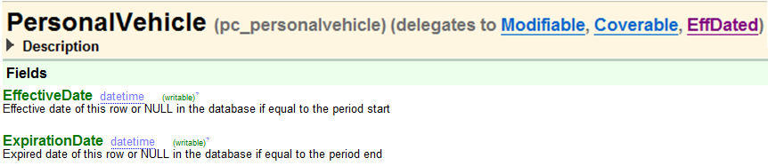
EffDated entities
EffDated entities are created to track the state of an entity over effective time
  Have EffectiveDate and ExpirationDate columns
If you are interested only in the last state of the object make it type=“retireable”

Slide 5
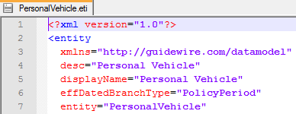
PolicyPeriod entity
PolicyPeriod entity is:
  the root/container of all EffDated entities on a policy graph
  not EffDated
Set relationship between a custom EffDated entity and PolicyPeriod
  effDatedBranchType=“PolicyPeriod" in the eti file
Notes:
In the default configuration, PolicyPeriod is the only option for a root object. PolicyPeriod is referred to as the parent object and the EffDated entities on it are often referred to as the child objects or sub-objects.
PolicyPeriod as an entity is not effdated. A new one is created each time there is any sort of change/update to the policy. PolicyCenter does not “revision” the PolicyPeriod, the data that comprises the PolicyPeriod i.e. objects on the policy are revisioned.
For example, think of PolicyPeriod as a box. In that box are all the things that can change. I may remove something, add something, or modify something in that box, and it is these items that are EffDated. When this happens, PolicyCenter puts everything in a new box i.e. PolicyPeriod which is cloned from the previous PolicyPeriod box. The box itself is exactly the same, but the stuff in it has changed.

Slide 6
EffDated entity columns
EffectiveDate and ExpirationDate – null value means this entity has same effective and expiration dates as its parent
  Default to PolicyPeriod.PeriodStart and PolicyPeriod.PeriodEnd since PolicyPeriod is the root entity
FixedId – a unique identifier that PolicyCenter generates when a new object is created
  Cannot be null
Branch – link to the associated PolicyPeriod
  Cannot be null
BasedOn – a pointer back to prior version of this entity
  If this is the first version, BasedOn is null
  Column on EffDated entity as well as the PolicyPeriod
Notes:
FixedId: FixedId has no relation to other attributes on the object. For example, a vehicle is given a FixedId of 22, a VIN of 12344 and then when it undergoes a PolicyChange later to correct the VIN number the VIN is 12345 but the FixedId cannot be changed and will remain as 22. Or you might correct the model on a vehicle but it’s still the same vehicle, i.e., it still has the same FixedId. If the fixed IDs for two vehicles match, they are versions of the same vehicle, not two different vehicles. If the fixed IDs do not match, they represent different vehicles.
Branch: Foreign key to the PolicyPeriod entity that contains this entity. Guidewire mandates that all entities within the same branch share the same Branch value. This value cannot be null.

Slide 7
BasedOn example
Driver.BasedOn and
PersonalVehicle EffDated entity has BasedOn property
Mar
Apr
May
Dec
Submission on Mar 1 (Eff Mar 1 – Dec 31)
policy with 1 car and 1 driver
Driver1.BasedOn = null
PersonalVehicle1.BasedOn = null
1
Policy Change 1 on Mar 2 (Eff Apr 1 - Dec 31)
change car 1, no change in driver
Driver2.BasedOn = Driver1
PersonalVehicle2.BasedOn = PersonalVehicle1
2
Policy Change 2 on Mar 3 – (Eff May 1 - Dec 31)
change car 1, no change in driver
Driver3.BasedOn = Driver1
PersonalVehicle3.BasedOn = PersonalVehicle2
1
3
Historical PolicyPeriod
Note that Driver2 is never used again
Enforced PolicyPeriod
Notes:
Consider the example where a submission is created on Mar 1 with one red car and one driver. This creates PolicyPeriod1, Driver1, and PersonalVehicle1. The BasedOn property for all of them are null at this point since a submission is not based on any prior policy period.
When policy change 1 changes the color of the car to green, a new policy period is cloned from PolicyPeriod1 so PolicyPeriod2.BasedOn has the value of PolicyPeriod1. The personal vehicle is modified so it is BasedOn the prior version of the vehicle i.e. PersonalVehicle2.BasedOn = PersonalVehicle1. But there is no change in Driver2 is based on Driver1.
Similarly, when another policy change 2, changes the color of the car to blue, a new policy period is cloned from PolicyPeriod2 so PolicyPeriod3.BasedOn has the value of PolicyPeriod2. The personal vehicle is modified so it is BasedOn the prior version of the vehicle i.e. PersonalVehicle3.BasedOn = PersonalVehicle2. But the driver is not modified so Driver3.BasedOn is assigned Driver1 and Driver2 is never used again.
The numbers 1, 2, and 3 denote the different policy revisions.

Slide 8
Lesson outline
EffDated entities
Structure of revisioning across effective time
Window mode and slice mode overview
Slice Mode APIs
Window mode APIs

Slide 9
PolicyPeriod
A PolicyPeriod is one "version" of the policy
    Has effective date (PeriodStart) and expiration date (PeriodEnd)
policy created
04/20/08
second auto added
07/20/08
teen driver
added
10/20/08
renewal
(premium changed)
04/20/09
$270
$450
$920
$990
1
2
3
3 versions, so 3 PolicyPeriods:
04/20/08 – 04/20/09
1 PolicyPeriod and 1 PolicyTerm: 04/20/09 – 04/20/10
1 PolicyTerm: 04/20/08 – 04/20/09
Notes:
The PolicyPeriod entity contains information about all effective dates within a single PolicyTerm or period which means that every change in policy is represented by a PolicyPeriod entity at the root of a complex graph of sub-objects such as policy lines, vehicles, coverages, and many others. The entire hierarchy of Guidewire entities are cloned in the database into new rows during policy changes, renewals, or other jobs that result in cloning everything in a branch. The cloned branch is updated with the changes (such as delete a driver or add a new car etc.). The changes made to this cloned branch will be visible only when a user views policy from that branch’s effective date. This cloned branch becomes the base to be cloned for future changes and so forth. (In contrast, a submission job’s branch is not cloned from another branch.)
Policy term and policy periods:
PolicyTerm
A new PolicyTerm is created whenever the policy contract is completely recreated. This occurs with a new policy (submission), a renewal, or a rewrite of an existing contract. A new PolicyTerm is not created when you amend a policy contract with a policy change job.
PolicyPeriod
The PolicyPeriod entity stores information for a specific revision of the contractual period of a policy. A revision occurs anytime a job occurs on a policy. A submission creates the first revision. Each additional transaction on the policy (such as a policy change) creates a new revision. Therefore, a policy almost always has multiple revisions, with one PolicyPeriod entity for each revision. During the contractual period, only one PolicyPeriod entity is in effect at a time. A new revision is created when you process a policy change that adds a car to the policy. The EffectiveDate for the car is several months into contractual period, and the ExpirationDate extends to the end of the period. PolicyCenter clones a new PolicyPeriod entity and its subentities and adds an entity for the new car. The contractual period now has two PolicyPeriods. The new PolicyPeriod entity is in effect. The old PolicyPeriod entity is preserved as a historical record of the policy.

Slide 10
Model time and effective time
To track policy changes over time, a policy must be considered in two different time dimensions:
  Model time is the actual real-world time when policies are created or jobs are bound
  Effective time is the time dimension of the policy itself within the policy period
Notes:
Model time: This is like tracking the history of previous changes in any online system that has an audit trail. When a branch is bound, PolicyCenter sets its branch model date to match the real-world date it was bound. Additionally, PolicyCenter increments the policy revision’s model number, which is an integer value that indicates the relative order of multiple versions of the same contractual policy revision. The bound revision with the latest model number is always the currently-active legally-enforced policy revision for that effective time range. Changes that happen later supersede earlier versions of the policy for the policy period’s effective time range. However, PolicyCenter keeps older branches in the database. Older branches are required to view the policy history. Use this to generate reports of the legally-binding state of the policy at a model date earlier than today.
Effective time: For example, what time range does the policy cover? This dimension of time is unique to a policy system. If the policy period is one year, each PolicyCenter policy period records the policy information for one year of effective time. Some objects on the policy may only exist for some range of effective time, or have different property values for different ranges of effective time.

Slide 11
Example
Jan 1
Effective time
Dec 31
Apr
May
Mar 1 – policy with 1 car effective Apr 1 - Dec 31
Model date: Mar 1
Effective date: Apr 1
1
Model time
Mar 2 – add car 2 effective from May 1 - Dec 31
Model date: Mar 2
Effective date: May 1
1
1
2
Mar 3 – Remove car 2
Model date: Mar 3
Effective date: May 1
1
3
X
Historical PolicyPeriod
Enforced PolicyPeriod
Notes:
The above example is of a policy revision 1 created on Mar 1 with one car effective from Apr 1 – Dec 31.
Policy revision 2 is created by cloning PolicyPeriod 1 when car 2 is added on Mar 2 effective from May 1 – Dec 31.
Policy revision 3 is created by cloning PolicyPeriod 2 when car 2 is removed on Mar 3 effective from May 1 – Dec 31.

Slide 12
Sub-objects across effective time (1)
Every policy revision is root of a complex graph of sub-objects such as vehicles, coverages, and so on
  If one of these object changes then that object has its own effective and expiration date
Consider an example, where a personal auto submission is created with one vehicle
Mar 1
1
Dec 31
PersonalVehicle
Coverage
Submission
Sub-object: Vehicle
Color: RED
EffectiveDate: null
ExpirationDate: null
FixedId: 12345
Notes:
If one object such as a vehicle does not change across effective time, there will be only one row in the database for that object at that model time. However, if it changes across effective time, the object is cloned into a new row in the database, differing in effective time begin and end dates. The insurance industry calls these begin and end dates i.e. the effective date and expiration date.
For example, suppose on March 1 a customer requests an auto policy for a red car, effective from March 1 through the end of the year.
PolicyCenter represents this across effective time for the vehicle as a row in the database:
A red car with effective date March 1 and expiration date September 1 (typically at 12:01am).

Slide 13
Sub-objects across effective time (2)
    On Sep 1, the customer calls and says the car was painted blue today
    A new policy revision is created by cloning a new row in the database differing in effective date and expiration date
    Expiration date of first row is the effective date
    of second row
    A row is effective at a date specified if:
    Effective date <= specified date < expiration date
Sub-object: Vehicle
PersonalVehicle
Color: RED
EffectiveDate: null
ExpirationDate: Sep 1
FixedId: 12345
2
Coverage
Policy Change
Sub-object: Vehicle
Color: BLUE
EffectiveDate: Sep 1
ExpirationDate: null
FixedId: 12345
Notes:
On September 1 the customer calls and says the car was painted today and is now blue.
PolicyCenter represents these changes across effective time for the vehicle as two rows:
A red car with effective date March 1 and expiration date September 1 (typically at 12:01am).
A blue car with effective date September 1 and expiration December 31
Note that the expiration date of the first row is the same as the effective date of the second row. This means the first row is effective up until the exact date and time of expiration, but not including that exact date and time. A row is effective at the date specified date if the following equation is true: effective_date <= specified_date < expiration_date
Effective and Expiration dates are stored in the EffectiveDate and ExpirationDate property of each PolicyPeriod sub-object respectively. These values can be null in the database, but they will never be null in Gosu. When you access the property using Gosu it automatically returns the correct date.
The same FixedId values means they are the same car with different effective date ranges. If another car was added then the FixedId would change.

Slide 14
Lesson outline
EffDated entities
Structure of revisioning across effective time
Slice mode and window mode overview
Slice Mode APIs
Window mode APIs

Slide 15
Two modes to access a branch’s objects
Usually, jobs change policy data across effective time
Slice mode is viewing policy data as of a specific date in effective time
  When you request objects on the policy in slice mode, PolicyCenter automatically gets the correct version of each object as of the slice date
Window mode is viewing all versions of policy data across all dates in effective time

Slide 16
Example scenario
Jan 1
Effective time
Dec 31
Apr
May
Jun
04/01: Submission
creates policy
with 1 red car
1
Model time
1
05/01: Change -
Add a blue car 2
1
2
06/01: Change -
Remove car 2
1
1
1
2
3
X
Enforced PolicyPeriod
Historical PolicyPeriod
Notes:
Consider a scenario where a policy is created using a submission transaction with one car effective from 04/01 for one year.
A policy change adds another car to the policy effective from 05/01 till the expiration date of the policy.
Another policy change removes car 2, effective from 06/01 till the expiration of the policy.
Note: This example is used throughout this lesson going forward.

Slide 17
Slice mode view as of:
Jan 1
Effective time
Dec 31
Apr
May
Jun
1
Apr 30?
1
Policy has one red car
May 30?
2
Policy has two cars (one red, one blue)
1
Nov 25?
3
X
Policy has one red car
On any date, you might not see all cars that exist at some point in that policy period
Notes:
When you request cars on the policy in slice mode, PolicyCenter automatically gets the correct version of each car as of the slice date. Also, PolicyCenter only returns the cars that are effective at the slice date.

Slide 18
Window mode view:
Lists all cars that existed on the policy for any amount of time along with the effective dates
  First, get a list of all cars that were ever on the policy
  Next, for each car, you want to iterate across all changes to that car across effective time
  Obtained by using the VersionList property on a policy period
There are two cars in VersionList but there are three versions of the policy
  Submission, Policy Change 1, Policy Change 2
Jan 1
Effective time
Dec 31
Apr
May
Jun
1
1
1
2
3
X
Notes:
There is exactly one row in the database for each version of a car. For example, if the car has had three different colors, there are three rows in the database that represent that car. The set of three rows that represent this one car is called a version list. From the version list, you can access every version of the car in the period. In this case, the version list contains three versions of the car, each at some point in effective time.

Slide 19
Lesson outline
EffDated entities
Structure of revisioning across effective time
Slice mode and window mode overview
Slice Mode APIs
Window mode APIs

Slide 20
getSlice(sliceDate)
Access a slice from a PolicyPeriod
slicedPolicyPeriod = aBranch.getSlice(sliceDate)
  Return value is in slice mode
  Returns sliced PolicyPeriod
  Displays view of PolicyPeriod as of slice date
Notes:
If you get properties on a slice mode object to access other objects, those objects are also automatically in slice mode. In typical code, you can navigate up or down the object graph hierarchy without worrying about the revisioning details. At any time you can get the object.SliceDate property to get the slice date.
In most cases, it is best to call getSlice on the root PolicyPeriod and navigate down the object graph from there. However, you can call getSlice on an individual revisioned sub-object of PolicyPeriod if necessary.
Be sure that the slice date that you pass to getSlice is in the effective date range for that object. If you try to pass a date outside the required range, then Gosu throws an exception.
For example, if you removed an auto from an auto policy before the slice date, Gosu throws an exception because that auto is not effective at that date. However, if you call getSlice on the PolicyPeriod and navigate down the object graph for that slice, you do not need to worry about unavailable effective dates for sub-objects. This is why it is typically best to call getSlice on the PolicyPeriod and navigate down the object graph from there.
The above example is the same that is used in the previous window mode and slide mode overview section.

Slide 21
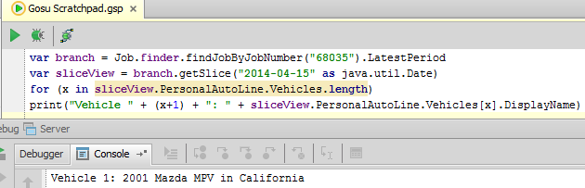
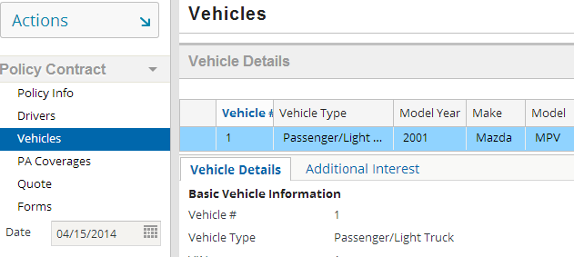
Example 1: getSlice using Gosu Tester and verified using date selector in the UI
Notes:
To access the latest PolicyPeriod use the LatestPeriod property on the findJobByJobNumber method. That way you can be sure that you are accessing the latest bound PolicyPeriod. Avoid using other methods such as the find query on a policy number which could return multiple PolicyPeriods and may not always return the latest bound PolicyPeriod.
The sliced policy version can also be seen in the user interface by entering a date in the date selector.

Slide 22
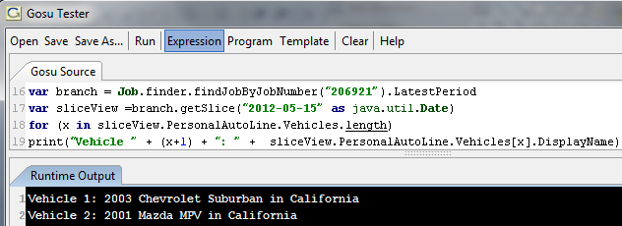
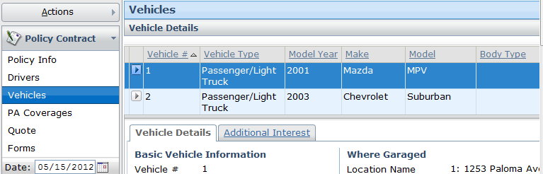
Example 2: getSlice using Gosu Tester and verified using date selector in the UI

Slide 23
Lesson outline
EffDated entities
Structure of revisioning across effective time
Slice mode and window mode overview
Slice Mode APIs
Window mode APIs

Slide 24
Version list overview
Version list represents all version of an object within one policy period
Use any object’s VersionList property to get a version list
versionList.AllVersions property gets all versions of this object
  Sorted on effective date for each version
versionList.AsOf(date) method gets the one version of this object on that date, or null if none were effective on that date
Notes:
In window mode, you can use version list to view policy objects across all effective time. If you have a version list, you can get various information about the object. For example, get all versions of the object, or navigate up or down the hierarchy to other entity instances or version lists.

Slide 25
Version list examples
Get all versions of a particular car in a policy period:
  var val = vehicleVL.AllVersions
    If the car was added and then removed in a subsequent change transaction (as discussed previously), the car would still be listed
    It existed on the policy period at some point
Get the car version that is effective on ‘date’
  var vehOnDate = vehicleVL.AsOf(date)
  Returns
    Single car object in window mode
    Null if no version of the car is effective at that date
Notes:
Similarly, to get the set of all drivers who were ever drivers of this car during this period, use the following Gosu code:
var drivers = vehicleVL.Drivers

Slide 26
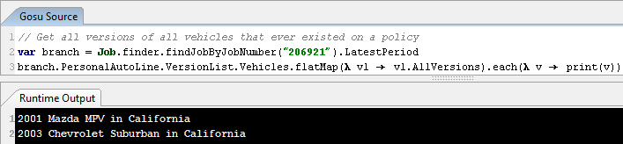
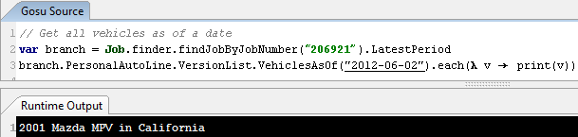
VersionList examples: Get vehicles on a policy
All versions of all vehicles that ever existed on the Policy
All vehicles as of specific date
Notes:
flatMap(collection) - Maps each element of the Collection to a Collection of values and then flattens them into a single List.

Slide 27
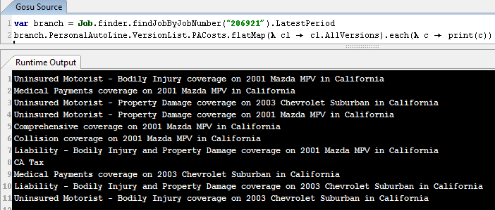

VersionList examples: Get costs on a policy
All costs on a personal auto policy
All costs on a vehicle at a specific date

Slide 28
Lesson objectives review
You should now be able to:
  Describe policy revisioning and EffDated entities
  Describe window mode and slice mode
  Access a policy in window and slice mode using Gosu

Slide 29
Review questions
What are EffDated entities?
What is the difference between effective time and model time?
Notes:
Answers
EffDated entities are created to track the state of an entity over effective time. They have an effective date and an expiration date.
Model time is the actual real-world time when policies are created or jobs are bound. Effective time is the time dimension of the policy itself within the policy period.

Slide 30
Notices
Copyright © 2001-2014 Guidewire Software, Inc. All rights reserved.
Guidewire, Guidewire Software, Guidewire ClaimCenter, Guidewire PolicyCenter, Guidewire BillingCenter, Guidewire Reinsurance Management, Guidewire ContactManager, Guidewire Vendor Data Management, Guidewire Client Data Management, Guidewire Rating Management, Guidewire InsuranceSuite, Guidewire ContactCenter, Guidewire Studio, Guidewire Product Designer, Guidewire Live, Guidewire DataHub, Guidewire InfoCenter, Guidewire Standard Reporting, Guidewire ExampleCenter, Guidewire Account Manager Portal, Guidewire Claim Portal, Guidewire Policyholder Portal, ClaimCenter, BillingCenter, PolicyCenter, InsuranceSuite, Gosu, Deliver Insurance Your Way, and the Guidewire logo are trademarks, service marks, or registered trademarks of Guidewire Software, Inc. in the United States and/or other countries.
All other trademarks are the property of their respective owners.
This material is confidential and proprietary to Guidewire and subject to the confidentiality terms in the applicable license agreement and/or separate nondisclosure agreement.
This file and the contents herein are the property of Guidewire Software, Inc. Use of this course material is restricted to students officially registered in this specific Guidewire-instructed course, or for other use expressly authorized by Guidewire. Replication or distribution of this course material in electronic, paper, or other format is prohibited without express permission from Guidewire.
Guidewire products are protected by one or more United States patents.
Notes:
Concepts of Revisioning - 30

