Slide 1
Concepts of Revisioning Contact and Location Information
14 March 2014
Notes:
Guidewire training materials contain Guidewire proprietary information that is subject to confidentiality and non-disclosure agreements. You agree to use the information in this manual solely for the purpose of training to implement Guidewire software solutions. You also agree not to disclose the information in this manual to third parties or copy this manual without prior written consent from Guidewire. Guidewire training may be given only by Guidewire employees or certified Guidewire partners under the appropriate agreement with Guidewire.

Slide 2
Lesson objectives
By the end of this lesson, you should be able to:
Explain the concepts of shared and revisioned data
Explain future dated, back dated, and current dated contact behavior
Explain revisioned location information
This lesson uses the notes section for additional explanation and information. To view the notes in PowerPoint, choose View→Normal or View→Notes Page. If you choose to print the notes for the lesson, be sure to select “Print hidden slides.”

Slide 3
Lesson outline
Sharing and revisioning basics
Revisioning contact information
Contact revisioning example
Revisioning location information

Slide 4
Review: PolicyPeriod
A PolicyPeriod is one "version" of the policy
Has effective date and expiration date
Model time is the actual real-world time when policies are created or jobs are bound
policy created 04/20/08
second auto added 07/20/08
teen driver added 10/20/08
renewal (premium changed) 04/20/09
$270
$450
$920
$990
1
2
3
3 versions, so 3 PolicyPeriods: 04/20/08 – 04/20/09
1 PolicyPeriod and 1 PolicyTerm: 04/20/09 – 04/20/10
1 PolicyTerm: 04/20/08 – 04/20/09
Notes:
The PolicyPeriod entity contains information about all effective dates within a single PolicyTerm or period which means that every change in policy is represented by a PolicyPeriod entity at the root of a complex graph of sub-objects such as policy lines, vehicles, coverages, and many others. The entire hierarchy of Guidewire entities are cloned in the database into new rows during policy changes, renewals, or other jobs that result in cloning everything in a branch. The cloned branch is updated with the changes (such as delete a driver or add a new car etc.). The changes made to this cloned branch will be visible only when a user views policy from that branch’s effective date. This cloned branch becomes the base to be cloned for future changes and so forth. (In contrast, a submission job’s branch is not cloned from another branch.)
Policy term and policy periods:
PolicyTerm
A new PolicyTerm is created whenever the policy contract is completely recreated. This occurs with a new policy (submission), a renewal, or a rewrite of an existing contract. A new PolicyTerm is not created when you amend a policy contract with a policy change job.
PolicyPeriod
The PolicyPeriod entity stores information for a specific revision of the contractual period of a policy. A revision occurs anytime a job occurs on a policy. A submission creates the first revision. Each additional transaction on the policy (such as a policy change) creates a new revision. Therefore, a policy almost always has multiple revisions, with one PolicyPeriod entity for each revision. During the contractual period, only one PolicyPeriod entity is in effect at a time. A new revision is created when you process a policy change that adds a car to the policy. The EffectiveDate for the car is several months into contractual period, and the ExpirationDate extends to the end of the period. PolicyCenter clones a new PolicyPeriod entity and its subentities and adds an entity for the new car. The contractual period now has two PolicyPeriods. The new PolicyPeriod entity is in effect. The old PolicyPeriod entity is preserved as a historical record of the policy.

Slide 5
Contacts and locations are shared
Contact and location information is shared between accounts and policies
Benefits of sharing information are:
Avoiding data re-entry and errors
Allowing the same contact to play multiple roles on the account and policy, such as account holder or named insured
Associating Contact to other entities such as Location or Vehicles
account
policy
Notes:
PolicyPeriod keeps a copy of all objects on the policy such as vehicles, contacts, coverages etc. This keeps track of all those items and what they look like at some time on the policy. Most of these objects, underneath the policy graph such as the vehicles and coverages, live on the policy only. But there are things like locations and contacts that live on the policy but also have life on the account so that they can be shared. The Account, unlike Policies, has no concept of versions of the data it stores.
Particular fields such as a contact’s phone number do not need a version of what it looked like at a particular time on the policy. At the same time, if there was no way of sharing contact information across policies, the phone number is information that would be required to enter each time a policy is revisioned or created.
In PolicyCenter, this information is stored on the account and can be used across accounts and policies. It is good to maintain contact details in one place for current and future transactions. Contact details on a policy, like other policy information, cannot be changed after a policy contract is written unless by another job such as a policy change.

Slide 6
Information can change
PolicyCenter supports sharing and revisioning information
Sometimes we are interested in most up-to-date contact info
Sometimes we are interested in information as it was at a given point in time
Revision: Information that is part of policy contract on an issued PolicyPeriod should be revisioned
When a Policy is issued, we want to keep a version of it at that point in time
It can change anytime a job is executed on it
Share: Information can be kept at the Account level so it can be shared, to avoid duplication
People move, get married and change their names, get new drivers licenses, etc.
Notes:
Once a policy is issued, it has to retain all of the information associated with it and should not update it even though a change in some of the information on the policy is reported. An issued policy is a paper mailed out and should not be changed. To change information on the policy, another job has to be executed on the policy.

Slide 7
When would you need contact revisioning?
A policy is bound and policy contract is written
But after two months, contact calls to change name
Policy contract cannot be changed
No other objects on the policy need to change
Only the name needs to be updated for future transactions
02/01/2009
Jane Smith
Jane Smith
Model time
Jane Doe
Jane Smith
04/01/2009
Notes:
Contacts and locations are something we need to consider uniquely because unlike other policy objects, they have a life both on the policy and on the account. Hence the information exists in two places. Account information can change independent of the policies on it.
In the example above, Jane Smith called to notify that she got married and changed her last name to Doe. PolicyCenter updates the last name on the account, but that does not automatically update the last name on the bound policy. Bound information cannot be changed. A policy change must be executed to update the name on the policy.
Generally, carriers would execute a policy change when her name changes and issue policy documents with the new name. Carriers and insured would prefer updated insurance documents with the new name. But the carrier also needs to track what her name used to be, so that information needs to be revisioned. However, information associated with contacts that is not part of the policy contract does not need to be revisioned. For example, the phone number for a Billing Contact three years ago is not important, but you need to know what it is now. You always want to see the most current phone number.
For similar reasons, it is necessary to revision location information.

Slide 8
Some fields on contact need to be changed
Job can pick up current contact data from Account
Model time
Account
Policy
02/01/09 - Submission
04/01/09 - Contact name changed
Updated contact name
05/01/09 – Policy change job picks up contact info from account
Picks up most recent contact info for change
Notes:
A separate revision of the policy is created for each subsequent policy job after submission. Any data in the policy graph, including revisioned contact data, can be changed in those subsequent jobs starting on the effective date of the job. Each time a policy job is started on the policy, it can pick up the most recent account level contact information for the revisioned fields (for non-revisioned contact fields, the user always sees the data stored at the account level). In the revision created by the new job, when new contact data is picked up from the account, then from the effective date of the job forward, that contact has the new data. In the part of the policy before the effective date of the job, it still has the old information.
The fields to be revisioned are marked on the account and policy. You define on a field by field basis for each role whether to revision basic contact information or account level role-specific information.
Consider the example continued above from the previous slide:
On 02/01/09 contact information exists on account and a policy is created through submission.
On 04/01/09 the contact calls to report that she got married and needs to change her name. No other objects on the policy need to change and since changing her name and marriage status in this case won’t affect the rating on the policy, a policy change is not executed. The information is updated on the Account only.
On 05/01/09 the contact calls to add one more driver with an effective date of 06/01/09. At this point two versions of the policy exist: Submission creates a policy revision #1 with old contact information, and Policy Change creates a policy revision #2 that starting from the effective date of the change has the new contact information, which it obtains from the account.
PolicyCenter determines whether to pick up the current contact date from the account based on the effective date of the job. Location information is picked up from the account irrespective of the effective date on the job.

Slide 9
Data inside and outside PolicyPeriod graph
Data outside PolicyPeriod | Data inside PolicyPeriod
Lives only on Account | Lives on both Policy and Account
Shared but not revisioned because we do not need to know how data has varied over time | Shared and revisioned because we need to know when it changed
When data changes, change is made to the Account only | Change is made to objects on the Policy
History is not available | History is available
Some data resides inside as well as outside PolicyPeriod graph which is needed at all times such as contact name
Notes:
Some contact data such as contact’s name resides both inside and outside the PolicyPeriod graph because it needs to be shared across policies and we also need a historical record of it.
Contact data like phone number only lives outside the policy graph because it needs to be shared but we don’t need a historical record of it.
Promoting a policy: As part of making a branch or policy period legally enforced, PolicyCenter performs a process called binding. This process is also called binding a branch or promoting a branch. The result is called a promoted branch or a bound branch. Once a policy period is promoted/bound, all data inside the policyPeriod graph, including revisioned contact information cannot be changed.
Branch: In PolicyCenter, policy revisions are often referred to as branches. Think of a branch as a graph of objects with PolicyPeriod at the root. The branch collectively represents a policy for one contractual period as of one moment in real-world time. Each one of these snapshots of the policy for one period is called a branch.

Slide 10
Lesson outline
Sharing and revisioning basics
Revisioning contact information
Contact revisioning example
Revisioning location information

Slide 11
Changes to a policy can be complicated
For example, consider a contact Jane Smith who is born in the year 1967 and gets an annual PA policy from say 07/01/14-07/01/15
On the same date, a BOP submission is also created for Jane Smith for her car (Current dated on the same account)
After two months – Contact calls to say that she is getting married in one week (future dated)
Change last name and marital status
Add another driver and rerate the policy
After three months – Contact calls to correct her birth year (back dated change)
Effective from the beginning of the policy
Notes:
The next few slides discuss the above scenarios and how PolicyCenter handles them. This only applies to revisioned contact fields.

Slide 12
To handle changes to current contact data
At the beginning of a job, PC checks if contact data is:
Current: Last update of contact <= Job Eff Date (Job is not in future)
Sync’ed to Account data throughout job
Modify contact’s last update time
Contacts are always synced to account for submissions and issuances
Notes:
The contact data is synced to the account data throughout the job because both the policy and the account contact data are considered “current” so changes to either one should be reflected in the other one. Data is copied to and from account and policy. For example, in a submission job shared and revisioned contact information may be edited such as last name or first name. The change gets made on both the account and policy.
PC considers the last time a contact was updated (telling us how “current” account contact information is) when compared to a job’s effective date to determine how to treat revisioned data. Contact information and any potential changes made to revisioned contact data during the course of a job can be considered current, future dated or back dated.
A contact’s last update time is updated each time the account level contact information gets modified:
If it is modified in the context of a policy job, it is set to the effective date of that job
If it is modified at the account or cross-account level, it is set to the current date.
For example, when a contact is created in the context of a submission, then the last update time is set to the effective date of the job (though it can never be in the future). And it can’t ever be moved backwards – it should always represent the latest date the contact was updated.
In the example, when Jane Smith get two policies (one PA and one BOP) policy on the same date, the contact information is copied over or shared from the account to both policies.
Data does not need to be synced during a cancellation or an audit job.

Slide 13
To handle a future dated change
At the beginning of a job, PC checks if contact data is:
Contact’s last update time is set each time the account level contact information gets modified
Future dated: Current date < Job Eff Date
Copy down from Account contact
Account and Policy not sync’ed during job
Contact data changes – creates a work item for the batch process Apply Pending Account Data Updates
Automatically updates account-level contact data on job date
Notes:
Copy down – Copy current information from the account to the policy.
When potential contact changes are considered to be future dated (i.e. the effective date of the job is in the future) then PolicyCenter copies down current information from the account, but changes do not flow back up to the account because the contact at the account level is considered to be current data, and cannot be future dated.
Contacts on submission and issuance jobs are always sync’ed to the account, even when the job is future dated. In that case, the contact update time is set to the current date, not the effective date of the job (since account contact data can never been future dated).

Slide 14
To handle a back dated change
At the beginning of a job, PC checks if contact data is:
Back dated: Last update of contact > Job Eff Date
Use policy-level data and make changes at policy level only
For contact changes:
PolicyCenter creates activities suggesting changes at account level
Creates notes to specify the changes
Notes:
Back dated – The contact information on the policy is back dated, and is neither copied down from the account, nor does it automatically copy any changes back up to the account.
Since the job is back dated relative to the current contact data, we don’t want to copy down from the account because we may end up overwriting contact information that was correct as of the job’s effective date (but is no longer effective). Similarly, we cannot assume that any changes made to contact data in the context of the job they should overwrite the current contact data, so we don’t want any changes automatically copied back up to the account. But since in many cases, users do want those changes made at the account level, we create activities so they actively determine whether those changes should be applied at the account level.
Note that contacts on submission and issuance jobs are always sync’ed to the account, even when the job is future dated. In that case, the contact update does not get changed, since it can never be moved backwards.

Slide 15
Revisioned and non-revisioned contact fields
Account
Policy
Contact
AccountContact
PolicyPeriod
PolicyLine
Account-ContactRole
Person
PALine
PolicyContactRole
FirstName
LastName
LicenseState
LicenseNum CellPhone
LastUpdatedTime
FirstName (synced)
LastName (synced)
PolicyDriver
LicenseState (synced)
LicenseNum (synced)
A
B
A has foreignkey to B
A
B
A extends B
Notes:
Concepts of Revisioning Contact and Location Information - 15
The Contact data model is designed to handle synchronization and revisions of contact information. The illustration above shows some the basic relationships of the Contact entity using personal auto as an example. Other lines of business have the same basic entity structure with their own PolicyLine subtype and fields.
The Contact entity has a number of subtypes including Person. The diagram shows some of the fields for a Person. The Contact entity has FirstName and LastName fields from its subtype Person entity. Some of the entities inside the PolicyPeriod dotted box have fields that can synchronize with the account when there is an open job on a policy. (Note, as explained in the previous slides, they’d only be synchronized when the contact change would be current, not when future or back dated.) These are marked as synced. On jobs when these fields are synced, when the policy is bound, these fields contain a copy of account fields at the time of binding. On jobs when these fields are not synced, changes are made directly to the policy fields themselves. If the account information for revisioned fields changes after binding, the bound policy is not affectedIn the default application:
During submission and issuance jobs, contact information is always synchronized between the policy and the account
During policy change, rewrite, reinstatement, or renewal, then the contact information is copied down and/or synchronized between the policy and the account, per the rules on the previous slides
During audit and cancellation jobs, contact information is never synchronized between the policy and the account
PolicyCenter, as for all entities that are part of the policy graph, creates another revision of these entities every time a new job is started on a policy.
The CellPhone field on the subtype Person is a non-revisioned field which is on the Account only.
Note: The above diagram shows some of the revisioned and non-revisioned fields on Contact of type Person. The revisioned fields are shared and synced between accounts and policies. For a complete list refer to the PolicyCenter Application Guide.

Slide 16
Lesson outline
Sharing and revisioning basics
Revisioning contact information
Contact revisioning example
Revisioning location information

Slide 17
Example: Future dated and back dated change
Policy as of 07/01/14 - 10/29/14
Policy as of 10/30/14 - 07/01/15
Model time
PA Submission 07/01/14 - 07/01/15
1
1
Jane Smith, Single, 4/1/1967
Jane Smith, Single, 4/1/1967
Change on 10/22/14 - Contact getting married on 10/30/14 (future dated) Work item created
2
2
Jane Smith, Single, 4/1/1967
Jane Doe, Married, 4/1/1967
10/30/14 Apply Pending Account Data Updates
Acct contact info updated
Change on 11/15/14 – Edit contact’s birth year (back-dated change)
3
3
Jane Smith, Single, 4/1/1965
Jane Doe, Married, 4/1/1965
Notes:
Consider the following example:
Jane Smith gets a new personal auto policy, effective from 07/01/14-07/01/15. She also get a new BOP policy at the same time, also effective from 07/01/14-07/01/15.
Future dated change: She calls on 10/22/14 to say that she is getting married on 10/30/14 and would like to change her last name to Doe. She would also like to add her husband as a driver so the policy would need to be rerated. A work item gets created on 10/22/14 to process the future dated change on the contact data. To ensure that, when a future dated change is made to revisioned contact data, that change is applied at the account/contact level on the effective date of the job (10/30/14) through a new batch process, Apply Pending Account Data Updates as shown above.
The policy shows Jane Smith as Single until 10/29/14 and as Married, with her last name updated to Doe from 10/30/14 to 07/01/15.
Back dated change: Some back dated changes should be made at the account/contact level. Some should not.
Jane calls on 11/15/14 to say that all this time her birth year was wrong on the policy and needs to be changed to 1965. The change related to Jane’s birth year is back dated as it needs to be made effective from the beginning of the policy (07/01/14). PolicyCenter creates activities and notes suggesting to the user that they may want to make these same changes at the account level. The user can decide whether to make the changes or not and in this case (of editing the birth date) the user should. The user will have to update this information on the account manually.

Slide 18
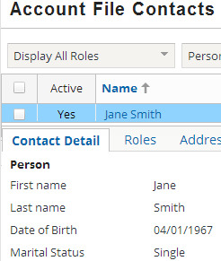
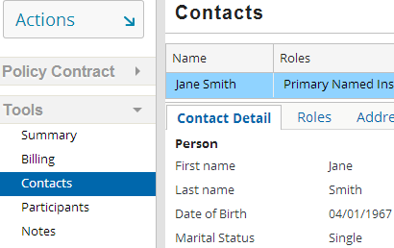

Example in UI: Create submission
1
Notes:
The next few slides discuss the example in the user interface.
In this slide a new Personal Auto policy is created for a year for Jane Smith who is single and born in the year 1967. She also gets a BOP policy for the same period.

Slide 19
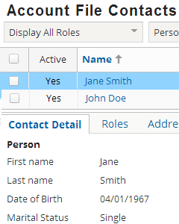
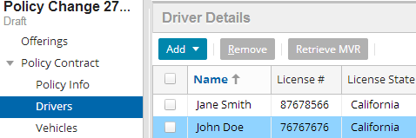
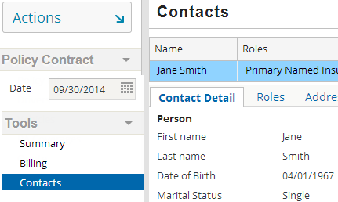
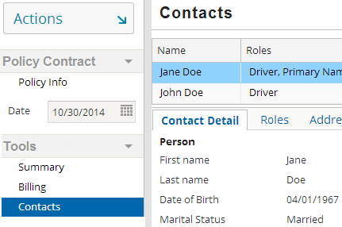
Future dated Policy Change – getting married on 10/30/14
2
2
Notes:
On 10/22/2014, Jane calls that to say she is getting married on 10/30/2014 and so her marital status should be updated to “Married” and the policy should be re-quoted again with two drivers. A policy change is created effective 10/30/2014.
The policy has different values for last name and status for contact information when viewed on different dates as shown in the screenshots above.

Slide 20
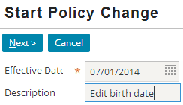
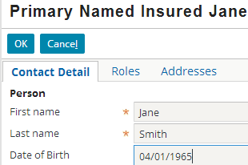
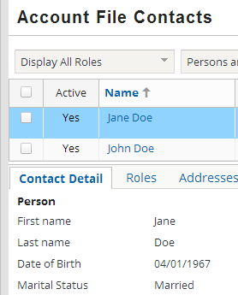
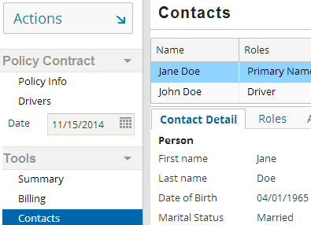
Back dated Policy Change – edit birth date
Jane calls to change her birth year to 1965 on 11/15/2014
Edit contact info
3
Notes:
On 11/15/2014, Jane calls to say that there is a mistake on her birth date and that the birth year should be 1965. This would be a back-dated policy change which would have to be effective dated from the beginning of the policy on 07/01/2014.
The back dated change creates activities and notes on the account as shown in next slide and user can decide whether to apply the changes or not.
Note that the batch process ran automatically on 10/30/14 that updated the contact status to “Married” and last name to “Doe” on the account.

Slide 21
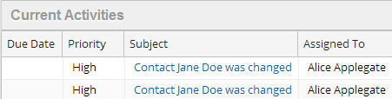
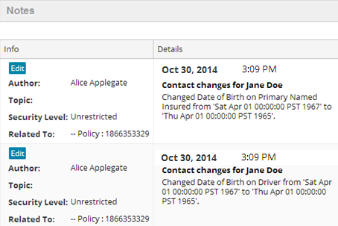
Activities and notes created on the account
Notes:
A change such as change in Jane’s birth year would required to be made on the account contact. Activities and notes are created on the account that suggest the user that they might want to make the same changes at the account level but the user can choose whether to make the change.
In this case, the user would want to go ahead and make the change on the account level also. Additionally, they would want to start a change on the BOP submission, also back dated to 07/01/14, to pick up the birth date change, since it is inaccurate on that policy also.

Slide 22
Lesson outline
Sharing and revisioning basics
Revisioning contact information
Contact revisioning example
Revisioning location information

Slide 23
Location information
Location information includes:
Basic location information such as address, city and state location name and phone
Policy-specific information such as tax location
Notes:
The concept of location revisioning is similar to contact revisioning. The synchronizing of the revisioned fields is the same as in case of current dated changes for contact data. The future dated and back dated change scenarios do not apply to locations because locations should not really change over time; changes to location information should generally be corrections which you’d want to apply throughout the life of the policy.

Slide 24
Location revisioning
Locations are shared
Policy location revisioned (field by field)
Account location
Location information is stored at account and policy levels
Location information is revisioned on field by field basis
Configuration user can define what information to revision
Location information that is part of policy contract is revisioned
In draft jobs, policy and account location information is generally synchronized
Notes:
In the default configuration, PolicyCenter revisions most of the location information. Because most location information is part of the policy contract, PolicyCenter must store that information about the location exactly as it was at the time that the policy was bound. This is similar to how it revisions all other information about the policy. For example, the address was entered as 122 Main, Apt D when the submission was bound. The insured calls in to report a small mistake in the address, and the address on the account is updated to 122 Main Street, Suite D. The address on the bound policy remains unchanged. A larger mistake in the location might require a policy change which reissues the documents. When you do a policy change, the location information is synchronized between the policy and account.
Some of the location information is not part of the policy contract and does not need to be revisioned. In the default configuration, the location name and phone number are not revisioned. For example, the phone number for a location three years ago is not important, but you need to know what it is now. The account and policy always displays the most current phone number.
Location number is a special case. Locations are numbered separately at the account and policy level anyway so you neither want to synchronize that field nor look at the account location number when viewing the policy. The location number at the policy level is revisioned (in the same way policy information is normally revisioned), but not synced because it is not shared between the account and policy.

Slide 25
Changing account location information
Changing account location information affects:
Pending Work Orders – these work orders always display up-to-date account level information
Quoted Work Orders – a work order is quoted but not bound and a revisioned field on account location changed
Bound Policies or Completed Work Orders – each bound work order gets copy of synchronized location information at time of binding
New Work Orders – locations on these work orders always display the current location information
Notes:
• Pending Work Orders—The changes are immediately apparent when you view pending work orders because those work orders always display the up-to-date information.
• Quoted Work Orders—When you try to bind a quoted but not bound submission, the application checks to see if the policy location information matches the account location information. The information will not match if someone made a change on the account location to a revisioned field after the work order was quoted.
If the locations do not match, you will see a validation error and will need to requote. This is because the change could have an effect on the quote. When you quote the policy again, the application synchronizes the policy location with the account location.
• Bound Policies or Completed Work Orders—Bound policies or completed work orders have copies of the synchronized location information at the time of binding. This information is included on the associated policy revision. Each bound policy or completed work order is a separate policy revision.
• New Work Orders—When new work orders on existing policies begin, the locations on those work orders always display the most recent location information from the account. It does not matter what the location information is in the revision they are based on.
Note: This is the behavior in the default configuration and is recommended by Guidewire. However, carriers can change at what points revisioned information is synchronized. This is discussed in the next lesson.

Slide 26
Location configuration
Location related entities that can be extended are:
PolicyLocation
AccountLocation
Line of business specific locations such as BOPLocation, IMLocation, and CPLocation
User can configure:
Which fields are revisioned on PolicyLocation or AccountLocation
On which jobs and when location information is synchronized
Notes:
All other entities in the default configuration can be extended.
In the base configuration, not all LOBs have line specific locations. Only three lines have line-specific locations, IM, CP and BOP as mentioned above.

Slide 27
Example: Revisioned location fields
Account
Policy
Account Location
PolicyPeriod
PolicyLine
LocationName
Phone
EmplCount
LocationNum
CPLine
PolicyLocation
CPLocation
Address
AddressL1 (synced)
AddressL2 (synced)
City (synced)
State (synced)
…
LocationNum
AddressL1
AddressL2
City
State
A
B
A has foreignkey to B
A
B
A extends B
Notes:
The above diagram displays some of the key entities relating locations on the CommercialPropertyLine.
In PolicyCenter, you can create locations on the account level and the policy level. PolicyCenter stores location information on the account, and policies on that account can access it. The location data model is designed to handle synchronization and policy revisions. You can add fields to the AccountLocation entity and then configure whether those fields are revisioned at the policy level. If they are revisioned, they are synchronized fields.
The AccountLocation entity is a subtype of the Address entity. You can add synchronized and unsynchronized fields to the AccountLocation entity. In the default configuration, all fields in Address and AccountLocation are revisioned except for LocationName, and Phone. Inside the PolicyPeriod Entities box, the PolicyLocation entity has fields that synchronize with the account when the policy is not bound. These are marked as synced. When the policy is bound, these fields contain a copy of account fields at the time of binding.
The PolicyLocation entity contains foreign keys to the AccountLocation and the PolicyPeriod entities. You can add fields to the PolicyLocation entity. These fields are used only on a specific policy, not across policies.
Note that LocationNum is revisioned but in the normal way most policy information is revisioned because locations are numbered separately at the account and policy levels.
Note: See the Data Dictionary for a complete list of entities and properties.
CPLine: CommercialPropertyLine
EmplCount: EmployeeCount
AddressL1: AddressLine1
AddressL2: AddressLine2

Slide 28
Lesson objectives review
By the end of this lesson, you should be able to:
Explain the concepts of shared and revisioned data
Explain future dated, back dated, and current dated contact behavior
Explain revisioned location information
This lesson uses the notes section for additional explanation and information. To view the notes in PowerPoint, choose View→Normal or View→Notes Page. If you choose to print the notes for the lesson, be sure to select “Print hidden slides.”

Slide 29
Review questions
Why do you need revisioned fields on contacts or locations?
How does PolicyCenter handle back dated changes on contact data?
Notes:
Answers
Revisioned fields are required on contacts or locations when some information is considered part of the policy contract and thus cannot be changed once the policy is bound and the contract written. If the field is revisioned, it can be changed on the account level even after the policy is bound. The information is updated on the account and can be obtained by policies for future jobs.
PolicyCenter creates activities and notes on the account specifying the changes made to the policy. A user can decide whether to apply the changes or not at the account level. The changes have to be applied manually.

Slide 30
Notices
Copyright © 2001-2014 Guidewire Software, Inc. All rights reserved.
Guidewire, Guidewire Software, Guidewire ClaimCenter, Guidewire PolicyCenter, Guidewire BillingCenter, Guidewire Reinsurance Management, Guidewire ContactManager, Guidewire Vendor Data Management, Guidewire Client Data Management, Guidewire Rating Management, Guidewire InsuranceSuite, Guidewire ContactCenter, Guidewire Studio, Guidewire Product Designer, Guidewire Live, Guidewire DataHub, Guidewire InfoCenter, Guidewire Standard Reporting, Guidewire ExampleCenter, Guidewire Account Manager Portal, Guidewire Claim Portal, Guidewire Policyholder Portal, ClaimCenter, BillingCenter, PolicyCenter, InsuranceSuite, Gosu, Deliver Insurance Your Way, and the Guidewire logo are trademarks, service marks, or registered trademarks of Guidewire Software, Inc. in the United States and/or other countries.
All other trademarks are the property of their respective owners.
This material is confidential and proprietary to Guidewire and subject to the confidentiality terms in the applicable license agreement and/or separate nondisclosure agreement.
This file and the contents herein are the property of Guidewire Software, Inc. Use of this course material is restricted to students officially registered in this specific Guidewire-instructed course, or for other use expressly authorized by Guidewire. Replication or distribution of this course material in electronic, paper, or other format is prohibited without express permission from Guidewire.
Guidewire products are protected by one or more United States patents.
Notes:
Concepts of Revisioning Contact and Location Information - 30

