Slide 1
Users, Groups, Organizations, and Permissions
28 February 2014
Notes:
Guidewire training materials contain Guidewire proprietary information that is subject to confidentiality and non-disclosure agreements. You agree to use the information in this manual solely for the purpose of training to implement Guidewire software solutions. You also agree not to disclose the information in this manual to third parties or copy this manual without prior written consent from Guidewire. Guidewire training may be given only by Guidewire employees or certified Guidewire partners under the appropriate agreement with Guidewire.

Slide 2
Lesson objectives
By the end of this lesson, you should be able to:
Describe the community model in PolicyCenter
Explain the users, groups, producer codes, and organizations in PolicyCenter
Manage users, groups, producers codes, and organizations
Grant access using permissions and assign roles in PolicyCenter
This lesson uses the notes section for additional explanation and information. To view the notes in PowerPoint, choose View→Normal or View→Notes Page. If you choose to print the notes for the lesson, be sure to select “Print hidden slides.”

Slide 3
Lesson outline
Producers and producer codes
Users, groups, and organizations
Working with users, groups, producer codes, and organizations
Permissions and roles
Grant permissions and assign roles

Slide 4
Security in PolicyCenter
Security is provided using:
A user must be assigned a role with the appropriate permissions
In the base configuration, the Superuser role:
is granted all permissions and
is responsible for granting permissions to other roles
Role
Permissions
Producer codes
001
002
Notes:
Security in PolicyCenter makes the application flexible, robust, and keeps your information protected. The PolicyCenter default application contains a set of roles that perform the policy tasks in most organizations. In order to perform these tasks, a user must be assigned a role with the appropriate permissions. Typically in the base configuration, the Superuser role is granted all permissions and is responsible for granting permissions to other roles. Once the roles are configured, then each PolicyCenter user is assigned a specific role that relates to the tasks to be performed.
Note: Although in the base configuration, Superuser has all permissions, but that could change if a customer adds custom permissions. Also, Superuser is configured in the base product as the role that would grant permissions to other roles, but a customer could configure any role to do that.

Slide 5
Types of security
Role-based security
Permissions: A permission is a granular task or ability to see or do something within PolicyCenter such as “create submissions” or “edit accounts”
Roles: A role is a named collection of permissions and typically maps to a job function or job title
Data-based security
Data-based security defines exactly what data one can access
Typically managed through producer codes
Examples: Policies and Accounts
001
002

Slide 6
Producers
Account
Carrier
Producer
The producer is an intermediary who:
Helps accounts find carriers that underwrite policies for them
Helps carriers find accounts for whom they underwrite policies
Producers typically are paid commissions for each policy underwritten through their assistance
Identified by a unique producer code
Notes:
A producer is a person or organization that has one or more agreements to sell business on behalf of the carrier. A producer could be responsible for many, one, or zero policies.
In the insurance industry, producers are typically referred to as agents, brokers, or internal sales force. The carrier may hold the account directly (the insurer contacts the account directly), in which case there is no producer. Producers typically get paid commissions for each policy underwritten through their assistance
In some cases, a producer agency has only one code associated with it. In other cases, a carrier may want to separately track two or more different categories of policies assigned to a single producer. In this case, the producer agency will have multiple codes, and the user must select the appropriate code.

Slide 7
Internal and external producers
Internal producers are employees or users in the company
Internal producers:
sell insurance for company
could be internal sales people from within company
definition may vary depending upon country or carrier
External producers usually belong to an external agency or organization
Some external producers are also called independent agents
Independent agents will always be external users

Slide 8
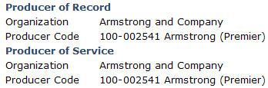
Producer types
Producer of Record
Producer that created the submission or record
Receives commission based upon the premium
Producer of Service
Person servicing the policy
Usually the same as the producer of record
If different than producer of record then receives commission only after the policy is renewed
Displayed on Policy Info page and Summary pages
Notes:
Producer of record is the one that created the policy. The producer of record may or may not service the account and have limited permissions on the policy and account. For a new policy, producer of record is the same as producer of service as shown in the example above.
If for some reason user decides they don’t like the agent and want a new one, then the producer of service changes. Producer that provides this new service is the producer of service. The old agent continues to get commission for the policy because he was the producer of record, the one that brought the business initially.
This can be viewed on the Policy Info page by typing the effective date in any policy.
A producer of service has permissions to edit policies for renewal and then becomes producer of record and can receive commissions.

Slide 9
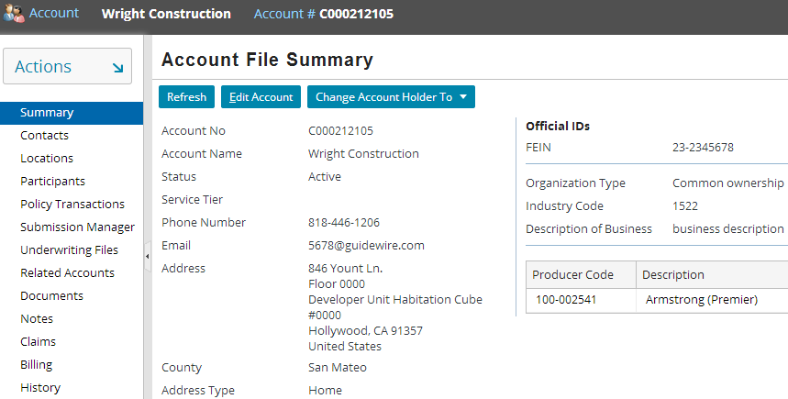

Producer code
001
A producer code is a unique ID (alphanumeric) assigned by the carrier to accurately track which agent or agency is responsible for which policies and accounts
Producer code also identifies the actual sales agent who sold the policy
002
Notes:
Producer code is used to be able to accurately track which agent or agency is responsible for which policies and accounts. In some cases, a producer agency has only one code associated with it. In other cases, a carrier may want to separately track two or more different categories of policies assigned to a single producer. In this case, the producer agency will have multiple codes, and the user must select the appropriate code. Carriers may think of producer codes as following their organization or group hierarchy, so assigning product codes to groups eases administration duties.

Slide 10
Producer code security
Producer code security applies at the following levels: Account Policy Job
Producer codes can :
place restrictions on user actions and access
have groups of permissions attached to them
trickle down the organization or group hierarchy
Producer code security can be turned on or off
001
002
Notes:
Restrictions can be placed upon access through producer code security beyond just the permissions associated with the matching producer code.
For a producer, the producer code security would typically be turned on, but for underwriters or auditors it may be off, thus allowing them to work on any policy. You can think of producer codes as an agreement between the producer and the carrier determining exactly what a producer can do. Attaching permissions to producer codes and attaching producer codes to users allows a carrier to:
Further customize what a producer can do
Track the performance of a producer
Tie the producer to a specific organization or region
Users inherit the producer codes through their group, and do not need to have producer codes assigned explicitly.

Slide 11
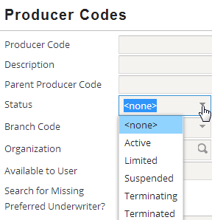
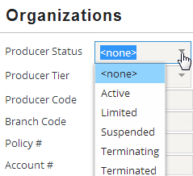
Prevent producer code misuse - Status field
Status field limits access to an agency whose contract has expired or to prevent producer code misuse
Default statuses are obtained from a typelist
Status field is available on both the Producer code Search and Organization Search pages
Notes:
Both the status of the matching producer code and the status of the user’s organization must be checked before allowing access through producer code security. Both statuses must either be Active or on the list of allowed statuses in the permission handler. Without any configuration to the security handlers, full permissions are granted when the status is Active. No permissions are allowed when the status is anything else, except for Renewals, which allow for Limited status. Producer codes are used for the account security checks in the absence of any policies or submissions.
To configure which permissions are allowed when the status of the producer code or agency is other than Active, refer to the Permissions lesson set in the further study modules or the PolicyCenter Configuration Guide.

Slide 12
Lesson outline
Producers and producer codes
Users, groups, and organizations
Working with users, groups, producer codes, and organizations
Permissions and roles
Grant permissions and assign roles

Slide 13
Users
A user is an individual who interacts with PolicyCenter
Every user on the policy is assigned a role on that policy
Typical users are:
Agent
Underwriter
Producer
Auditor (internal and external)
Insurer
Notes:
Each policy is usually managed by several users. Every user assigned to a policy has a role on that policy, such as underwriter, customer service representative, or producer.
A user can:
perform policy transactions or look up the status of a policy
manage activities, assignment rules, notes, attached documents, history, team views and more
belong to one or more groups

Slide 14
User categories
An internal user is an internal employee of the carrier
Can potentially see external user’s group and permissions
An external user is a person outside the company
And need to access PolicyCenter data
Known by the system for assignment purposes
Typically producers
And must be associated with an organization
Captive agents are sometimes
internal users when they are employees of the Carrier and
sometimes external users who have an exclusive contract to do business with a carrier
Access is controlled through roles and producer codes
user
producer
Notes:
Typically, the user belongs to at least one group that represents the actual reporting relationship found in the company’s organizational chart. This is the main group that the user works in and the supervisor that the user normally reports to. Users can belong to an unlimited number of groups or need not belong to any group.
Captive agents are sometimes internal but they will often be external users because they are often not actually employees of the carrier, they just have an exclusive contract to do business with that carrier. So they’ll often get modeled as external users. In other cases, they will, in fact, be employees and so would get modeled as internal users. You can also have internal users who are CSRs or something equivalent who are not agents, but are selling policies through a call center and might be using producer codes.

Slide 15
Groups
Alice Applegate (UW)
Bruce Baker (UW)
Eastern Region Underwriting
Steve Smith (supervisor)
A Group is a collection of users and activities queued for the group
PolicyCenter organizes users into groups and sub-groups
Each group contains:
Users
Producer codes
Queues and Regions
Notes:
Administrators create groups based on:
geographical regions
divisions and
departments
Each group can also contain sub-groups which have their own users and producer codes etc.
Users can belong to one or more groups. Group membership influences several PolicyCenter aspects of functionality. For example, once a policy is assigned to a group, the assignment engine can automatically assign it to one of the users in the group using the round robin selection.

Slide 16
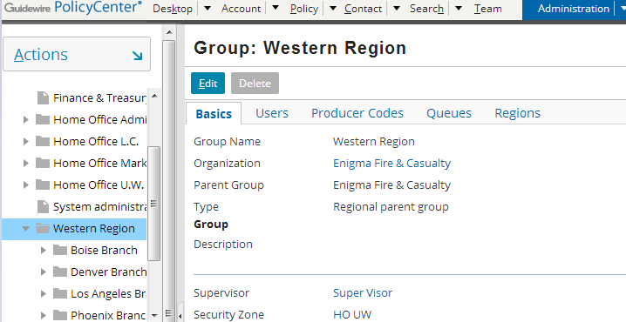
View groups using Administration tab
User should have admin privileges to view the groups using Administration tab

Slide 17
Organization / Community model
Carrier (internal organization)
Agency (external organization)
Groups of users
Groups of producers
User with a role on a policy
Producer code
Producer
001
001
An organization is a business entity which represents either the carrier itself or an external company of producers
Notes:
PolicyCenter needs to maintain information about how you organize people and their work. In many cases, you can edit this information within the PolicyCenter administration screens.
Users, groups, and producer codes all belong to one organization. Organization can be the organization of the carrier or an external organization, such as an agency. Organization has groups within it. A users can be assigned to any number of these groups. Producer codes can be assigned to groups or directly to users in an organization
Users have a list of producer codes that have been allowed for them, either explicitly, or through one of the groups to which the user is assigned. Internal users, groups, organizations, and permissions, as well as external, can have producer codes assigned to them. External users may only have producer codes from their organization assigned to them, but internal users may have any external producer codes assigned explicitly to them.

Slide 18
Lesson outline
Producers and producer codes
Users, groups, and organizations
Working with users, groups, producer codes, and organizations
Permissions and roles
Grant permissions and assign roles

Slide 19
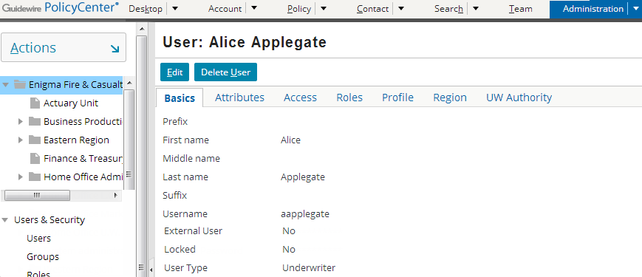
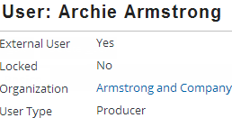
Managing users
Managed through Administration tab
Every user field has details about:
what a user owns (assignment) and/or
what a user can access (permissions)
External user’s organization is explicitly listed
Notes:
Administrators define users, giving them membership in groups, roles, credentials etc. Both the Team tab and the Administration tab contain User Profile screens that allow administrators to define and edit these characteristics.
User information can be viewed and managed in the Administration tab. Users can use the left sidebar links to search or edit users, groups, organizations, regions, or producer codes. They can view, edit or create roles (this is discussed in detail in the Permissions lesson). They can also define attributes that the system can use for making assignment decisions.
When you create an external user, the fields and available values in the User sub-tabs change. External users must be associated with an Organization. The tree browser (as seen on the Administration tab) will always show the home organization of the user (either internal or external).

Slide 20
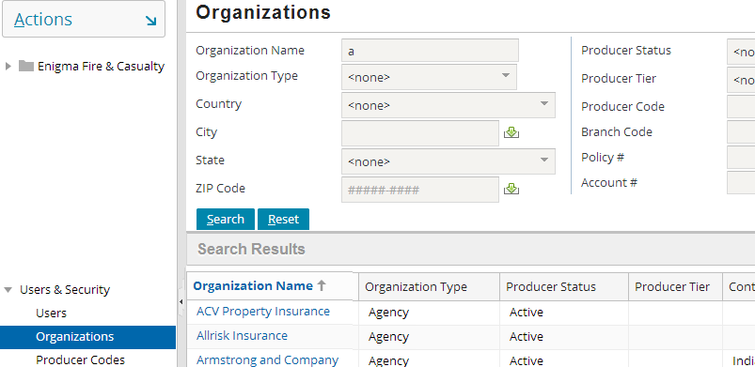
Internal/external user access
An internal user can potentially see or edit the external users' group and organization details
External organizations as seen by aapplegate
Notes:
Typically, the user belongs to at least one group that represents the actual reporting relationship found in the company’s organizational chart. This is the main group that the user works in and the supervisor that the user normally reports to. Users can belong to an unlimited number of groups or need not belong to any group.
An external user cannot view or edit internal user or their organization details.
Access is controlled through roles and producer codes.

Slide 21
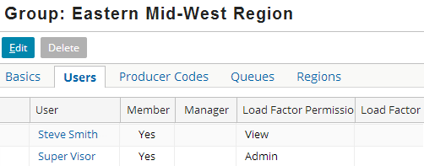
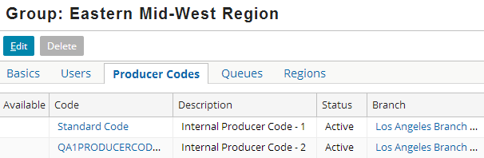
Group detail - Users and producer codes
Any user (internal or external), assigned to the group has access to all producer codes available to the group
Users tab lists all users assigned to group
Producer Codes tab lists all producer codes assigned to the group
Notes:
The above slide shows users and producer codes in the group Eastern Mid-West Region. The producer codes tab shows all producer codes available to the parent group, which can be made available to the current group. All users in this group can use the producer codes available to the group. This is not implicit, a user has to be granted access to producer codes and groups through the Access tab on the user. External user has to explicitly specify what organization they belong to.

Slide 22
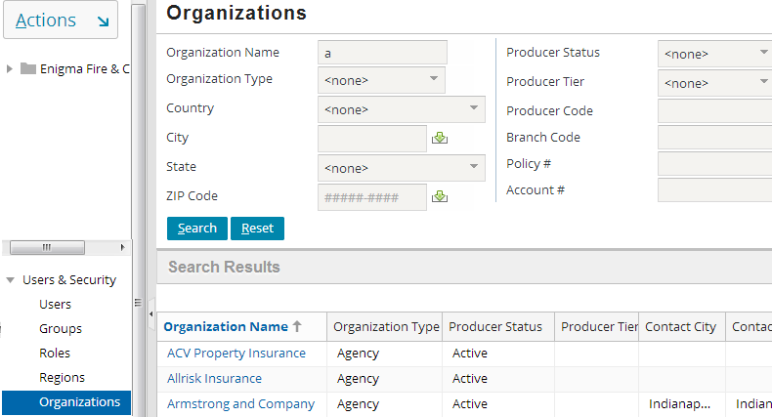
Searching organizations
Search organizations beginning with “a”
Click on name links to view organization details
Notes:
To search for a user, group or a producer code click on similar links . After searching the results are displayed as links so the user can view the entity details by clicking on it.

Slide 23
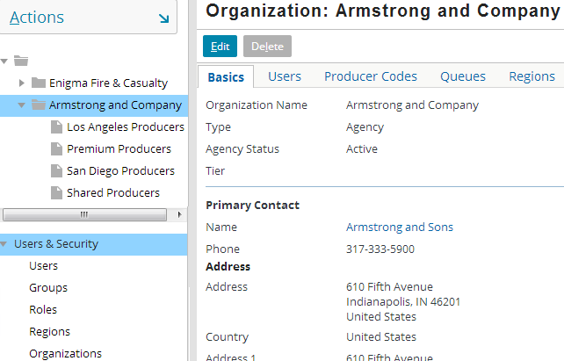
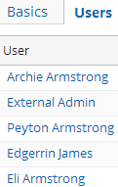
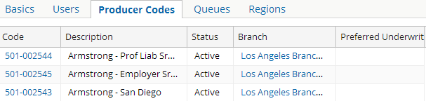
Managing organizations
Organization
Groups within Org.
Notes:
An organization can be the carrier’s organization or an external organization, such as an agency. The tree structure of organization and the groups within it are displayed in the left sidebar.
The Basics card displays the Organization info like its name, type, address, supervisor and so on. The load factor used by assignment rules to assign an activity to a user or group within this organization is also displayed here.
The Users card on the screen lists users under that organization. Users have a list of producer codes that have been allowed for them, either explicitly, or through one of the groups to which the user is assigned. Internal Users, Groups, Organizations, and Permissions, as well as external, can have producer codes assigned to them. External users may only have producer codes from their organization assigned to them, but internal users may have any external producer codes assigned explicitly to them.
Carriers may think of producer codes as following their organization or group hierarchy, so assigning product codes to groups eases administration duties.
The Producer Codes card displays the producer codes and a list view of description, status, branch, and the preferred underwriter for each code.
You can click on Organizations to display the Organization screen.

Slide 24
Delegate management using User Admin role
Internal organizations delegate management of external companies
By assigning User Admin role to a user within that external company
User admin builds sets of Users, Groups, Organizations, and Permissions to represent external company
User admin or other users in the external company do not have access to other organizations
Internal organization has access and complete administrative rights to the external company
Using the Administration tab
Notes:
Because managing both the internal company and the external company can become quite complex, you can delegate management of external producer companies to a designated external User Admin. This can be done by assigning the User Admin role to a user within that external organization. That user will have permission to administer Users, Groups, Organizations, and Permissions within the user’s organization, but will not have access to other organizations. Delegating allows a User Admin to build the set of Users, Groups, Organizations, and Permissions that represent an external company. Even though you can delegate administration of these external companies, you still have access and complete administrative rights from the Administration tab.
The difference between a Supervisor and a User Admin is that a Supervisor has access to the Team screen related to a group whereas the User Admin has the ability to manage Users, Groups, Organizations, and Permissions. Also there is no limit on the number of User Admins in an organization.
Roles are discussed later in this lesson.

Slide 25
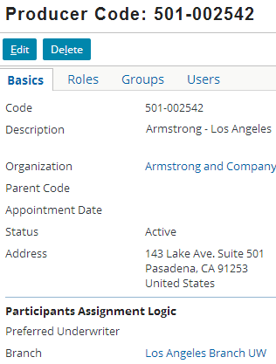
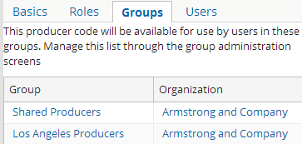
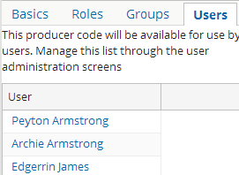
View or edit producer code details
Producer code details can be viewed or modified
Modify producer code
Notes:
The Basics tab lists the code, description, organization, status and other info related to the producer code.
The Groups tab lists the groups that have this producer code security. This defines what the users within these groups can access and what actions they can perform.
The Users tab lists the users that have access to this producer code. These users belong to one of the groups listed under the Groups tab.
Carriers may think of producer codes as following their organization or group hierarchy, so assigning product codes to groups eases administration duties.
One should have superuser or useradmin privileges to manage producer codes.

Slide 26
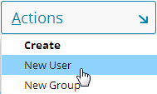
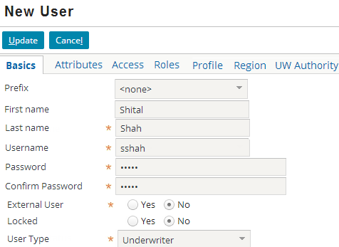
Create a new user
Select Administration tab
Actions → New User
Enter user details in the different tabs
Notes:
The commands to create a new group, new producer code or a new organization are also listed under the Actions menu. Select the item you want to create and populate the fields in the different tabs with details about the entity.

Slide 27
Lesson outline
Producers and producer codes
Users, groups, and organizations
Working with users, groups, producer codes, and organizations
Permissions and roles
Grant permissions and assign roles

Slide 28
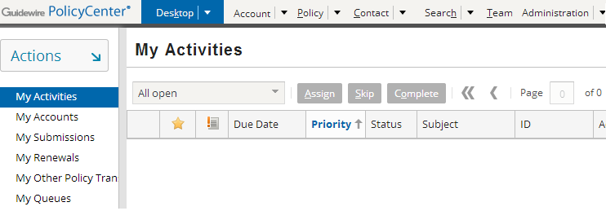
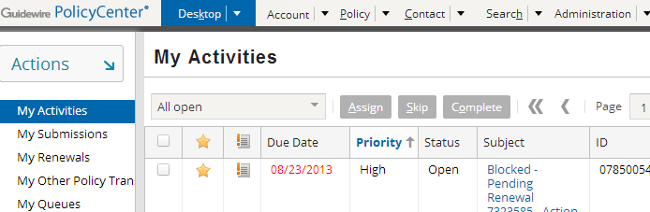
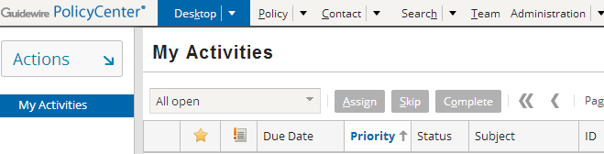
Access
Rick Ralston (SU)
Alice Applegate (UW)
User (Internal admin)
Access is the ability to see and do things within PolicyCenter based on your user identity
Notes:
PolicyCenter has a rich set of access functionality that is managed through a set of permissions.

Slide 29
System permissions
View user
View groups
View team
Edit users
Edit groups
Own activities
A system permission is a granular ability to see or do something within PolicyCenter
Notes:
In the example above, the system permissions have been arranged in columns based on the thing the permission pertains to. The second column has only two permissions because you cannot own a group. The third column has only one permission because it pertains to an aspect of the PolicyCenter user interface. The team tab cannot be edited or owned.
System permissions are often referred to simply as "permissions".
The entire list of system permissions can be seen in the Security Dictionary.

Slide 30
Permissions can influence access
Whether or not a user has a given permission can determine what they can:
View/navigate to
Create, edit, and/or delete
Own
Act on
Notes:
The list of abilities in the slide above is meant as a general way of viewing of permissions and not an official categorization. There are some permissions which map directly to one of the words listed above. For example, there are "view accounts" and "view audit" permissions. Other permissions map less directly to the words listed above. For example, there is a “bind policy change" permission and a “bind submission" permission, both of which can be thought of as "act on" permissions.
All permissions change the user experience in one of two ways:
A permission could control whether an aspect of the user interface is visible or not. (For example, users who do not have the View Team permission simply don't see the Team tab, whereas users who do have this permission do see the tab.)
A permission could control whether or not a user succeeds or fails at a given task. (For example, if a user attempts to bind a submission or bind a policy change, the binding fails. The user can save a draft at that point, and a user with the bind submission or bind policy change permission respectively can perform those task successfully.)

Slide 31
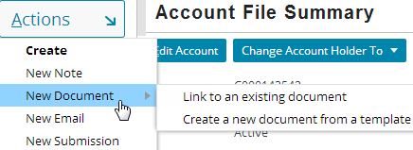
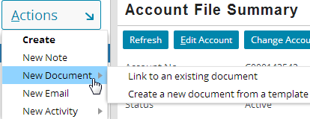
Create object permissions
Alice Applegate
Create submission
Adam Auditor
Create submission
Notes:
PolicyCenter typically prevents the user from taking an action they are not allowed to do by not displaying the particular button or menu item for the permission. There may be cases where a permission is not controlled by a menu item or a button. In such cases, PolicyCenter may display an error message with the permission restriction.
In the example above:
Alice Applegate is an underwriter with the Create documents and Create a New Submission permissions. When she wants to create a document she clicks on the Actions menu and can create one using the New Document menu item. She also gets a further submenu with options to choose from to create a new document by Linking to an existing document or Create a new document from a template. Similarly, she can create new submissions from the menu.
Adam Auditor is an auditor and does not have Create a New Submission permission, so when he clicks on the Actions menu he does not get the menu item New Submission.
(The behavior of how you want the permission restriction to work in PolicyCenter application can be configured.)
Note: Some of the examples in this lesson have been created for training purposes and may not be available in sample data.

Slide 32

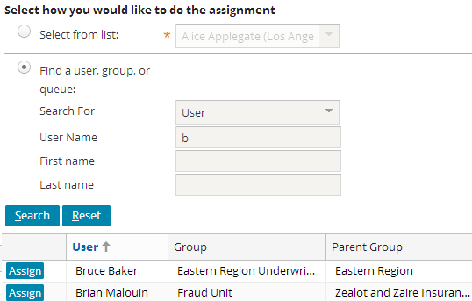

Own object permissions
Bruce Baker
Own Activity
Brian Malouin
Own Activity
Notes:
In the example above:
Bruce Baker is an underwriter with the Own Activity permission. When someone attempts to assign an activity to Bruce, he becomes the owner of the activity.
Brian Malouin is a user admin without the Own Activity permission. When someone attempts to assign an activity to Brian, the system prevents the assignment and informs the user that Bruce lacks the permission needed to own an activity.

Slide 33
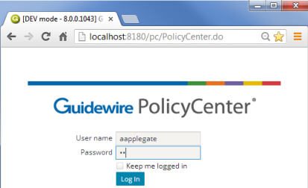
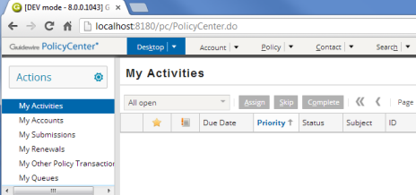

A user's permissions are determined during login
username and password
Desktop: Activities
authenticated? what permissions? which start page?
Yes! View Account, ... Desktop: Activities
pc data
Notes:
When an end user attempts to log on to an application, the following occurs:
The user supplies their user name and password to PolicyCenter via the login page.
PolicyCenter queries its database to authenticate the user and determine which permissions are assigned to the user and what the user's start page is. In the base product, authentication is managed through the PolicyCenter database. There is a table in the database which stores user names and password. (The system can also be configured to authenticate against an existing user domain structure.) Permissions determine which screens the user can navigate to and which actions the user can perform. The startup view is the first page rendered after log in.
PolicyCenter authenticates the user.
PolicyCenter renders the appropriate startup view with permissions appropriate for that user.
Note that there is one login, “su” (for Super User), which is exempt from permission checks. This user is built in to the application by Guidewire, and inherently can do pretty much anything in the application. Generally, you would not assign any real user this login in a production implementation of PolicyCenter; but it can be very useful during development.
A user's permissions are determined during log-in. However, if an administrator changes a user's permissions while that user is logged in, the new permissions are applied immediately.

Slide 34
Roles
Underwriter Assistant
Underwriter
View account Create account Create activities Edit submission Edit rewrite ...
View account View sensitive notes View sensitive docs Create account Create activities Create audit Edit submission Edit rewrite Edit rates and premium overrides ...
A role is a named collection of permissions used to simplify the assignment of permissions to users
Typically, a role maps to a job title or a job function
Notes:
There are no absolute rules regarding how the permission/role structure must be built to accommodate users with varying levels of access. For example, if underwriters should be able to do everything an underwriter assistant can do as well as some underwriter-only tasks, then:
You could create the an Underwriter role so it has all the permissions of the Underwriter Assistant role plus the additional permissions. Underwriter Assistant users get just the Underwriter assistant role. Underwriter users get just the Underwriter role.
You could create the Underwriter role so it has only the additional permissions that Underwriter Assistants do not get. Underwriter Assistants users get just the Underwriter Assistants role. Underwriter gets both the Underwriter Assistant and the Underwriter role.
Roles have permissions that map to a job function. For example, the producer role contains the set of permissions appropriate for someone who is a producer. This role might have the create submissions or edit accounts permissions, but it would not have the create users or even issue submissions permissions. Similarly, a producer clerical role might have only create submissions and not edit accounts. You can have one or more roles (you must have at least one). You are granted all of the permissions that are contained in any of the roles that are assigned. Roles provide the basic security that governs which actions you can take within PolicyCenter.

Slide 35
Mapping roles to users
Dennis Right
Bruce Baker
Rick Ralston
Underwriter Assistant
Underwriter
Underwriter
Supervisor
Each user is given one or more roles
A user has all the permissions of the roles s/he is given
Notes:
In the example above:
Dennis Right is an underwriter assistant, and therefore has all the permissions of an underwriter assistant through the underwriter assistant role.
Bruce Baker is an underwriter , and therefore has all the permissions of a underwriter through the underwriter role.
Rick Ralston is an underwriting supervisor, and therefore has all the permissions of a underwriting supervisor. To accomplish this, he has both the Underwriter role and the Supervisor role. (Presumably, the Supervisor role does not contain all permissions normally associated to an underwriter.)
PolicyCenter permissions only give you the ability to do something. Unlike the permission structure of some other systems, PolicyCenter does not have any permissions that specifically deny a person the ability to do something. The only way to prevent someone from having a given permission is to not assign them any roles that have that permission. Roles are cumulative which means that a user gets all of the permissions associated with one or more roles in which they have been assigned.

Slide 36
Lesson outline
Producers and producer codes
Users, groups, and organizations
Working with users, groups, producer codes and organizations
Permissions and roles
Grant permissions and assign roles

Slide 37
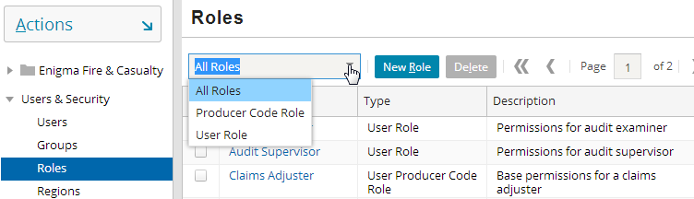
Managing roles
Administration tab → Users & Security → Roles
Accessing the Roles list view requires the "Manage Roles" permission that determines whether a user can edit/create roles
Roles can be filtered
Notes:
The screenshot above is taken from a superuser login. New role can be created via the Administration tab by superusers. Alternately users with specific manageroles permission can edit or create new roles. The manageroles permission is not linked specifically to superusers. But this can be configured using Guidewire Studio.
Roles displayed in this list view can be filtered based on role type using the filter drop-down at the top to display all roles, producer code roles or user roles.
A new role can be added or deleted through this screen.

Slide 38
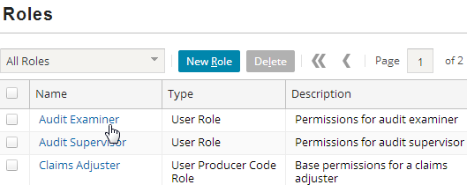
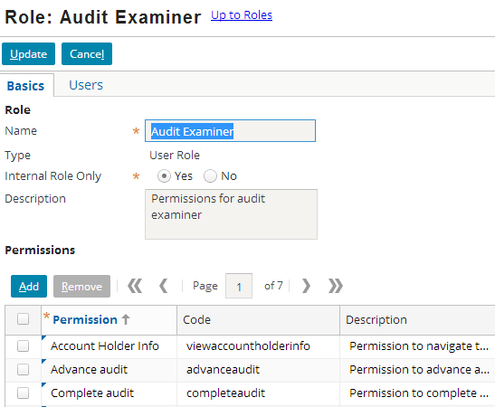
Modifying permissions in a role
Permission list is filtered
Notes:
To add a permission to a role:
Navigate to the role.
Click the Edit button in the screen toolbar.
Click the Add button in the permissions list view toolbar.
In the new row, select the desired permission from the drop-down.
Click Update.
To remove a permission from a role:
Navigate to the role.
Click the Edit button in the screen toolbar.
Select the permission row to delete.
Click the Remove button in the permissions list view toolbar.
Click Update.
When adding new permissions to a role, the drop down list of permissions include only the permissions that the role currently does not have meaning that it is filtered.

Slide 39
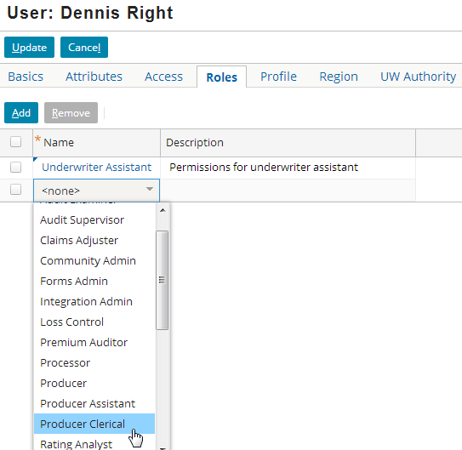
Modifying roles for a user
A user can be given one or many roles using the Roles list in the Roles drop-down list
Notes:
To grant a role to a user:
Navigate to the user.
Click the Edit button in the screen toolbar.
Click the Add button in the roles list view toolbar.
In the new row, select the desired role from the drop-down (this drop-down lists roles that this user does not already have only).
Click Update.
To revoke a role from a user:
Navigate to the user.
Click the Edit button in the screen toolbar.
Select the role row to delete.
Click the Remove button in the role list view toolbar.
Click Update.
Modifying a user's roles requires the "Grant roles to users" permission, which is typically given to managers.

Slide 40
Lesson objectives review
You should now be able to:
Describe the community model in PolicyCenter
Explain the users, groups, producer codes, and organizations in PolicyCenter
Manage users, groups, producers codes, and organizations
Grant access using permissions and assign roles in PolicyCenter

Slide 41
Review questions
Name some of the user roles in PolicyCenter.
What is a producer code? What does it identify?
What is an organization?
When does PolicyCenter determine which permissions a given user has?
How many permissions can a given role have?
State true or false:
Every user must have at least one role.
An internal user could be assigned any producer code for any organization.
Notes:
Answers
1. Underwriter, Producer, Auditor, Underwriter assistant…
A producer code is a unique ID (alphanumeric) assigned by the carrier to determine what a producer can do. Producer code and its description identify the sales office that sold the policy.
An organization is a business entity which represents either the Carrier itself or an external company for any set of PC users, typically producers.
PolicyCenter determines the permissions for a given user when that user logs in.
A role can have any number of permissions. PolicyCenter has certain zero-permission roles in the base product to essentially show as placeholders.
True or False:
True
True

Slide 42
Notices
Copyright © 2001-2014 Guidewire Software, Inc. All rights reserved.
Guidewire, Guidewire Software, Guidewire ClaimCenter, Guidewire PolicyCenter, Guidewire BillingCenter, Guidewire Reinsurance Management, Guidewire ContactManager, Guidewire Vendor Data Management, Guidewire Client Data Management, Guidewire Rating Management, Guidewire InsuranceSuite, Guidewire ContactCenter, Guidewire Studio, Guidewire Product Designer, Guidewire Live, Guidewire DataHub, Guidewire InfoCenter, Guidewire Standard Reporting, Guidewire ExampleCenter, Guidewire Account Manager Portal, Guidewire Claim Portal, Guidewire Policyholder Portal, ClaimCenter, BillingCenter, PolicyCenter, InsuranceSuite, Gosu, Deliver Insurance Your Way, and the Guidewire logo are trademarks, service marks, or registered trademarks of Guidewire Software, Inc. in the United States and/or other countries.
All other trademarks are the property of their respective owners.
This material is confidential and proprietary to Guidewire and subject to the confidentiality terms in the applicable license agreement and/or separate nondisclosure agreement.
This file and the contents herein are the property of Guidewire Software, Inc. Use of this course material is restricted to students officially registered in this specific Guidewire-instructed course, or for other use expressly authorized by Guidewire. Replication or distribution of this course material in electronic, paper, or other format is prohibited without express permission from Guidewire.
Guidewire products are protected by one or more United States patents.
Notes:
Users, Groups, Organizations, and Permissions - 42

