Slide 1
Configuring Underwriting Authority
30 April 2014
Notes:
Guidewire training materials contain Guidewire proprietary information that is subject to confidentiality and non-disclosure agreements. You agree to use the information in this manual solely for the purpose of training to implement Guidewire software solutions. You also agree not to disclose the information in this manual to third parties or copy this manual without prior written consent from Guidewire. Guidewire training may be given only by Guidewire employees or certified Guidewire partners under the appropriate agreement with Guidewire.

Slide 2
Lesson objectives
By the end of this lesson, you should be able to:
Understand the concepts of underwriting authority
Understand configuration of underwriting authority
Configure new underwriting issues
This lesson uses the notes section for additional explanation and information. To view the notes in PowerPoint, choose View→Normal or View→Notes Page. If you choose to print the notes for the lesson, be sure to select “Print hidden slides.”

Slide 3
Lesson outline
Underwriting authority overview
Define underwriting issues
Underwriting approval process
Configure approval of underwriting issues
Configuring underwriting authority

Slide 4
Underwriting process
Policy has Issues
Policy sent to Underwriter
?
?
?
Agent is creating policy
Agent requests approval from UW
UW has to approve issues on Policy, Agent cannot edit policy
UW releases policy back to agent
Policy has issues that block quoting
?
Agent can view quote, bind and issue policy
UW approves issue(s) and quotes Agent cannot edit policy or see the quote
Notes:
An agent or a producer is creating a policy using the submission job. If the policy has an issue that blocks quoting, the agent cannot view the quote until the underwriter approves the issue and releases the policy back to the agent. Once the underwriter approves the blocking issue then the agent can view the quote and then bind and issue the policy. Or the agent can edit the policy, potentially raising new issues. The new issues will again have to go through the underwriting process.

Slide 5
Underwriting authority
Underwriting authority provides underwriting rules and an underwriting infrastructure which user can modify or augment
Underwriting rules examples are:
jurisdiction of coverage
minimum or maximum amounts
PolicyCenter creates an issue for an underwriter which prevent the agent from binding the policy until the underwriter approves the issue
Notes:
Users can modify the underwriting infrastructure such as they can define underwriting issues or determine the types of underwriting issues that a user can approve. The underwriting rules specify things such as the state or jurisdiction of coverage and minimum or maximum amounts. For example, when an agent creates a new policy, certain terms of that policy may need to be reviewed by underwriting before the policy can be bound. The underwriting rules of the carrier require that an underwriter approve any vehicle valued at over $100,000. If an agent adds a car valued at $200,000 in a personal auto policy, an underwriter must give approval for that car. PolicyCenter creates an issue for the underwriter which prevents the agent from binding the policy until the underwriter approves the issue.

Slide 6
Underwriting issues
An underwriting issue is created when a condition evaluated, based on data in PolicyCenter, gives undesirable result(s)
UW issues can stop jobs unless approved
UW issues are raised:
automatically, based on policy choices
manually, when a user adds them on the UW Issues screen
optionally, with a value to indicate the extent of the risk
Notes:
The UWIssue entity refers to the underwriting issues in the data model. There are certain issues that can be approved by agents themselves, but certain other need special approval from underwriters. For example, if the driver or applicant has a suspended/revoked license then the agent cannot quote the policy and an underwriting issue is raised and sent to the underwriter for approval as shown in the screenshot above. Alternately, if a driver is driving a vehicle garaged in CA but has a valid driving license in MA, then agents can verify the license and underwriting issue will not be raised.
PolicyCenter raises issues automatically based on policy choices such as the types of vehicles on a policy or coverage amounts.

Slide 7
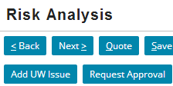
Creating underwriting issues
Generally, UW issues are automatically generated based on “anything” on the policy or account such as:
a level or coverage or price of a coverable or
a jurisdiction or
more complex issue such as driver in urban areas
UW rules generate the UW issues
UW issues are also automatically removed when the condition goes away
In addition, issues can be added manually
Manual issues do not get removed automatically

Slide 8
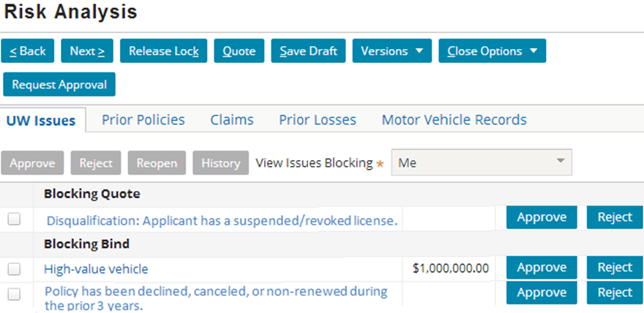
UW issues in the user interface
PolicyCenter displays underwriting issues on Risk Analysis → UW Issues tab
Agent requests approval from underwriter
Buttons displayed for underwriter only
Blocking points
UW issues
Notes:
The above screenshot, shows the Risk Analysis page for the agent creating a policy through submission. The policy has one issue blocked at Quote and two issues blocked at Bind. Of the two issues, the agent has Approve permissions to approve the High-value vehicle issue (the button is available), but cannot approve any of the other issues at Quote or Bind since they are grayed out. The agent would then have to click the Request Approval button on the top of the page so that the underwriter can approve these issues.
Once the agent click on the Request Approval button, the UW Activity page opens which gives the agent an option to edit activity and send the request to an underwriter. The UW Activity page is discussed in the next slide.
The underwriter’s Risk Analysis page has the Reject/Approve buttons available for each issue, depending on the underwriter’s permissions and a set of buttons on the top of the page. These are additional buttons to Add an Issue and Lock for Review.
Add UW Issue—Add an underwriting issue.
Request Approval—Request approval from another user or underwriter. Takes you to the UW Activity screen where you create an activity to review and approve issues on the policy. The UW Activity screen allows you to select how you would like PolicyCenter to assign the activity.
Lock for Review—Lock the policy for underwriting review. The policy cannot be edited until you release the lock. This choice appears if you have the editlockoverride permission. After you click this button, all users see Under UW Review in the Info Bar.

Slide 9
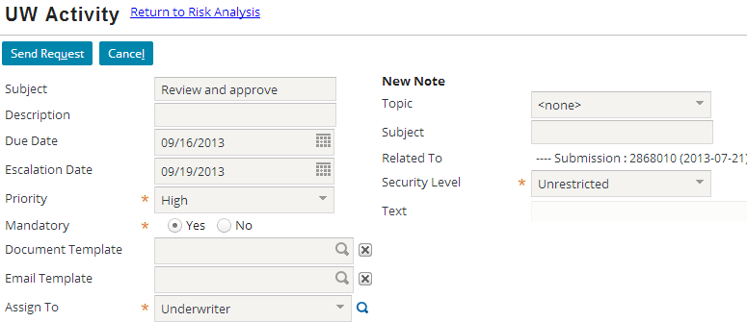
UW activity created to request approval
Agent enters details of the activity and sends the request
Notes:
A specific underwriter can be selected from the list of underwriters. Agent can edit other details of the activity as shown in the screenshot above.
Once the agent clicks the Send Request button the policy is sent to an underwriter for approval. The underwriter name shows in the Info bar on top of the page. The underwriter sees the activity in his/her Desktop. The underwriter can open the activity and process it.
An underwriter can return an issue unapproved back to the agent. When the underwriter decides to reject an issue, that does not reject the policy. The underwriter may ask the agent to get extra documents etc. and agent can discuss the issue again with the customer. They can together decide to reject the issue, but the agent cannot approve the issue. The agent can then create the policy without any blocking underwriting issues.
An underwriter may not have sufficient permissions to approve all the issues on the policy. In such cases, the underwriter can click on the Request Approval button and request approval from other underwriters or supervisors up in the chain. Developers can configure who the issue is sent to, in such cases using Guidewire Studio.
Some underwriting issues can be partially approved, meaning that underwriter approves some of the issues on the policy but not all of them. In such situations, the agent discusses the issues with the customers and they can come to an understanding and edit values causing the issue, or ask for more documents to clear the issue or some way to settle the issue, or reject the issue. An agent has permission to reject the issue. If they decide to edit values then the issue may be sent for approval if the issue is a blocking issue, or may just disappear depending upon the edits.

Slide 10
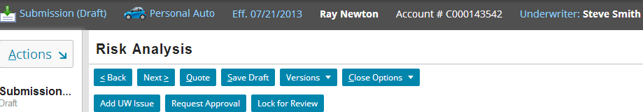
Lock for UW review
An underwriter can lock the policy for changes when it is being reviewed by clicking the Lock for Review button
After the policy is locked, Under UW review is displayed in the Info bar of the policy
Notes:
There is a need to be able to "lock" the state of a policy that is under review so that underwriters don't have things changing unexpectedly as they work through issues or quotes. While a policy is being reviewed, it is locked for changes from the perspective of the producer/agent, but an underwriter can make changes as required. Similarly, details of the “new” quotes, while under review, can be viewed by underwriters but not agents. If a transaction is already quoted, and the underwriter doesn’t edit the transaction or re-quote or re-rate it, then the agent can still see the quote. This lets the agent discuss the policy with the insured, while waiting for “final signoff” by underwriting, such as documentation or inspections. The ability to edit/see while these restrictions are active are controlled by new permissions. After the underwriter has reviewed the policy, a “Release Lock” button appears through which the underwriter releases the policy back to the agent to view the quote and process the policy.

Slide 11


How are UW issues raised?
No issues on Risk Analysis page
Submission with VIN FRE1, $200,000 value
JobProcess-UWIssue- Evaluator()
IPolicyEvaluation-Plugin calls LOB-specific evaluator classes that evaluate and raise UW issues
Checks at every blocking point and creates issues by retrieving definition from UWIssueType system table
UW Issues created: 1. High vehicle value 2. Vehicle req. FRE approval
Notes:
In general, Guidewire recommends that you raise underwriting issues as early as possible. Carefully consider the point at which the underwriting issue blocks progress. For example, you can raise fire hazard issues before quoting a policy, but have the issue block binding. By raising underwriting issues early, the user is aware of the issues early and can plan how to deal with them.
Consider example of a submission job, where the user adds a high value vehicle with a VIN number. The high value vehicle causes PolicyCenter to raise underwriting issues before quoting.
In the base configuration, the IPolicyEvaluationPlugin checks whether there are issues to create before quote for this policy period and its lines of business. For example, the High value vehicle issue type raises an issue if vehicle cost is greater than $100,000. In this case, the code creates an issue based on the VIN number and another issue for high-value vehicle. The IPolicyEvaluationPlugin plugin has input parameters for the current checking set (Quote Issues) and policy period. The plugin calls evaluator classes that evaluate and raise underwriting issues. The plugin calls line-of-business-specific evaluators (PA_UnderwriterEvaluator.gs for example) for each line of business in the policy period. The plugin then calls the default evaluator (DefaultUnderwriterEvaluator.gs). You can modify the evaluator classes to raise underwriting issues for your underwriting issue types.
The evaluators retrieve issue type definitions from the UWIssueType system table. When determining whether to raise an issue, the evaluators use the system table and the underwriting authority of the current user.
The IPolicyEvaluationPlugin checks for orphaned issues and removes them. In this case, the plugin finds no orphaned issues. Orphaned issues are underwriting issues that were generated by this checking set but are no longer an issue at this time.
Before quoting, the Gosu code checks for issues that block quote and any earlier blocking points. In this example, there are issues that block quote. PolicyCenter displays a screen listing the VIN issue that blocks quote and does not quote the policy. PolicyCenter does not highlight the issue for the high value vehicle because job progress is already blocked at an earlier point.

Slide 12
Lesson outline
Underwriting authority overview
Define underwriting issues
Underwriting approval process
Configure approval of underwriting issues
Configuring underwriting authority

Slide 13


Underwriting issue types
An underwriting issue type defines the underwriting issue in the UWIssueType system table
In Product Designer, Go to System Tables → uw_issue_type.xml
Columns related to defining UW issue
Columns related to approving UW issue
Notes:
The UWIssueType system table displays UWIssueType entities. Configuration users should create and manage the set of issue types and their characteristics very carefully. Guidewire recommends that you do not remove issue types once they have been deployed in a production system.
The UWIssueType columns can be divided into two categories:
Columns related to defining UW issue
Columns related to approving UW issue
PolicyCenter uses underwriting issue type values:
to initially set the user interface for approvals that do not already have an approval present
as automated approvals for auto-approvable issues and issues in automated processes
for determining availability of the Approve button, indicating that you can approve a specific issue to the default level
The following slides discuss columns for defining UW issue followed by columns for approving UW issues.

Slide 14
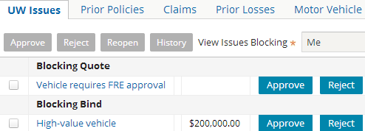
Configuring columns related to defining issue Columns: Code, Name, and Description
UW issue in UI
Code: Identify the issue type
Name: Name for issue type to identify it in the admin UI
Description: Description for the issue type in the admin UI
Notes:
The above screenshot is of the UWIssue – PA: High-value vehicle, added in the user interface. The columns define this issue in Product Designer. This slide and some of the following slides discuss all the columns for defining an issue.
Code: Use the Code column to identify the issue type. The code must be unique for all issue types. The code may be used in the UnderwriterEvaluator classes.
Name: Use the Name column to specify a name for the issue type.
Description: Use the Description column to specify a description for the issue type.
In general, user should select codes and names based on a “sortable” scheme so that related issues appear together in Product Designer and in the admin UI. In PolicyCenter, it is done by LOB, other options might be a carrier-specific numbering scheme present in underwriting manuals.

Slide 15
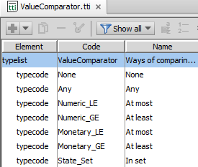
Columns: Comparator
Defines how to compare issue value to specify if:
Value of an issue is within authority granted to a user
Value of an approval is within authority granted to user
Value of an issue is within associated value of approval
Values defined in ValueComparator typelist
Notes:
Comparator: The ValueComparator typelist defines the comparators that issue values can use. You can add to the ValueComparator typelist. Each ValueComparator typekey has an associated UWIssueValueComparatorWrapper Gosu class that performs the comparison.
Values in the base configuration are:
Any - For use only with authority grants. Signifies that the user has the authority to approve an issue of any value. You can specify this value to approve a value of any amount, or any value in a set.
At least[Numeric_GE] - The issue value must be greater than or equal to the approval or authority grant value. Treat the value as a BigDecimal. Select this value if the issue has an associated value where a smaller number is associated with more risk, such as a deductible.
At least[Monetary_GE] - The issue value must be greater than or equal to the approval or authority grant value. Treat the value as a MonetaryAmount. Select this value if the issue has an associated value where a smaller number is associated with more risk, such as a deductible.
At most[Numeric_LE] - The issue value must be less than or equal to the approval or authority grant value. Treat the value as a BigDecimal. Select this value if the issue has an associated value where a larger number is associated with more risk, such as total premiums or total insured value.
At most[Monetary_LE] - The issue value must be less than or equal to the approval or authority grant value. Treat the value as a MonetaryAmount. Select this value if the issue has an associated value where a larger number is associated with more risk, such as total premiums or total insured value.
In set[State_Set] - Treat the authority grant or approval value as a set of jurisdictions, and the issue value must be within that set.
None - Has no associated value. Use for issues that are either there or not.

Slide 16
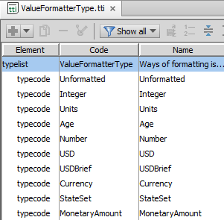
Columns: ValueFormatterType
Value formatter: Define which output formatter to use
Values defined in ValueFormatterType typelist
Notes:
ValueFormatterType: The ValueFormatterType typelist defines these values. The formatter types allow the presentation of values in a localizable and consistent manner in the user interface. Only output uses formatters. You can configure formatters to meet a wide range of output needs. You can view the code for formatter types by navigating to ValueFormatter.gs located in gw → job → uw package in Studio.
Values are:
Age - Formats the value as an age followed by the abbreviation yrs.
Currency - Formats the value as the currency associated with the current locale.
MonetaryAmount - Formats the value as a MonetaryAmount, which contains a value and a currency.
Integer - Formats the value as an integer.
Number - Formats the value as a BigDecimal.
StateSet - Formats the value as a state.
USD - Formats the value as a U.S. dollar (with cents).
USDBrief - Formats the value as a U.S. dollar (without cents).
Unformatted - Does not format the value.
Units - Formats the value as an integer followed by the word units.
TestFormatter - Used only for testing.

Slide 17

Blocking points
A blocking point stops progress of the job until an issue is approved
Specific issue types can be configured as informational (non-blocking)
Agent can progress further in job
Do not need approval from underwriters
Quote
Underwriter approves issues
Agent creates submission
UW issues blocking quote, bind or issue
Policy can be quoted, bound and issued
Notes:
User defines a blocking point for each issue type. For example, PolicyCenter prevents a user from binding a policy until high-value vehicle underwriting issue is approved.
Blocking points can be set at quote step to non-blocking so that issue does not stop the job at the quote step, but shows up as an informational issue on the Risk Analysis page as shown in the screenshot above. When the underwriting issue is informational, the agent can progress further in the job and quote, bind and issue the policy. Informational issues do not need approval from underwriters.
Note that you can detect issues early, but then block at a much later point.
For example, you can detect fire-breathing clowns before quoting a policy, but have the issue block binding.
By doing this, you can provide added visibility to PolicyCenter users, and improve their ability to plan their work.
In general, detect issues as early as possible, and think carefully about where they will block progress.
Some problem that could occur, for example, if a field were to be only available on a quote screen (e.g., manual pricing adjustment factor), but its value blocked quote – meaning you could never get back to the screen to change it.
The list of issue types and their blocking point is listed in the uw issue types.xml system table.

Slide 18
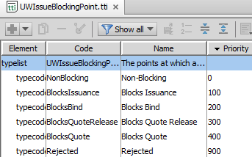
Column: Blocking Point
UWIssueBlockingPoint typelist defines these values
Lower blocking point has a higher priority because:
when you check a specific blocking point , the higher priority ones are also checked
Lowest
Highest
Notes:
The UWIssueBlockingPoint typelist represents the places at which an issue can block. The priority of the typecode is used to order the blocking point, with larger numbers indicating a more restrictive blocking point.
Non-Blocking - These are sometimes referred to as informational issues. These issues do not block progress unless specifically rejected by a user.
Blocks Issuance - Prevents issuance for submission jobs Prevents binding for jobs that do not have a separate issuance step.
Blocks Bind - The issue blocks binding the policy.
Blocks Quote Release - Allows quoting to be performed, but unauthorized users cannot view the quote until an underwriter has the opportunity to review and approve it. The job cannot progress further.
Blocks Quote - Prevents quoting and steps leading up to quoting. Use Blocks Quote for validation issues which would prevent the rating engine from being able to compute a quote correctly. Blocks Quote can be used for other types of issues, as well. However, if a job has a Blocks Quote issue, PolicyCenter will not call the rating engine, and the job will remain in draft state. Do not use Blocks Quote for issues that need information from a valid quote. For example, do not use Blocks Quote for an issue related to total premium.
Rejected - The most restrictive value. Rejects the issue. A rejected issue prevents the job from crossing any blocking point.

Slide 19
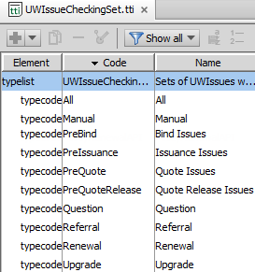
Column: Checking Set
A checking set represents a point in a job at which issues can be raised such as pre-quote, bind or pre-issuance
Each issue type defines a checking set
Used to specify when to check whether an issue type exists
Defined in UWIssueCheckingSet typelist
Notes:
For each checking set, rules determine whether or not to create issues. Use the CheckingSet column to specify when to check for existence or absence of an issue type. The rules further enforce which jobs check for that issue type. In some cases, PolicyCenter uses the CheckingSet value to filter issue types for display in the user interface. In PolicyCenter, the checking set code values are defined in the UWIssueCheckingPoint typelist. The values are:
All - PolicyCenter checks for this issue at all blocking points. An existing issue is removed if the evaluators do not trigger this type of issue. Issues in this checking set may come from external systems in a way that is not necessarily synchronized with the job flow. For example, a claim system sends notice of excessive claims, or a billing system sends notice of a delinquent account. If you have an issue that cannot change once the policy is quoted (without re-editing the policy), do not use this checking set.
Manual - The issue is created because the user manually added an issue to the policy period. PolicyCenter displays all issues with Checking Set equal to Manual on the Risk Analysis screen.
PreBind - The issue is created prior to binding. Use for issues that can only be detected immediately prior to binding the job.
PreIssuance - The issue is created prior to issuing the policy for submission jobs. The issue is created prior to binding for jobs that do not have a separate issuance step. Use for issues that can only be detected immediately prior to issuance.
PreQuote (displayed as Quote Issues) - The issue is created prior to generating a quote. Use for issues that can be detected on the policy period even before it is quoted such as issues that related to data which is entered in draft mode.
PreQuoteRelease (displayed as Quote Release) - The issue is created after a valid quote, but before the quote is released. Use for issues that can be detected after the policy period has a valid quote. Issues that need information from a valid quote can use this checking set.
[Continued]

Slide 20
(Notes only slide)
Notes:
Question - An issue is created based on answers to a question set. In the default configuration, these issues are created before quote. For information on how to associate an issue with a question in Product Designer, see Configuration Guide.
Referral - This issue is checked for every time the rules are run. An issue is created because there is an underwriting referral reason on the policy. PolicyCenter displays all issues with Checking Set equal to Referral on screens where users can add a UWReferralReason to the policy. You can also add a referral reason to a policy using the addReferralReason API.
Renewal - The issue can be created at one of two renewal checks. The timing of these renewal checks is specified in the RenewalProcess.gs job class.
Upgrade - In certain cases, Guidewire uses this value when upgrading PolicyCenter. Do not use this value for any other purpose.

Slide 21
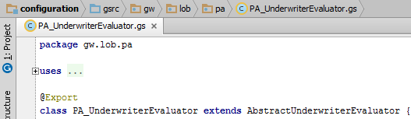
Evaluators process the issue
IPolicyEvaluationPlugin triggers policy evaluation and calls evaluator classes to raise issues
Evaluator classes contain methods that raise underwriting issues based upon the checking set
Default evaluator class DefaultUnderwriterEvaluator.gs raises UW issues for all LOBs
Each LOB implements its own evaluator class
Notes:
The IPolicyEvaluationPlugin is the starting point for evaluating whether to create an underwriting issue. This plugin creates a PolicyEvalContext object and then evaluates (evaluator.evaluate method) whether to raise issues for the current checking set and policy lines associated with the policy period.
The plugin uses a default class (DefaultUnderwriterEvaluator.gs) and line-of-business-specific classes (PA_UnderwriterEvaluator.gs for example) to determine whether or not to raise underwriting issues.
Each line of business implements its own evaluator class. For example, the evaluator for the personal auto line of business is PA_UnderwriterEvaluator.gs. These evaluator classes contain methods that raise underwriting issues for a checking set. For example, the onRenewal method in the default evaluator raises underwriting issues for the Renewal checking set.
If you make code changes to the methods that raise underwriting issues, the code must adhere to the following:
The method must raise issues only for that checking set.
Only one checking set can raise a given underwriting issue type.
In the default configuration, the evaluators always raise auto-approvable issues regardless of whether the current (or other) user has sufficient authority to approve them. The evaluators always raise these issues because the issue needs to exist for the least-privileged user of the system. This approach separates the underwriting guidelines for things require approval from the approval levels assigned to users. For users with sufficient authority to approve the resulting issue, PolicyCenter usually does not display the issue in the user interface. (The user can easily view the issue by selecting different view options.)
You can configure the application to raise auto-approvable issues only when one or more users would be unable to approve them. One reason to do this would be to improve performance by reducing the number of auto-approvable issues being raised and silently approved.

Slide 22
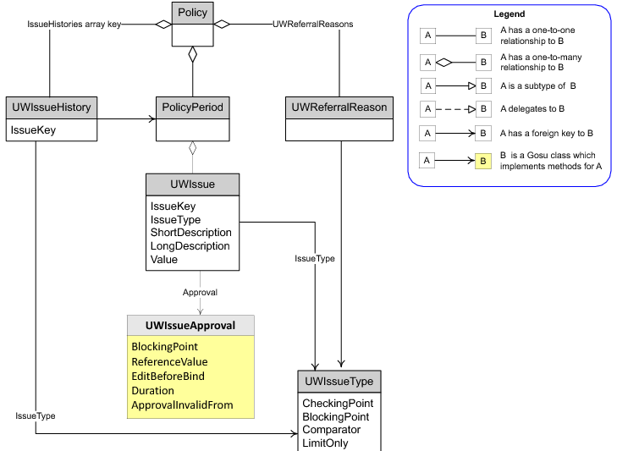
UWIssue object model
Notes:
The above diagram shows some entities associated with underwriting issues:
PolicyPeriod - Stores information for a specific period of a policy.
UWIssue - These are the issues that evaluator classes create. The issues link to issue types and can contain an approval. These entities can vary in effective time and are copied from branch-to-branch, just like any other effective-dated entity. Some fields on this entity are:
IssueKey and IssueType – These two fields uniquely identify the issue.
ShortDescription – Description of the issue that appears in the user interface.
LongDescription – Long description of the issue that appears in the user interface. Some users may have permission to view the short description but not the long description.
Value – The value, if any, associated with this issue. If present, the value is compared with authority grants to determine if the user can approve this issue. The value is also compared with approvals to determine if the approval still applies.
UWIssueHistory - This entity represents a history of issues and approvals on the policy. The IssueKey field is a reference to the UWIssue with that IssueKey. PolicyCenter maintains the history in a set of non-effdated entities on the policy and outside of the context of any particular job or policy period. PolicyCenter maintains this history for the following reasons:
The entity captures events that happen on branches that do not end up binding.
The entity persists after issues are removed or approvals expire.
The entity persists even if the related periods are archived. Since this entity attaches directly to the policy, it is retireable rather than effdated.
UWIssueType - This entity defines issue types. Use Studio to view and edit these entities in the UWIssueType system table.
(Continued)

Slide 23
(Notes only slide)
Notes:
UWReferralReason - This entity is similar to the UWIssue entity but exists off of the policy rather than the policy period. This entity is used for marking a policy issue outside of a job. It identifies the details of a corresponding UWIssue that will be generated the next time the application checks for UWIssues. Because of the close relationship between a UWReferralReason and the associated UWIssue, the default user interface displays them in a similar way.
UWIssueApproval - This object represents the approval or rejection of an issue. Approvals can be generated either by a user clicking to approve or reject an issue, or automatically by the application. Automatic approval is most commonly seen for auto-approvable issues, but also occurs during unattended processing, such as in routine renewal. You can identify automatically-generated approval through the IsManual property.

Slide 24
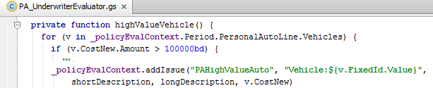
Issue keys
Issue key is a string provided UWIssue that associates it with a particular instance of the issue
A combination of IssueType and IssueKey uniquely identify each UWIssue for that policy
Issue keys are:
Created based on what they affect such as an entire policy, a particular entity or relate to a state
Usually permanent fixed IDs that will not change over time such as VIN for a vehicle
Automatically handled by PolicyEvalContext
Notes:
When creating an issue, any pre-existing issue with the given type and key will be returned, and any deactivated issue that matches will be activated and then returned. The key allows you to identify an issue which is the same as another issue that might have been raised at another point in time.
If you modify the code, and there happen to be two issues that are the same, then any approval or rejection applies to both of them. As a result, the method of forming the key for a given type of issue is critical. If the key matches unintentionally, approval or rejection of one issue incorrectly applies to the other.
If the key does not match for issues that are the same, it can lead to the need to constantly reapprove a given issue. Guidewire recommends that you do not change the algorithm for forming the key for an issue once that rule is in production. If you change the algorithm, it is likely that current issues will be treated as orphaned. New copies of them will be created, requiring new approvals or rejections.
For issues that affect the policy as a whole, such that there is only ever one such issue, use the code of the type as the key for the issue. Total policy premium is an example of this. Thus, if the premium goes up or down, the same issues will be edited, rather than raising new issues each time.
Vehicle:$(v.FixedId.ObjValue) – Recall that FixedId is a unique identifier that PolicyCenter generates when a new object is created. FixedId cannot be null. So in this example the Issue key will be “Vehicle:” followed by the evaluation of the expression “${v.FixedId.ObjValue}”, which is the value of the FixedId of a vehicle. ObjValue is not required (Jira: PC19670).

Slide 25
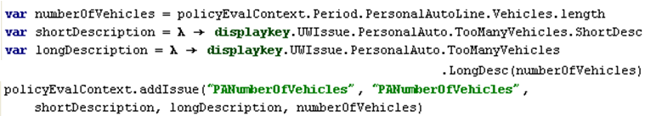
Add underwriting issues using addIssue method
addIssue method is defined under: configuration → gsrc → gw → policy → PolicyEvalContext
addIssue( issueTypeCode, key, shortDescriptionBlock, longDescriptionBlock, value ) where:
IssueTypeCode: code of the issue type from UWIssueType
key: IssueKey for the UWIssue
shortDescriptionBlock = \ -> shortDescriptionDisplayKey
longDescriptionBlock = \ -> longDescriptionDisplayKey
value: value that is checked to raise the issue
Notes:
If you implement custom logic to add new issues, you can use an instance of a PolicyEvalContext object just as in the built-in implementation. However, instead of using the invoke method to invoke the rule set, to add an issue use the addIssue method on the PolicyEvalContext object. PolicyEvalContext implements logic to add new issues or find an existing UW issue.
The short description is used as an issue title and in “alert” dialogs in the UI.
The long description should provide enough information for the underwriter to be able at least identify the portions of the policy to examine for additional information about the contributing factors (for example, the number of vehicles on a policy and a driver with a poor record)
If no such issue exists, creates a new issue.
Syntax:
addIssue(issueTypeCode, key, \ -> shortDescriptionDisplayKey, \ -> longDescriptionDisplayKey, value)
But, because the display keys are so long, the code becomes unreadable. It is better practice to declare the variables for short and long descriptions earlier and use them in the addIssue method. The example in the screenshot above creates a UWIssue if the number of vehicles on a policy is greater than or equal to 5.

Slide 26
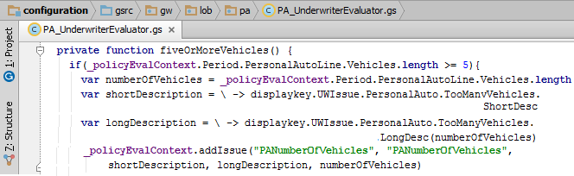
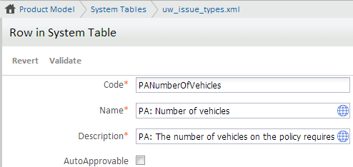
Example: Five or more vehicles
Product Designer
Notes:
The logic as to when the issue should be raised, what values to compare such as the number of vehicles on a submission, and when is shown in the example above. Guidewire recommends you create long and short descriptions of the issue using display keys.
The “PA: Number of vehicles” underwriting issue is generated as a result of the above code. The code states that if the number of vehicles is greater than or equal to 5, create the shortDescription and longDescription value using display keys and add the issue “PANumberOfVehicles”. Guidewire recommends that you do not put a direct value for comparison since the values may change in effective time. Use values that will remain fixed over effective time of a policy such as the VIN for a vehicle.

Slide 27
Lesson outline
Underwriting authority overview
Define underwriting issues
Underwriting approval process
Configure approval of underwriting issues
Configuring underwriting authority

Slide 28
UWIssueApproval object
Approval is created when user approves or rejects an issue
Creates UWIssueHistory entity automatically every time
UWIssueApproval object represents an approval
UWIssueApproval Added to history If already exists, then updated
UWIssueApproval Replaces or adds approval with blocking pt. = Rejected
UWIssueApproval Removes existing approval Blocks at blocking point
Notes:
To approve an issue, you must have an authority grant in an authority profile for that issue type. If the issue has a value, the authority grant must be valid for that value.
Note: In the default configuration, the Approve button is only available when the user has the authority to approve the issue to its default level. You can modify the configuration if you have a different use case.
UWIssueHistory entities are created when issues appear or disappear, or when approvals are modified. When just the value of an issue changes, it does not create a new UWIssueHistory in the default configuration.
At any point in effective time, each UWIssue can have at most one approval. If you reapprove an issue, PolicyCenter removes any existing approvals from that point forward in effective time. Approvals always extend from the current slice the user is working with until the end of the period. An issue is eligible for approval if it currently blocks progress and has not been rejected. If the issue has already been rejected, it must be reopened before being approved. If the issue has been approved through issuance with a sufficient value, it must be reopened before being approved for a different value or different approval settings.
Rejections: Rejections generate an approval, in case it does not exist already, but with the BlockingPoint set to Rejected. The user must have the uwreject permission. The user can reject an issue if:
• It is eligible for approval.
• It is a non-blocking issue and has not already been rejected.
Reopening: Reopening an issue removes an approval from the issue. The issue then blocks at the blocking point associated with the issue type. To reopen an issue, you must have the uwreopen permission or be able to approve the issue.
Please refer to the Application Guide for details on configuring the Underwriting Issue History.

Slide 29

Underwriting approval process
Review complete
UW releases the policy
UW or user with higher authority profiles receive activity to approve issues on policy
Underwriter reviews policy
UW issues may or may not be approved
PC sends activity to InitialReferrer
InitialReferrer may approve or reject issues (if any)
Notes:
Underwriting Approval Process: UW issues are created during any job such as a submission or a policy change. Since job has a one-to-one relationship with PolicyPeriod the underwriting issues are on a PolicyPeriod. In the underwriting approval process, the policy period can be referred to users with higher or different authority profiles. The assignment can be customized in the field to use Assignment Rules, as needed to match customer practices. These users receive activities notifying them they need to approve issues on the policy. A particular policy may be referred to several users before being approved. When the underwriter or whoever is reviewing the policy, feels that the review of the policy is complete, whether issues have been approved or not, they click the Release Lock button. This releases the policy from underwriting, and PolicyCenter sends an activity to the user who initiated the referral.
The InitialReferrer role stores the name of this user. (The underwriter can modify the recipient and other fields in the activity.) To facilitate passing policies between agents and underwriters, a given policy period can be flagged as edit locked and quote hidden. After an agent hands these policies to an underwriter, the agent usually cannot edit the policy or view am unreleased quote. The permissions for editing or viewing the quote while under review are usually reserved for underwriters.
InitialReferrer: The InitialReferrer user role facilitates passing policies between underwriting and producers. The initial referrer is the user who referred the policy to underwriting. When requesting approval for issues on a policy period, if the InitialReferrer user role is not set, the role is set to the current user. When the underwriter releases the policy by clicking the Release button, the InitialReferrer role is unset. An activity is sent to the InitialReferrer on the period. You can also customize the InitialReferrer user role.
The InitialReferrer user role is a transient role assigned to users in the context of their role in the job. Because it is a transient role, it is assigned by the job code rather than being assigned to the user in the Administration tab. Because it is a transient role, it is not in the UserRole typelist.

Slide 30
Authority profiles and authority grants
Authority profiles determine the types of underwriting issues that a user can approve
Authority profiles are assigned to users
Each user can have zero or more authority profiles assigned to them
Multiple profiles allow fine-grained control
Job-level, “Underwriter 1”
Expertise, “Farm Equipment”
Incremental, “Joe’s Special”
Authority grants allow users to approve a specific issue
Issues types with values can have a limit or “any” for approval
Authority profiles often contain multiple authority grants
Notes:
Authority grants are similar to physical letters of authority. Each authority grant is based on an issue type defined in the UWIssueType system table. The authority grant can specify the values which need additional approval.
Users can have zero or more Authority Profiles assigned to them. Authority profiles is different than a role.
In the examples above, Job-level is the job grade a customer might have. In the base application the job-levels are Underwriter 1, Underwriter 2, and so on.
When an underwriter has a specific expertise such as knowledge about Farm Equipment one can assign authority grants related to specific class codes and create a profile with those grants.
Incremental, “Joe’s Special” – bumps Joe’s authority up a bit, since he isn’t quite ready for a promotion to “Underwriter 2”, meaning that the person has all the grants for “Underwriter 1” and some additional grants but not all the grants that he needs to be at “Underwriter 2” level.

Slide 31
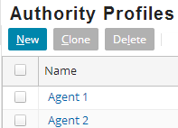
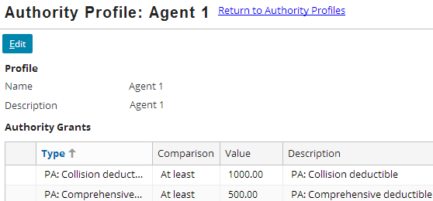
Authority grants in the user interface
Authority grants are assigned to authority profiles
Administration tab → Users & Security → Authority Profiles
Click to add or modify an authority grant
Notes:
In the base configuration, as shown in the screenshot above, the Agent 1 profile has the following authority grants for personal auto policies:
• The collision deductible is at least $1000. A user with the Agent 1 profile cannot approve a deductible less than this.
• The comprehensive deductible must be at least $500. A user with the Agent 1 profile cannot approve a deductible less than this.
• Can approve the Garage State underwriting issue if the state of garaging is California, Oregon, or Washington. Any other state triggers a Garage states underwriting issue.
• The total premium can be $200 at most. A user with the Agent 1 profile cannot approve a total premium greater than this amount.
Configuration users can define authority grants in the UWIssueType system table.

Slide 32
Lesson outline
Underwriting authority overview
Define underwriting issues
Underwriting approval process
Configure approval of underwriting issues
Configuring underwriting authority

Slide 33
Auto-approvable issues
Auto-approvable issues are approved automatically only if:
Issue does not already have an approval or rejection
Approval will unblock progress
No non-auto-approvable issues block progress
No other issues block progress
User has the authority to approve all blocking, auto-approvable issues to their default values
Summary: Auto-approvable issues are approved in an “all-or-nothing” way, and are only approved when doing so will let the policy progress
Notes:
If all of the above conditions are true, then PolicyCenter automatically, and transparently, makes that set of approvals as the user progresses the job.
An automated approval has an AutomaticApprovalCause which you can use to identify these approvals in the user interface. In the default configuration, this value is jobNumber@BlockingPoint for automated approvals that happen during normal job processes.
NOTE: Guidewire recommends that you define all auto-approvable issues with DefaultValueAssignmentType set to Fixed. This is to avoid a situation where the user can approve the issue, but the default approval would be outside of their authority. During automated processing, such as unattended renewals, the auto-approvable approval logic applies to all issues, including those that are not identified as auto-approvable.

Slide 34
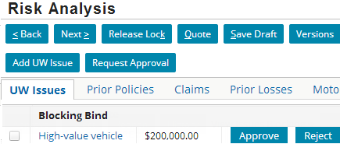
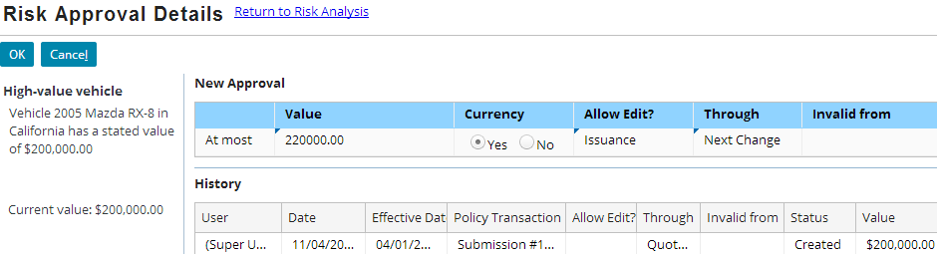
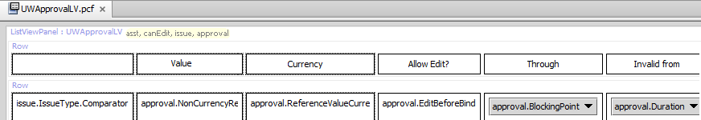
Configuring columns related to approvals
UWApprovalLV screen configures approvals
Notes:
AutoApprovable issues for which the user has the authority to approve, are hidden by default and do not show up in the user interface, unless the user selects to view all issues, or to view from the perspective of a user without authority to approve the issue. Depending on their authority grants permission, some agents may be able to view the approval in edit mode while some of them can view them in read-only mode.

Slide 35


Columns: AutoApprovable, DefaultEditBeforeBind, DefaultDurationType
AutoApprovable: Issue needs underwriter approval or approve automatically if user has proper authority grant
DefaultEditBeforeBind: Remove or save the approval from the policy, if policy is edited before binding
DefaultDurationType: Specifies DurationType property on new approvals that indicates when an approval will expire
NextChange
EndOfTerm
OneYear
ThreeYears
Rescinded
Notes:
AutoApprovable : Auto-approvable issues can be automatically approved if the user has an authority grant that permits an approval at the default level. If PolicyCenter can approve all blocking auto-approvable issues at the default level, then PolicyCenter approves all blocking issues. Otherwise, PolicyCenter approves none. The default level is the amount in the authority grant plus any offset amount or percentage from the UWIssueType system table. Possible values are true or false.
Set AutoApprovable to false for issues which should always be explicitly approved by an authorized user. Typically, these are the unusual or exceptional situations that are not on most policies.
Set AutoApprovable to true for issues that, while they prevent unauthorized users from progressing the job, they are not unusual or even obviously approvable if the user is authorized. In fact, not presenting common issues to an authorized user may make it easier to focus on the more important and unusual issues.
DefaultEditBeforeBind: Use the DefaultEditBeforeBind column to specify the default value of the EditBeforeBind property on new approvals. If false, the approval is removed if the policy is edited before binding this job. If true, the approval remains if the policy is edited before binding.
DefaultDurationType: The UWApprovalDurationType typelist defines these values. When determining the validity of the approval, the application looks at the effective date of the current job and of future jobs. For example, suppose you have a one year approval at the beginning of a six month policy. This approval extends through any policy changes in the current term, the six month renewal, and any policy changes in the following term. It does not cover a second renewal.

Slide 36

Columns: DefaultApprovalBlockingPoint, DefaultValueAssignmentType, DefaultValueOffsetAmount
Approval value = UWIssue.value + 10% * (UWIssue.value)
DefaultApprovalBlockingPoint: Specifies the default approval blocking point when issue is opened for approval
DefaultValueAssignmentType: Specifies how to compute a default approval value from the value of the issue
DefaultValueOffsetAmount: Used only if DefaultValueAssignmentType is Offset Amount or Offset Percentage
Notes:
DefaultApprovalBlockingPoint: Use the DefaultApprovalBlockingPoint column to specify the blocking point for the default approval used when there is no existing approval for auto-approval, or for pre-populating the new approval screen. This value must be at least one level higher than the BlockingPoint, or both must be Non-Blocking. This column has the same values as the BlockingPoint column and come from the UWIssueBlockingPoint typelist. The default approval blocking point is used primarily for two things:
Determining the UI setting for approval point on issues that have not been “human touched”
Determining the approval point for issues that are automatically approved
For many cases, “non-blocking” is the “right” value for this – these would be issues that if an underwriter “just approves” an issue it would allow the job to be completed through issuance without further approvals. Similarly, if it is an auto-approvable issue (or treated as auto-approvable during an unattended process, such as renewal), no further approvals would be required.
The times one would want to set the approval to a point before non-blocking would be when the carrier’s business practice require that additional underwriter interaction is required before coverage is provided, either at bind (for jobs that have a bind step) or at issuance. You might, for example, set the default approval point for a certain auto-approvable issue to “blocks bind” which would allow quotes (for users with approval authority on the specific issue) to be generated and revealed without any manual approval, but require an explicit approval to allow coverage to be bound (or issued).
Setting the default approval point to be later than the blocking point is so that the approval actually does something. For example, if the blocking point is “blocks quote release” and the default approval point is either “blocks quote” or “blocks quote release” then if an approval is made using the default, no further progress is possible as the process has already advanced to (or past) the approval point.
DefaultValueAssignmentType: Use the DefaultValueAssignmentType column to specify how to compute a default approval value from the value of the issue. PolicyCenter uses this value if Comparator is At least or At most. The UWValueAssignmentType typelist defines the possible values for this column.
[continued…]

Slide 37
(Notes only slide)
Notes:
They are:
null—Set this value to null for issues that have a non-numeric value or that do not have an associated value.
Fixed—The default approval value is copied directly from the issue value.
Offset Amount—The DefaultValueOffsetAmount is added to (or subtracted from) the issue value to produce the default approval value. Use this setting only with issues that have a numeric value.
Offset Percentage—The DefaultValueOffsetAmount is treated as a percentage increase or decrease, and the issue value is offset by that percentage to produce the default approval value. Use this setting only with issues that have a numeric value.
DefaultValueOffsetAmount: Use the DefaultValueOffsetAmount column if DefaultValueAssignmentType is Offset Amount, Offset Percentage or Fixed. If the DefaultValueAssignmentType is set to OffsetAmount or OffsetPercent, this field is the associated value or percent to use in the offset calculation. Positive values of DefaultValueOffsetAmount will produce a default approval value that is somewhat riskier than the issue value.
The above three column values and comparator contribute to the calculation of the approval value. The configuration developer can set these columns based on how they want this issue type to be handled.
As shown in the example, the at most comparator can be used for determining the risk associated with the value of a car. If the authority grant provides default approval at $200,000 with 10% offset, the user can approve a car whose value is as high as $220,000.
Similarly, the at least comparator can be used for determining the risk of a deductible. If the authority grant provides default approval for at least $1000, with 10% offset, then the user can approve a deductible as low as $900.
DefaultValueOffsetCurrency
Use the DefaultValueOffsetCurrency column if DefaultValueAssignmentType is Offset Amount. This field sets the default currency to use in the offset calculation.

Slide 38
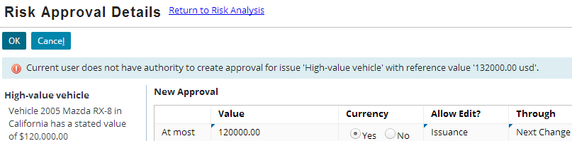
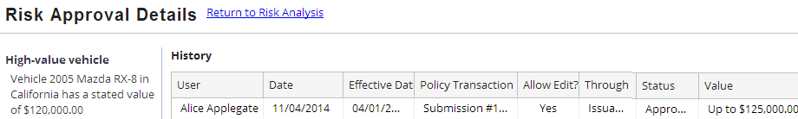
Authority profile limits what an UW can approve
Example: A vehicle valued at $120,000.
Authority profile is set At Most $125,000 and offset approval is 10% in uw_issue_types table
Change value 132,000 → 125,000 then UW can approve
Error because UW only has approval limit of 125,000
Notes:
The authority profile provides the limit an UW can approve. It does provide an offset. For example, a vehicle valued at $120,000. Lets say the authority profile is set At Most $125,000 and in the uw_issue_types system table we set the offset approval to 10%.
In the approval screen it will show an At most value of $132,000 (120,000 + 10% of 120,000 = 120,000 + 12,000 = 132,000) defined by the uw_issue types table. However, since the UW only has an approval limit of $125,000, they will need to change that $132,000 value to $125,000 before they can approve otherwise the system will throw an error as shown in the screenshot.

Slide 39
Lesson outline
Underwriting authority overview
Define underwriting issues
Underwriting approval process
Configure approval of underwriting issues
Configuring underwriting authority

Slide 40
Implementing underwriting authority
Steps to configure UW authority are:
Define a new issue type
Add values defining new issue type
Create values approving new issue type
Add function create issue in PA_UnderwriterEvaluator
Add authority grant for new issue type
Notes:
Each of these steps are discussed in detail in the following slides.

Slide 41
1. Define a new issue type
Points to think about to come up with a clear definition of the issue type:
Issue exists or new?
Decide value on fields that will raise the issue.
Does this issue need a value to be associated with it?
On which job (submissions, policy changes, etc.) should this issue be detected?
Should it be detected at multiple points, or can it be detected at one point only?
At what point in the job does is the issue raised?
Add a new row in the UWIssueType table to define the new issue type
Notes:
This slide provides some food for thought on defining a new issue: As an example we are going to create an issue type for a driver who is more than 80 years old. Next, what fields on the PolicyPeriod will need to be examined to determine whether this issue is present on the policy? What programming logic will be needed?
Is there a natural value associated with this issue, and will the value affect which underwriters can approve that issue?
A value can be a number, a currency amount, a state (or set of states), a class code (or a range of class codes), or anything that can be easily represented by users as a string.
It is not required that a value be associated with an issue, if it does not affect which underwriters will be able to approve particular issues.
That is, if an issue type is "Driver is over 80 years old", but whether any specific UW can approve the issue does not depend on how much older the driver is.
You also need to grant the appropriate authority to approve this issue to underwriters.
On which job types (submissions, policy changes, etc) and at which job lifecycle transitions (quoting, binding, etc) should this issue be detected?
For example, issues that will not change after a job is quoted may be detected at only one point, and may be detected as early as quoting, and there is no reason to ever try to detect the issue again.
As another example, if PolicyCenter receives payment delinquency information from a billing system, we may want the corresponding issue to be raised at the next lifecycle point -- quoting, binding, issuance -- no matter when it is detected.
What progress do you wish block with this issue? – Quote, Prequote, Bind?

Slide 42
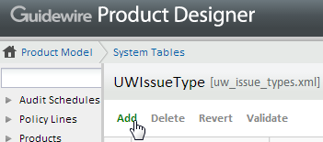
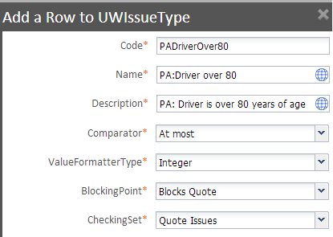
1a. Add values defining new issue type
In Product Designer, add a new row for new issue type
Add column values defining new issue type
Notes:
The new underwriting issue being created is in case of a driver who is above 80 years of age. To allow maximum age of 80 years the Comparator is At most, ValueFormatterType would be an integer.
We would like to block this issue before giving a quote amount, so the blocking point is pre-quote or Blocks Quote. And the checking set where this value needs to be checked would be with Quote issues.
If an existing Comparator types cannot be used, refer to the Application Guide for details on creating a new comparator.
If an existing ValueFormatterType cannot be used, refer to the Application Guide for details on creating a new ValueFormatterType.

Slide 43


1b. Create values approving new issue type
Add column values related to approving new issue type in Studio:
Is the issue auto-approvable?
Remove/save approval on policy when edited before bind
When does the approval expire?
Blocking point when issue is raised and needs approval
Nothing to compute, age is fixed so copy value to UWIssue.value
Validate and commit the change
Synchronize system tables
Notes:
Add column values in the table related to approving the new issue. Is it auto-approvable? For an underwriter approving the issue when will it expire by default. What is the default approval blocking point? Does this value have an offset or onset?
You will need to restart the server to deploy this modification of the UWIssueType system table.

Slide 44
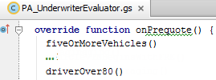
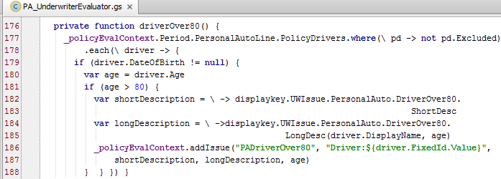
2a. Add function create issue in PA_UnderwriterEvaluator
…
Notes:
Logic needs to be defined as to what value should be checked to see when an issue will have to be raised. This is done by modifying the PA_UnderwriterEvaluator Gosu class. Define a new function with an appropriate name to check the drivers age and raise and issue. Find where the field you need to check for comparing value is? What is the comparison? How would you like to handle the result of the comparison? When the condition is met write the code to generate the issue.
The above code checks the age of each driver entered on the policy. A UWIssue is created if the driver is more than 80 years old.
You will also need to decide on which jobs this issue needs to be checked and at what blocking point. The rule in the example above needs to be checked at PreQuote so it is created under onPrequote().

Slide 45
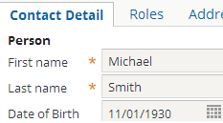
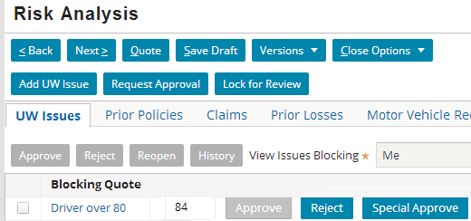
Result: UWIssue created for driver over 80
Add driver over 80 on a submission job
Click Quote
Issue is created
Available only for user with uwapproveall permission when authority is not granted for new issues
Authority not yet granted
Notes:
In the above example, you see a Special Approve button. Since the authority grant for this issue has not been created yet, only users such as su with the uwapproveall permission, get this button to be able to approve this issue. The user must confirm that they wish to use this permission before the application displays the screen that allows them to approve the issue.
Authority needs to be given to an agent or an underwriter so that they can approve the issue when needed. The next slide does this. Since the authority grant for this issue has not been given, the Approve button appears grayed (not available).

Slide 46
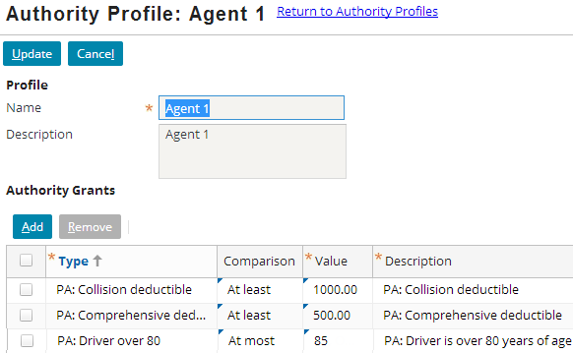
3. Add authority grant to approve new issue type
Grant Agent1 authority to approve issues for driver over 80 but at most 85
Notes:
The issue type name, comparator, and description are obtained automatically from the UWIssueType system table.
The steps to add authority grants to users are discussed in detail in the Introduction to Underwriting Authority lesson in the Introduction course.

Slide 47
Lesson objectives review
You should now be able to:
Understand the concepts of underwriting authority
Understand configuration of underwriting authority
Configure new underwriting issues

Slide 48
Review questions
What is underwriting authority?
What does the UWIssueType system table define?
What does an evaluation rule do?
What values should be used as IssueKey to raise issues? Should this value be changed after a rule is in production?
Name three blocking points for an issue.
What is a checking set?
Notes:
Answers
Underwriting authority provides underwriting rules and an underwriting infrastructure which user can modify or augment
The UWIssueType system table defines the underwriting issues in the base product. It can be extended to add new issues. The table defines columns related to defining the underwriting issues as well as the columns related to approving the underwriting issues.
An evaluation rule determines whether or not to create an issue for each checking set defined in the UWIssueType table. The logic to raise the issues is stated in a rule in the evaluation rule set.
Values that uniquely identify the issue and do not change over the life time of the policy should be used to raise underwriting issues. Guidewire recommends that you do not change the algorithm for forming the key for an issue once that rule is in production.
Quote, bind, prequote, issuance
A checking set represents a point in a job at which issues can be raised such as pre-quote, bind or pre-issuance.

Slide 49
Notices
Copyright © 2001-2014 Guidewire Software, Inc. All rights reserved.
Guidewire, Guidewire Software, Guidewire ClaimCenter, Guidewire PolicyCenter, Guidewire BillingCenter, Guidewire Reinsurance Management, Guidewire ContactManager, Guidewire Vendor Data Management, Guidewire Client Data Management, Guidewire Rating Management, Guidewire InsuranceSuite, Guidewire ContactCenter, Guidewire Studio, Guidewire Product Designer, Guidewire Live, Guidewire DataHub, Guidewire InfoCenter, Guidewire Standard Reporting, Guidewire ExampleCenter, Guidewire Account Manager Portal, Guidewire Claim Portal, Guidewire Policyholder Portal, ClaimCenter, BillingCenter, PolicyCenter, InsuranceSuite, Gosu, Deliver Insurance Your Way, and the Guidewire logo are trademarks, service marks, or registered trademarks of Guidewire Software, Inc. in the United States and/or other countries.
All other trademarks are the property of their respective owners.
This material is confidential and proprietary to Guidewire and subject to the confidentiality terms in the applicable license agreement and/or separate nondisclosure agreement.
This file and the contents herein are the property of Guidewire Software, Inc. Use of this course material is restricted to students officially registered in this specific Guidewire-instructed course, or for other use expressly authorized by Guidewire. Replication or distribution of this course material in electronic, paper, or other format is prohibited without express permission from Guidewire.
Guidewire products are protected by one or more United States patents.
Notes:
Configuring Underwriting Authority - 49

