Slide 1
Field-Level Validation
14 March 2014
Notes:
Guidewire training materials contain Guidewire proprietary information that is subject to confidentiality and non-disclosure agreements. You agree to use the information in this manual solely for the purpose of training to implement Guidewire software solutions. You also agree not to disclose the information in this manual to third parties or copy this manual without prior written consent from Guidewire. Guidewire training may be given only by Guidewire employees or certified Guidewire partners under the appropriate agreement with Guidewire.

Slide 2
Lesson objectives
By the end of this lesson, you should be able to:
Implement field-level validation in the data model
Implement field-level validation in the user interface
This lesson uses the notes section for additional explanation and information. To view the notes in PowerPoint, choose View→Normal or View→Notes Page. If you choose to print the notes for the lesson, be sure to select “Print hidden slides.”

Slide 3
Lesson outline
Field-level validation in data model
Field-level validation in UI

Slide 4
Field-level validation
Validation is a general application behavior that prevents a user from saving invalid business data
For example, specifying a policy expiration date that is prior to the policy's effective date
Field-level validation is a validation behavior tied to one or more specific fields
Can be implemented at:
Data model level (using field-level validators)
UI level (using validation expressions)
Notes:
There are other types of validation beyond field-level validation. For example, business rules can execute validation behavior at a global level when the error may not relate to one specific field. For example, imagine that an insurance carrier allows up to 4 cars to be covered on a single personal auto policy. Then, imagine that on a given policy, an underwriter enters five cars. The business data is invalid, but there isn't any one field that is causing the error.

Slide 5
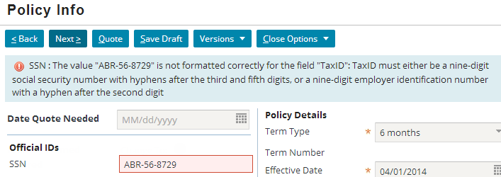
Field-level validators
A field-level validator is a pattern that is tied to one or more fields in the data model
If field value does not match pattern, data cannot be saved and error message is displayed
Notes:
Field validators are useful when the validation logic involves simple pattern matching and the pattern holds true every time the field is used.

Slide 6
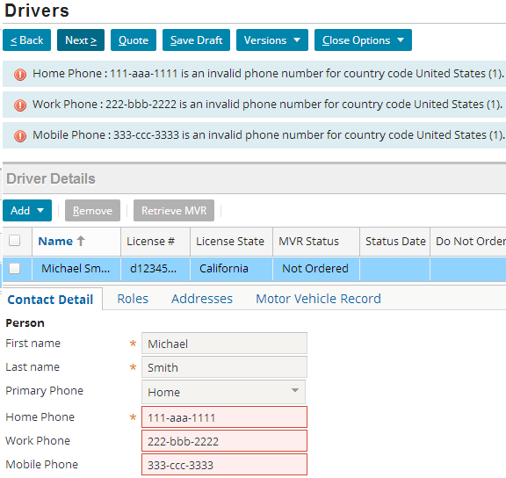
Field validators can be reused
Same field validator can be used for multiple fields
Notes:
One of the major advantages of using a field-level validator is they can be defined once and reused for fields that are accepting similar values. In the example above, all the phone numbers use the same validation that is defined only once.

Slide 7
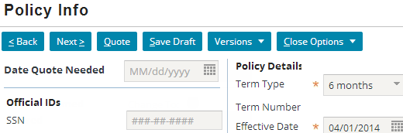
Components of a field-level validator
Name - Name of validator, such as SSN
Value - Pattern which must be matched, such as: Nine digits, hyphens after third and fifth digit
Description - Display message when pattern not matched, such as: TaxID must either be a nine-digit social security number or a nine-digit employee id number…
Input mask - Optional mask applied to any field tied to validator, such as “###-##-####"
Notes:
Field is validated as you type in the value. Until the entire value is correct the field is displayed with a red background indicating that the value is not correct. When a correct value is entered the red background goes away.

Slide 8
Steps to implement field-level validator
Create error message display key
Create field validator
Associate field validator to entity field
Deploy the changes

Slide 9
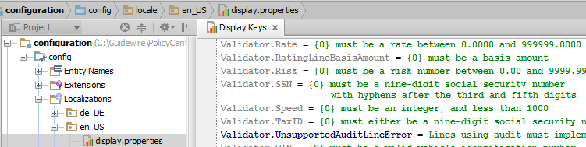
1. Create error message display key
In Studio, go to configuration → config → Localizations → en_US → display.properties
Field-level validator error message conventions
Grouped under Validator node
Begin with place-holder for widget name: {0}
Notes:
Display keys for locations or widgets are referenced in Studio. When you create a reference to a display key (a string starting with "displaykey."), you can name a display key that doesn't already exist and then specify the value for the new display key by pressing ALT + Enter. This opens a dialog box in which you can enter the display key value.
Field-level validator display keys are referenced in XML files, not in Studio. Therefore, there is no way when editing the validator to open a dialog box in which the value of a new display key can be entered. Consequently, the display key must be created "manually" in the appropriate display.properties files separate from the editing of the field validator.

Slide 10
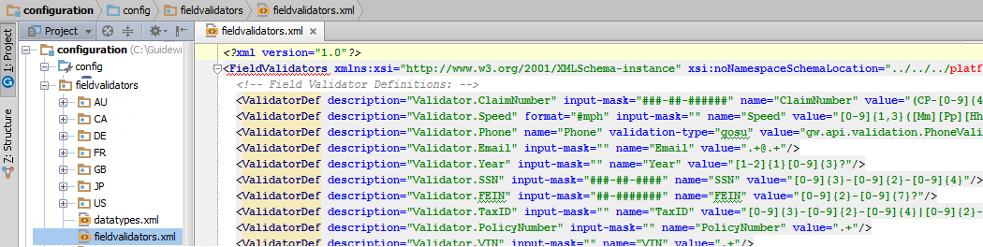
Step 2: Create field validator
Field validators declared in fieldvalidators.xml

Slide 11
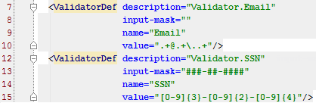
Validator def: Name and description
Each validator declared in <ValidatorDef> tag
name attribute names validator
description attribute names display key
Display keys must be used (cannot be hard-coded string)
Do not include "displaykey." in value

Slide 12
Validator def: Value
Syntax for pattern includes:
[charRange]{X} - X characters in charRange, which can be any combination of 0-9, a-z, and A-Z
[charRange]{X, Y} - From X to Y characters in charRange
.+ - Any non-empty string
\. - A period (the "\" is an escape character
Most other characters (such as -) are treated as literals
Notes:
In the screenshot above, the pattern for the Email validator is:
Any non-empty string, specified as: .+
An "at" symbol, specified as: @
Any non-empty string, specified as: .+
A period, specified as: \.
Any non-empty string, specified as: .+
In the screenshot above, the pattern for the SSN validator is:
Any 9 digits separated by a “-” after the 3rd and the 5th digit, specified as: [0-]{3}-[0-9]{2}-[0-9]{4}
A hyphen, specified as: -
Any three digits, specified as: [0-9]{3}
Characters that are not treated as literals and must be escaped include: [ ] ( ) { } . * + ?
The above example for Email has been modified from what appears in the fieldValidators.xml, to cover most of the patterns for examples.
For a complete listing of syntax for validator patterns, consult the Configuration Guide for PolicyCenter.

Slide 13
Validator def: Input Mask
Syntax for input masks:
# - Numeric characters the user can type
Rendered in UI as a “#"
All other characters (such as -) are treated as literals
To specify no input mask, use ""
Notes:
If a mask has fixed characters on the end, the application displays those characters outside of the text field. For example ####mph appears as a field #### with mph on the outside end of it.
For a complete listing of syntax for input masks, consult the Configuration Guide for your PolicyCenter.
The default value used to display and input mask is a “.” but configuration users can change this symbol using the InputMaskPlaceholderCharacter setting in config.xml.

Slide 14
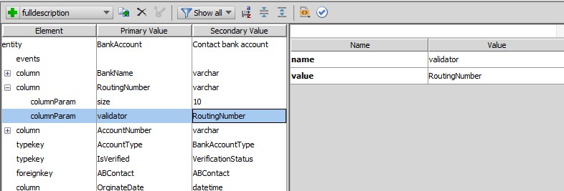
Step 3: Associate validator to entity field (1)
For custom fields (fields not declared in base app), use child <columnParam> tag in appropriate extension file
Edit here
Notes:
The above example has been borrowed from TrainingApp. There is no example in the base product of associating validator to an entity not declared in the base application.

Slide 15
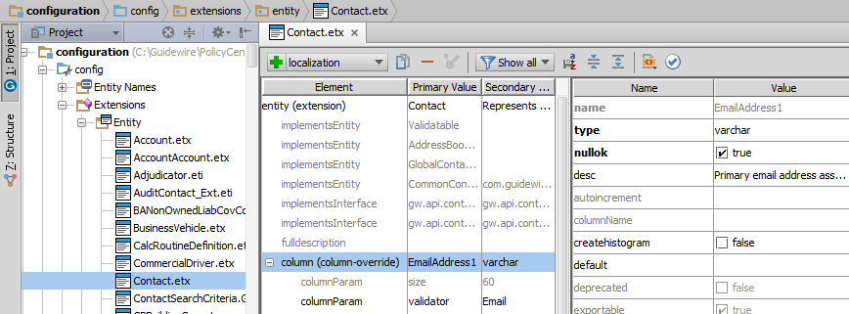
Step 3: Associate validator to entity field (2)
For base app fields, use <column-override> tag with child <columnParam> tag in appropriate extension file

Slide 16
Step 4: Deploy changes
New and modified field validators are data model changes
To deploy data model changes, restart application server
Field-level validators are not listed in Data Dictionary
Notes:
Because field-level validators are not listed in the Data Dictionary, there is no need to regenerate the Data Dictionary when you are making only field-level validator changes.

Slide 17
Lesson outline
Field-level validation in data model
Field-level validation in UI

Slide 18
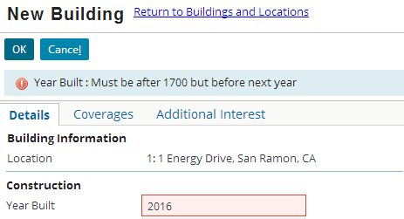
Field-level validation in the user interface
Implemented by logic tied to given atomic widget
Useful when you want same field to be treated differently in different parts of application, or
Logic is simple enough that it makes sense to store it at UI level
Notes:
Field-level validation is typically tied to the two widget types used most often to enter data: inputs and cells.
Validation error messages are displayed at the top of the screen in the same way that other errors, such as required fields with missing values, are shown.
Field-level validation checks data only when it is entered through that specific PCF file. It does not check data entered other ways, such as through other PCF files, through Gosu code (such as business rules and enhancement functions), or through import processes.

Slide 19
Validation expression
A validation expression is an expression associated to a single atomic widget that implements field-level validation
If expressions returns NULL, save is allowed
If expression returns string (an error message), then save is prevented, field is flagged, and message is displayed at top of screen
If year is between 1700 and next year?
Returns NULL
Save allowed
Returns Error
Save prevented
Notes:
Validation expressions can be a Gosu expression which returns either NULL or a string (such as a call to a function).
Sometimes they are written using a ternary expression that returns either NULL or a string (typically stored as a display key).
If NULL is returned, the data is considered valid and the save is allowed.
If errorMessage is returned:
The widget is flagged.
The string (the error message) is displayed.
The save is prevented.

Slide 20
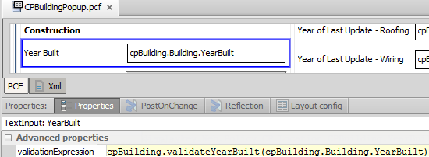
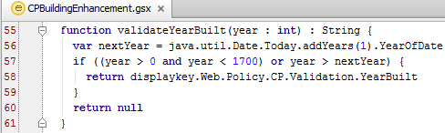
validationExpression example
save allowed
save prevented
Notes:
The above example is taken from the CPBuildingPopup pcf. The year built has a validationExpression property that calls the validateYearBuilt() function. This function is defined in the CPBuildingEnhancement.gsx. If the expression user wants to enter is simple enough that it can be specified using an if/else statement or a ternary expression, that can also be used in the ValidationExpression property. A return value of null implies the save is allowed because the validation condition was met. Otherwise the data is invalid and an error message is displayed and the user has to enter a valid value into the field.

Slide 21
Value in an expression
Written using function call statement or a ternary operator if the code is simple
Using ternary operator
Syntax: condition ? NULL : errorMessage, or condition ? errorMessage : NULL
NULL and error message can come in either order
Left side value returned when condition evaluates to true
Right side value returned when condition evaluates to false

Slide 22
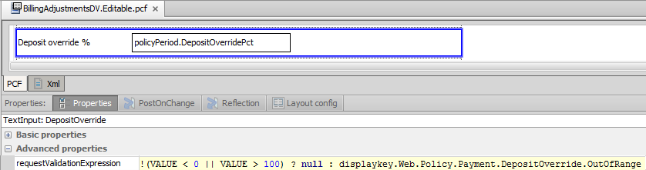
requestValidationExpression property
requestValidationExpression using ternary operator:
Request validation expressions are executed during any call to the server
Whether to commit data or
To move to another part of current location such as from one card to another
Notes:
Inputs and cells have two attribute which can be used for validation expressions: validationExpression and requestValidationExpression. Request validation expressions are executed during any call to the server, whether it is to commit data or to simply move to another part of the current location (such as from one card to another). This means that the condition can be evaluated before the user attempts to commit the data. However, the condition does not have access to the current value of any widget. It can check only the last saved value of widgets beyond the given widget.
Commit validation expressions are executed when the application attempts to commit the widget's value. This means that the condition is evaluated immediately before the data is saved. However, because all widget values are being saved at this point in time, the condition can check the value of other widgets as well.
The vast majority of the time that you want to implement a validation expression, it should be using the validationExpression attribute. This is considered to be the more user-friendly approach as it doesn't evaluate the data until the user is done with his or her work. requestValidationExpression is designed for the small number of cases where an invalid data value is so egregious that it may cause an egregious reaction such as a thrown exception, even before the user commits the data. As shown in the example above for DepositOverride, the value of deposit override percentage has to be between 0 and 100. If the value is not in this range then an error message is displayed using a displaykey.

Slide 23
Lesson objectives review
You should now be able to:
Implement field-level validation in the data model
Implement field-level validation in the user interface

Slide 24
Review questions
With regards to field-level validation, under what circumstances would you use a <column-override> tag?
What happens if a widget's validation expression returns null?
You need to create a driver’s license ID field. Would this be a data level validation or field level validation?
Notes:
Answers
You would use the <column-override> tag when associating a field-level validator to a field in the base application data model.
The save is allowed. (A return value of null signifies that the validation condition was met.)
This would be a field level validation. The driver’s license would be a pattern such as first letter is a character, followed by all numbers. Everywhere the user has to enter a driver’s license id this pattern has to be matched. Hence it should be validated at the field level.

Slide 25
Notices
Copyright © 2001-2014 Guidewire Software, Inc. All rights reserved.
Guidewire, Guidewire Software, Guidewire ClaimCenter, Guidewire PolicyCenter, Guidewire BillingCenter, Guidewire Reinsurance Management, Guidewire ContactManager, Guidewire Vendor Data Management, Guidewire Client Data Management, Guidewire Rating Management, Guidewire InsuranceSuite, Guidewire ContactCenter, Guidewire Studio, Guidewire Product Designer, Guidewire Live, Guidewire DataHub, Guidewire InfoCenter, Guidewire Standard Reporting, Guidewire ExampleCenter, Guidewire Account Manager Portal, Guidewire Claim Portal, Guidewire Policyholder Portal, ClaimCenter, BillingCenter, PolicyCenter, InsuranceSuite, Gosu, Deliver Insurance Your Way, and the Guidewire logo are trademarks, service marks, or registered trademarks of Guidewire Software, Inc. in the United States and/or other countries.
All other trademarks are the property of their respective owners.
This material is confidential and proprietary to Guidewire and subject to the confidentiality terms in the applicable license agreement and/or separate nondisclosure agreement.
This file and the contents herein are the property of Guidewire Software, Inc. Use of this course material is restricted to students officially registered in this specific Guidewire-instructed course, or for other use expressly authorized by Guidewire. Replication or distribution of this course material in electronic, paper, or other format is prohibited without express permission from Guidewire.
Guidewire products are protected by one or more United States patents.
Notes:
Field-Level Validation - 25

