Slide 1
Validation Rules
28 February 2014
Notes:
Guidewire training materials contain Guidewire proprietary information that is subject to confidentiality and non-disclosure agreements. You agree to use the information in this manual solely for the purpose of training to implement Guidewire software solutions. You also agree not to disclose the information in this manual to third parties or copy this manual without prior written consent from Guidewire. Guidewire training may be given only by Guidewire employees or certified Guidewire partners under the appropriate agreement with Guidewire.

Slide 2
Lesson objectives
By the end of this lesson, you should be able to:
Describe basic validation rule behavior
Use validation rules to validate non-policy objects in PolicyCenter
Create validation rules that raise warnings and errors
Create validation rules that identify invalid fields
This lesson uses the notes section for additional explanation and information. To view the notes in PowerPoint, choose View→Normal or View→Notes Page. If you choose to print the notes for the lesson, be sure to select “Print hidden slides.”

Slide 3
Lesson outline
Validation rule basics
Validation levels and the validation graph
Create validation rules
Warnings and errors

Slide 4
Validation rules
Validation rules check the validity of the data in non-policy objects such as an account or a producer code, and if necessary warn the user of potential issues or prevent the data from being committed
Validation rules are written as business rules in Gosu
Rule-based validation is also known as validation on-commit
Notes:
This lesson discusses adding rule based validation using Gosu. To validate objects on a policy validation classes are used which are discussed in a separate lesson.
IMPORTANT PolicyCenter does not permit you to modify objects during validation rule execution that require changes to the database. If it is allowed, that would make it impossible to ever completely validate data. (Data validation would be an ever-shifting target.)

Slide 5
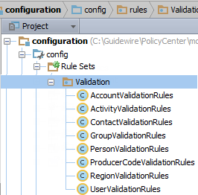
Performing validation through business rules
Validation rules can be used to:
Ensure that the user enters data that makes sense
Ensure that the user enters all necessary data
Manage relationships between data fields
Notes:
Use the validation rules to flag problems with data that needs to be fixed before allowing the user to submit the item for further processing. Rule-based validation is also known as commit-cycle validation because it occurs only during a data bundle commit.
The screenshot above shows the different objects on which validation rules can be written in the base configuration. For example, validation rules on producer code are written in the ProducerCodeValidationRules and rules validating the account object are written in the AccountValidationRules folder.

Slide 6
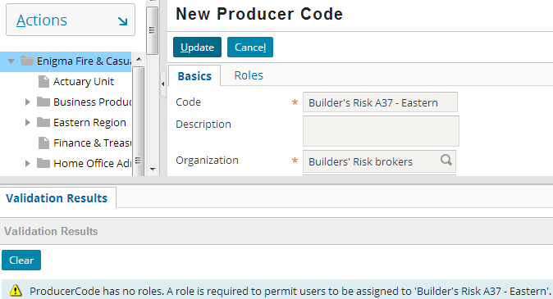
Validation during save
Consists of validation checks coded in business rules for validatable entities
Checked when validatable entity is committed to database
Notes:
Validation rules prevent invalid data from being saved. Validation rules can be used to validate the data before save. Validation rules are used for validation associated to non-policy objects.
At the time PolicyCenter commits a data “bundle” containing that object to the database; specific “validatable” entities trigger execution of rule-based validation.

Slide 7
Logic that prevents invalid data
ProducerCodeRoles.length=0
001
When condition is not met
Save is not allowed
Condition: Producer code should have at least one role
pc data
001
ProducerCode Roles.length=2
When condition is met
Save is allowed
Notes:
In the example, the validation logic states that if a producer code does not have any role then the producer code should not be saved.
In the top example, the producer code is modified in a way that does not meet the validation logic. When the user clicks Update, the save is prevented.
In the bottom example, the producer code is modified in a way that meets the validation logic. When the user clicks Update, the save is allowed.

Slide 8
Lesson outline
Validation rule basics
Validation levels and the validation graph
Create validation rules
Warnings and errors

Slide 9
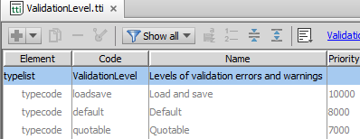
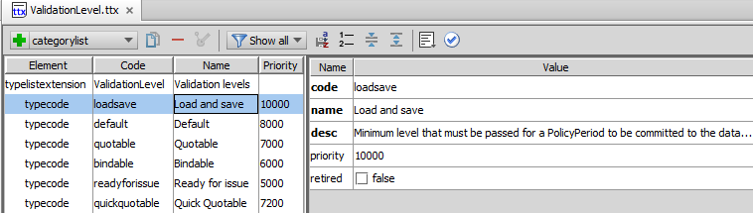
Validation levels
Internal levels
Defined in ValidationLevel typelist
Three internal levels cannot be deleted
Non-internal levels can be modified or deleted
New levels can be added
Notes:
In the base configuration, PolicyCenter defines a set of validation levels (in typelist ValidationLevel) that you can use to verify how valid data is before continuing. (It is possible for you to create your own validation levels.) PolicyCenter uses the “priority” attribute of the type keys to order the validation levels.
In the base configuration, Guidewire defines three immutable validation levels – loadsave, default and quotable. (They are defined in configuration → config → Metadata → typelist → ValidationLevel.tti, you cannot modify them.)
PolicyCenter provides other validation levels – bindable, quickquotable, and readyforissue in the base configuration. However, as Guidewire defines these levels in the ValidationLevel.ttx typelist, it is possible to modify, remove, or even add to them using the Studio typelist editor.

Slide 10
Rule-based validation and validation levels
Every validation rule is tied to a validation level
At default validation level
PolicyCenter runs validation rules during commit process
PolicyCenter validates data imported from an external account
Notes:
All data must pass “loadsave” level to be saved to the database.
When data is brought in from an external account PolicyCenter validates that data against the default validation level.

Slide 11
Validation graph
During database commit, rules engine performs validation
Validation is triggered when:
Validatable object is created or changed
Validatable sub-object is created, changed, or removed
"triggersValidation" attribute on the field controls this behavior
Notes:
PolicyCenter gathers the entities that reference a changed entity into a virtual graph. This graph maps all the paths from each type of entity to the top-level validatable entities like Account and ProducerCode. PolicyCenter queries these paths in the database or in memory to determine which validatable entities (if any) reference the entity that was inserted, updated, or removed.
The rule engine determines the validation graph by traversing the set of foreign keys and arrays that trigger validation. For example, the data model marks the ProducerCodeRoles array on ProducerCode as triggering validation. Therefore, any changes made to a producer code role causes the Rules engine to validate the producer code as well.

Slide 12
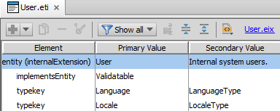
Validating entities
Entity must implement Validatable delegate
Notes:
To be validatable, an entity (or subtype, or delegate, or base object) must implement the Validatable delegate. For a complete list of entities that trigger validation in the base PolicyCenter configuration refer to the PolicyCenter Rules Guide.
Note: All validatable entities in the default configuration already have this attribute. Users would need to add this line, only if you made a new entity validatable. Only non-policy objects can be made validatable.

Slide 13
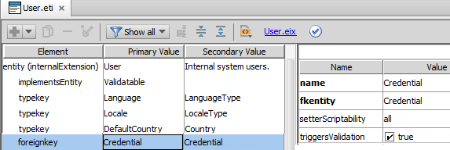
triggersValidation attribute
Sub-objects don’t get validation rules run on them
Sub-objects or child objects are not defined as validatable
Use triggersValidation attribute on sub-objects such as foreignkeys or arrays, to trigger validation rules on the validatable entity when sub-object changes
Set triggersValidation to true in parent entity’s metadata file
Notes:
PolicyCenter sets the validation triggers so that modifying a validatable entity in a bundle causes system to validate that entity and all its parents.
If you update a user's credential, you might reasonably expect validation rules to execute before the Rule engine commits the updates to the database. However, updating a user’s credential does not by default trigger rules to the container or parent object (User, in this case). The reason is that implementation (at the metadata level) of a user’s credential is a pointer (link) from a User entity to a Credential entity. To get it to trigger validation, you need to use the “triggersValidation” attribute.
The objects related to the trigger validation are marked in the data model using the triggersValidation tag. The virtual validation graph maps all the paths from each type of entity to the top-level validatable entities like Account or User. PolicyCenter queries these paths in the database or in memory to determine which validatable entities (if any) reference the entity that was inserted, updated, or removed.

Slide 14
Traversing the validation graph
Rules engine applies validation rules any time you modify a validatable entity’s contents directly
Example: Changes to sub-objects Contact, Credential, and UserSettings trigger validation of the parent object User (but not vice versa)
Contact
User
User
Credential
User is parent object
UserSettings
Sub-objects have foreign key to User
Notes:
Guidewire sets the validation triggers so that modifying a validatable entity causes PolicyCenter to validate that entity and all its parents. Otherwise PolicyCenter does not check all of the indirect objects.
Consider the example where you update an object linked to an object. In the example above, the data model marks the Contact, Credential, and UserSettings fields on User as triggering validation. Therefore, any changes made to Contact, Credential, or UserSettings causes the rules engine to validate the User.
Guidewire PolicyCenter comes preconfigured with a number of high-level entities that trigger validation (meaning that they are validatable). These entities are (in alphabetic order):
• Account
• Activity
• Contact
• Group
• ProducerCode
• Region
• User

Slide 15
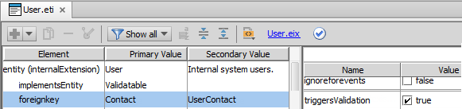
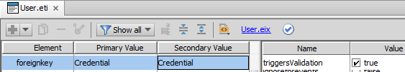

Validation graph example
In the parent entity’s metadata file such as User.eti
triggersValidation=“true” for all sub-objects (Contact, Credential etc.) that should trigger validation on parent
Notes:
The Rule engine determines the validation graph by traversing the set of foreign keys and arrays that trigger validation.
If the triggersValidation was not set to true for Contact for example, then a change to Contact will not trigger validation to the User.
Setting the triggersValidation attribute to true ensures that the Rule engine runs validation rules on the parent object any time that you modify the sub-object such as the Contact or Credential. (This is only true if the container object implements the Validatable delegate.) If you want to validate a child object that is not a validatable entity itself you need to do it this way. Indeed, that is probably the primary use case for triggersValidation.
New validation rule sets can be created for any entity that is not on the policy graph. So in the case of the example above, a new rule set can be theoretically created for Credential to write validation rules on it.
WARNING Guidewire places the base entity definition files in .../modules/configuration/config/metadata. Do not modify these files in any way.

Slide 16
Lesson outline
Validation rule basics
Validation levels and the validation graph
Create validation rules
Warnings and errors

Slide 17
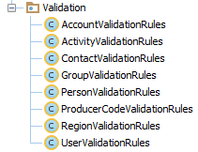
Validation rule set
PolicyCenter has some Validatable entities, that have their own rules set
To create a new validation rule, create it in the appropriate validation rule set
Notes:
The above is the list of validatable entities in the base application. If you want to add validation rules on any of these non-policy objects, create validation rules in the appropriate rule set.

Slide 18
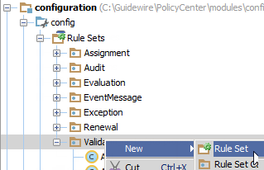
Create a new rule set
If rule set exists for an entity such as Account, add rules to AccountValidationRules
If rule set does not exist on the new non-policy entity, then create a new rule set
configuration → Rule Sets → right click Validation → New → Rule Set
Create rules to validate the entity in the new rule set
Notes:
In the base configuration, rule sets have been created for some of the non-policy objects in PolicyCenter. If you want to validate a non-policy object that does not have its own rule set, then you will have to first create a rule set for that entity and then you can define validation rules on that entity in the rule set.
Creating rule sets and rules is discussed in detail in the Gosu Rules lesson in the Configuration Fundamentals course.

Slide 19
Lesson outline
Validation rule basics
Validation levels and the validation graph
Create validation rules
Warnings and errors

Slide 20
Validation rule outcomes
There are three possible outcomes to a validation rule:
Reject with error - The action is prevented and a message is displayed to the user interface
Reject with warning - The action is permitted, but the user is warned of some potential issue
No rejection - The object is valid and the action is permitted

Slide 21
Validation methods
Validation methods
reject() - Error or warning; no highlighting of widget
rejectField() - Error or warning; highlights widget corresponding to given field on root object
rejectSubField() - Error or warning; highlights widget corresponding to given field on a related object
All methods are available on every validatable object

Slide 22
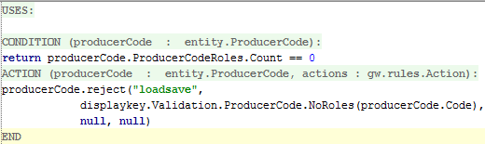
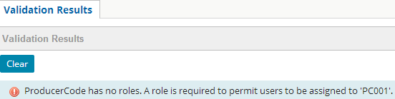
The reject method
Used for both warning and errors
Syntax: object.reject(errorLevel, errorMessage, warnLevel, warnMessage)
Reject method gives error – data cannot be saved
Notes:
Since the rule condition is not met in the example screenshot above an error message is displayed. The user tries to save a newly created ProducerCode which does not have any roles by clicking the Update button, hence an error message is displayed. The error is written to be displayed at the “loadsave” validation level within the ProducerCodeValidation Ruleset. The errorMessage string is in the displaykey NoRoles.
Note: PolicyCenter default configuration does not have many rules defined and uses the rule-based validation extensively. Hence, the example above and most of the examples in this section have been created for training purposes.

Slide 23
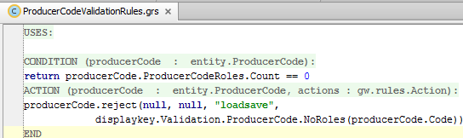

reject method gives warning
Reject method gives warning Data can be saved
Notes:
The difference between a reject warning and a reject error is the arguments passed to the reject method.
Depending on their requirement, configuration developers can use reject method to create warning or errors. The main difference between warnings and errors is that a warning displays the error message but allows data to be saved when the Update button is clicked the second time, whereas in case of reject method for error, data cannot be saved until the error is corrected.

Slide 24
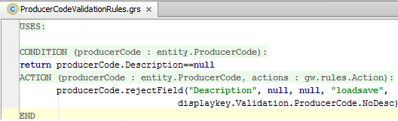
The rejectField method
Used for both warning and errors
Highlights the field that gave error or warning in the UI
Syntax: object.rejectField(strRelativeFieldPath, errorLevel, errorMessage, warnLevel, warnMessage)
path is relative to producerCode; does not start with “producerCode"
Notes:
The strRelativeFieldPath argument is the relative path rendered as a string from the root object to the field that failed validation. Do not specify the root object in the relative path string. PolicyCenter implicitly adds the root object at the beginning of the path. If you specify the root object (for example, if you specify “producerCode.Description" in the example above), then PolicyCenter will typically not be able to find the desired field to highlight. (It will look for a field following the path "producerCode.Description". Given that no such field exists, no field will get highlighted.)

Slide 25
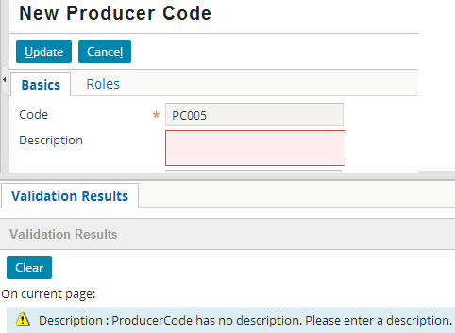
rejectField example
Invalid field is highlighted
Page is specified
Notes:
When the screen is in edit mode, a red background appears next to the field (whether it was raised by a warning or an error).

Slide 26
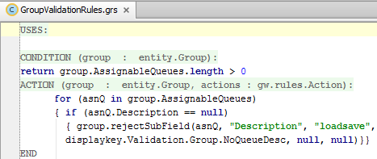
The rejectSubField method
Recommended when field is within an array on root object
Syntax: object.rejectSubField(relatedObject, strRelativeFieldPath, errorLevel, errorMessage, warnLevel, warnMessage)
Notes:
When rejecting a sub-field, the strRelativeFieldPath argument should be written relative to the relatedObject. For example, the code above shows the related object to be asnQ (which is the current value of the iterator on the AssignableQueues array.) Therefore, the queue represented by “asnQ” is implicitly added to the second parameter. The parameter itself only needs to specify the field on the related object, which in this case is "Description".
Note that the above rejection could have been done using rejectField, but it would be somewhat uglier since the call to rejectField would need to explicitly call out the specific item in the array being rejected:
for (asnQ in group.AssignableQueues index i) {
if (asnQ.Description == null) {
group.rejectField("AssignableQueues [" + i +"].Description", “loadsave", displaykey.Validation.Group.NoQueueDesc, null, null)
}
}
Note: The above example has been created for training.

Slide 27
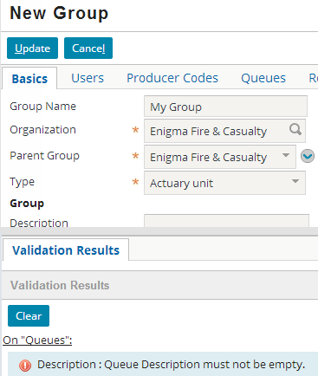
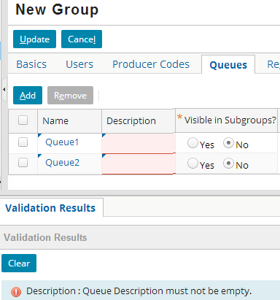
rejectSubField example
Provides link to page/tab if you are on a different tab or page
Highlights all fields in the array that violate the condition

Slide 28
Lesson objectives review
You should now be able to:
Describe basic validation rule behavior
Use validation rules to validate non-policy objects in PolicyCenter
Create validation rules that raise warnings and errors
Create validation rules that identify invalid fields

Slide 29
Review questions
Which type of objects in PolicyCenter use validation rules? Give two examples.
Can existing validation levels be removed from PolicyCenter? Can new levels be added?
If you have an existing reject statement which raises only a warning, how would you change it to instead raise an error?
The first argument of rejectField is a "relative path" to the object to highlight. Why is it relevant to keep in mind that the path is relative?
Notes:
Answers
All non-policy objects use validation rules in PolicyCenter. Examples of non-policy objects are account, users, regions, producercodes, groups, activity, and contact.
Yes, any of the non-internal level can be removed. However, the three internal levels (loadsave, default, and quotable) cannot be removed. Yes, new levels can be added.
You would swap the order of the final two pairs of arguments. The first pair should be the last pair and vice versa.
It is important to keep this in mind because the root object must be omitted from the path. If you include the root object, then PolicyCenter will not be able to find the field to highlight.

Slide 30
Notices
Copyright © 2001-2014 Guidewire Software, Inc. All rights reserved.
Guidewire, Guidewire Software, Guidewire ClaimCenter, Guidewire PolicyCenter, Guidewire BillingCenter, Guidewire Reinsurance Management, Guidewire ContactManager, Guidewire Vendor Data Management, Guidewire Client Data Management, Guidewire Rating Management, Guidewire InsuranceSuite, Guidewire ContactCenter, Guidewire Studio, Guidewire Product Designer, Guidewire Live, Guidewire DataHub, Guidewire InfoCenter, Guidewire Standard Reporting, Guidewire ExampleCenter, Guidewire Account Manager Portal, Guidewire Claim Portal, Guidewire Policyholder Portal, ClaimCenter, BillingCenter, PolicyCenter, InsuranceSuite, Gosu, Deliver Insurance Your Way, and the Guidewire logo are trademarks, service marks, or registered trademarks of Guidewire Software, Inc. in the United States and/or other countries.
All other trademarks are the property of their respective owners.
This material is confidential and proprietary to Guidewire and subject to the confidentiality terms in the applicable license agreement and/or separate nondisclosure agreement.
This file and the contents herein are the property of Guidewire Software, Inc. Use of this course material is restricted to students officially registered in this specific Guidewire-instructed course, or for other use expressly authorized by Guidewire. Replication or distribution of this course material in electronic, paper, or other format is prohibited without express permission from Guidewire.
Guidewire products are protected by one or more United States patents.
Notes:
Validation Rules - 30

