Slide 1
Validation Classes
14 March 2014
Notes:
Guidewire training materials contain Guidewire proprietary information that is subject to confidentiality and non-disclosure agreements. You agree to use the information in this manual solely for the purpose of training to implement Guidewire software solutions. You also agree not to disclose the information in this manual to third parties or copy this manual without prior written consent from Guidewire. Guidewire training may be given only by Guidewire employees or certified Guidewire partners under the appropriate agreement with Guidewire.

Slide 2
Lesson objectives
By the end of this lesson, you should be able to:
Describe validation classes used by PolicyCenter
Identify which objects should use validation classes
Explain how validation levels are used
Invoke class-based validation from different locations in PolicyCenter
Write validation checks needed to validate objects on a policy
This lesson uses the notes section for additional explanation and information. To view the notes in PowerPoint, choose View→Normal or View→Notes Page. If you choose to print the notes for the lesson, be sure to select “Print hidden slides.”

Slide 3
Lesson outline
Class-based validation overview
Validation levels
Class-based validation configuration
Validation chaining
Invoking class-based validation
Add a new validation check

Slide 4
Class-based validation
Class-based validation is validation used on-demand
Class-based validation allows users to:
choose at what time to validate a data object
decide how to validate data objects
write validation logic in Gosu classes
Everything on the policy graph is validatable
Entities on a policy graph need not be defined specially or as validatable
Validation class can perform any number of checks against any entities on a policy graph
Notes:
You can perform class-based validation on basically any business object on a policy graph (including those objects that you create by extending a base object). You are quite free to write your own Gosu validation classes and implement your own validation logic.
Note: PolicyCenter field-level validation is not part of the class- or rule-based validation framework. Field-level validation does not involve Gosu business rules or classes. It is simply part of the PCF rendering framework.

Slide 5
Class-based validation basics
A validation class must implement the PCValidation interface, or subclass a class that does
Class-based validation uses validation levels
Different validation levels are used at certain points in a job
Class-based validation can be performed on policy-related objects only such as:
PolicyContactRole
PolicyLocation
PolicyPeriod
Line of business entities such as PALine or BALine
Policy-specific entities such as PersonalVehicle or BusinessVehicle
Notes:
PolicyCenter performs class-based validation on policy-related entities, any time that you call for validation on the entity.
There is nothing particularly special about these entities, meaning that they are not “validatable” entities in the sense that rule-based validation entities are defined as validatable. Guidewire merely provides validation classes for these entities in the base configuration. You are quite free to write your own Gosu validation classes and implement your own validation logic. A validation class can perform any number of checks against any policy-related entities in the system. In other words, everything in the policy graph is validatable.

Slide 6
Validation classes used commonly across lines
Classes shared across LOB reside under configuration → gsrc → gw → policy:
PolicyPeriodValidation
PolicyLineValidation
PolicyLocationValidation
PolicyContactRoleValidation
Notes:
There is nothing particularly special about these entities, meaning that they are not “validatable” entities in the sense that rule-based validation entities are defined as validatable. Guidewire merely provides validation classes for these entities in the base configuration. You are quite free to write your own Gosu validation classes and implement your own validation logic. A validation class can perform any number of checks against any policy-related entities in the system. In other words, everything in the policy graph is validatable.

Slide 7
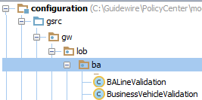
LOB specific validation classes
LOB specific validations classes, subclass PCValidationBase, which implements PCValidation:
Classes for BA LOB
Notes:
The classes reside under gsrc → gw → lob → [LOBName]. The example in the screenshot is for the Commercial Auto line of business. The Gosu classes for validation of Commercial Auto line of business defined in the base configuration are BALineValidation and BusinessVehicleValidation as shown in the example above.
Following is the list of validation classes in the base configuration of PolicyCenter:
(BA)
BALineValidation
BusinessVehicleValidation
(BOP)
BOPLineValidation
BOPBuildingValidation
BOPLocationValidation
BOPPolicyInfoValidation
(CP)
CPLineValidation
CPBuildingValidation
(GL)
GLLineValidation
GLExposureValidation
(IM)
IMLineValidation
IMARPartValidation
IMSignPartValidation
(continued)

Slide 8
(Notes only slide)
Notes:
(PA)
PALineValidation
PersonalVehicleValidation
(WC)
WCLineValidation
WCJurisdictionValidation
WCPolicyInfoValidation

Slide 9
Lesson outline
Class-based validation overview
Validation levels
Class-based validation configuration
Validation chaining
Invoking class-based validation
Add a new validation check

Slide 10
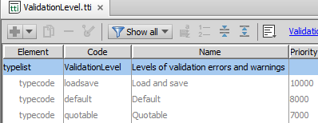
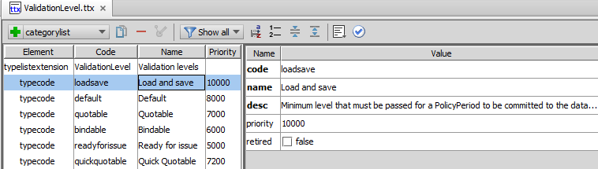
Review: Validation levels
Internal levels
Defined in ValidationLevel typelist
Three internal levels cannot be deleted
Non-internal levels can be modified or deleted
New levels can be added
Notes:
In the base configuration, PolicyCenter defines a set of validation levels (in typelist ValidationLevel) that you can use to verify how valid data is before continuing. (It is possible for you to create your own validation levels.) PolicyCenter uses the “priority” attribute of the type keys to order the validation levels.
In the base configuration, Guidewire defines three immutable validation levels – loadsave, default and quotable. (They are defined in configuration → config → Metadata → typelist → ValidationLevel.tti, you cannot modify them.)
PolicyCenter provides other validation levels – bindable, quickquotable, and readyforissue in the base configuration. However, as Guidewire defines these levels in the ValidationLevel.ttx typelist, it is possible to modify, remove, or even add to them using the Studio typelist editor.

Slide 11
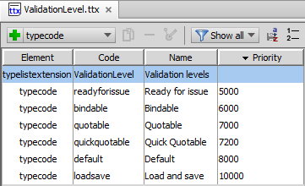
Validation level priority
The higher the priority value, the less restrictive the validation at that level is
high
Restriction
less
Notes:
In the base configuration “bindable” with a priority of 6000 is more restrictive than “quotable” with a priority of 7000. You can also think of this as tighter and looser (smaller numbers are tighter) to indicate more or less restrictive validation levels.

Slide 12
Validation levels and class-based validation
Run validation at a certain level on an entity or a wizard step
See if all the validation checks required at the level are passed
Add errors or warnings as needed for checks not passed
PolicyCenter provides methods to determine what validation level is currently being tested
Notes:
PolicyCenter provides methods in the PCValidationBase class to validate the entities in the base configuration.
Unlike ClaimCenter an entity does not have a validation level associated with it. In PolicyCenter if the entity is validated at default level the next requirement may be to validate it at the quotable level or bindable level and then again at the default level. It is dependent upon how and when user wants to validate the entity.

Slide 13
Lesson outline
Class-based validation overview
Validation levels
Class-based validation configuration
Validation chaining
Invoking class-based validation
Add a new validation check

Slide 14


PolicyCenter validation classes
PolicyCenter takes the object oriented approach
Validation classes validate an entity on the policy graph
OR potentially a wizard step
Validate Commerical Auto LOB and Business Vehicle
Validate the Policy Info wizard step in a submission
Notes:
Each validation class is either for validating a specific policy graph entity such as a Business Auto line of business or a business vehicle as shown in the example above. Or it could be when you want to validate all the objects on a page in a jobwizard step such as validating all objects on the policy info page in a BOP submission wizard or on a Worker Compensation submission as shown in the screenshot above.

Slide 15
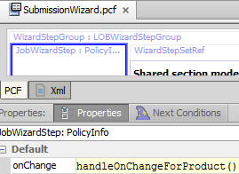
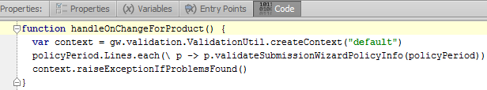


Validation at the end of a wizard step
Sometimes you want to validate all the objects on one screen in the wizard
Called from JobWizardStep
Written on Code tab on JobWizard
Notes:
You can write a validation class to validate all objects on a page in a jobwizard step and call that class when you leave the jobwizard step. For example, the Submission jobwizard has code in the Code tab which calls the validation methods defined in the validation classes for BOPPolicyInfoValidation class or the WCPolicyInfoValidation class, both classes specific to that wizard step. The method is called on the JobWizardStep: PolicyInfo as shown above.

Slide 16

Validation-related classes and interfaces
gw.validation
PCValidation (interface)
PCValidationBase (abstract class)
Context
Level
PCValidationContext
Result
Result
PCValidationResult
ValidationLevel typelist
ValidationResult
A
B
A has foreignkey to B
A
B
A extends B
Guidewire Platform
Notes:
PolicyCenter provides the following in the package gw.validation:
PCValidation: Interface that all validation classes must implement
PCValidationBase: Abstract convenience class that takes a PCValidationContext instance
PCValidationContext: Class that takes a ValidationLevel and creates a new PCValidationResult object during initialization
PCValidationResult: Class that contains the object methods to use in generating warnings and errors
The diagram above shows the relationship between the classes in the validation package. The PCValidationBase is an abstract class that implements PCValidation. The PolicyLineValidation class extends from abstract PC Validation base class. All the classes in the base configuration such as PALineValidation, BOPValidation etc. are all subclasses of PolicyLineValidation class. All of these classes are discussed in detail in the following slides.

Slide 17
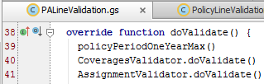

PCValidation interface
All Gosu validation classes must extend PCValidation
Entity validation classes extend PCValidationBase such as PersonalVehicleValidation or BOPBuildingValidation classes
Policy Line validation classes extend PolicyLineValidation such as PALineValidation or BOPLineValidation classes
Validation classes have a doValidate or a validateImpl method
Calls other methods that check a single problem
Notes:
The PCValidationBase exposes an abstract method validateImpl that subclasses can implement. PolicyLineValidation extends PCValidationBase and contains default logic that is not changeable by subclasses and hence finalizes validateImpl and has another overridable method called doValidate for its subclasses.
There are a few validation classes for some basic entities in the base product for example, BOPBuildingValidation extends AbstractBuildingValidation. The building validation classes are called from the line-specific validation classes, e.g. BOPLineValidation calls BOPBuildingValidation.
Any Gosu class (or any interface defined in Gosu) that implements PCValidation can perform validation logic. The first method in any validation class is the doValidate or the validateImpl() method. It directs the flow of logic in a class. It simply calls other methods and each one of these methods checks for a single problem. The doValidate or the validateImpl method performs no checks itself.

Slide 18
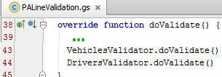


Define methods that test for a single issue
Call them in the Validator class
For example, methods to validate issues on personal auto objects are defined in PALineVehiclesValidator.gs and called using doValidate method
Notes:
In the example, above the PALineValidation calls the VehiclesValidator.doValidate which is defined in the PALineVehiclesValidator class. The PALineValidation class also defines PALineVehiclesValidator as VehiclesValidator and is used in the call statement. The PALineVehiclesValidator defines and calls methods such as atLeastOneVehicle and allGaragesInSameState, all of which have a very narrowly focused purpose.
Classes that implement this interface can create methods that test for a single issue to validate data objects and call those methods from their implementation of the doValidate or validateImpl method.

Slide 19
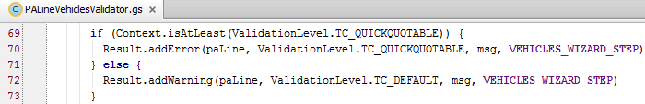
PCValidationContext
PCValidationBase constructor defines validation context PCValidationContext
PCValidationContext:
Takes a ValidationLevel at which to perform validation
Creates a new PCValidationResult to store validation results (errors and warnings)
Notes:
The PCValidationContext class provides several important methods used in managing validation. This class gathers contextual information for validation, including the validation level, results for accumulating errors and warnings, and a record of the classes and validation methods that have been visited. Use this method to create a PCValidationResult object to add errors or warnings after validation is performed.

Slide 20
PCValidationContext methods
isAtLeast(valLevel) - Tests if the level specified by ValidationContext is at least at valLevel
addToVisited(validation, methodName) - Provides opportunity to trace validation logic
hasVisited(className, methodName) – Indicates whether the combination of validation object and method have been seen before
returns true if the combination has been visited before
showVisited()
Produces a string that lists the validation methods that were visited as validation was performed with the provided Context
Notes:
This class has several important methods for use in managing validation. The above slide describes some of them briefly.
isAtLeast: This method is simply a test used to determine if validation should be checked. The isAtLeast method uses the validation levels priority - i.e., if valLevel is set to quotable then this method would only return true if the validation level specified in ValidationContext was quotable, bindable or readyForIssue. Using this method you could also check for the validation level in the Context being equal to a specific validation level.
addToVisited: This method provides the opportunity to trace validation logic, but it does not do so automatically. To be effective, each method needs to make this call and pass in a methodName that matches its name. Every method invoked should call this method. validation is the instance of the validation class to track and methodName is the method that is being invoked.
hasVisited: className is the fully qualified validation class name, including package and methodName is the method being invoked.
showVisited: The string list of validation methods visited, which is produced by this method, is useful for debugging.
For more details on each method please refer to the Gosu Reference Guide.

Slide 21
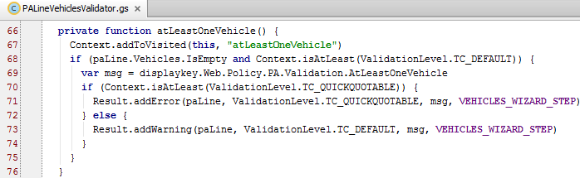
Context method example
atLeastOneVehicle method checks whether at least one vehicle is specified for a personal auto submission
Adds this method to the list of visited methods
Verifies that validation is being run at different validation levels
Notes:
In the example above, the atLeastOneVehicle method in the PALineVehiclesValidator.gs class uses the methods available on the validation context. The addToVisited method is used to register the fact that the method has been called. The Context.addToVisited should appear as the first line of all methods so that once the method is visited; its name (which is the second argument) is added to the list of visited methods.
The isAtLeast is used to determine if a certain validation check should be run, based on the validation level currently being checked. In the example above, if the validation level is default or higher (that is, quotable, bindable, readyForIssue) and the PA Line has no Vehicles in it, then add an appropriate message using displaykey AtLeastOneVehicle. Then another check is done to see if the validation level is at least “quotable” (that is quotable, bindable, or readyForIssue) and further validation checks are done in the following code (not displayed on the slide), that adds error and warning messages as appropriate.
Note that the addToVisited method has been added for training purpose.

Slide 22
PCValidationResult holds validation results
PCValidationResult is created by Context methods
PCValidationResult class provides methods that hold the resulting warnings and errors:
addError(object, valLevel, errorMessage, wizardStepId)
addFieldError(object, strRelativeFieldPath, valLevel, errorMessage, wizardStepId)
addWarning(object, valLevel, warningMessage, wizardStepId)
addFieldWarning(object, strRelativeFieldPath, valLevel, warningMessage, wizardStepId)
where: valLevel means that the error or warning will be added at that level or any level more restrictive
Notes:
PCValidationResult holds the warnings and errors added by the validation implementation classes as problems are discovered. PCValidationResult contains a number of object methods that are mentioned in the slide above that you can use in generating warnings and errors.
The arguments to the PCValidationResult methods are explained below:
object – the object you are validating
valLevel – validation level at which the error/warning should be added. For example, if the error/warning is added at the quotable level then it appears at quotable, bindable, and readyforissue levels.
errorMessage/warningMessage – error message you want to be displayed when there is an error. Guidewire recommends using displaykeys for all string objects.
wizardStepId – (Optional) The id of the wizard step of the object. If you supply the wizardStepID, the method creates a link to the wizard step with the ID wizardStepId, if that is not the current step.
The addFieldError and addFieldWarning have additional field strRelativeFieldPath which is a string relative to the path to the field.
PCValidationResults inherits several different forms of the reject method from the (platform) ValidationResult class (which it subclasses).

Slide 23
Validation result example
Checks a condition and displays the following warning or error message at the appropriate wizard step
Error or warning messages at quotable and default validation levels respectively
msg
Notes:
The first condition checks two things: (1) first, paLine.Vehicles.IsEmpty checks whether there are values in the Vehicles array; (2) second, that the level validation is being run at is at least at the default level. The second conditional statement adds an error message if the validation level is quickquotable or higher, or a warning if the same condition is true but the current validation level we are testing at is default, that is, lower than quickquotable. The errorMessage is specified in the variable msg using a displaykey and used when an error or warning is displayed as shown in the next slide.
VEHICLES_WIZARD_STEP is a static final variable defined in the class with value “PersonalVehicles”, which is the wizardStepId of the Vehicles step in the Personal Auto submission wizard.

Slide 24
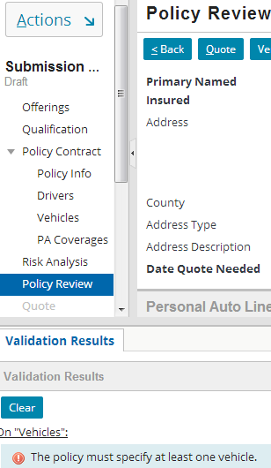
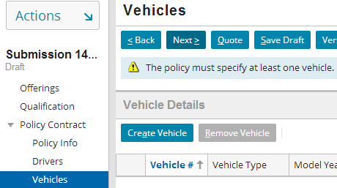
Validation results in the user interface
Validation warning at “default” level
2.
1.
Validation error at “quotable” level
link to the wizard step
Notes:
Note that the warning is displayed as soon as you leave the Vehicles step in the submission wizard. Since you are on the Vehicles page a link to the page is not displayed.
When you are on the PolicyReview wizard step and you click the Quote button to get a quote, the validation is performed at “quotable” level and an error is displayed with a link to the Vehicles wizard step where the error occurred. The user can click on that link which takes them to the Vehicles page where they can enter a vehicle and fix the error.

Slide 25
Lesson outline
Class-based validation overview
Validation levels
Class-based validation configuration
Validation chaining
Invoking class-based validation
Add a new validation check

Slide 26
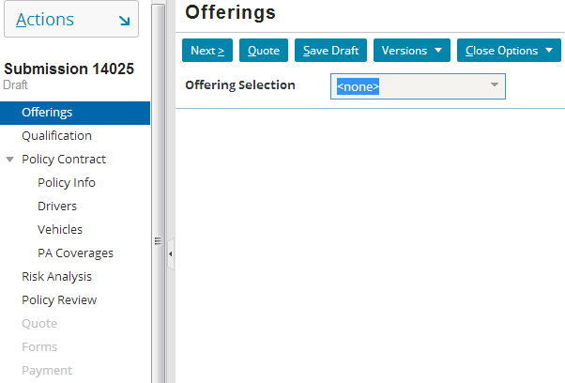
Validation chaining
Validation chaining is the process of one validation class calling another validation class to perform additional validation checks
Validate Period
Validate Line
Next
Validate Driver
Next
Validate Vehicle
Notes:
For example, if validating a Personal Auto line policy period, the code calls the Period Validate which then calls a class that validates the policy line. In turn, these classes chain to validations of entities they hold.
Note: Validation chaining is not automatic. For a class to perform validation chaining, you must specifically construct it to do so.

Slide 27
Validation chain flow
1. Call validate() method which in turn calls other methods
2. Invoke validate method on another validation class (may have to loop through a set of objects)
3. Classes chain to validations of entities they hold
A class must be specifically set to perform validation chaining
In the base configuration, PolicyPeriodValidation class performs validation chaining
Notes:
Objects on the PolicyPeriod are part of the policy-graph.

Slide 28
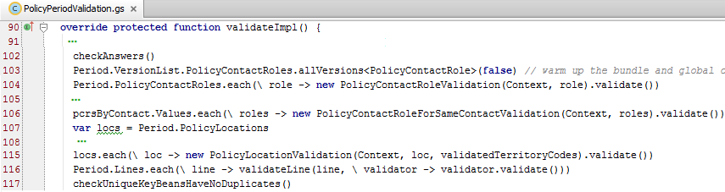
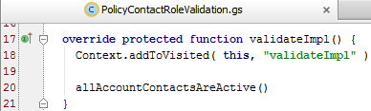

Example: PolicyPeriodValidation chaining(1)
1
2
3
4
1
2
Notes:
Initially, the PolicyPeriodValidation validate method executes a number of validation methods defined in PolicyPeriodValidation, each of which tests for a certain condition. Then for some validation other validation classes are called:
PolicyContactRoleValidation when called performs validation on all contact roles on the policy period. The PolicyContactRoleValidation class gets called within a block to validate each contact role on the policy period.
PolicyContactRoleForSameContactValidation performs validation that runs on all PolicyContactRoles that share the same contact. This also loops through all the shared contacts.

Slide 29
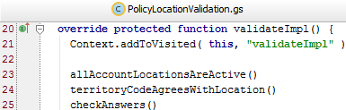


Example: PolicyPeriodValidation chaining (2)
3
4
Notes:
PolicyLocationValidation gets called to validate each location. It also validates all territory codes on each PolicyLocation. Code executes a loop through all of the Location objects in PolicyLocations. For each Location, it calls the PolicyLocationValidation validate method on that object. The code that makes that call is in the PolicyLocationValidation class. For every PolicyLocation in the PolicyLocations array, an instance of the PolicyLocationValidation class is created using the Context object and the current location. Then, the validate() method for that instance is called. This executes validation logic against that particular PolicyLocation.
The validateLine function calls the PolicyLineValidation class to validate individual lines on the policy. The line validation classes may chain to other validation classes to validate specific entities and so on.

Slide 30
Lesson outline
Class-based validation overview
Validation levels
Class-based validation configuration
Validation chaining
Invoking class-based validation
Add a new validation check

Slide 31
Invoking class-based validation
Class-based validation must be explicitly invoked through:
Code, job processes, wizard steps, workflow steps, integration plug-ins, or from any Gosu code
To invoke validation from a particular PolicyCenter location:
Wizard steps - use beforeSave attribute for that step
Pop-ups - use beforeCommit attribute for that pop-up
Notes:
The PolicyCenter user interface framework handles rendering of all errors and warnings raised through exceptions automatically. In case of workflow steps, user can invoke validation.

Slide 32
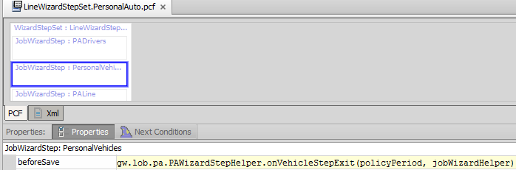
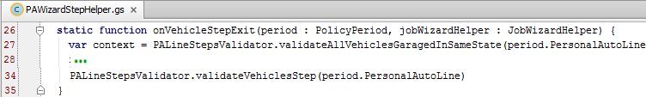
Invoking validation in a job wizard step
Invoking atLeastOneVehicle validation on a PA submission
Specified in the beforeSave attribute of the step
Notes:
The beforeSave attribute value consists of the following expressions:
beforeSave = gw.lob.pa.PAWizardStepHelper.onVehiclesStepExit(policyPeriod, JobWizardHelper).
This expression invokes the onVehiclesStepExit method on the PAWizardStepHelper class. The PAWizardStepHelper class calls the validateVehiclesStep in the PALineStepsValidator class which has specific checks to perform before committing the Vehicles wizard step, including the validateVehiclesStep method which is discussed in the next slide.

Slide 33
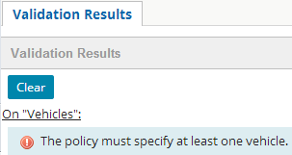
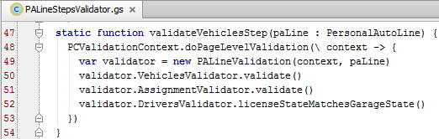


validateVehicleStep static method
All statements within validateVehicleStep method are executed in sequence
Notes:
The function creates validation object as an instance of PALineValidation.
The next steps are all method calls for validation checks defined in the PALineVehiclesValidator.gs and all the checks are executed in the sequence specified below:
atLeastOneVehicle() – The error mentioned above is displayed as a result of this method call.
allGaragesInSameState()
vinIsUniqueInPeriod()
validateEachVehicle which has the statement - paLine.Vehicles.each( \ vehicle → new PersonalVehicleValidation( context, vehicle).validate()) This checks for each vehicle in paLine arrray of Vehicles, validates each vehicle using the PersonalVehicleValidation class. This statement creates an instance of PersonalVehicleValidation context object for each vehicle.
Then the AssignmentValidator and DriverValidator classes are called to validate driver assignment and to validate drivers respectively.

Slide 34
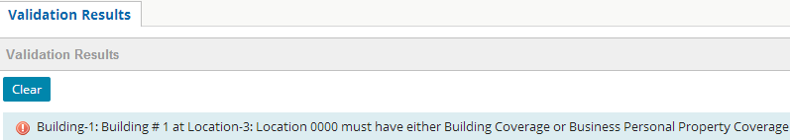
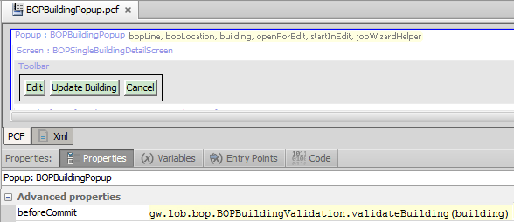
Invoking validation in a pop-up
Calls validateBuilding method in the BOPBuildingValidation
Notes:
The BOPBuildingPopup invokes validation on a building on a BOP policy as shown in the screenshot above. When the user creates a BOP submission and adds a building without any base coverage, the error in the screenshot above is displayed. The BOPBuildingValidation class has a method validateBuilding which in turn chains to the checkAtLeastOneBaseCov method which displays this error. These methods are discussed in the next slide.

Slide 35


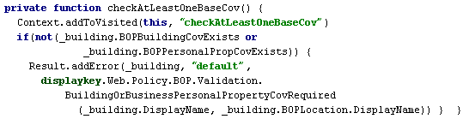
validateBuilding method
Notes:
validateBuilding method is a static method defined to check validation for the current building only. Full policy inspection is not necessary to perform this validation check. The first statement in the method creates the Context object at the default validation level. The second statement creates an instance of the BOPBuildingValidation with context object and bldg and calls or chains to the validate() method of the class.
The validate() method registers that it has been called using the Context object, and calls the checkAtLeastOneBaseCov().
The checkAtLeastOneBaseCov method first registers itself using the addToVisited method and checks at the default validation level whether a building coverage or a property coverage exists on the new building being added. If none of these coverages exist on the building then an error message is displayed using the displaykey BuildingOrBuisinessPersonalPropertyCovRequired.

Slide 36
Lesson outline
Class-based validation overview
Validation levels
Class-based validation configuration
Validation chaining
Invoking class-based validation
Add a new validation check

Slide 37
Creating a new validation class (1)
For new entities:
Create new validation class for entity you want to validate or
Create new validation class when you create a new LOB
For existing entities:
If a validation class for the entity exists add validation check methods to that class
If the validation class does not exist, then create new validation class
New class should extend PCValidationBase or PCValidation
Use an existing validation class as a reference
Notes:
When you want to validate a new object, you will have to create a new validation class for that object whether it is a new line of business or a new entity. Then you can add your validation check methods to validate the objects.
If the entity already exists in PolicyCenter, it is still possible that it does not have any validation checks on it and hence no validation class exists for it. In that case you will still have to create a new validation class and then add validation checks to that class. Guidewire recommends that you follow the above mentioned object oriented approach and write validation checks on an object in the objects validation class.
You should always create a validation class for any new LOB.
Though generally validation is entity based, sometimes you will want to validate wizard steps specifically, and thus will create wizard step specific validation classes, as mentioned in previously.

Slide 38

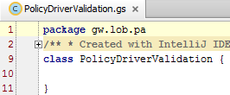
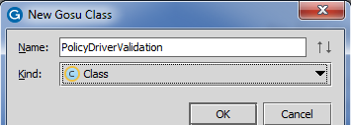
Creating a new validation class (2)
1.
2.
3.
[Object]Validation
Notes:
Step 1: Right click lob to create a new package for a new line of business class such as BL for BicycleLine.
If the lob package already exists then create the class by right-clicking the package name as shown in the example above.
Step 2: Give a two to three character abbreviation for LOB name followed by Line if you are creating a new class to validate a line of business.
If creating a new class for an object then name the class as [Object name (full or abbreviated)] such as PA for Personal Auto, followed by Validation.
Step 3: PolicyCenter by default adds the package gw.lob.pa for personal auto since this new class was created in the personal auto line of business.

Slide 39
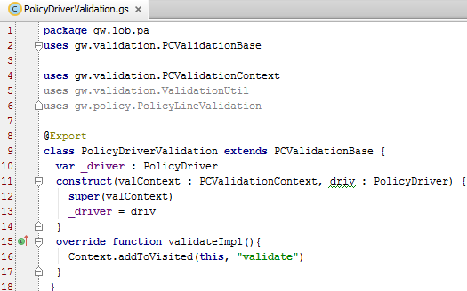
Add basic validation class code
Validation packages
Object to validate
Validation Context object
validate method
Notes:
The code in step 3 is given below for easy copy-paste. It does not get added automatically. This is the basic code that will be needed by any class. Users will have to modify it with the appropriate object and LOB names.
_driver is an internal variable, defined within the class.
The construct method, to construct a driver validation context, is passed driv as argument when it is called. driv is the specific PolicyDriver being validated.
Here is the code:
package gw.lob.pa
uses gw.validation.PCValidationBase
uses gw.validation.PCValidationContext
uses gw.validation.ValidationUtil
uses gw.policy.PolicyLineValidation
@Export
class PolicyDriverValidation extends PCValidationBase {
var _driver : PolicyDriver
construct(valContext : PCValidationContext, driv : PolicyDriver) {
super(valContext)
_driver = driv
}
override function validateImpl(){
Context.addToVisited(this, "validate")
}
}

Slide 40
Adding a validation check
Steps:
Edit/add appropriate validation class
Add the validation check method
Call method from validateImpl()
Invoke the method
Verify the result in the UI
Example: Add a validation check that warns a user when they create a red car that red cars result in higher premiums
Notes:
The following slides create a validation check for the example mentioned above. For the purpose of training we are assuming that this car is a personal vehicle on a personal auto policy and create the validation check based on that.

Slide 41
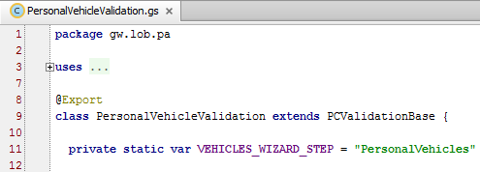
1. Edit/add appropriate validation class
Edit PersonalVehicleValidation.gs
Notes:
First you will have to decide whether this validation can be added to an existing class or a new validation class needs to be created. In this example, the object whose color is to be checked is a personal vehicle, so this would be added to the PersonalVehicleValidation class. Open that class for editing.
If, on the other hand, you needed to add a validation check for a new entity that didn’t already have any validation checks and no validation checks exist for it, you would need to create a new validation class to validate that specific entity.

Slide 42
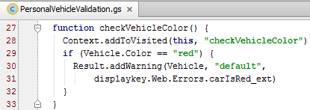
2. Add the validation check method
Notes:
The above function is added to check whether the color of the vehicle is red. If the color of the vehicle is red then a warning is added to be displayed at the default validation level stating that - Red cars result in higher premiums. This warning string is created using the displaykey carIsRed_ext.
You will need to restart the server because of display key addition.

Slide 43
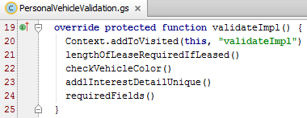
3. Call method from validateImpl()
Notes:
The validateImpl method of any class calls all the methods in a logical sequence. Add the validation check for vehicle color to the validateImpl method of a PersonalVehicleValidation class.
Note: In case where you had to create a new validation class then you will also have to create a validateImpl () method and then add the method call statement to the method. For the example, we are creating a validation check for a personal vehicle and adding the method call statement to the validateImpl() method of the PersonalVehicleValidation class.

Slide 44





4. Invoke the method
Color of a vehicle is entered on Vehicles step of job wizard
Validation should be invoked on this Vehicles step
Notes:
The validation class methods have to be invoked explicitly and are not called automatically. For this example we do not need to add extra code to the beforeSave attribute of the wizard step since the onVehicleStepExit calls validateVehiclesStep method which calls PALineValidation whose VehiclesValidator creates instances and validates each vehicle in the PersonVehicleValidation class. The above slide explains the validation chaining on vehicles step of the job wizard.
The beforeSave attribute of personal auto submission wizard calls the validateVehiclesStep of the PAWizardStepHelper class, which calls the PALineStepsValidator which starts all validation on PALine using validation chaining.

Slide 45
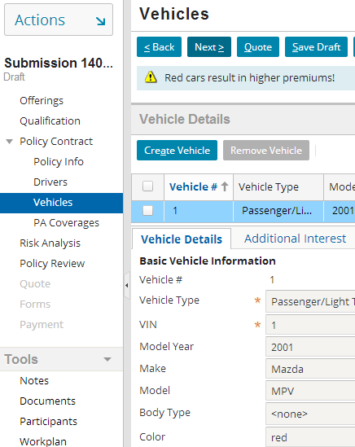
5. Verify the result in the UI
Add a vehicle with Color value “red” on the Vehicles step of a personal auto submission

Slide 46
Lesson objectives review
You should now be able to:
Describe validation classes used by PolicyCenter
Identify which objects should use validation classes
Explain how validation levels are used
Invoke class-based validation from different locations in PolicyCenter
Write validation checks needed to validate objects on a policy

Slide 47
Review questions
Name the validation context method that produces a string of methods that were visited as validation was performed.
Name three policy-related objects in PolicyCenter on which class-based validation is performed.
Define validation chaining.
Name the PCF attributes used to invoke class-based validation in a popup and in a job wizard.
State true or false:
All entities in PolicyCenter can be validated.
All validation classes must have a validateImpl or doValidate method.
The doValidate method should be last method in a class.
Notes:
Answers
The showVisited() method shows a list of methods as a string that were visited as validation was performed.
Class-based validation can be performed on PolicyContactRole, PolicyLocation, PolicyPeriod, or any LOB entities, or any other policy-specific entities.
Validation chaining is the process of one validation class calling another validation class to perform additional validation checks.
beforeSave attribute for a job wizard step and beforeCommit attribute on a popup.
True or false:
True
True
False

Slide 48
Notices
Copyright © 2001-2014 Guidewire Software, Inc. All rights reserved.
Guidewire, Guidewire Software, Guidewire ClaimCenter, Guidewire PolicyCenter, Guidewire BillingCenter, Guidewire Reinsurance Management, Guidewire ContactManager, Guidewire Vendor Data Management, Guidewire Client Data Management, Guidewire Rating Management, Guidewire InsuranceSuite, Guidewire ContactCenter, Guidewire Studio, Guidewire Product Designer, Guidewire Live, Guidewire DataHub, Guidewire InfoCenter, Guidewire Standard Reporting, Guidewire ExampleCenter, Guidewire Account Manager Portal, Guidewire Claim Portal, Guidewire Policyholder Portal, ClaimCenter, BillingCenter, PolicyCenter, InsuranceSuite, Gosu, Deliver Insurance Your Way, and the Guidewire logo are trademarks, service marks, or registered trademarks of Guidewire Software, Inc. in the United States and/or other countries.
All other trademarks are the property of their respective owners.
This material is confidential and proprietary to Guidewire and subject to the confidentiality terms in the applicable license agreement and/or separate nondisclosure agreement.
This file and the contents herein are the property of Guidewire Software, Inc. Use of this course material is restricted to students officially registered in this specific Guidewire-instructed course, or for other use expressly authorized by Guidewire. Replication or distribution of this course material in electronic, paper, or other format is prohibited without express permission from Guidewire.
Guidewire products are protected by one or more United States patents.
Notes:
Validation Classes - 48

