Slide 1


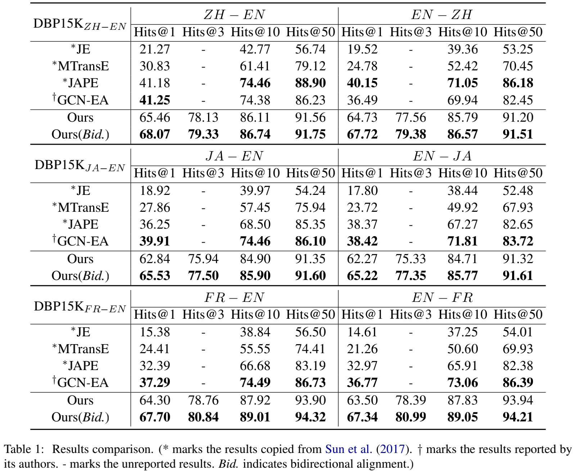

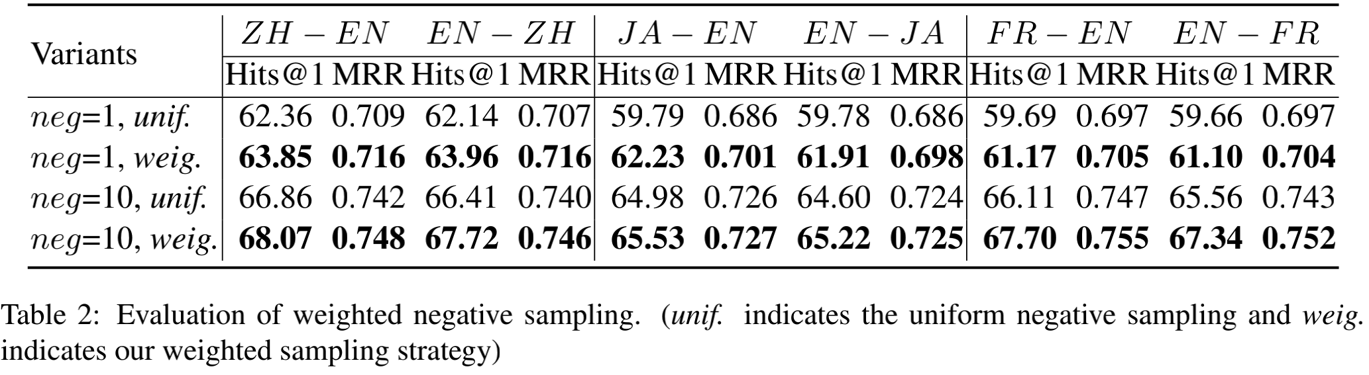
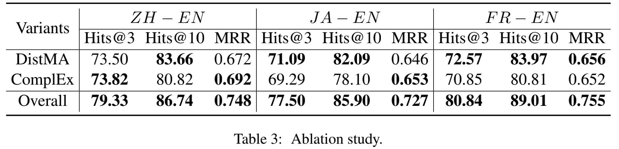
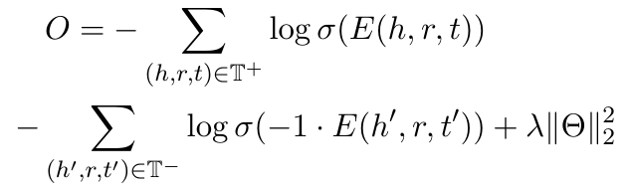
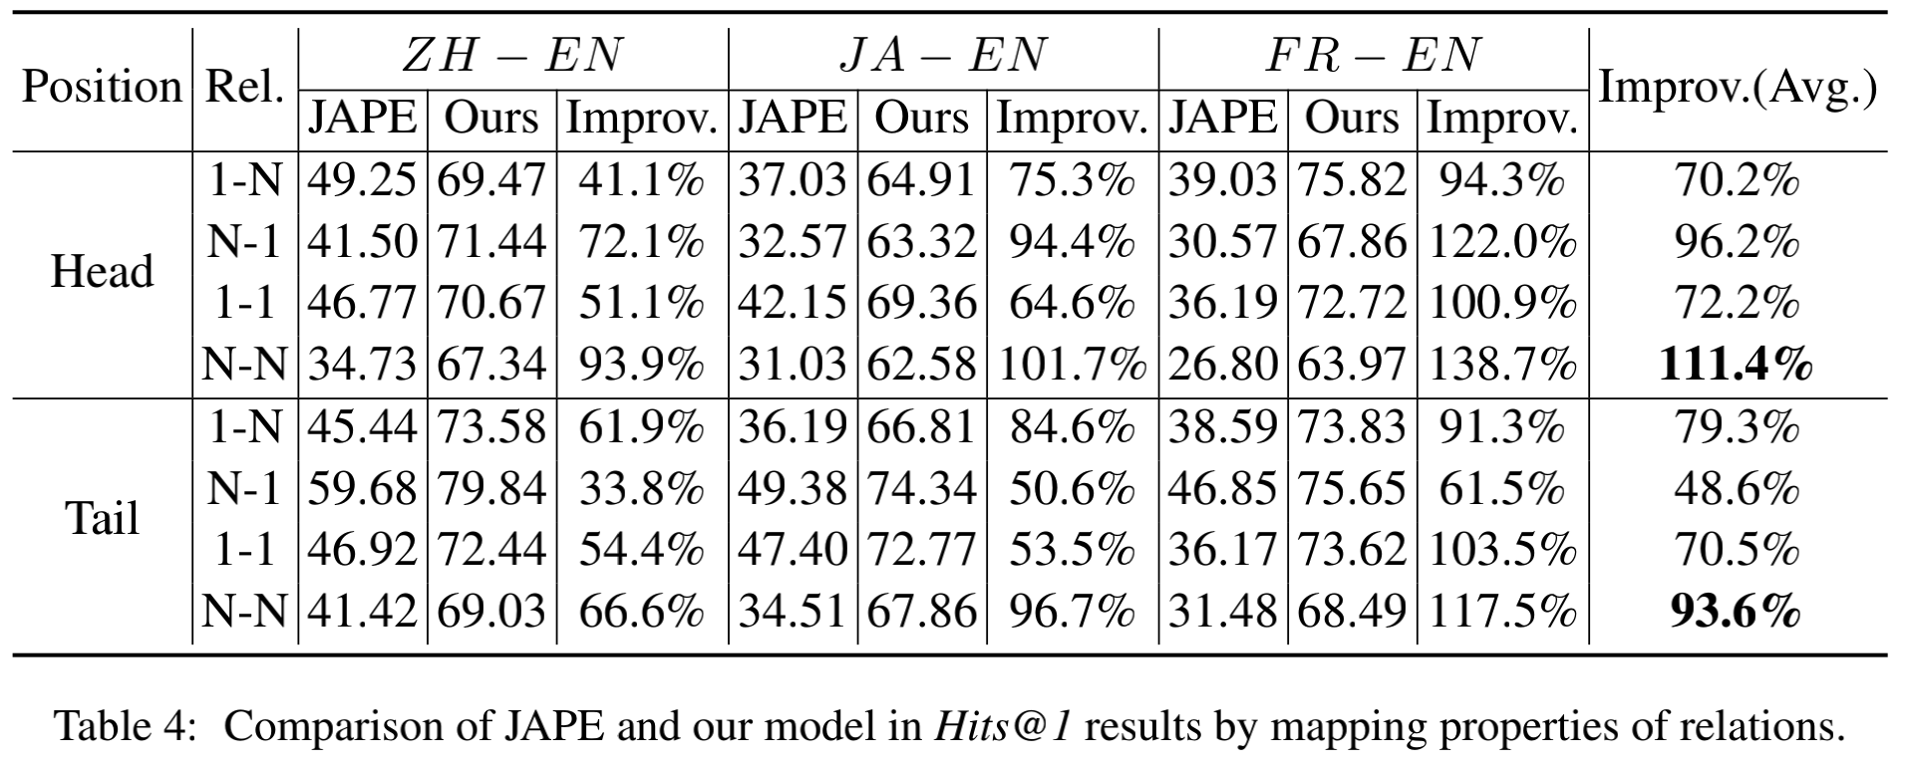
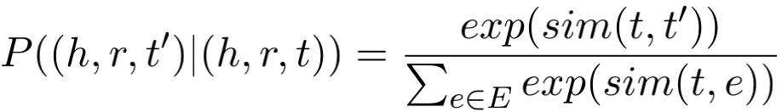

Modeling Multi-mapping Relations for Precise Cross-lingual Entity Alignment
Xiaofei Shi and Yanghua Xiao
School of Computer Science, Fudan University, Shanghai, China
Introduction
Evaluation
√
Motivations
Previous methods pay little attention to modeling multi-mapping (1-N, N-N) relations, resulting in low precision.
Dot products over embeddings. The success of DistMult(Yang et al., 2015) and ComplEx (Trouillon et al., 2016) in knowledge representation learning shows that the dot products of embeddings can naturally handle multi-mapping relations.
Through defining dot product-based energy function, the model can better capture the semantics of both 1-1 and multi-mapping relations.
Dataset
DBP15K: Proposed by Sun et al (2017), containing three cross-lingual real-world datasets(ZH-EN, JA-EN, FR-EN) , in which each was built with 15 thousand ILLs from multilingual versions of DBpedia. The average number of entities, relations and relational triples of the three datasets are 166,255/4,291/420,025 respectively.
Evaluation Metrics
Hits@k: The percentage of correctly aligned entities ranked in the top-k. Generally, Hits@1 indicates the precision.
MRR: The average of the reciprocal ranks of all test instances.
Baseline Models
Main Results
Contributions
We propose a new KG embedding framework to jointly embed entities and relations from different KGs into a uniﬁed embedding space using a small set of pre-aligned pairs obtained from inter-lingual links.
We propose a weighted sampling strategy for hard negative example selection.
We regard the alignment prediction as a bidirectional selection problem, and we propose to combine ranking matrices from both directions to align entities.
We evaluate the proposed approach on three real-world cross-lingual datasets. Experimental results (especially with the metric Hits@1) show that our approach signiﬁcantly outperforms four representative embedding-based methods for cross-lingual entity alignment.
Models | Description
JE (Hao et al., 2016) | A variant of TransE (Bordes et al., 2013) model.
MTransE (Chen et al., 2017) | Encoding each KG based on TransE, and then learns cross-lingual transitions between different KGs.
JAPE (Sun et al., 2017) | Encoding both structure and attributes of KGs.
GCN-EA (Wang et al., 2018) | Employing GCNs to encode KGs.
Methodology
Multilingual KG Embedding
DistMA
The model defines a basic product-based energy function to measure the plausibility of the triple (h, r, t).
ComplEx
To improve the ability of the model to encode antisymmetric relations like is_father_of, part_of, we utilize the ComplEx (Trouillon et al., 2016).
Joint Embedding
The final energy function for each triple is defined as:
Parameter Sharing
The pre-aligned pair share embedding to bridge different KGs.
Final Objective Function
Evaluation of Weighted Negative Sampling
Ablation Study
Hits@1 Results by Mapping Properties of Relations
T⁺ and T⁻ are positive and negative triples set.
Weighted Negative Sampling
We sample negative triples according to the following probability distribution (take the tail entity as an example):
b₃ is the most similar entity with a₁ in [b₁, b₂, b₃] .
Conclusion
Bidirectional Alignment
We refine the final ranking matrix M₁₂ (M₁₂[i][j] denotes the index of b_{j} (KG₂) in the ranking list of a_{i} (KG₁) ) as:
 | b₁ | b₂ | b₃
a₁ | 2 | 3 | 1
a₂ | - | - | -
a₃ | - | - | -
 | a₁ | a₂ | a₃
b₁ | 1 | - | -
b₂ | 2 | - | -
b₃ | 3 | - | -
This paper presents a simple and effective embedding framework for multilingual KGs, which defines product-based function over embeddings to better handle both 1-1 and multi-mapping relations.
We propose a weighted sampling strategy to generate hard negative examples during training. Moreover, we propose to align entities from both directions.
Experimental results on real-world datasets show that our method signiﬁcantly outperforms four competitors, especially with the metric Hits@1, indicating our method is more precise.
M₁₂
 | b₁ | b₂ | b₃
a₁ | 3 | 5 | 4
a₂ | - | - | -
a₃ | - | - | -
M₂₁
Final M₁₂
Now, b₁ is the most similar entity with a₁ in [b₁, b₂, b₃] .
Fudan Knowledge Works

