Slide 1


Time Series Analysis for Efficient Sample Transfers
Hemanta Sapkota, Bahadir A. Pehlivan, Engin Arslan
University of Nevada - Reno

Slide 2

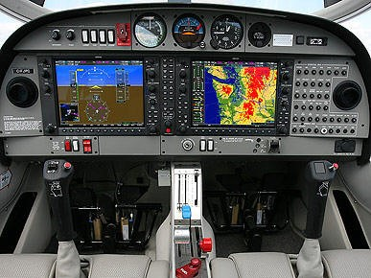

Big Data Era
New Gen Aircrafts will be generating 5 terabytes of data per flight
Each telescope of EHT generates 350 terabytes of data per day
Facebook generates
4 petabytes new data per day
Notes:
First Picture by Marina Hinic from pexels.com
Second Picture by Panumas Nikhomkhai from pexels.com
Third picture by EHT of Blackhole

Slide 3
Underutilization of High Speed Networks
There exists 100 Gbps high speed networks but they are not utilized efficiently. Some reasons are:
CPU limitations
Poor file system performance
Buffer size performance
Transport protocol inefficiency

Slide 4
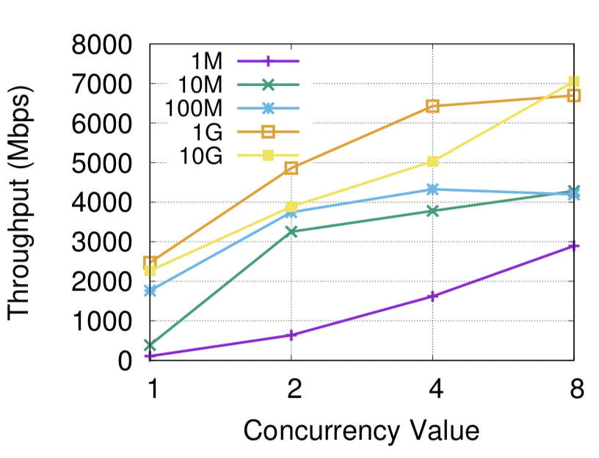
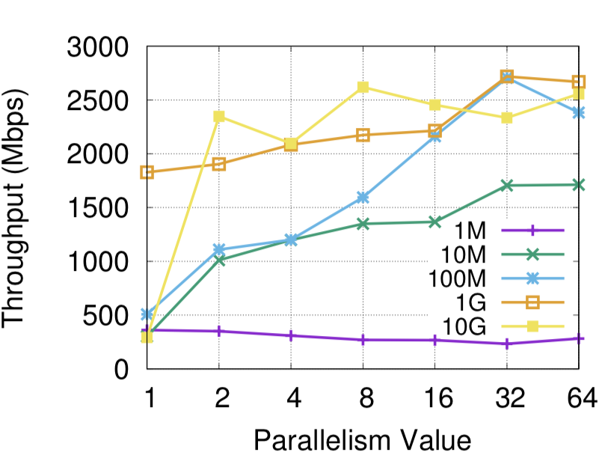
Application Layer Solutions
Different application layer parameters impact throughput of transfer.
But maximum throughput yielding parameter is not always known and vary with network conditions.
So, to find a good parameter configuration which yields maximum throughput, we want to do multiple sample transfer with different parameter configuration.

Slide 5
Application Layer Solutions
Concurrency: 2,
Parallelism: 6,
Pipelining: 2
Let’s say we have large file to transfer, then we would run sample transfer and predict the throughput with each configuration, that way we can choose configuration with maximum throughput.
In the following example we would use configuration 3 to transfer the whole file.
Config 1
Config 2
Config 3
…...
Config n
1050 Mbps
2738 Mbps
4205 Mbps
2152 Mbps
Configurations: Parallelism, Pipelining, Concurrency, Buffer Size.

Slide 6
Problem
So now the problem is predicting convergence throughput as fast as we can.
In this paper we will show experiments involving different methods and find a method which predicts convergence throughput with high accuracy and fast.

Slide 7
Related Work: Fixed Data Size
In this approach, certain percentage of data (e.g. 15%) is transferred.
And the predicted average throughput is the average throughput of that percentage of data transfer.
Problem with this approach is that 15% of large file (e.g. 100GB) is very large and 15% of small file (e.g. 1GB) is very small. This will produce long convergence time in some cases and high error rate in other cases.

Slide 8
Related Work: Adaptive
This approach was defined in “Big data transfer optimization through adaptive parameter tuning” paper.
The basic idea is that we will only say the throughput converged, when two points are close to certain threshold.
And we use average of those two throughput as predicted average throughput.
But fluctuation on network throughput can have impact on this approach.

Slide 9
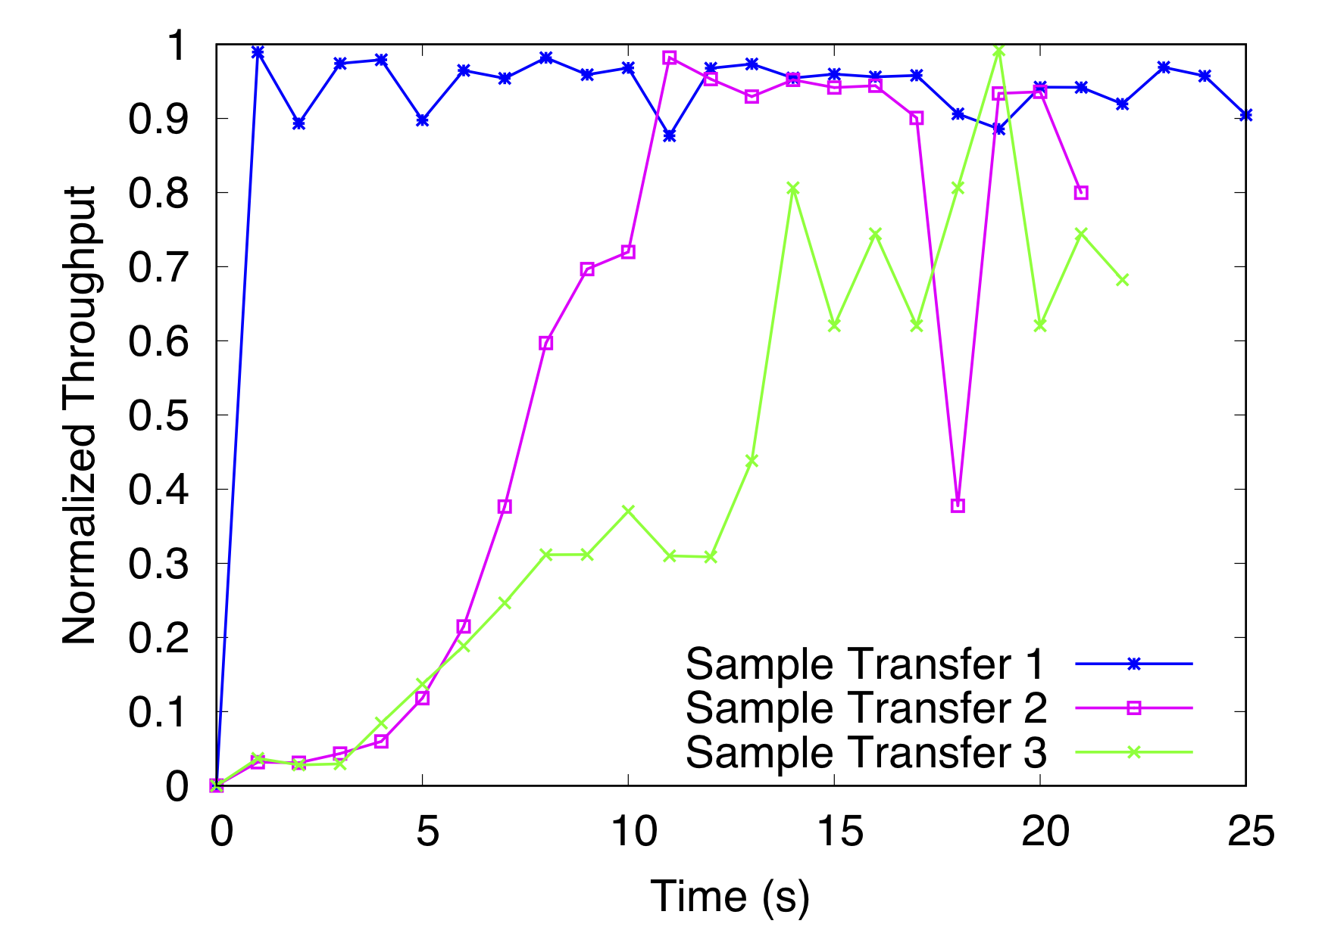
Related Work: Adaptive
Sometimes throughput converges fast and has less fluctuation like in Sample Transfer 1.
But most of the time there is network fluctuation like in Sample transfer 3 and adaptive approach would predict average throughput at 10 sec, but it is converging at 15 sec.

Slide 10
Time Series Analysis For Throughput Prediction
Initial points are fed into model.
Model makes a prediction.
When value of next point in time is known, If prediction is close enough algorithm terminates.
Otherwise it predicts next point considering recently added data as well.
When it terminates predicted points are used to estimate average throughput.

Slide 11
Time Series Models
Autoregressive (AR) model
Autoregressive Moving Average (ARMA) Model
Autoregressive Integrated Moving Average (ARIMA) model

Slide 12
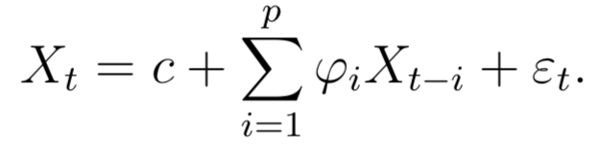
Autoregressive (AR) Model
The model uses last “p” points to fit the model and estimate all values of “𝜑” and “ε_{t}”.
Here, the assumption is that final value is linearly dependent on previous values in addition with some error.
Autoregressive model uses past forecast to predict the new forecast.

Slide 13
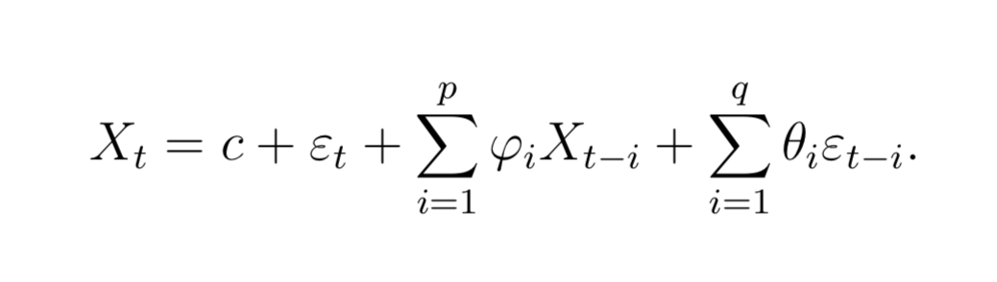
ARMA Model
In addition to Autoregressive, ARMA also uses Moving average part.
Moving average uses error of previous forecast to make new prediction. So, as we have more data to fit, the error starts to fade away.

Slide 14
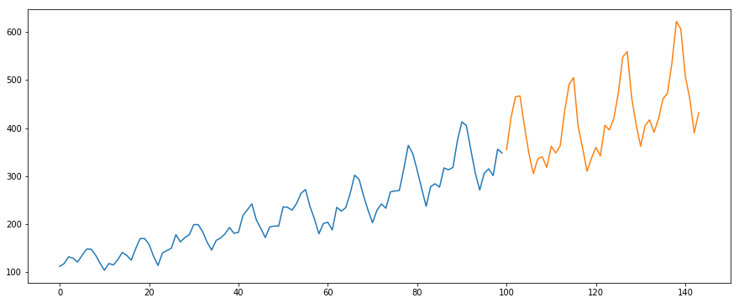
ARIMA Model
In addition to Autoregressive and moving average, ARIMA also makes data stationary if there is seasonality in the data.
Throughput doesn’t seem to have any seasonality in it because ARIMA performs worst of three Time series models.

Slide 15
EXPERIMENTS

Slide 16
System Specs of Experimental Networks
Specs | Storage | Memory (GB) | Bandwidth (Gbps) | RTT (ms) | Transfer Count
XSEDE | Lustre | 96 | 10 | 40 | 28,209
ESnet | RAID-0 | 128 | 100 | 89 | 5,218
Pronghorn | GPFS | 192 | 10 | 0.1 | 2,316
HPCLab | NVMe SSD | 64 | 40 | 0.1 | 16,383
Total |  |  |  |  | 52,126

Slide 17
What Do We Measure?
We use two metrics to measure the performance of models.
Convergence Time: The time it takes for model to have a prediction.
Error Rate: Percentage closeness of estimation to real average throughput.

Slide 18
Experiments - Optimal Convergence Time
Takes average of last four points, stops when it is close enough to the actual throughput of whole transfer, which we know beforehand.
We will calculate optimal convergence time for different threshold. If threshold is 20%, it will stop when the average of last four points is less than equal to 20%.
Time it requires to stop is Optimal Convergence time.

Slide 19
Experiments - Optimal Convergence Time
Threshold 10%, average throughput: 200Mbps
40, 90, 150, 190 (Average: 117.5) (Closeness: (200-117.5)/200=41.25%)
40, 90, 150, 190, 160 (Average: 147.5) (Closeness:(200-147.5)/200=26.25%)
40, 90, 150, 190, 160, 210 (Average: 177.5) (Closenes: (200-177.5)/200=11.25%)
40, 90, 150, 190, 160, 210, 200 (Average: 190) (Closeness: (200-190)/200=5%)
Error Rate: 5% Optimal Convergence Time: 7 seconds

Slide 20
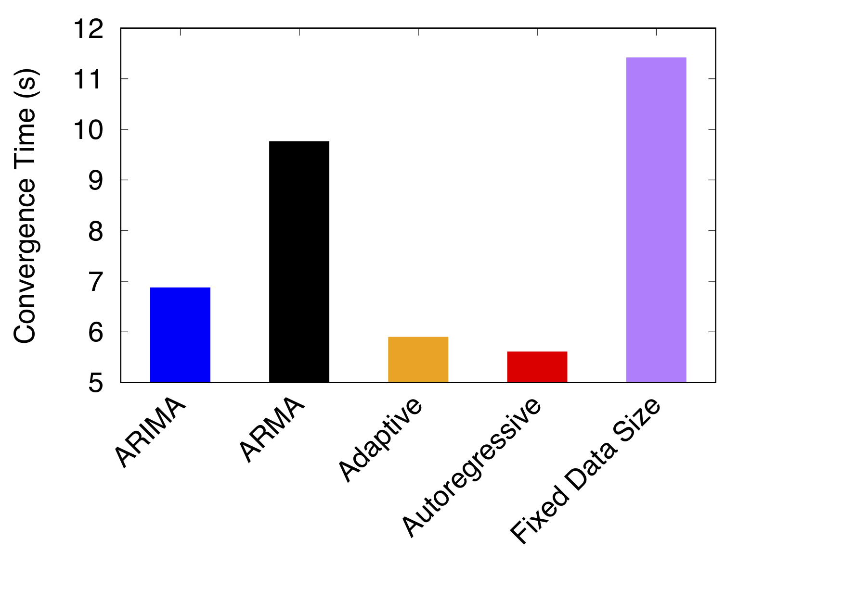
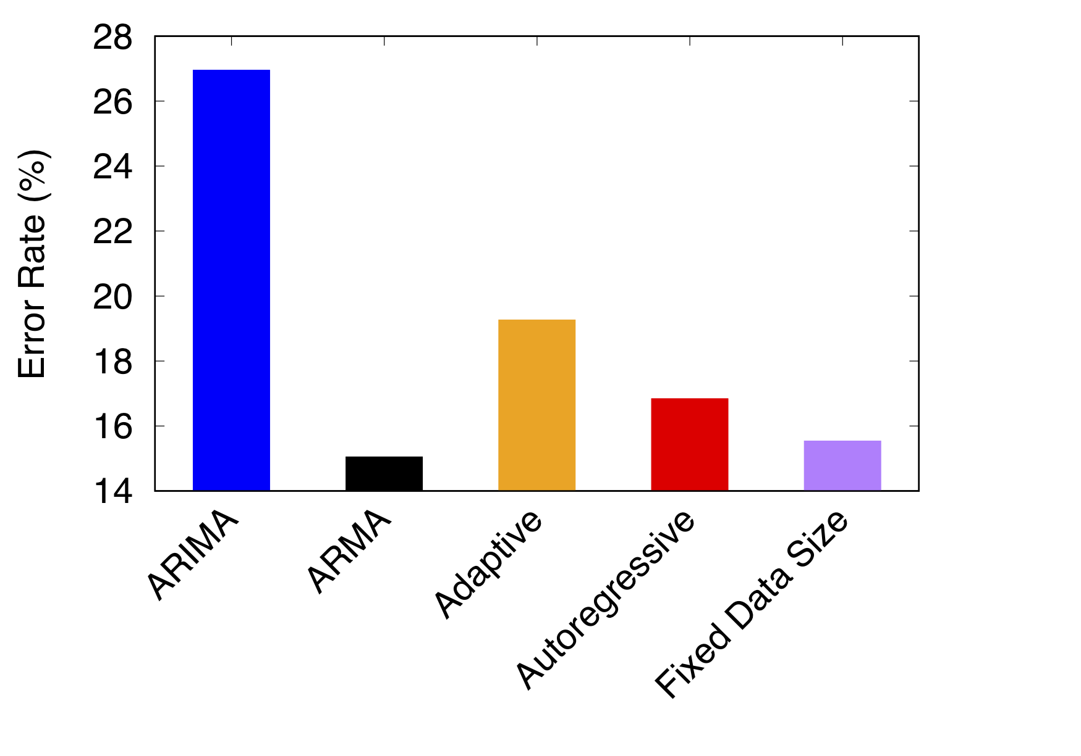
Experiments - Overall
Fixed data size has good error rate but very long convergence time.
ARIMA and ARMA are performing bad in terms of error rate and convergence time.
Adaptive is getting high error rate on overall.
Autoregressive has low convergence time and low error rate.

Slide 21
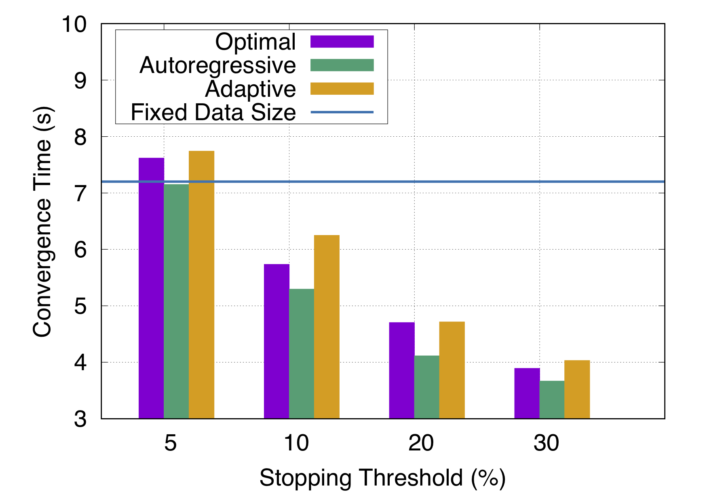
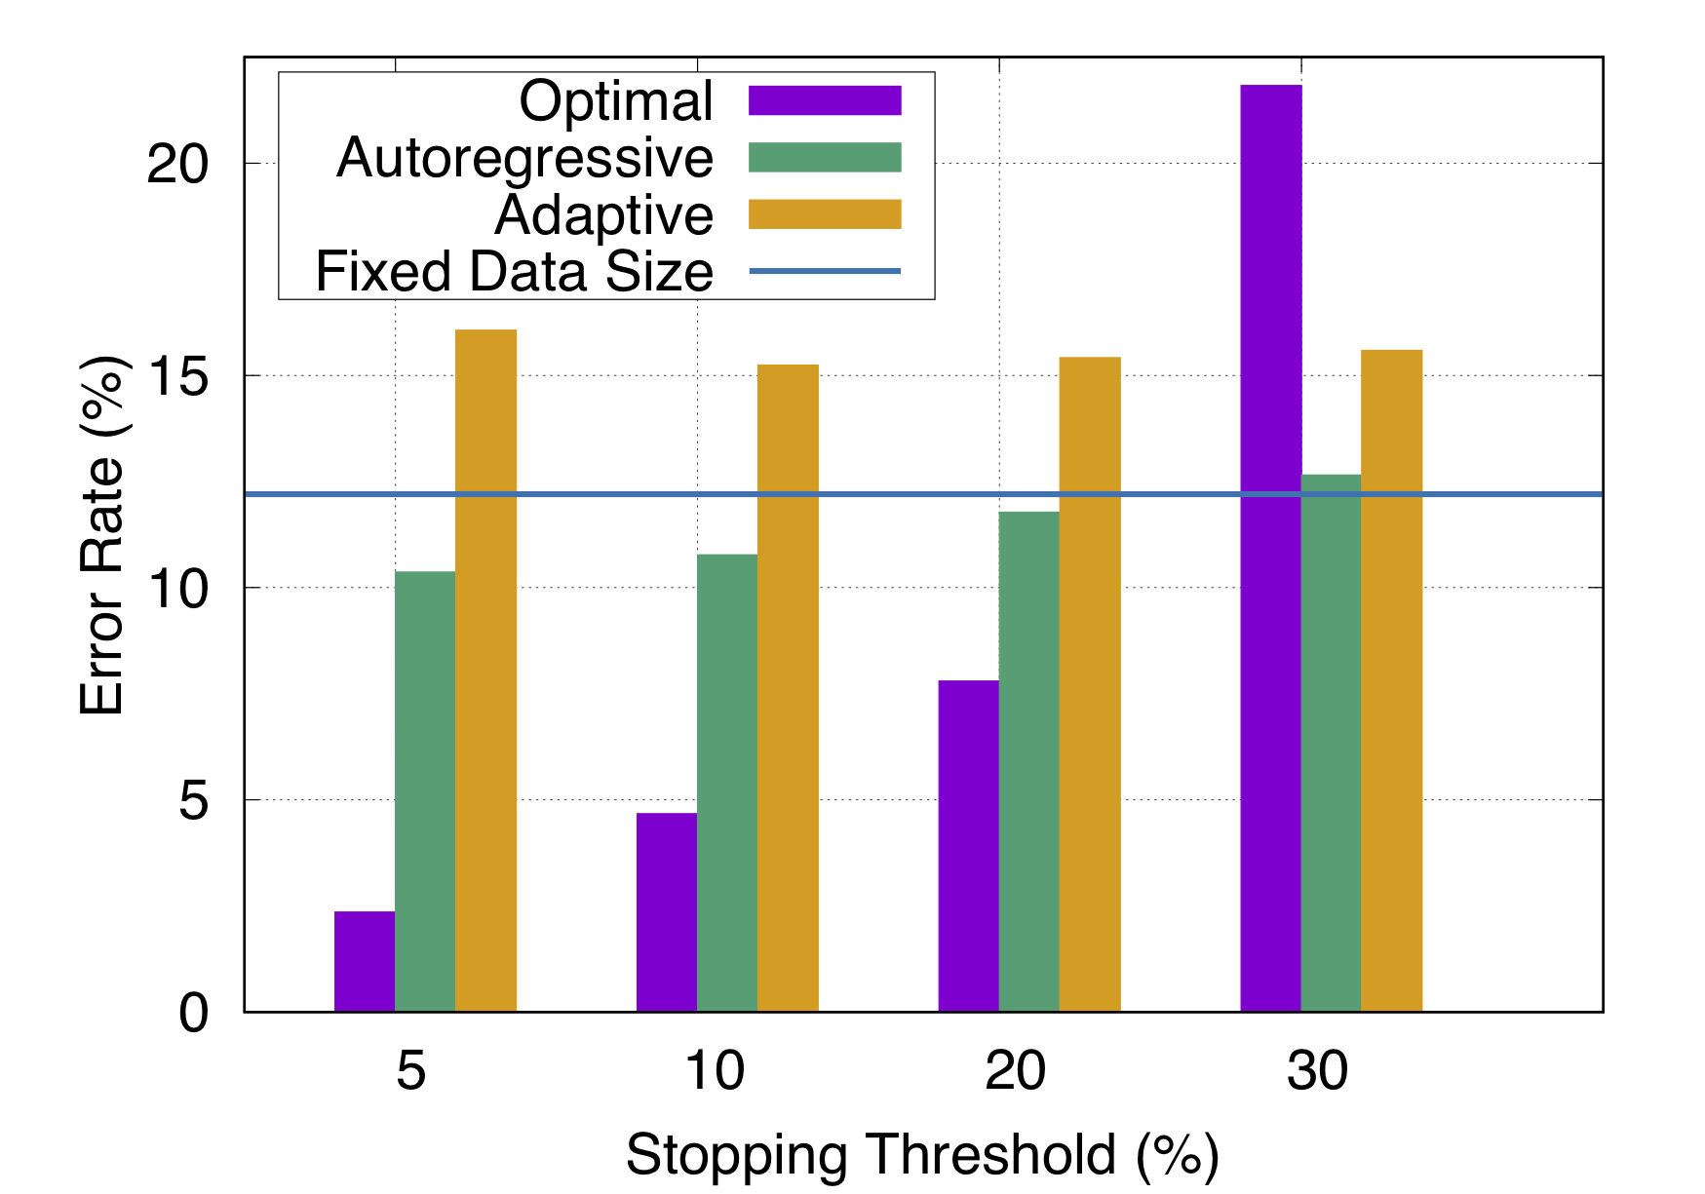
Experiments - HPCLab
In terms of convergence time, Autoregressive is doing even better than Optimal.
Adaptive and Fixed data size have very high error rate and high convergence time.

Slide 22
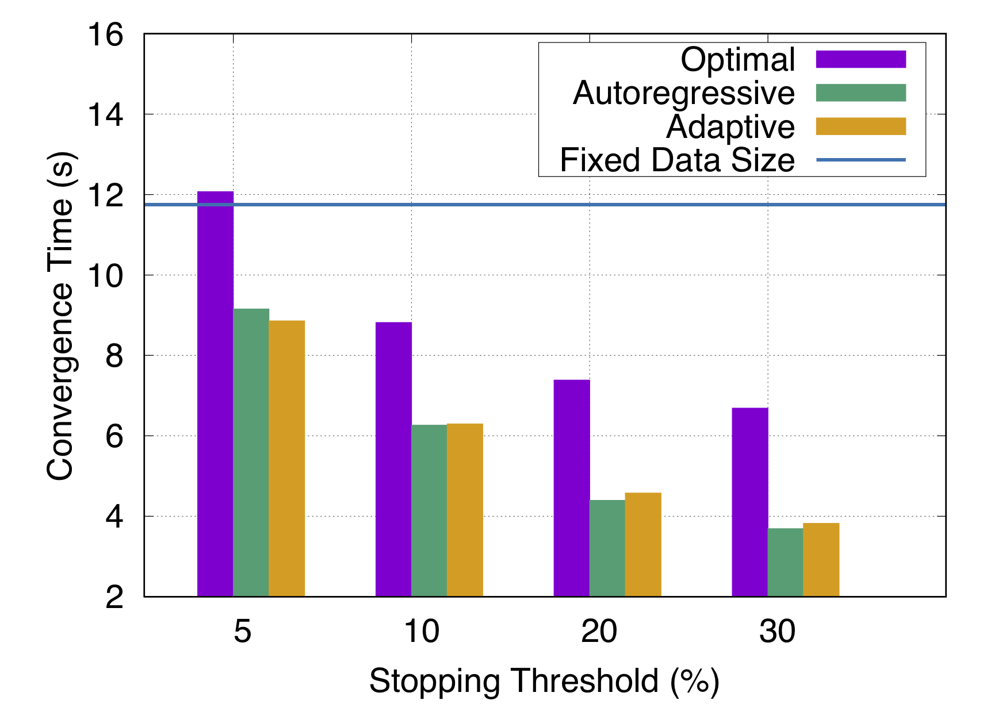
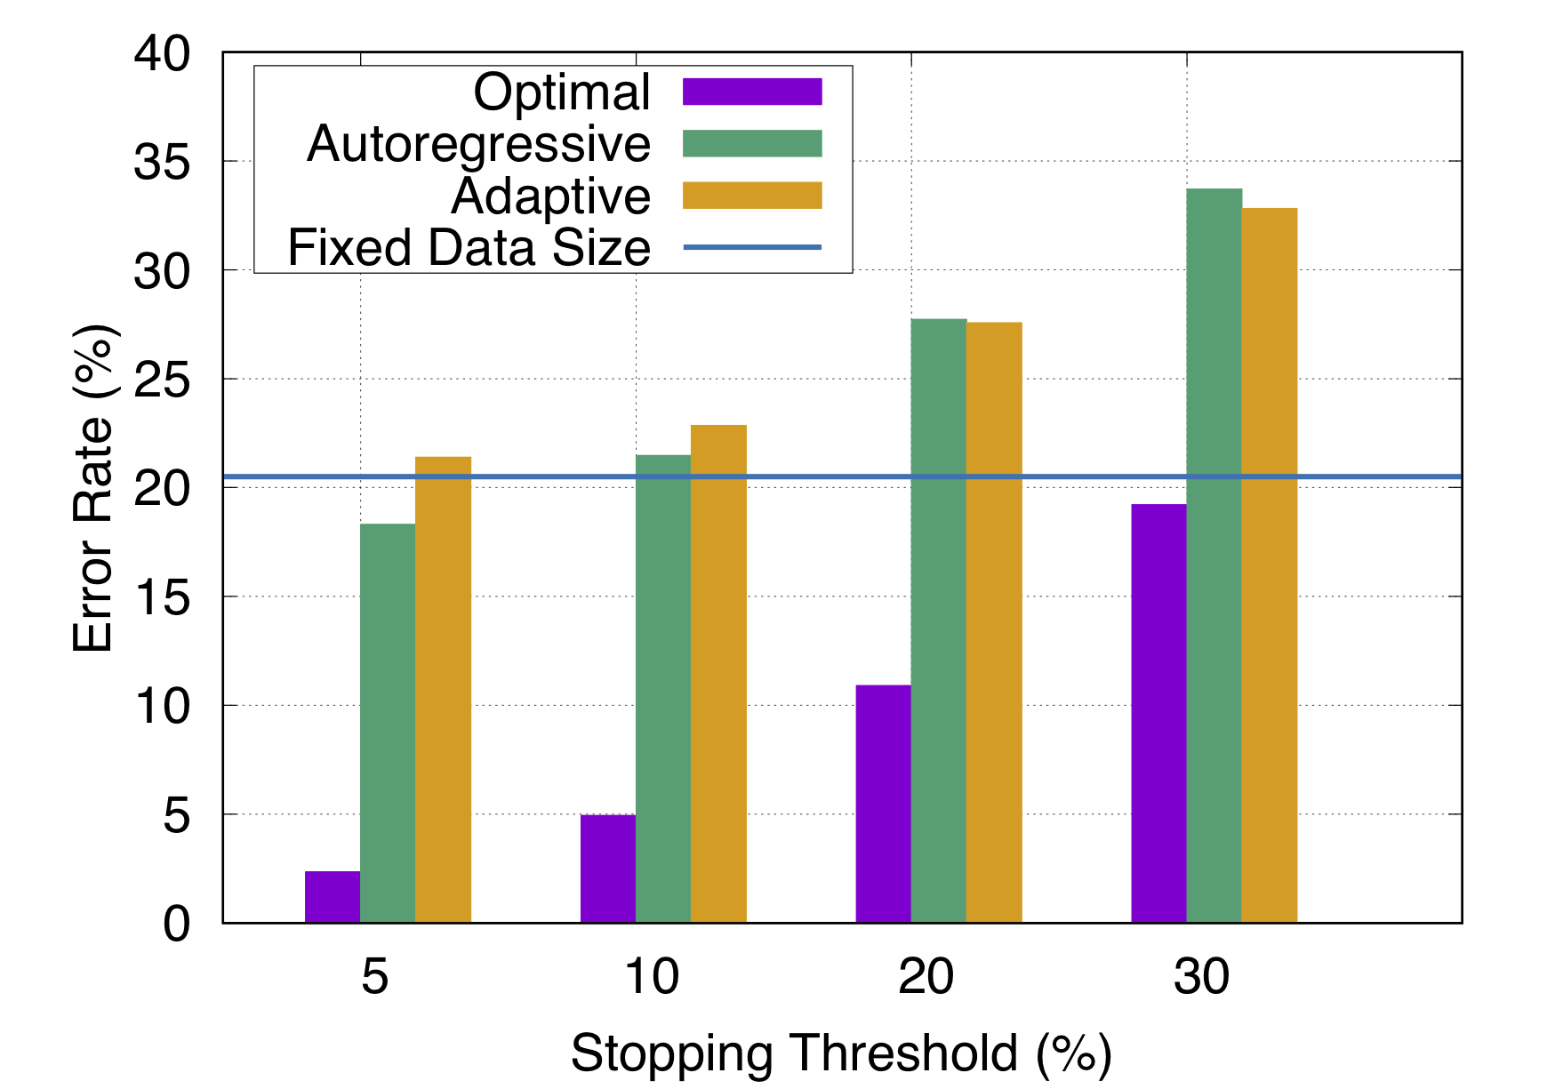
Experiments - XSEDE Network
Fixed Data Size is having high convergence time and about the same error rate with Autoregressive.
Adaptive has slightly higher convergence time and higher error rate.

Slide 23
Data Collection with Higher Frequency
So far on all the experiments done, throughput data was collected once in every second.
So we tried to see if this experiment holds on throughput data collected with higher frequency, like we tried to experiment on throughput data collected once in every 100 ms.

Slide 24
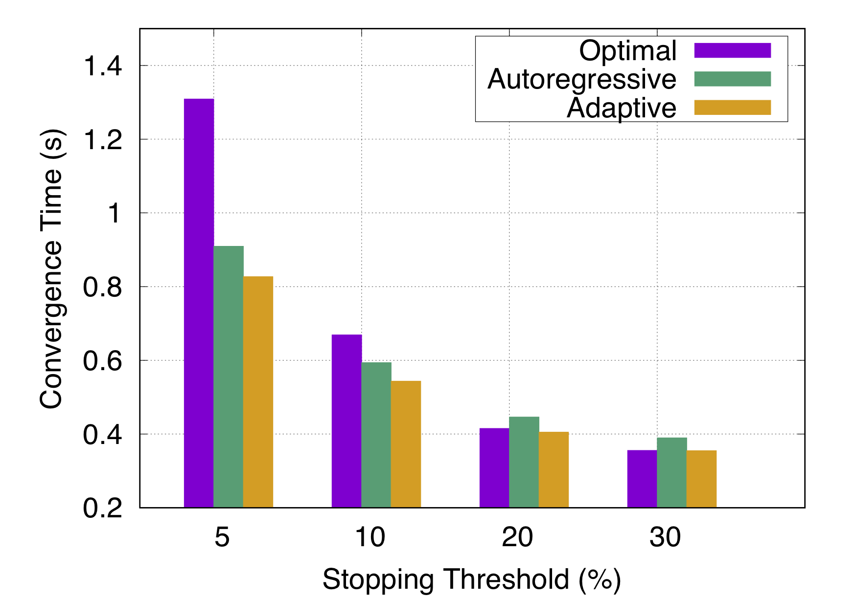
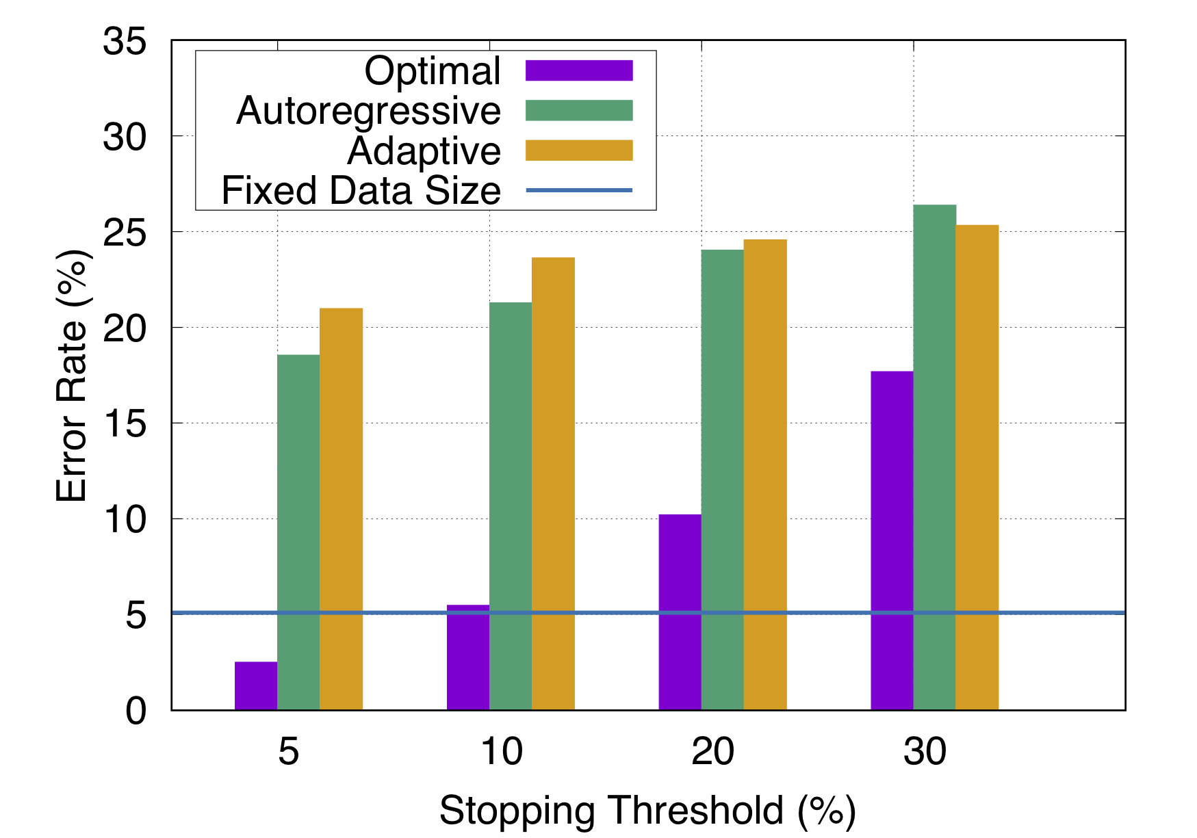
Data Collection with Higher Frequency
Fixed data size has high convergence time so it is not shown in figure.
Autoregressive has less error rate than Adaptive but longer convergence time by small margin.
With frequency data, convergence time can decrease.

Slide 25
CONCLUSION

Slide 26
Conclusion
Fixed data size model has a high convergence time. Adaptive approach has bad performance when there is fluctuation on transfer throughput.
Autoregressive model has lower convergence time (around 5 sec) and lower error rate (less than 20%) compared to actual average throughput in most of the cases.
And if the end goal is to have faster convergence time then, frequency data can make 4-6x reduction in convergence time with some increase in error rate.

Slide 27
Thank you

Slide 28
Future works
Using neural nets to find the Convergence throughput seems to be working, we are currently doing research on that.
And once we are confident with our results, we will start working on real-time throughput optimization problems.

