Slide 1




Automatic Detection of Network Traffic Anomalies and Changes
Astha Syal¹, Alina Lazar¹, Jinoh Kim², Alex Sim³, Kesheng Wu³
¹Department of Computer Science and Information Systems, Youngstown State University
²Department of Computer Science and Information Systems, Texas A&M University-Commerce
³Scientific Data Management Research Group, Lawrence Berkeley National Laboratory
Notes:
Hi everyone, I am Astha Syal, I am a graduate student from Youngstown State University. This is work I have done with my advisor Alina Lazar and our collaborators Jinoh Kim from Texas A&M commerce and Alex Sim and John Wu from LBNL.

Slide 2

Introduction and Motivation
Computer networks grow in size and complexity
Network traffic monitoring and analysis becomes important
TCP (Transmission Control Protocol)
UDP(User Datagram Protocol)
Possible problems: packet losses, duplication and reordering
Notes:
As computer networks grow in size, complexity and available services, network engineers have to spend significant time and effort to tune and optimize the network performance. Network traffic monitoring can provide important insights about current state of the network. Methodologies and tools have been developed to help network engineers with their routines of traffic monitoring and problem detection. Data collection is the first step to diagnose the network performance to understand the implications and interconnection of users' behavior.

Slide 3
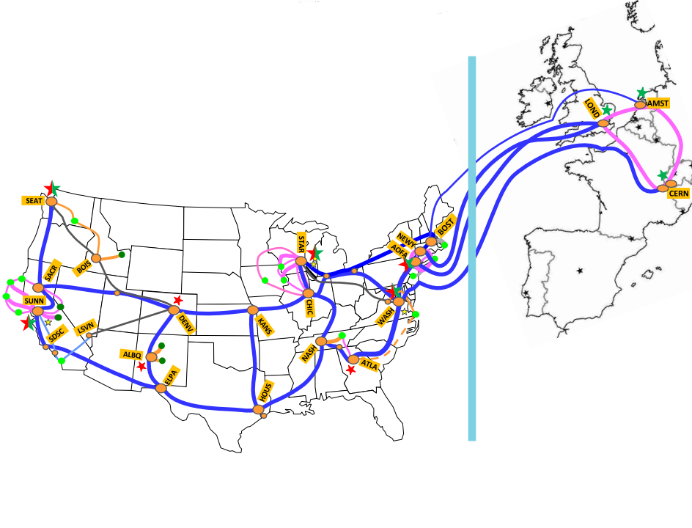
ESnet
The Energy Sciences Network is a high-performance, unclassified network built to support scientific research
Funded by the U.S. Department of Energy’s Office of Science (SC) and managed by Lawrence Berkeley National Laboratory
Notes:
The Energy Sciences Network (ESnet) is a high-performance, unclassified network built to support scientific research. Funded by the U.S. Department of Energy’s Office of Science (SC) and managed by Lawrence Berkeley National Laboratory, ESnet provides services to more than 40 DOE research sites, including the entire National Laboratory system, its supercomputing facilities, and its major scientific instruments. ESnet also connects to 140 research and commercial networks, permitting DOE-funded scientists to productively collaborate with partners around the world.
Spurred by the growth of large international collaborations in high energy physics, climate science, and genomics, the research community’s needs to manage and transfer large quantities of data are exploding in scope and complexity. Currently ESnet carries around 20 petabytes of data monthly. The level of traffic over the ESnet network has increased an average of 10 times every 4 years, propelled by the rising tide of data produced by more powerful supercomputers, global collaborations that can involve thousands of researchers, and specialized facilities like the Large Hadron Collider and digital sky surveys. It’s expected that ESnet will need to carry over 100 petabytes of data per month by 2016.
Large scientific facilities use Science DMZ, which includes several dedicated data transfer nodes and high performance data movement tools, to attain high network transfers for high performance scientific applications. Network traffic analysis and prediction play a vital role in maintaining healthy operations within all varieties of complex and diverse computer networks. Online traffic monitoring information, collected over time, can be used to predict future traffic volume and unexpected events in real-time.

Slide 4

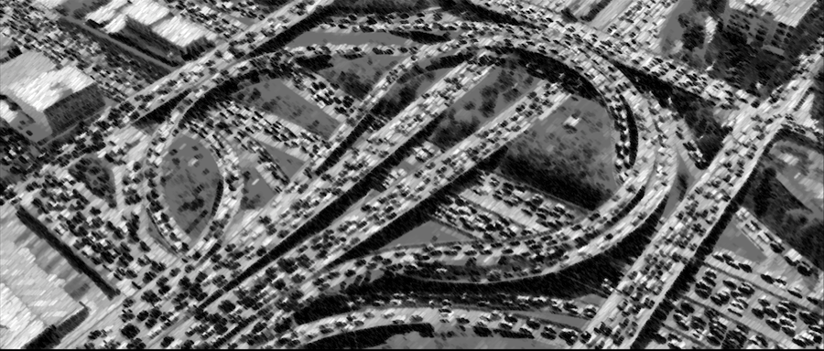
Network Traffic Congestion
Notes:
Low Bandwidth ~ Netflix is consuming at peak 40% of the internet, Additional Reasons: Broadcast storms, Outdated Hardware, Bad Configuration Management Cyber Attacks
One performance characteristic of a network can be measures using the average network throughout. High throughput means that the network is running smoothly, while a state of stable low throughput is usually a sign of network congestion known as "congestive collapse". Network congestion takes place when a network link is transferring more data packets than it can handle and usually exhibits the reduced quality of service. This network state is usually due to interference among the server's shared physical resources involved in these transfers, such as network links, disk storage systems, and CPUs. Typical effects include packet loss, duplication, and retransmission. A typical consequence of congestion is imminent decrease in network throughput. Identifying factors that contribute to the decrease of network throughput is very important in determining resource allocations to use in scheduling requests.

Slide 5

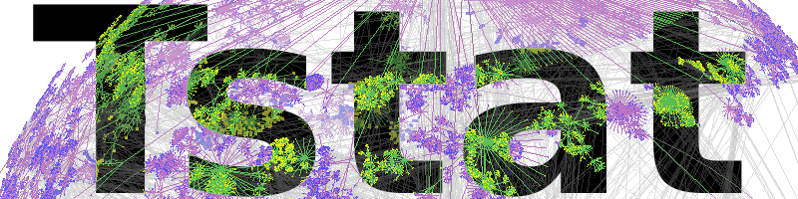

Tstat Data Collection at LBNL
Data Node
Router
LBL Internal Network
ESnet
Traffic Stats
Network Data recorded during File Transfers
TCP statistics (Tstat files)
Research Question: Using large datasets of Tstat data can we identify time windows with consistent low throughput?
Notes:
Tstat is an open source passive traffic analyzer developed at Telecommunication Network Group (TNG) of Politecnico di Torino, design for network engineers. It started as a branch of TCPtrace with a focus on TCP statistics only, but over the years it evolved in a full fledge monitoring solution offering an extensive set of measurements for IP, TCP and UDP, as well as traffic classification capabilities through a combination of Finite State Machine Deep Packet Inspection (FSM DPI) and Behavioral engines.
The main goal of this paper is to demonstrate that supervised machine learning approaches applied to passive measurements of network flow datasets can be potentially used to identify states of congestive collapse. Assigning labels based on the average throughput to categorize network traffic flows grouped by time intervals, can help with the analysis of these large network datasets. After the initial binary labeling of network transfer flows to a small predefined number of clusters, the features of each time window can be used to generate a classification model of the traffic. New incoming flows can then be classified on the fly and assigned to one of the two classes (low versus normal throughput time window).

Slide 6
Current Drawbacks
Problems:
Not real-time, only checked when something is wrong
Large datasets to analyze
Ideal case: Automate detection of low throughput and raise an alert
No training (labelled) datasets available
Data does not follow the same distribution
Machine learning models are black boxes
Network traffic data is high volume, heavy stream of high dimensionality data
Notes:
Machine learning has been employed in many network applications, such as traffic prediction, traffic classification, intrusion detection, network management, network adaptation, performance prediction, and configuration extrapolation. Specifically, machine learning methods have been proposed to identify bottlenecks and explain the status of network traffic using features from passive network measurements.
However, analyzing the network traffic data using machine learning and statistical methods is challenging for several reasons.
- The network data is usually automatically collected as a high volume heavy stream of high dimensionality that needs to be analyzed in real-time to provide alerts in case of unexpected events. Another important challenge is the lack of labeled ground truth for evaluating the machine learning methods Even if network data can be relatively easy to collect, there is no automatic way to acquire labels based of the problem to solve. High-quality ground truth datasets often need to be manually created, a process that is time consuming, requires solid domain knowledge, and may have serious privacy issues, especially in the case of analyzing real traffic traces.
Machine learning models are build on existing data with the hope that their high generalizability makes them adaptable to the high-variance future network traffic values. Given the often changes of these dynamic systems, it would be unacceptable to require a model retraining for every time interval manifesting significant network traffic changes.
To build well-performing models, for most machine learning algorithms it is required that the training data follows the same distribution as the target distribution. This assumption is not always true or practical in dynamically changing networking environments, where the features are highly dependent on timing, physical equipment and transfers interactions. Although previous research showed that the machine learning models built using training data from a specific network environment can, to some degree, perform well in other network environments, more research in transfer learning is necessary. The analysis and methods presented in this paper provide a first step towards identifying important features to detect the network status.
Even if state of the art machine learning algorithm can achieve good performance when trained on networking data, many of the resulting models are still black boxes, not humanly readable or easily interpretable. The accountability and interpretability properties create big obstacles in practical implementations of these models. If expert network engineers do not understand how the models behave, they cannot integrate this knowledge in the real systems to provide new ways for network adaptation and configuration extrapolation.

Slide 7
Main Contributions
Statistical Analysis:
To extract throughput threshold values to label the time intervals as 'low’ versus 'normal'.
UMAP:
To provide a 2-dimensional representation of the datasets to understand the structure of the data.
Supervised Machine Learning:
Classification experiments performed on real network data collected from eight DTNs using Tstat.
Evaluation:
Checking the results of this supervised learning approach, especially the false positives and false negatives, using throughput plots.

Slide 8
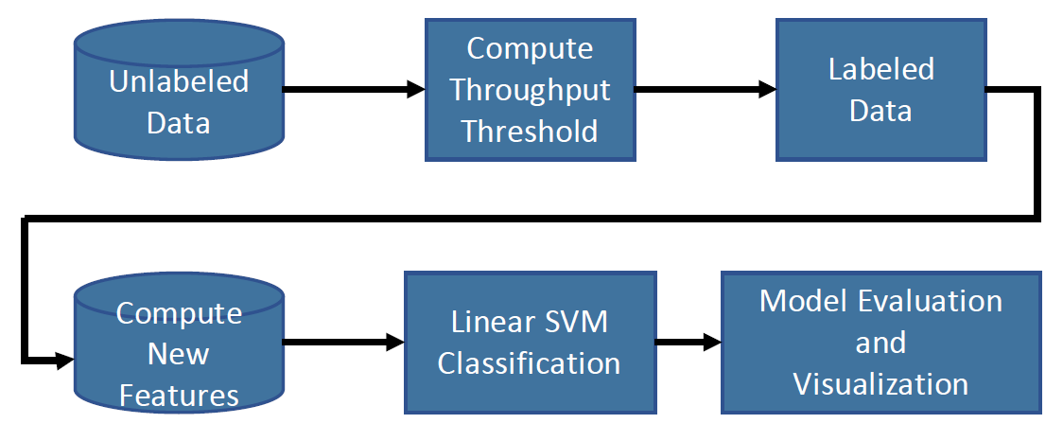
Machine Learning Approach
Research Question:
Using Tstat data features can we classify upcoming time intervals as low throughput with good accuracy, precision and recall?
Notes:
Traffic flows collected in the Tstat logs have no feature or variable to designate them as anomalies. However, for this paper we consider labeling the network transfers using the average throughput per time window and an adaptive threshold set as the first quartile of the dataset. Then, supervised machine learning algorithms are used to predict which flows are slow and which are normal. Specifically, a supervised approach based on the linear version of the popular Support Vector Machine (SVM) approach was found suitable to build models that automatically classifies the traffic flow time windows into two separate groups with similar characteristics in terms of their throughput. All the steps of this approach are highlighted in Fig.

Slide 9
UMAP – Dimensionality Reduction
UMAP is a dimension reduction technique that works well for 2D visualizations, and for general non-linear dimension reduction.
Based on manifold theory and fuzzy topological data analysis.
The algorithm builds a weighted k-neighbor graph to efficiently approximate the k-nearest-neighbor computation and calculates spectral embeddings.
The embeddings are optimized using Stochastic Gradient Descent algorithm.
The algorithm assumes the data is uniformly distributed on a Riemannian manifold, assumption that does not always hold for real data.
Notes:
Uniform Manifold Approximation and Projection (UMAP) is a new dimension reduction technique that can be used for visualizations similar to other manifold data embedding techniques, and also for general non-linear dimension reduction. It is based on manifold theory and fuzzy topological data analysis. The algorithm builds a weighted k-neighbor graph to efficiently approximate the k-nearest-neighbor computation and calculates spectral embeddings that are later optimized using the stochastic gradient descent algorithm. The algorithm is founded on assumptions that the data is uniformly distributed on a Riemannian manifold, an assumption that does not always hold for real data.

Slide 10
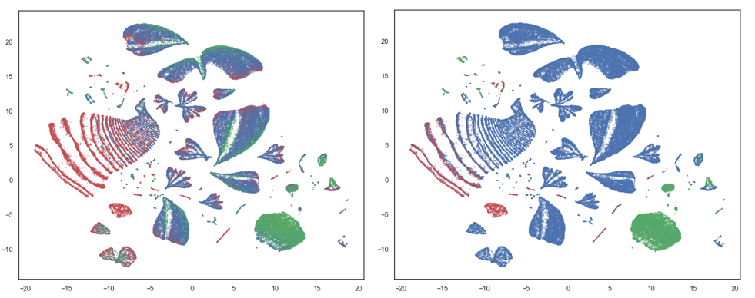
UMAP - Representation
Notes:
To understand the underlying structure of this particular dataset, a two-dimensional representation in an embedding space for the node 5 dataset is presented in Figure. Similar to principal component analysis (PCA) representations, the values of the x-axis and y-axis of the UMAP scatterplot are nothing more than a representation in the embedding two-dimensional space.
Part (a) of this figure shows all the individual flow with their calculated throughput. Red represents flows with low throughput (throughput lower than the first quartile), blue means normal (throughput between the first quartile and the third quartile), while green shows the high performing flows (throughput larger than the third quartile).
Part (b) shows the same network transfers, colored using the same encoding; however this time the flows are assigned with the majority class of the one-hour time windows in which they belong.

Slide 11
Linear SVM
An SVM training algorithm builds a linear hyperplane with the property of having the largest margin.
Data points, are mapped so the two categories are divided by the optimal hyperplane that has the largest gap.
Linear SVMs can be solved efficiently using the coordinate descent algorithm for the optimization step.
Notes:
The proposed method employs a linear SVM algorithm to identify time intervals with low averages of the throughput values over the entire dataset. SVMs are supervised learning models that usually provide high performance for classification and regression analysis. Given a set of training examples, each marked as belonging to one or the other of two classes, an SVM training algorithm builds a linear hyperplane with the specific property of having the largest margin. In other words, the individual data points are mapped so that the points of the two categories are divided by the optimal hyperplane that has the largest gap. The optimization step of linear SVMs can be solved efficiently using the coordinate descent algorithm, thereby reducing the convergence iteration to linear time, making this algorithm run very fast compared to other classification methods. The linear SVMs method was selected because of the low computational time required for training and high accuracy rates obtained on the testing sets.

Slide 12
Tstat (TCP Statistic and Analysis Tool)
Network traffic statistics at the flow level can be collected using passive monitoring tools such as Tstat.
For TCP connections, congestion window size, out-of-sequence segments, duplicated segments, number of bytes and segments retransmitted, and RTT values are just some of the statistics collected.
Tstat only saves completed flows.
Tstat also records UDP messages. UDP communication contributes a very low percent of the total bytes moved from/to the major computer center.
Notes:
Tstat offers output statistics at packet and flow level. The flow-level analysis provides a summary of the connection properties that is logged for further analysis. It can be used to collect many different statistics for TCP, UDP, and RTP/RTCP traffic. For TCP connections, congestion window size, out-of-sequence segments, duplicated segments, number of bytes and segments retransmitted, and RTT are some of the statistics that it collects. Tstat distinguishes between completed and not completed flows, and between clients (hosts that actively open a connection) and servers (hosts that passively listen for connection requests). Tstat} also records UDP messages. However, since UDP communication contributes a very low percent of the total bytes moved from/to the major computer center, we did not included UDP communications in this study.

Slide 13
Tstat (TCP STatistic and Analysis Tool) Datasets
Notes:
At LBL 90K of TCP flows are collected per node daily and an approximate total of 10GB of compressed data logs are collected yearly on ten DTNs. The Tstat data used for this study was collected and provided by the NERSC computing facility at LBNL. The Tstat data contains source and destination IP addresses, and so is not publicly available for privacy reasons. To simplify our analysis, for this study we eliminated all flows that carry less than 10MB of data both ways. Table shows the number of network transfer in each dataset and also the number of time intervals. The datasets for nodes 1 to 4 contain six months worth of transfers collected between 01/01/2017 - 06/28/2017, while the datasets for nodes 5 to 8 are smaller and have approximately one month worth of data collected between 06/01/2017 - 06/28/2017.

Slide 14
Summary Statistics
Notes:
For each dataset all the features with constant values are eliminated. We also eliminate features involved in the calculation of the throughput because it is used to assign the output labels. Table shows the summary statistics for the calculated throughput for all eight nodes. The first quartile values in this table are used as threshold values for our experiments. Network transfers that take place closer in time are highly correlated compared with transfers that are far apart. To account for this important characteristic of the datasets we add two additional features which where assigned based on the previous and two time intervals preceding the current time window.

Slide 15
Experiments and Results
All features are normalized using the MinMax Scaling procedure.
The datasets are divided into time intervals based on three time frequencies: 5, 30 and 60 minutes.
Averages for all the features including throughput are calculated and saved for further input into the classification algorithm.
First, we used the entire datasets for all the eight nodes and divided each of them based on the time stamp in training and testing sets. The last week or last month of data is used for testing and the rest to build the model.
Second, the second set of experiments are done for node 1 through 4, where the datasets contain a larger number of network flows collected over 6 months. For these datasets we run cross validation using a Time Series Split with k=6 sets.

Slide 16
Notes:
Overall, the results presented in Table show accuracy greater than 83%, precision more than 68% for all the datasets, while recall is less than 50% in only two cases for node 8.

Slide 17
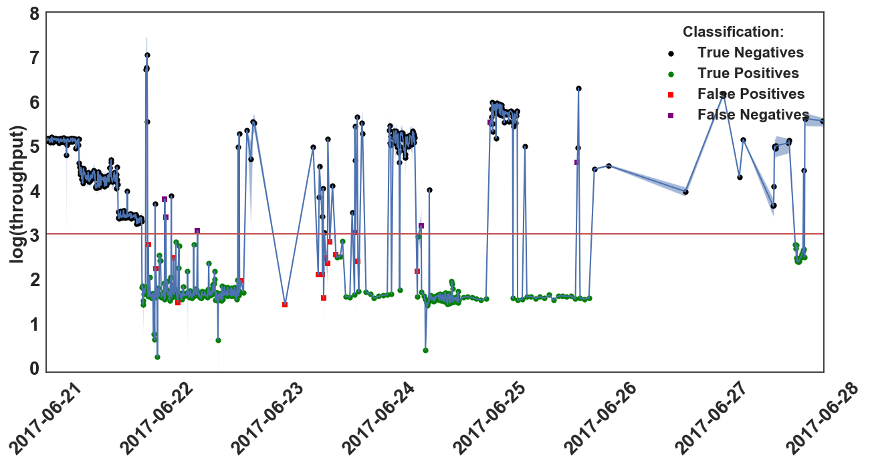
Average throughput for node 7, 5min time windows
Notes:
Best results are observed for node 7 and node 6 and are shown in Figure. These two figures clearly show that our classification models have no problem correctly identifying contiguous intervals of low network performance. The number of false negatives is insignificant, a fact denoted by the high rates of the precision measure. The number of false positives is higher, as reflected by the recall rate. This is observed especially during times when time intervals with high throughput alternate with time intervals of low throughput.

Slide 18
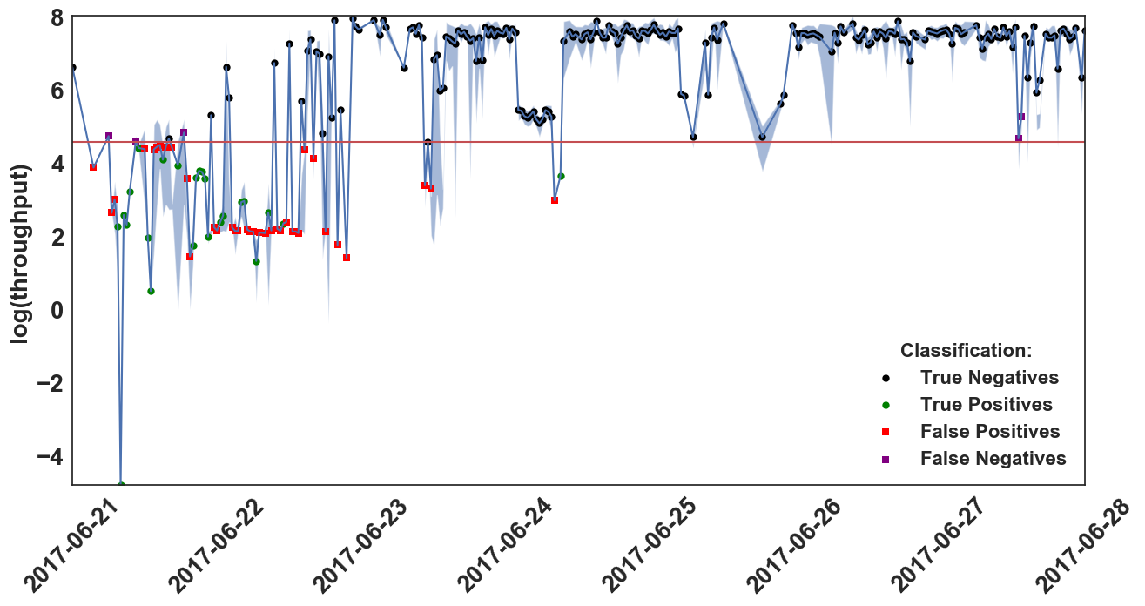
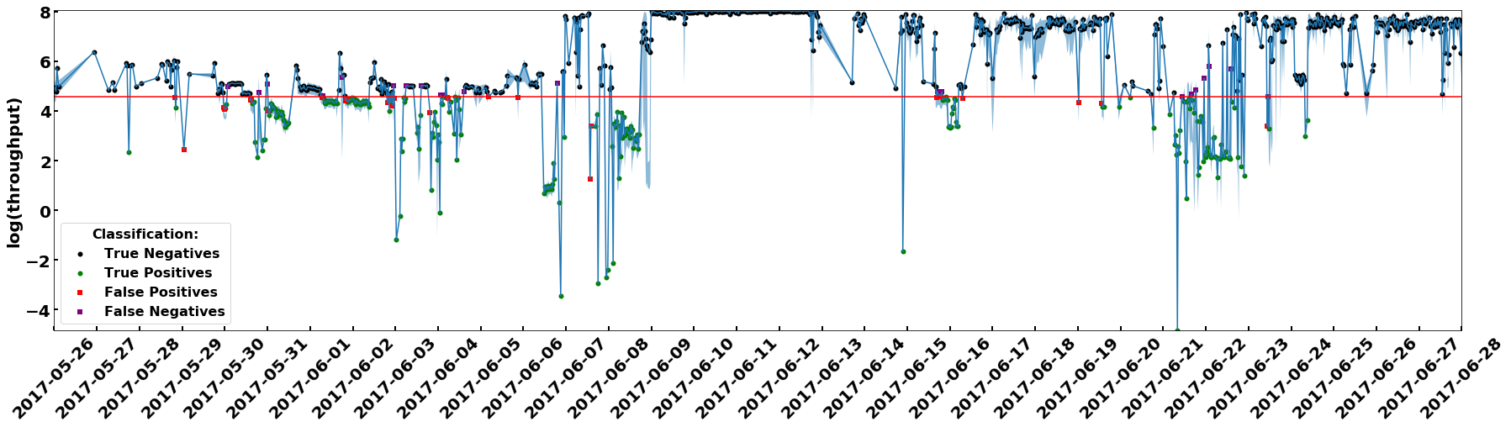
Average throughput for node 8, 30min time windows
Notes:
Finally, we take a look at the results for node 8, where recall is the lowest. The test set of this dataset, has a very low ratio (between 18% and 20%) of transfers with low throughput, fact that makes this test set harder to classify. In this case there are four false negatives instances, two of them very close to the throughput threshold. A third of the false positives are very close to the average throughput and the others alternate with time intervals with high throughput (low recall).

Slide 19
Cross-validation Results
Notes:
The results are presented in Table. Accuracy is greater than 86%, precision does not fall less than 79% and the lowest recall is only 75%. Overall, the best results are obtained for node 3 and time interval of 30 minutes, and the worst are for node 4 and 30 minutes time intervals. Node 3 has more 30-minute time intervals than node 4, however the testing results for node 4 applied on the last month's dataset shows a much lower recall. Node 3 has 44 false negatives and 48 false positives where node 4 has 13 false negatives and 93 false positives.

Slide 20
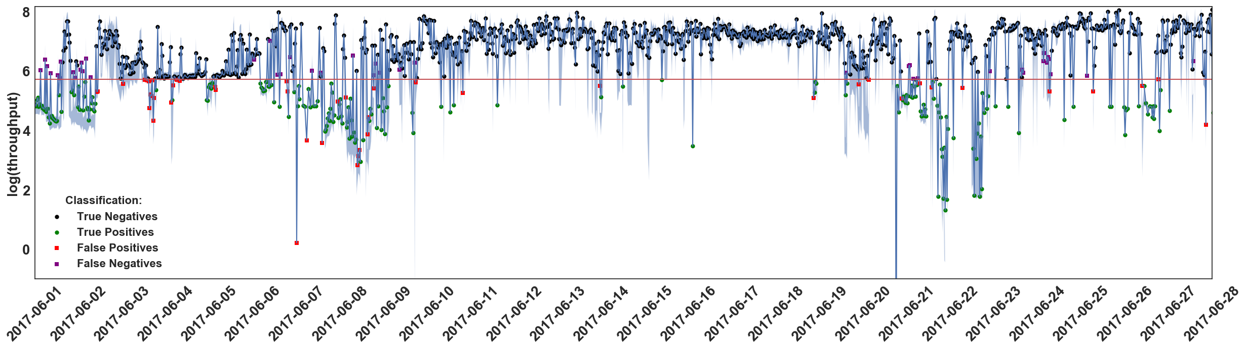
Average throughput node 3, 30min time windows
Notes:
Node 3 has more 30-minute time intervals than node 4, however the testing results for node 4 applied on the last month's dataset shows a much lower recall. Node 3 has 44 false negatives and 48 false positives.

Slide 21
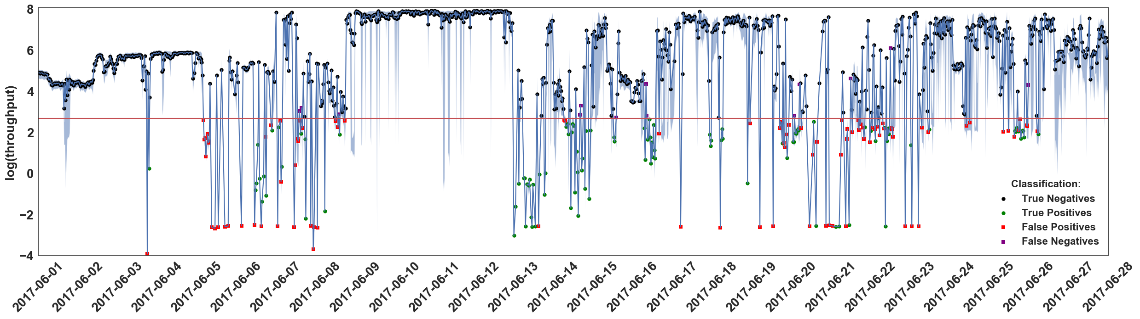
Average throughput node 4, 30min time windows
Notes:
Node 4 has 13 false negatives and 93 false positives.
As shown in Table the number of time intervals in our experiments vary from 412 to 47,310. It is well known that linear SVMs are capable of training datasets with over 500,000 instances in seconds. It takes less than 4 seconds to train and .02 to test the dataset for node 1 with 5 minutes time intervals which is the largest dataset used in our experiments. Data preprocessing and training can be done offline and so it doesn't slow down the detection. Testing works fast, making this method suitable for quick detection.

Slide 22
Conclusions
Reliable network transfers are essential for successful operations at large scientific facilities where petabytes are transferred daily.
To identify possible problems such as low throughput, we propose to classify the traffic flows captured by Tstat with a linear SVM classification algorithm.
Our system splits the Tstat log streams into chunks so as to make predictions in near real-time.
Tests show that this new method is able to accurately detect abnormally low throughput time intervals.

Slide 23
Conclusions
This paper presents a supervised data analytics system that effectively mines network traffic data. The proposed methodology is based on a two-phase approach:
assigns binary classification labels to network transfers using an adaptive threshold based on the throughput mean.
builds a classification model to predict new data labels in real-time to identify traffic with low throughput.

Slide 24
Conclusions
The tests on the proposed method showed its ability to accurately identify large windows of low throughput, but also showed problems in case of isolated or alternating intervals.
In future, we plan to extend the current system:
To include of more time related features.
To use feature selection techniques to eliminate highly correlated features.
To apply the same approach to other datasets to investigate the generalization capabilities of the presented method.

Slide 25

Acknowledgements
This work was supported by:
The Office of Advanced Scientific Computing Research, Office of Science, of the U.S. Department of Energy under Contract No. DE-AC02-05CH11231.
The Office of Workforce Development for Teachers and Scientists (WDTS) under the Visiting Faculty Program (VFP), Office of Science, the U.S. Department of Energy.
The Office of Research at Youngstown State University.
This research used resources of the National Energy Research Scientific Computing Center.
Student travel grant for HPDC’19, sponsored by NSF.

