Slide 1
Global Financial Markets: The Big Picture

Slide 2
Financial Markets
Markets and intermediaries
Lenders
Retail
Companies/
Institutions
Borrowers
Retail
Companies
Governments
Reward
Risk
  Provision of a payment mechanisms
  Management of maturity terms
  Transformation of risk
  Provision of liquidity
  Cost efficiency
Notes:
Provision of a Payment Mechanism
The facilitation of payments of funds by non-cash means
Management of Maturity Terms
Those with surplus cash often want easy access/redemption, but those who have the deficit often require use of the funds over a much longer term. A financial market brings these two apparent opposing needs together.
An effective financial market provides both surplus and deficit parties with a greater choice in how to save and borrow funds
Transformation of Risk
Borrowers often require funds for inherently risky investments, but savers often require security.
Financial markets allow the risk to be evaluated, spread and rewarded (for taking on).
Provision of Liquidity
Savers require liquidity to readily redeem their assets into cash at short notice and a fair price.
Financial Markets bring together numerous potential buyers and sellers.
Cost Efficiency
Economies of scales in systems and volumes

Slide 3
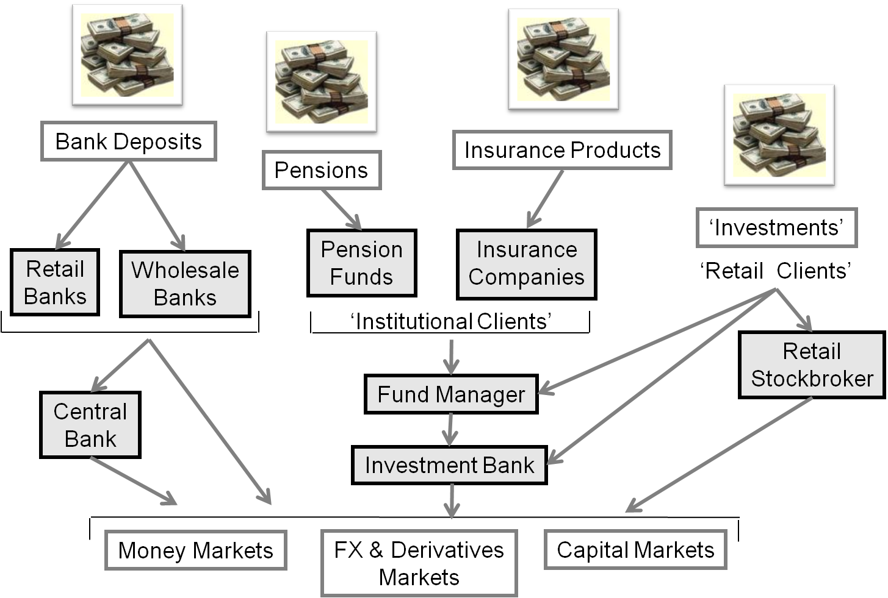

Slide 4
Market Participants (Wholesale)
Sell-side
Buy-side
Support
  Brokers – agents on behalf of clients
  Direct market participants, e.g. members of a stock exchange
  Inter-dealer brokers (IDB’s) act as intermediaries between
  market-makers and provide anonymity
  Proprietor traders
  Individual investors
Investment managers acting for institutional investors
Private client brokers acting for high net worth individuals
Hedge funds
  Stock exchanges
  Clearing houses
  Industry bodies
  (e.g. ISMA or ISDA)
  Regulators
  Data vendors (e.g. Bloomberg or Reuters)
  Custodians

Slide 5
Sell-side – A typical Investment Bank
Front office – Revenue generating; clients = Corporates/Governments/Banks/Asset Managers
Capital markets
Investment banking
Traders and market makers
Fund/quant research analysts
Sales people
Debt/ equity capital markets
Corp financiers and M&A specialists
Structurers
Middle office – Reporting, cost saving and efficiency improvements
Clients = Front office, senior management
IT analysts, business analysts, prime brokerage
Legal and compliance officers, HR
Senior management – CEO, COO, CTO, CFO, etc.
Credit/market risk analysts (reporting)
Product controllers (finance)
Back office – Processing, cost saving and efficiency improvements
Clients = Front/middle office, external clients, senior management
Operations/support analysts

Slide 6
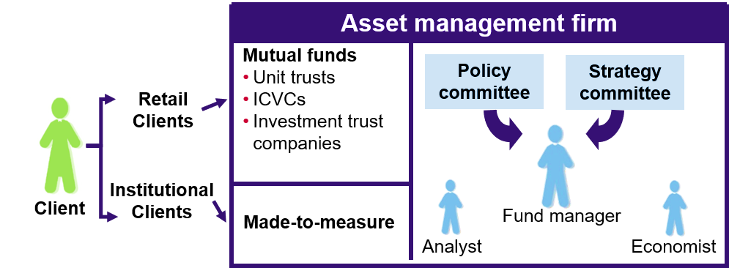
Buy Side – an Asset Management Firm
Notes:
Fund management firms use their expertise in research and risk management in order to invest clients’ money. By doing so, they earn fees called initial charges (can be rebated), annual management charges (AMC) on assets under management (AUM), performance fees (on hedge fund type strategies) and sometimes exit fees for early redemption:

Slide 7
Different Investment Philosophies
  Active fund managers do not believe the markets to be efficient:
    Pick assets that could outperform the benchmark over the fund’s
    investment horizon
    Theoretically cheap, recovery plays, unethicals, etc.
    Seek to beat the market
    Consumes research – broker and in-house
    Styles: Growth, value, income, etc.
  Passive fund managers believe the market is efficient, it is impossible to
  outperform the index:
    Benchmark should therefore be replicated or tracked
    No one can beat the market (in the long run)
    Light on research, heavy on IT
  A hedge fund’s aim is to:
    Provide absolute returns (Alpha) – regardless of market direction
    Take short or long positions
    Consumes research

Slide 8
Buy Side – Hedge Funds
  Hedge funds:
  Are generally not open to the public or promoted to private investors (with exceptions)
  Use creative, innovative and often aggressive investment strategies
  Invest their own money alongside their clients
  Hedge fund managers earn a management fee and will also earn a performance fee if
  targets are met. For example 'Two And Twenty’ - hedge fund managers charge a flat 2%
  of total asset value management fee and an additional 20% of performance
  (using ‘watermarks)
Notes:
BREAKING DOWN 'Two And Twenty'
The 2% management fee is paid to hedge fund managers regardless of the fund’s performance.
A hedge fund manager with $1 billion of assets under management (AUM) earns $20 million even
if the fund performs poorly. The 20% profit fee is only paid once the fund achieves a
level of performance that exceeds a certain profit threshold, typically around 8%.
Some investors, who have never paid the 20% fee because there haven’t been any profits, consider the 2% management fee to be too high relative to the overall performance of many funds.
The Alignment of Interests Association (AOI), which represents pension funds, endowments, foundations and family offices in the US, said there was still merit to investing in hedge funds but not without changes to the model. Under the traditional fee structure, hedge funds charge a 2 per cent management fee, in addition to a 20 per cent performance fee. As returns at some of the larger hedge funds falter, investors have become wary that some managers are more concerned about increasing the amount of money invested with them in order to collect more management fees, which disincentivises them to take more risk. Investors are paying less scrutiny to the performance fee, which rewards higher returns. “Management fees should not function to generate profits,” the AOI says in a report published on Tuesday. “This creates a conflict of interest for the parties because fund investors are vested in the performance of individual funds, while managers are vested in the health and growth of the business as a whole.” The “2 and 20” fee structure dates back to 1949, when Alfred Winslow Jones founded AW Jones & Co, considered by many to be the first hedge fund. According to the AOI, his model required investors to pay him a 20 per cent incentive fee, a figure inspired by Phoenician merchants, who charged one-fifth of profits from a successful journey. Related article Machine learning set to shake up equity hedge funds AI seen becoming powerful enough to forecast market moves better than humans By the 1980s, funds that mimicked Mr Jones’s strategy started charging a management fee. While initially about 1 per cent, that figure rose to 2 per cent in the early 1990s, and the “2 and 20” quickly became an industry standard. But hedge fund returns have faltered over the past few years, with many being outperformed by cheaper, passive index-tracking funds, and investors have started to question the strategy and the high fees. “Alpha exists,” said Robert Lee, deputy chief investment officer at Texas Tech University. “And it should be rewarded handsomely. Beta however, often masquerading as alpha, is today a commoditised exposure. Beta should be cheap.” Several studies indicate that hedge fund fees have already been significantly reduced, with the average management fee closer to 1.5 per cent. The AOI said that there was no problem paying management fees as long as they were covering legitimate costs. One possible solution is for funds to introduce a tiered management fee, whereby the amount is reduced every time the manager hits another level of assets under management, the AOI said. Investors have also asked some managers to stop at a certain level of assets under management to avoid returns becoming diluted, or to manage a bespoke mandate for them at a negotiated cost. One of the more common discounts is a founders’ share class, where early investors in a fund pay a lower fee.

Slide 9
Active vs. Passive vs. Absolute Returns
Value
Hedge fund
Cash
Active
Market
Passive
Time

Slide 10
Market Economics

Slide 11
Central Banks
  The Role of Central Banks
  Main policies:
    Monetary policy – management of the supply and demand of money
      Inflation
      Labour market / economy
      Financial stability
      National debt
  Activities include:
    Banker to the banking system and government
    Managing national debt
    Regulating the domestic banking system
    Lender of last resort
    Setting official short-term interest rates
    Controlling the money supply
    Issuing notes and coins
    Holding gold/foreign currency reserves

Slide 12
Inflation
Credit Creation
  Cause? Banks lend more than they hold in reserves
Impact of Inflation
  Problems caused by inflation:
    Real value of salaries/pensions eroded
    Real value of investments eroded
    Exports may become less competitive
  Positive aspects:
    Rising house prices contribute to a ‘feel good factor’
    Borrowers benefit: the real value of debt falls
    Real value of a country’s national debt may fall

Slide 13
Circular Flow of Income
Imports
Abroad
Taxes
Government
Savings
Financial System
Households
Exports
Good and services
Government spending
Wages
Factors of Production
Investment
Firms

Slide 14
Gross Domestic Product (GDP)
    The total value of output from WITHIN a country
    Where:
      C = Consumer expenditure
      I = Private investment in firms
      G = Government expenditure
      X = Exports
      M = Imports

Slide 15
Equity Markets

Slide 16
Equity Features
Ordinary Shares
  Features
    Part-owner of the company (voting rights)
    VARIABLE profit distributions (dividends)
    Rank after debt providers and preference shares
Preference shares
  Features
    Normally NO voting rights
    FIXED dividend
    Rank after debt providers but before ordinary shares

Slide 17
Shareholder Entitlement
  Voting on resolutions at general meetings
    Resolutions
      Ordinary
      Special
  Dividends
    These may be paid in cash or shares.
    With each dividend payment an ex-div, record and payment date will be declared

Slide 18
Equity Issuance Methods
  Placing
    New shares placed with institutional investors by an issuing house (investment bank)
  Offer for sale
    New shares offered by an issuing house (investment bank) to the general public
    Types:
      Offer for sale by tender
        Issuing house invites offers from the public
      Offer for sale by subscription
        Underlying company offers the issue to the public
  Intermediaries offer
    A number of brokers place an issue with their clients

Slide 19
Further Issuance (Follow – On Offerings)
Rights Issues
  Existing shareholders have the right to subscribe for new shares in proportion to their current holdings, at a discount to current market price
Scrip (‘Bonus’ or ’Capitalisation’) Issues
  Existing shareholders have the right to subscribe for new shares in proportion to their current holdings, for FREE

Slide 20
Alternative Trading Venues
  Over-the-counter (OTC)
    Decentralised trading
    Securities not listed on exchange
  Multilateral trading facilities (MTFs)
    Trading platforms organised by investment firms, e.g. BATS Chi-X Europe, Turquoise
  Dark pools
    MTFs that have opted out of the requirements for pre-trade transparency
    Allow large trades to be traded without price impact, thus potentially getting a better price on sizeable orders
  Systematic Internalisers
    Investment firms dealing own account in liquid shares outside a regulated market of MTF

Slide 21
  Organised trading facilities (OTFs)
    Multilateral system which is not a regulated market or MTF
    New category of trading facility introduced in MiFID II to capture trading in bonds and certain kinds of derivatives that would not be traded on organised markets or MTFs
    Trading on regulated markets and MTFs is governed by rules whereas trading on OTFs is discretionary

Slide 22
Interest Rates, Money Markets and FX

Slide 23
Reference Rates
LIBOR fixing - Historically
A sample of the various inter-bank offered rates at 11.00am WAS taken each business day by the British Banking Association (BBA). This is referred to as the BBA 11.00am LIBOR Fixing.
Calculation of BBA 11.00am LIBOR:
  The British Bankers' Association (BBA), were advised by the LIBOR Panel Banks and Users Group (LPBAUG)
  Reference panel of between 6 and 18 contributor banks for each currency calculated
  11.00am each day banks submitted their inter-bank offer rates for various periods
  BBA removed top four and bottom four values for each rate and took an average of the middle eight
  Rates WERE quoted in 10 currencies and in 15 maturities
  Individual banks were selected within this guiding principle, based upon 3 criteria:
    scale of market activity
    reputation and;
    perceived expertise in the currency concerned.
Notes:
The British Bankers’ Association ceased quoting Libor for eight maturities and stopped all quotes for two currencies, in line with its plan to cut the number of benchmarks following the rate-rigging scandal.
The London-based lobby group ceased publishing Libor for the Canadian and Australian dollars at the end of May 2013, according to its website. It discontinued maturities such as the two-week, five-month and 11-month tenors for all remaining currencies. That brings the number of quoted rates to 37, according to the BBA. Rebecca Park, a spokeswoman for the BBA, declined to comment on the process, first announced in November.
12 Jun 2013 BBA LIBOR today announced that following the recommendations set out in the Wheatley Review, with effect from 1st July 2013, the publication of individual bank’s submissions to LIBOR will be embargoed for 3 months. The BBA also announced today that the publication of “same day” EURO LIBOR rates for 1 week and 1 month, will cease from 31st July 2013. These 2 rates were supplemental to the “spot” EUR LIBOR rates for all seven LIBOR tenors, which will continue as usual. Individual bank submissions will remain available in real-time to the LIBOR benchmark administrators for the purposes of calculating the rate and for monitoring and surveillance. The information will also remain available to the FCA for the purpose of supervision.
Individual submissions will be published after a period of 3 months. The daily publication of the final LIBOR rates will not be affected.
Since the Review was published in September 2012, the BBA has been fully committed to implementing its recommendations and working to ensure a smooth transition to a new administrator. This has so far involved consulting on streamlining the number of LIBOR currencies and maturities, so that instead of ten currencies and 15 maturities there will be five currencies and seven maturities quoted every day. The last rates for the New Zealand dollar were published at the end of February, and the final publication of Swedish Kroner and Danish Krone rates occurred last Thursday (28th March). At the end of May, the Canadian and Australian dollar rates will also cease publication. We are also announcing today that, with effect from today (2nd April 2013), Euro LIBOR rates and Euro same-day LIBOR rates will no longer be published on UK bank holidays. This brings Euro LIBOR into line with all other LIBOR currencies.
Historically - AUD (Australian Dollar)
CAD (Canadian Dollar)
CHF (Swiss Franc)
DKK (Danish Krone)
EUR (Euro)
GBP (Sterling)
JPY (Japanese Yen)
NZD (New Zealand Dollar)
SEK (Swedisk Krona)
USD (US Dollar)

Slide 24
Reference Rates
LIBOR fixing – And then….
A sample of the various inter-bank offered rates at 11.00am taken each business day by the ICE Benchmark Administration (IBA).
  instead of the previous ten currencies and 15 maturities there are now just five currencies and seven maturities quoted every day.
  New Zealand Dollar, Swedish Krona, Danish Krone, Canadian and Australian Dollar no longer quoted
  With effect from 1st July 2013, the publication of individual bank’s submissions to LIBOR was embargoed for 3 months.
  Individual bank submissions remain available in real-time to the LIBOR benchmark administrators for the purposes of calculating the rate and for monitoring and surveillance.
  Individual submissions published after the 3 months embargo period.
  The daily publication of the final LIBOR rates not affected.
  The setting of LIBOR becomes a Regulated/Specified Activity
  And now?...............
Notes:
The British Bankers’ Association ceased quoting Libor for eight maturities and stopped all quotes for two currencies, in line with its plan to cut the number of benchmarks following the rate-rigging scandal.
The London-based lobby group ceased publishing Libor for the Canadian and Australian dollars at the end of May 2013, according to its website. It discontinued maturities such as the two-week, five-month and 11-month tenors for all remaining currencies. That brings the number of quoted rates to 37, according to the BBA. Rebecca Park, a spokeswoman for the BBA, declined to comment on the process, first announced in November.
12 Jun 2013
BBA LIBOR today announced that following the recommendations set out in the Wheatley Review, with effect from 1st July 2013, the publication of individual bank’s submissions to LIBOR will be embargoed for 3 months. The BBA also announced today that the publication of “same day” EURO LIBOR rates for 1 week and 1 month, will cease from 31st July 2013. These 2 rates were supplemental to the “spot” EUR LIBOR rates for all seven LIBOR tenors, which will continue as usual.
Individual bank submissions will remain available in real-time to the LIBOR benchmark administrators for the purposes of calculating the rate and for monitoring and surveillance. The information will also remain available to the FCA for the purpose of supervision.
Individual submissions will be published after a period of 3 months. The daily publication of the final LIBOR rates will not be affected.
Since the Review was published in September 2012, the BBA has been fully committed to implementing its recommendations and working to ensure a smooth transition to a new administrator. This has so far involved consulting on streamlining the number of LIBOR currencies and maturities, so that instead of ten currencies and 15 maturities there will be five currencies and seven maturities quoted every day. The last rates for the New Zealand dollar were published at the end of February, and the final publication of Swedish Kroner and Danish Krone rates occurred last Thursday (28th March). At the end of May, the Canadian and Australian dollar rates will also cease publication. We are also announcing today that, with effect from today (2nd April 2013), Euro LIBOR rates and Euro same-day LIBOR rates will no longer be published on UK bank holidays. This brings Euro LIBOR into line with all other LIBOR currencies.

Slide 25
Reference Rates
LIBOR
  The underlying market LIBOR measures is no longer liquid
  LIBOR is often used to hedge the general level of interest rates, although seen as inefficient given it includes a term bank credit component
  Transition from LIBOR to risk-free rates (RFRs) by the end of 2021
  RFRs seen as robust alternatives to LIBOR and are already available., such as the Sterling Overnight Index Average (SONIA) benchmark, produced by BoE
  RFRs do not require credit spread due to their overnight and near risk free nature.
  RFRs are, therefore, in most cases expected to be lower than their IBOR equivalents.
  BoE issued a joint statement with the FCA supporting and encouraging liquidity providers in the sterling non-linear derivatives market to adopt new quoting conventions for inter-dealer trading based on SONIA instead of LIBOR
Notes:
IBORs are "term rates", which means they are published for different periods of time such as 3 months or 6 months and are "forward looking", which means they are published at the beginning of the borrowing period. Due to IBORs “forward looking” nature it incorporates a term premium to compensate for the risk of default over the term for which it is calculated.
Most RFRs are "backward-looking" overnight rates based on actual historic transactions. They are published at the end of the overnight borrowing period. RFRs therefore do not incorporate any term premium which is imbedded in the IBOR calculation due to lending to another bank on a longer-term basis.
“From 1 April 2021, HSBC will no longer sign new lending contracts based on GBP LIBOR that mature post 2021, regardless of the jurisdiction or governing law used in the documentation. We will offer Sterling Overnight Index Average (SONIA) or the Bank of England’s Bank Rate as alternatives to GBP LIBOR where available and subject to eligibility criteria.
From 1 July 2021, in line with the ARRC’s best practice recommendation and regulatory guidance, we aim to stop offering new USD LIBOR-based loans, securitisations and derivatives that mature post 2021 and offer the Secured Overnight Financing Rate (SOFR) as an alternative, wherever possible”
The British Bankers’ Association ceased quoting Libor for eight maturities and stopped all quotes for two currencies, in line with its plan to cut the number of benchmarks following the rate-rigging scandal.
The London-based lobby group ceased publishing Libor for the Canadian and Australian dollars at the end of May 2013, according to its website. It discontinued maturities such as the two-week, five-month and 11-month tenors for all remaining currencies. That brings the number of quoted rates to 37, according to the BBA. Rebecca Park, a spokeswoman for the BBA, declined to comment on the process, first announced in November.
12 Jun 2013
BBA LIBOR today announced that following the recommendations set out in the Wheatley Review, with effect from 1st July 2013, the publication of individual bank’s submissions to LIBOR will be embargoed for 3 months. The BBA also announced today that the publication of “same day” EURO LIBOR rates for 1 week and 1 month, will cease from 31st July 2013. These 2 rates were supplemental to the “spot” EUR LIBOR rates for all seven LIBOR tenors, which will continue as usual.
Individual bank submissions will remain available in real-time to the LIBOR benchmark administrators for the purposes of calculating the rate and for monitoring and surveillance. The information will also remain available to the FCA for the purpose of supervision.
Individual submissions will be published after a period of 3 months. The daily publication of the final LIBOR rates will not be affected.
Since the Review was published in September 2012, the BBA has been fully committed to implementing its recommendations and working to ensure a smooth transition to a new administrator. This has so far involved consulting on streamlining the number of LIBOR currencies and maturities, so that instead of ten currencies and 15 maturities there will be five currencies and seven maturities quoted every day. The last rates for the New Zealand dollar were published at the end of February, and the final publication of Swedish Kroner and Danish Krone rates occurred last Thursday (28th March). At the end of May, the Canadian and Australian dollar rates will also cease publication. We are also announcing today that, with effect from today (2nd April 2013), Euro LIBOR rates and Euro same-day LIBOR rates will no longer be published on UK bank holidays. This brings Euro LIBOR into line with all other LIBOR currencies.

Slide 26
Reference Rates
SONIA
The Sterling Overnight Indexed Average (SONIA) measures the rate paid by banks on overnight funds. It is calculated as a trimmed mean of rates paid on overnight unsecured wholesale funds
  SONIA is robust because it is anchored in active, liquid underlying markets
  SONIA does not include a term bank credit risk component so is a better measure of the general level of interest rates than LIBOR
  SONIA can be compounded to be used in term contracts
  SONIA rate appears on the business day after the day the rate relates at 9 a.m
  Delayed publication allows the bank to account for a higher volume of activity

Slide 27
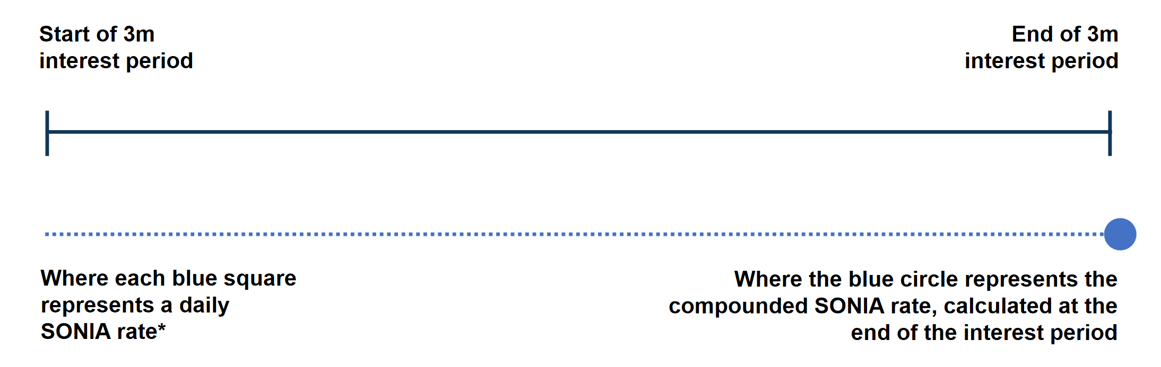
Reference Rates
SONIA
The most established way to use SONIA to calculate interest in contracts is called ‘compounded in arrears’
  This involves taking the SONIA rate for each business day over the interest period to calculate the applicable rate
  *On weekends and bank holidays, the SONIA rate is held constant from the last working day
Source: Bank of England
Notes:
Compounded SONIA is extremely robust:
•Overnight SONIA is underpinned by ~£60bn1worth of daily transactions, reported to the Bank of England
•Taking this rate every business day means there is a very large volume of transactions underpinning the final interest rate. E.g. £60bn x number of business days in interest period = significant volume
Calculating interest on a compounded basis reduces the contribution of ‘one-off’ volatility in interest rates, that may occur due to unusual supply and demand factors affecting a benchmark rate on a particular day
When using compounded SONIA, the interest rate payable is aggregated over the interest period and finalised at the end. The eventual rate becomes increasingly certain as the end of each period approaches and most of the SONIA observations are known.
•But we know firms need a period of certainty over their payments to operate smoothly. The market has therefore developed conventions to provide time after the last SONIA observation for the final interest to be calculated & verified before it needs to be paid.
•For example, the period for calculating interest may start (typically) five days before the actual interest period begins, so it finishes that number of days before the interest is due.

Slide 28
Reference Rates
Term SONIA (TSRR)
SONIA can also be compounded to be used in term contracts (forward looking)
  Unlike LIBOR, a term SONIA rate would not reflect term bank credit risk.
  The UK authorities and the Working Group on Sterling Risk-Free Reference Rates have made clear they expect the use of such forward-looking benchmarks to be relatively limited
  Calculated using OIS / SONIA Futures

Slide 29
Reference Rates
EURIBOR
Euribor, or the Euro Interbank Offer Rate, is a reference rate that is constructed from the average interest rate at which eurozone banks offer unsecured short-term lending on the inter-bank market
The maturities range from one week to one year
Loans are often structured as repurchase agreements (repos) intended to maintain bank liquidity
Euribor is calculated by a benchmark administrator called Global Rate Set Systems Ltd. and offered by the European Money Markets Institute (EMMI)
€STR
Reflects the wholesale euro unsecured overnight borrowing costs of banks located in the euro area
Published on each TARGET2 business day based on transactions conducted and settled on the previous business day (T+1)
Deemed to have been executed at arm’s length and thus reflect market rates in an unbiased way
Notes:
There are 20 panel banks that contribute to Euribor. These are the financial institutions that handle the largest volume of eurozone money market transactions. As of 2018, these panel banks include:
Belfius (Belgium)
BNP Paribas (France)
HSBC France
Natixis (France)
Crédit Agricole (France)
Société Générale (France)
Deutsche Bank (Germany)
DZ Bank (Germany)
National Bank of Greece
Intesa Sanpaolo (Italy)
Monte dei Paschi di Siena (Italy)
UniCredit (Italy)
Banque et Caisse d'Épargne de l'État (Luxembourg)
ING Bank (Netherlands)
Caixa Geral De Depósitos (Portugal)
Banco Bilbao Vizcaya Argentaria (Spain)
Banco Santander (Spain)
CECABANK (Spain)
CaixaBank (Spain)
Barclays (Britain)

Slide 30
Money Markets Instruments

Slide 31
T-Bills and Commercial Paper
Short-dated fixed income securities
Companies and governments can use fixed income instruments to raise money for short-term periods:
Governments
    These are zero coupon discount instruments called bills:
      UK and US T-bills
      German Bubill
      France BTF
      Japan – Financing Bills
  Corporates
    Corporations issue instruments similar to government bills called commercial paper or CP

Slide 32
UK Treasury bills (T-bills)
T-bills are negotiable, zero-coupon obligations of Her Majesty’s Government issued and administered by the Debt Management Office (DMO) mainly used to fund the Government’s cash flow situation:
    Issued with maturities of one, three, six, and twelve months
    Very low (practically zero) risk
    Issued at a discount and redeemed at par
DMO
DMO
T-bill
GBP 1,000,000 Nominal value
182 day
T-bill
GBP 1,000,000 Nominal value
GBP 995,000
GBP 1,000,000
Primary dealer
Primary dealer

Slide 33
Commercial paper
US commercial paper (USCP) is an unsecured form of borrowing issued by major financial and non-financial corporations. Maturities average about 30 days, max 270.
Euro commercial paper (ECP) may have maturities up to 365 days (‘Euro’ refers to non-domestic currency issue):
Two main uses:
      Long-term financing (rolling over maturing CP)
      Matching fluctuating demands for cash
Purchasers:
      MM mutual funds, insurance companies, pension funds
Each issuer will have their CP rated by rating agencies
Notes:
Euro Commercial Paper is an unsecured general obligation in the form of a promissory bearer note, issued on a discount or interest-bearing basis by large commercial and industrial organizations. Maturities of ECP range from a few days up to one year, with most being 182 days; the minimum amount is usually $500,000.

Slide 34
Certificates of deposit (CD)
A CD is a certificate representing funds deposited at a bank for a named period at a fixed interest rate.
Note: CDs pay interest.
CDs are valued by present valuing the maturity amount of principal plus interest.
Certificate of deposit
GBP 10,000,000 six month 1% p.a
Investor
Bank
GBP 10m for six months at 1% p.a.

Slide 35
Repurchase Agreements (Repos)
A repo transaction in which one party sells another a security. At the same time, as part of the same agreement, the selling party agrees to repurchase identical securities on a specified later date at a specified price.
There are two legs to a classic repo:
  The seller delivers securities and receives cash from the buyer
  The difference between the cash received by the seller in leg one and returned in leg two is known as the repo rate and is the cost of the borrowed money
A ‘repo’ is therefore a ‘sale and repurchase agreement’:
  Legally: A sale and repurchase of bonds
  Economically: A cash loan secured by bonds
A sale and repurchase is a ‘repo’, whereas a purchase and sell back is a ‘reverse repo’, or a ‘reverse

Slide 36
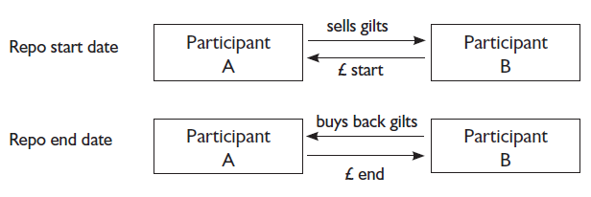
Repo Market (example)
  DMO’s ‘Standing Repo Facility’
  Reverse repos to GEMMs (for any amount above £5m nominal)
  Main purpose of repo market: liquidity

Slide 37
Foreign Exchange

Slide 38
Foreign Exchange (FX)
Introduction
  OTC institutional market dominated by banks
  No physical market place
  Types of transaction:
    Spot
    Forward
  Most commonly quoted currency pairs:
    USD/JPY
    USD/CHF
    GBP/USD
    EUR/USD
  Cross rates

Slide 39
Factors Affecting Foreign Exchange Rates
Interest rate parity
  Explains the relationship between spot rates and forward rates
  Relies on the principle of zero arbitrage
  Rationale:
    1. Converting a £ sum to $s today (at the spot rate), depositing in the US (at the US interest rate) and re-converting at the forward rate should generate the same sterling value as;
    2. Depositing the same £ sum in the UK for the same period
12 months
Spot rate
12 month forward rate

Slide 40
Cryptocurrencies
Virtual or electronic currencies
  Encryption technology controls issuance/ records ownership and payments
  Digital wallets
  Considered potentially high risk or speculative
  Risks to consider:
    Volatility
    Decentralised
    Unregulated
    Not reserve-backed
    Scalability
    Susceptible to human error, technical glitches and hacking

Slide 41
Distributed Ledger Technology (DLT)
DLT
  Replacement of a centralised ledger with a decentralised network of computers (‘nodes’) holding the same ledger
  Consensus algorithm
  ‘Public’ or ‘Private’
  E.g. Blockchain
  Advantages:
    Trustworthy and reliable record due to consensus
    Prevents a single point of failure
    Difficult to hack as many ‘nodes’ involved
    Removes potential costs and delays

Slide 42
Bonds

Slide 43
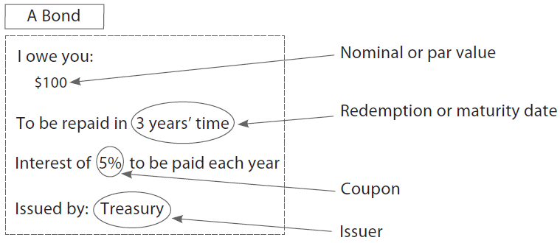
Fixed Income
Features and Characteristics
  Issuer
  Nominal value (or par value)
  Coupon
  Redemption/maturity date

Slide 44
The Present Value of a Bond
Discounting
  Interest rates and bond prices
    Inverse relationship

Slide 45
The Present Value of a Bond
Example
  A bond paying 6.5% (annual) coupons is redeemable (at par) in two years time. The interest rate is currently 5%.
  What is the present value of the year 2 cash flow?
  What is the price of the bond?

Slide 46
Accrued Interest
£
Dirty Price
£100
Clean Price
Coupon Period
Time
Cum Period
Ex Period
(7 days)
Ex-date
Coupon Paid Date

Slide 47
Accrued Interest
  Quoted price of a bond = ‘Clean price’
  Actual price paid = ‘Dirty price’
  Difference between clean and dirty prices? Accrued interest
  Accrued interest on gilts calculated on an ‘actual/actual’ day count convention
  Accrual period: Day following the last coupon payment to the settlement date (T+1)
  Ex-dividend period for gilts: seven working days

Slide 48
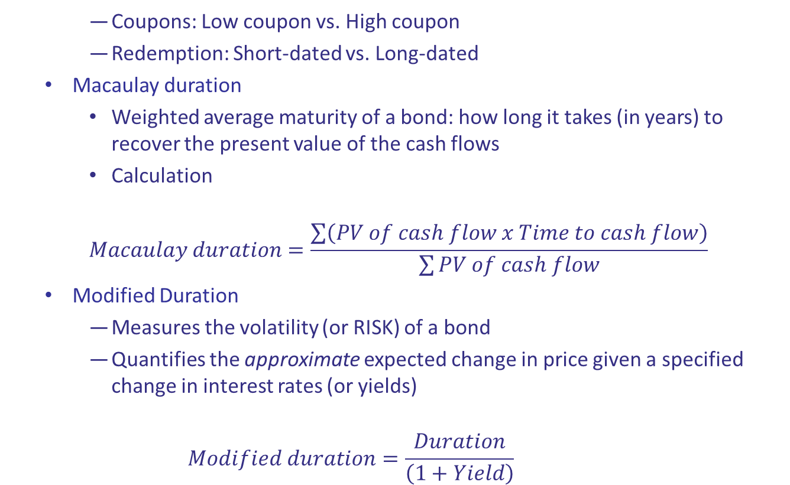
Bond risk
    Coupons: Low coupon vs. High coupon
    Redemption: Short-dated vs. Long-dated
  Macaulay duration
    Weighted average maturity of a bond: how long it takes (in years) to recover the present value of the cash flows
    Calculation
    $$Macaulay duration=\frac{\sum{\left(PV of cash flow x Time to cash flow\right)}}{\sum{PV of cash flow}}$$
  Modified Duration
    Measures the volatility (or RISK) of a bond
    Quantifies the approximate expected change in price given a specified change in interest rates (or yields)
    $$Modified duration=\frac{Duration}{\left(1+Yield\right)}$$

Slide 49
Yields
  Flat yield
    Calculation
        Flat yield = (Annual coupon/Price) x 100
    Use: non-taxpaying, income focused investors
  Gross redemption yield (GRY), or yield to maturity (YTM)
    Use: non-taxpaying, long-term investors
  Net redemption yield
    Use: taxpaying, long-term investor

Slide 50
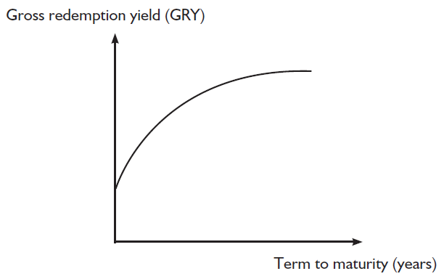
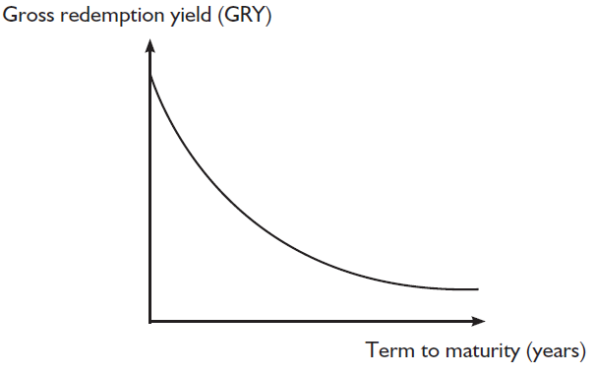
Yield Curves
  Normal yield curve/Inverted (‘abnormal’) yield curve
    Liquidity preference theory
    Expectation theory

Slide 51
Corporate Debt
Secured Debt
  Security reduces the impact of possible default
  Types of security:
    Fixed charge
    Floating charge

Slide 52
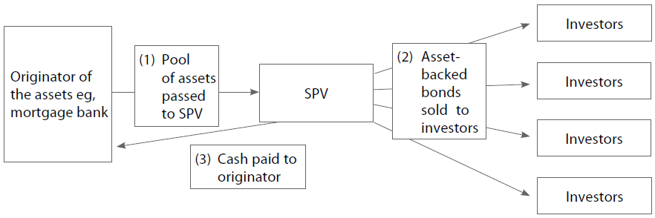
Asset-backed securities (ABSs)
    Securitisation
    Examples of ABS:
      Mortgage-backed securities (MBSs)
      Collateralised debt obligations (CDOs)
      Collateralised bond obligations (CBOs)

Slide 53
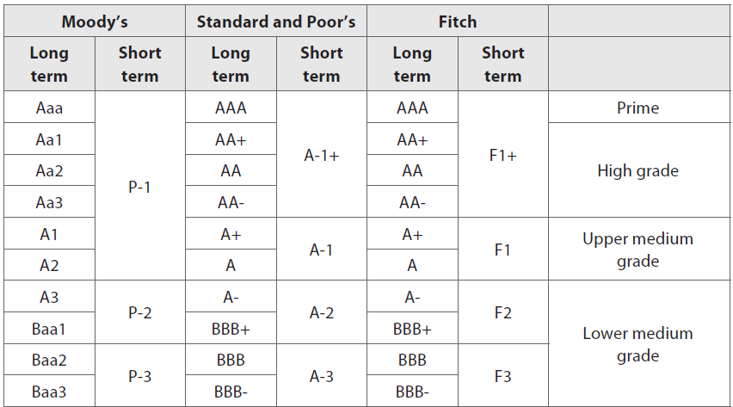
Credit Ratings (Investment Grade)

Slide 54
Derivatives

Slide 55
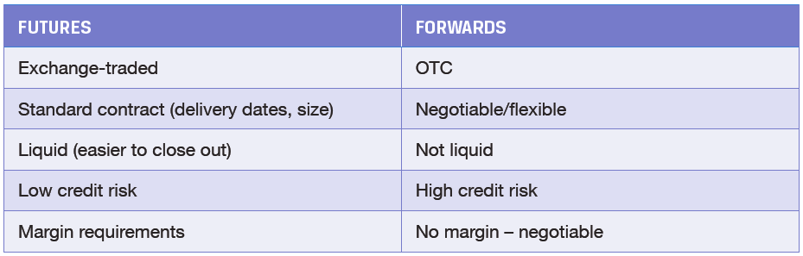
Types of Derivatives
  Forward contract
    A contract between a buyer and a seller to exchange an underlying asset on a future date, at a price agreed today
    Traded OTC
  Futures contract
    Exchange-traded forward, with standardised contract specifications

Slide 56
  Swap (contract for difference)
    Agreement to exchange a series of cash flows
    Traded OTC
  Option
    A contract between a buyer and a seller giving the RIGHT to exchange an underlying asset for a pre-agreed price
    Exchange-traded or OTC

Slide 57
Pricing Futures and Forwards
Fair value and costs of carry
  Imagine you are asked to quote someone a price for delivering a tonne of Cocoa in 3mth’s time. How would you determine the 3-month delivery price? You could:
    Make an educated guess
    Buy the asset now and hold it until the delivery date (the less risky choice)
In the second instance you would need to know:
  The price of the asset now (cash price)
  Your costs of holding the asset until delivery
  Any benefits obtained from holding the asset until delivery
Fair value = Cash cost + Cost of carry - Benefits of carry

Slide 58
Further Uses of Futures: Portfolio Hedging
Hedging with futures
  Futures may be used to reduce the exposure to the risk of an underlying asset
  There are two types of hedge:
    1. Short hedge (aka producer’s/farmer’s hedge) where the owner of the asset sells a futures contract to reduce exposure.
    2. Long hedge (aka consumer’s hedge) where the asset must be bought in the future. Here a futures contract is bought securing the price of the underlying.

Slide 59
Long Hedge
Short underlying
Long future
Loss Profit
Underlying price

Slide 60
Short Hedge
Short future
Long underlying
Loss Profit
Underlying price

Slide 61
Options
What is an option?
  A contract for the right to buy or sell:
    a particular asset;
    at a particular price;
    on or before a specified date
Options may be
  Vanilla – the option is plain and ordinary
  Exotic – the option has a special feature not usually associated with a vanilla option
Vanilla options
  Call options – the right to buy
  Put options – the right to sell

Slide 62
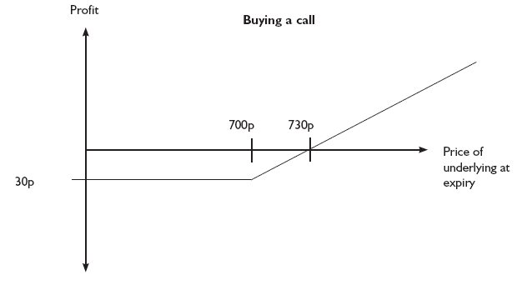
Options: Profit & Loss Profiles
  Long call
    Long a March ABC plc 700 call @ 30

Slide 63
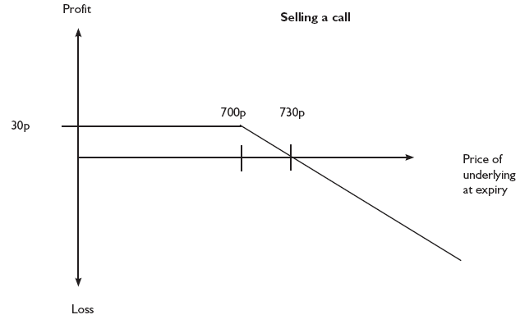
  Short call
    Short a March ABC plc 700 call @ 30

Slide 64
  Long a June ABC plc 115 put @ 10
30
20
10
0
80 90 100 110 120 130 140
-10
-20
-30

Slide 65
  Short a June ABC plc 115 put @ 10
30
20
10
0
80 90 100 110 120 130 140
-10
-20
-30

Slide 66
Option Pricing
The premium
  The premium is paid by the holder of an option to the writer.
  It represents the value of the right to buy (call) or sell (put) at the strike.
The premium may be split into two components, intrinsic value and time value:
  Intrinsic value is the built-in profit the option has by virtue of the underlying’s price and its strike price. For example, a 100 call when the underlying is trading at 110 will have intrinsic value of 10.
  Note: Intrinsic value will be positive or zero.
  Time value represents the remaining life the option has regardless of any intrinsic value:
Premium = Intrinsic value + Time value

Slide 67
Factors That Influence The Option Premium
There are five factors that drive option premiums:
  The price of the underlying
  The strike price of the option
  The option’s remaining life
  The volatility of the underlying asset
  Interest rates
These are usually input into a pricing model to calculate a return:
The price of the underlying
The strike price of the option
Volatility
The option’s remaining life
Interest rates
Option pricing model
e.g. Black-Scholes
Premium value

Slide 68
Interest Rate Swaps
An interest rate swap is an agreement in which floating interest payments are swapped for fixed interest payments on a reference, or notional, principal amount.
It is important to remember the main features of an interest rate swap:
  The term
  The notional
  The cash flow calculations
  The frequency
Fixed interest rate on a notional amount for the term of the swap
Fixed Rate Payer
Fixed Rate Receiver
Floating interest rate on a notional amount for the term of the swap

Slide 69
Credit Derivatives
  Credit default swap
    A buyer pays a premium to a seller for protection against bond default
    If default occurs:
      The seller receives the bond and pays the face value to the buyer (physical settlement); or
      The seller pays agreed notional principle to the buyer (cash settlement)

