Slide 1
Macro Fundamentals

Slide 2
What is Macro

Slide 3
Why is macro important?
Market may swing dramatically in either direction on a day-to-day basis (even in the absence of any corporate news)
Shifting macro perspectives and interpretations by the market may play a significant role in these volatile short-term trends, not necessarily because of the intrinsic value of the company itself
Macroeconomic news influences daily swings in the market. By building an understanding of what impacts the markets the most, you can successfully navigate them

Slide 4
Business cycle
Geopolitics
(& politics)
Monetary policy
Fiscal
policy
Inflation vs. economy
Market structures
Macro regime
Market perception
Financial conditions
“Macro opportunity”
Right (trending)
Wrong (contrarian)

Slide 5
Types of macro regimes
Regime | Economic Growth (Trend) | Inflation (Trend) | Characteristics & Asset Performance
Expansive (Goldilocks) | Rising | Falling/Low | Peak performance for risk assets. Strong profits, low input costs, and easy monetary policy. Best for: Equities, Credit (Corporate Bonds).
Contractionary (Stagflationary) | Falling | Rising/High | Most challenging regime. Falling demand meets rising costs. Central banks face a dilemma. Best for: Commodities, Gold, Cash/Short-Term Bonds (Defensive).
Recovery (Reflationary) | Rising | Rising/High | Early cycle growth and policy stimulus. Demand picks up, driving both growth and prices higher. Best for: Cyclical Equities, Commodities, Inflation-Protected Bonds (TIPS).
Slowdown (Deflationary) | Falling | Falling/Low | Late cycle risk reduction. Weak demand, low pricing power, and falling rates. Best for: High-Quality/Long-Duration Government Bonds, Defensive Equities, Quality/Low Volatility Factors.

Slide 6
How to tell?
Econometric analysis of macro and market data
Regime
Policy analysis
Technical analysis of security prices (volume, charts, sentiment…)
Fundamental analysis of stocks (earnings releases)
Mainstream media (The Economist, Barron’s…)
Perception

Slide 7
Financial Markets

Slide 8
Structure of Financial Markets
Markets and intermediaries
Lenders
Retail
Companies/
Institutions
Borrowers
Retail
Companies
Governments
Reward
Risk
  Provision of a payment mechanisms
  Management of maturity terms
  Transformation of risk
  Provision of liquidity
  Cost efficiency

Slide 9
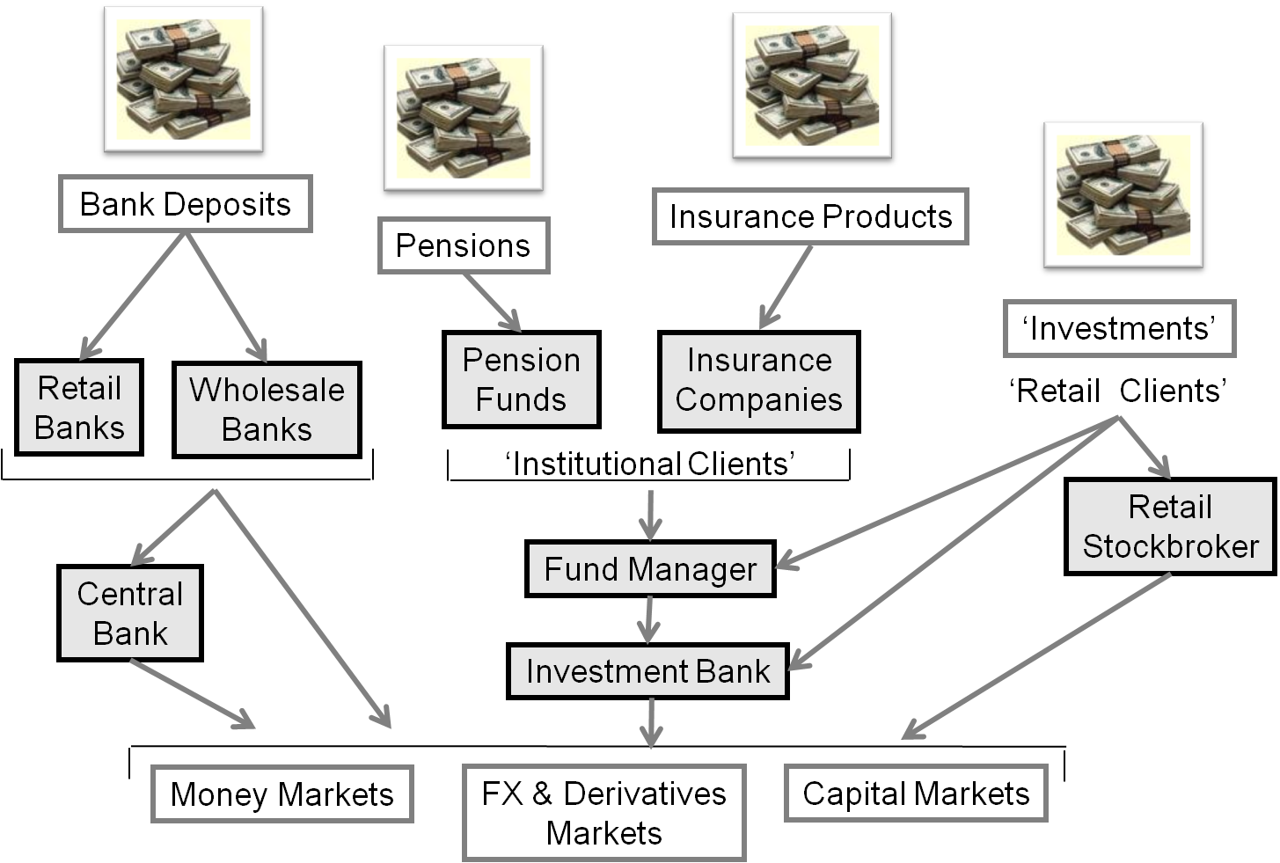

Slide 10
Sell-side – A typical Investment Bank
Front office – Revenue generating; clients = Corporates/Governments/Banks/Asset Managers
Capital markets
Investment banking
Traders and market makers
Fund/quant research analysts
Sales people
Debt/ equity capital markets
Corp financiers and M&A specialists
Structurers
Middle office – Reporting, cost saving and efficiency improvements
Clients = Front office, senior management
IT analysts, business analysts, prime brokerage
Legal and compliance officers, HR
Senior management – CEO, COO, CTO, CFO, etc.
Credit/market risk analysts (reporting)
Product controllers (finance)
Back office – Processing, cost saving and efficiency improvements
Clients = Front/middle office, external clients, senior management
Operations/support analysts

Slide 11
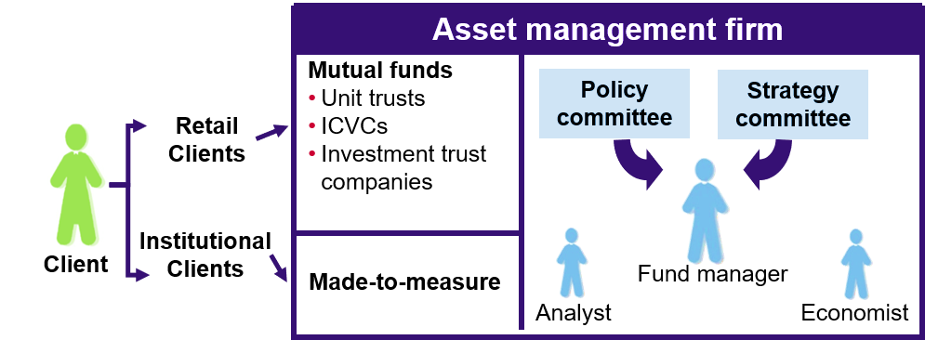

Buy Side – Asset Manager

Slide 12
Buy Side – Hedge Funds
  Hedge funds:
  Are generally not open to the public or promoted to private investors (with exceptions)
  Use creative, innovative and often aggressive investment strategies
  Invest their own money alongside their clients
  Hedge fund managers earn a management fee and will also earn a performance fee if targets are met. For example: 'Two And Twenty’ - hedge fund managers charge a flat 2% of total asset value management fee and an additional 20% of performance

Slide 13
Different Investment Philosophies
  Active fund managers do not believe the markets to be efficient:
    Pick assets that could outperform the benchmark over the fund’s
    investment horizon
    Theoretically cheap, recovery plays, unethicals, etc.
    Seek to beat the market
    Consumes research – broker and in-house
    Styles: Growth, value, income, etc.
  Passive fund managers believe the market is efficient, it is impossible to
  outperform the index:
    Benchmark should therefore be replicated or tracked
    No one can beat the market (in the long run)
    Light on research, heavy on IT
  A hedge fund’s aim is to:
    Provide absolute returns (Alpha) – regardless of market direction
    Take short or long positions
    Consumes research

Slide 14
Central Banks
  The Role of Central Banks
  Mandate
    Monetary policy – management of the supply and demand of money
    Regulatory policy – ensuring financial stability
    Debt relief – ensuring smooth functioning of fiscal policy

Slide 15
Circular Flow of Income
Imports
Abroad
Taxes
Government
Savings
Financial System
Households
Exports
Good and services
Government spending
Wages
Factors of Production
Investment
Firms

Slide 16
Economic data

Slide 17
Types of data
Leading indicators vs. lagging indicators
  Leading
    Stock prices
    Yield curve
    Jobless claims
    Consumer sentiment
    PMI…
  Lagging
    GDP
    Non-farm payrolls
    Inflation
Hard data vs. soft data
  Hard: objective
  Soft: subjective

Slide 18
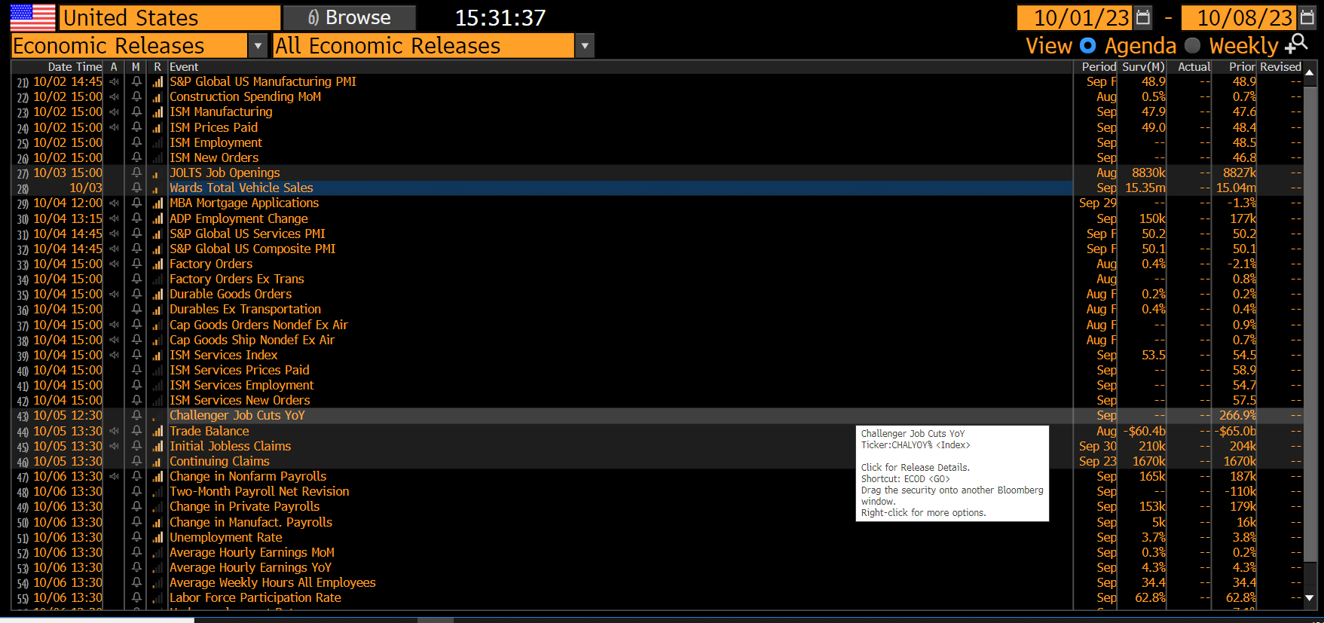
Bloomberg calendar
Actual, data reported by gov
Expected (economist survey consensus)
Relative importance

Slide 19
Gross Domestic Product (GDP)
    The total value of output from WITHIN a country
    Where:
      C = Consumer expenditure
      I = Private investment in firms
      G = Government expenditure
      X = Exports
      M = Imports

Slide 20
Key macro-economic indicators
Inflation
  CPI vs. PPI vs. PCE
  Each country will have a slightly different basket for their inflation data
    In the US: Headline, Core (ex-food and energy) and Supercore (services inflation ex-food, energy and housing)
  The Fed’s mandate is to return inflation back down to 2%, so they closely watch inflation numbers, as well as the overall trend
    To some degree, you can ‘predict’ what the number will be (Even though this is highly difficult and complex)
    For example, say it’s October. On the 12th October, September’s CPI readings are released. Technically, one can review all of the past monthly increases in prices to ‘predict’ what CPI would be for the month of September

Slide 21
Inflation
Credit Creation
  Cause? Banks lend more than they hold in reserves
Impact of Inflation
  Problems caused by inflation:
    Real value of salaries/pensions eroded
    Real value of investments eroded
    Exports may become less competitive
  Positive aspects:
    Rising house prices contribute to a ‘feel good factor’
    Borrowers benefit: the real value of debt falls
    Real value of a country’s national debt may fall

Slide 22
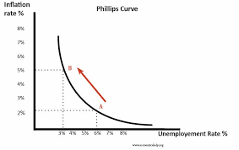
Key macro-economic indicators
Unemployment data
  This is known as an NFP (Non Farm Payrolls) report, and is published by the BLS (Bureau of Labor Statistics.
  Philips curve

Slide 23
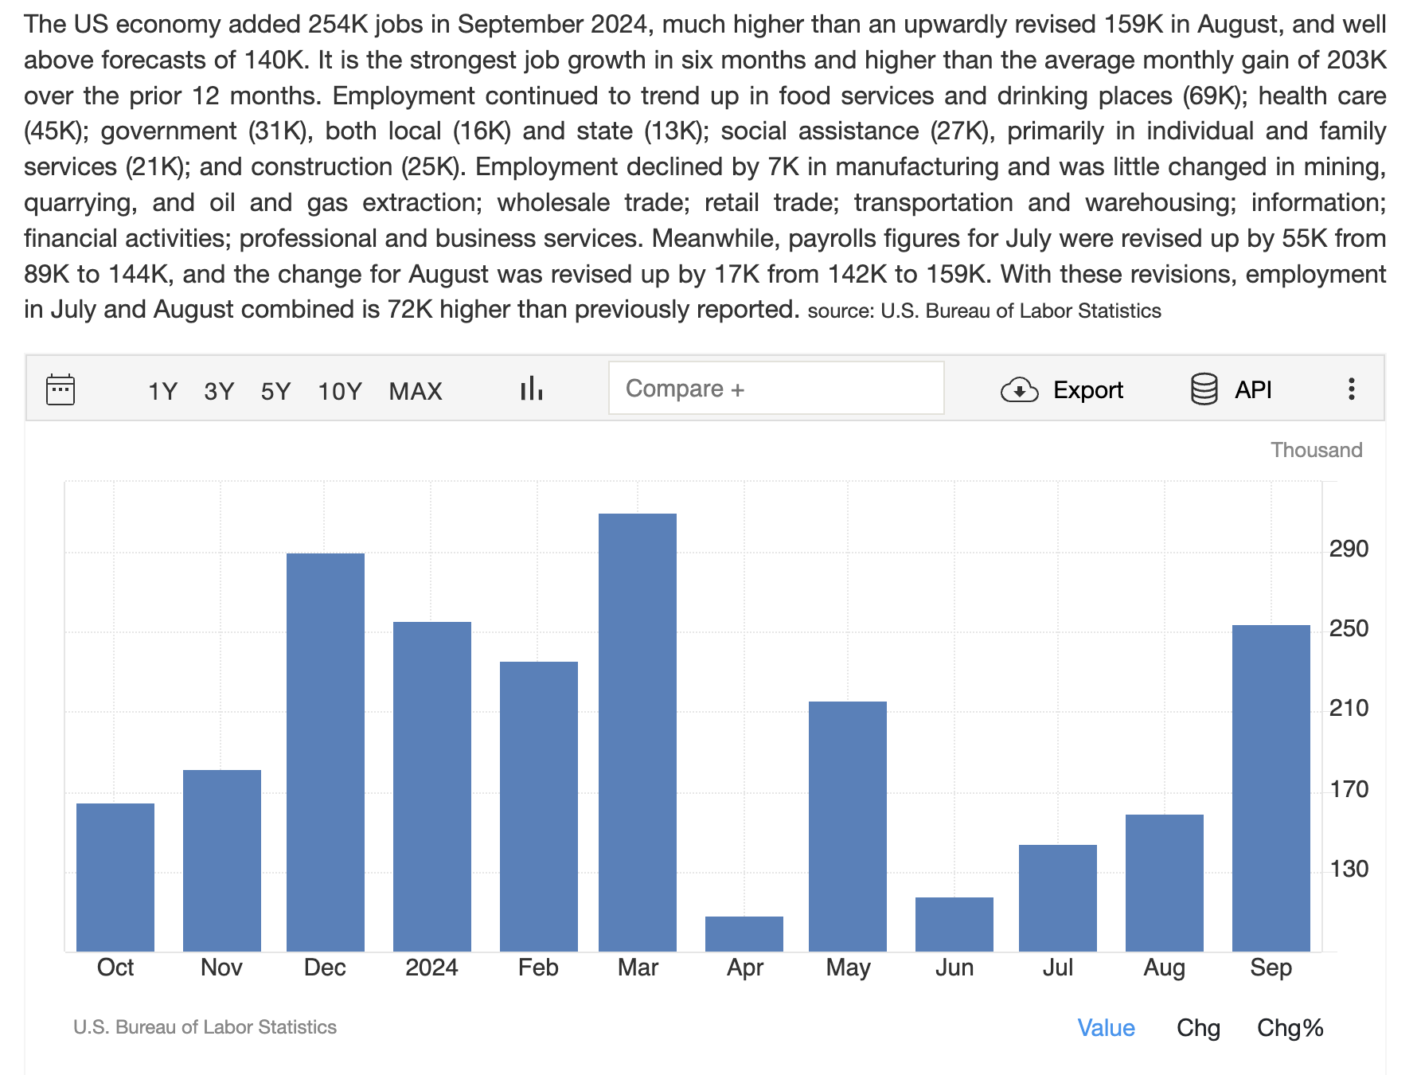
United States Non-Farm Payrolls

Slide 24
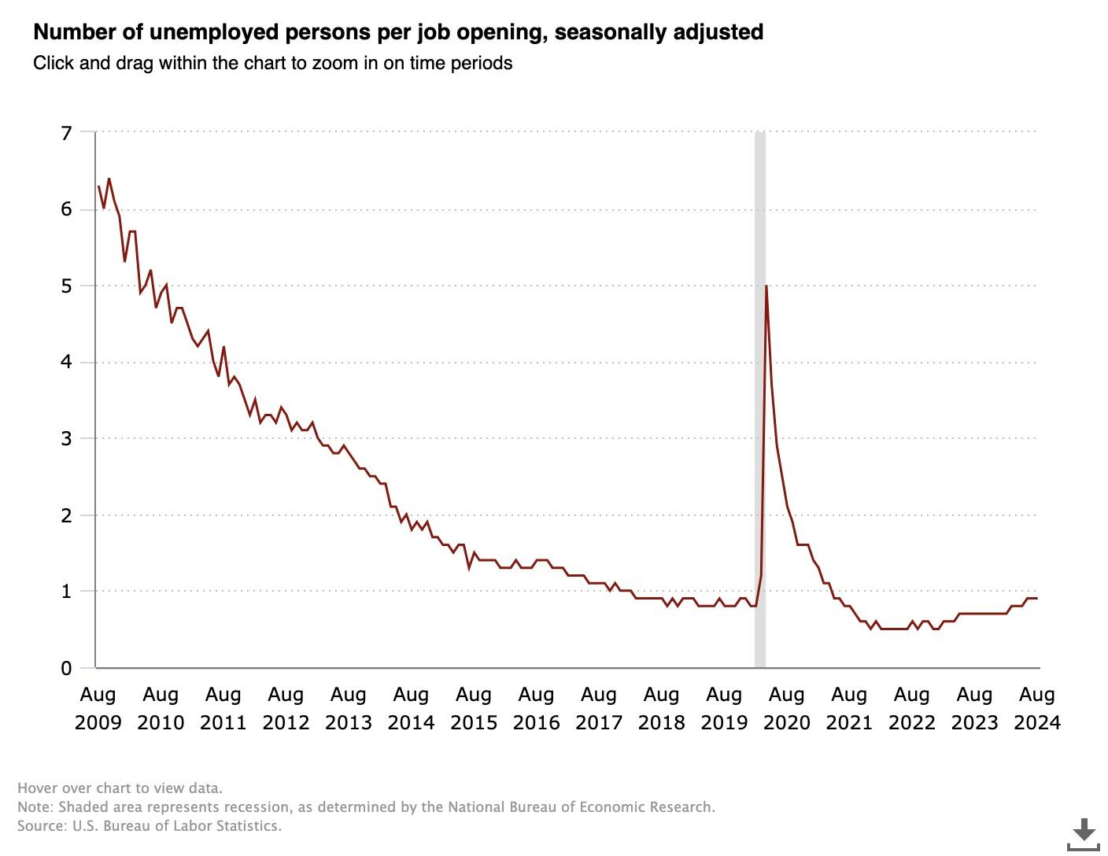

Slide 25
PMI (Purchasing Managers Index)
Purchasing Manager’s Index data is considered a leading indicator, as it provides insights into the health and direction of a country’s manufacturing/service industry over the coming months.
These reports are released early on in the month, usually at the beginning, and have a significant impact on financial market performance that day.
  Prices Paid Index
    Can influence the path of inflation, as it’s direct data from businesses showing how much they paid for goods/services, raw materials etc.
  Main Index
    Measures confidence of business leaders going forward.
    Below 50 = contractionary, above 50 = expansionary
      Higher confidence = higher investment = higher inflation and tighter labor market = higher interest rates(prevent economy from overheating)

Slide 26
Carry Trade
Borrow in a low-interest asset (e.g. JPY)
Invest in a high-interest asset (e.g. USD)
Assumption: direction stays the same forever i.e. the macro narrative needs to stay the same (no volatility)

Slide 27
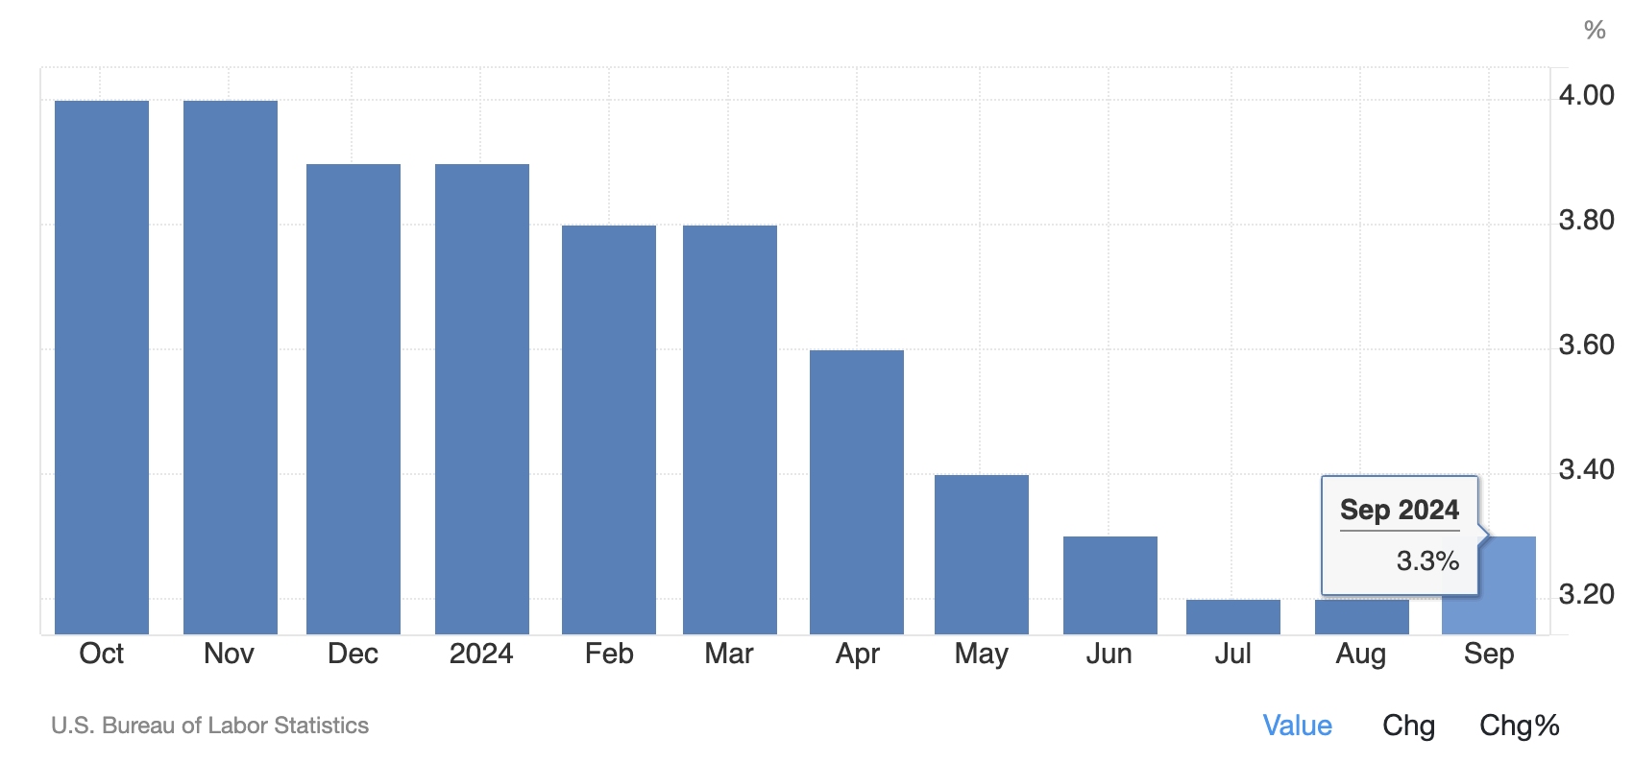
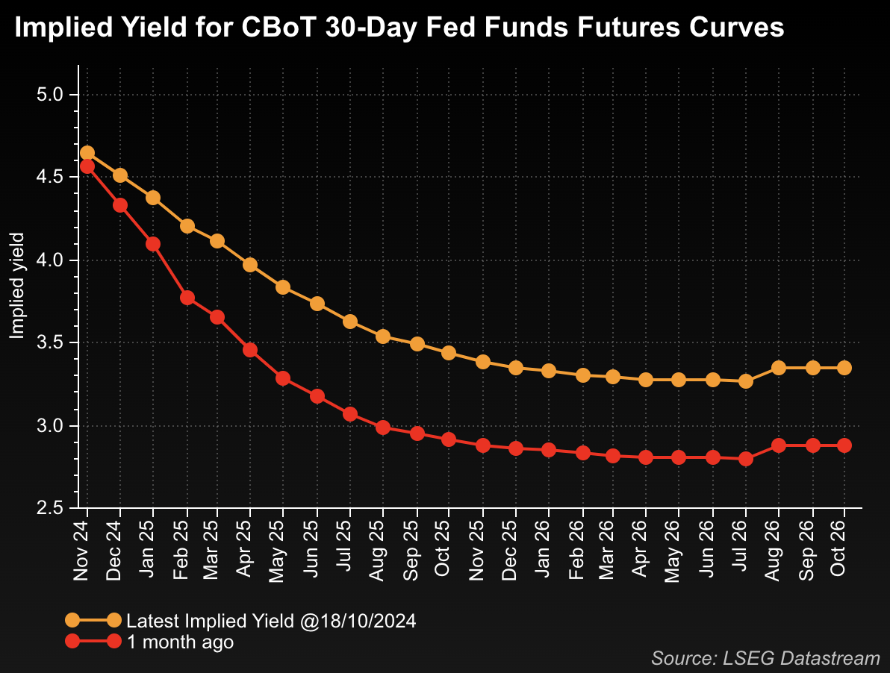
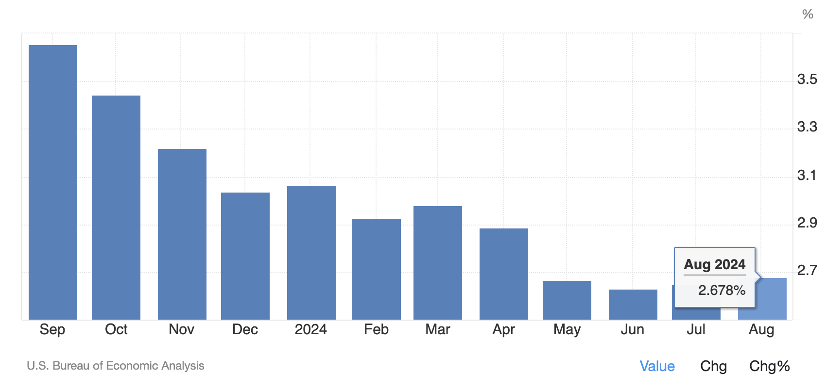
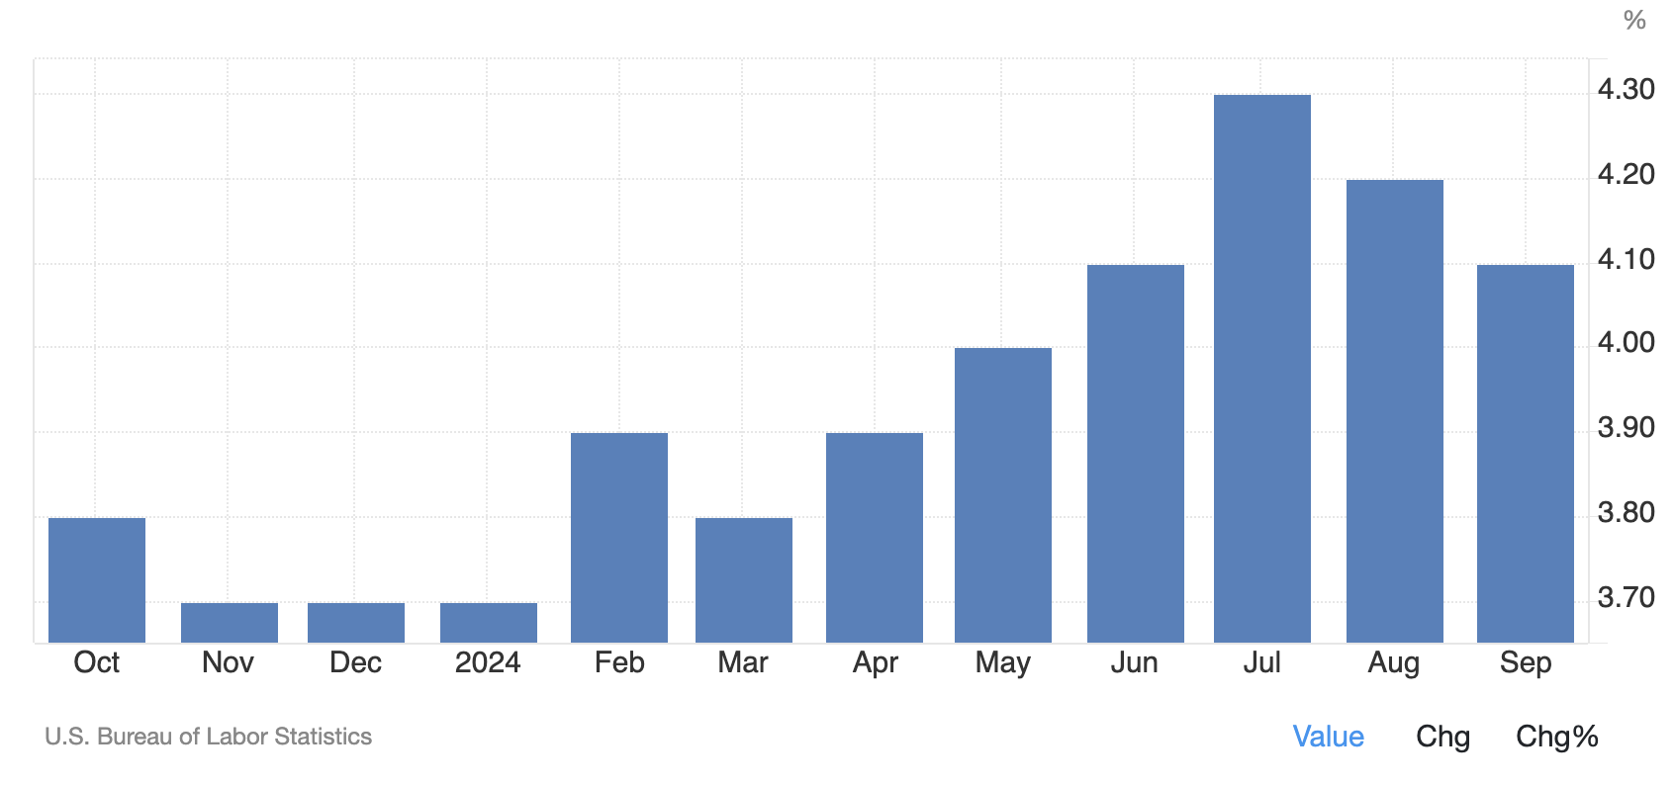
Data prints taken together could shape markets narratives
US Core CPI YoY
US Core PCE YoY
US Unemployment
…

Slide 28
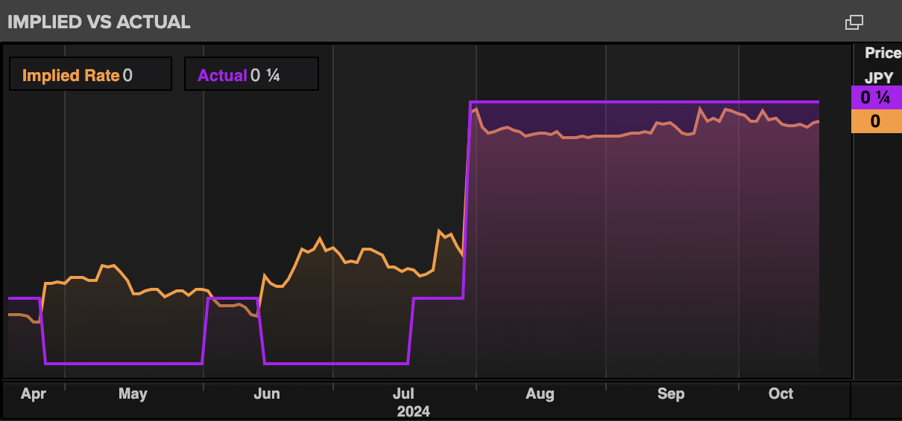
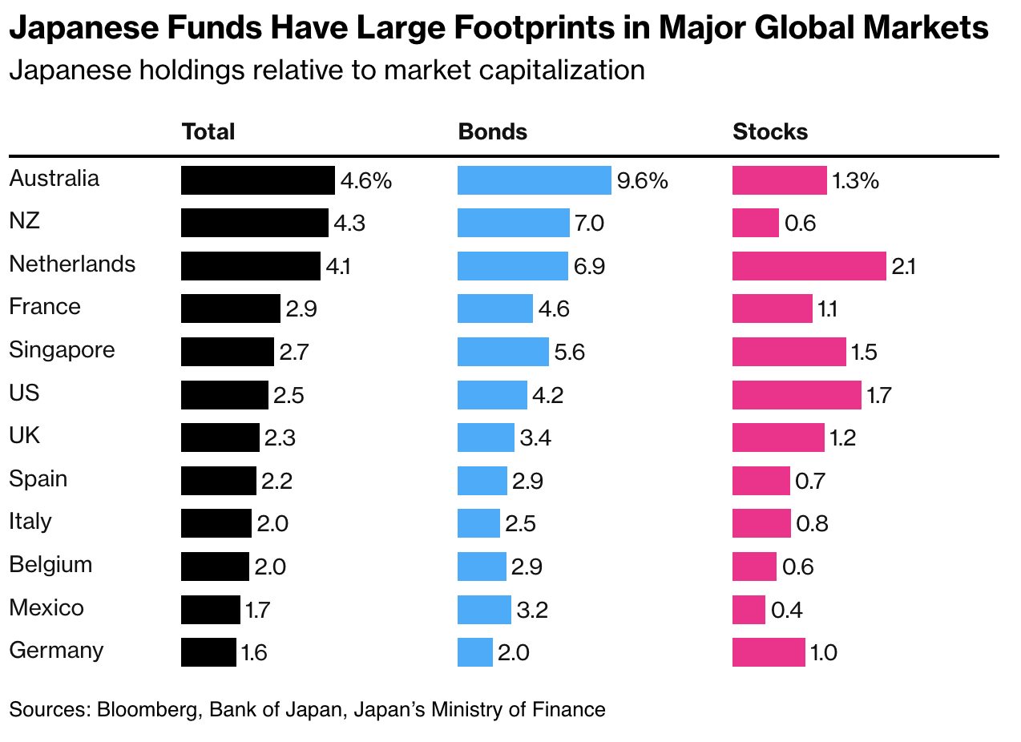
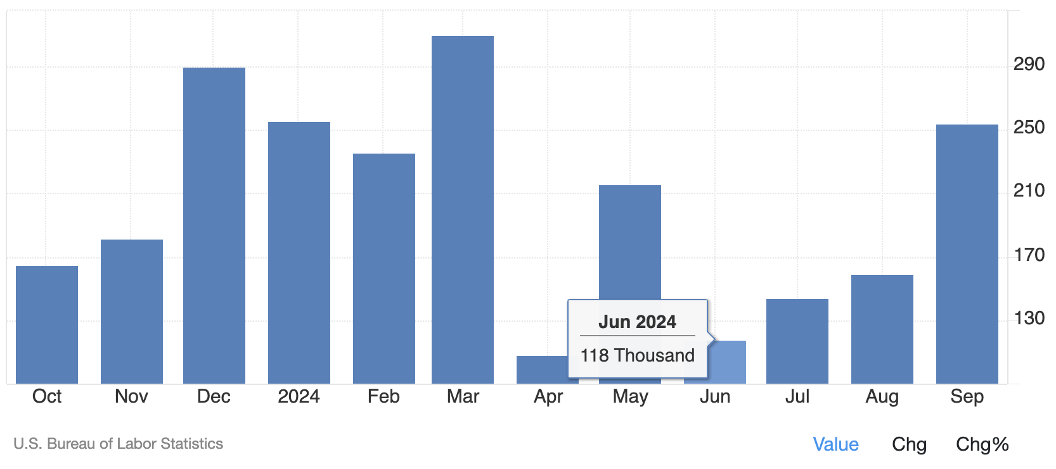
A shock to markets narratives - Japan carry trade unwind
BoJ surprise rate hike in July
Japanese funds’ heavy footprints in major global markets
US Non-farm

Slide 29
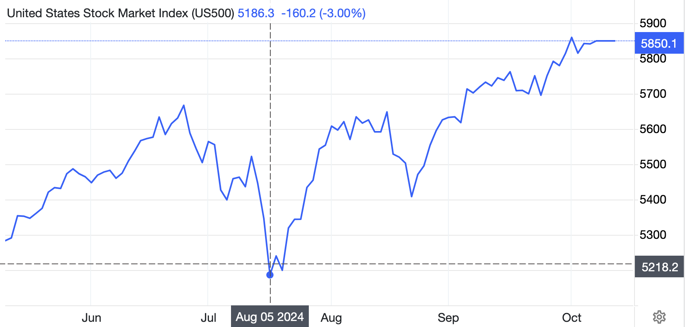
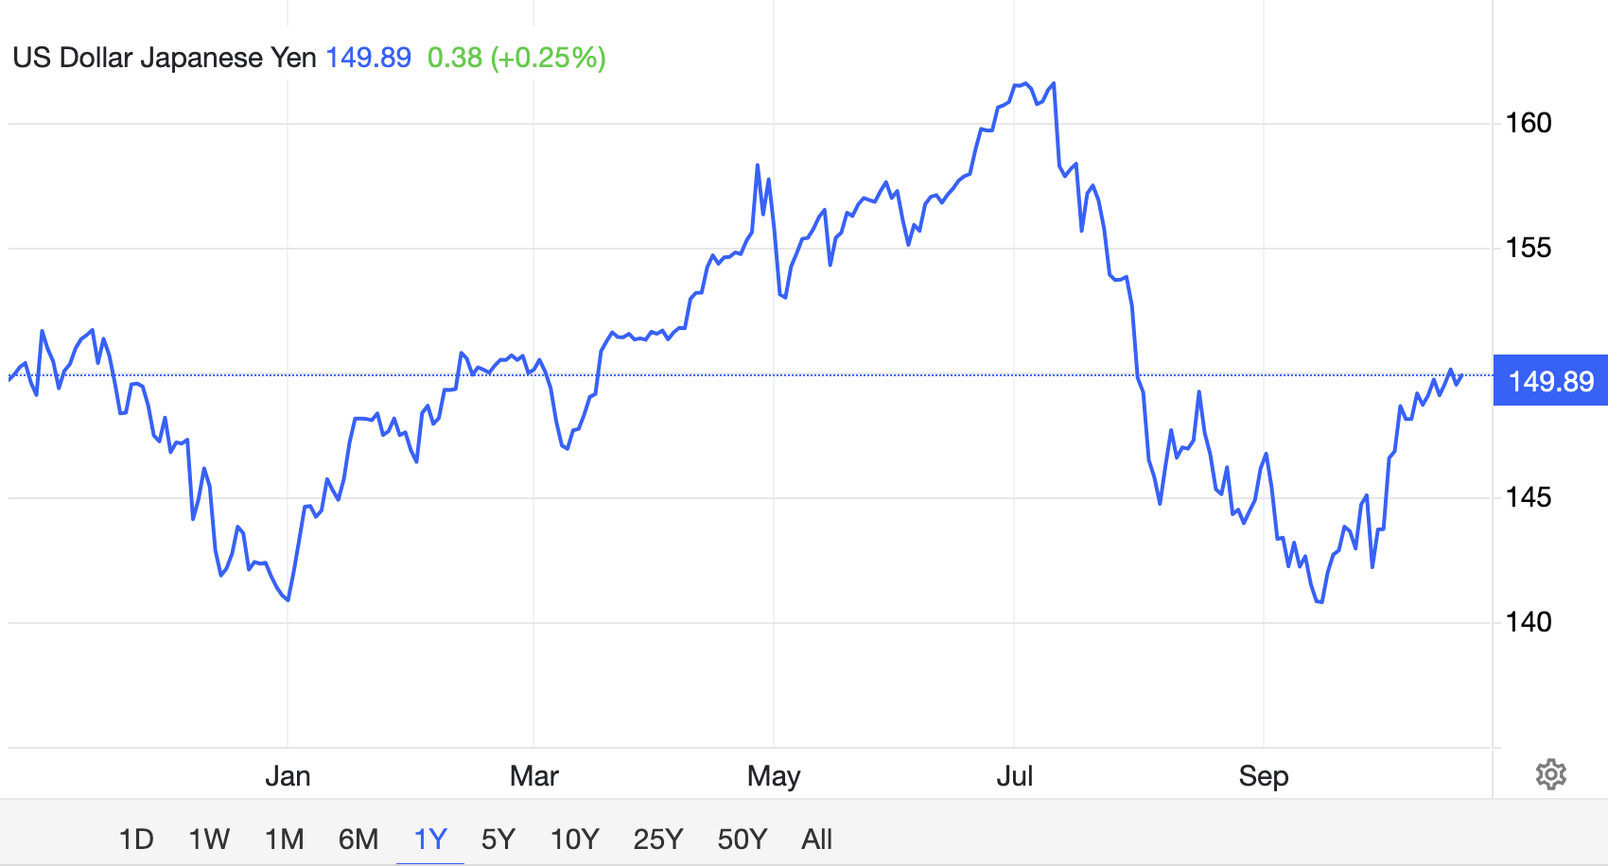
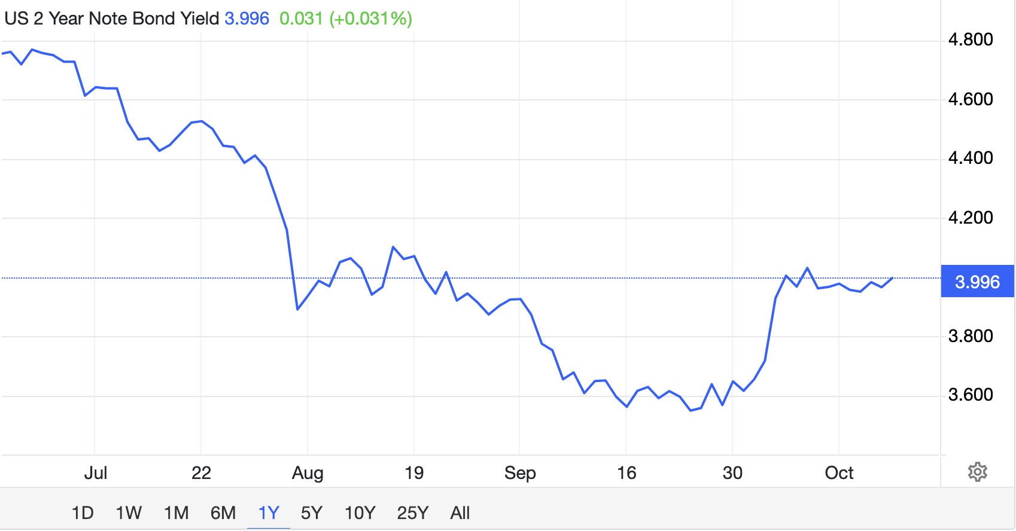
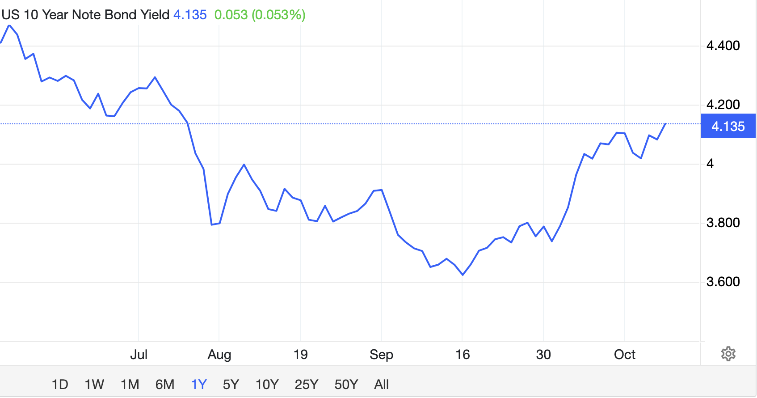
A shock to markets narratives - Japan carry trade unwind
S&P500
USDJPY hence sold off
US 10yr
US 2yr

Slide 30
Biggest Macro Narratives?

Slide 31
Biggest Macro Narratives
1
Fiscal Dominance
2
Fiat Debasement
3
(End of) US Exceptionalism
4
AI Bubble
5
K-Shaped Economy

