Slide 1
Rates Fundamentals

Slide 2
Table of Contents
Fixed income basics
Post-08 changes in monetary policy
Different “bets” in rates markets

Slide 3
Fixed income basics

Slide 4
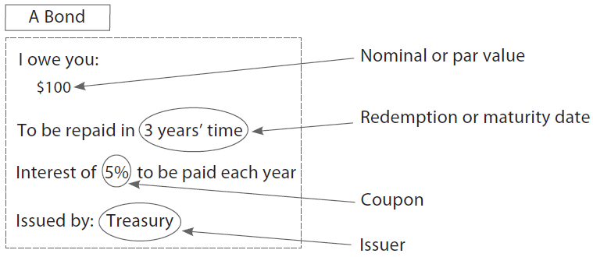
Fixed Income
Basic Features
Issuer
Nominal value (or par value)
Coupon
Redemption/maturity date

Slide 5
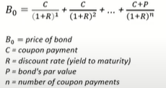
Pricing
Like any asset, fixed income is priced by discounting cashflows with the risk-free interest rate
When interest rate rises, cashflows are discounted more stringently
  New bonds pay higher interest rate, so old (i.e. existing) bonds become less popular and so cheaper

Slide 6
Duration & Convexity
Duration: a number that tells you – how sensitive is a bond to changes in interest rates?
Convexity: positive vs. negative – positive convexity is asymmetric upside for the investor – when the bond’s price rises when its yield falls more than when its price falls when its yield rises

Slide 7
Rates vs. Credit
Rates
Credit
What’s the level of interest rate?
Bet on Interest Rate Risk
Macro
Will the borrower
default?
Bet on Credit Risk
Borrower-specific

Slide 8
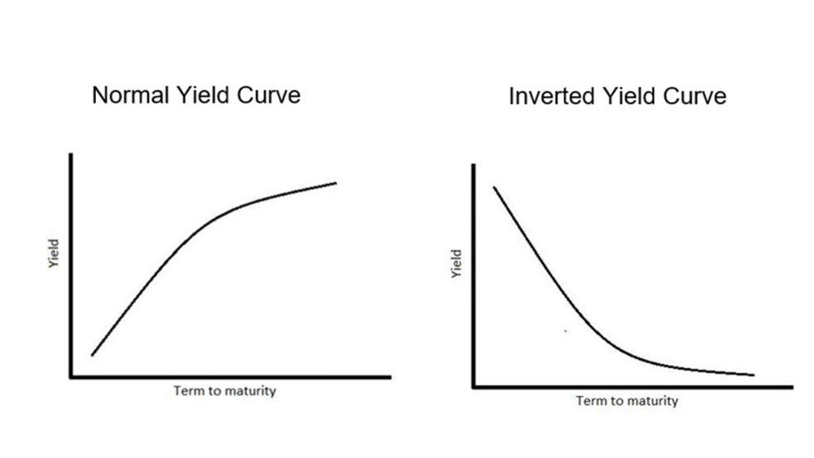
Yield Curve

Slide 9
Short-end, Belly, Long-end Rates
Interest rates essentially make you decide whether you save or spend money, which effectively affects economic activity
Higher interest rates means more expensive borrowing and more attractive saving, so economy cools as folks spend less, business invest less into projects
US issues bonds up to 30 year maturity, each bucket of maturity is affected by different factors
  Short-end (1-month to 2-year): current and immediate path of policy rate (what’s the Fed doing today?)
  Belly (3- to 7-year): intermediate path of policy rate and business cycle (when will the Fed pivot?)
  Long-end (10-year to 30-year): long-term economic prospects (what’s the long-term inflation/growth?)

Slide 10
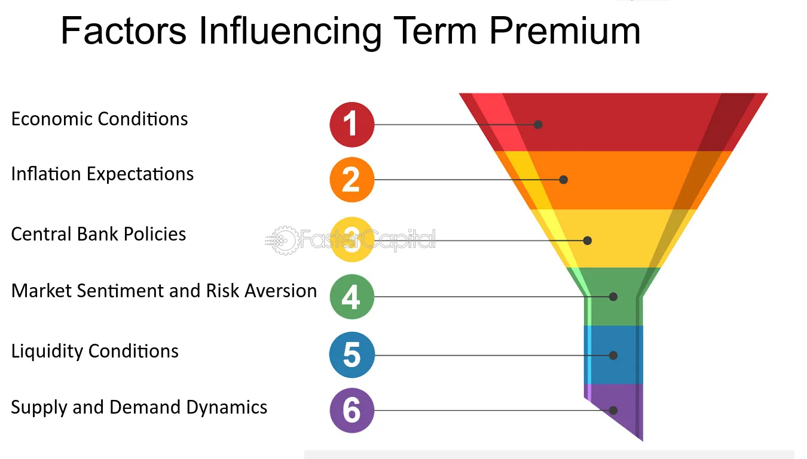
Longer you go, the bond is more influenced by TP
Long-term rate = expected short-term rates + term premium
I can roll a series of short-term rates into a long-term rate, but it’s not guaranteed the rates don’t change! TP is my insurance!

Slide 11
Post-08 changes in monetary policy

Slide 12
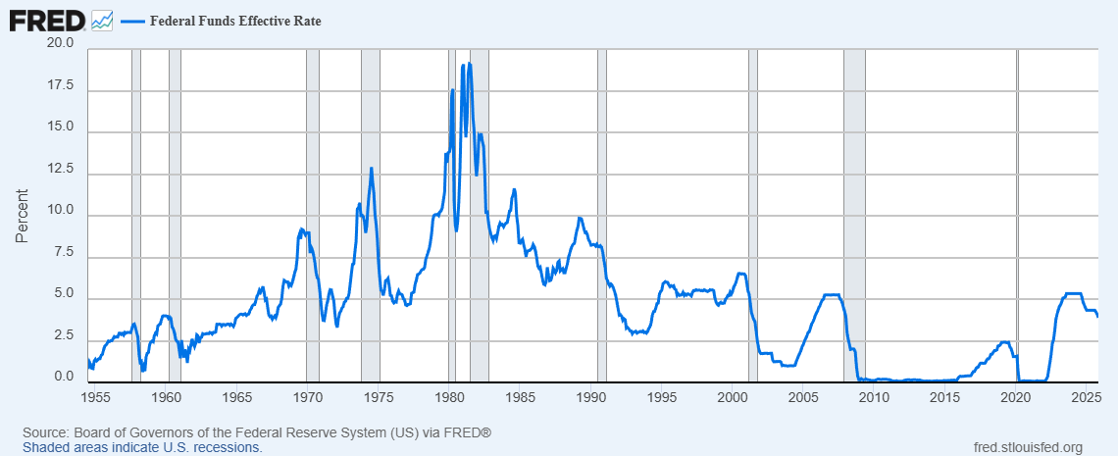
History of US interest rates

Slide 13
Cutting rates below 0?
Great Recession after GFC
Fed cut rates from 5.50% to 0.50%
You can’t cut rates below 0%
  Why?

Slide 14
Cutting rates below 0?
Great Recession after GFC
Fed cut rates from 5.50% to 0.50%
You can’t cut rates below 0%
  Why?
    It means if you deposit money at banks, you have to pay for it!
    People will have to withdraw money from their bank accounts
    Monetary policy works by influencing savings and investment decisions, no savings – monetary policy will no longer work!

Slide 15
So what did the Fed do instead?
Quantitative Easing (QE): buying long-term government bonds
  I (Fed) will pay you so you can spend money on things rather than save!
  Conducting monetary policy on the long-end, not the short-end
A Regime of ample reserves

Slide 16
Then, inflation hit in 2022
Fed did the reverse – hiking rates + QT
Ample reserves → scarce reserves
Fed ended QT in December 2025
In a regime of scarce reserves, short-term interest rates are more volatile (banks are more sensitive to changes in STIR)…

Slide 17
Different “bets” in rates markets

Slide 18
What are the different possible ways to trade rates?
Directional bet: higher vs. lower rates?
Curvature bet: steeper vs. flatter yield curve?
Basis bet: will there be a difference between cash and its derivative?
Breakeven bet: will inflation be higher than markets expect?

Slide 19
Directional bets
Buy bonds across the board
Raise the duration of my portfolio

Slide 20
Curvature bets
Bull
Bear
Steepener
Flattener

Slide 21
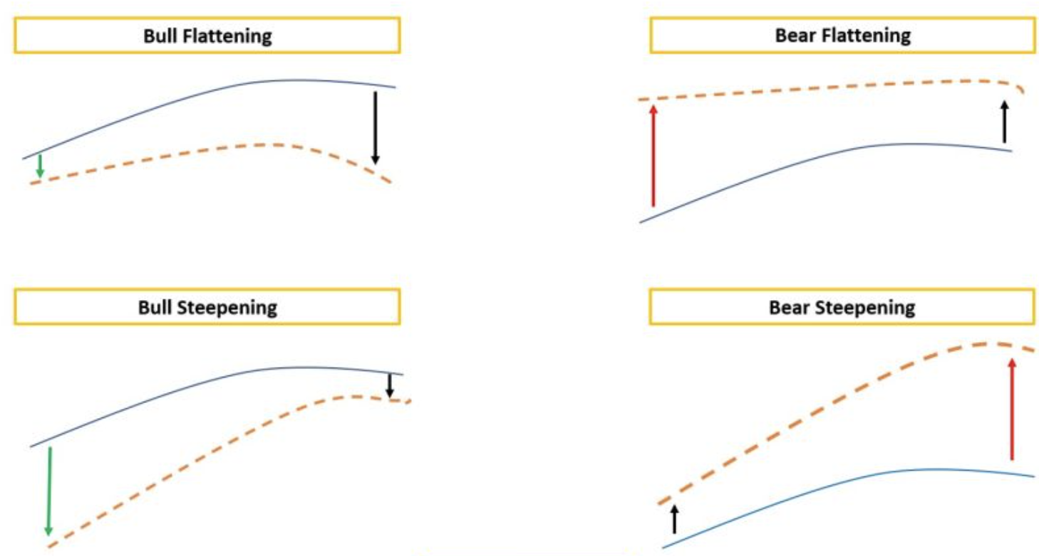
Curvature bets
Spots & Curve trades – steepeners, flatteners. E.g. 2s10s steepener trade

Slide 22
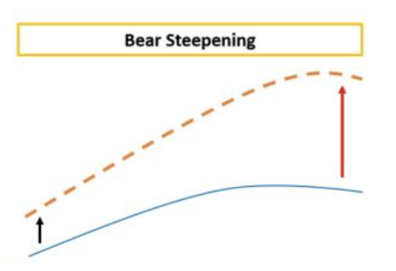
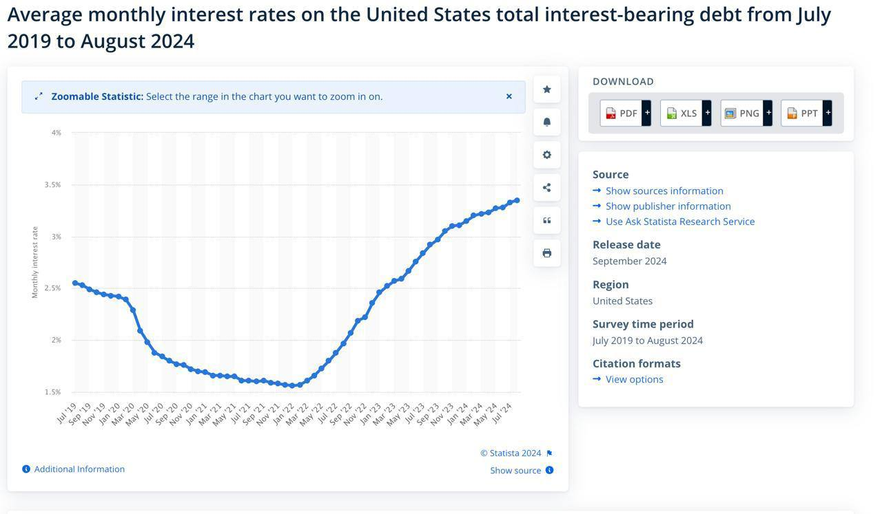
Curvature bets
Bear Steepener Trade in the US
Interest rates will increase by a much larger extent in the long end compared to the short-end
ie Short long term treasury bond (20 years) and long short term treasury bond (2 years)
Thesis:
Short term rate cuts are already priced in by market
Long term inflationary pressures, rising deficits (increasing
issuance) in the US
Rising interest rates on US debt will make it more difficult
For cheap borrowing and long term rates/yield curve will
Remain elevated
Notes:
Note that a steepener trade can be DV01 neutral depending on the sizing of the trades (DV01 refers to the dollar value of one basis point move in interest rates, and therefore DV01 neutral trade means that it neutralises interest rate risk).

Slide 23
Basis trade
Basis: difference in payoff between the cash security and its derivative security
It arises because of market frictions (i.e. it’s not normal)
Since the late 2010s, US has been expanding fiscal deficit → more supply for treasuries
At the same time, banks (traditional market makers in bonds) are heavily regulated → less demand for treasuries
NBFIs have taken on increasing role in treasury market making, but they come with very different incentives
More supply + less demand → less liquidity + more market frictions

Slide 24
Basis trade – Real Money
1. Client gives me $10m to manage for 10 years
2. In 10 years’ time, I need to generate X% return
3. At the end, I get Y% of my AUM

Slide 25
Basis trade – Fast Money
1. Client gives me $10m to manage for 1 quarter/month
2. In 1 quarter/month, I need X% return
3. At the end, I get Y% of my AUM + Z% performance fee

Slide 26
Basis trade
Fast Money
Buy
Treasury bond
Sell
Treasury future
Real Money
Buy

Slide 27
Basis trade – volatile!
Basis is typically very small (a few bps)
Hedge funds employ leverage via repo with banks, collateralising the bonds they buy

Slide 28
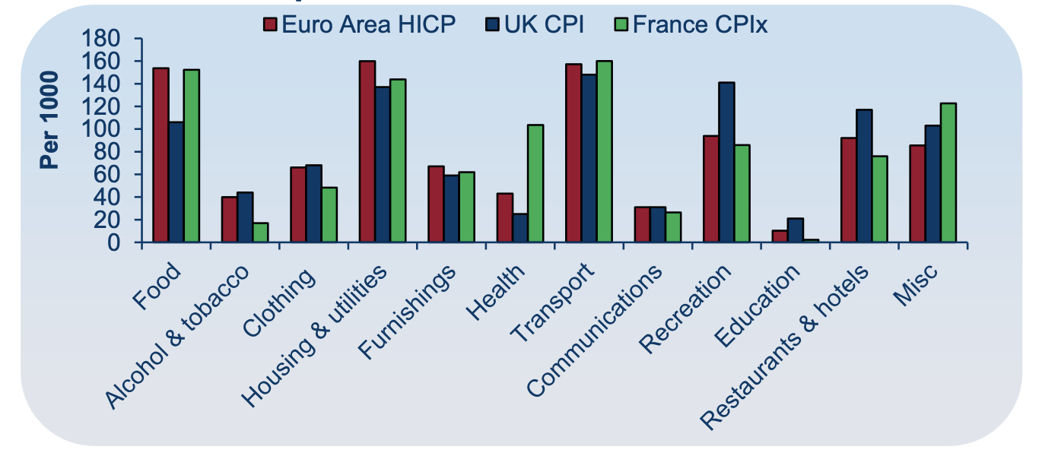
Breakeven bet
Inflation linked products are a type of indexed product, meaning cash flows depend on an index
  In the UK, the RPI is commonly used
    Note: RPI is changing soon. Index will soon become like the CPIH from 2030
  In the USA, CPI is more commonly used
Inflation linked products are used to commonly hedge large corporate inflation exposure
  i.e. Pension pay-outs that increase with an inflation index
Notes:
to learn more about RPI vs CPIH: https://www.lcp.com/media/1150122/202008-rpi-will-be-aligned-to-cpih-from-2030-with-no-compensation-for-holders-of-index-linked-gilts.pdf

Slide 29
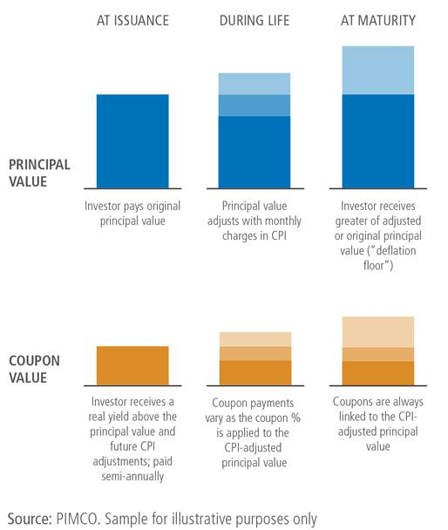
Breakeven bet
Inflation Linked Government Bonds are similar to vanilla (normal) government bonds where you have incremental, predetermined cashflows. But the difference here is that both the coupons and the face value are scaled in accordance with the inflation index (specified for the product)
  Why would I ever buy a nominal bond if I can just always be protected from inflation with these?
Inflation Swaps
  Similar to normal IRS but instead the referenced rate is an inflation rate
  Usually zero-coupon
  Keep an eye out for the 5y5y
Notes:
inflation swap: one party transfers inflation risk to a counterparty in exchange for a fixed payment (other party receives variable payment linked to inflation rate)
The principal (face value) of TIPS increases with inflation and decreases with deflation, based on the CPI. If inflation rises, the principal of TIPS goes up, and if there's deflation, it goes down.

Slide 30
Breakeven Inflation Rate
The difference between the yield on the nominal and linker is known as the breakeven inflation rate
  This can be seen as market expectations of future inflation rates

