Slide 1
Credit Fundamentals

Slide 2
Structure
Introduction to credit
Credit ratings – where macro and fundamentals come in
Credit products and derivatives and how they are priced
Idea generation

Slide 3
Introduction to Credit

Slide 4
Credit vs. Rates
Credit – bet on the borrower to not default (and if they do, you cover enough for yourself)
Rates – bet on the shape of yield curve (interest rates) of a country

Slide 5
Categories
Sovereign vs. Corporate
Investment Grade vs. High Yield
  Developed Markets vs. Emerging Markets
Public (Bonds) vs. Private (Loans)
Hard-currency vs. Local-currency

Slide 6
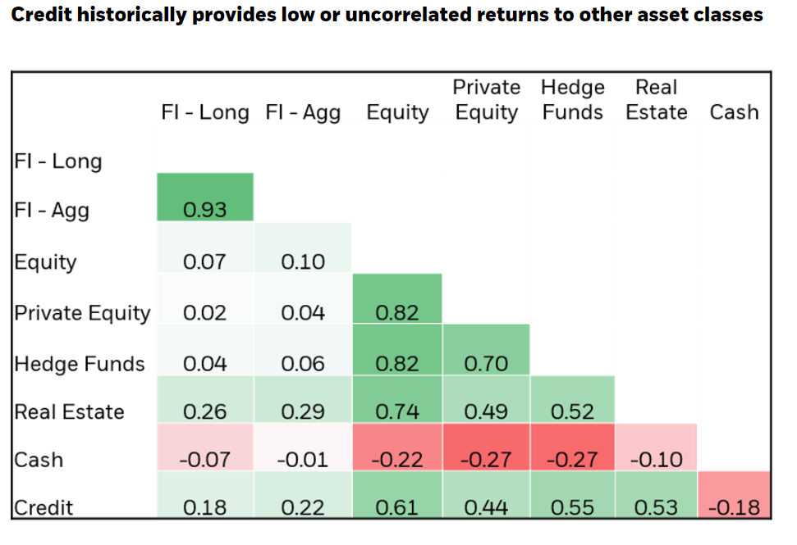
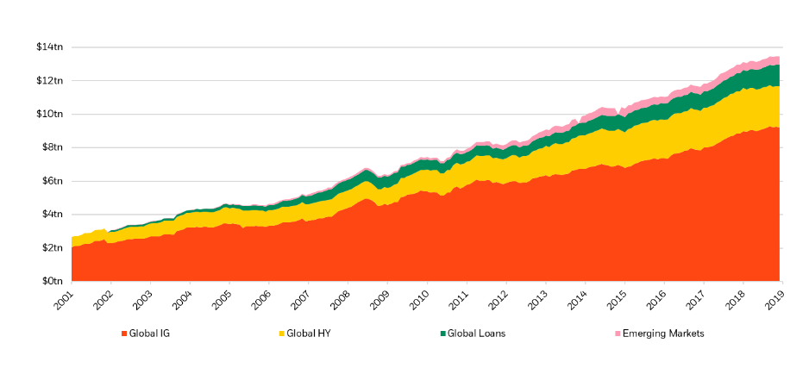
Why Invest in Credit?
Good diversification benefits
Stable stream of income (yield)
Access to borrower-specific features
Notes:
Isabelle

Slide 7
Credit as a Career
Sales & Trading – secondary market
“Investment Banking” – primary market
  Leveraged Finance
  DCM
Buy Side
  Private Credit
  Liquid Credit
  Distressed Debt / Special Situations
Notes:
Isabelle

Slide 8
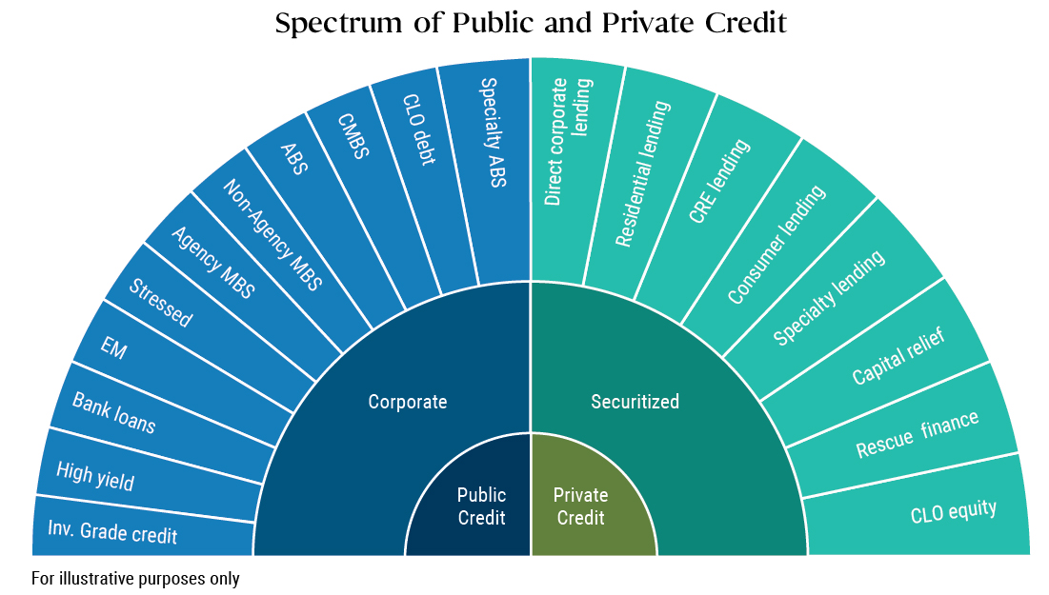

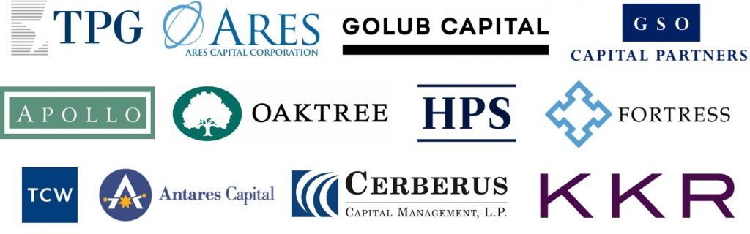
Public vs Private
Public market debt mostly issued by “sell-side” banks, traded on public exchanges and so are liquid, subject to regulatory and disclosure requirements
Private market debt is provided by “buy-side” firms – products are not traded and illiquid, unrated

Slide 9
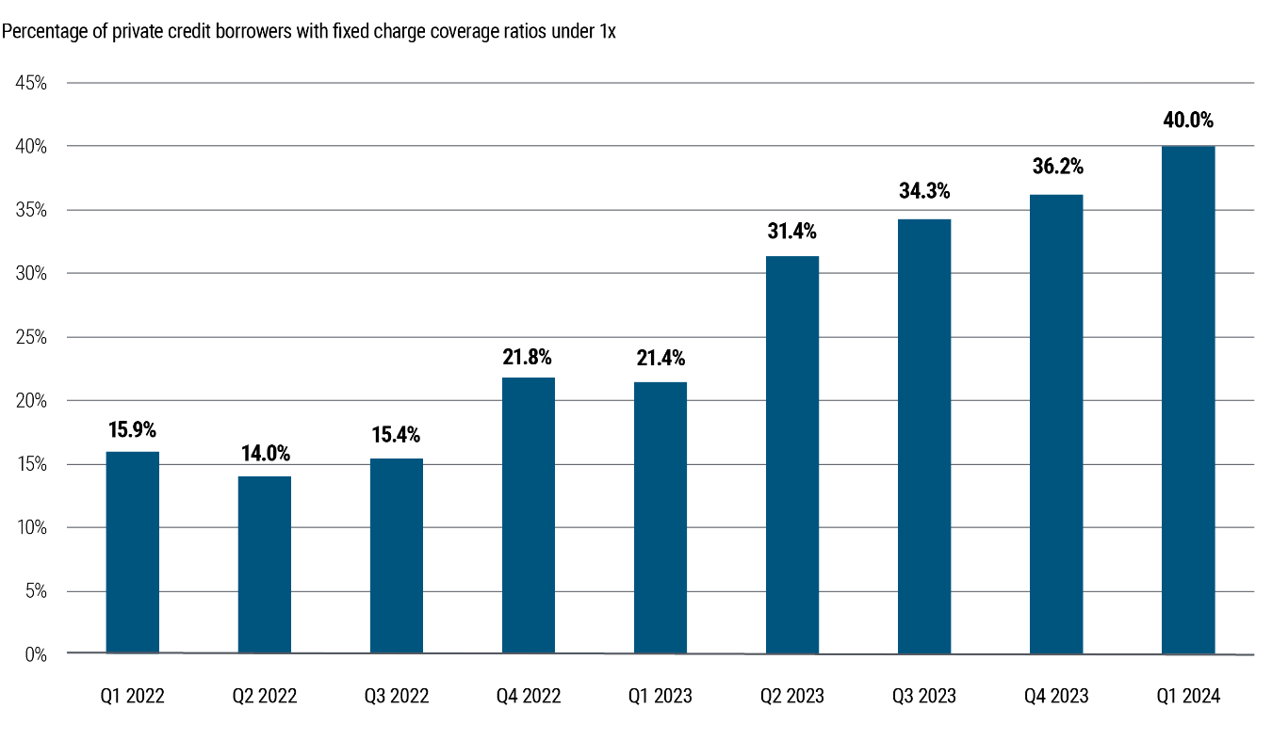
Private credit market
Banks have retreated from traditional lending post-Dodd Frank
Boom over the past few years and likely to continue
Heavily concentrated in sectors such as tech and health services
Typically issued by smaller, leveraged companies financed with floating-rate debt

Slide 10
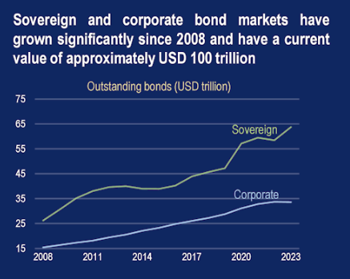
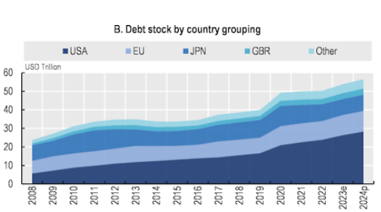
Sovereign credit
Governments (developed or emerging) raise money in their own currency (local currency) or another currency (hard currency, usually USD and more common for EM)
Governments can borrow domestically, but due to limited funds available may also market their debt internationally or seek out arrangements with other govts/international organisations
Notes:
Isabelle

Slide 11
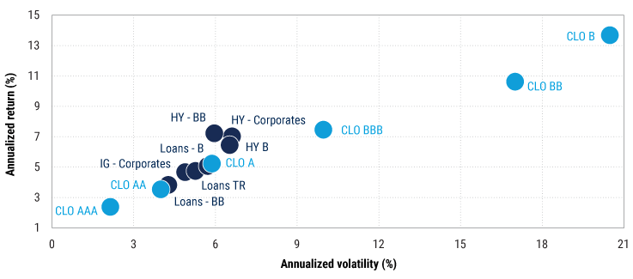
Risk-return scatterplot for credit investments

Slide 12
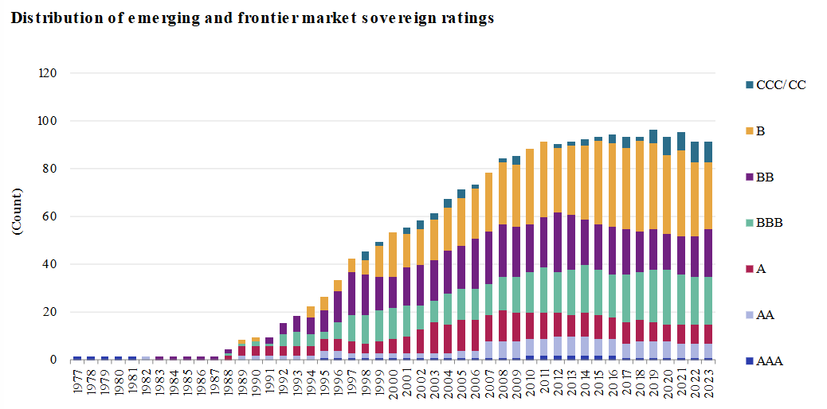
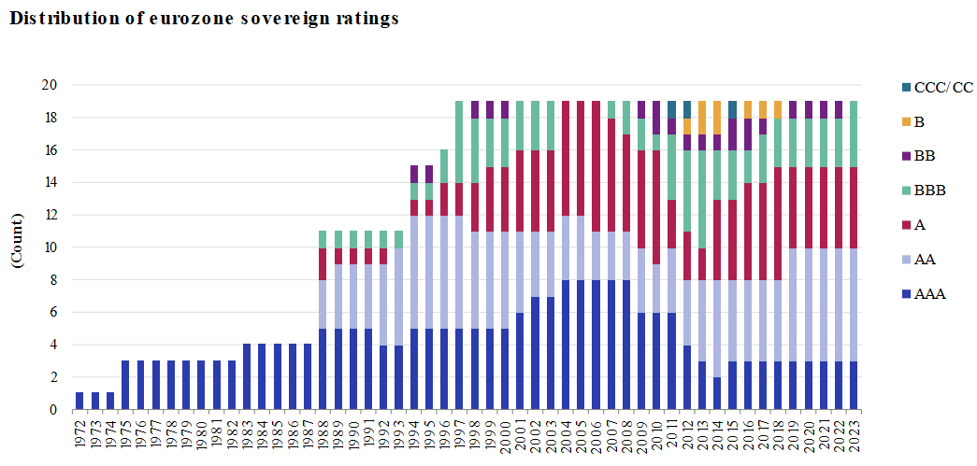
Developed vs. emerging markets
Developed markets: highly liquid government bond markets, stable economic conditions, and low credit risk
  USTs, JGBs, Eurozone debt (but country credit risk can vary; Germany as benchmark)
Emerging markets: higher yields due to greater credit and currency risks, number of investable EM countries has more than doubled in past 20 years.
  LatAm (Brazil, Mexico, Argentina), Eastern Europe, some ASEAN (Indonesia, Malaysia)
  More financially advanced countries can target domestic investors, others have less developed domestic capital market so issue bonds externally in hard currency
Notes:
Isabelle
Default distribution resembles corporate issuers at higher credit rating levels for EM

Slide 13
Credit Analysis

Slide 14
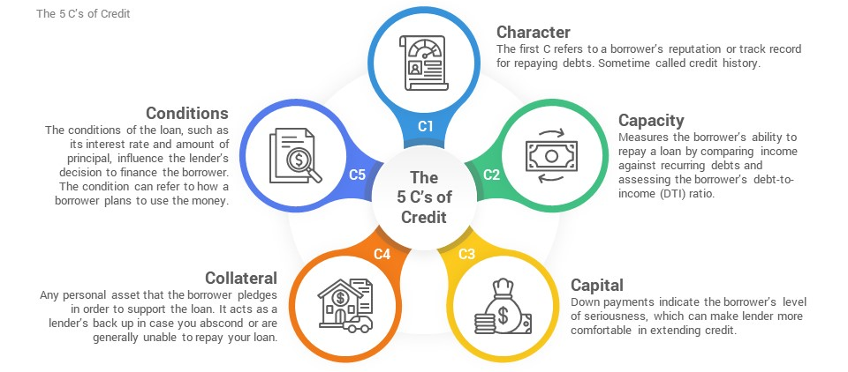
5Cs of basic credit analysis

Slide 15
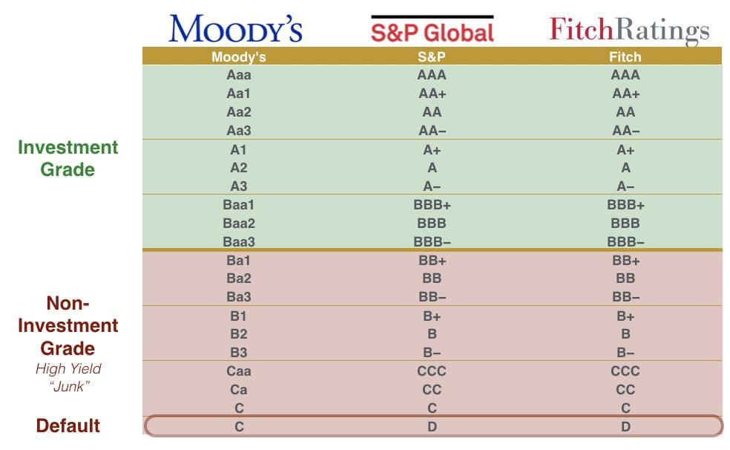
Credit Ratings
Risk assessment for investors seeking portfolio strategy and diversification
Higher credit ratings lead to lower interest rates and thus lower borrowing costs
Eligibility for inclusion into different bond indices

Slide 16
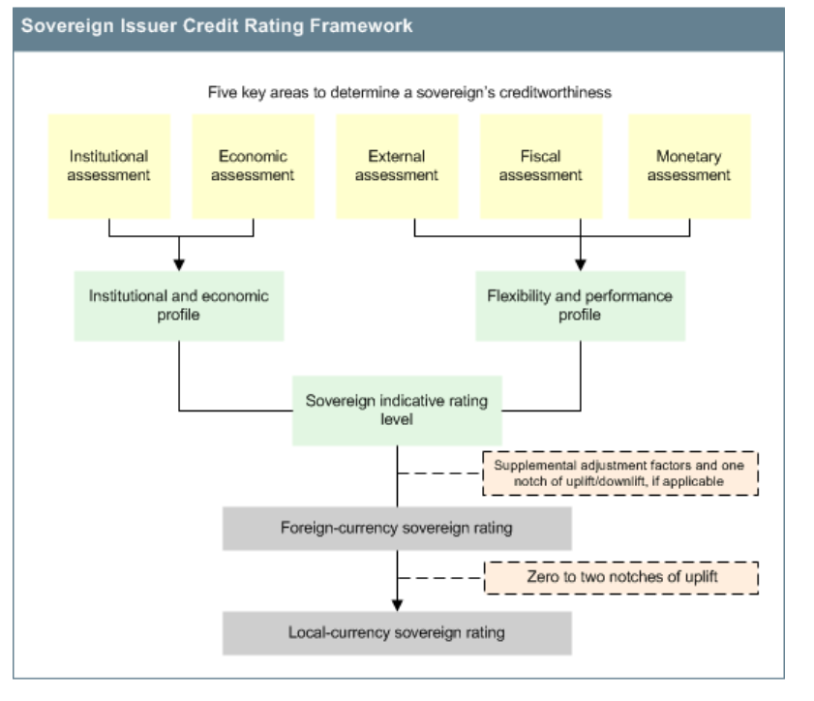
Credit Rating Methodology – S&P
Country of incorporation and currency that bond is raised in is very important
Sovereign rating determines risk-free rate for the country – becoming the base of cost of funding
Notes:
Isabelle

Slide 17
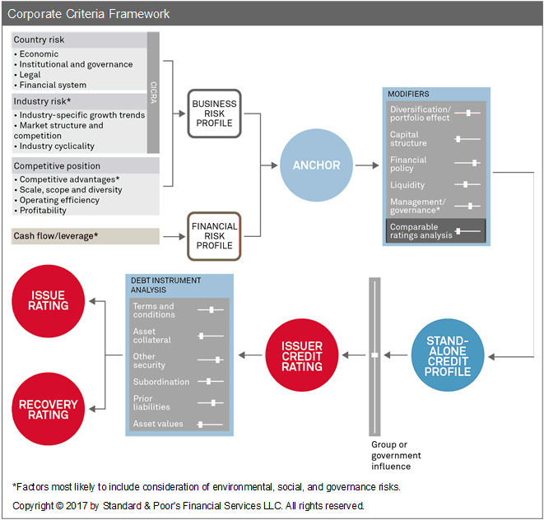
Credit Rating Methodology – S&P
Start with macro – country and industry that company operates in
Continue with micro – company ratios that would affect repayment
Finish with individual credit analysis – structure and terms of credit product
Notes:
Focus on macro, but can consider individual credit analysis in how to best express your views?

Slide 18
Basic Jargon
Covenants: Set of rules that the issuer must follow
Split into Financial and Restrictive Covenants
EBITDA: Earnings before Interest, Taxation, Depreciation and Amortisation
Leverage Ratio: Debt/EBITDA
Interest Coverage Ratio: EBIT/Annual Interest Expense
Debt Service Coverage Ratio: EBITDA/Interest + Principal Repayments
Notes:
Isabelle
Bonds can have either a floating interest rate or a fixed interest rate.
Floating rate bonds have interest payments that adjust periodically based on a benchmark rate plus a fixed spread. For example, a floating rate bond might have a rate of LIBOR + 200 basis points. This means that if the LIBOR rate is 1%, the bond's interest rate will be 3% (1% + 2% or 200 basis points).
Fixed rate bonds, on the other hand, have an interest rate that remains constant over the life of the bond. This gives investors predictable income but doesn’t benefit from rising interest rates like a floating rate bond might.
Some bonds have a call provision, which allows the issuer to redeem, or "call," the bond before its maturity date. This is typically done when interest rates drop, allowing the issuer to refinance at a lower rate.
For example, if a company issued a bond at 5% interest but rates in the market have since fallen to 3%, it may "call" the bond, repay investors, and then issue new debt at the lower rate, saving on interest costs.
From an investor’s perspective, the call provision adds some risk, as they could lose a high-yielding bond earlier than expected and might have to reinvest at a lower rate.
Convertible bonds offer a unique feature where, under certain conditions, the bond can be converted into a specified number of shares of the issuer’s stock.
Convertibility might be allowed after a specific date or if the issuer’s stock reaches a certain price. This feature gives bondholders the potential for equity upside if the company performs well and the stock price rises.
For investors, convertibility is attractive because it provides a bond’s fixed income along with the possibility of converting to equity and benefiting from share price gains.
In the event of a company’s liquidation (for example, if it goes bankrupt), there is an order of priority in which creditors are paid. This is known as the liquidation preference.
Typically, senior debt holders (like senior bondholders) are paid first, followed by junior debt holders (such as subordinated or unsecured bonds), and then any hybrid instruments like convertible bonds, which are lower in priority.
For investors, understanding the liquidation preference is critical because it influences the recovery amount they may receive in the worst-case scenario, where the company is unable to meet all its obligations.
Some bonds come with credit enhancements to reduce the risk of default and make the bond more attractive to investors. Common forms of credit enhancement include:
Guarantee: Another entity, such as a parent company or a government, guarantees the bond’s payments, making it more secure.
Letter of Credit: A bank provides a letter of credit to back the bond, promising to cover interest or principal payments if the issuer cannot meet them.
Collateral: The bond might be secured by specific assets, such as real estate or equipment, which can be sold to repay investors if the issuer defaults.
Credit enhancement can be reassuring for investors, as it adds an extra layer of security and reduces the risk of loss.
Look at bond on the right
Issuer, instrument, currency, assessing risk associated with country/specific asset factors
Identification information
Information about payments and time to maturity -> helps you work out pattern of cash flows for bond valuation

Slide 19
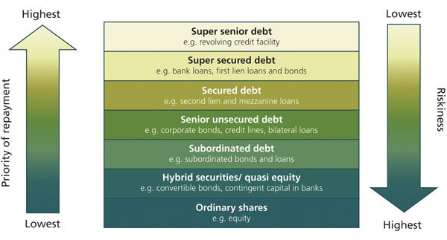
Capital Structure
Main difference between bonds and loans is that bonds are traded publicly through an exchange, while loans are not traded publicly.
Bonds are typically unsecured while loans are generally secured by collateral
Notes:
Isabelle
Inverse relationship between priority of repayment and riskiness
Secured debt -> backed by some sort of collateral, making it less risky because investors can seize collateral in event of default

Slide 20
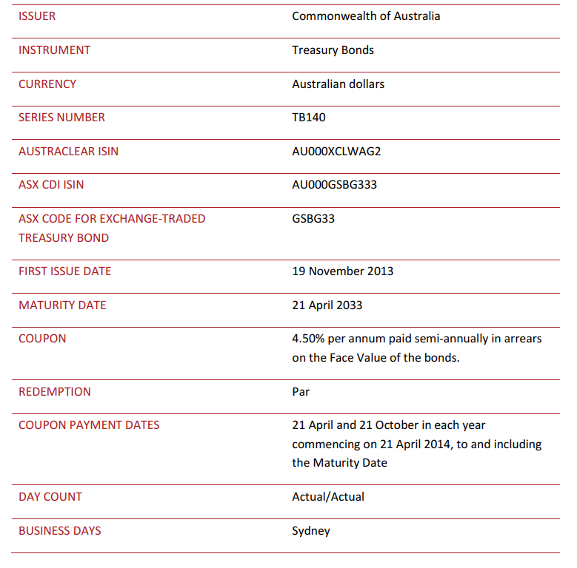
Bond terms & structure
Floating rate: e.g. LIBOR + 200 or fixed rate
Call provision: Bond can be called by issuer – usually to refinance at lower rate
Convertibility: after a certain date or upon fulfilling a condition, into certain number of shares
Liquidation preference: Senior > Junior > Hybrid (Convertibles)
Credit enhancement: guarantee, letter of credit, collateral
Notes:
Isabelle
Bonds can have either a floating interest rate or a fixed interest rate.
Floating rate bonds have interest payments that adjust periodically based on a benchmark rate plus a fixed spread. For example, a floating rate bond might have a rate of LIBOR + 200 basis points. This means that if the LIBOR rate is 1%, the bond's interest rate will be 3% (1% + 2% or 200 basis points).
Fixed rate bonds, on the other hand, have an interest rate that remains constant over the life of the bond. This gives investors predictable income but doesn’t benefit from rising interest rates like a floating rate bond might.
Some bonds have a call provision, which allows the issuer to redeem, or "call," the bond before its maturity date. This is typically done when interest rates drop, allowing the issuer to refinance at a lower rate.
For example, if a company issued a bond at 5% interest but rates in the market have since fallen to 3%, it may "call" the bond, repay investors, and then issue new debt at the lower rate, saving on interest costs.
From an investor’s perspective, the call provision adds some risk, as they could lose a high-yielding bond earlier than expected and might have to reinvest at a lower rate.
Convertible bonds offer a unique feature where, under certain conditions, the bond can be converted into a specified number of shares of the issuer’s stock.
Convertibility might be allowed after a specific date or if the issuer’s stock reaches a certain price. This feature gives bondholders the potential for equity upside if the company performs well and the stock price rises.
For investors, convertibility is attractive because it provides a bond’s fixed income along with the possibility of converting to equity and benefiting from share price gains.
In the event of a company’s liquidation (for example, if it goes bankrupt), there is an order of priority in which creditors are paid. This is known as the liquidation preference.
Typically, senior debt holders (like senior bondholders) are paid first, followed by junior debt holders (such as subordinated or unsecured bonds), and then any hybrid instruments like convertible bonds, which are lower in priority.
For investors, understanding the liquidation preference is critical because it influences the recovery amount they may receive in the worst-case scenario, where the company is unable to meet all its obligations.
Some bonds come with credit enhancements to reduce the risk of default and make the bond more attractive to investors. Common forms of credit enhancement include:
Guarantee: Another entity, such as a parent company or a government, guarantees the bond’s payments, making it more secure.
Letter of Credit: A bank provides a letter of credit to back the bond, promising to cover interest or principal payments if the issuer cannot meet them.
Collateral: The bond might be secured by specific assets, such as real estate or equipment, which can be sold to repay investors if the issuer defaults.
Credit enhancement can be reassuring for investors, as it adds an extra layer of security and reduces the risk of loss.
Look at bond on the right
Issuer, instrument, currency, assessing risk associated with country/specific asset factors
Identification information
Information about payments and time to maturity -> helps you work out pattern of cash flows for bond valuation

Slide 21
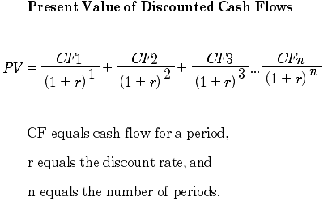
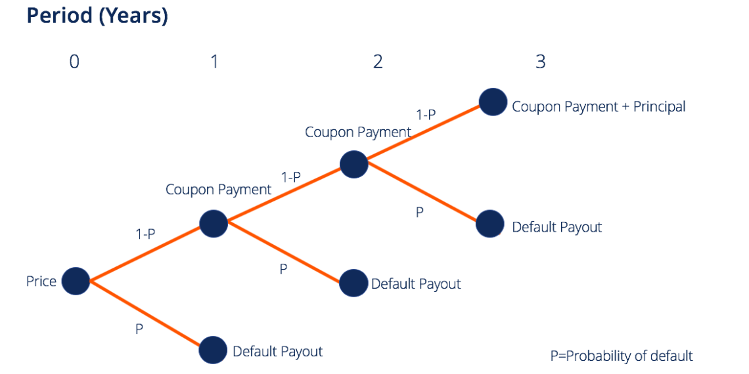
Basic Bond Valuation
Simple DCF, with simulated future default rates
Discounted value of future expected payments (interest and principal) received
Notes:
Isabelle
The future cash flows (coupons and principal) are discounted back to the present using the appropriate discount rate, often the yield to maturity (YTM) or the bond’s required rate of return.
This gives the present value of expected cash flows under the assumption that the bond will not default.
To account for the possibility of default risk, we need to adjust the bond’s cash flows for the likelihood that the issuer may not make all of its payments. The process involves using simulated future default rates to adjust the expected future cash flows.
Steps Involved in Adjusting for Default Risk:
Simulate Default Probabilities:
A simulated default rate is essentially an estimate of the probability that the bond issuer will default at each future time point. These rates may change over time due to economic factors, creditworthiness of the issuer, or other external conditions.
For example, an issuer may have a higher chance of defaulting in the final years of the bond’s life if it has financial difficulties, or if the bond is near maturity.
Adjust Cash Flows for Default Risk:
Assume that once a company or sovereign defaults, it cannot pay its future coupons.
Period 1: either default with probability p and some default payout (e.g. collateral to seize), or don’t default (probability 1-p) and receive normal coupon payment, in the second case we can continue on to time period 2 and repeat same analysis, where you receive 2nd coupon payment with probability (1-p)^2 (i.e. didn’t default in period 1 or period 2) or default with probability p(1-p)
Discount the Adjusted Cash Flows:
Once the cash flows are adjusted for default risk, they are discounted back to the present using the same discount rate (YTM) as in the basic DCF model, assuming the default risk is properly factored into the rate.
The present value of the bond would then be calculated as:
This formula now reflects the probability-adjusted value of future cash flows, accounting for potential defaults at each time period

Slide 22
Understanding Pricing/Yields
Trader 1: Got any Google 4 ¼ 27’s?
Trader 2: Offering 50 at 98 ¾
Average Price = (100 + 98.75)/2 = 99.375
Average Yield = 4.25 + (100-98.75)/2 = 4.875%
YTM = 4.875% / 99.375 = 4.91%
Actual YTM = 4.92%
Notes:
Isabelle
The future cash flows (coupons and principal) are discounted back to the present using the appropriate discount rate, often the yield to maturity (YTM) or the bond’s required rate of return.
This gives the present value of expected cash flows under the assumption that the bond will not default.
To account for the possibility of default risk, we need to adjust the bond’s cash flows for the likelihood that the issuer may not make all of its payments. The process involves using simulated future default rates to adjust the expected future cash flows.
Steps Involved in Adjusting for Default Risk:
Simulate Default Probabilities:
A simulated default rate is essentially an estimate of the probability that the bond issuer will default at each future time point. These rates may change over time due to economic factors, creditworthiness of the issuer, or other external conditions.
For example, an issuer may have a higher chance of defaulting in the final years of the bond’s life if it has financial difficulties, or if the bond is near maturity.
Adjust Cash Flows for Default Risk:
Assume that once a company or sovereign defaults, it cannot pay its future coupons.
Period 1: either default with probability p and some default payout (e.g. collateral to seize), or don’t default (probability 1-p) and receive normal coupon payment, in the second case we can continue on to time period 2 and repeat same analysis, where you receive 2nd coupon payment with probability (1-p)^2 (i.e. didn’t default in period 1 or period 2) or default with probability p(1-p)
Discount the Adjusted Cash Flows:
Once the cash flows are adjusted for default risk, they are discounted back to the present using the same discount rate (YTM) as in the basic DCF model, assuming the default risk is properly factored into the rate.
The present value of the bond would then be calculated as:
This formula now reflects the probability-adjusted value of future cash flows, accounting for potential defaults at each time period

Slide 23
Credit Products

Slide 24
Credit products
Vanilla bond e.g. Bank of America 5y note
  Traded in lot sizes of USD100k, USD250k, USD1m etc.
  Purchased by HNW individuals, asset managers, insurance companies etc.
Securitized products
  ABS – asset backed securities - loans, leases, receivables
  MBS – mortgage backed securities
Convertible bonds
  Can be converted into equity

Slide 25
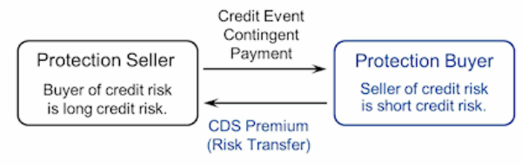
Credit derivatives – Credit default swaps
Premium paid is equal to expected loss from default – theoretically assuming risk neutrality – “credit insurance”
  By speculating on loss on default, can generate alpha from buying/selling CDS
  Example triggers: ratings downgrade, event of default, cross-default
  Only liquid for very large corporates e.g. Apple, otherwise OTC
Industry practice to pay 100bps per year as premium and present value of the actual premium upfront

Slide 26
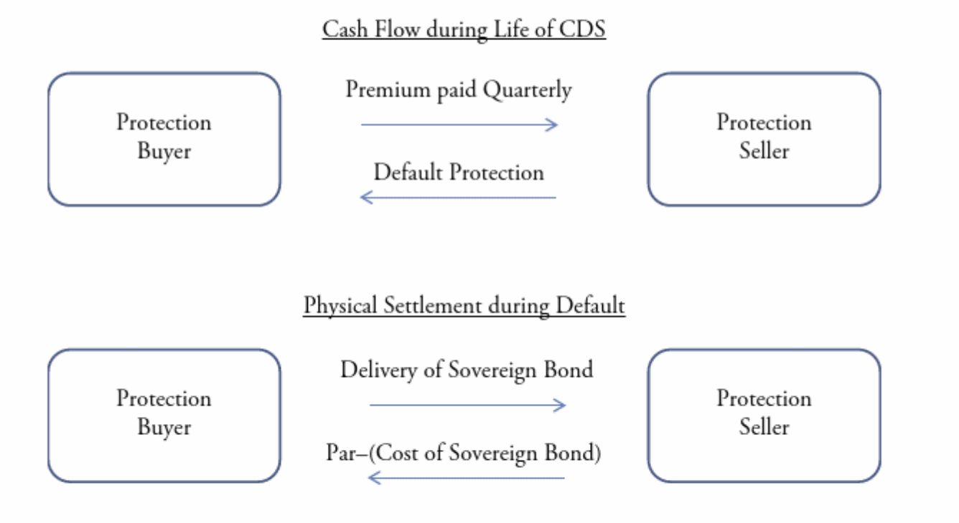
Credit derivatives – Credit default swaps
Credit risk (counterparty risk)- risk that the company defaults (failure to repay or meet contractual obligations)

Slide 27
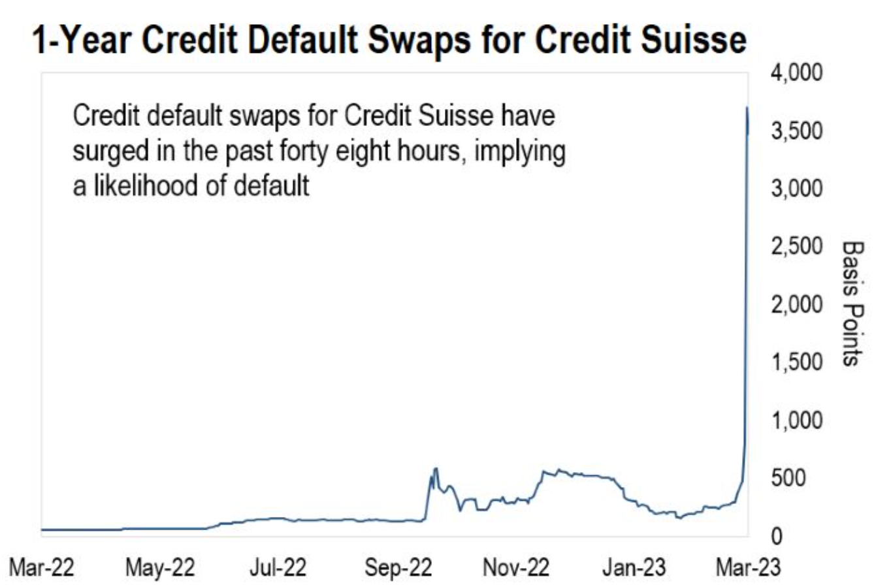
CDS for CS 2022-2023

Slide 28
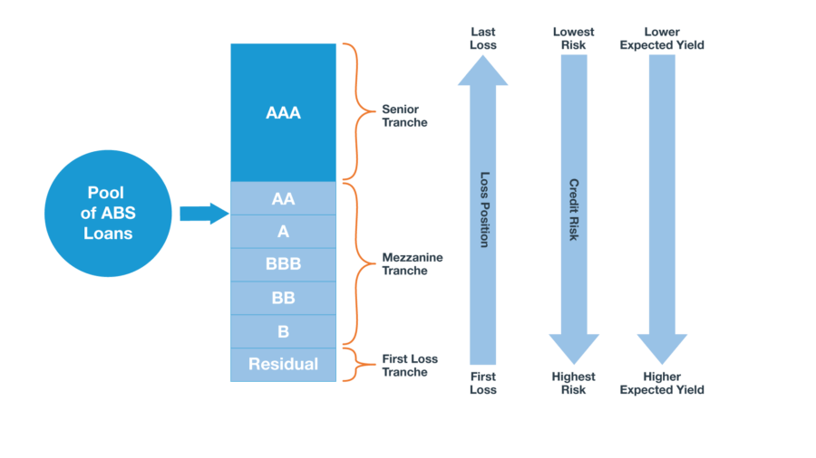
Asset-Backed Securities ABS
Common types:
Collateralized debt obligation (issued by a special purpose vehicle)
  Loans, bonds, cash-market debt instruments, mortgages
Home equity loans (for those who did not qualify for a mortgage)
Auto loan
Student loan
Priced by underwriters and administered by servicers

Slide 29
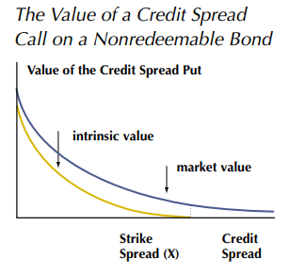
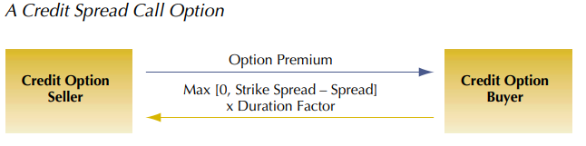
Credit derivatives – credit spread options
Similar to equity puts & calls but now the strike is a spread level
  Usually, spread is between company’s debt and some benchmark level (e.g. LIBOR)
Credit spread puts increase in value as the yield spread on a bond increases
Credit spread calls increase in value as the yield spread on a bond decreases
Notes:
Isabelle
Credit spread options are derivatives that allow investors to hedge or speculate on changes in the credit spread (the difference in yield between a corporate or sovereign bond and a risk-free benchmark rate).
Investors use these options to manage exposure to credit risk, particularly changes in a bond's credit quality.
Structure Similar to Equity Options:
Like equity puts and calls, credit spread options offer the right (not the obligation) to benefit from changes in the credit spread.
However, instead of a strike price for an asset, the strike here is a specific credit spread level.
A credit spread call option increases in value when the credit spread widens (indicating worsening credit conditions).
Intuition: If a bond’s credit spread widens, it suggests the bond is riskier, and yields are rising relative to a safer benchmark. A call option profits from this, so it’s essentially a bet against the issuer’s credit quality. If you buy an equity call -> betting on the price to rise (vs. here, betting on yields to rise)
Suppose an investor buys a credit spread call option with a strike spread of 300 basis points. If the bond’s spread widens to 350 basis points, the call option gains value, as the actual spread is now higher than the strike. The buyer pays 50*Duration factor to credit option seller.
A credit spread put option gains value when the credit spread narrows (indicating improving credit conditions).
Intuition: If credit spreads narrow, the bond is perceived as safer, and its yield spread over the benchmark falls. The put option profits from this, so it’s like betting on credit quality improvement. If you buy an equity put, betting on the price to fall, here we are betting on the yield spread to fall
Intrinsic Value and Option Payoff:
Intrinsic Value: The difference between the strike spread and the current spread determines the option’s intrinsic value.
Payoff: The payoff for a credit spread call option can be calculated as Max(0, Strike Spread - Current Spread) x Duration Factor.
Duration Factor: This is used to scale the payoff according to the bond’s sensitivity to spread changes.

Slide 30
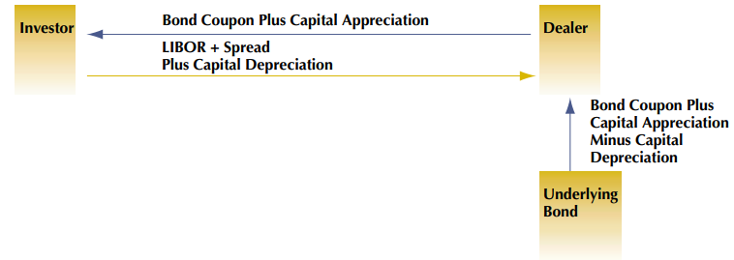
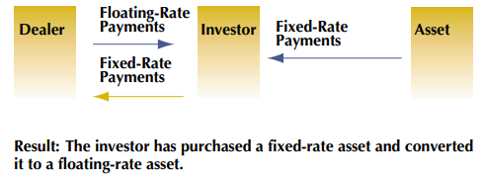
Credit derivatives – Swaps
Total return swap
Asset swap
Total return swaps utilise the bank’s balance sheet – essentially provides leverage as investor can obtain the asset’s return without owning it
Asset swaps allow investors to exchange the fixed payment of their assets into a floating one – allowing them to speculate
Notes:
Isabelle
Total Return Swaps (TRS)
Key Points:
Total return swap
In a Total Return Swap, the investor does not directly own the underlying asset but gets exposure to its total return (capital gains + dividends for equities/coupon payments for bonds), which is a capital efficient way to take a position on an asset
The bank or financial institution providing the TRS uses its balance sheet to facilitate the transaction, which effectively provides leverage to the investor who only puts up margin rather than buying the asset outright. This means the investor can gain the economic benefits of owning an asset without the capital requirements or risks of actually owning it.
Asset swap
An asset swap involves exchanging the fixed cash flows (interest payments) from an asset (typically a bond or debt instrument) for floating-rate payments, such as LIBOR or SOFR-based payments.
The investor typically wants to convert the fixed interest payment on their bond into a floating payment, either for speculation (e.g. if they believe interest rates will rise you might want to convert fixed to floating, if fall -> floating to fixed at lower rate to secure predictable returns) or hedging (if they have floating-rate liabilities).
Payoff Flow in Total Return Swap
In a Total Return Swap (TRS), the flow of payoffs is as follows:
The investor receives the total return from the reference asset. This includes:
Capital appreciation (if the asset’s price increases).
Income generated (such as dividends for equities or interest payments for bonds).
The investor does not own the asset but effectively gains exposure to the asset's performance as if they did.
Investor will pay bank some base rate (e.g. LIBOR) + spread on the notional value to compensate the bank for taking on risks associated with holding the underlying bond, plus any capital depreciation if the asset’s price falls
Payoff Flow in Asset Swap
In an Asset Swap, the flow of payoffs is as follows:
Investor (Fixed Income Receiver):
The investor receives the fixed payments from their bond or debt instrument (the underlying asset) which they hold or purchased. These payments are typically periodic interest payments (coupons).
However, in the asset swap, the investor will convert these fixed payments into a floating rate
Counterparty (Floating Payment Receiver):
The counterparty (often a bank or financial institution) receives the floating rate payments (such as LIBOR + spread or SOFR + spread).
In exchange, they pay the investor the fixed payments of the underlying asset (such as the bond’s coupon payments).
Flow of Payments:
If the floating rate rises (e.g., if interest rates increase), the investor may benefit more from the floating payments they receive compared to the fixed coupon payments they would have originally received from the bond.
Conversely, if interest rates fall, the investor is still receiving the fixed coupon, which might be more advantageous than the floating rate (depending on the swap structure).
In both cases (TRS and Asset Swaps), the swaps allow the parties to transform the characteristics of the asset’s return or cash flows, creating flexible and customizable financial instruments for leverage, speculation, or hedging.

Slide 31
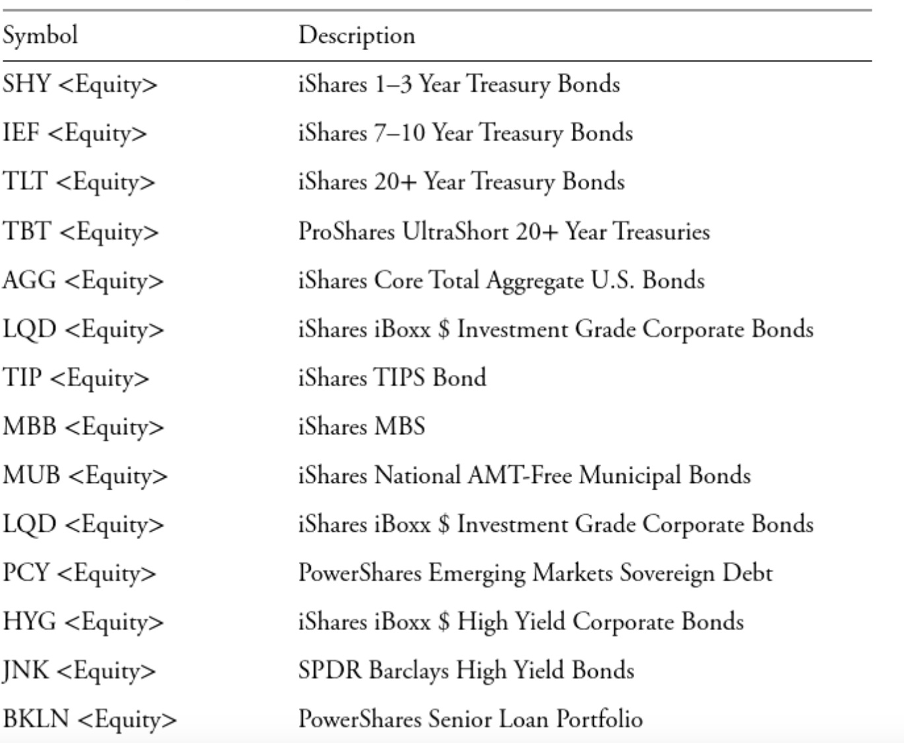
Fixed Income ETFs
Credit index ETFs can be used to gain exposure to various diversified fixed income portfolios (it replicates an underlying bond index, and it’s more liquid)
List of common fixed income ETFs
Notes:
Isabelle
Bonds -> but maybe you don’t want to hold idiosyncratic risk by holding one or two or even a handful of bonds
So maybe you want to hold a portfolio of various bonds, but it’s a pain to go and source them yourselves
So express view through just purchasing an ETF, fixed basket of bonds that provides diversification and replicates an underlying bond index

Slide 32
Idea Generation

Slide 33
Type 1: Single Company Fundamentals
Trade ideas based on change in company’s fundamentals which may affect future repayment/default probability
Bond prices are direct indicators of credit quality, barring any changes to the underlying base rate. E.g. If a bond is trading at 70, the company is probably distressed.
If you believe credit conditions will improve, you long
If you believe otherwise, you short

Slide 34
Type 1: Single Company Fundamentals
Longing a bond is very straightforward, you just collect the yield and wait for price appreciation
Shorting is much more complicated, because it requires you selling the bond and then buying it back at a lower price
Unlike shorting a stock, shorting a bond requires you to pay the coupon during the duration of the whole trade. This gets expensive quickly, especially amongst high-yield issuers.
Hence, the more efficient way is to purchase a CDS on that specific credit instead.

Slide 35
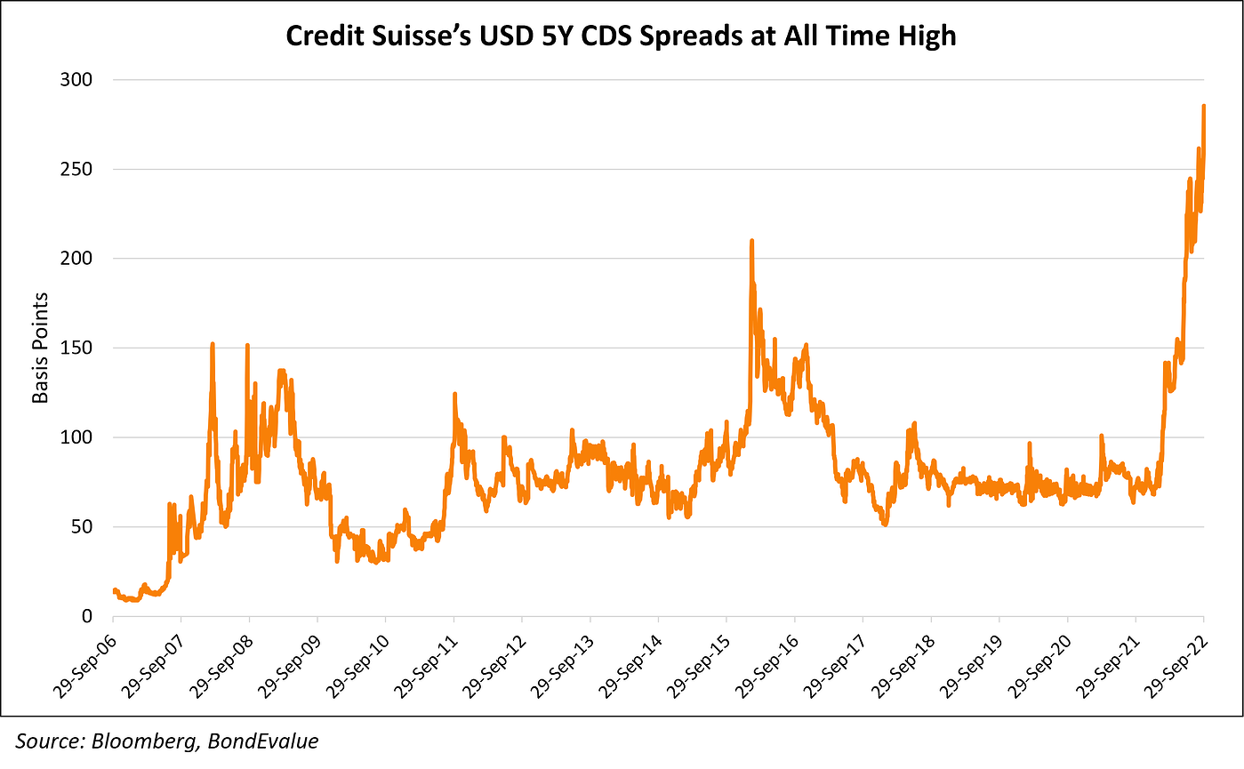
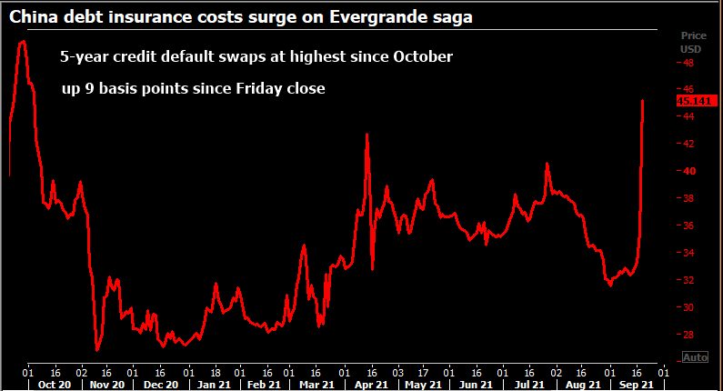
Type 1: Single Company Fundamentals

Slide 36
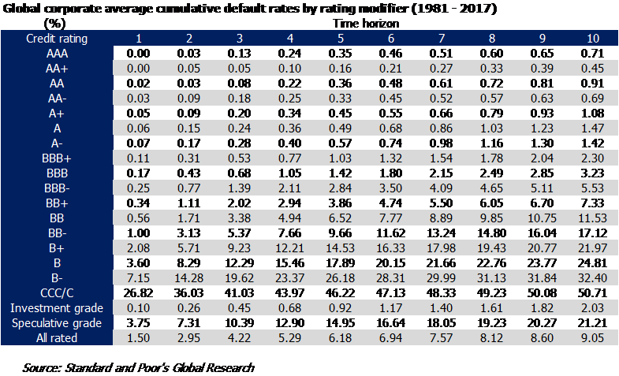
Type 2: Mispricings
Pricing of public bonds and credit derivatives are often based on credit ratings from reputable firms
  Banks have their own internal ratings system to manage their portfolio of debtors and to make lending decisions
  Private credit firms have to make their own assessments of firm default probability to price private credit
Generating alpha by locating mispricings

Slide 37
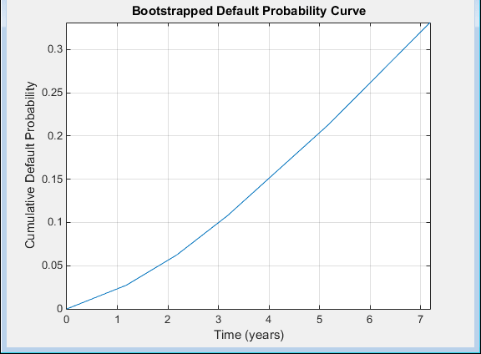
Type 2: Mispricings
Finding the market default rates of any firm
  Market CDS premium
  How much their bonds are trading at
  Recent loan/financing rate
  Recovery rate – generally set at 40%

Slide 38
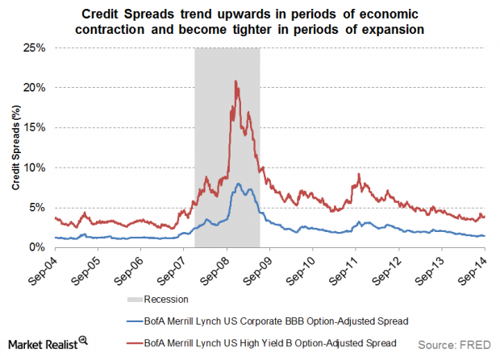
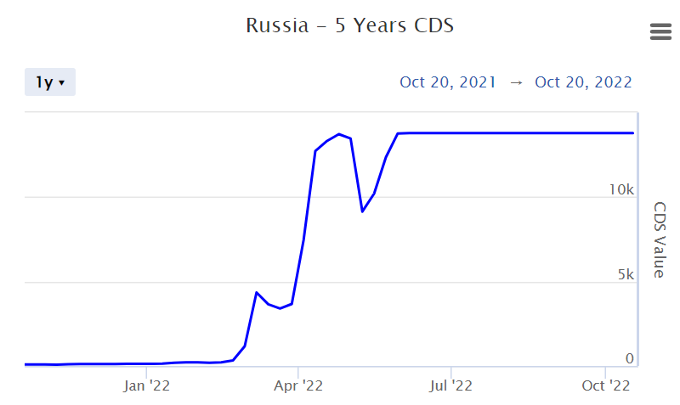
Idea generation – macro driven
Predicting recessions, political events, business cycles where industries perform poorer – credit is a cyclical market where spreads will reflect macro outlook
Market confidence in credit will be reflected in credit spreads

Slide 39
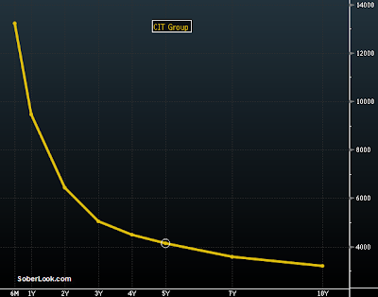
Idea generation – steepeners/flatteners
Steepener: Short short term CDS and Long long term CDS
A play on general market recovery/recession or mispricing of certain ends of the curve, can look at business cycles
Generally only 5y CDS is liquid, sometimes 1y and 10y as well

Slide 40
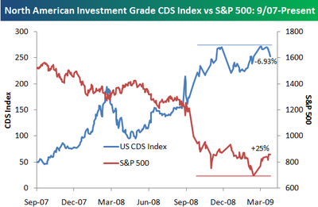
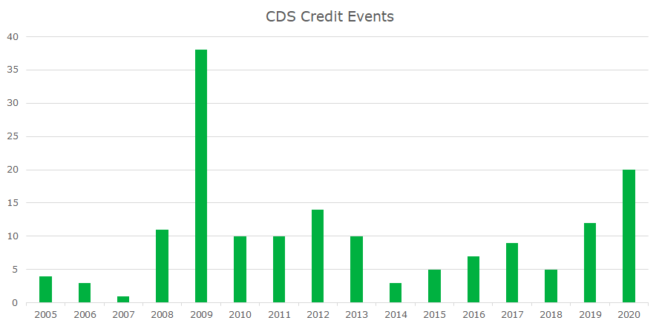
Case study – 08’ financial crisis
CDS trades shown in The Big Short (2015) and The Greatest Trade Ever (2009)
Both cases investors made bets against the US housing market and that people would default on their mortgages

Slide 41
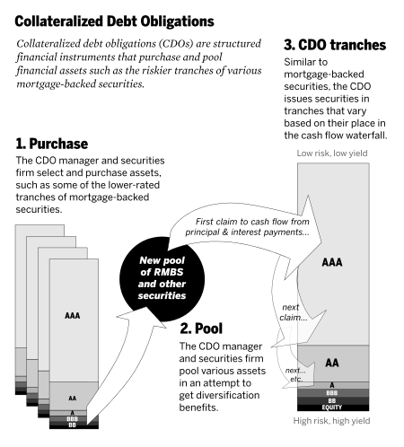
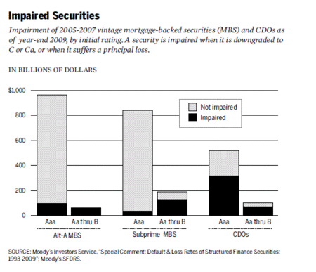
Case study – 08’ financial crisis
CDS on subprime mortgage-backed securities
Came at a low price as these were highly rated securities by ratings firms – poor quality assets, but they were highly diversified

