Slide 1
FX Fundamentals

Slide 2
What is FX Trading?
Bet on the direction of an exchange rate
  One currency over another – WHICH will do well
The largest financial market by volume, it operates 24/7
Highly macro-relevant:
  Interest rates / monetary policy
  Geopolitical events
  Economic data: GDP growth, inflation, unemployment rates
  Liquidity

Slide 3
Exchange rate regimes
Different economies have different exchange rate regimes
  Floating: most countries in the world (liquid, free)
  Fixed: countries that want better economic credibility / stability e.g. USD/KZT (Kazakhstan)
  Managed floating: countries that want both e.g. China
Fixed / managed floating regimes are traded via NDFs (not your typical FX spot / forwards)
  Because you can’t easily get capital out of the country – there is not much KZT outside Kazakhstan! So, you can only settle your USD/KZT trades in dollars only

Slide 4
G10 vs. EM
G10: the 10 most liquid currencies, all advanced economies (except China)
EM: less liquid currencies, in developing economies

Slide 5
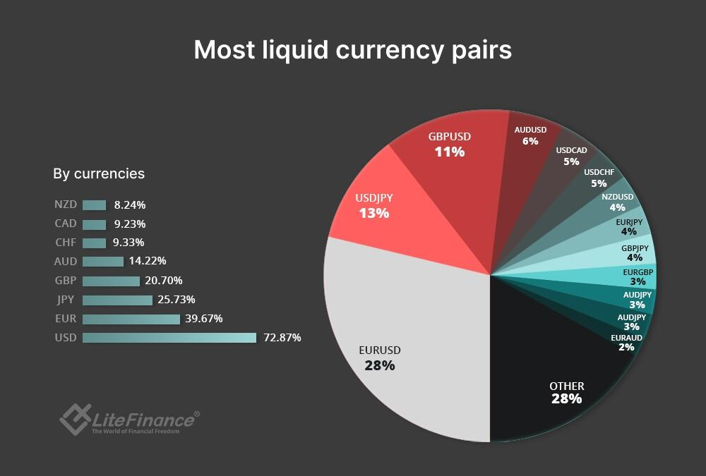

Slide 6
Liquidity
Liquidity: the extent to which an asset can be bought / sold quickly at stable prices
Liquidity can be assessed by bid/ask spread
  Bid price: the price at which something is bought
  Ask price: the price at which something is sold
  Market makers (the big banks) make their profits based on this spread
If a market has high liquidity e.g. US Treasuries or EURUSD, the bid-ask spread will be low, as the order book is full of supply and demand
If a market has low liquidity, such as Sri Lankan Government Bonds or some distressed corporate bond, spreads will be wider (i.e you may not be able to buy/sell them at their desired price)
Liquidity can fall quickly in market crises

Slide 7
Role of CBs
Intervention mechanisms:
1. Interest rates
2. Balance sheet management i.e. buying / selling government bonds
2. Forward guidance
3. Direct FX intervention

Slide 8
FX instruments
Spot is affected by the following factors:
  Relative economic health (e.g. Current Account, terms of trade)
  Reserves (intervention)
  Monetary policy spot usually strengthens in rate hike env.
  Geopolitical risk
Forwards determined by interest rate parity & relative funding premium of one currency to another

Slide 9
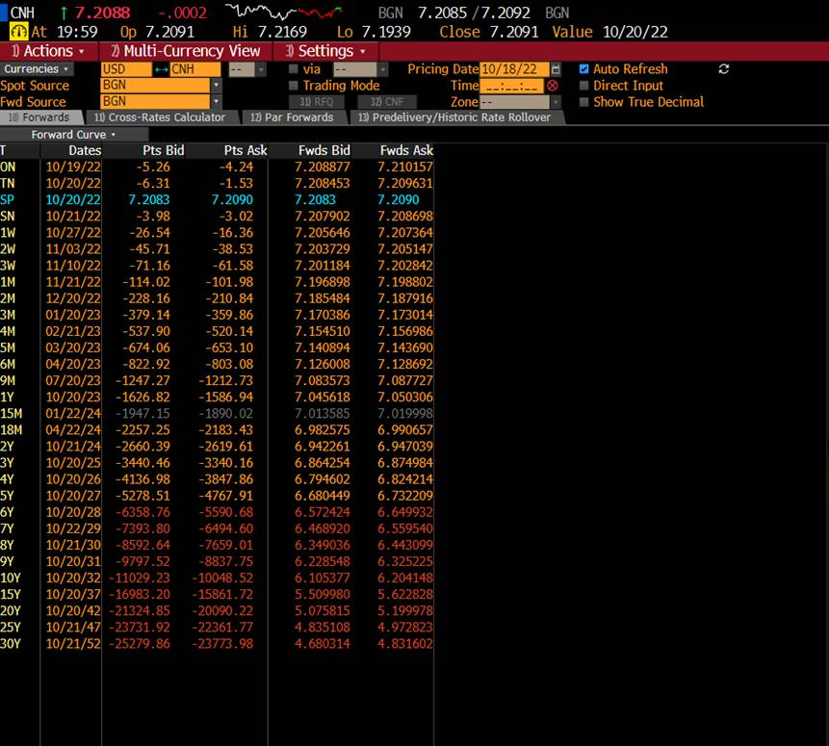
Spot
FX spot rate is the value of base currency in relation to term currency
For USD/EUR, USD is the base, EUR is the term
If USD/EUR is quoted at 0.92, it means $1 for 0.92 EUR
P&L are reported in the denominator currency
Spot rate refers to settlement in T+2 (2 business day’s time) with exceptions such as USDCAD where it is T+1

Slide 10
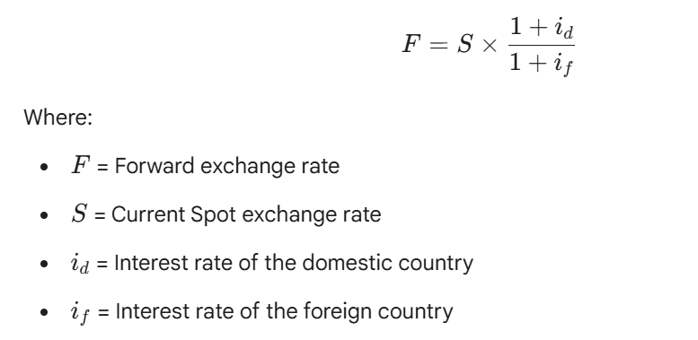
Forward
Notes:
A forward will have both interest rate risk and FX risk unless hedged, while swaps simply have interest rate risk.

Slide 11


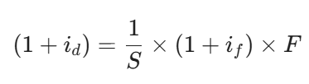

Interest rate parity
Say you can invest in either domestically or abroad, what are your options?
Option A
  Invest in the domestic asset – no FX involved
Option B
  Exchange for 1 unit of domestic currency into foreign currency at S today
  You grow this amount over time (you need to “switch the currency” so either 1/S or 1/F)
    1/S *
  You swap back the return into domestic currency via the forward rate
    1/S * * F
Option A and Option B must have the same return (for there to be “parity”):

Slide 12
Forward
Notes:
A forward will have both interest rate risk and FX risk unless hedged, while swaps simply have interest rate risk.

Slide 13
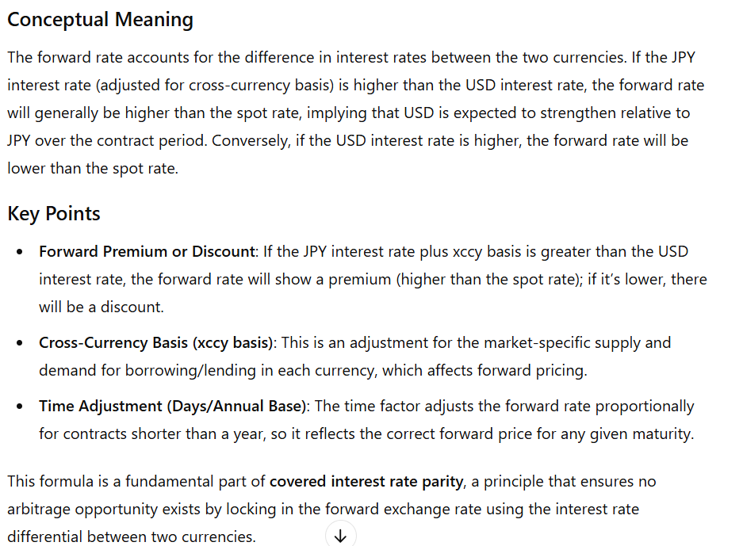
Forward

Slide 14
Interest rate parity
If the equation doesn’t hold – there’s opportunity for arbitrage – long one currency and short the other
Usually, it holds because of arbitrage via carry trade

Slide 15
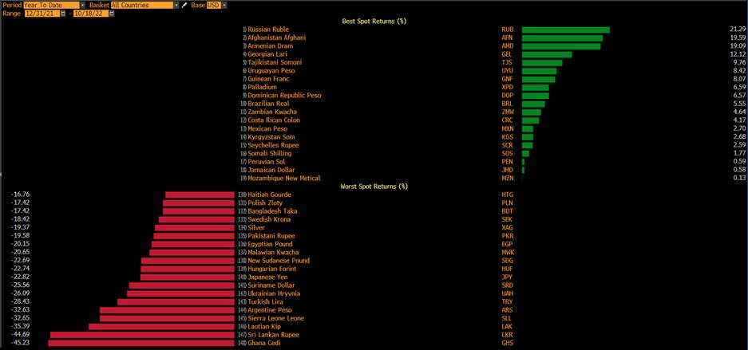
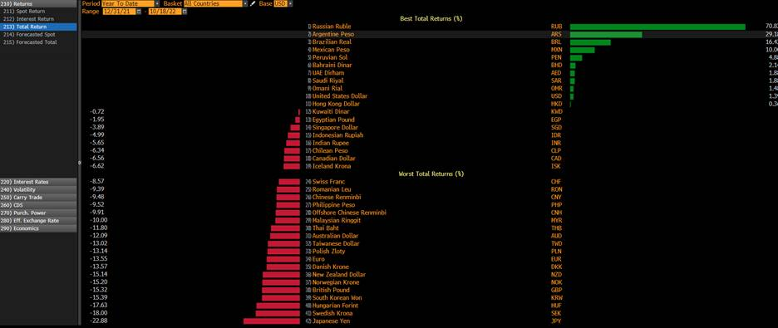
Carry Trades
If one believes that interest rate parity will not materialise, one can simply borrow the low-interest rate currency at that country’s interest rate and buy the higher interest rate currency to earn its higher rate
Effectively you earn the interest rate differential

Slide 16
Correlations
USD, GBP/EUR – risk-on/risk-off
CHF – gold
NOK and CAD – oil
AUD and NZD – copper
All currencies – government bond yields

Slide 17
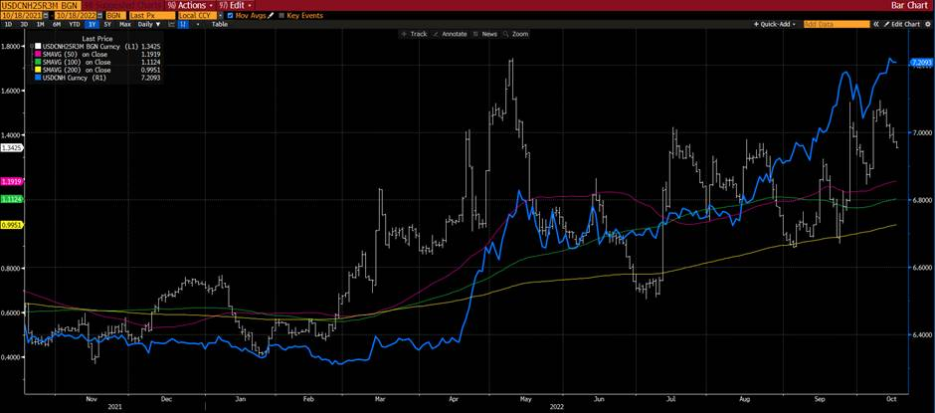
Technical analysis
Technicals are widely used when trading FX, even in professional settings such as banks, HFs
Essentially, they’re a way of assessing market sentiments and psychological levels/thresholds
  v

Slide 18
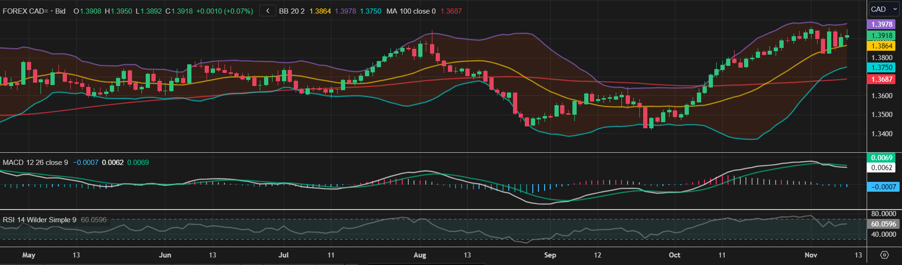
Technicals

Slide 19
Trade formulation
What’s the consensus “story” – one-liner e.g. you see FT talking about “BOJ will hike rates”
Pull up the chart of the currency pair – what does the market tell you? Does the market agree with the consensus – could it reverse?
Evaluate fundamentals of the two countries – is one growing whilst the other is lagging, is one central bank hiking whilst another is easing? Can these fundamentals change?
Evaluate other relevant assets to identify correlations e.g. if copper is rising, could AUD and NZD also go up?

