Slide 1
Commodities
Markets, Structure, Trade examples

Slide 2
Commodities Market
What commodities markets can you name?

Slide 3
Commodities Market
Examples:
Energy
Agricultural/Softs
Livestock
Industrial Metals
Precious Metals

Slide 4
Commodities Market
Examples:
Energy: Oil, Gas, Coal, Gasoline, Heating Oil, Diesel
Agricultural/Softs: Soybeans, Corn, Wheat, Orange Juice
Livestock: Hogs, Cattle
Industrial Metals: Copper, Lithium, Zinc, Iron Ore
Precious Metals: Gold, Silver, Platinum, Palladium

Slide 5
Commodities Market
Drivers…
Energy: geopolitics (oil) and seasonality (gas)
Agricultural/Softs: weather and logistics
Livestock: crush/feed ratio (is it more expensive to crush or feed?)
Industrial Metals: long-term demand and supply disruptions
Precious Metals: monetary policy, central bank demand, speculative demand

Slide 6
Commodities vs. other asset classes

Slide 7
Commodities vs. other asset classes
Relevance to macro
  Rates and FX: interest rates, economic policy, data etc. (MOST RELEVANT)
  Commodities: supply and demand (RELEVANT BUT LESS SO)
  Equity and Credit: company fundamentals (LEAST RELEVANT)

Slide 8
Supply and demand
Is this commodity scarce? Is it in a shortage?
  How is this commodity used? Can its usage change? E.g. silver
  How much supply is there for it? Can its supply be disrupted? E.g. oil

Slide 9
Types of Trades
Flat Price: e.g. Spot or Forward Price of Gold (per Oz)
Time Spreads: e.g. M1 - M6 time spread. Backwardation vs Contango.
Arbitrage Routes: e.g. Gasoline Arb, Diesel EW.
Supply Chain Dynamics: e.g. Crack Spreads, Crush Spreads, Spark Spreads
Product Diffs: e.g. ProNap, Gain Spreads.

Slide 10
Types of Trades
Flat Price: e.g. Spot or Forward Price of Gold (per Oz). Buying the commodity in isolation for usage.
Time Spreads: e.g. M1 - M6 time spread. Backwardation vs Contango. Storage and supply dynamics.
Arbitrage Routes: e.g. Gasoline Arb, Diesel EW. Price differentials in different loading bays/Physical arbitrage. Indication of relative supply/demand.
Supply Chain Dynamics: e.g. Crack Spreads, Crush Spreads, Spark Spreads
Reflects profits that producers make.
Product Diffs: e.g. ProNap, Gain Spreads. Reflects cost/price advantage from switching, can also be supply chain dynamics

Slide 11
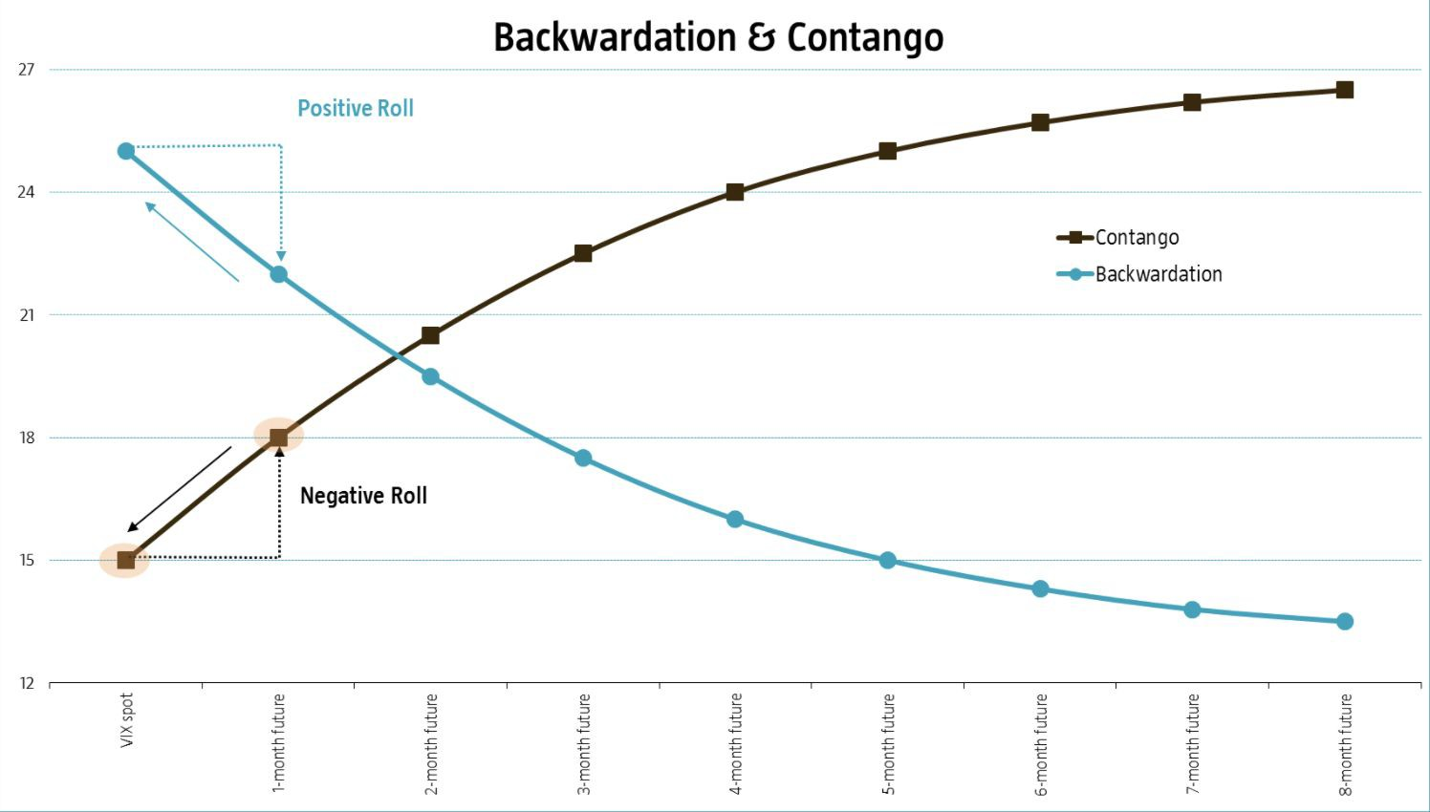
Forward Curve

Slide 12
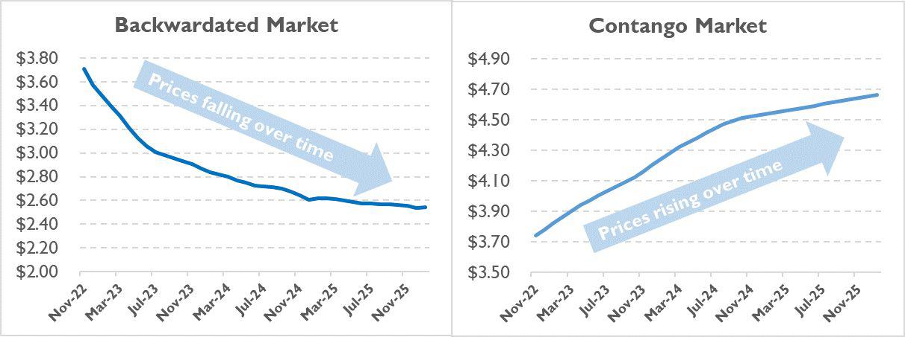
Forward Curve

Slide 13
Indication
What does backwardation and contango signal?
Can we construe one as “bullish” and another as “bearish” ?

Slide 14
Indication
Most commodities are normally in contango
Those that are in normally backwardation:
Livestock
Natural gas (seasonally)

Slide 15
Trading Process
Idea Generation: Is supply or demand or both being disrupted? Within what timeframe?
  Factors
    Events
    Seasonality
    Macro
    Relative value
  Risk vs. Reward: probability of winning RELATIVE TO losing?
Trade structure: Swaps, Futures, Options, Swaptions - what exact product and which part of the curve?
Positioning: Is the market long or short? What does this mean for pricing in?
Timing: Technical Analysis - Trend entry, Trading windows/patterns
Risk Management: Stop loss, Correlations, VaR

Slide 16
Case study: Gold

Slide 17
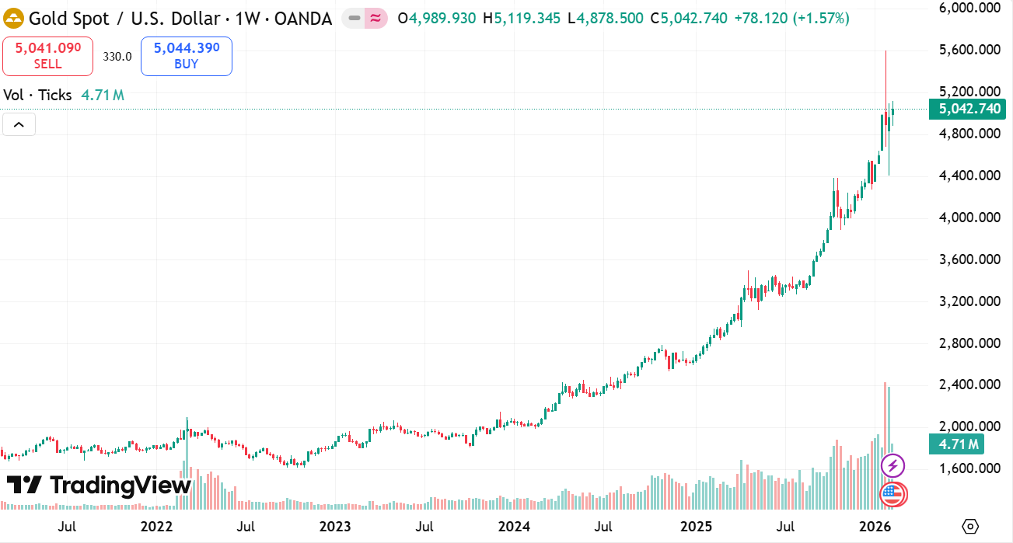

Slide 18
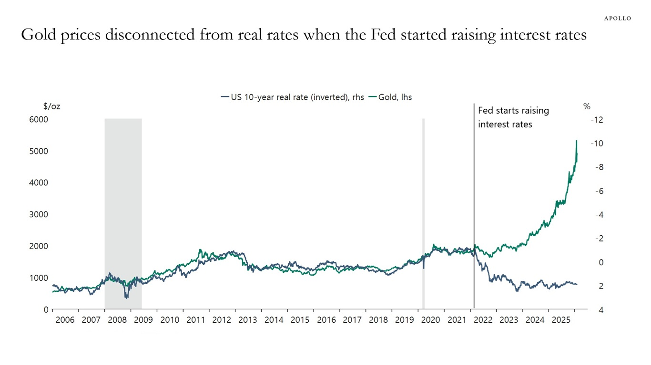

Slide 19
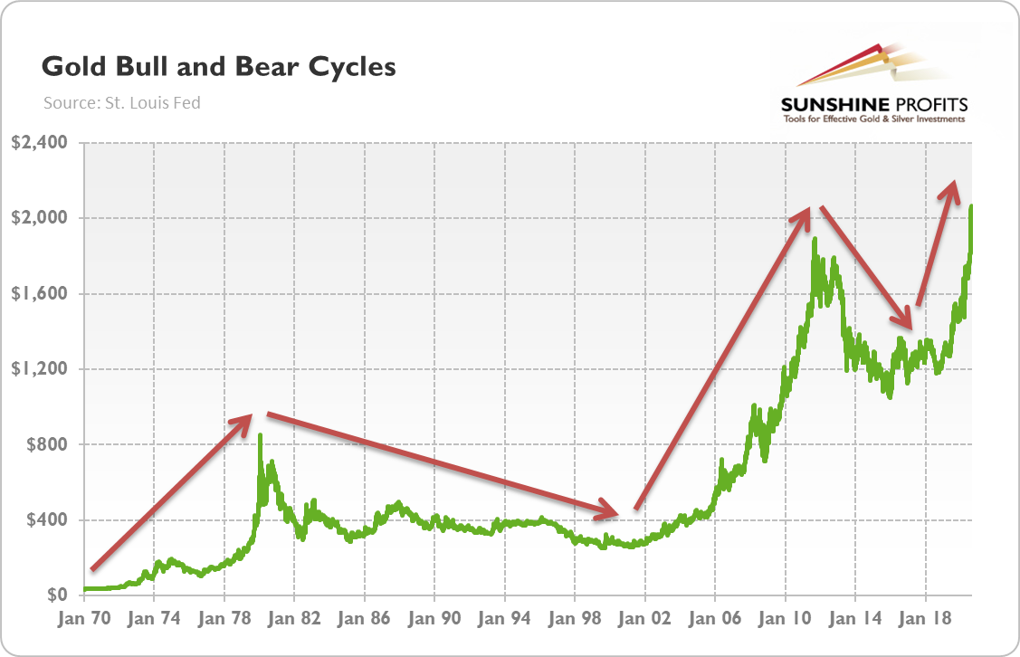

Slide 20
Case study: Oil

Slide 21
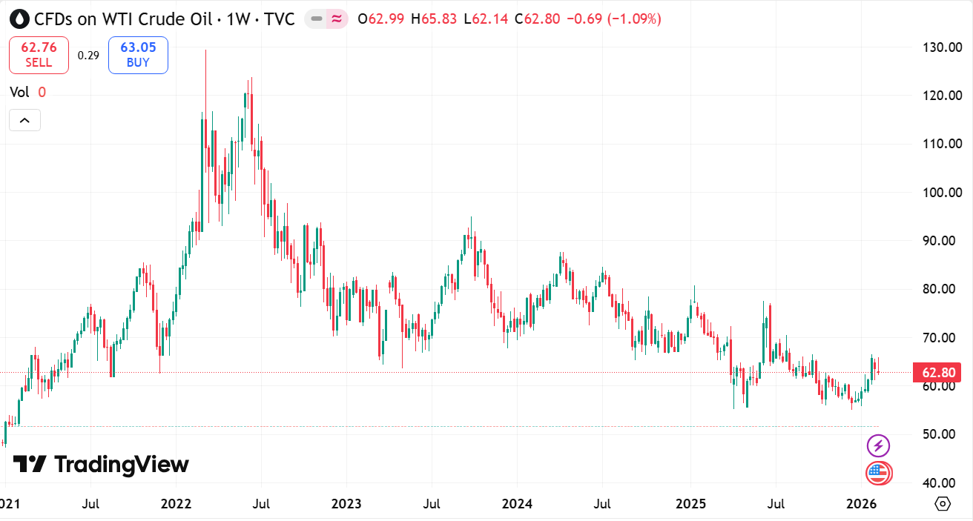

Slide 22


