Slide 1

MBP Capital
2024/25 Bootcamp
Options & Volatility

Slide 2
Definitions
Option Definition
A financial option is a contract that gives the buyer the right, but not the obligation, to buy (call) or sell (put) some asset(s) at a specified price for a specified period of time or point in time
  The buyer is said to exercise the option if he/she chooses to invoke the specified rights in the contract
Option Types
Call: gives the buyer of the option the right to buy the underlying asset
Put: gives the buyer of the option the right to sell the underlying asset
European: gives the buyer of the option the right to exercise only on the expiration date
American: gives the buyer of the option the right to exercise at any time during the life of the option
Option Terms
Parameters needed to price an stock option
Strike price (K)
Time to expiration (T)
Current stock price (S)
Implied volatility (σ)
Risk-free interest rate (r)
Dividends expected during the lifetime of the option (q)

Slide 3
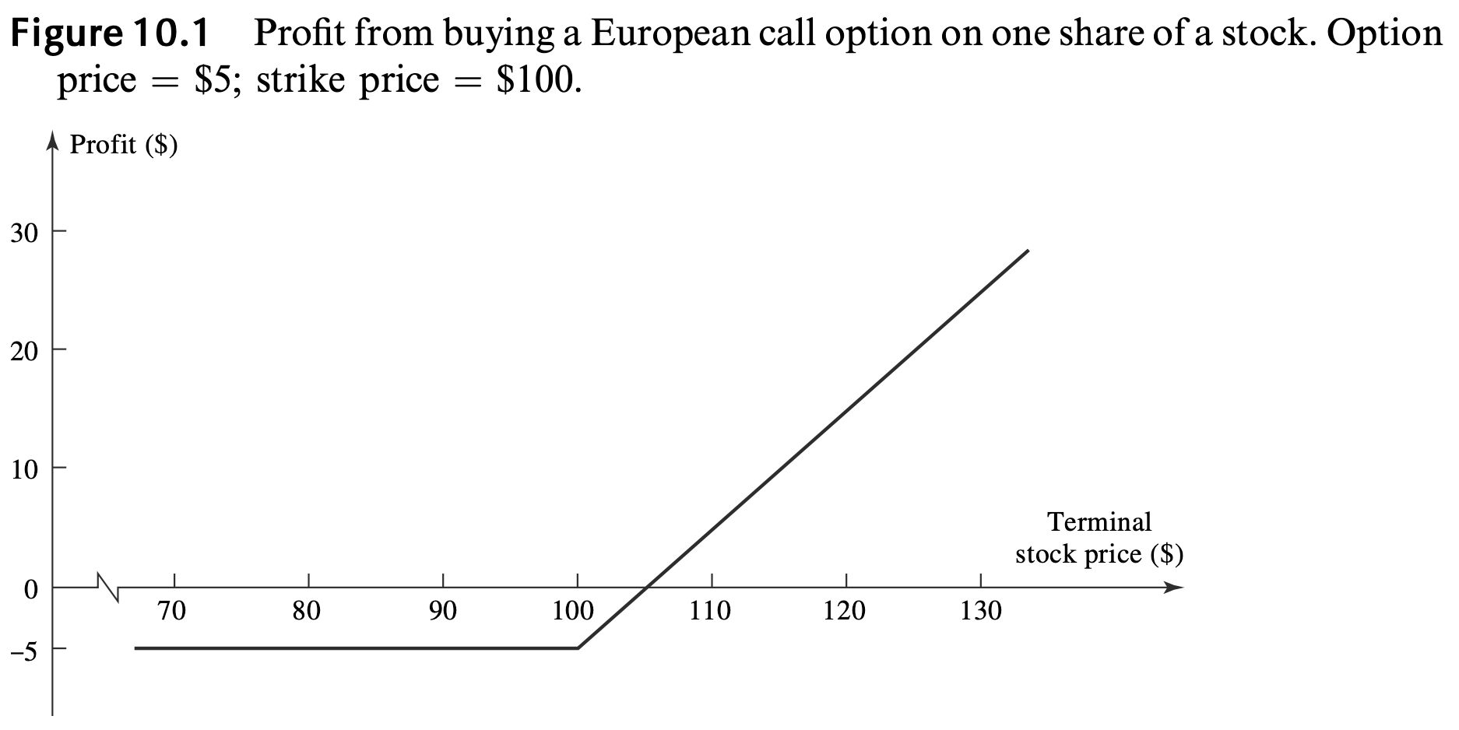
Call Option
Consider the situation of an investor who buys a European call option with a strike price of $100 to purchase one share of a certain stock. Suppose that the price of an option to purchase one share is $5.
Payoff = max(S_{T} – K, 0) where K is the strike price and S_{T} is the final price of the underlying asset

Slide 4
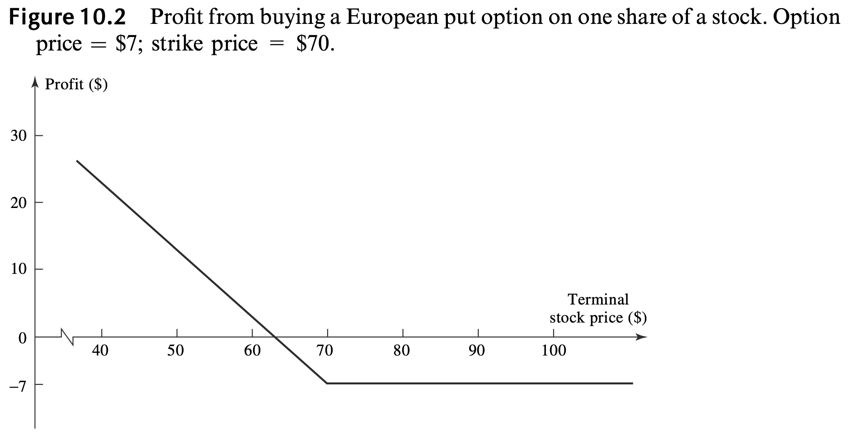
Put Option
Consider the situation of an investor who buys a European put option with a strike price of $70 to sell one share of a certain stock. Suppose that the price of an option to sell one share is $7.
Payoff = max(K – S_{T}, 0) where K is the strike price and S_{T} is the final price of the underlying asset

Slide 5
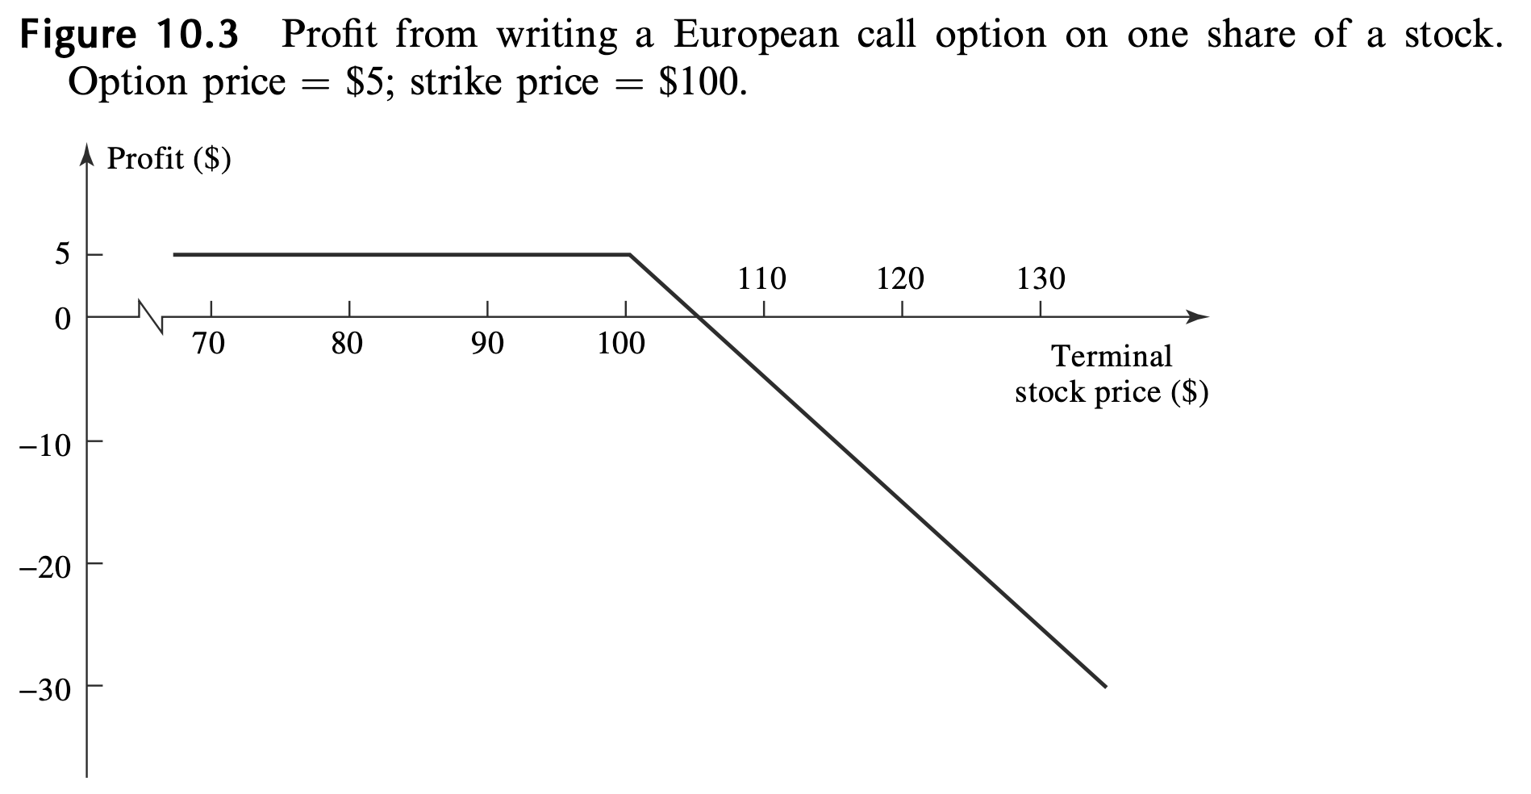
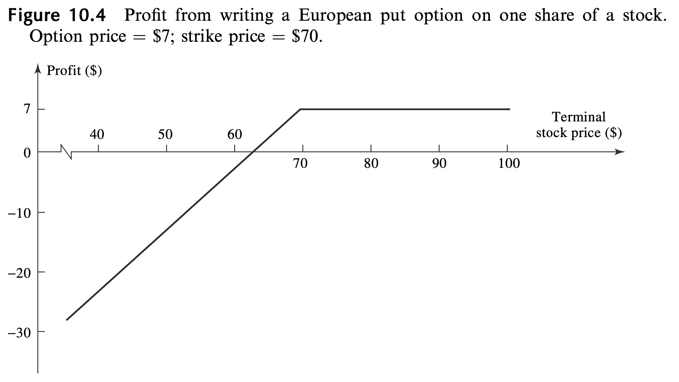
Option Positions
There are two sides to every option contract. On one side is the investor who has taken the long position (i.e., has bought the option). On the other side is the investor who has taken a short position (i.e., has sold or written the option). The writer of an option receives cash up front, but has potential liabilities later. The writer’s profit or loss is the reverse of that for the purchaser of the option.
There are four types of option positions:
Long call
Long put
Short call
Short put
Payoff = – max(S_{T} – K, 0) = min(K – S_{T}, 0)
Payoff = – max(K – S_{T}, 0) = min(S_{T} – K, 0)

Slide 6
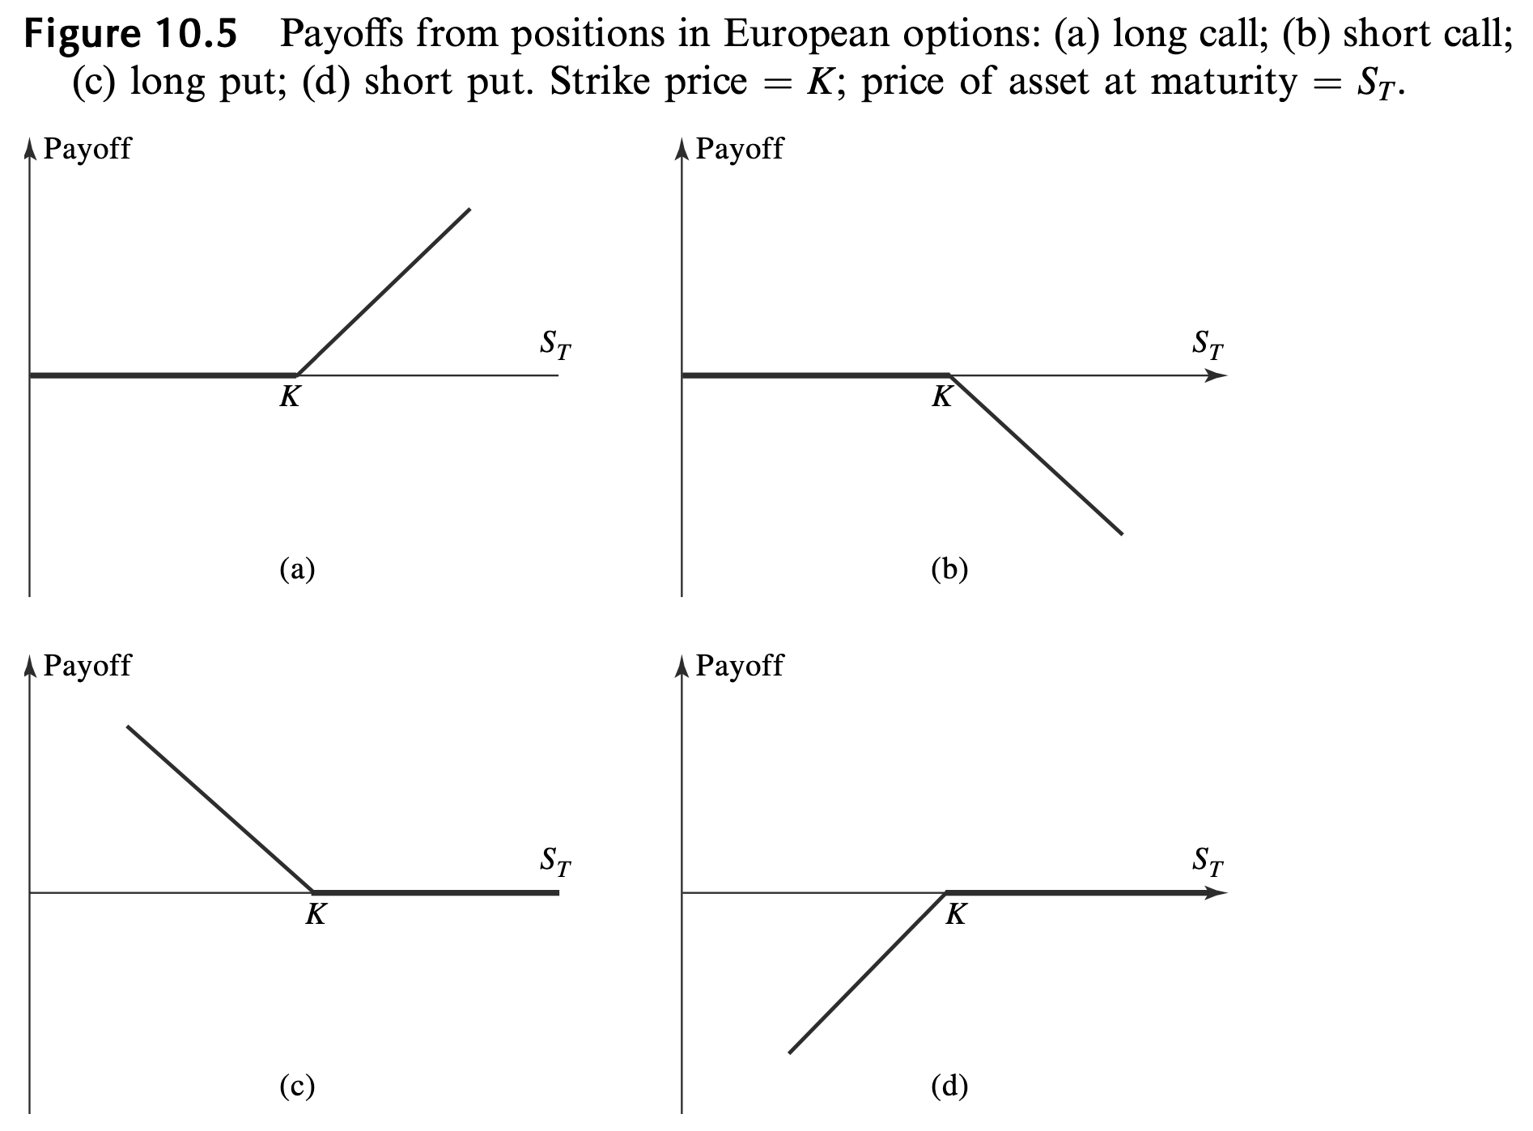

Slide 7
Terminology
ITM vs ATM vs OTM
Intrinsic Value vs Time Value
The intrinsic value of an option is defined as the value it would have if there were no time to maturity, so that the exercise decision had to be made immediately.
  For a call option, the intrinsic value is therefore max(S – K, 0)
  For a put option, it is max(K – S, 0)
The time value is the value of the ability to choose whether to exercise the option at expiry.
  This “optionality” is essentially due to the existence of volatility in the underlying asset.
  Even if the option is ITM, it will have time value, which reflects the possibility that the option will have an even higher intrinsic value at expiry.
Option Value = Intrinsic Value + Time Value
 | In the money (ITM) | At the money (ATM) | Out of the money (OTM)
Call | S > K | S = K | S < K
Put | S < K | S = K | S > K
Profit
Call value
Time value
Intrinsic value
Spot
Profit
Put value
Time value
Intrinsic value
Spot

Slide 8
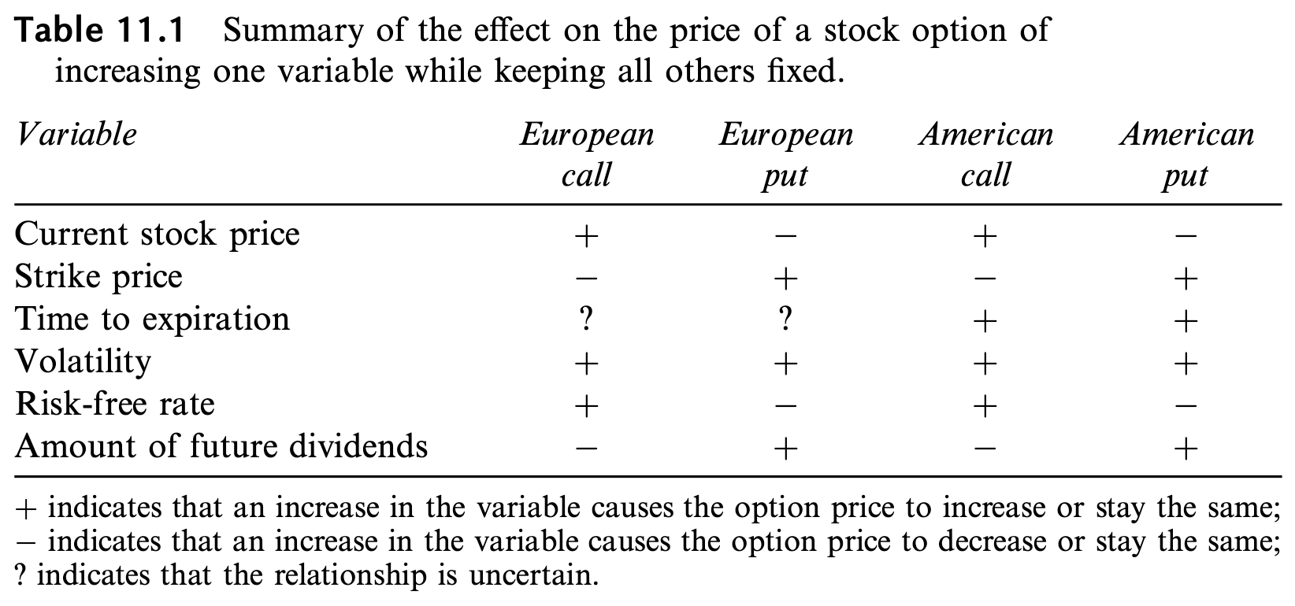
Factors Affecting Option Prices
Time to expiration
Although European put and call options usually become more valuable as the time to expiration increases, this is not always the case.
  Consider two European call options on a stock: one with an expiration date in 1 month, the other with an expiration date in 2 months. Suppose that a very large dividend is expected in 6 weeks. The dividend will cause the stock price to decline, so that the short-life option could be worth more than the long-life option.*
* We assume that, when the life of the option is changed, the dividends on the stock and their timing remain unchanged.

Slide 9
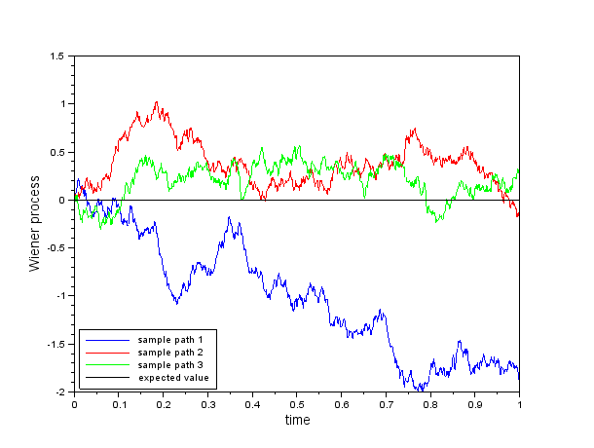
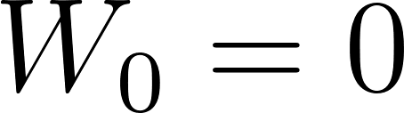
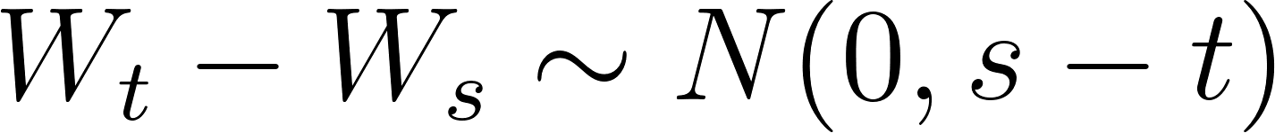
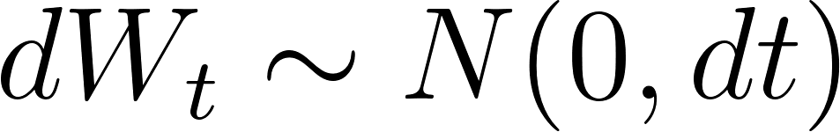
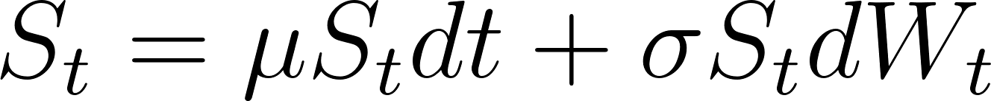
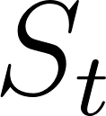



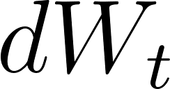
Understanding Randomness
Introduction:
One of the most important aspects of trading is being able to price an asset and is why quant researchers are paid so much
Back in the 1900s, stock prices were theorised to behave randomly, exhibiting elements of Brownian motion (like the diffusion of particles in a fluid)
Wiener Processes:
A process is just a system that you can analyse over time
A Wiener process simply has some important properties being:
Each process is independent over continuous time interval
telling us that
Geometric Brownian Motion:
In finance we model stock prices using the following stochastic differential equation:
    where: is the stock price at time , is the expected return, is the volatility of the stock, and is a random Wiener process
So we have a deterministic part that is predictable (e.g based on market trends) and a random Stochastic part (representing uncertainty) (this also shows us why day trading is pretty silly)
Notes:
A Wiener process represents a drunk man’s walk over a continuous time period

Slide 10


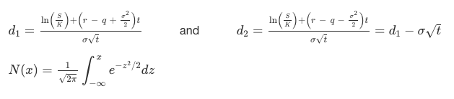
Black-Scholes
Black-Scholes is a framework developed by Fischer Black and Myron Scholes in 1973 and won them the Nobel prize in Economics
It has been heavily built upon in the last 50 years (try to see why) and is used for pricing European-style options
It is built on the following (simplistic) assumptions:
The stock price following Geometric Brownian Motion
The option can be perfectly hedges by continuously trading the underlying
The risk-free interest rate (r) is constant over time
Markets are frictionless (no transaction costs or taxes)
The stock pays no dividends (though we can adjust this)
European call price:
European put price:
Where
Intuition (part 4.2.3.1)
https://bookdown.org/maxime_debellefroid/MyBook/a-deeper-understanding-of-options.html

Slide 11
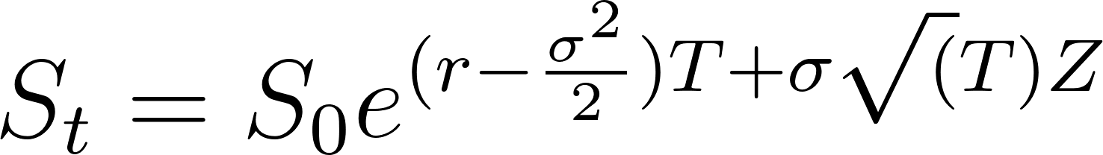
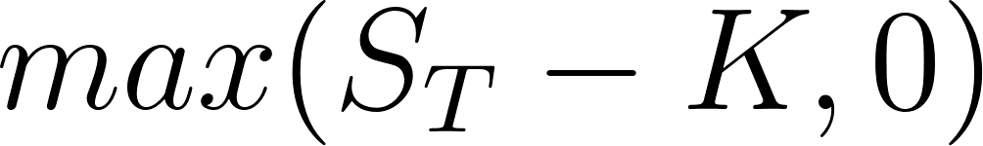
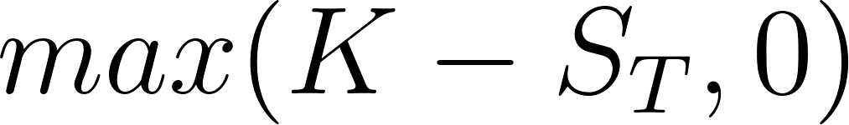
Improvements to Black-Scholes
There are a lot of assumption that Black and Scholes made when developing the model, and therefore the model is not used anymore
However, its assumptions have been reduced over time with more complex models which are still used today:
Heston Model (non-constant (Stochastic) volatility)
Merton’s Jump Diffusion Model
Monte Carlo Simulations
The simplest way to price an option, especially for those who haven’t come across stochastic calculus, would be to use Monte Carlo Simulation
Monte Carlo Simulations:
  This is a numerical method that simulates a large sample of random scenarios to model a complex system (such as the random process of a stock’s price)
We simply use the stock formula (see Appendix) :
We simulate a large amount of (which are log-normally distributed) and calculate the payoffs for calls ( ) and puts ( )
Finally we average the simulated payoffs and then multiply this by a discount rate of (e^-rt) to get our option price

Slide 12
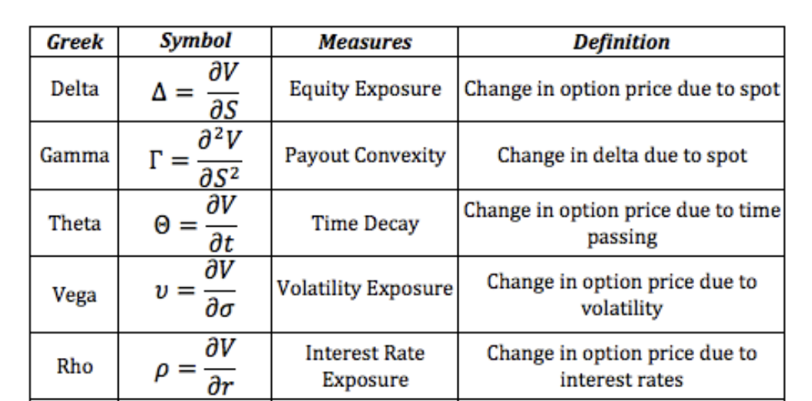
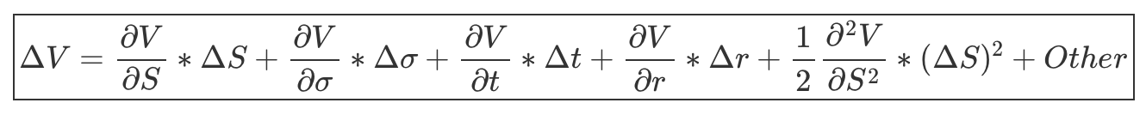
Greeks
The “Greeks” is the name given to a set of sensitivities of a derivative price to market parameters
In practical terms, these sensitivities indicate the variation of the derivatives price if “small changes” in specified parameters occur
Each Greek letter measures a different dimension to the risk in an option position and the aim of a trader is to manage the Greeks so that all risks are acceptable
Common Greeks used in the market:

Slide 13
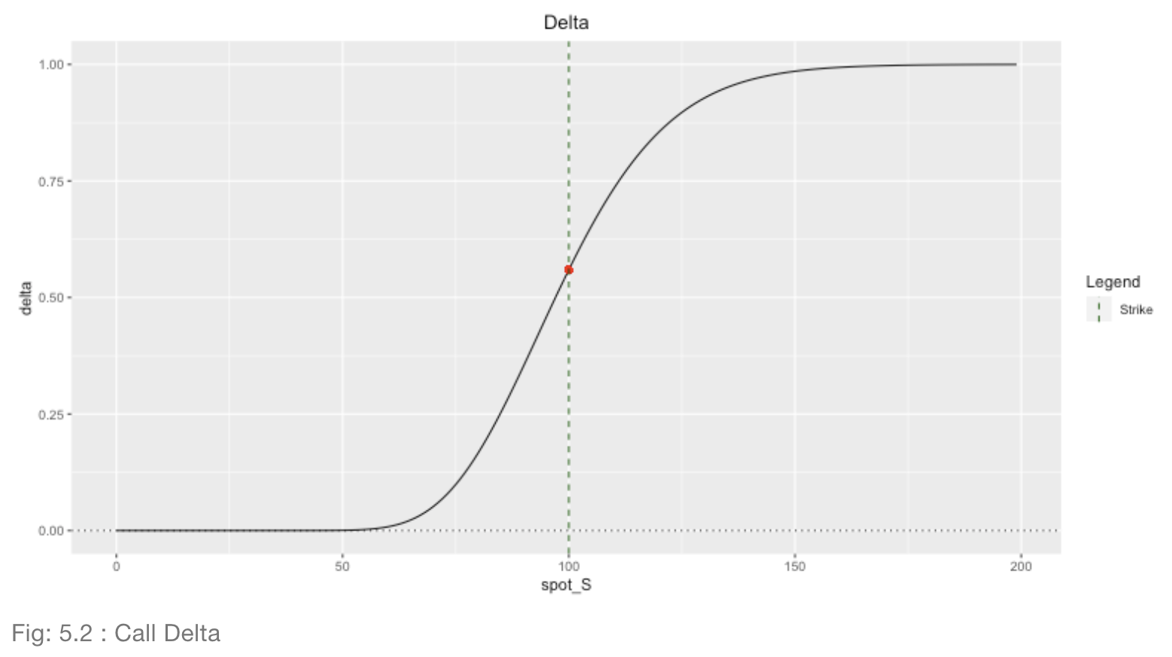
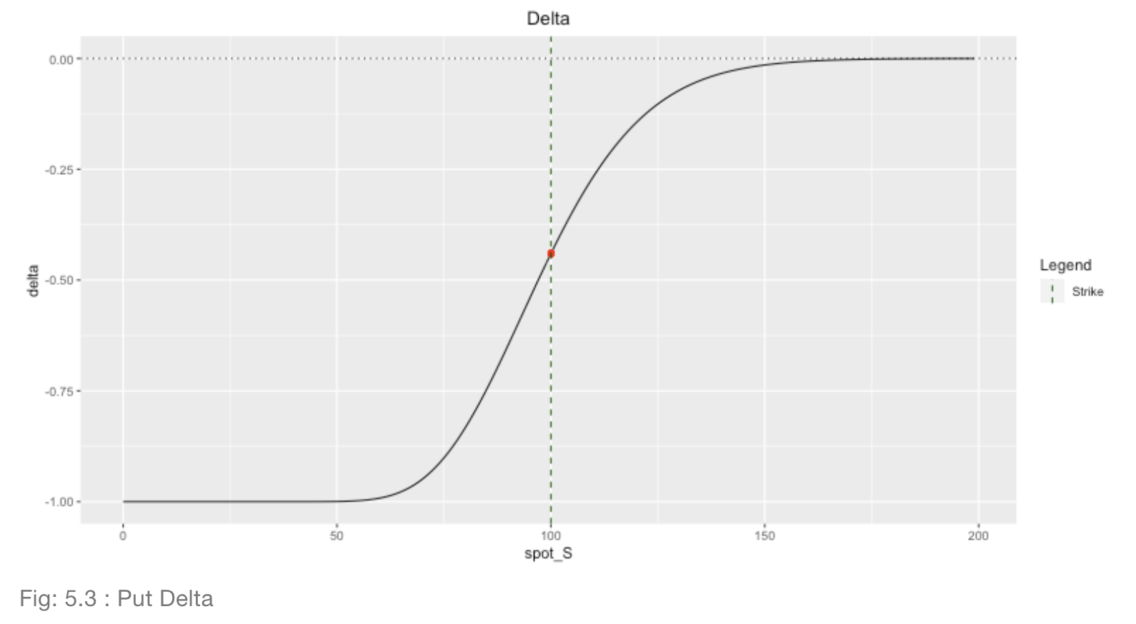
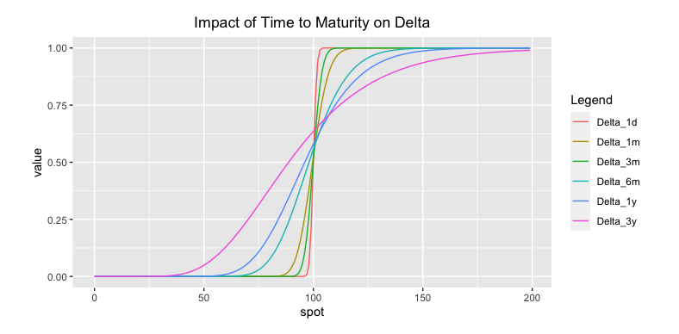
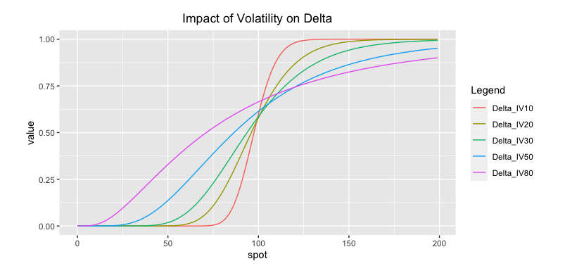
Greeks: Delta
Delta measures how sensitive an option’s value is to changes in the underlying price
Graphically, it is the slope of the tangent line on the options value
It is normally quoted in percent and gives how much of percentage of the actual stock is required to hedge the option

Slide 14
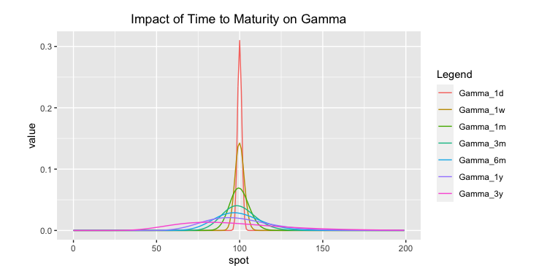
Greeks: Gamma
Gamma measures the change in delta due to the change in underlying price
Gamma for both calls and puts are the same
When you buy an option, you have a positive Gamma position. When you sell an option, you have a negative Gamma position
Gamma measures how to adjust the hedge to remain “delta-neutral” as the spot changes
Options with high Gamma require more frequent hedge adjustments than options with low Gamma

Slide 15
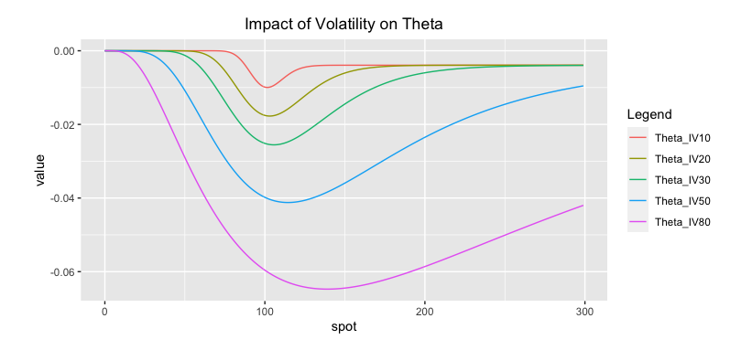
Greeks: Theta
Theta is defined as the rate of change of the option price respected to the passage of time
The higher the volatility, the higher the option price and the time value, the more time value to lose, the larger the absolute value of theta
Theta loss speeds up as maturity approaches

Slide 16
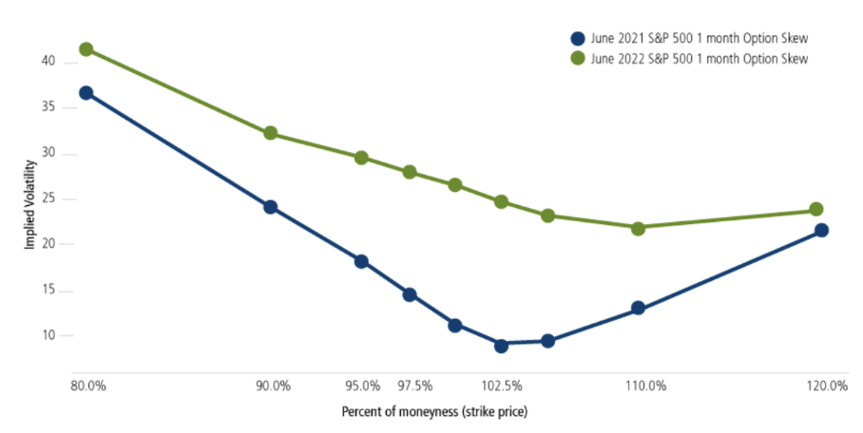
Volatility
Volatility measures the standard deviation of an asset price over time
It represents the uncertainty or risk associated with an underlying asset price
It is typically negatively correlated with the price of an asset, especially in equity markets. Does anyone know why?
Types of Volatility:
Historical volatility: the volatility of previous movements (which do NOT dictate future movements)
Implied volatility: The market’s expectations of future volatility (derived from the strike price of an option using Black-Scholes models). We see a smile because the assumptions of the Black-Scholes model do not fully reflect real-world market dynamics (particularly because investors are more concerned with extreme events and willing to pay higher premiums to hedge that exposure)
Notes:
Stock price falls -> debt-to-equity rises and investor uncertaintyt

Slide 17
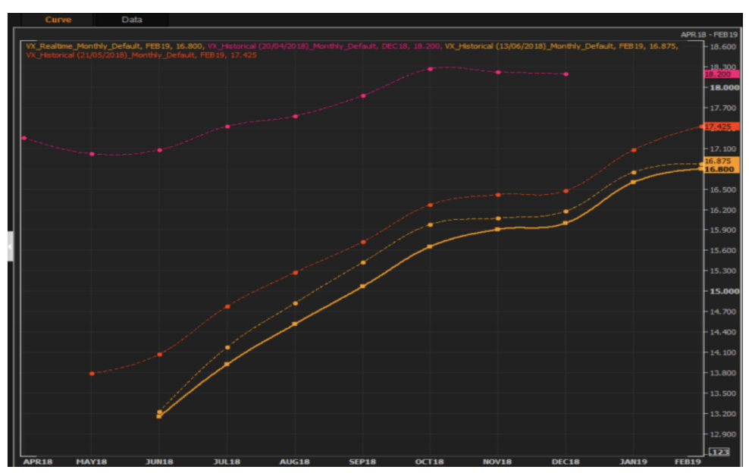
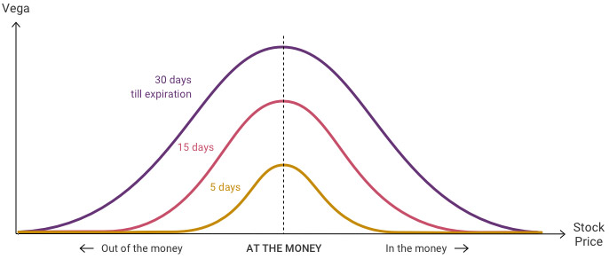
Implied Volatility and Vega
One way to measure Implied Volatility to use the VIX (CBOE Volatility Index) as a proxy for the implied vol of the S&P 500 and for the overall market uncertainty
It calculates a weighted average of implied vols across ranges of SPX options
It is upwards sloping because volatility is cumulative
  Think of the volatility of summation of several r.vs (Wiener processes)
Vega
  Vega measures an option price sensitivity to change in implied volatility:
    v = dV/do
  It is positive for both calls and puts (since higher implied vol demands higher risk premiums to sellers of calls and puts as price movements are both ways)
  Vega falls as expiration approaches as the effects of volatility are reduced
  Vega is maximised ATM since uncertainty is maximised here because ATM options maximise uncertainty of whether the option will expire ITM or OTM

Slide 18
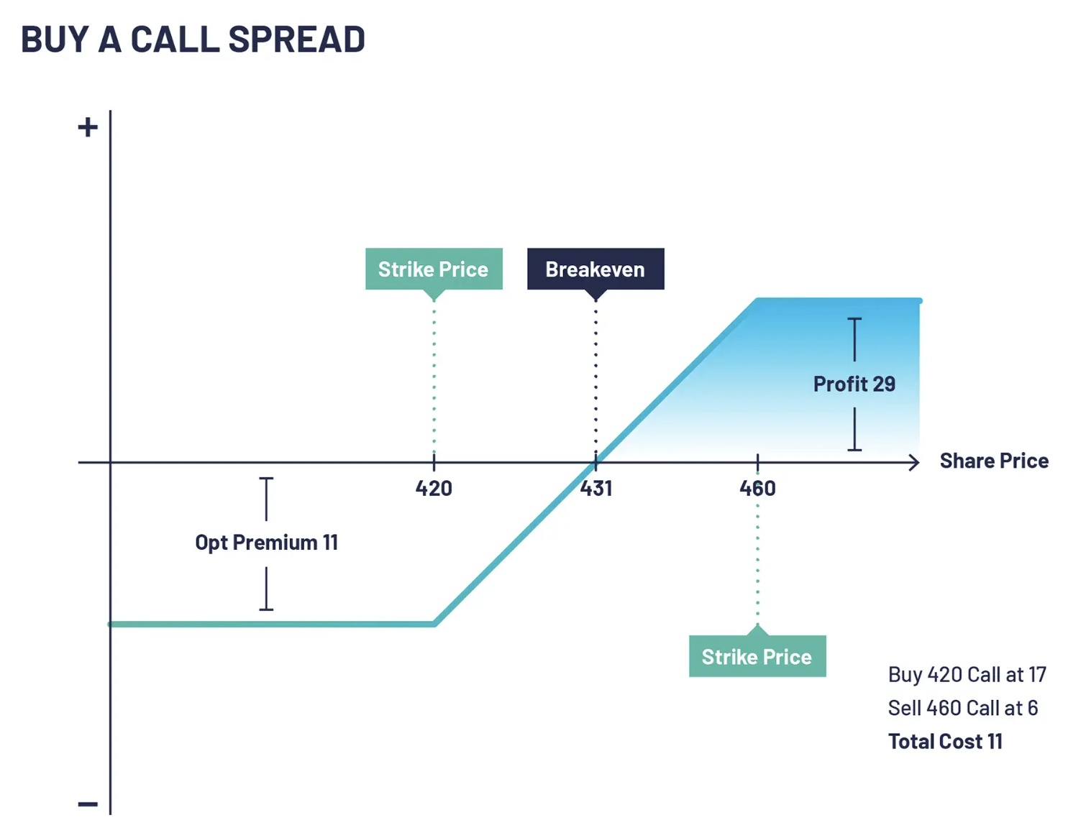
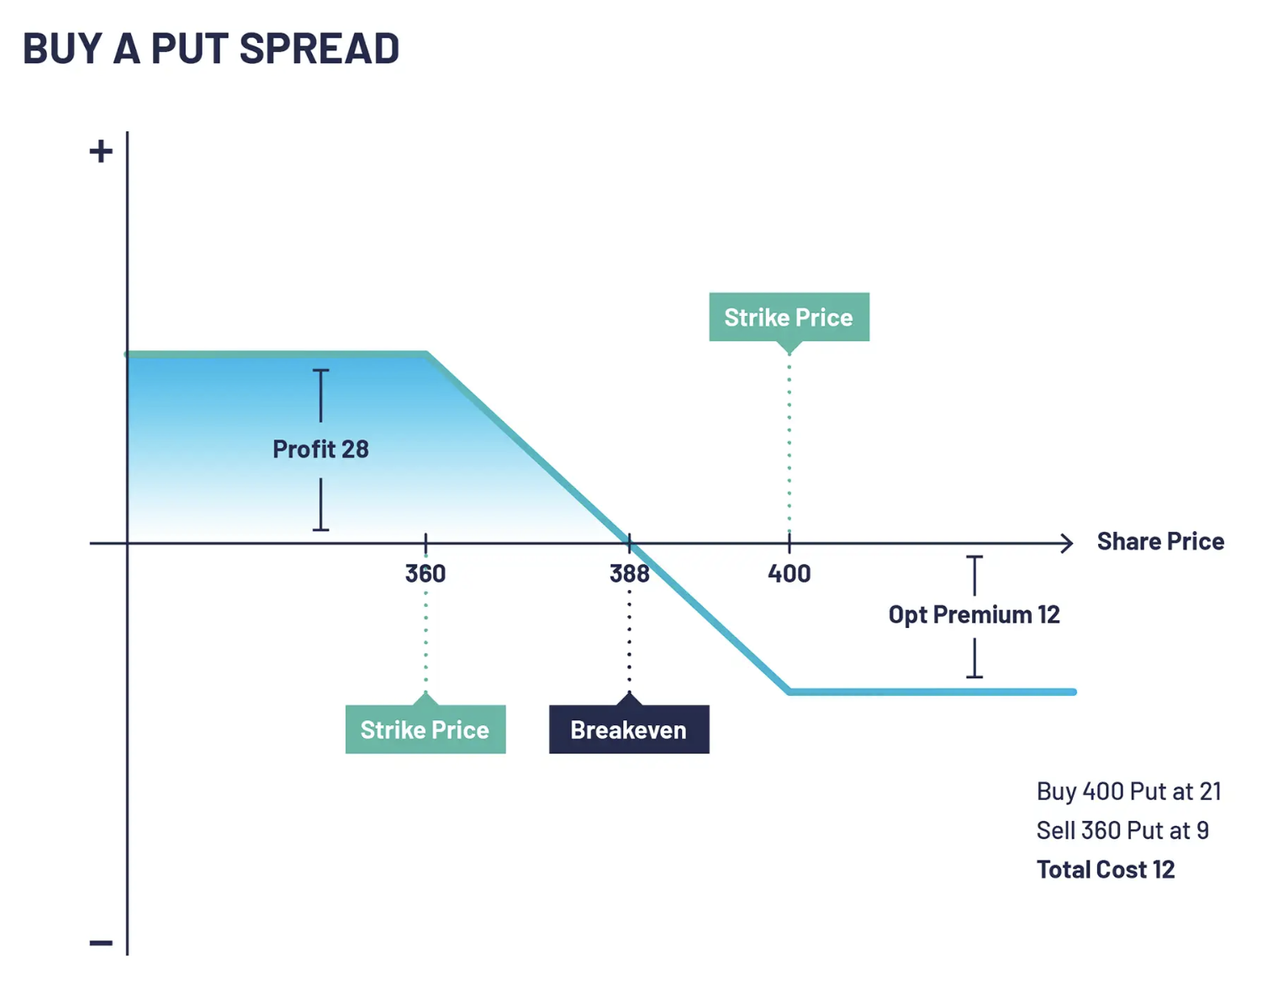
Vanilla Trading Strategies
Buy a call + sell a call with higher strike
Anticipate a moderately bullish move
The premium received from the sale of the higher strike call option helps to offset the cost of buying the lower strike call
Maximum loss: net premium paid
Maximum profit: higher strike – lower strike – net premium paid
Buy a put + sell a put with lower strike
Profit from a decline in the stock price
Cheaper to execute than buying an outright put
Maximum loss: net premium paid
Maximum profit: higher strike – lower strike – net premium paid

Slide 19
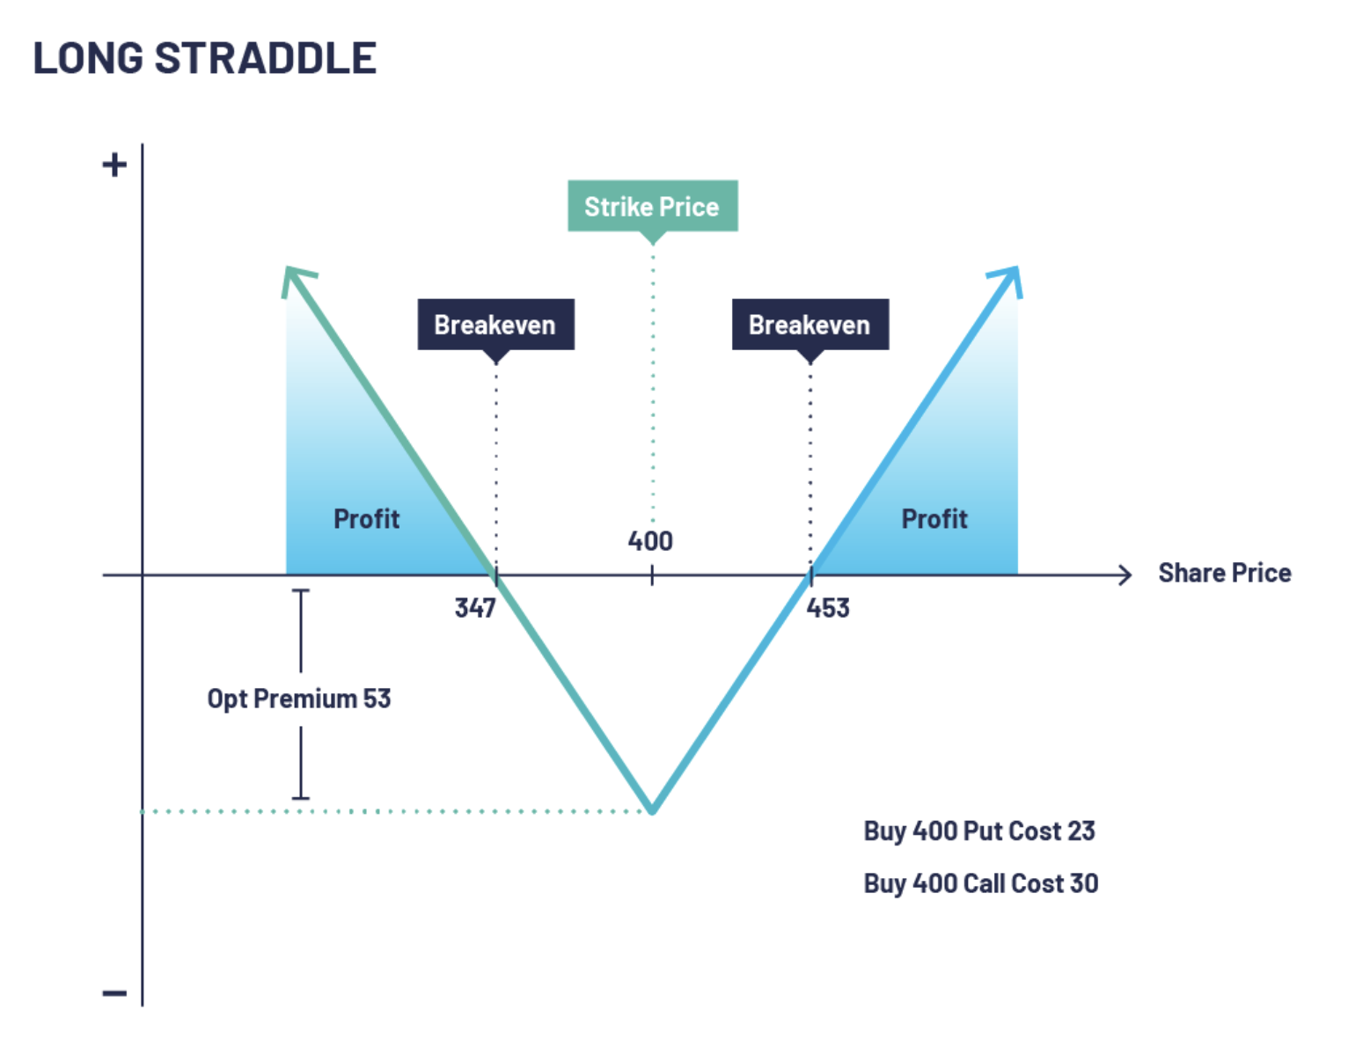
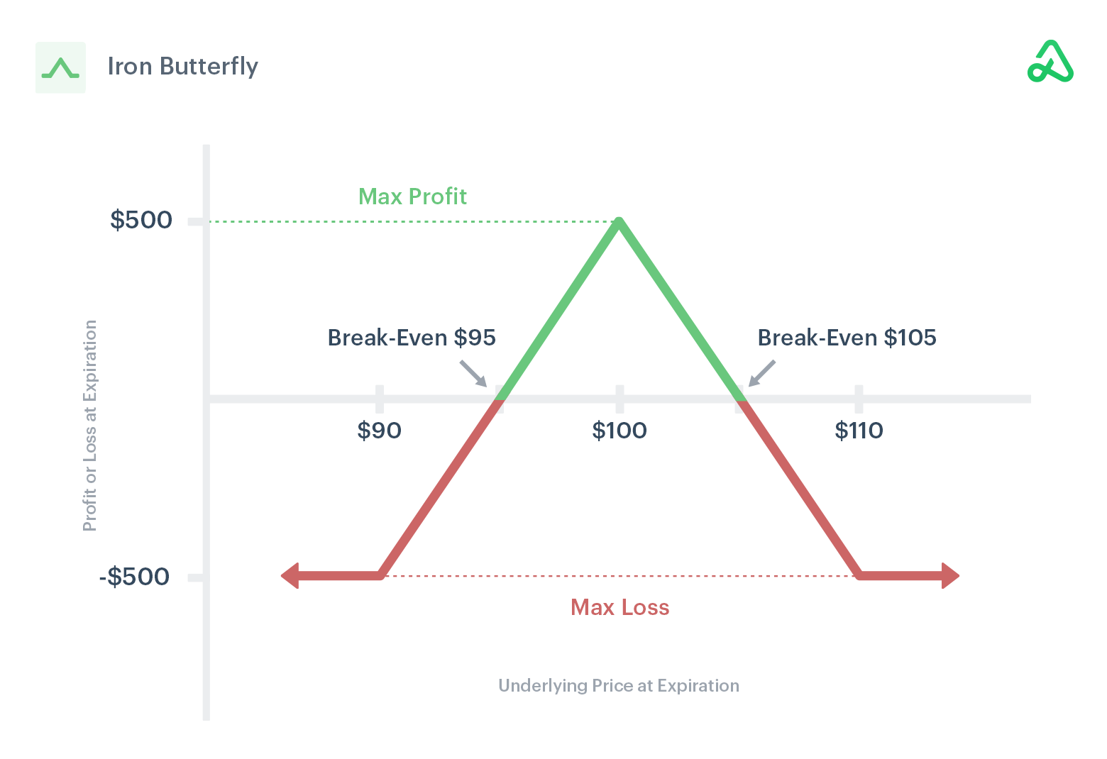
Vanilla Trading Strategies
Buy a call + buy a put with same strike
Expect a sharp move in prices in either direction
Achieve potential profits regardless of which way the underlying asset price moves, provided the move is strong enough to cover the cost of the options premiums
Maximum loss: sum of premiums paid for both options
Maximum profit: unlimited
Buy OTM put with lower strike + sell ATM call + sell ATM put + buy OTM call with higher strike
Take advantage of a drop in volatility and minimal movement from the underlying asset
Maximum loss: strike of bought call – strike of sold call - premiums received
Maximum profit: premiums received

Slide 20
Trade Example
Imagine a scenario where you believe there is an underpricing of strong geopolitical tensions coupled up with the central bank planning on pausing interest rate hikes (despite Jay Powell saying the opposite)
Macro Implications:
Weaker USD (interest rate parity adjustments), stronger EM currencies and equities, increased gold prices (gold is positively correlated with implied volatility which has risen)
Trade Thesis:
Lower rates weaken the USD and increase demand for gold, driving its price higher
Trade Strategy:
Long Call Option on Gold ETF or Futures targeting XAU/USD specifically
Enter at a strike price of slightly OTM to benefit from leverage
Choose short term expiry date after the anticipated central bank meeting and decision
No hedge necessary since our risk is only capture through the risk premium
If you are unsure about the interest rate decisions of the Fed (i.e you think both strong cuts and hikes are equally mispriced) you can capture this through a non-directional strategy. Does anyone have any ideas?

Slide 21
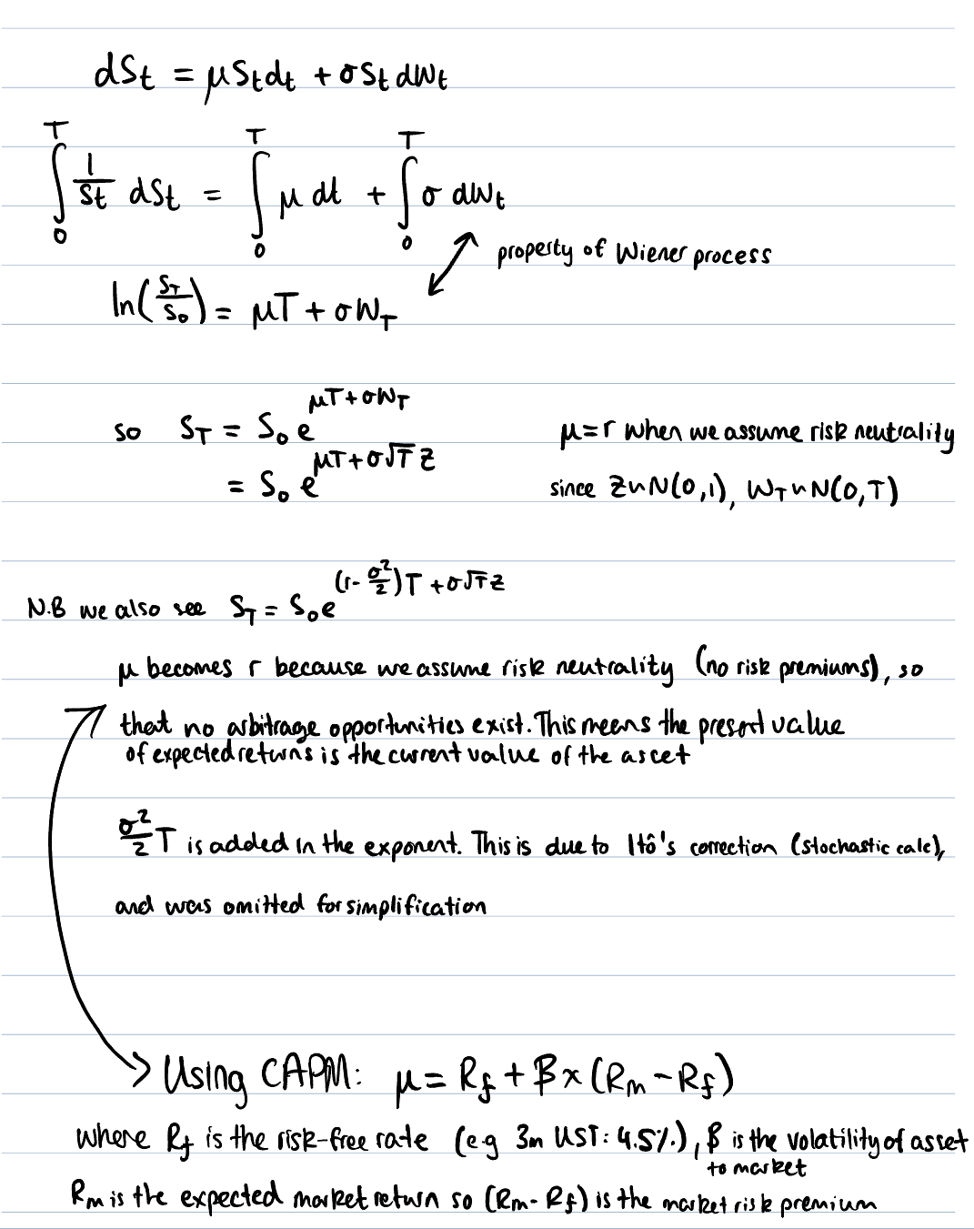
Appendix

Slide 22
