Slide 1
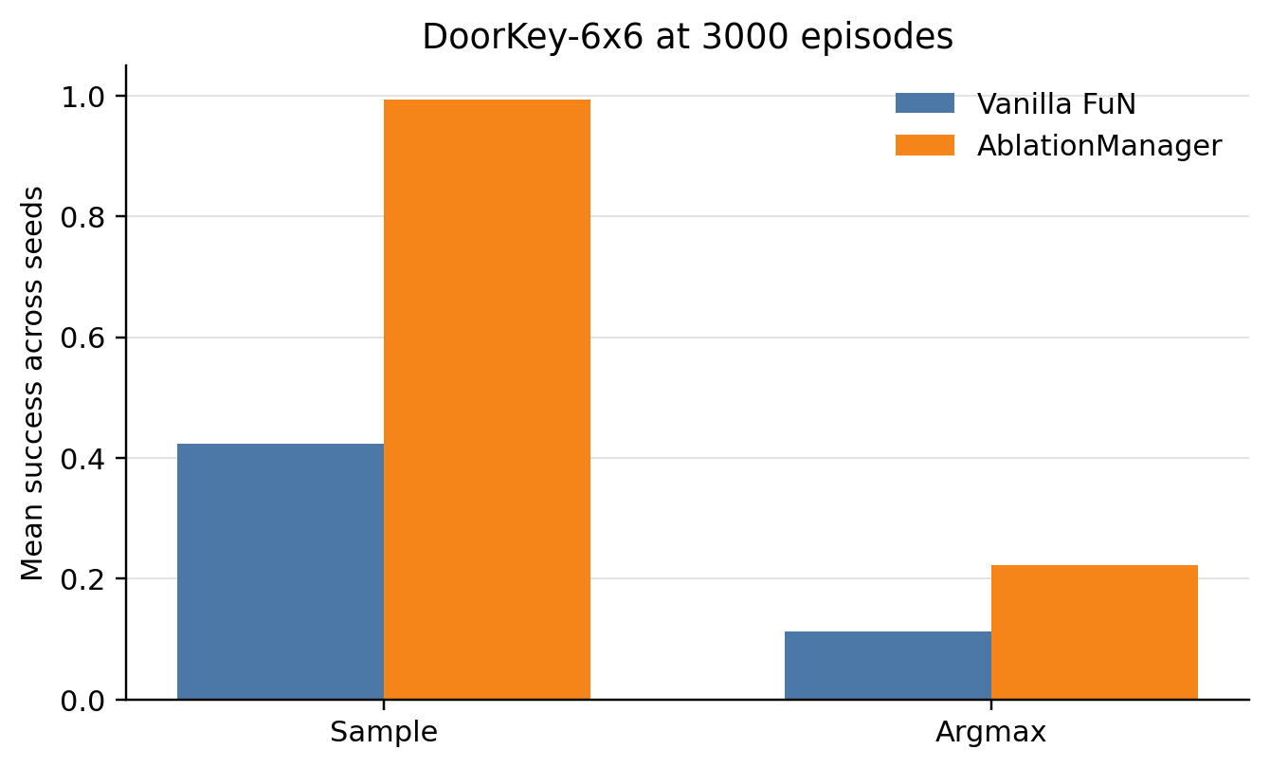
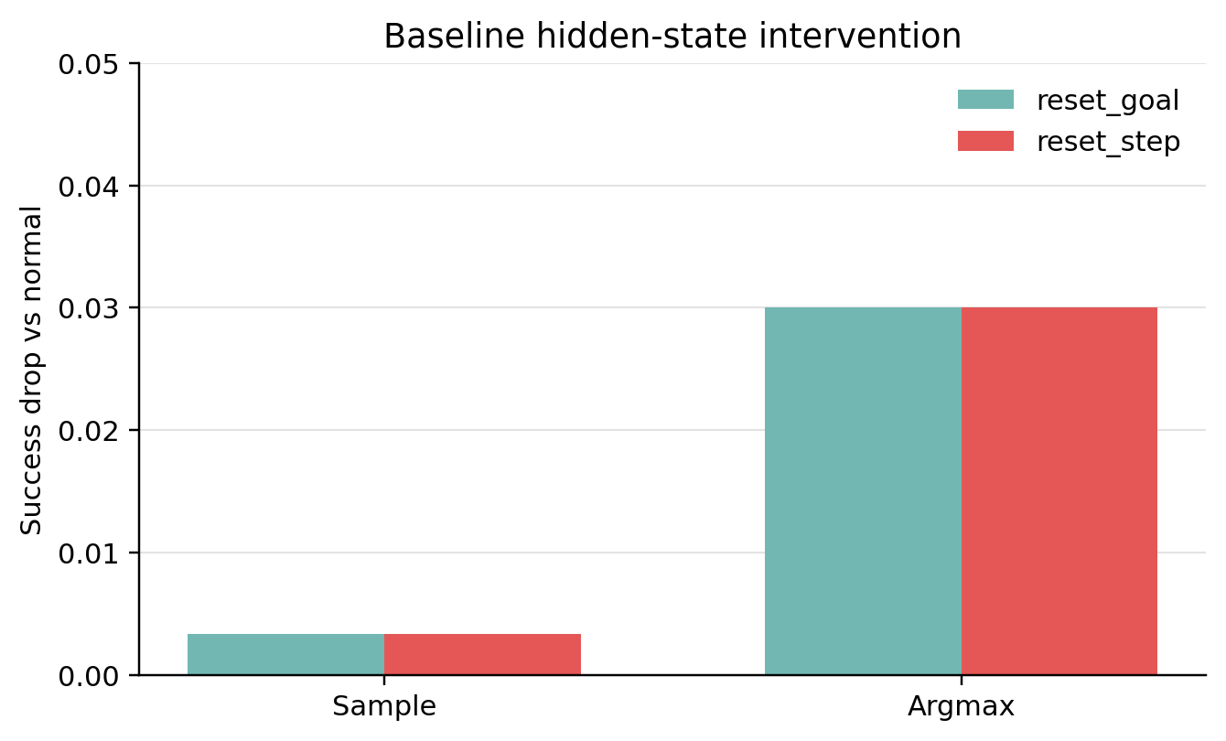
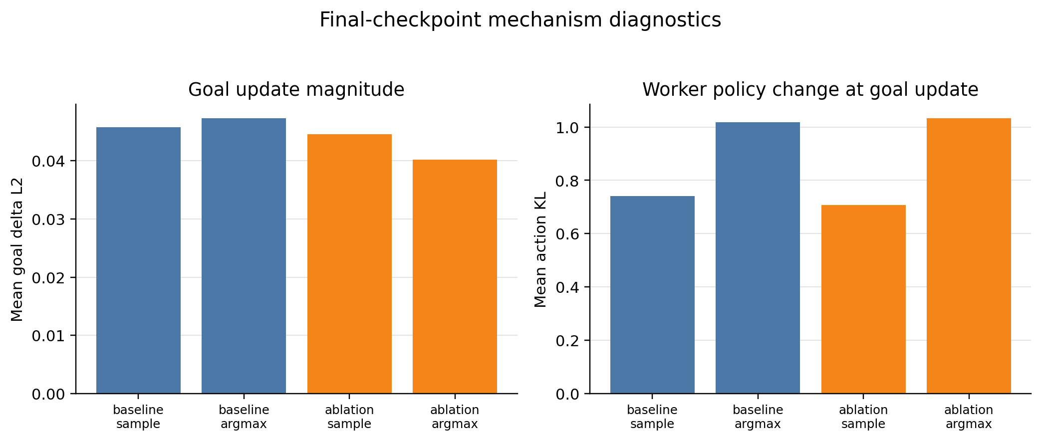
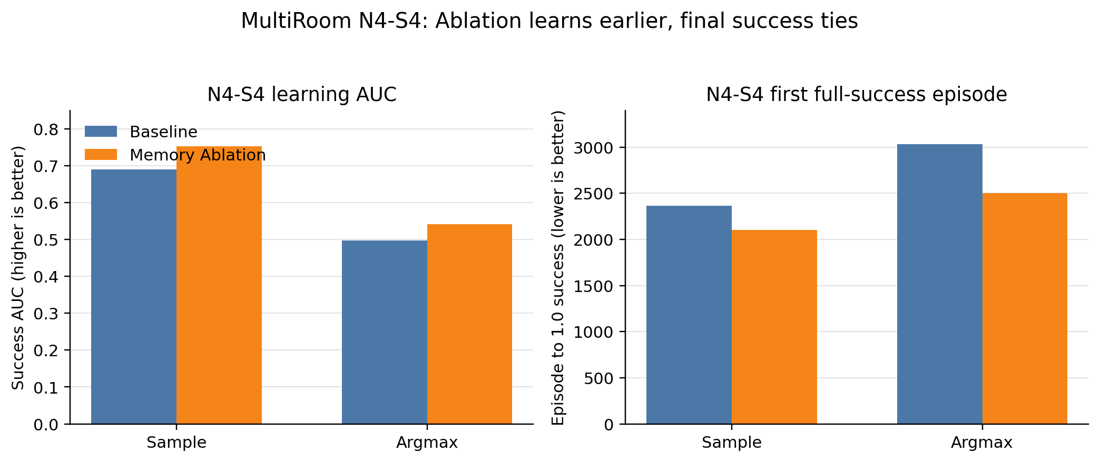
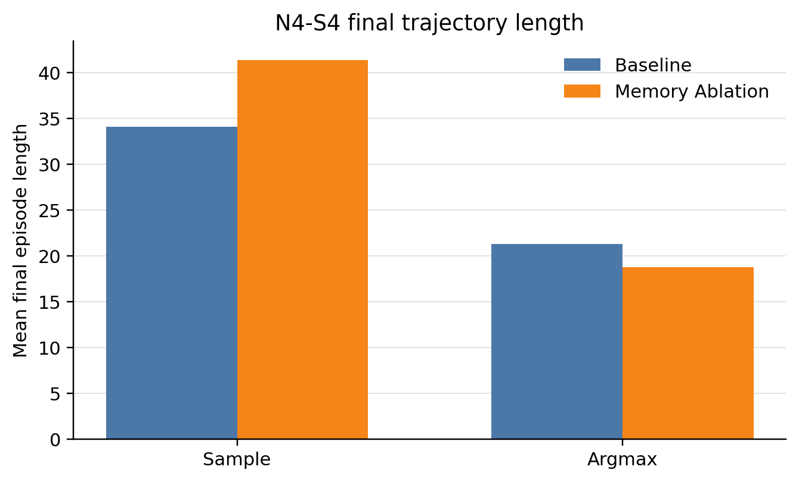
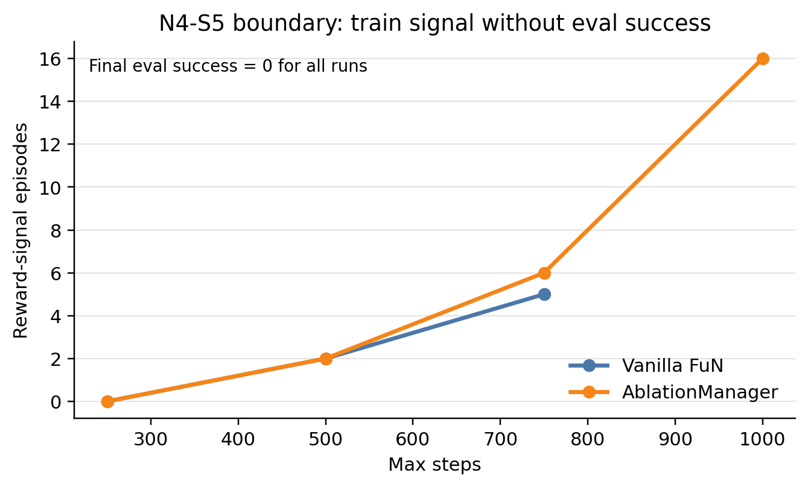
A Reinforcement Learning Approach for Mitigating Reward Sparsity in Multi-Goal Game Environments
FuN Manager Memory Ablation in MiniGrid
Dept. of Electrical and Computer Engineering 2020-11486 Minseong Bu
1.
Research Background and Question
4.
Result 1 — DoorKey-6x6:
Sample Efficiency under a Limited Budget
6.
Mechanism Diagnostics
Reward sparsity in reinforcement learning prevents an agent from receiving useful success rewards, making exploration and credit assignment difficult. This problem is especially clear in MiniGrid DoorKey and MultiRoom environments, where the agent must execute several sub-behaviors in the right order, such as opening doors, moving across rooms, and reaching the goal. A simple flat policy often struggles to obtain meaningful reward signals early in training.
This project focuses on the Manager-Worker structure of Feudal Networks (FuN). In FuN, a high-level Manager generates a latent goal, and a low-level Worker selects actions conditioned on that goal. In the standard Vanilla FuN setting, the Manager maintains a recurrent hidden state, allowing it to accumulate past observations while generating subgoals.
The main question is whether this recurrent memory is actually necessary for MiniGrid navigation. To test this, I compared Vanilla FuN with a Memory Ablation Manager that removes the recurrent hidden state while keeping the same goal interface.
2.
Method
DoorKey-6x6 is harder than the simple DoorKey-5x5 task, but it remains a useful environment for comparing learning dynamics. Under a 3000-episode budget, Memory Ablation achieved a sample success rate of 0.993, while Vanilla FuN reached only 0.423. This shows that the ablated Manager formed a successful stochastic behavior distribution much faster under the same training budget.
When the same checkpoints were evaluated with argmax actions, both models performed worse than in sample mode, but Memory Ablation still performed better: 0.223 versus 0.113. This gap indicates that the policy had learned successful trajectories in its stochastic distribution before those trajectories became the dominant deterministic choice.
With a larger two-stage budget, the difference mostly disappeared. After 5000 episodes of training and 1000 episodes of low-entropy fine-tuning, both models reached a mean argmax success of 0.943. Therefore, the advantage of Memory Ablation should be interpreted as faster and more consistent learning under limited budget, not as a strict final-performance superiority.
▦
⬢
↻
★
🤖
➜
Observation
Encoder
Manager
Goal
Worker
Policy
Action
Vanilla FuN
uses recurrent Manager memory
Memory Ablation
removes hidden state, keeps goal interface
Two diagnostic analyses were added to understand why Memory Ablation learned faster in N4-S4. First, I intervened on the trained Baseline checkpoint by resetting its hidden state during evaluation. If the final policy strongly depended on recurrent memory, this intervention should have caused a large performance collapse. However, the average argmax success drop was only about 0.03. This suggests that the final Baseline policy had relatively weak dependence on the recurrent hidden state.
Second, I analyzed the relationship between Manager goals and Worker action distributions. The argmax mean goal_delta_l2 was 0.0473 for Vanilla FuN and 0.0402 for Memory Ablation, indicating that Ablation produced slightly more stable goal changes. Meanwhile, the action-distribution KL immediately after goal updates was about 1.0 for both models. This means that goal updates did affect the Worker policy, but the effect did not require recurrent memory in the final checkpoint.
These diagnostics support the interpretation that Manager memory was not essential at convergence, but they should not be overstated as a complete proof of why Ablation learned faster.
Vanilla FuN receives a state embedding from the observation encoder. The Manager updates a GRU-based recurrent hidden state and generates a goal vector. The Worker then receives both the current state embedding and the active goal, and outputs logits over the discrete MiniGrid action space. The goal is updated every fixed goal-update interval, and the same goal is reused between updates.
The Memory Ablation Manager changes only the memory mechanism. It removes the recurrent hidden state while keeping the goal interface, Worker network, rollout collection, loss structure, and evaluation pipeline as close as possible to the baseline. This makes the ablation a minimal intervention designed to isolate the effect of Manager memory.
Both sample and argmax evaluations were used. Sample evaluation reflects the stochastic policy used during training, while argmax evaluation tests whether the policy has consolidated into a deterministic high-probability action sequence suitable for deployment-like execution.
MiniGrid navigation
5.
Result 2 — MultiRoom N4-S4:
Same Final Success, Different Learning Process
3.
Experimental Setup
7.
Boundary Environment — MultiRoom N4-S5
The study was expanded step by step. In the first stage, I implemented MiniGrid execution, observation preprocessing, rollout logging, and the forward-pass structure for the Encoder, Manager, Worker, and FuNModel. In the second stage, I connected rollout collection, reward-to-go returns, advantage computation, worker/value/manager losses, trainer logic, optimizer updates, evaluation, and CSV/JSON logging to make Vanilla FuN trainable.
Next, I stabilized the baseline by adding checkpoint save/load, seed-separated logs, GCP execution, and sample/argmax checkpoint evaluation. The same training pipeline was then reused for the Memory Ablation Manager.
The experiments were extended from DoorKey to MultiRoom environments: DoorKey-6x6, MultiRoom N3-S5, MultiRoom N4-S4, and the harder MultiRoom N4-S5 boundary setting. The main metrics were success rate, mean return, episode length, success AUC, and the episode at which a success threshold was first reached.
MultiRoom N3-S5 bridge result (argmax)
MultiRoom N4-S5 was used as a boundary condition showing the limits of the current approach. In N4-S4, both models eventually reached 100% final success. In the harder N4-S5 setting, however, all tested runs remained at 0 final evaluation success for both models.
I also ran a max-steps sweep with limits of 250, 500, 750, and 1000 steps. Increasing the step budget did not recover evaluation success. However, the training process was not entirely reward-free. The best reward-signal episode count was 5 for Vanilla FuN and 16 for Memory Ablation. This indicates that Ablation encountered sparse rewards more often, but these signals did not generalize into a stable evaluation policy.
Therefore, the N4-S5 result should be treated as an honest limitation rather than a failed experiment. The current FuN and ablation structures are not sufficient for reliably solving this harder sparse-reward environment without additional exploration, curriculum learning, or stronger training signals.
Metric
Vanilla FuN
Memory Ablation
Best argmax success
1.000
1.000
Best argmax return
0.784
0.790
Best argmax episode length
14.400
14.000
In MultiRoom N4-S4, final success alone hides the difference between the two models. The three-seed mean final success was 1.000 for both sample and argmax evaluation in both models, and the final returns were also very close. Thus, the value of this environment is not in asking which model eventually solves the task, but in examining how each model reaches that solution.
Memory Ablation learned faster on average. The sample success AUC was 0.753 for Memory Ablation and 0.690 for Vanilla FuN. The argmax success AUC was also higher for Memory Ablation, 0.541 compared with 0.497. A higher AUC means that the model maintained higher success earlier and for a larger portion of training, rather than only matching the final performance.
Threshold crossing also favored Memory Ablation. The average episode to reach 1.0 sample success decreased from 2366.7 to 2100.0, and the average episode to reach 1.0 argmax success decreased from 3033.3 to 2500.0. This suggests that recurrent memory was not a necessary condition for solving N4-S4, and that the simpler Manager was sufficient for faster learning in this setting.
8.
Conclusion
◎
Overall, removing the recurrent memory from the FuN Manager did not destroy performance in the tested MiniGrid environments. In DoorKey-6x6 and MultiRoom N4-S4, Memory Ablation often learned faster and more consistently under limited training budgets. In DoorKey-6x6, the 3000-episode sample success improved substantially, and in MultiRoom N4-S4, both final success rates were identical while success AUC and threshold-crossing episodes favored Memory Ablation.
At the same time, Vanilla FuN could catch up under larger budgets, and both models failed to solve the harder MultiRoom N4-S5 setting. Therefore, the conclusion is not that Memory Ablation is universally superior. A safer interpretation is that, for several tested multi-goal MiniGrid navigation settings, a simpler Manager without recurrent hidden memory was sufficient and sometimes more sample-efficient.
This suggests that recurrent memory may add optimization burden when the environment can be solved primarily from the current observation and goal interface. More difficult sparse-reward tasks will require stronger exploration strategies and broader mechanism analysis.
💡
Future Work
• Apply curriculum learning to N4-S5 and harder tasks
• Combine intrinsic reward or exploration bonuses
• Analyze hidden-state dependence at early checkpoints
• Cluster Manager goals and compare trajectory-level behavior
• Fairly compare Transformer Manager, recurrent Manager, and ablation variants

