Slide 1
Artificial Neural Networks
Biointelligence Laboratory
Department of Computer Engineering
Seoul National University

Slide 2
Contents
Introduction
Perceptron and Gradient Descent Algorithm
Multilayer Neural Networks
Designing an ANN for Face Recognition Application

Slide 3
Introduction

Slide 4

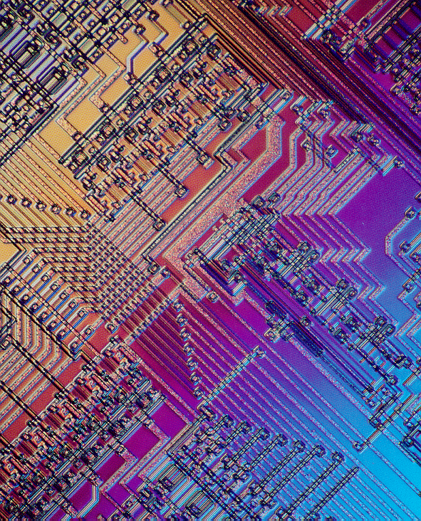
The Brain vs. Computer
1. 10 billion neurons
2. 60 trillion synapses
3. Distributed processing
4. Nonlinear processing
5. Parallel processing
1. Faster than neuron (10⁻⁹ sec)
cf. neuron: 10⁻³ sec
3. Central processing
4. Arithmetic operation (linearity)
5. Sequential processing

Slide 5
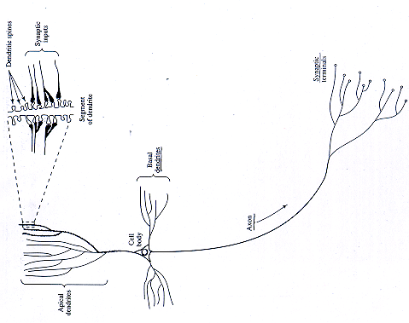
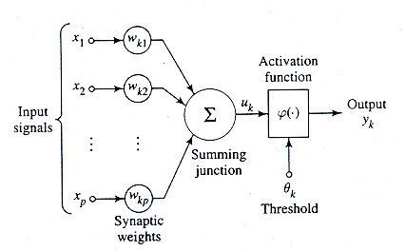
From Biological Neuron to
Artificial Neuron
Dendrite
Cell Body
Axon

Slide 6
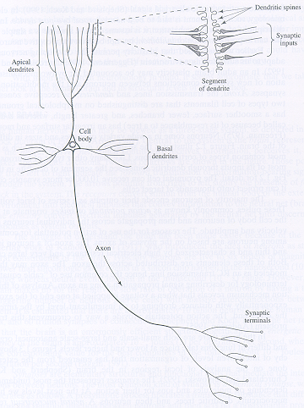
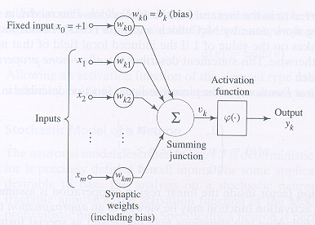
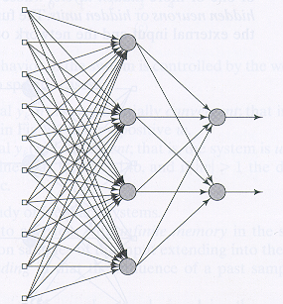
From Biology to
Artificial Neural Networks

Slide 7
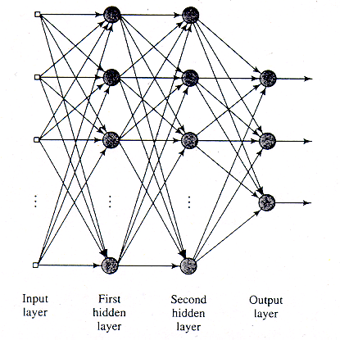
Properties of Artificial Neural Networks
A network of artificial neurons
Characteristics
  Nonlinear I/O mapping
  Adaptivity
  Generalization ability
  Fault-tolerance (graceful degradation)
  Biological analogy
<Multilayer Perceptron Network>

Slide 8
Types of ANNs
Single Layer Perceptron
Multilayer Perceptrons (MLPs)
Radial-Basis Function Networks (RBFs)
Hopfield Network
Boltzmann Machine
Self-Organization Map (SOM)
Modular Networks (Committee Machines)

Slide 9
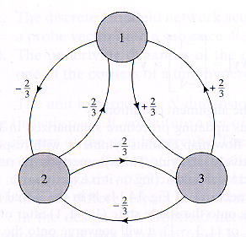
Architectures of Networks
<Multilayer Perceptron Network>
<Hopfield Network>

Slide 10
신경망 학습에 적합한 문제
학습 예가 많은 수의 <속성,값>의 쌍으로 표현되는 문제
출력 결과가 이산치, 실수값, 또는 이들의 벡터로 표현되는 문제
학습 예제에 에러(noise)가 존재하는 문제
긴 학습 시간이 허용되는 문제
빠른 수행시간을 요구하는 문제
학습된 결과를 사람이 이해하는 것이 중요하지 않은 문제

Slide 11
Example of Applications
NETtalk [Sejnowski]
  Inputs: English text
  Output: Spoken phonemes
Phoneme recognition [Waibel]
  Inputs: wave form features
  Outputs: b, c, d,…
Robot control [Pomerleau]
  Inputs: perceived features
  Outputs: steering control

Slide 12
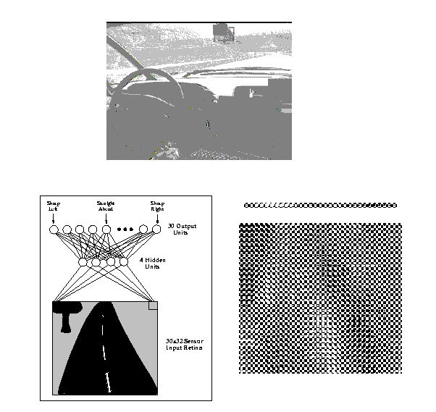
Application:
Autonomous Land Vehicle (ALV)
NN learns to steer an autonomous vehicle.
960 input units, 4 hidden units, 30 output units
Driving at speeds up to 70 miles per hour
ALVINN System
Image of a
forward -
mounted
camera
Weight values
for one of the
hidden units

Slide 13
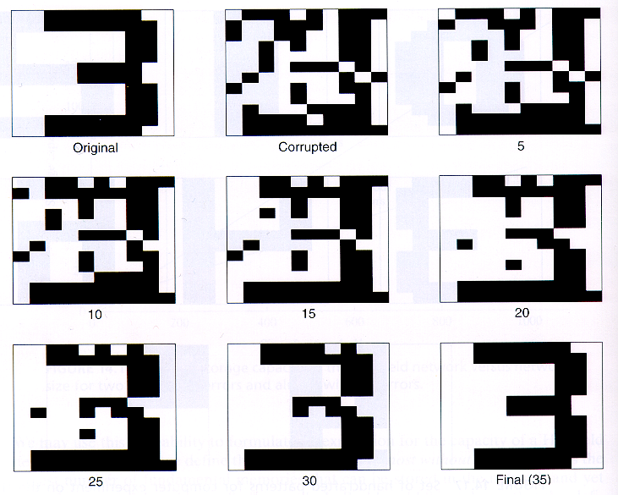
Application:
Data Recorrection by a Hopfield Network
corrupted
input data
original
target data
Recorrected
data after
20 iterations
Recorrected
data after
10 iterations
Fully
recorrected
data after
35 iterations

Slide 14
Perceptron and
Gradient Descent Algorithm

Slide 15
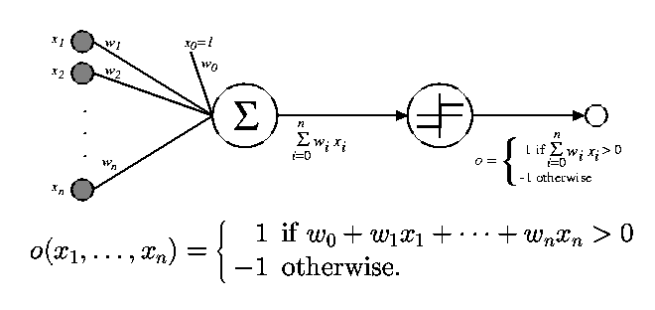
Architecture of Perceptrons
Input: a vector of real values
Output: 1 or -1 (binary)
Activation function: threshold function

Slide 16
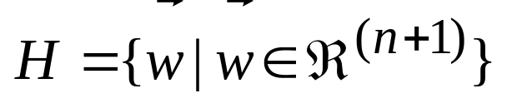
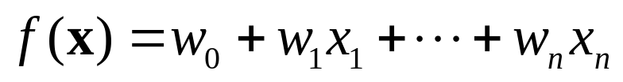
Hypothesis Space of Perceptrons
Free parameters: weights (and thresholds)
Learning: choosing values for the weights
Hypotheses space of perceptron learning
  n: input vector의 차수
  Linear function

Slide 17
Perceptrons and Decision Hyperplanes
Perceptron represents a hyperplane decision surface in the n-dimensional space of instances (i.e. points).
The perceptron outputs 1 for instances lying on one side of the hyperplane and outputs -1 for instances lying on the other side.
Equation for the decision hyperplane: wx = 0.
Some sets of positive and negative examples cannot be separated by any hyperplane
Perceptron can not learn a linearly nonseparable problem.

Slide 18
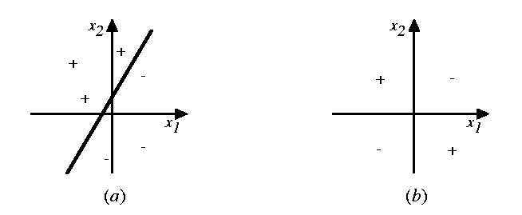
Linearly Separable v.s. Linearly Nonseparable
(a) Decision surface for a linearly separable set of examples (correctly classified by a straight line)
(b) A set of training examples that is not linearly separable.

Slide 19
Representational Power of Perceptrons
A single perceptron can be used to represent many boolean functions.
  AND function: w₀ = -0.8, w₁ = w₂ = 0.5
  OR function: w₀ = -0.3, w₁ = w₂ = 0.5
Perceptrons can represent all of the primitive boolean functions AND, OR, NAND, and NOR.
  Note: Some boolean functions cannot be represented by a single perceptron (e.g. XOR). Why not?
Every boolean function can be represented by some network of perceptrons only two levels deep. How?
  One way is to represent the boolean function in DNF form (OR of ANDs).

Slide 20
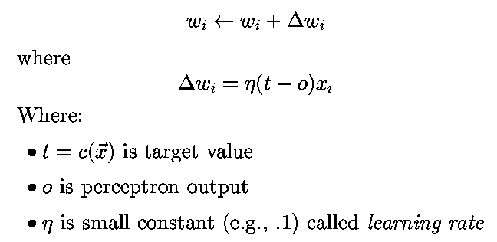
Perceptron Training Rule
Note: output value o is +1 or -1 (not a real)
Perceptron rule: a learning rule for a threshold unit.
Conditions for convergence
  Training examples are linearly separable.
  Learning rate is sufficiently small.

Slide 21
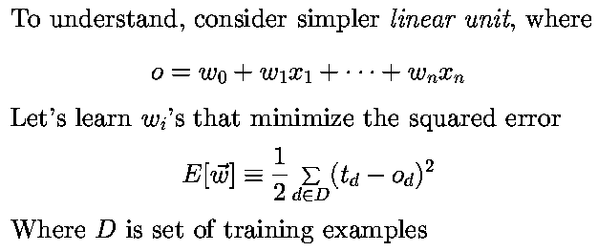
Least Mean Square (LMS) Error
Note: output value o is a real value (not binary)
Delta rule: learning rule for an unthresholded perceptron (i.e. linear unit).
  Delta rule is a gradient-descent rule.

Slide 22
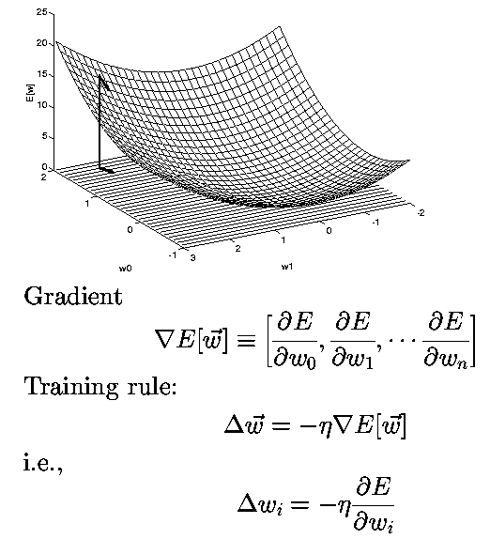
Gradient Descent Method

Slide 23
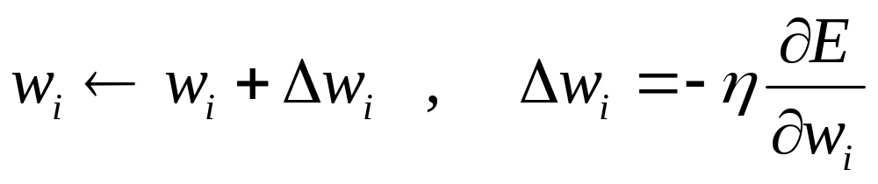
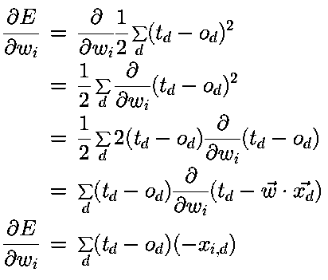
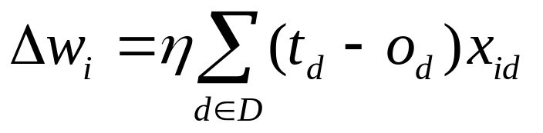
Delta Rule for Error Minimization

Slide 24
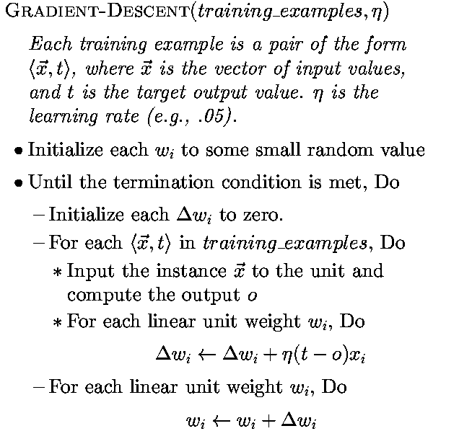
Gradient Descent Algorithm for Perceptron Learning

Slide 25
Properties of Gradient Descent
Because the error surface contains only a single global minimum, the gradient descent algorithm will converge to a weight vector with minimum error, regardless of whether the training examples are linearly separable.
  Condition: a sufficiently small learning rate
If the learning rate is too large, the gradient descent search may overstep the minimum in the error surface.
  A solution: gradually reduce the learning rate value.

Slide 26
Conditions for Gradient Descent
Gradient descent is an important general strategy for searching through a large or infinite hypothesis space.
Conditions for gradient descent search
  The hypothesis space contains continuously parameterized hypotheses (e.g., the weights in a linear unit).
  The error can be differentiated w.r.t. these hypothesis parameters.

Slide 27
Difficulties with Gradient Descent
Converging to a local minimum can sometimes be quite slow (many thousands of gradient descent steps).
If there are multiple local minima in the error surface, then there is no guarantee that the procedure will find the global minimum.

Slide 28
Perceptron Rule v.s. Delta Rule
Perceptron rule
  Thresholded output
  Converges after a finite number of iterations to a hypothesis that perfectly classifies the training data, provided the training examples are linearly separable.
  linearly separable data
Delta rule
  Unthresholded output
  Converges only asymptotically toward the error minimum, possibly requiring unbounded time, but converges regardless of whether the training data are linearly separable.
  Linearly nonseparable data

Slide 29
Multilayer Perceptron

Slide 30
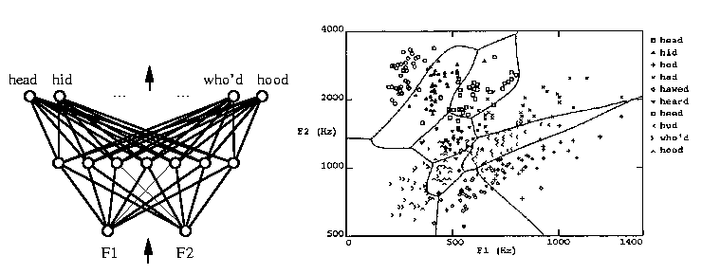
Multilayer Networks and its Decision Boundaries
Decision regions of a multilayer feedforward network.
The network was trained to recognize 1 of 10 vowel sounds occurring in the context “h_d”
The network input consists of two parameter, F1 and F2, obtained from a spectral analysis of the sound.
The 10 network outputs correspond to the 10 possible vowel sounds.

Slide 31
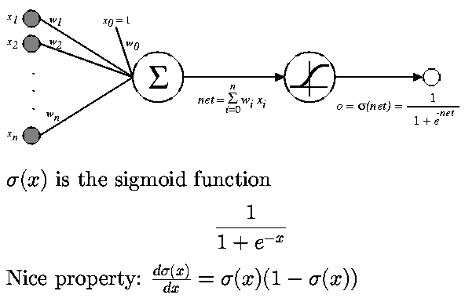
Differentiable Threshold Unit
Sigmoid function: nonlinear, differentiable

Slide 32
Backpropagation (BP) Algorithm
BP learns the weights for a multilayer network, given a network with a fixed set of units and interconnections.
BP employs gradient descent to attempt to minimize the squared error between the network output values and the target values for these outputs.
Two stage learning
  forward stage: calculate outputs given input pattern x.
  backward stage: update weights by calculating delta.

Slide 33
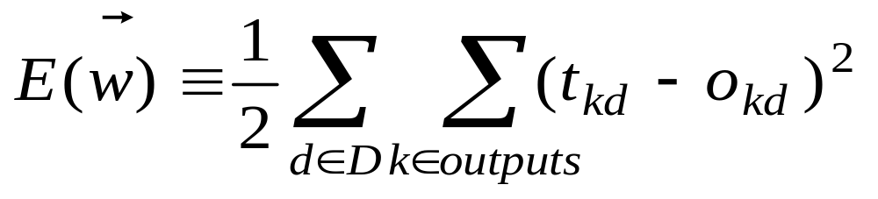
Error Function for BP
E defined as a sum of the squared errors over all the output units k for all the training examples d.
Error surface can have multiple local minima
  Guarantee toward some local minimum
  No guarantee to the global minimum

Slide 34
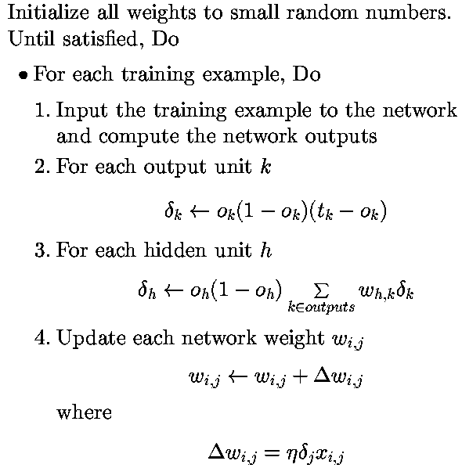
Backpropagation Algorithm for MLP

Slide 35
Termination Conditions for BP
The weight update loop may be iterated thousands of times in a typical application.
The choice of termination condition is important because
  Too few iterations can fail to reduce error sufficiently.
  Too many iterations can lead to overfitting the training data.
Termination Criteria
  After a fixed number of iterations (epochs)
  Once the error falls below some threshold
  Once the validation error meets some criterion

Slide 36
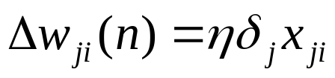
Adding Momentum
Original weight update rule for BP:
Adding momentum α
  Help to escape a small local minima in the error surface.
  Speed up the convergence.

Slide 37
Derivation of the BP Rule
Notations
  x_{ij} : the ith input to unit j
  w_{ij} : the weight associated with the ith input to unit j
  net_{j} : the weighted sum of inputs for unit j
  o_{j} : the output computed by unit j
  t_{j} : the target output for unit j
  σ : the sigmoid function
  outputs : the set of units in the final layer of the network
  Downstream(j) : the set of units whose immediate inputs include the output of unit j

Slide 38
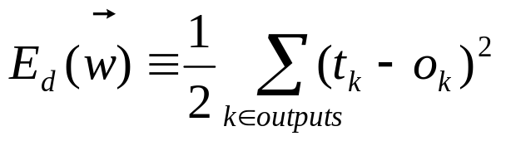
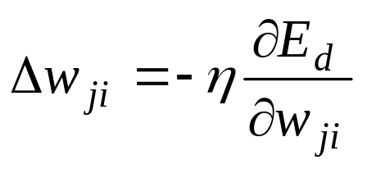
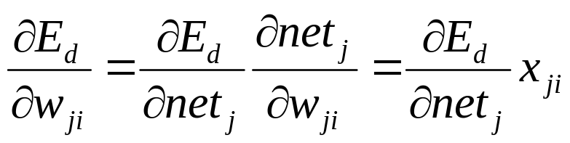
Derivation of the BP Rule
Error measure:
Gradient descent:
Chain rule:

Slide 39
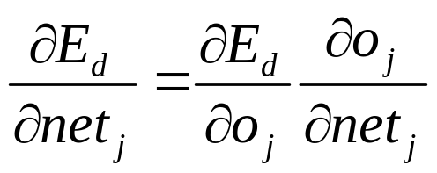
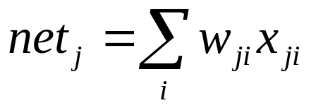
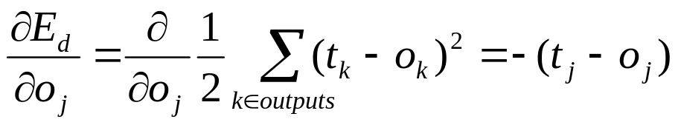
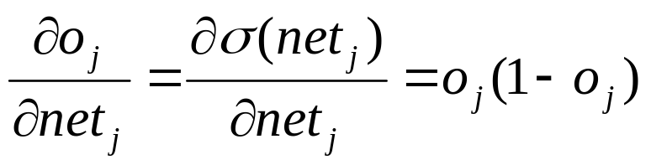
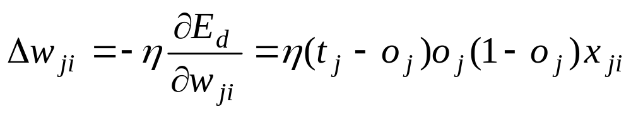
Case 1: Rule for Output Unit Weights
Step 1:
Step 2:
Step 3:
All together:

Slide 40
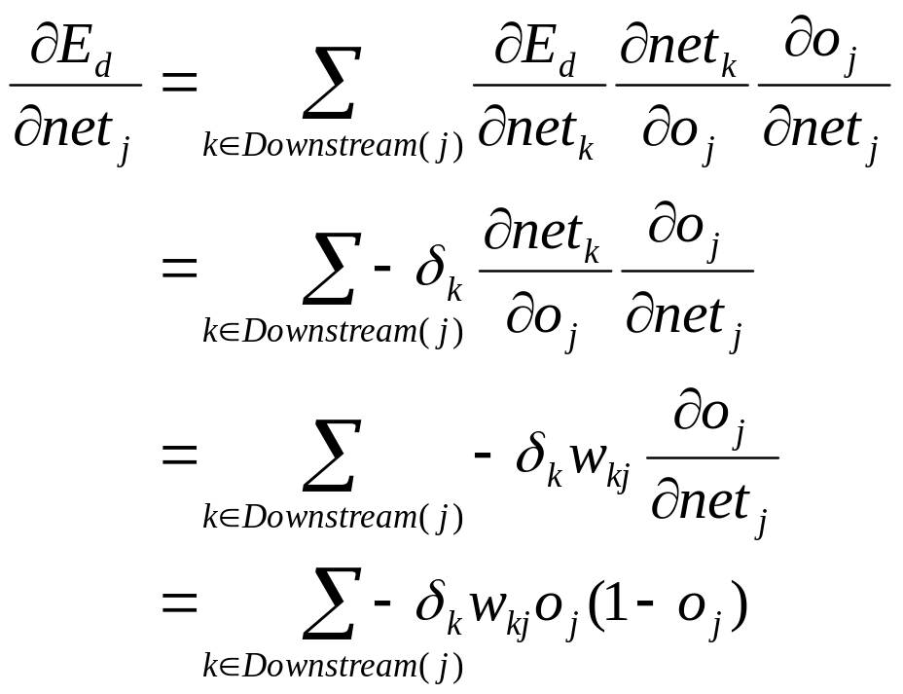
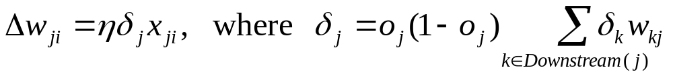
Case 2: Rule for Hidden Unit Weights
Step 1:
Thus:

Slide 41
BP for MLP: revisited

Slide 42
Convergence and Local Minima
The error surface for multilayer networks may contain many different local minima.
BP guarantees to converge local minima only.
BP is a highly effective function approximator in practice.
  The local minima problem found to be not severe in many applications.
Notes
  Gradient descent over the complex error surfaces represented by ANNs is still poorly understood
  No methods are known to predict certainly when local minima will cause difficulties.
  We can use only heuristics for avoiding local minima.

Slide 43
Heuristics for Alleviating the Local Minima Problem
Add a momentum term to the weight-update rule.
Use stochastic descent rather than true gradient descent.
  Descend a different error surface for each example.
Train multiple networks using the same data, but initializing each network with different random weights.
  Select the best network w.r.t the validation set
  Make a committee of networks

Slide 44
Why BP Works in Practice?
A Possible Senario
Weights are initialized to values near zero.
Early gradient descent steps will represent a very smooth function (approximately linear). Why?
  The sigmoid function is almost linear when the total input (weighted sum of inputs to a sigmoid unit) is near 0.
The weights gradually move close to the global minimum.
As weights grow in a later stage of learning, they represent highly nonlinear network functions.
Gradient steps in this later stage move toward local minima in this region, which is acceptable.

Slide 45
Representational Power of MLP
Every boolean function can be represented exactly by some network with two layers of units. How?
  Note: The number of hidden units required may grow exponentially with the number of network inputs.
Every bounded continuous function can be approximated with arbitrarily small error by a network of two layers of units.
  Sigmoid hidden units, linear output units
  How many hidden units?

Slide 46
NNs as Universal Function Approximators
Any function can be approximated to arbitrary accuracy by a network with three layers of units (Cybenko 1988).
  Sigmoid units at two hidden layers
  Linear units at the output layer
  Any function can be approximated by a linear combination of many localized functions having 0 everywhere except for some small region.
  Two layers of sigmoid units are sufficient to produce good approximations.

Slide 47
BP Compared with CE & ID3
For BP, every possible assignment of network weights represents a syntactically distinct hypothesis.
  The hypothesis space is the n-dimensional Euclidean space of the n network weights.
Hypothesis space is continuous
  The hypothesis space of CE and ID3 is discrete.
Differentiable
  Provides a useful structure for gradient search.
  This structure is quite different from the general-to-specific ordering in CE, or the simple-to-complex ordering in ID3 or C4.5.

Slide 48
Hidden Layer Representations
BP has an ability to discover useful intermediate representations at the hidden unit layers inside the networks which capture properties of the input spaces that are most relevant to learning the target function.
When more layers of units are used in the network, more complex features can be invented.
But the representations of the hidden layers are very hard to understand for human.

Slide 49
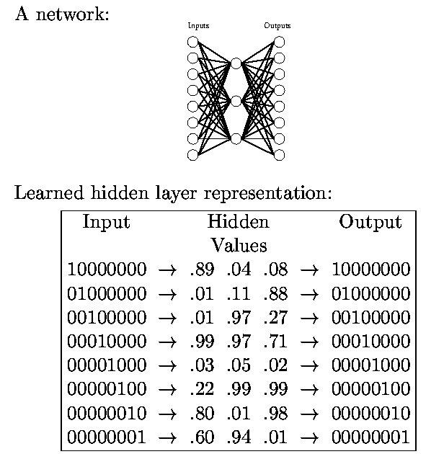
Hidden Layer Representation for Identity Function

Slide 50
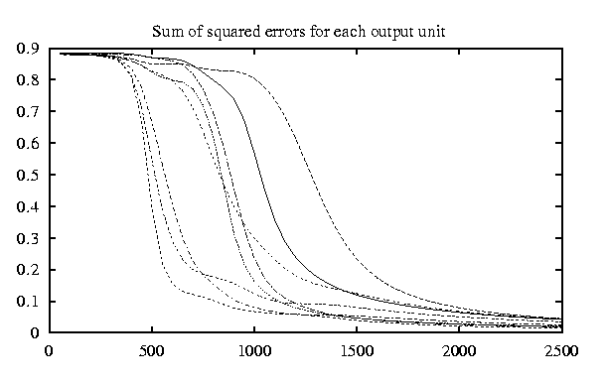
Hidden Layer Representation for Identity Function
The evolving sum of squared errors for each of the eight
output units as the number of training iterations (epochs)
increase

Slide 51
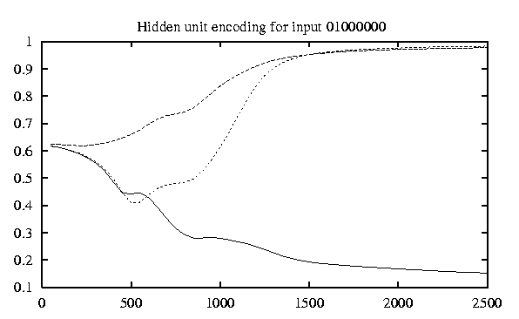
Hidden Layer Representation for Identity Function
The evolving hidden layer representation for the
input string “01000000”

Slide 52
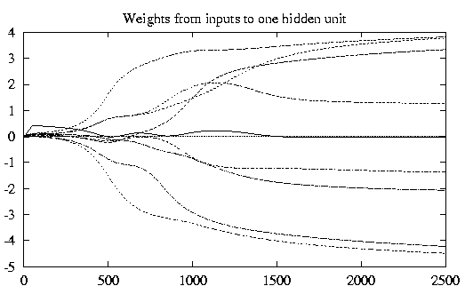
Hidden Layer Representation for Identity Function
The evolving weights for one of the three hidden units

Slide 53
Generalization and Overfitting
Continuing training until the training error falls below some predetermined threshold is a poor strategy since BP is susceptible to overfitting.
  Need to measure the generalization accuracy over a validation set (distinct from the training set).
Two different types of overffiting
  Generalization error first decreases, then increases, even the training error continues to decrease.
  Generalization error decreases, then increases, then decreases again, while the training error continues to decreases.

Slide 54
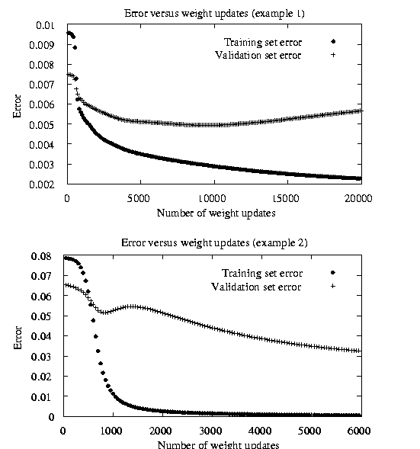
Two Kinds of Overfitting Phenomena

Slide 55
Techniques for Overcoming the Overfitting Problem
Weight decay
  Decrease each weight by some small factor during each iteration.
  This is equivalent to modifying the definition of E to include a penalty term corresponding to the total magnitude of the network weights.
  The motivation for the approach is to keep weight values small, to bias learning against complex decision surfaces.
k-fold cross-validation
  Cross validation is performed k different times, each time using a different partitioning of the data into training and validation sets
  The result are averaged after k times cross validation.

Slide 56
Designing an Artificial Neural Network for Face Recognition Application

Slide 57
Problem Definition
Possible learning tasks
  Classifying camera images of faces of people in various poses.
  Direction, Identity, Gender, ...
Data:
  624 grayscale images for 20 different people
  32 images per person, varying
    person’s expression (happy, sad, angry, neutral)
    direction (left, right, straight ahead, up)
    with and without sunglasses
  resolution of images: 120 x128, each pixel with a grayscale intensity between 0 (black) and 255 (white)
Task: Learning the direction in which the person is facing.

Slide 58
Factors for ANN Design in the Face Recognition Task
Input encoding
Output encoding
Network graph structure
Other learning algorithm parameters

Slide 59
Input Coding for Face Recognition
Possible Solutions
  Extract key features using preprocessing
  Coarse-resolution
Features extraction
  edges, regions of uniform intensity, other local image features
  Defect: High preprocessing cost, variable number of features
Coarse-resolution
  Encode the image as a fixed set of 30 x 32 pixel intensity values, with one network input per pixel.
  The 30x32 pixel image is a coarse resolution summary of the original 120x128 pixel image
  Coarse-resolution reduces the number of inputs and weights to a much more manageable size, thereby reducing computational demands.

Slide 60
Output Coding for Face Recognition
Possible coding schemes
  Using one output unit with multiple threshold values
  Using multiple output units with single threshold value.
One unit scheme
  Assign 0.2, 0.4, 0.6, 0.8 to encode four-way classification.
Multiple units scheme (1-of-n output encoding)
  Use four distinct output units
  Each unit represents one of the four possible face directions, with highest-valued output taken as the network prediction

Slide 61
Output Coding for Face Recognition
Advantages of 1-of-n output encoding scheme
  It provides more degrees of freedom to the network for representing the target function.
  The difference between the highest-valued output and the second-highest can be used as a measure of the confidence in the network prediction.
Target value for the output units in 1-of-n encoding scheme
  < 1, 0, 0, 0 > v.s. < 0.9, 0.1, 0.1, 0.1 >
  < 1, 0, 0, 0 >: will force the weights to grow without bound.
  < 0.9, 0.1, 0.1, 0.1 >: the network will have finite weights.

Slide 62
Network Structure for Face Recognition
One hidden layer v.s. more hidden layers
How many hidden nodes is used?
  Using 3 hidden units:
    test accuracy for the face data = 90%
    Training time = 5 min on Sun Sprac 5
  Using 30 hidden units:
    test accuracy for the face data = 91.5%
    Training time = 1 hour on Sun Sparc 5

Slide 63
Other Parameters for Face Recognition
Learning rate η = 0.3
Momentum α = 0.3
Weight initialization: small random values near 0
Number of iterations: Cross validation
  After every 50 iterations, the performance of the network was evaluated over the validation set.
  The final selected network is the one with the highest accuracy over the validation set

Slide 64
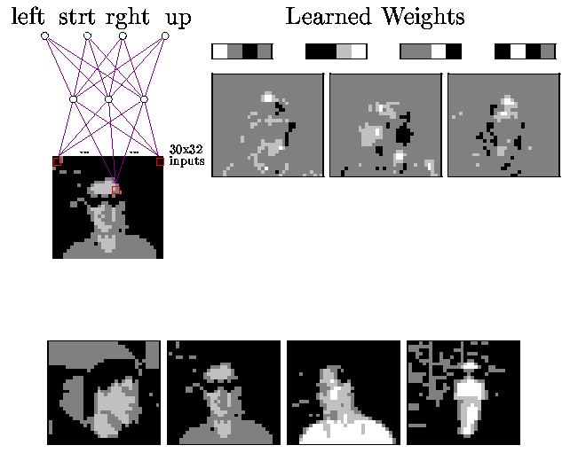
ANN for Face Recognition
960 x 3 x 4 network is trained on gray-level images of faces to predict whether a person is looking to their left, right, ahead, or up.

