Slide 1
Artificial Intelligence
Chapter 14
Resolution in the Propositional Calculus
Biointelligence Lab
School of Computer Sci. & Eng.
Seoul National University

Slide 2
Outline
A New Rule of Inference: Resolution
Converting Arbitrary wffs to Conjunctions of Clauses
Resolution Refutations
Resolution Refutation Search Strategies
Horn Clauses

Slide 3
14.1 A New Rule of Inference: Resolution
Literal: either an atom (positive literal) or the negation of an atom (negative literal).
Ex: The clause {P, Q, ¬R}is wff
(equivalent to P ∨ Q ∨ ¬R)
Ex: Empty clause {} is equivalent to F

Slide 4
14.1.2 Resolution on Clauses
From {λ} ∪ Σ₁ and {¬λ} ∪ Σ₂
We can infer Σ₁ ∪ Σ₂
  called the resolvent of the two clauses
  this process is called resolution
Examples
  R ∨ P and ¬P ∨ Q ⇒ R ∨ Q : chaining
  R and ¬R ∨ P ⇒ P : modus ponens
  Chaining and modus ponens is a special case of resolution
  P ∨ Q ∨ R ∨ S with ¬P ∨ Q ∨ W on P ⇒ Q ∨ R ∨ S ∨ W

Slide 5
14.1.2 Resolution on Clauses (Cont’d)
  P ∨ Q ∨ ¬R and P ∨ W ∨ ¬Q ∨ R
    Resolving them on Q: P ∨ ¬R ∨ R ∨ W
    Resolving them on R: P ∨ ¬Q ∨ Q ∨ W
    Since ¬R ∨ R and ¬Q ∨ Q are True, the value of each of these resolvents is True.
    We must resolve either on Q or on R.
    P ∨ W is not a resolvent of two clauses.

Slide 6
14.1.3 Soundness of Resolution
To show soundness of an inference rule R,
  Show that Δㅏ_{R}w implies Δㅑw.
Since {λ} ∪ Σ₁ and {¬λ} ∪ Σ₂ ㅏ_{res} Σ₁ ∪ Σ₂,
  Show {λ} ∪ Σ₁ and {¬λ} ∪ Σ₂ both have true, Σ₁ ∪ Σ₂ is true.
Proof: reasoning by cases
  Case 1
    If λ is True, Σ₂ must True in order for {¬λ}∪ Σ₂ to be True.
  Case 2
    If λ is False, Σ₁ must True in order for {λ}∪ Σ₁ to be True.
  Either Σ₁ or Σ₂ must have value True.
  Σ₁ ∪ Σ₂ has value True.

Slide 7
14.2 Converting Arbitrary wffs to Conjunctions of Clauses (CNF)
Any wff in propositional calculus can be converted to an equivalent CNF.
Ex: ¬(P ⊃ Q) ∨ (R ⊃ P)
  ¬(¬P ∨ Q) ∨ (¬R ∨ P) Equivalent Form Using ∨
  (P ∧ ¬Q) ∨ (¬R ∨ P) DeMorgan
  (P ∨ ¬Q ∨ P) ∧ (¬Q ∨ ¬R ∨ P) Distributive Rule
  (P ∨ ¬R) ∧ (¬Q ∨ ¬R ∨ P) Associative Rule
Usually expressed as {(P ∨ ¬R), (¬Q ∨ ¬R ∨ P)}

Slide 8
14.3 Resolution Refutations
Resolution is not complete.
  For example, P ∧ R ㅑ P ∨ R
  We cannot infer P ∨ R using resolution on the set of clauses {P, R} (because there is nothing that can be resolved)
We cannot use resolution directly to decide all logical entailments.

Slide 9
Proof by Contradiction
Reductio by absurdum
  If the set Δ has a model but Δ ∪ {¬w} does not, then Δㅑw.
If we can show that Δ∪{¬w}ㅏ_{res}{} (equivalent to F), then Δㅑw.

Slide 10
Resolution Refutation Procedure
Convert the wffs in Δ to clause form, i.e. a (conjunctive) set of clauses.
Convert the negation of the wff to be proved, ω, to clause form.
Combine the clauses resulting from steps 1 and 2 into a single set, Γ.
Iteratively apply resolution to the clauses in Γ and add the results to Γ either until there are no more resolvents that can be added or until the empty clause is produced.

Slide 11
Completeness of Resolution Refutation
Completeness of resolution refutation
  The empty clause will be produced by the resolution refutation procedure if Δ ㅑ ω.
  Thus, we say that propositional resolution is refutation complete.
Decidability of propositional calculus by resolution refutation
  If Δ is a finite set of clauses and if Δ ㅑ ω,
  Then the resolution refutation procedure will terminate without producing the empty clause.

Slide 12
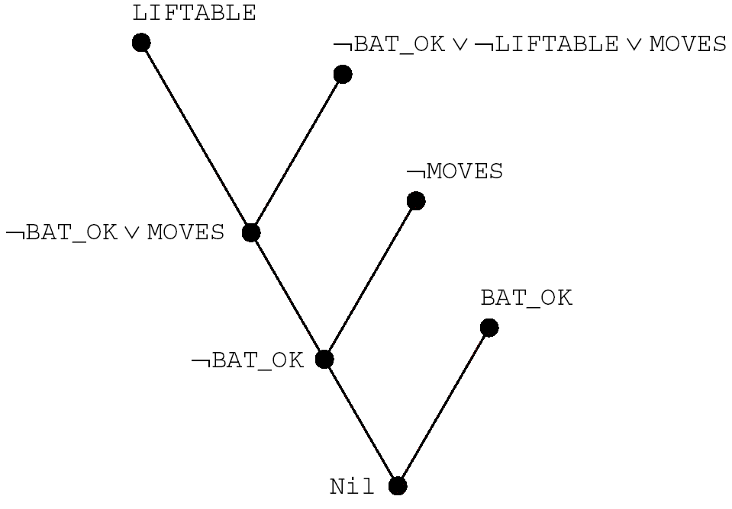
A Resolution Refutation Tree
Given:
1. BAT_OK
2. ¬MOVES
3. BAT_OK ∧ LIFTABLE
⊃ MOVES
Clause form of 3:
4. ¬BAT_OK ∨ ¬LIFTABLE
∨ MOVES
Negation of goal:
5. LIFTABLE
Perform resolution:
6. ¬BAT_OK ∨ MOVES
(from resolving 5 with 4)
7. ¬BAT_OK (from 6, 2)
8. Nil (from 7, 1)
Figure 14.1 A Resolution Refutation Tree

Slide 13
14.4 Resolution Refutations Search Strategies
Ordering strategies
  Which resolutions should be performed first?
  Breadth-first strategy
  Depth-first strategy
    with a depth bound, use backtracking.
  Unit-preference strategy
    prefer resolutions in which at least one clause is a unit clause.
Refinement strategies
  Set of support
  Linear input
  Ancestry filtering

Slide 14
Refinement Strategies
Permit only certain kinds of resolutions to take place at all.
Set of support strategy
  Allows only those resolutions in which one of the clauses being resolved is in the set of support, i.e., those clauses that are either clauses coming from the negation of the theorem to be proved or descendants of those clauses.
  Refutation complete
Linear input strategy
  at least one of the clauses being resolved is a member of the original set of clauses.
  Not refutation complete
Ancestry filtering strategy
  at least one member of the clauses being resolved either is a member of the original set of clauses or is an ancestor of the other clause being resolved.
  Refutation complete

Slide 15
14.5 Horn Clauses
A Horn clause: a clause that has at most one positive literal.
Ex: P, ¬P ∨ Q, ¬P ∨ ¬Q ∨ R, ¬P ∨ ¬R
Three types of Horn clauses.
  A single atom: called a “fact”
  An implication: called a “rule”
  A set of negative literals: called “goal”
There are linear-time deduction algorithms for propositional Horn clauses.

