Slide 1
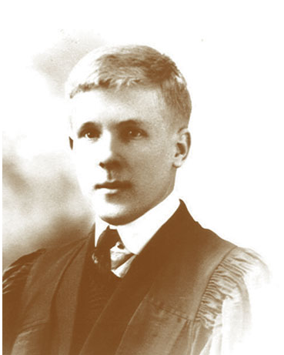
A transition to modern: Hebb
YI, SeongBae

Slide 2
Questions
What is the main idea of Hebb’s theory if we say in a easy way?
Why it is important to repeat to learn something?
What is the difference between Hebb and other behaviorists?

Slide 3
Contents
Hebb’s Neurophysiological Assumptions
Hebb’s rule
Habituation and Sensitization
Hebb’s contribution

Slide 4
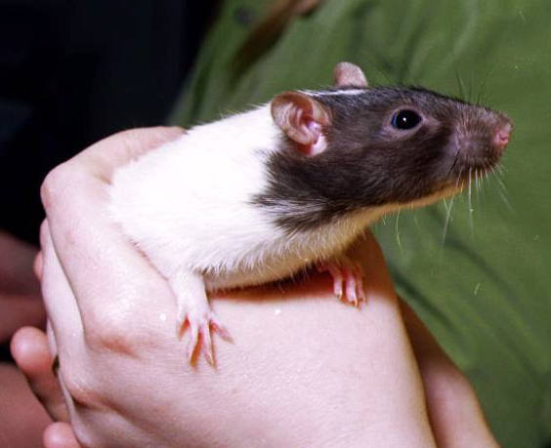
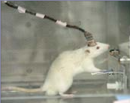
Hebb’s experiment
He found that His pet is smarter than others in lab.
In repeated experiment, a rat with more abundant stimulus(in more active environment), it has more enlarged synapse
The enlarged area of a brain consumes more energy than others
It means that more active areas of the brain form more synase associations and links

Slide 5
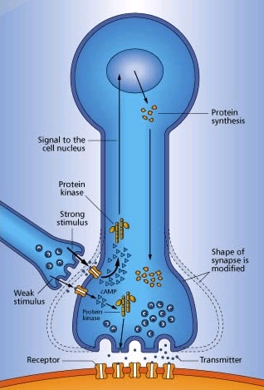
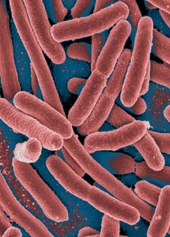
Hebb’s Neurophysiological Assumptions (Hebb’s rule)
Repeated transmission of impulses between two cells leads to permanent facilitation of transmission between these cells.
Espescially, repeated strong stimulus often makes neurons enlarged, and the amout of released transmitters increases significantly
P. aurelia, a unicellular animal, can be also trained. Todd Hennessey gave them electric shocks + siren repeatedly, and they ran away only with the siren. A bacterium also can be trained. Bacteria and neurons are a kinds of protien

Slide 6

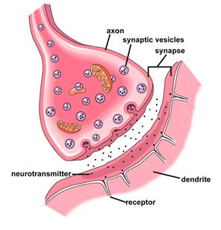
Hebb’s Neurophysiological Assumptions (cell asembly)
Neural cells may be reactivated repeatedly because of their own activity
The circuit of firing is called a cell asembly
Neuron
synapse
Cell assembly

Slide 7
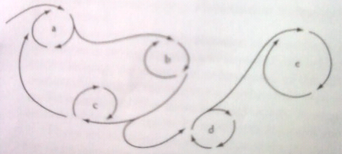
Hebb’s Neurophysiological Assumptions (phase sequence)
If a number of related cell assemblies are simultaneously active, they will become linked in phase sequence
We can think that each cell assembly corresponds to a simple sensory input, while a phase sequence corresponds to more complex action, for example, a recognition
Small circuits are cell assemblies which form more complex circuit, phase sequences

Slide 8
Hebb’s rule
If input from neuron A contributes often enough to firing of neuron B, then the synapse form A to B will change and become stronger
A
B
A
B
A
B
The connections become stronger and more active
In large scale, the repetition of the same sensory event leads to the same pattern of neural firing and, eventually, to the formation of associated assemblies of cells.

Slide 9

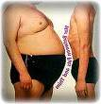

Hebb’s rule (cont.)
In other words, repetition of simulation, that is learning, leads to repeated activation of the same sets of neurons and to the eventual formation of cell assemblies and phase sequences
It explains - why we must repeat when study, why it is important to have a good habit when young, or why it is so hard to change a habit
Learning reoganize brain, brain reoganize character

Slide 10





Habituation and Sensitization
In experiments on aplysia, it quickly habituates to repeated light touches and stops responding. Habituation is clear evidence that something has been learned
But repeated stimulation does not always lead to habituation. If we use electric shocks, the aplysia’s siphon may cause instant and very decided retraction
Neurologically, sensitization leads to long-term potentiation(LTP)-a lasting increase in the responsiveness of neurons
In contrast, habituation leads to long-term depression (LTD)-a lasting decline in the responsiveness of relevant neurons.
zzz
IF
Habituation
IF
Sensitization

Slide 11
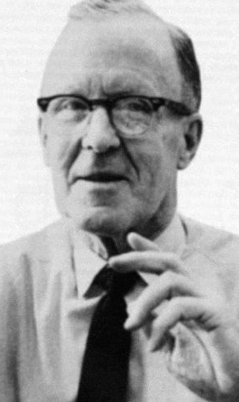
Hebb’s contribution
He focused on higher mental processes rather than traditional S-R theories
He brought a consideration of phsiological mechanisms back into the study of learning and behavior
The idea, that learning change the physical structure of the brain, acts as the basic assumption of neuroscience
Some of his thought are used as the basis of a neural network model (Chapter 8)

Slide 12
Questions and Answers
What is the main idea of Hebb’s theory if we say in a easy way?
  Learning can reoganize the brain (enlarged synpase, faster firing, neuron associations)
Why it is important to repeat to learn something?
  Repeated stimulus and response make related phase sequences function more efficiently
What is the difference between Hebb and other behaviorists?
  He focused on higher mental processes rather than traditional S-R theories
  He did not analyze behavior at a molecular level(reductionist) but did at a molar perspective, he assumed that behavior could be understood as a whole

Slide 13
Thank you

