Slide 1
Artificial Intelligence Chapter 22.
22. Planning

Slide 2
22.1 STRIPS Planning Systems

Slide 3
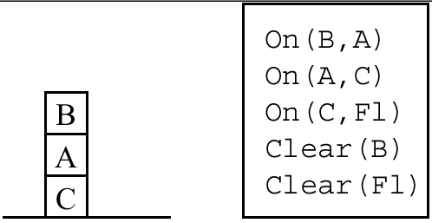
Describing States and Goals
Frame problem (planning of agent actions) ← state space + situation-calculus approaches
Planning states and world states
  planning states: data structure that can be changed in ways corresponding to agent actions – state description
  world states: fixed states

Slide 4
Search process to a goal
Goal wff γ and variables (x1, x2, …, xn)
  goal wffs of the form (∃x1, x2, …, xn)γ (x1, x2, …, xn) is written as γ (x1, x2, …, xn).
Assumption
  existential quantification of all of the variables.
  the form of a goal is a conjunction of literals
Search methods
  attempt to find a sequence of actions that produces a world state described by some state description S, such that S|= γ
    state description satisfies the goal
  substitution σ exists such that σγ is a conjunction of ground literals.
  Forward search methods and Backward search methods

Slide 5
Forward Search Methods (1)
Actions ⬅ Operators
  based on STRIPS system operator
  before-action, after-action state descriptions
A STRIPS operator consists of:
  1. A set, PC, of ground literals called the preconditions of the operator. An action corresponding to an operator can be executed in a state only if all of the literals in PC are also in the before-action state description.
  2. A set, D, of ground literals called the delete list.
  3. A set, A, of ground literals called the add list.

Slide 6
STRIPS operators
STRIPS assumption
  when we delete from the before-action state description any literals in D and add all of the literals in A, all literals not mentioned in D carry over to the after-action state description.
STRIPS rule (an operator schema)
  has free variables and ground instances (actual operators) of these rules
  example)
move(x,y,z)
PC: On(x,y)ΛClear(x)ΛClear(z)
D: Clear(z),On(x,y)
A: On(x,z),Clear(y),Clear(F1)

Slide 7
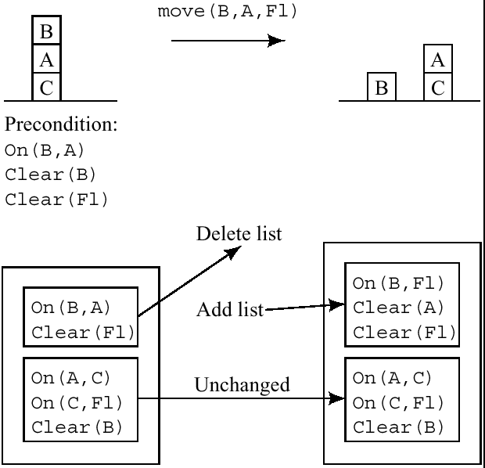
Figure 22.2 The application of a STRIPS operator

Slide 8
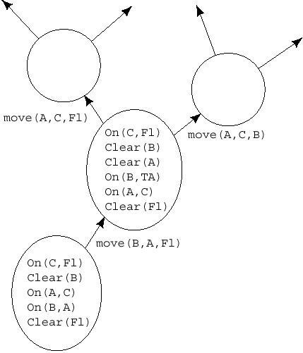
Forward Search Methods (2)
General description of this method
  Generate new state descriptions by applying instances of STRIPS rules until a state description is produced that satisfies the goal wff.
  One heuristic: identifying and exploiting islands toward which to focus search
    make forward search more efficient
Figure 22.3. part of a search graph
generated by forward search

Slide 9
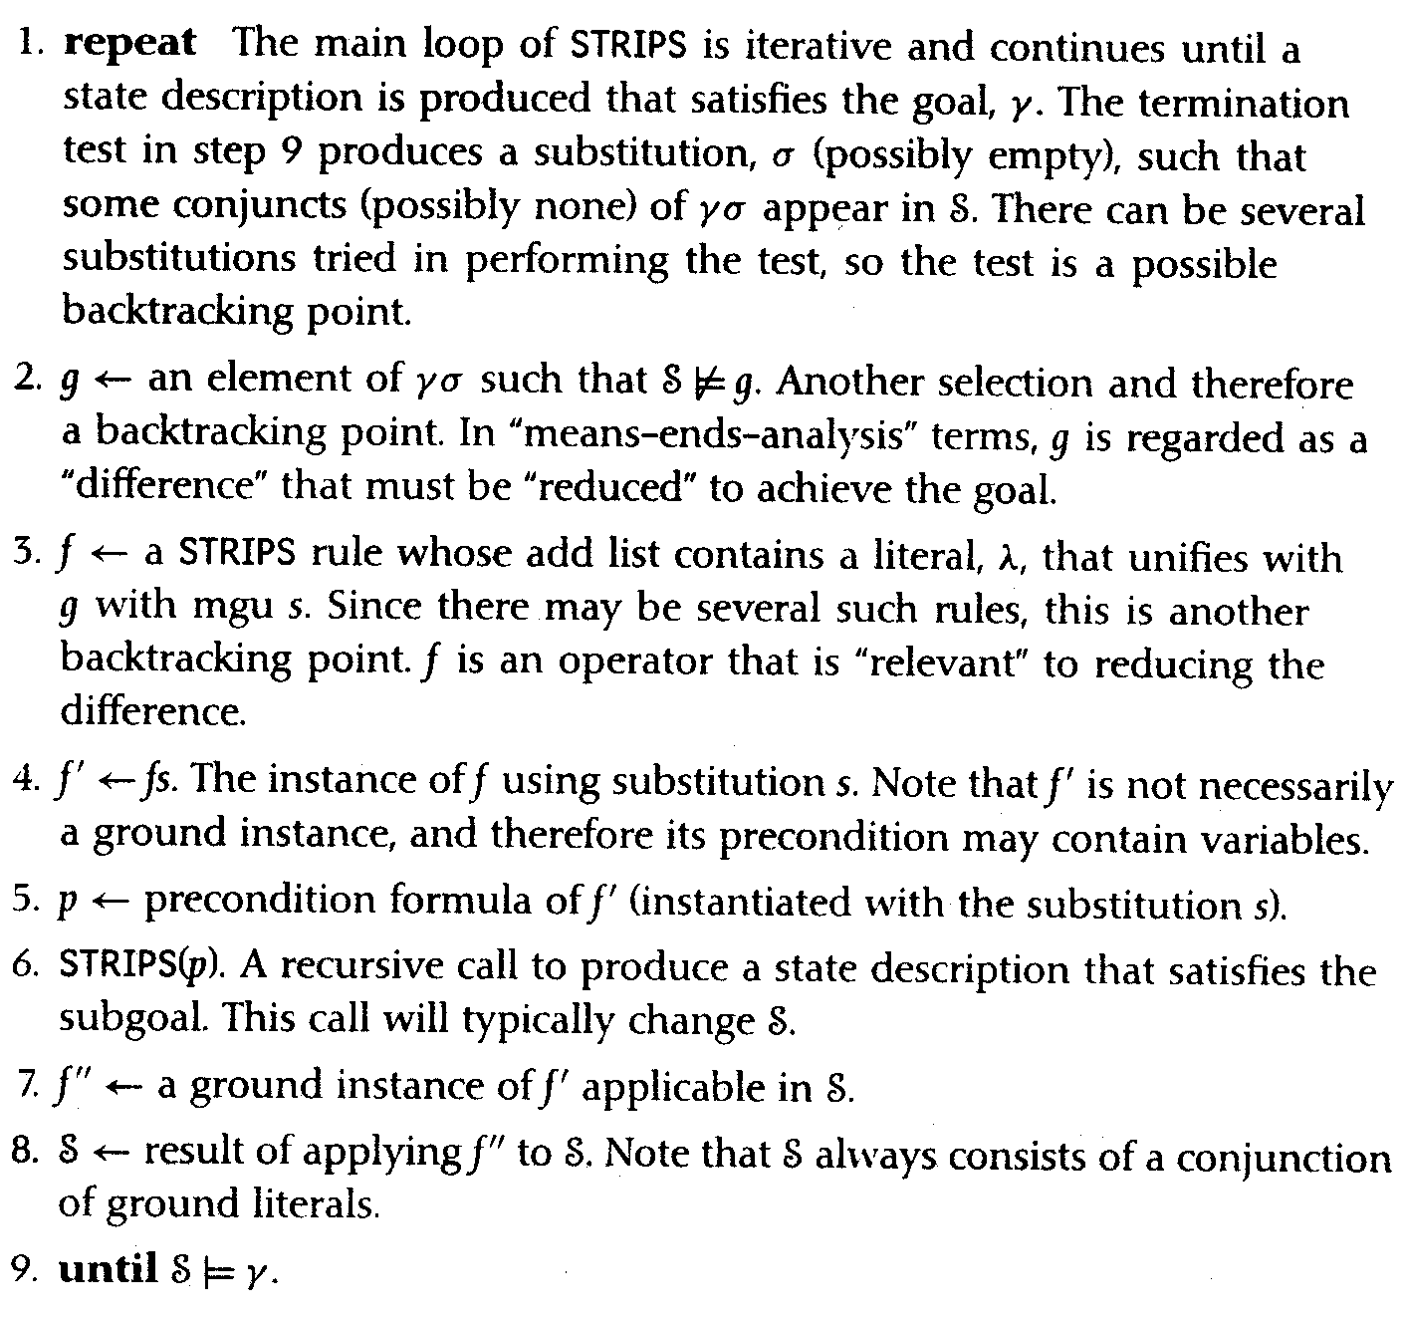
Recursive STRIPS
Divide-and-conquer: a heuristic in forward search
  divide the search space into islands
    islands: a state description in which one of the conjuncts is satisfied
    STRIPS(γ): a procedure to solve a conjunctive goal formula γ.

Slide 10
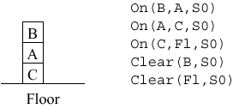
Example of STRIPS(γ) with Fig 21.2 (1)
→ goal: On(A,F1)ΛOn(B,F1)ΛOn(C,B)
The goal test in step 9 does not find any conjuncts satisfied by the initial state description.
Suppose STRIPS selects On(A,F1)as g. The rule instance move(A,x,F1)has On(A,F1)
on its add list, so we call STRIPS recursively to achieve that rule’s precondition, namely,
Clear(A)ΛClear(F1)ΛOn(A,x). The test in step 9 in the recursive call produces the
substitution C/x, which leaves all but Clear(A)satisfied by the initial state. This literal is
selected, and the rule instance move(y,A,u)is selected to achieve it.
We call STRIPS recursively again to achieve the rule’s precondition, namely
Clear(y)ΛClear(u)ΛOn(y,A). The test in step 9 of this second recursive call pro-
duces the substitution B/y, F1/u, which makes each literal in the precondition one that
appears in the initial state. So, we can pop out of this second recursive call to apply an ope-
rator, namely, move(B,A,F1), which changes the initial state to

Slide 11
Example of STRIPS(γ) with Fig 21.2 (2)
On(B,F1)
On(A,C)
On(C,F1)
Clear(A)
Clear(B)
Clear(F1)
Now, back in the first recursive call, we perform again the step 9 test (namely,
Clear(A)ΛClear(F1)ΛOn(A,x). This test is satisfied by our changed state descrip-
tion with the substitution C/x, so we can pop out the first recursive call to apply the oper-
ator move(A,C,F1) to produce a third state description:
On(B,F1)
On(A,C)
On(C,F1)
Clear(A)
Clear(B)
Clear(F1)

Slide 12
Example of STRIPS(γ) with Fig 21.2 (3)
Now we perform the step 9 test in the main program again. The only conjunct in the
original goal that does not appear in the new state description is On(C,B). Recurring
again from the main program, we note that the precondition of move(C,F1,B)is already
satisfied, so we can apply it to produce a state description that satisfy the main goal, and
the process terminates.

Slide 13
Plans with Run-Time Conditionals
Needed when we generalize the kinds of formulas allowed in state descriptions.
e.g. wff On(B,A) V On(B,C)
  branching
    The system does not know which plan is being generated at the time.
    The planning process splits into as many branches as there are disjuncts that might satisfy operator preconditions.
  runtime conditionals
    Then, at run time when the system encounters a split into two or more contexts, perceptual processes determine which of the disjuncts is true.
      e.g. the runtime conditionals here is “know which is true at the time”

Slide 14
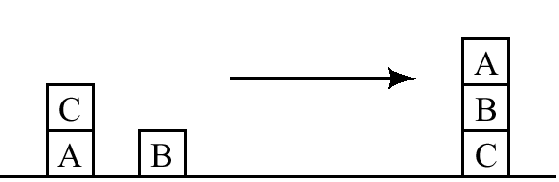
The Sussman Anomaly
e.g.
  STRIPS selection: On(A,B)→On(B,C)→On(A,B)…
Difficult to solve with recursive STRIPS (similar to DFS)
Solution: BFS
  BFS: computationally infeasible
  → “BFS+Backward Search Methods”
goal condition:
On(A,B) Λ On(B,C)
Figure 22.4
A
B
A
A
B
C
B
C
A
B
C
C
A
A
B
C
B
C

Slide 15
Backward Search Methods
General description of this method
  Regress goal wffs through STRIPS rules to produce subgoal wffs.
Regression
  The regression of a formula γ through a STRIPS rule α is the weakest formula γ’ such that if γ’ is satisfied by a state description before applying an instance of α (and γ’ satisfies the precondition of that instance of α), then γ will be satisfied by the state description after applying that instance of α.

Slide 16
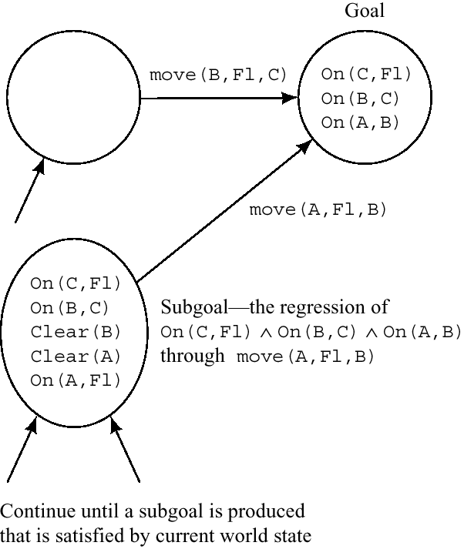
Example of Regressing a Conjunction through a STRIPS Operator (1)
B
A
Problem:
Select any operator, here we choose move(A,F1,B)
  among three conjuncts in the goal state, this operator achieves On(A,B), so On(A,B)needn’t be in the subgoals.
  but any preconditions of the operator not already in the goal description must be in the subgoal (here, Clear(B), Clear(A), On(A,F1)).
  the other conjuncts in the goal wffs (On(C,F1), On(B,C)) must be in the subgoal.
A
B
C
C
alternative
On(C,F1)ΛOn(B,C)ΛOn(A,B)
example here
Figure 22.5

Slide 17
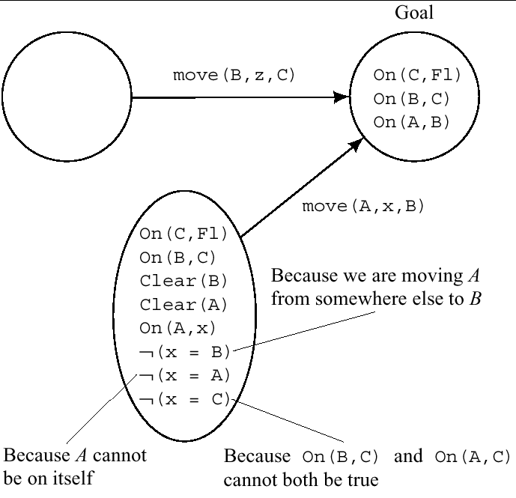
Example of Regressing a Conjunction through a STRIPS Operator (2) – using a variable
Least Commitment Planning using schema variables
restrictions
Figure 22.6

Slide 18
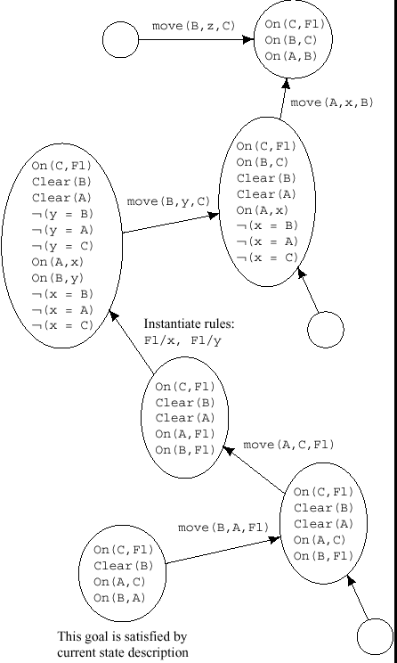
Example of Regressing a Conjunction through a STRIPS Operator (3) – a whole procedure
Efficient but complicated
Cannot know whether this is computationally feasible
Example of Regressing a Conjunction through a STRIPS Operator (3) – a whole procedure

Slide 19
22.2 Plan Spaces and Partial-Order Planning (POP)

Slide 20
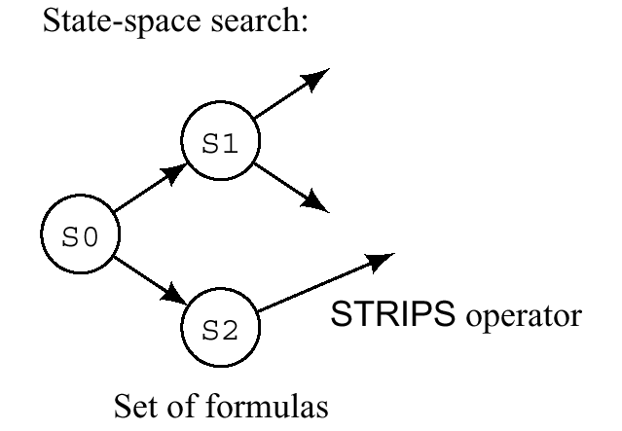
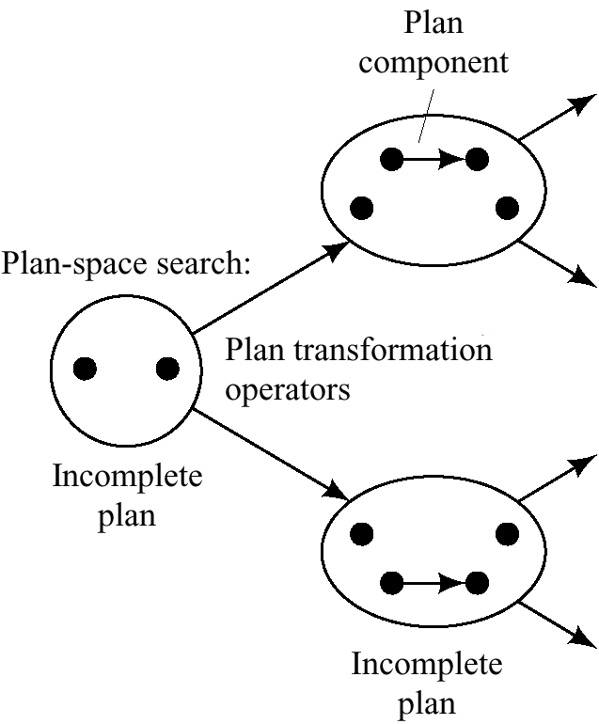
Two Different Approaches to Plan Generation (Figure 22.8)
State-space search: STRIPS rules are applied to sets of formulas to produce successor sets of formulas, until a state description is produced that satisfies the goal formula.
Plan-space search

Slide 21
Plan-space Search
General description of this method
  The successor operators are not STRIPS rules, but are operators that transform incomplete, uninstantiated or otherwise inadequate plans into more highly articulated plans, and so on until an executable plan is produced that transforms the initial state description into one that satisfies the goal condition
Includes
  (a) adding steps to the plan
  (b) reordering the steps already in the plan
  (c) changing a partially ordered plan into a fully ordered one
  (d) changing a plan schema (with uninstantiated variables) into some instance of that schema

Slide 22
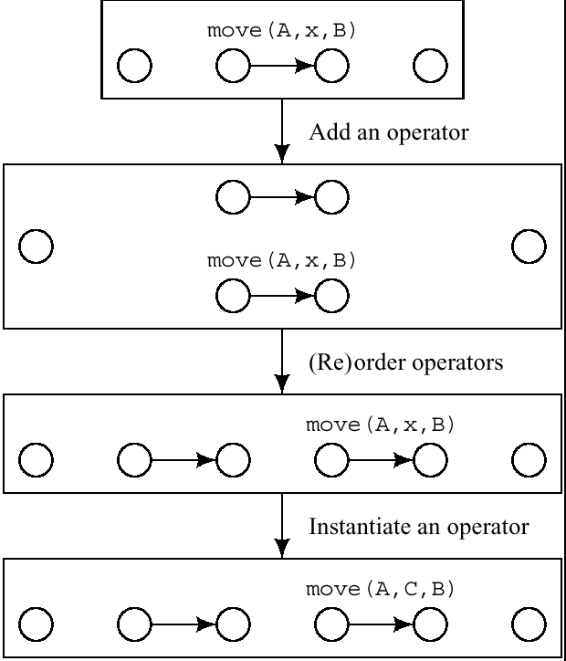
Some Plan-Transforming Operators
Figure 22.9

Slide 23
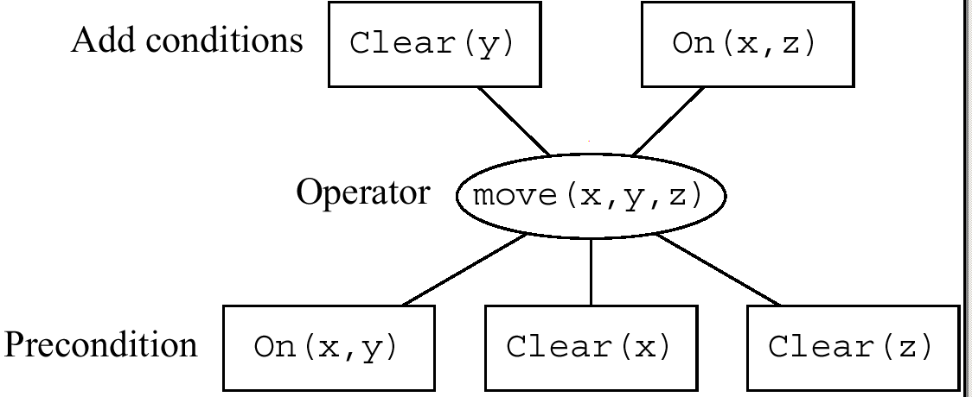
Description of Plan-space Search (1)
- general representation
The basic components of a plan are STRIP rules
: labeled with
precondition and effect
literals of the rules
: results
: labeled with
the name of STRIPS rules
Figure 22.10 Graphical Representation of a STRIP Rule
An example with Figure 22.4
goal condition:
On(A,B) Λ On(B,C)
Figure 22.4

Slide 24
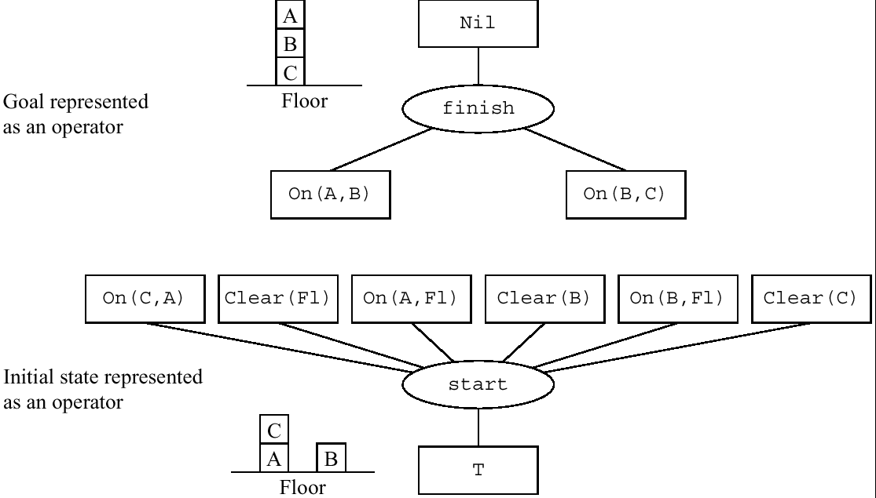
The Initial Plan Structure
-Goal wff and the literals of the initial state
add conditions: Nil
virtual rule
preconditions:
the overall goal
Figure 22.11 Graphical Representations of finish and start Rules

Slide 25
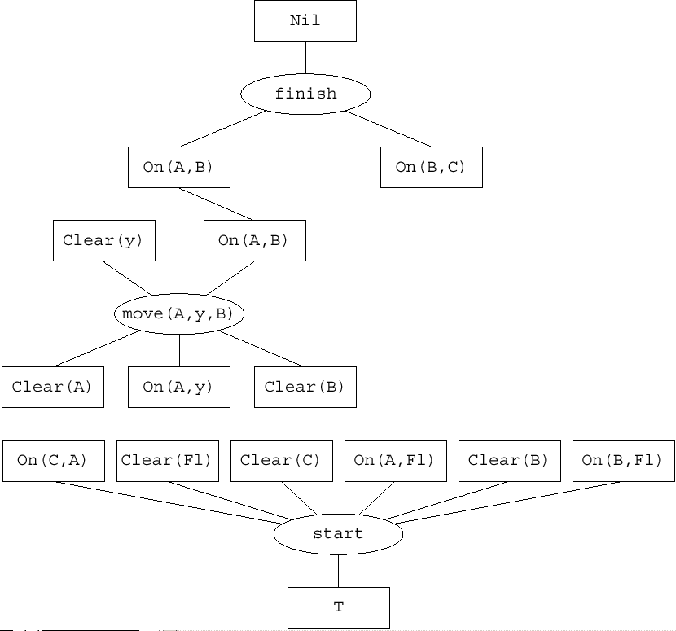
The Next Plan Structure
Suppose we decide to achieve On(A,B)by adding the rule instance move(A,y,B). We add the graph structure for this instance to the initial plan structure. Since we have decided that the addition of this rule is supposed to achieve On(A,B), we link that effect box of the rule with the corresponding precondition box of the finish rule.
Into what y can be instantiated? (here: F1)
Figure 22.12 The Next Plan Structure

Slide 26
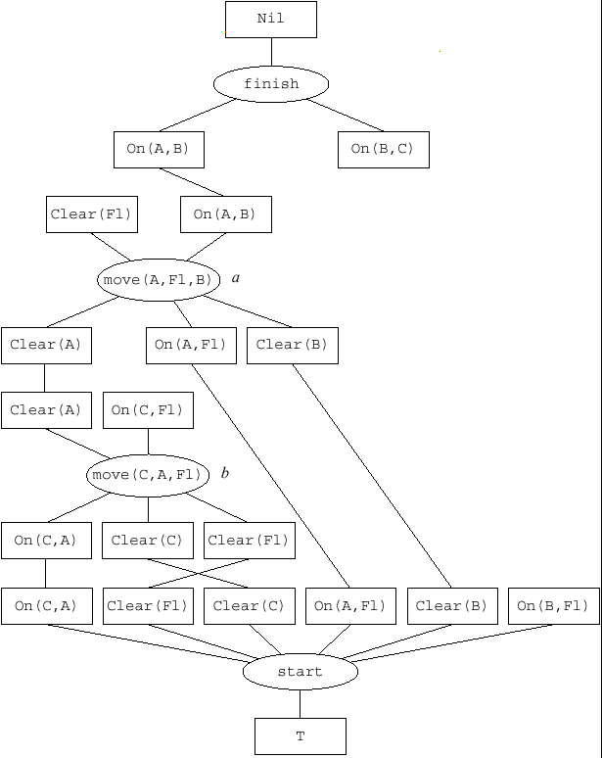
A Subsequent Plan Structure
Instantiated y into F1
Insert another rule move(C,A,y)and instantiate y into F1.
Restriction: b < a
Now, On(A,B)is satisfied.
How to achieve On(B,C)?
satisfied
Figure 22.13 A Subsequent Plan Structure

Slide 27
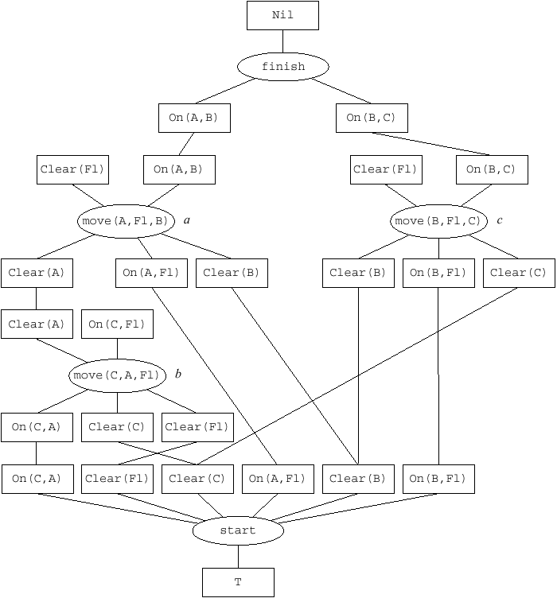
A Later Stage of the Plan Structure
Insert another rule move(B,z,C)and instantiate z into F1.
Threat arc
  rules a, b, c are only partially ordered.
  Threat arc: possible problem occurred by wrong order of a, b, c.
Figure 22.14 A Later Stage of the Plan Structure

Slide 28
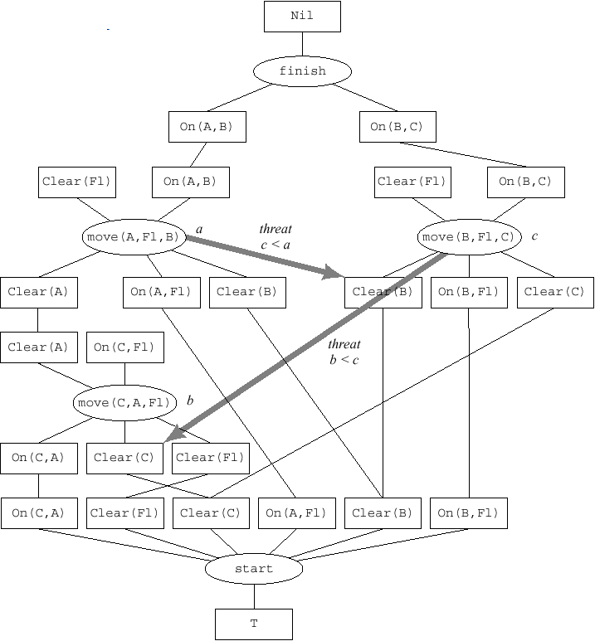
Putting in the Threat Arcs
Thread arc
  drawn from operator (oval) nodes to those precondition (boxed) nodes that (a) are on the delete list of the operator, and (b) are not descendants of the operator node
  threat c < a
    move(A,F1,B)deletes Clear(B).
    move(A,F1,B)threatens move(B,F1,C)because if the former were to be executed first, we would not be able to execute the latter.
  threat b < c
Figure 22.15 Putting in the Threat Arcs

Slide 29
Discharging threat arcs by placing constraints on the ordering of operators
Find all the consistent set of ordering constraints
  here, c < a, b < c
Total order: b < c < a.
Final plan: {move(C,A,F1),move(B,F1,C),move(A,F1,B)}

Slide 30
22.3 Hierarchical Planning

Slide 31
ABSTRIPS
Assigns criticality numbers to each conjunct in each precondition of a STRIPS rule.
  The easier it is to achieve a conjunct (all other things being equal), the lower is its criticality number.
ABSTRIPS planning procedure in levels
  1. Assume all preconditions of criticality less than some threshold value are already true, and develop a plan based on that assumption. Here we are essentially postponing the achievement of all but the hardest conjuncts.
  2. Lower the criticality threshold by 1, and using the plan developed in step 1 as a guide, develop a plan that assumes that preconditions of criticality lower than the threshold are true.
  3. And so on.

Slide 32
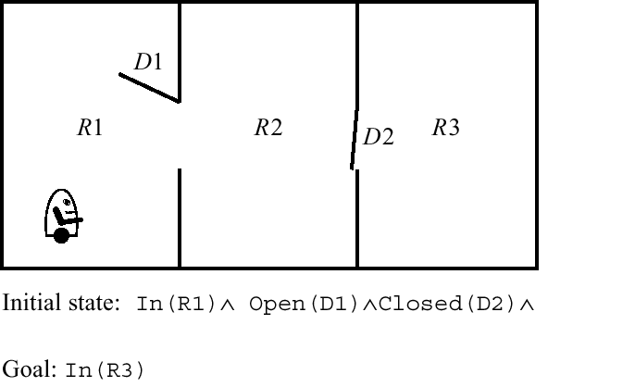
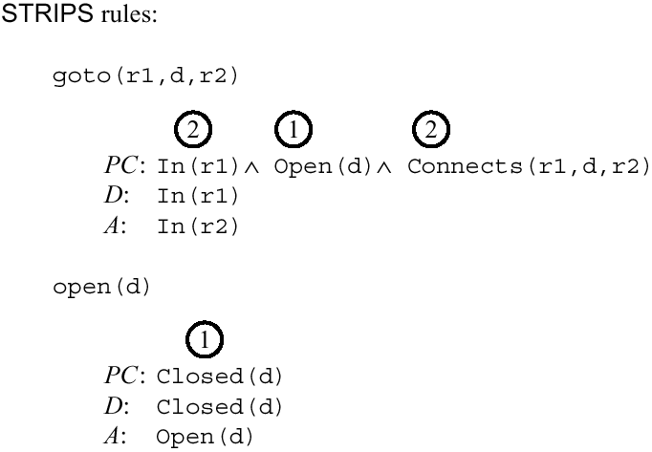
An example of ABSTRIPS
goto(R1,d,r2): rules which models the action schema of taking the robot from room r1, through door d, to room r2.
open(d): open door d.
n : criticality numbers of the preconditions
Figure 22.16 A Planning Problem for ABSTRIPS

Slide 33
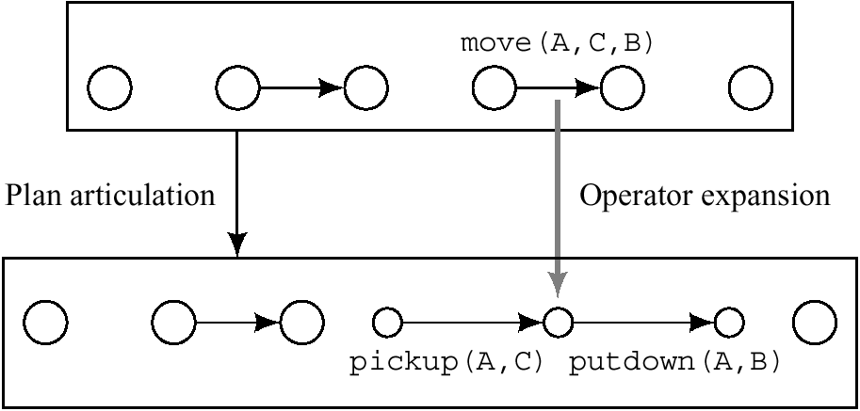
Combining Hierarchical and Partial-Order Planning
NOAH, SIPE, O-PLAN
“Articulation”
  articulate abstract plans into ones at a lower level of detail
Figure 22.17 Articulating a Plan

Slide 34
22.4 Learning Plans

Slide 35
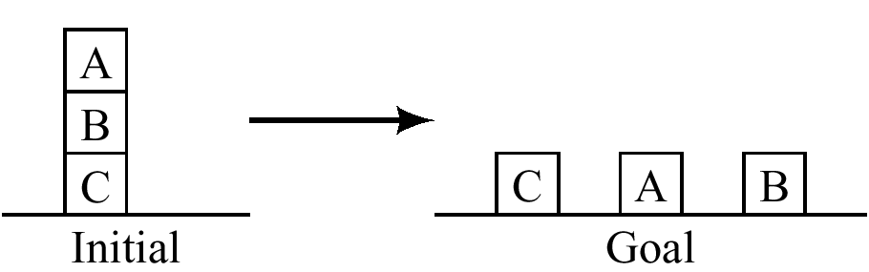
22.4 Learning Plans
learning new STRIPS rules consisting of a sequence of already existing STRIPS rules
Figure 22.18 Unstacking Two Blocks

Slide 36
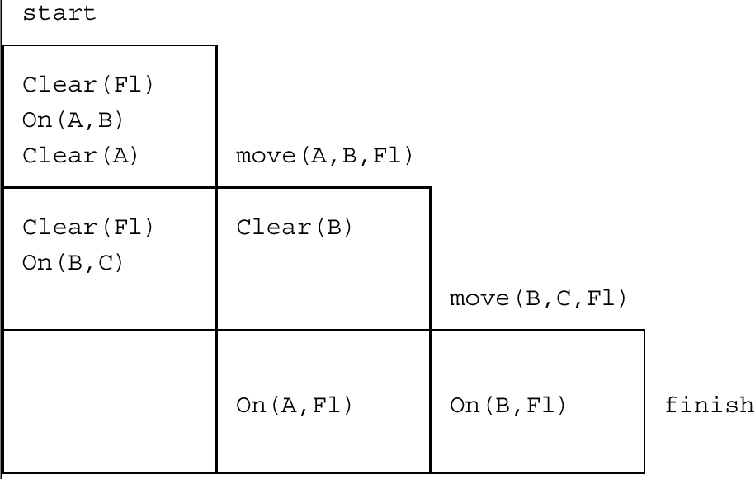
Learning Plans (cont’d)
Figure 22.19 A Triangle Table for Block Unstacking

Slide 37
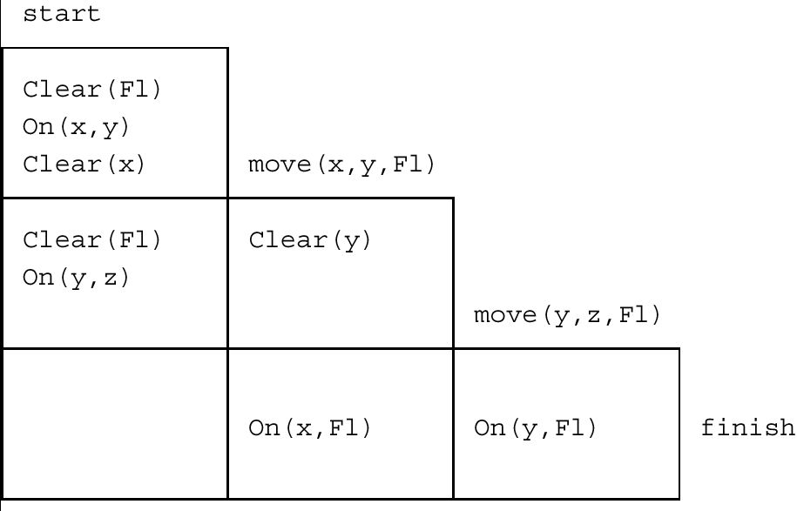
Learning Plans (cont’d)
Figure 22.20 A Triangle-Table Schema for Block Unstacking

Slide 38
Additional Readings and Discussion
[Lifschitz 1986]
[Pednault 1986, Pednault 1989]
[Bylander 1994]
[Bylander 1993]
[Erol, Nau, and Subrahmanian 1992]
[Gupta and Nau 1992]
[Chapman 1989]
[Waldinger 1975]
[Blum and Furst 1995]
[Kautz and Selman 1996], Kautz, Mcallester, and Selman 1996]
[Ernst, Millstein, and Weld 1997]
[Sacerdoti 1975, Sacerdoti 1977]
[Tate 1977]
[Chapman 1987]
[Soderland and Weld 1991]
[Penberthy and Weld 1992]
[Ephrati, Pollack, and Milshtein 1996]

Slide 39
Additional Readings and Discussion
[Minton, Bresina, and Drummond 1994]
[Weld 1994]
[Christensen 1990, Knoblock 1990]
[Tenenberg 1991]
[Erol, Hendler, and Nau 1994]
[Dean and Wellman 1991]
[Ramadge and Wonham 1989]
[Allen, et al. 1990]
[Wilkins, et al. 1995]
[Allen, et al. 1990]
[Minton 1993]
[Wilkins 1988]
[Tate 1996]

