Slide 1
Decision Tree Learning
Seong-Bae Park

Slide 2
Main Idea
Classification by Partitioning Example Space
Goal : Approximating discrete-valued target functions
Appropriate Problems
  Examples are represented by attribute-value pairs.
  The target function has discrete output value.
  Disjunctive description may be required.
  The training data may contain missing attribute values.

Slide 3
Example Problem (Play Tennis)
Day | Outlook | Temperature | Humidity | Wind | PlayTennis
D1 D2 D3 D4 D5 D6 D7 D8 D9 D10 D11 D12 D13 D14 | Sunny Sunny Overcast Rain Rain Rain Overcast Sunny Sunny Rain Sunny Overcast Overcast Rain | Hot Hot Hot Mild Cool Cool Cool Mild Cool Mild Mild Mild Hot Mild | High High High High Normal Normal Normal High Normal Normal Normal High Normal High | Weak Strong Weak Weak Weak Strong Strong Weak Weak Weak Strong Strong Weak Strong | No No Yes Yes Yes No Yes No Yes Yes Yes Yes Yes No

Slide 4
Example Space
Yes
(Outlook = Overcast)
No
(Outlook = Sunny &
Humidity = High)
Yes
(Outlook = Sunny &
Humidity = Normal)
Yes
(Outlook = Rain
& Wind = Weak)
No
(Outlook = Rain
& Wind = Strong)

Slide 5
Decision Tree Representation
Outlook
Sunny
Rain
Overcast
Humidity
YES
Wind
High
Normal
NO
YES
NO
YES

Slide 6
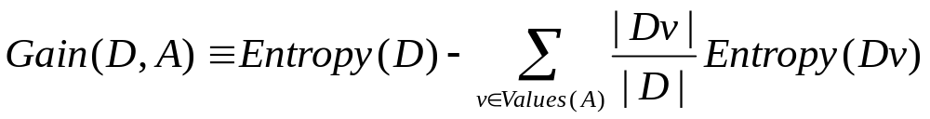
Basic Decision Tree Learning
Which Attribute is Best?
  Select the attribute that is most useful for classifying examples.
  Quantitative Measure
    Information Gain
    For Attribute A, relative to a collection of data D
    Expected Reduction of Entropy

Slide 7
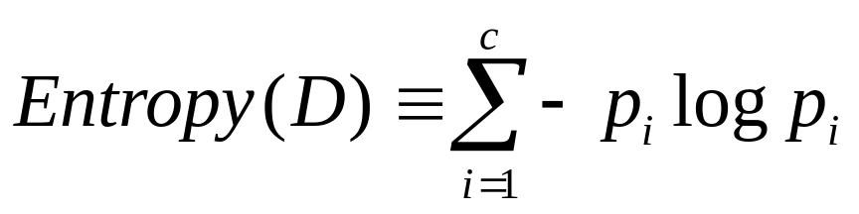

Entropy
Impurity of an Arbitrary Collection of Examples
Minimum number of bits of information needed to encode the classification of an arbitrary member of D
1.0
Entropy(S)
0.0
1.0

Slide 8
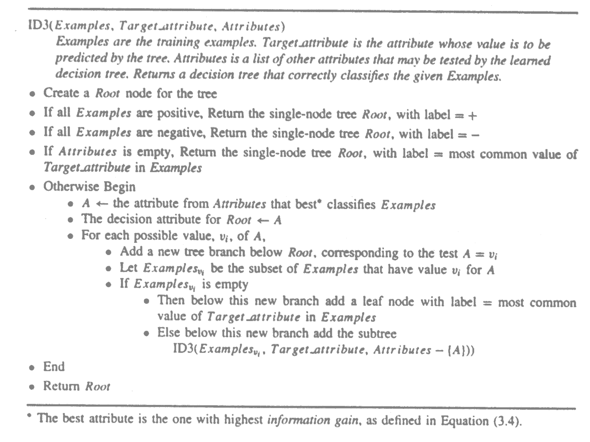
Constructing Decision Tree

Slide 9
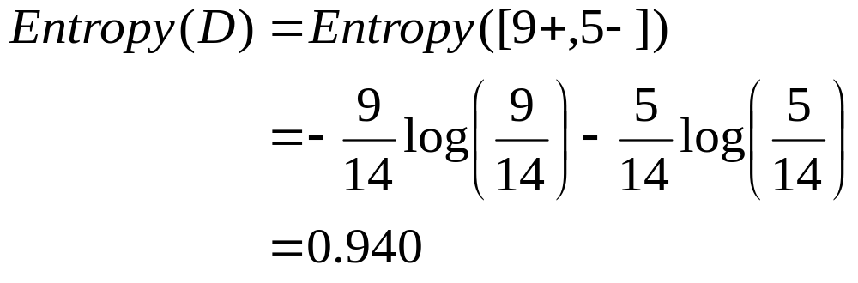
Example : Play Tennis (1)
Entropy of D

Slide 10
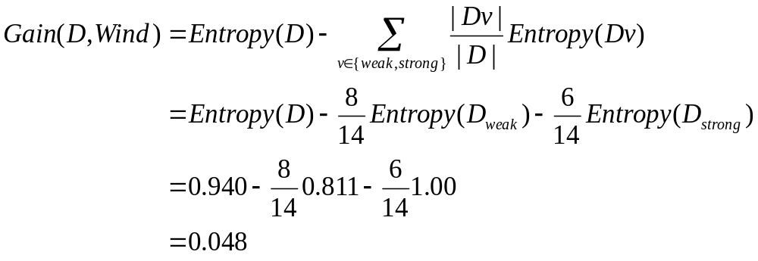
Example : Play Tennis (2)
Attribute Wind
  D = [9+,5-]
  D_{weak} = [6+,2-]
  D_{strong}=[3+,3-]
[9+,5-] : E = 0.940
Wind
Weak
Strong
[6+,2-] : E = 0.811
[3+,3-] : E = 1.0

Slide 11

Example : Play Tennis (3)
[9+,5-] : E = 0.940
Attribute Humidity
  D_{high} = [3+,4-]
  D_{normal}=[6+,1-]
Humidity
High
Normal
[3+,4-] : E = 0.985
[6+,1-] : E = 0.592

Slide 12
Example : Play Tennis (4)
Best Attribute?
  Gain(D, Outlook) = 0.246
  Gain(D, Humidity) = 0.151
  Gain(D, Wind) = 0.048
  Gain(D, Temperature) = 0.029
[9+,5-] : E = 0.940
Outlook
Sunny
Rain
Overcast
[2+,3-] : (D1, D2, D8, D9, D11)
[4+,0-] : (D3, D7, D12, D13)
YES
[3+,2-] : (D4, D5, D6, D10, D14)

Slide 13
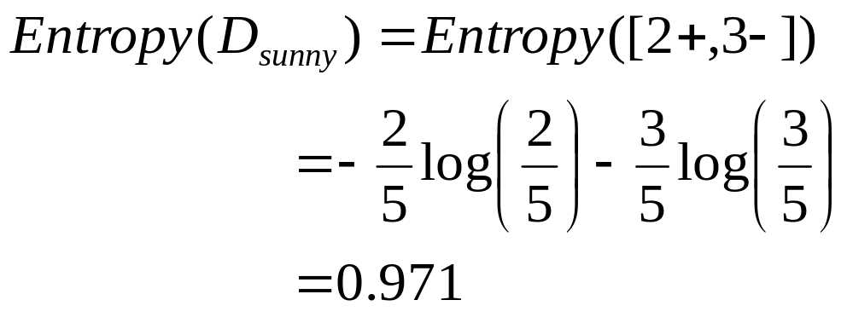
Example : Play Tennis (5)
Entropy D_{sunny}
Day | Outlook | Temperature | Humidity | Wind | PlayTennis
D1 D2 D8 D9 D11 | Sunny Sunny Sunny Sunny Sunny | Hot Hot Mild Cool Mild | High High High Normal Normal | Weak Strong Weak Weak Strong | No No No Yes Yes

Slide 14
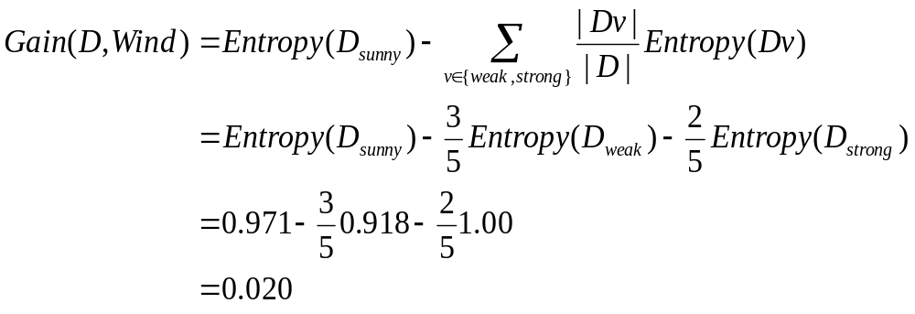
Example : Play Tennis (6)
Attribute Wind
  D_{weak} = [1+,2-]
  D_{strong}=[1+,1-]
[2+,3-] : E = 0.971
Wind
Weak
Strong
[1+,2-] : E = 0.918
[1+,1-] : E = 1.0

Slide 15

Example : Play Tennis (7)
Attribute Humidity
  D_{high} = [0+,3-]
  D_{normal}=[2+,0-]
[2+,3-] : E = 0.971
Humidity
High
Normal
[0+,3-] : E = 0.00
[2+,0-] : E = 0.00

Slide 16
Example : Play Tennis (8)
Best Attribute?
  Gain(D, Humidity) = 0.971
  Gain(D, Wind) = 0.020
  Gain(D, Temperature) = 0.571
[9+,5-] : E = 0.940
Outlook
Sunny
Overcast
Rain
Humidity
YES
[3+,2-] : (D4, D5, D6, D10, D14)
High
Normal
NO
YES

Slide 17

Example : Play Tennis (9)
Entropy D_{rain}
Day | Outlook | Temperature | Humidity | Wind | PlayTennis
D4 D5 D6 D10 D14 | Rain Rain Rain Rain Rain | Mild Cool Cool Mild Mild | High Normal Normal Normal High | Weak Weak Strong Weak Strong | Yes Yes No Yes No

Slide 18

Example : Play Tennis (10)
Attribute Wind
  D_{weak} = [3+,0-]
  D_{strong}=[0+,2-]
[3+,2-] : E = 0.971
Wind
Weak
Strong
[3+,0-] : E = 0.00
[0+,2-] : E = 0.00

Slide 19
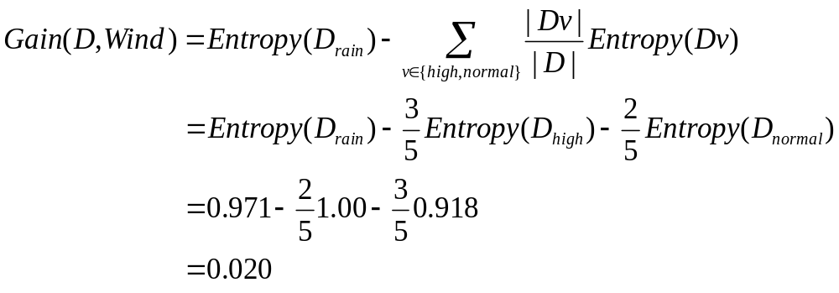
Example : Play Tennis (11)
[2+,3-] : E = 0.971
Attribute Humidity
  D_{high} = [1+,1-]
  D_{normal}=[2+,1-]
Humidity
High
Normal
[1+,1-] : E = 1.00
[2+,1-] : E = 0.918

Slide 20
Example : Play Tennis (12)
Best Attribute?
  Gain(D, Humidity) = 0.020
  Gain(D, Wind) = 0.971
  Gain(D, Temperature) = 0.020
Outlook
Sunny
Rain
Overcast
Humidity
YES
Wind
High
Normal
NO
YES
NO
YES

Slide 21
Avoiding Overfitting Data
Data Overfitting
  Consider the following:
    (Outlook = Sunny & Humidity = Normal & PlayTennis = No)
  Wrong Decision Tree Prediction
    (Outlook = Sunny & Humidity = Normal) ⇒ Yes
  What if we prune ‘Humidity’ node?
    When (outlook = Sunny), PlayTennis ⇒ No
    Can be correctly predicted.

Slide 22
Avoiding Overfitting Data (2)
Outlook
Sunny
Rain
Overcast
(2+,3-)
NO
YES
Wind
NO
YES

Slide 23
Avoiding Overfitting Data (3)
Definition
  Given a hypothesis space H, a hypothesis h ∈ H is said to overfit the data if there exists some alternative hypothesis h’ ∈ H, such that h has smaller error than h’ over the training examples, but h’ has a smaller error than h over entire distribution of instances.
Occam’s Razor
  Prefer the simplest hypothesis that fits the data.

Slide 24
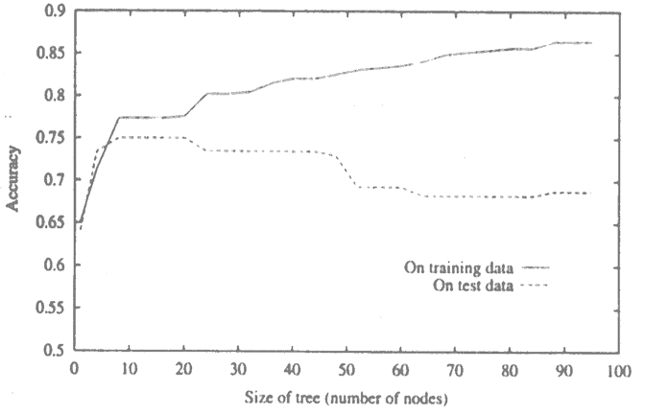
Avoiding Overfitting Data (4)

Slide 25
Avoiding Overfitting Data (5)
Solutions
1. Partition examples into training, test, and validation set.
2. Use all data for training, but apply a statistical test to estimate whether expanding (or pruning) a particular node is likely to produce an improvement beyond the training set.
3. Use an explicit measure of the complexity for encoding the training examples and the decision tree, halting growth of the tree when this encoding is minimized.

Slide 26
Decision Tree Tool: C4.5
Reference:
  Ross Quinlan, C4.5: Programs for Machine Learning, Morgan Kaufmann Publishers, 1993.
Source Code Download
  http://www.cse.unsw.edu.au/~quinlan/

Slide 27
How to Use C4.5 (1)
First Step
  Define the classes and attributes
  .names file: labor-neg.names
Good, bad.
Duration: continuous.
Wage increase first year: continuous.
Wage increase second year: continuous.
Wage increase third year: continuous.
Cost of living adjustment: none, tcf, tc.
Working hours: continuous
Pension: none, ret_allw, empl_contr.
Standby pay: continuous.
Shift differential: continuous.
Education allowance: yes, no.
Statutory holidays: continuous.
Vacation: below average, average, generous.
Longterm disability assistance: yes, no.
Contribution to dental plan: none, half, full.
Bereavement assistance: yes, no.
Contribution to health plan: none, half, full.

Slide 28
How to Use C4.5 (2)
Second Step
  Provide information on the individual cases
  .data file: labor-neg.data
  Example:
    1, 2.0, ?, ?, none, 38, none, ?, ?, yes, 11, average, no, none, no, none, bad.
    2, 4.0, 5.0, ?, tcf, 35, ?, 13, 5, ?, 15, generous, ?, ?, ?, ?, good.
    2, 4.3, 4.4, ?, ?, 38, ?, ?, 4, ?, 12, generous, ?, full, ?, full, good.
  ?: unknown or inapplicable values
  .test file: labor-neg.test

Slide 29
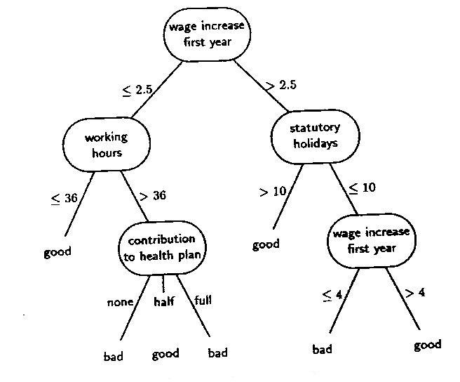
How to Use C4.5 (3)
Third Step
  Run C4.5
  Command:
    c4.5 –f labor-neg –u

Slide 30
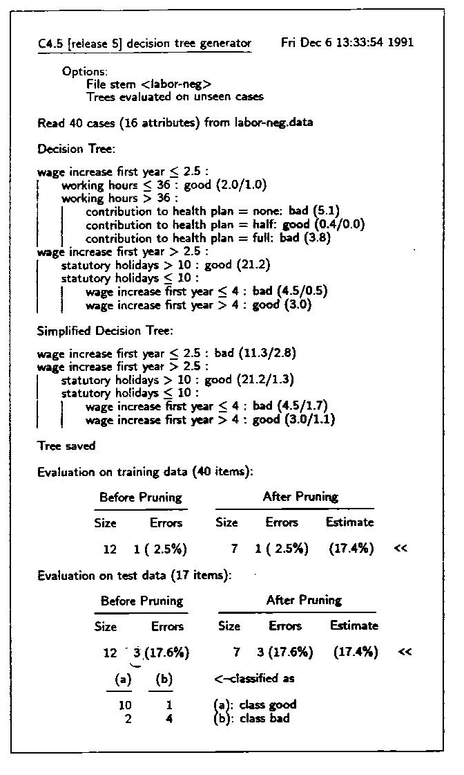

Slide 31
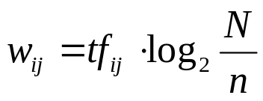
Example: Learning to Classify Text
Representing Document in a Vector
  Dimension = |Vocabulary|
  Weight of a term t_{j} appeared in the document d_{i}
    tf_{ij}: the frequency of t_{j} in d_{i}
    N: the number of total documents
    n: the number of documents where t_{j} occurs at least once

Slide 32
HPV Sequence Database
The HPV Sequence Database
  Los Alamos National Laboratory
  http://
    <definition>
    Human papillomavirus type 80 E6, E7, E1, E2, E4, L2, and L1 genes.
    </definition>
    <source>
    Human papillomavirus type 80.
    </source>
    <comment>
    The DNA genome of HPV80 (HPV15-related) was isolated from histologically normal skin, cloned, and sequenced. HPV80 is most similar to HPV15, and falls within one of the two major branches of the B1 or Cutaneous/EV clade. The E7, E1, and E4 orfs, as well as the URR, of HPV15 and HPV80 share sequence similarities higher than 90%, while in the usually more conservative L1 orf the nucleotide similarity is only 87%. A detailed comparative sequence analysis of HPV80 revealed features characteristic of a truly cutaneous HPV type [362]. Notice in the alignment below that HPV80 compares closely to the cutaneous types HPV15 and HPV49 in the important E7 functional regions CR1, pRb binding site, and CR2. HPV 80 is distinctly different from the high-risk mucosal viruses represented by HPV16. The locus as defined by GenBank is HPVY15176.
    </comment>

Slide 33
Representing Document
Stemming and stopword list
  Porter’s Stemmer
  Remove numeric expression and prepositions
  |Vocabulary| = 1434
HPV80 Description
  42: 0.445260 145: 3.367296 205: 3.367296
  211: 0.476924 215: 1.352393 296: 2.990987
  314: 1.227230 388: 0.090151 521: 2.451005
  529: 2.114533 530: 1.421386 544: 0.764606
  579: 1.575536 580: 2.674149 608: 2.961831
  763: 1.495494 772: 1.863218 780: 0.034783
  851: 2.114533 987: 1.683134 1004: 2.674149
  1076: 2.268646 1093: 0.764606 1148: 1.421386
  1187: 2.961831 1201: 2.774846 1206: 1.227230
  1211: 1.662548 1377: 1.757858 1404: 0.841567

Slide 34
Classify HPVs
Goal
  Classify the Risk Types of HPVs related with cervical cancer
  Class: High, Low
Training Set: (Virology, Prentice Hall, 1994)
  HPV6: Low
  HPV11: Low
  HPV16: High
  HPV18: High
  HPV31: High
  HPV33: High
  HPV45: High

Slide 35
Classifying All HPVs
C4.5 [release 8] decision tree generator
----------------------------------------
Options:
File stem <hpv>
Trees evaluated on unseen cases
Read 7 cases (1434 attributes) from hpv.data
Decision Tree:
W546 > 1.86322 : 1 (5.0)
W546 <= 1.86322 :
| W432 > 0 : 1 (3.0)
| W432 <= 0 :
| | W785 > 0 : 1 (3.0/1.0)
| | W785 <= 0 :
| | | W511 <= 0 :
| | | | W142 <= 1.49549 : 0 (40.0)
| | | | W142 > 1.49549 : 1 (3.0/1.0)
| | | W511 > 0 :
| | | | W544 <= 0 : 1 (2.0)
| | | | W544 > 0 : 0 (2.0)
Evaluation on training data (7 items):
Before Pruning After Pruning
---------------- ---------------------------
Size Errors Size Errors Estimate
13 0( 0.0%) 13 0( 0.0%) (0.0%) <<
Evaluation on test data (76 items):
Before Pruning After Pruning
---------------- ---------------------------
Size Errors Size Errors Estimate
13 2(2.6%) 13 2(2.6%) (13.3%) <<

Slide 36
Summary
Decision Tree provides a practical method for concept learning and discrete-valued functions.
ID3 searches a complete hypothesis space.
Overfitting is an important issue in decision tree learning.

