Slide 1
Artificial Intelligence
Chapter 19
Reasoning with Uncertain Information
Biointelligence Lab
School of Computer Sci. & Eng.
Seoul National University

Slide 2
Outline
Review of Probability Theory
Probabilistic Inference
Bayes Networks
Patterns of Inference in Bayes Networks
Uncertain Evidence
D-Separation
Probabilistic Inference in Polytrees

Slide 3
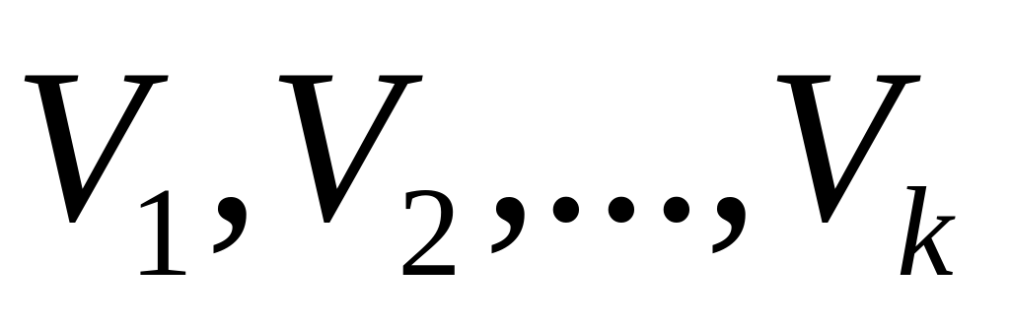
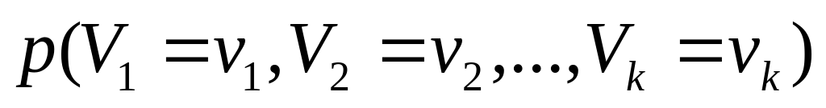
19.1 Review of Probability Theory (1/4)
Random variables
Joint probability
Ex.
(B (BAT_OK), M (MOVES) , L (LIFTABLE), G (GUAGE)) | Joint Probability
(True, True, True, True) | 0.5686
(True, True, True, False) | 0.0299
(True, True, False, True) | 0.0135
(True, True, False, False) | 0.0007
… | …

Slide 4
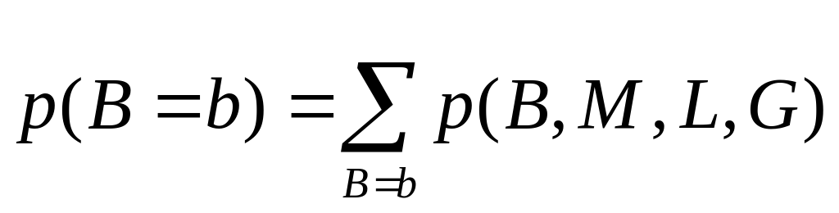
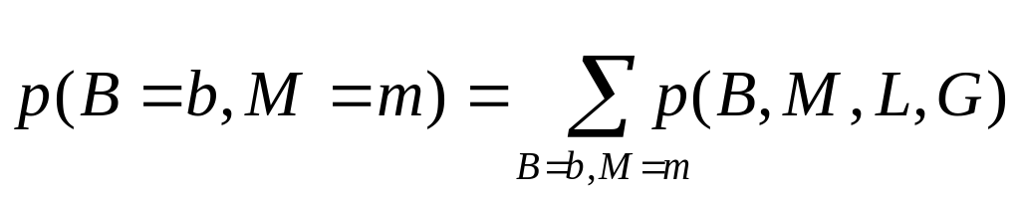
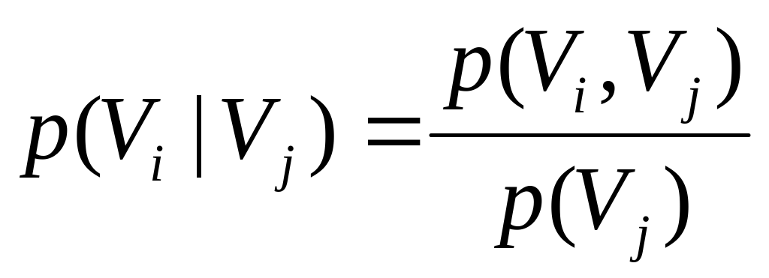
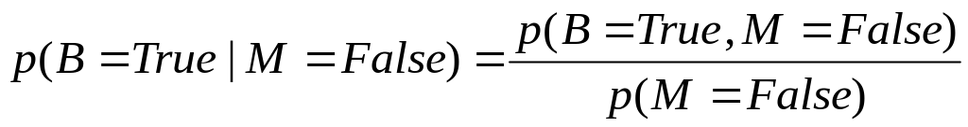
19.1 Review of Probability Theory (2/4)
Marginal probability
Conditional probability
  Ex. The probability that the battery is charged given that the are does not move
Ex.

Slide 5
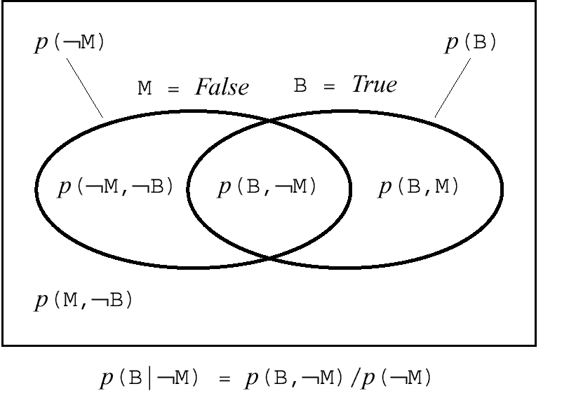
19.1 Review of Probability Theory (3/4)
Figure 19.1 A Venn Diagram

Slide 6
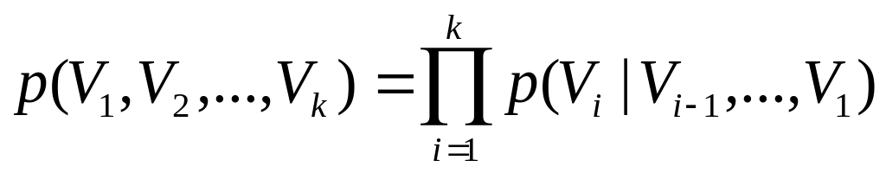
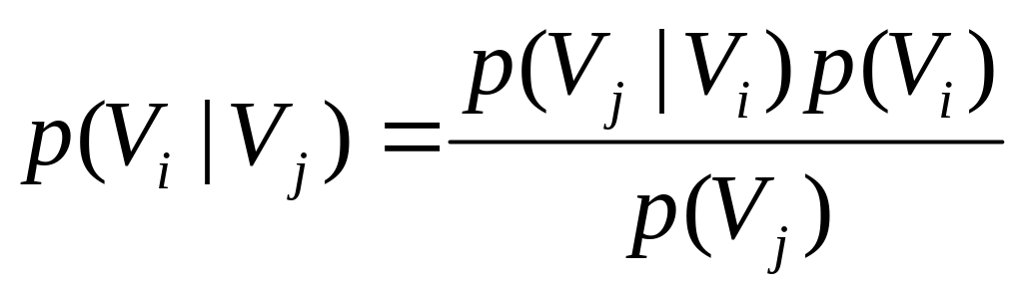
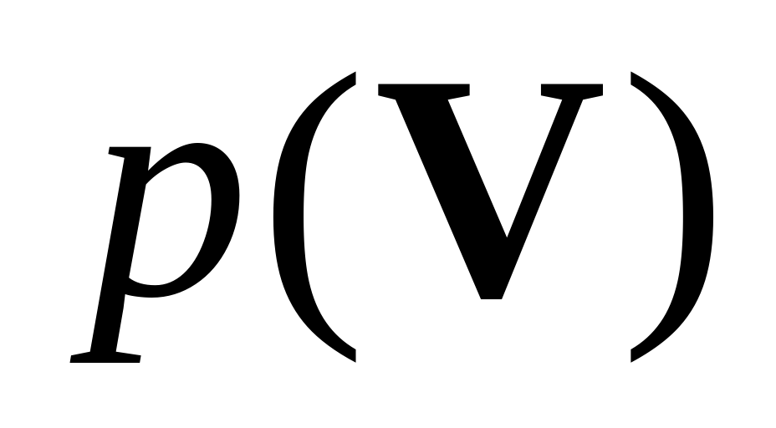
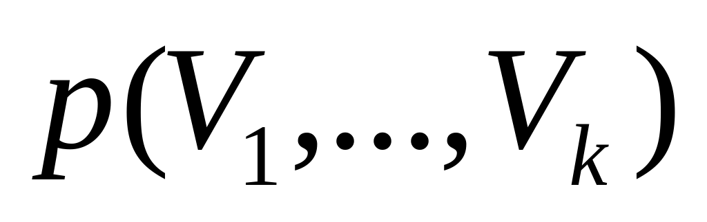
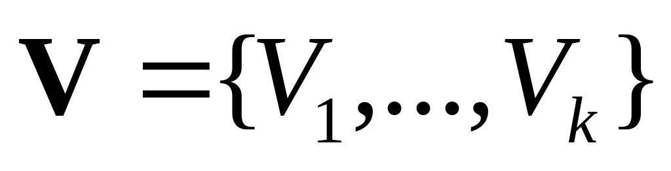
19.1 Review of Probability Theory (4/4)
Chain rule
Bayes’ rule
  Abbreviation for
  where

Slide 7
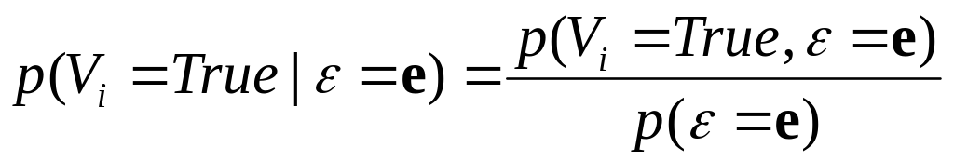
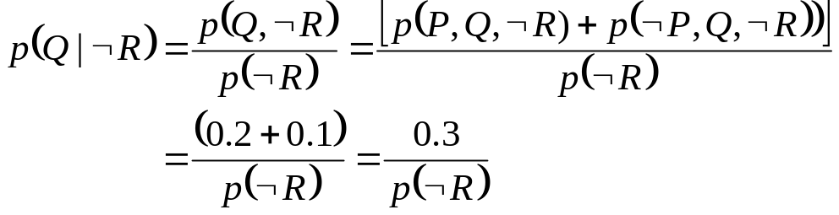
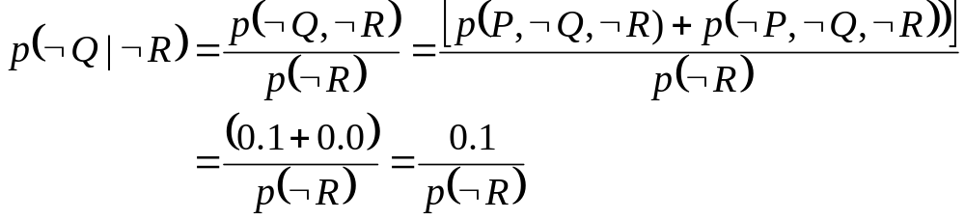
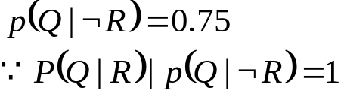
19.2 Probabilistic Inference
The probability some variable V_{i} has value v_{i} given the evidence ε =e.
p(P,Q,R) | 0.3
p(P,Q,¬R) | 0.2
p(P, ¬Q,R) | 0.2
p(P, ¬Q,¬R) | 0.1
p(¬P,Q,R) | 0.05
p(¬P, Q, ¬R) | 0.1
p(¬P, ¬Q,R) | 0.05
p(¬P, ¬Q,¬R) | 0.0

Slide 8
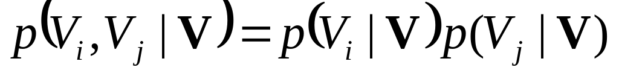
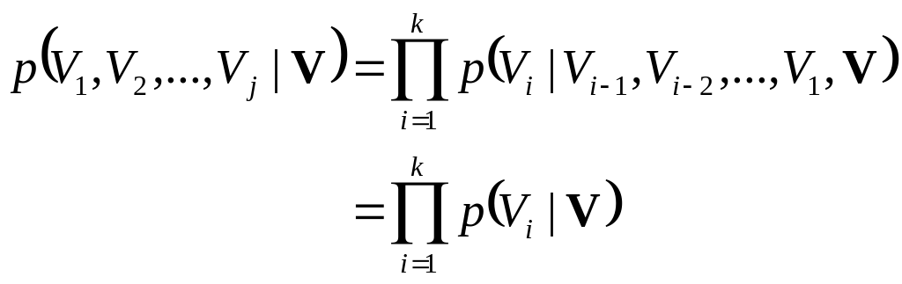
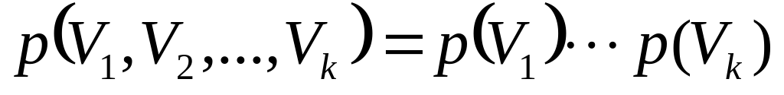
Statistical Independence
Conditional independence
Mutually conditional independence
Unconditional independence

Slide 9
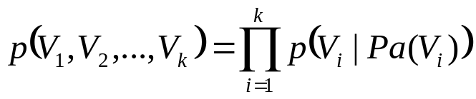
19.3 Bayes Networks (1/2)
Directed, acyclic graph (DAG) whose nodes are labeled by random variables.
Characteristics of Bayesian networks
  Node V_{i} is conditionally independent of any subset of nodes that are not descendents of V_{i}.
Prior probability
Conditional probability table (CPT)

Slide 10
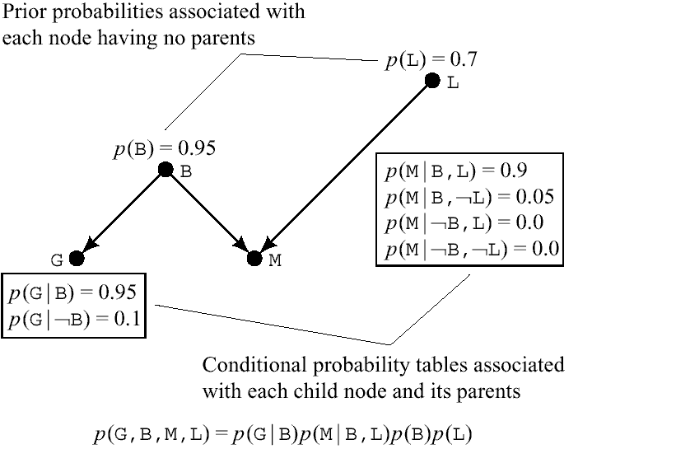
19.3 Bayes Networks (2/2)

Slide 11
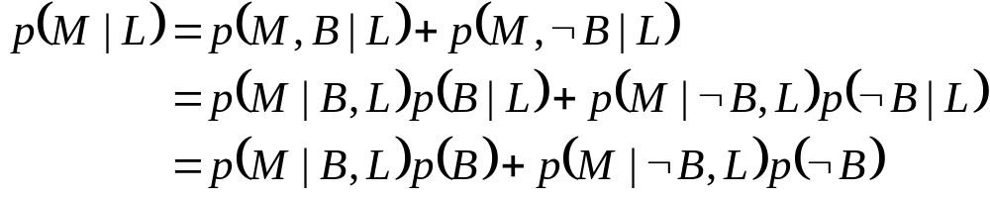
19.4 Patterns of Inference in Bayes Networks (1/3)
Causal or top-down inference
  Ex. The probability that the arm moves given that the block is liftable

Slide 12

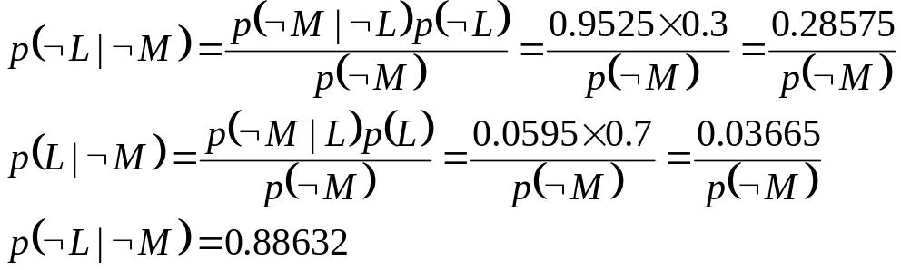
19.4 Patterns of Inference in Bayes Networks (2/3)
Diagnostic or bottom-up inference
  Using an effect (or symptom) to infer a cause
  Ex. The probability that the block is not liftable given that the arm does not move.
(using a causal reasoning)
(Bayes’ rule)

Slide 13
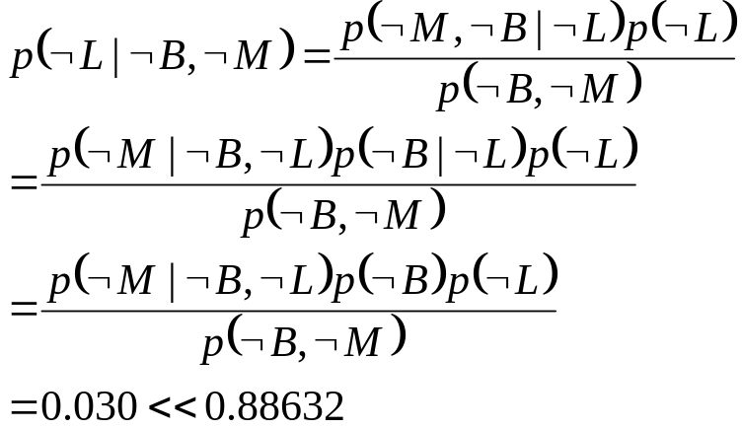
19.4 Patterns of Inference in Bayes Networks (3/3)
Explaining away
  ¬B explains ¬M, making ¬L less certain
(Bayes’ rule)
(def. of conditional prob.)
(structure of the Bayes network)

Slide 14
19.5 Uncertain Evidence
We must be certain about the truth or falsity of the propositions they represent.
  Each uncertain evidence node should have a child node, about which we can be certain.
  Ex. Suppose the robot is not certain that its arm did not move.
    Introducing M’ : “The arm sensor says that the arm moved”
      We can be certain that that proposition is either true or false.
    p(¬L| ¬B, ¬M’) instead of p(¬L| ¬B, ¬M)
  Ex. Suppose we are uncertain about whether or not the battery is charged.
    Introducing G : “Battery guage”
    p(¬L| ¬G, ¬M’) instead of p(¬L| ¬B, ¬M’)

Slide 15
19.6 D-Separation (1/3)
ε d-separates V_{i} and V_{j} if for every undirected path in the Bayes network between V_{i} and V_{j}, there is some node, V_{b}, on the path having one of the following three properties.
  V_{b} is in ε, and both arcs on the path lead out of V_{b}
  V_{b} is in ε, and one arc on the path leads in to V_{b} and one arc leads out.
  Neither V_{b} nor any descendant of V_{b} is in ε, and both arcs on the path lead in to V_{b}.
V_{b} blocks the path given ε when any one of these conditions holds for a path.
Two nodes V_{i} and V_{j} are conditionally independent given a set of node ε

Slide 16
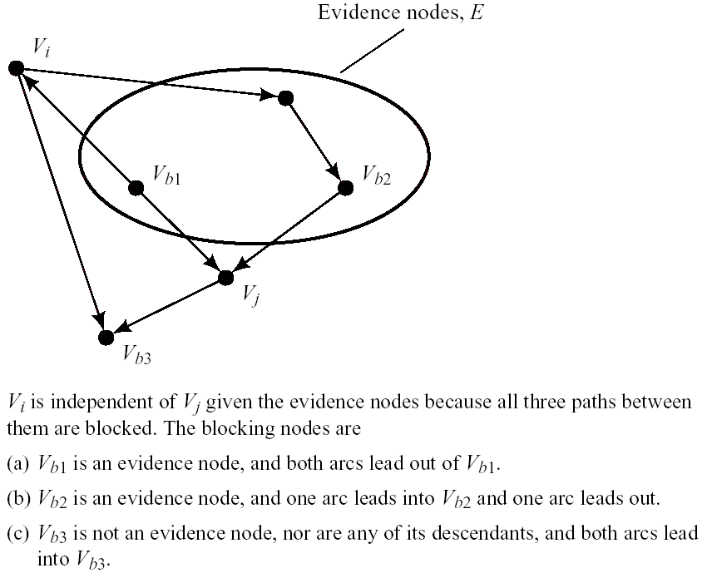
19.6 D-Separation (2/3)
Figure 19.3 Conditional Independence via Blocking Nodes

Slide 17
19.6 D-Separation (3/3)
Ex.
  I(G, L|B) by rules 1 and 3
    By rule 1, B blocks the (only) path between G and L, given B.
    By rule 3, M also blocks this path given B.
  I(G, L)
    By rule 3, M blocks the path between G and L.
  I(B, L)
    By rule 3, M blocks the path between B and L.
Even using d-separation, probabilistic inference in Bayes networks is, in general, NP-hard.

Slide 18
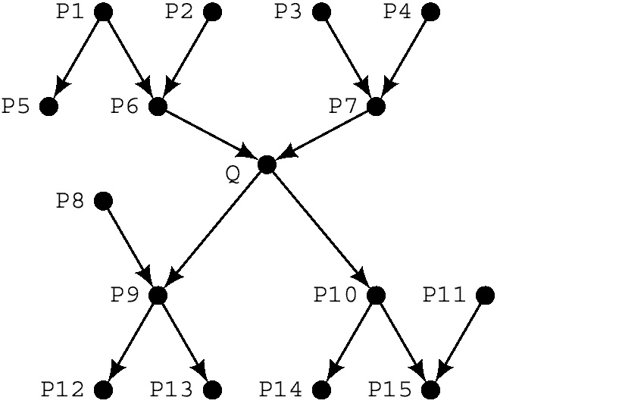
19.7 Probabilistic Inference in Polytrees (1/2)
Polytree
  A DAG for which there is just one path, along arcs in either direction, between any two nodes in the DAG.

Slide 19
19.7 Probabilistic Inference in Polytrees (2/2)
A node is above Q
  The node is connected to Q only through Q’s parents
A node is below Q
  The node is connected to Q only through Q’s immediate successors.
Three types of evidence.
  All evidence nodes are above Q.
  All evidence nodes are below Q.
  There are evidence nodes both above and below Q.

Slide 20
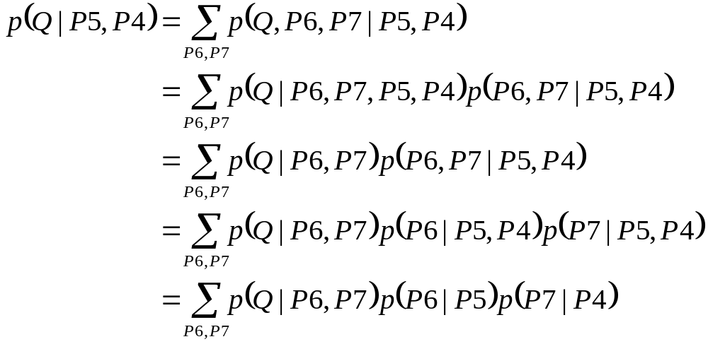
Evidence Above (1/2)
Bottom-up recursive algorithm
Ex. p(Q|P5, P4)
(Structure of
The Bayes network)
(d-separation)
(d-separation)

Slide 21
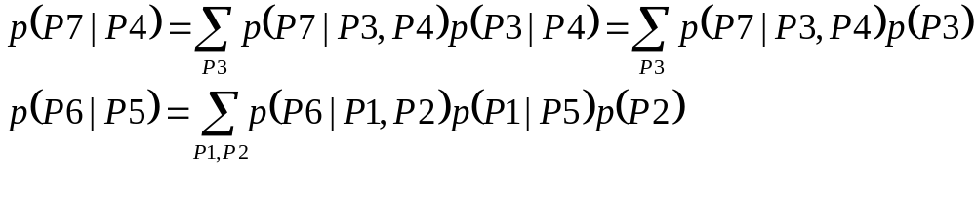
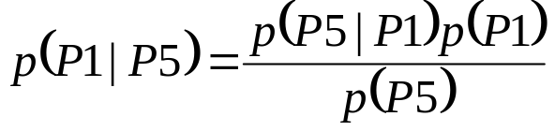
Evidence Above (2/2)
Calculating p(P7|P4) and p(P6|P5)
Calculating p(P5|P1)
  Evidence is “below”
  Here, we use Bayes’ rule

Slide 22
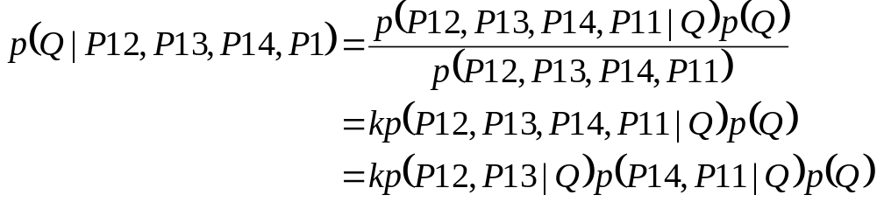
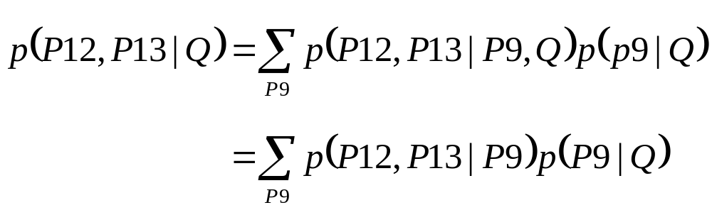
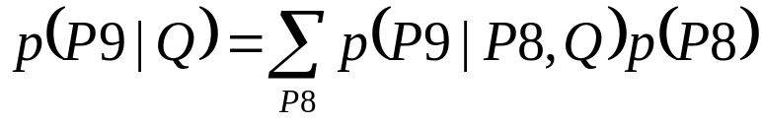
Evidence Below (1/2)
Top-down recursive algorithm

Slide 23
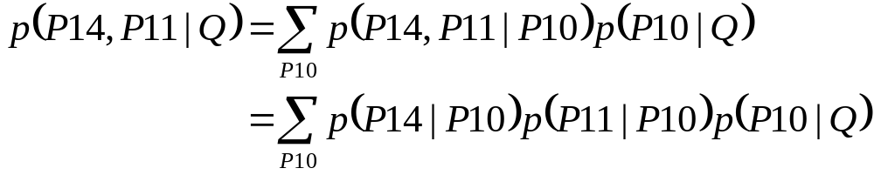
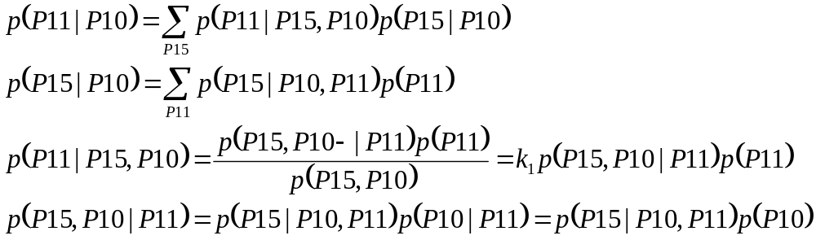
Evidence Below (2/2)

Slide 24
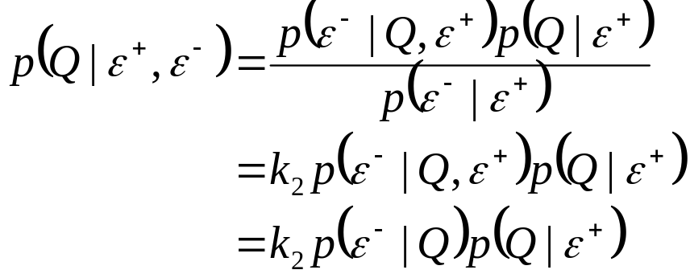
Evidence Above and Below
ε⁺
ε⁻

Slide 25

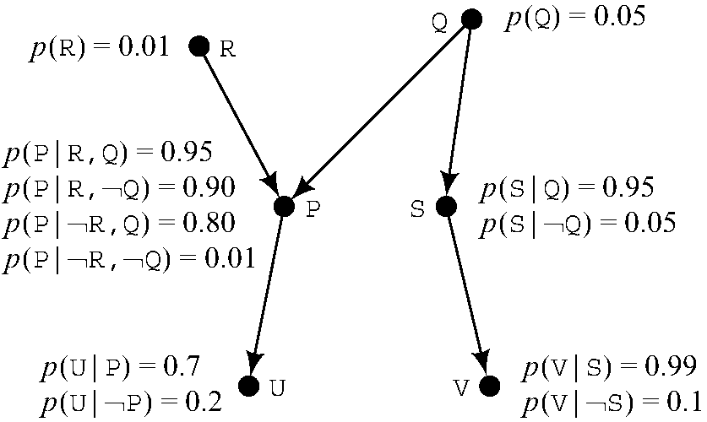
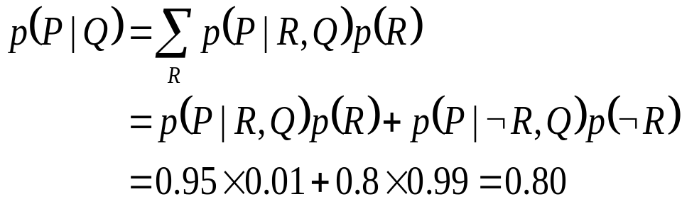
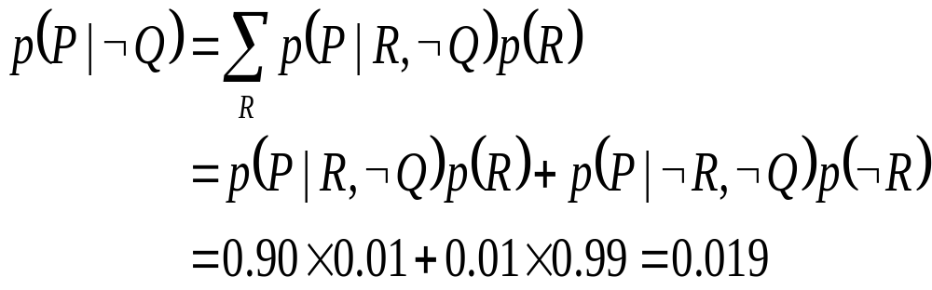
A Numerical Example (1/2)

Slide 26
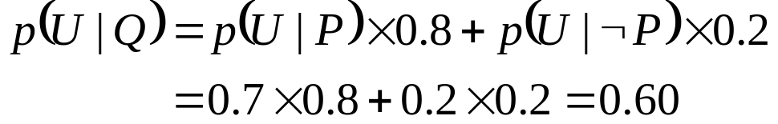
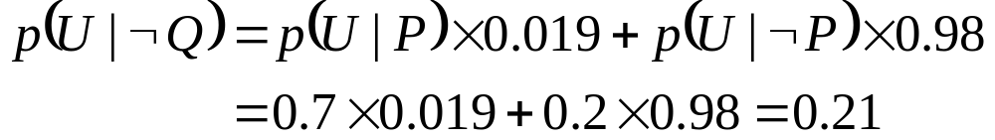
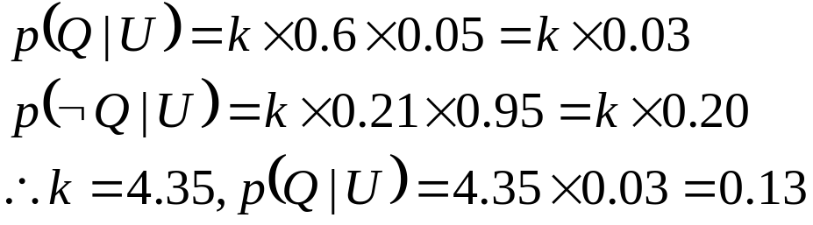
A Numerical Example (2/2)
Other techniques
  Bucket elimination
  Monte Carlo method
  Clustering

Slide 27
Additional Readings (1/5)
[Feller 1968]
  Probability Theory
[Goldszmidt, Morris & Pearl 1990]
  Non-monotonic inference through probabilistic method
[Pearl 1982a, Kim & Pearl 1983]
  Message-passing algorithm
[Russell & Norvig 1995, pp.447ff]
  Polytree methods

Slide 28
Additional Readings (2/5)
[Shachter & Kenley 1989]
  Bayesian network for continuous random variables
[Wellman 1990]
  Qualitative networks
[Neapolitan 1990]
  Probabilistic methods in expert systems
[Henrion 1990]
  Probability inference in Bayesian networks

Slide 29
Additional Readings (3/5)
[Jensen 1996]
  Bayesian networks: HUGIN system
[Neal 1991]
  Relationships between Bayesian networks and neural networks
[Hecherman 1991, Heckerman & Nathwani 1992]
  PATHFINDER
[Pradhan, et al. 1994]
  CPCSBN

Slide 30
Additional Readings (4/5)
[Shortliffe 1976, Buchanan & Shortliffe 1984]
  MYCIN: uses certainty factor
[Duda, Hart & Nilsson 1987]
  PROSPECTOR: uses sufficiency index and necessity index
[Zadeh 1975, Zadeh 1978, Elkan 1993]
  Fuzzy logic and possibility theory
[Dempster 1968, Shafer 1979]
  Dempster-Shafer’s combination rules

Slide 31
Additional Readings (5/5)
[Nilsson 1986]
  Probabilistic logic
[Tversky & Kahneman 1982]
  Human generally loses consistency facing uncertainty
[Shafer & Pearl 1990]
  Papers for uncertain inference
Proceedings & Journals
  Uncertainty in Artificial Intelligence (UAI)
  International Journal of Approximate Reasoning

