Slide 1
Artificial Intelligence
Chapter 2
Stimulus-Response Agents
Biointelligence Lab
School of Computer Sci. & Eng.
Seoul National University

Slide 2
Outline
2.1 Perception and Action
  Perception
  Action
  Boolean Algebra
  Classes and Forms of Boolean Functions
2.2 Representing and Implementing Action Functions
  Production Systems
  Networks
  The Subsumption Architecture

Slide 3
2.1 Perception and Action
Stimulus-response (S-R) agents
  Machines that have no internal state and that simply react to immediate stimuli in their environments
  Based on motor response to rather simple functions of immediate sensory inputs
  Example: Machina speculatrix, Braitenberg machine

Slide 4
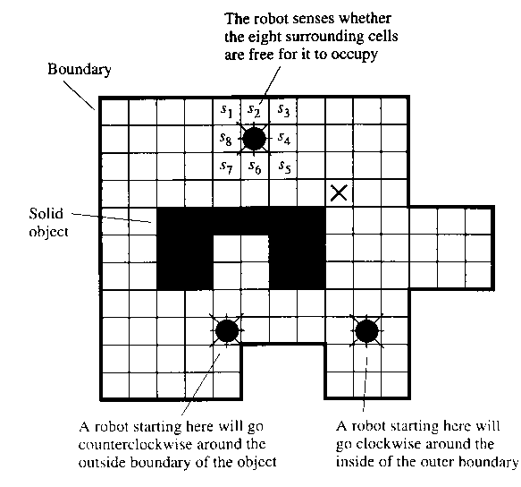
A Robot in a Two-Dimensional Grid World (1/4)
Environment
  Enclosed by boundaries
  Contains unmovable objects
  No tight spaces
    Spaces between objects and boundaries that are only one cell wide
Task
  Go to a cell adjacent to a boundary or object and then follow that boundary along its perimeter

Slide 5
A Robot in a Two-Dimensional Grid World (2/4)
Sensory inputs:
Robot movements
  north moves the robot one cell up in the cellular grid
  east moves the robot one cell to the right
  south moves the robot one cell down
  west moves the robot one cell to the left
Division of processes
  Perception processing and action computation

Slide 6
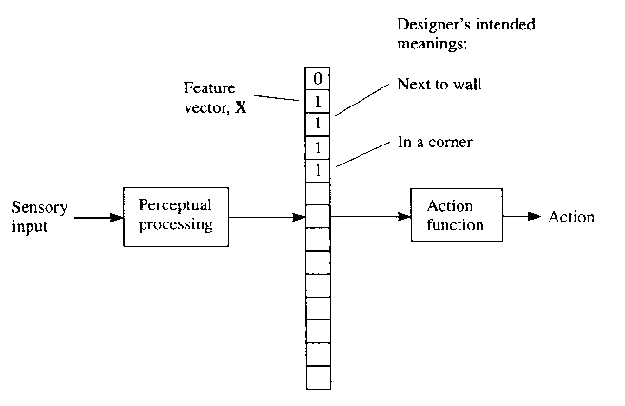

A Robot in a Two-Dimensional Grid World (3/4)
Perceptual processing
  produces feature vector X
  numeric features: real number
  categorical features: categories
Action computation
  selects an action based on feature vector

Slide 7
A Robot in a Two-Dimensional Grid World (4/4)
The split between perception and action is arbitrary
The split is made in such a way that the same features would be used repeatedly in a variety of tasks to be performed
The computation of features from sensory signals can be regarded as often used library routines
  needed by many different action functions
The next problems
  (1) converting raw sensory data into a feature vector
  (2) specifying an action function

Slide 8
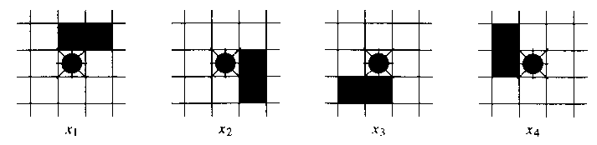

Perception
For the robot task, there are four binary-valued features of the sensory values that are useful for computing an appropriate action
Perceptual processing might occasionally give erroneous, ambiguous, or incomplete information about the robot’s environment
  Such errors might evoke inappropriate actions
For robots with more complex sensors and tasks, designing appropriate perceptual processing can be challenging

Slide 9
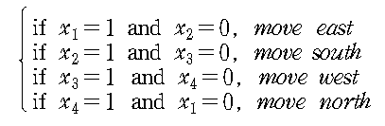
Action
Specifying a function that selects the appropriate boundary-following action
  None of the features has value 1, the robot can move in any direction until it encounters a boundary

Slide 10




Boolean Algebra
Boolean algebra is a convenient notation for representing Boolean functions
  Rules for Boolean algebra
  Commutative
  Associative
  DeMorgan’s law
  Distributive law

Slide 11



Classes and Forms of Boolean Functions
A conjunction of literals or a monomial:
  The conjunction itself is called a term
Bound of the number of monomials of size k or less:
A clause or a disjunction of literals:
Terms and clauses are duals of each other
Disjunctive normal form (DNF): disjunction of terms
  K-term DNF: disjunction of k terms
Conjunctive normal form (CNF): conjunction of clauses
  K-clause CNF: the size of its largest clause is k

Slide 12
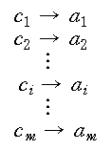
2.2 Representing and Implementing Action Functions: Production systems (1)
Production system comprises an ordered list of rules called production rules or productions
  , where is the condition part and is the action part
  Production system consists of a list of such rules
  Condition part
    Can be any binary-valued function of the features
    Often a monomial
  Action part
    Primitive action, a call to another productive system, or a set of actions to be executed simultaneously

Slide 13
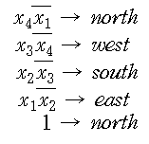
Production Systems (2)
Production system representation for the boundary following routine
  An example of a durative systems-system that never ends
Teleo-reactive (T-R) programs
  Each properly executed action in the ordering works toward achieving a condition higher in the list
  Usually easy to write, given an overall goal for an agent
  Quite robust: actions proceed inexorably toward the goal
  Can have parameters that are bound when the programs are called
  Can call other T-R programs and themselves recursively

Slide 14
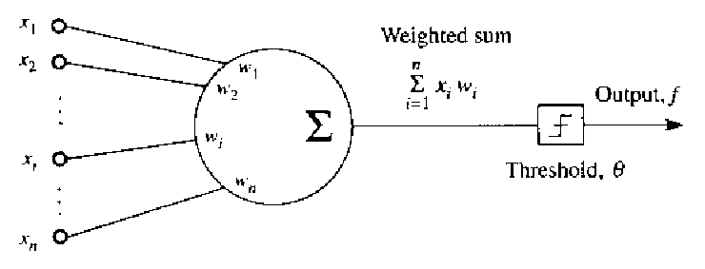

Networks (1/4)
TLU separates the space of input vectors yielding an above-threshold response from those yielding a below-threshold response by a linear space-called a hyperplane
Threshold logic unit (TLU)
  Circuit consists of networks of threshold elements or other elements that compute a nonlinear function of a weighted sum of their inputs
Linearly separable functions
  The boolean functions implementable by a TLU
  Many boolean functions are linearly separable
  Exclusive-or function of two variables is an example of not linearly separable

Slide 15

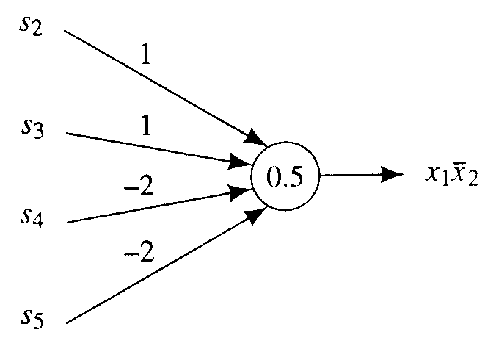
Networks (2/4)
An implementation of the boundary following production rule
Neural network
  Network of TLUs
  For more complex problems
  TLUs are thought to be simple models of biological neurons
  Connection weights
  Threshold value

Slide 16
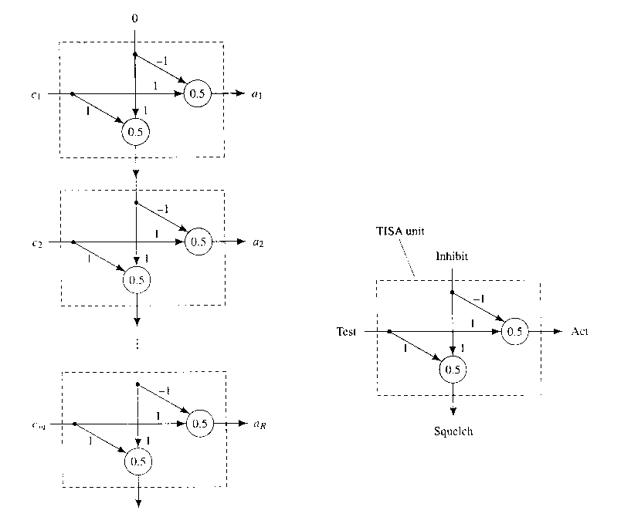
Networks (3/4)
A simple network structure with repeated combination of inverters and AND gates can be used to implement any T-R program

Slide 17
Networks (4/4)
TISA (Test, Inhibit, Squelch, Act)
  Each rule in the T-R program is implemented by a subcircuit (called a TISA) with two inputs and two outputs
  One TLU in the TISA computes the conjunction of one of its input with the complement of the other input; the other TLU computes the disjunction of its two inputs
    The inhibit input =1 when none of the rules above has a true condition
    The test input =1 only if the condition , corresponding to this rule is satisfied
    The act output =1 when the test input =1 and the inhibit input=0
    The squelch output=1 when either the test input or the inhibit input is 1

Slide 18
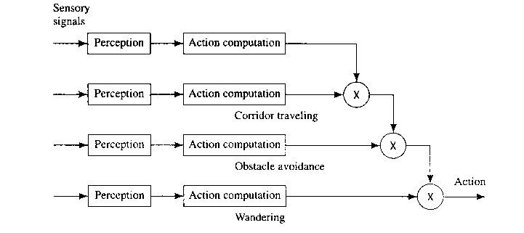
The Subsumption Architecture (1/2)
Proposed by Rodney Brooks
The general idea: An agent’s behavior is controlled by a number of “behavior modules”

Slide 19
The Subsumption Architecture (2/2)
If the sensory inputs satisfy a precondition specific to that module, then a certain behavior program, also specific to that module, is executed
One behavior module can subsume another
Complex behaviors can emerge from the interaction of a relatively simple reactive machine with complex environment

