Slide 1
Chapter 20.
Learning and Acting with Bayes Nets

Slide 2
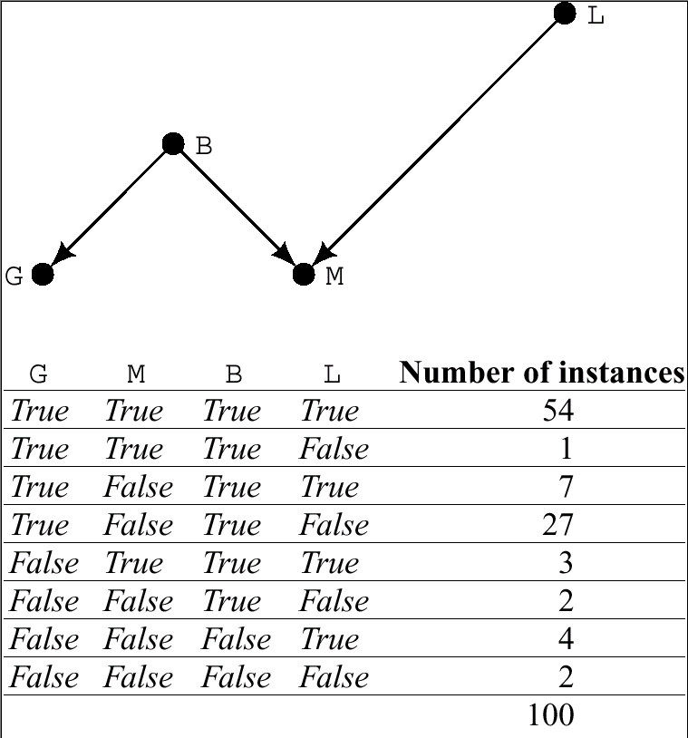
A Network and a Training Data

Slide 3
Learning Bayes Nets
The problem of learning a Bayes network is the problem of finding a network that best matches (according to some scoring metric) a training set of data, Ξ.
  By “finding network”, we mean finding both the structure of the DAG and the conditional probability tables (CPTs) associated with each node in the DAG.
Known network structure
  No missing data
  Missing data
Learning network structure
  The scoring metric
  Searching network space

Slide 4
Known Network Structure
If we knew the structure of the network, we have only to find the CPTs.
No missing data
  Easy
  Each member of the training set Ξ has a value for every variable represented in the network.
Missing data
  More difficult
  The values of some of the variables are missing for some of the training records.

Slide 5
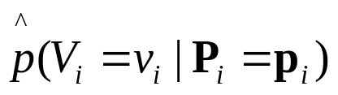
No Missing Data
If we have an ample number of training samples, we have only to compute sample statistics for each node and its parents.
CPT for some node V_{i} given its parents P(V_{i})
  There are as many tables for the node V_{i} as there are different values for V_{i} (less one).
  In Boolean case, just one CPT for a V_{i}.
  If V_{i} have k_{i} parent nodes, then there are 2^{ki} entries (rows) in the table.
  The sample statistics for v_{i} and p_{i}
    Given by the number of samples in Ξ having V_{i} = v_{i} and P_{i} = p_{i} divided by the number of samples having P_{i} = p_{i}

Slide 6
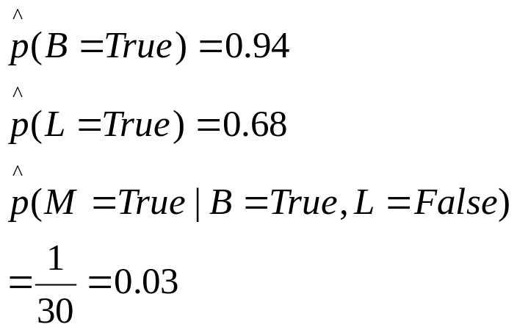
An Example for No Missing Data

Slide 7
Some Notices
Some of the sample statistics in this example are based on very small samples.
  This can lead to possibly inaccurate estimates of the corresponding underlying probabilities.
  In general, the exponentially large number of parameters of a CPT may overwhelm the ability of the training set to produce good estimates of these parameters.
  Mitigating this problem is the possibility that many of the parameters will have the same (or close to the same) value.
It is possible that before samples are observed, we may have prior probabilities for the entries in the CPTs.
  Bayesian updating of the CPTs, given a training set, gives appropriate weight to the prior probabilities.

Slide 8
Missing Data
In gathering training data to be used by a learning process, it frequently happens that some data are missing.
  Sometimes, data are inadvertently missing.
  Sometimes, the fact that data are missing is important in itself.
The latter case is more difficult to deal with than the former.
  In this lecture, we only deal with the former case.

Slide 9
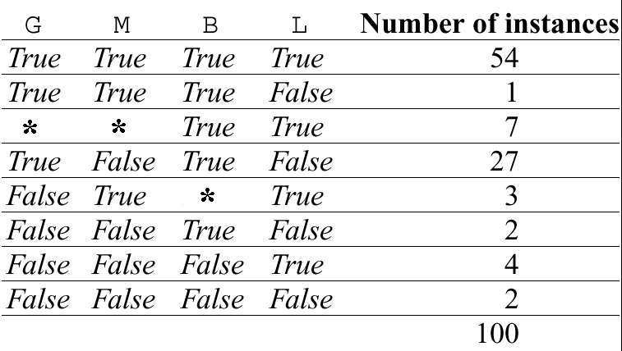
An Example of Missing Data

Slide 10
The Weighted Sample
For the three cases (G, M, B, L) = (False, True, *, True)
  p(B|-G,M,L) could be computed with the CPTs of the network. (Of course, there are no CPTs yet.)
  Then, each of these three examples could be replaced by two weighted samples.
    One in which B = True, weighted by p(B|-G,M,L)
    The other in which B = False, weighted by p(-B|-G,M,L) = 1 – p(B|-G,M,L)
Each of the seven cases (G, M, B, L) = (*, *, True, True) could be replaced by for weighted samples.
Now, the estimates of the CPTs could be computed with the weighted samples and the rest of the samples.

Slide 11
The Expectation-Maximization (EM) Algorithm
First, random values are selected for the parameters in the CPTs for the entire network.
Secondly, the needed weights are computed.
Thirdly, these weights are in turn used to estimate new CPTs.
Then, the second step and the third step are iterated until the CPTs converge.

Slide 12
Learning Network Structure
If the network structure is not known, we must then attempt to find that structure, as well as its associated CPTs, that best fits the training data.
The scoring metric
  To score candidate networks
Searching among possible structures

Slide 13

The Scoring Metric
Several measures can be used to score competing networks.
  One is based on a description length.
The idea based on the description length
  Suppose we wanted to transmit the training set, Ξ, to someone.
  To do so, we encode the values of the variables into a string of bits, and send the bits.
Efficient codes take advantage of the statistical properties of the data to be sent, and it is these statistical properties that we are attempting to model in the Bayes network.
The best encoding requires L(Ξ,B) bits

Slide 14
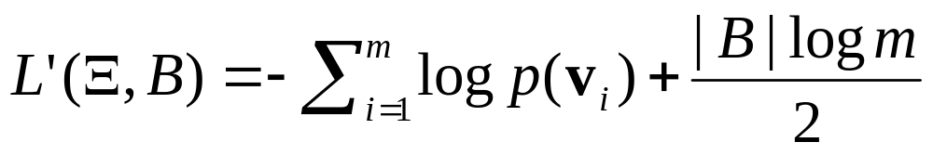
Minimum Description Length
Given some particular data, Ξ, we might to try to find the network B₀ that minimizes L(Ξ,B).
log p[Ξ] (Ξ consists of m samples v₁, …, v_{m}.)
  Given a network structure and a training set, the CPTs that minimize L(Ξ,B) are just those that are obtained from the sample statistics computed from Ξ.
L(Ξ,B) alone favors large networks with many arcs.
  In order to transmit Ξ, we must also transmit a description of B so that the receiver will be able to decode the message.

Slide 15
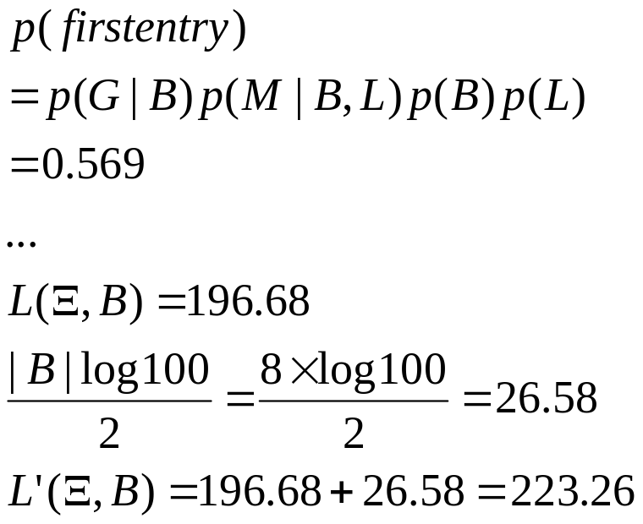
An Example for the Network Score

Slide 16
Searching Network Space
The set of all possible Bayes Nets is so large that we could not even contemplate any kind of exhaustive search.
Hill-descending or greedy search
  We start with a given initial network, evaluate L’(Ξ,B), and then make small changes to it to see if these changes produce networks that decrease L’(Ξ,B).
The computation of description length is decomposable into the computations over each CPT in the network.

Slide 17
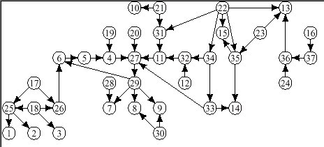
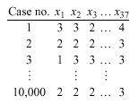
An Example of Structural Learning (1/2)
Target network generates training data.

Slide 18
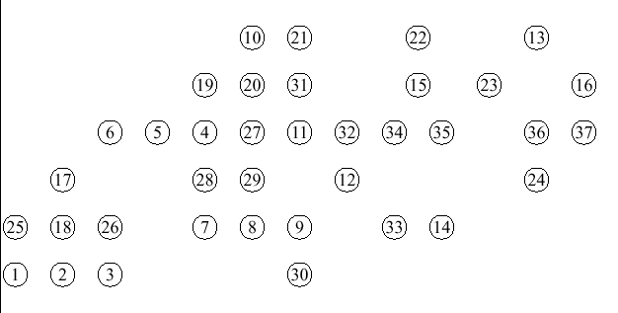
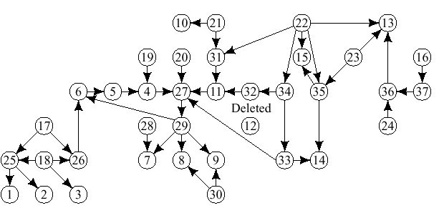
An Example of Structural Learning (2/2)
Induced network learned from prior network and training data

Slide 19
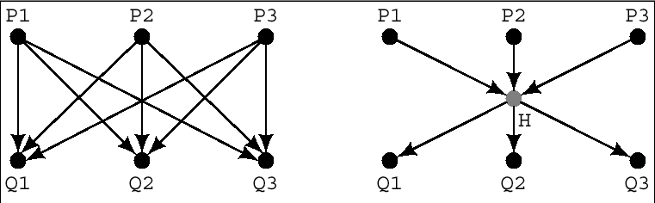
Hidden Nodes
The description-length score of the network on the right will be better if this one also does as well or better at fitting the data.
Hidden nodes can be added in the search process and the values of the corresponding hidden variables are missing, so the EM algorithm is used.

Slide 20
Probabilistic Inference and Action
The general setting
  An agent that uses a sense/plan/act cycle
  A goal
    A schedule of rewards that are given in certain environmental states.
    The rewards induce a value for each state in terms of the total discounted future reward that would be realized by an agent that acted so as to maximize its reward.
  Our new agent knows only the probabilities that it is in various states.
  An action taken in a given state might lead to any one of a set of new states-with a probability associated with each.
    Through planning and sensing, an agent selects the action that maximizes its expected utility.

Slide 21
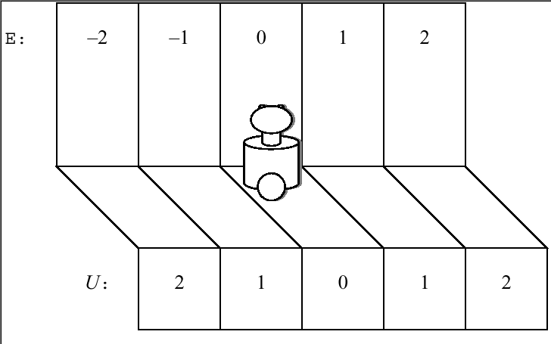
An Extended Example
  E: a state variable {-2, -1, 0, 1, 2}
  Each location has a utility U.
  E₀ = 0
  A_{i}: the action at the i-th time step {L, R}
    A successful move 0.5; no effect 0.25; an opposite move 0.25
    S_{i}: the sensory signal at the i-th time step
  The same value with E_{i} 0.9; Each of the other values 0.025

Slide 22
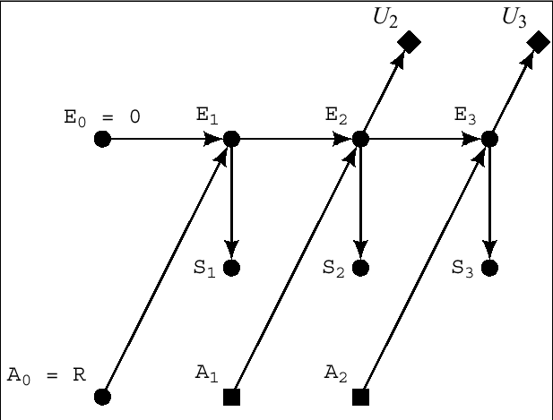
Dynamic Decision Networks (1/2)

Slide 23
Dynamic Decision Networks (2/2)
A special type of belief network
After given the values E₀ = 0, A₀ = R, and S₁ = 1, we can use ordinary probabilistic inference to calculate the expected utility value, U₂, that would result first from A₁ = R, and then from A₁ = L.
Box-shaped nodes (): decision nodes
Diamond-shaped nodes (): utility variables

Slide 24
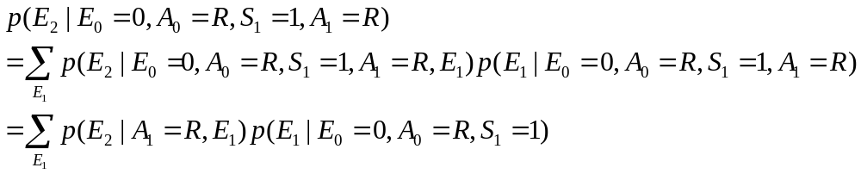
Computation of Ex[U₂] (1/2)
The environment is Markovian by this network structure.
Ex[U₂|E₀ = 0, A₀ = R, S₁ = 1, A₁ = R]
Ex[U₂|E₀ = 0, A₀ = R, S₁ = 1, A₁ = L]
Using the polytree algorithm

Slide 25
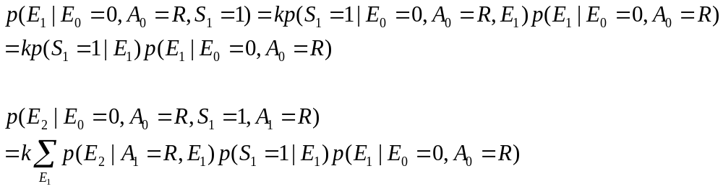
Computation of Ex[U₂] (2/2)
With this probability, the Ex[U₂] given A₁=R can be calculated.
Similarly, Ex[U₂] given A₁=L can be calculated.
Then the action that yields the larger value is selected.

Slide 26
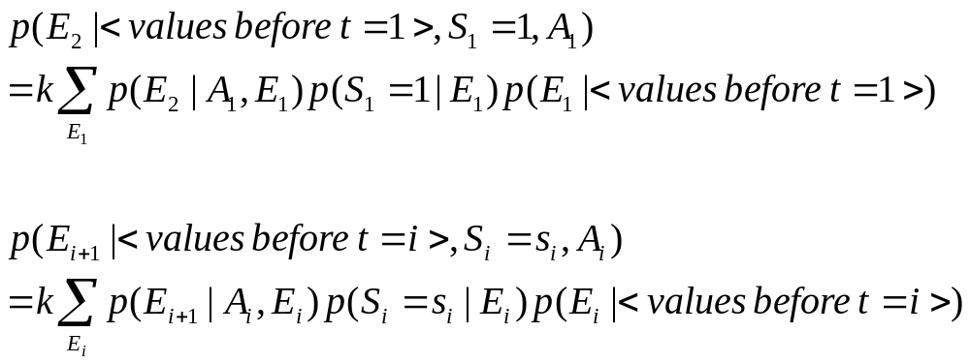
Generalizing the Example

Slide 27
Making Decisions about Actions (1/2)
From the last time step, (i - 1) (and after sensing S_{i – 1} = s_{i - 1}), we have already calculated p(E_{i}|<values before t = i>) for all values of E_{i}.
At time t = i, we sense S_{i} = s_{i} and use the sensor model to calculate p(S_{i} = s_{i}|E_{i}) for all values of E_{i}.
From the action model, we calculate p(E_{i + 1}|A_{i}, E_{i}) for all values of E_{i} and A_{i}.
For each value of A_{i}, and for a particular value of E_{i + 1}, we sum the product p(E_{i + 1}|A_{i}, E_{i})p(S_{i} = s_{i}|E_{i})p(E_{i}|<values before t = i>) over all values E_{i} and multiply by a constant, k, to yield values proportional to p(E_{i + 1}|<values before t = i>, S_{i} = s_{i}, A_{i}).

Slide 28
Making Decisions about Actions (2/2)
We repeat the preceding step for all the other values of E_{i+1} and calculate the constant k to get the actual values of p(E_{i+1}|<values before t = i>, S_{i} = s_{i}, A_{i}) for each value of E_{i+1} and A_{i}.
Using these probability values, we calculate the expected value of U_{i+1} for each value of A_{i}, and select that A_{i} that maximizes that expected value.
We take the action selected in the previous step, advance i by 1, and iterate.

Slide 29
Additional Readings and Discussion
Learning Bayes nets is an active field of research with important new papers appearing annually.
[Neal 1991] describes methods for learning Bayes nets using neural networks.
[Friedman 1997] describes a technique for learning Bayes nets when both the structure of the network is unknown and when there is missing data.
The evaluation of utilities in stochastic situation constitutes the subject matter of decision theory.

