Slide 1
Artificial Intelligence
Chapter 4.
Machine Evolution
Biointelligence Lab
School of Computer Sci. & Eng.
Seoul National University

Slide 2
Overview
Introduction
  Biological Background
  What is an Evolutionary Computation?
Components of EC
Genetic Algorithm
Genetic Programming
Summary
  Applications of EC
  Advantage & disadvantage of EC
Further Information

Slide 3
Introduction

Slide 4
Biological Basis
Biological systems adapt themselves to a new environment by evolution.
  Generations of descendants are produced that perform better than do their ancestors.
Biological evolution
  Production of descendants changed from their parents
  Selective survival of some of these descendants to produce more descendants

Slide 5
Darwinian Evolution (1/2)
Survival of the Fittest
  All environments have finite resources (i.e., can only support a limited number of individuals.)
  Lifeforms have basic instinct/ lifecycles geared towards reproduction.
  Therefore some kind of selection is inevitable.
  Those individuals that compete for the resources most effectively have increased chance of reproduction.

Slide 6
Darwinian Evolution (2/2)
Diversity drives change.
  Phenotypic traits:
    Behaviour / physical differences that affect response to environment
    Partly determined by inheritance, partly by factors during development
    Unique to each individual, partly as a result of random changes
  If phenotypic traits:
    Lead to higher chances of reproduction
    Can be inherited
  then they will tend to increase in subsequent generations,
  leading to new combinations of traits …

Slide 7
Evolutionary Computation
What is the Evolutionary Computation?
  Stochastic search (or problem solving) techniques that mimic the metaphor of natural biological evolution.
Metaphor
EVOLUTION
Individual
Fitness
Environment
PROBLEM SOLVING
Candidate Solution
Quality
Problem

Slide 8
General Framework of EC
Generate Initial Population
Fitness Function
Evaluate Fitness
Termination Condition?
Yes
Best Individual
No
Select Parents
Crossover, Mutation
Generate New Offspring

Slide 9
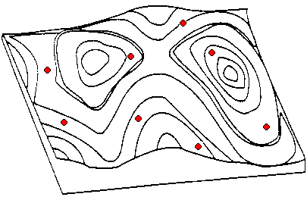
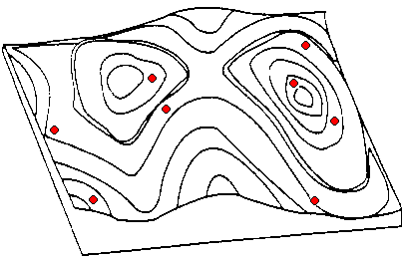
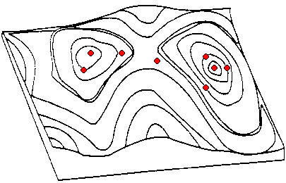
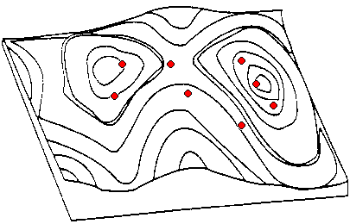
Geometric Analogy - Mathematical Landscape

Slide 10
Paradigms in EC
Evolutionary Programming (EP)
  [L. Fogel et al., 1966]
  FSMs, mutation only, tournament selection
Evolution Strategy (ES)
  [I. Rechenberg, 1973]
  Real values, mainly mutation, ranking selection
Genetic Algorithm (GA)
  [J. Holland, 1975]
  Bitstrings, mainly crossover, proportionate selection
Genetic Programming (GP)
  [J. Koza, 1992]
  Trees, mainly crossover, proportionate selection

Slide 11
Components of EC

Slide 12
Example: the 8 queens problem
Place 8 queens on an 8x8 chessboard in such a way that they cannot check each other.

Slide 13
Representations
Candidate solutions (individuals) exist in phenotype space.
They are encoded in chromosomes, which exist in genotype space.
Encoding : phenotype → genotype (not necessarily one to one)
Decoding : genotype → phenotype (must be one to one)
Chromosomes contain genes, which are in (usually fixed) positions called loci (sing. locus) and have a value (allele).
In order to find the global optimum, every feasible solution must be represented in genotype space.

Slide 14
The 8 queens problem: representation
Phenotype:
a board configuration
Genotype:
a permutation of
the numbers 1 - 8
Obvious mapping
1
3
5
2
6
4
7
8

Slide 15
Population
Holds (representations of) possible solutions
Usually has a fixed size and is a multiset of genotypes
Some sophisticated EAs also assert a spatial structure on the population e.g., a grid.
Selection operators usually take whole population into account i.e., reproductive probabilities are relative to current generation.
Diversity of a population refers to the number of different fitnesses / phenotypes / genotypes present (note not the same thing)

Slide 16
Fitness Function
Represents the requirements that the population should adapt to
a.k.a. quality function or objective function
Assigns a single real-valued fitness to each phenotype which forms the basis for selection
  So the more discrimination (different values) the better
Typically we talk about fitness being maximised
  Some problems may be best posed as minimisation problems, but conversion is trivial.

Slide 17
8 Queens Problem: Fitness evaluation
Penalty of one queen:
  the number of queens she can check
Penalty of a configuration:
  the sum of the penalties of all queens
Note: penalty is to be minimized
Fitness of a configuration:
  inverse penalty to be maximized

Slide 18
Parent Selection Mechanism
Assigns variable probabilities of individuals acting as parents depending on their fitnesses.
Usually probabilistic
  high quality solutions more likely to become parents than low quality
  but not guaranteed
  even worst in current population usually has non-zero probability of becoming a parent
This stochastic nature can aid escape from local optima.

Slide 19
Variation operators (1/2)
Crossover (Recombination)
  Merges information from parents into offspring.
  Choice of what information to merge is stochastic.
  Most offspring may be worse, or the same as the parents.
  Hope is that some are better by combining elements of genotypes that lead to good traits.
  Principle has been used for millennia by breeders of plants and livestock
Example
1
3
5
2
6
4
7
8
1
3
5
4
2
8
7
6
8
7
6
5
4
3
2
1
8
7
6
2
4
1
3
5

Slide 20
Variation operators (2/2)
Mutation
  It is applied to one genotype and delivers a (slightly) modified mutant, the child or offspring of it.
  Element of randomness is essential.
  The role of mutation in EC is different in various EC dialects.
Example
  swapping values of two randomly chosen positions
1
3
5
2
6
4
7
8
1
3
7
2
6
4
5
8

Slide 21
Initialization / Termination
Initialization usually done at random,
  Need to ensure even spread and mixture of possible allele values
  Can include existing solutions, or use problem-specific heuristics, to “seed” the population
Termination condition checked every generation
  Reaching some (known/hoped for) fitness
  Reaching some maximum allowed number of generations
  Reaching some minimum level of diversity
  Reaching some specified number of generations without fitness improvement

Slide 22
Genetic Algorithms

Slide 23
(Simple) Genetic Algorithm (1/5)
Genetic Representation
  Chromosome
    A solution of the problem to be solved is normally represented as a chromosome which is also called an individual.
    This is represented as a bit string.
    This string may encode integers, real numbers, sets, or whatever.
  Population
    GA uses a number of chromosomes at a time called a population.
    The population evolves over a number of generations towards a better solution.

Slide 24
Genetic Algorithm (2/5)
Fitness Function
  The GA search is guided by a fitness function which returns a single numeric value indicating the fitness of a chromosome.
  The fitness is maximized or minimized depending on the problems.
  Eg) The number of 1's in the chromosome Numerical functions

Slide 25
Genetic Algorithm (3/5)
Selection
  Selecting individuals to be parents
  Chromosomes with a higher fitness value will have a higher probability of contributing one or more offspring in the next generation
  Variation of Selection
    Proportional (Roulette wheel) selection
    Tournament selection
    Ranking-based selection

Slide 26
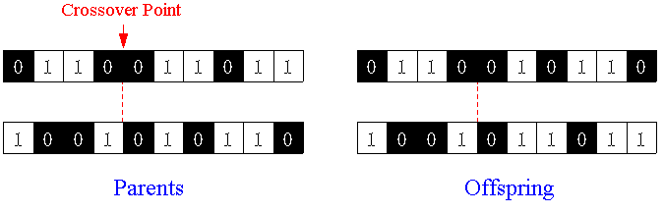
Genetic Algorithm (4/5)
Genetic Operators
  Crossover (1-point)
    A crossover point is selected at random and parts of the two parent chromosomes are swapped to create two offspring with a probability which is called crossover rate.
    This mixing of genetic material provides a very efficient and robust search method.
    Several different forms of crossover such as k-points, uniform

Slide 27
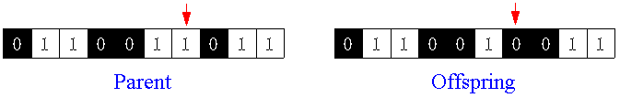
Genetic Algorithm (5/5)
  Mutation
    Mutation changes a bit from 0 to 1 or 1 to 0 with a probability which is called mutation rate.
    The mutation rate is usually very small (e.g., 0.001).
    It may result in a random search, rather than the guided search produced by crossover.
  Reproduction
    Parent(s) is (are) copied into next generation without crossover and mutation.

Slide 28
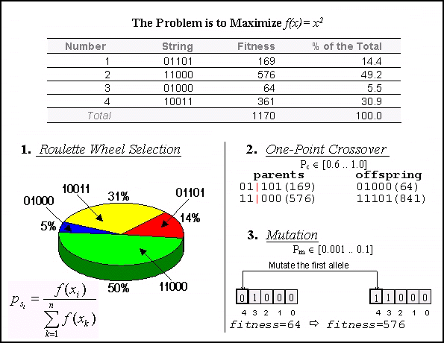
Example of Genetic Algorithm

Slide 29
Genetic Programming

Slide 30
Genetic Programming
Genetic programming uses variable-size tree-representations rather than fixed-length strings of binary values.
Program tree
= S-expression
= LISP parse tree
Tree = Functions (Nonterminals) + Terminals

Slide 31
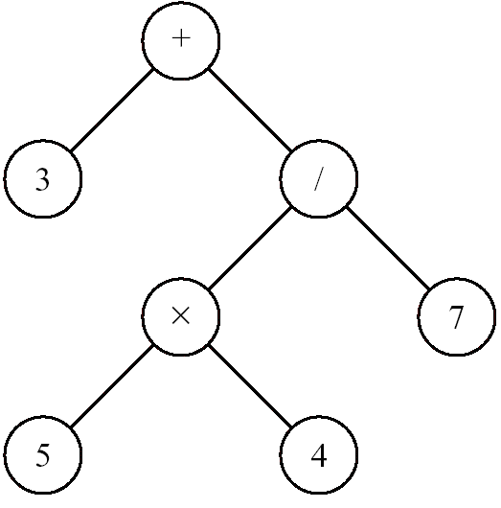
GP Tree: An Example
Function set: internal nodes
  Functions, predicates, or actions which take one or more arguments
Terminal set: leaf nodes
  Program constants, actions, or functions which take no arguments
S-expression: (+ 3 (/ (× 5 4) 7))
Terminals = {3, 4, 5, 7}
Functions = {+, ×, /}

Slide 32
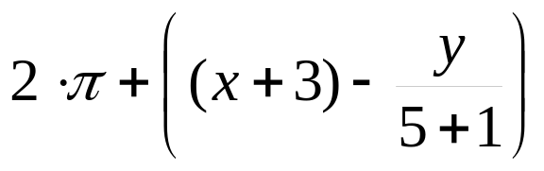
Tree based representation
Trees are a universal form, e.g. consider
Arithmetic formula
Logical formula
Program
(x ∧ true) → (( x ∨ y ) ∨ (z ↔ (x ∧ y)))
i =1;
while (i < 20)
{
i = i +1
}

Slide 33
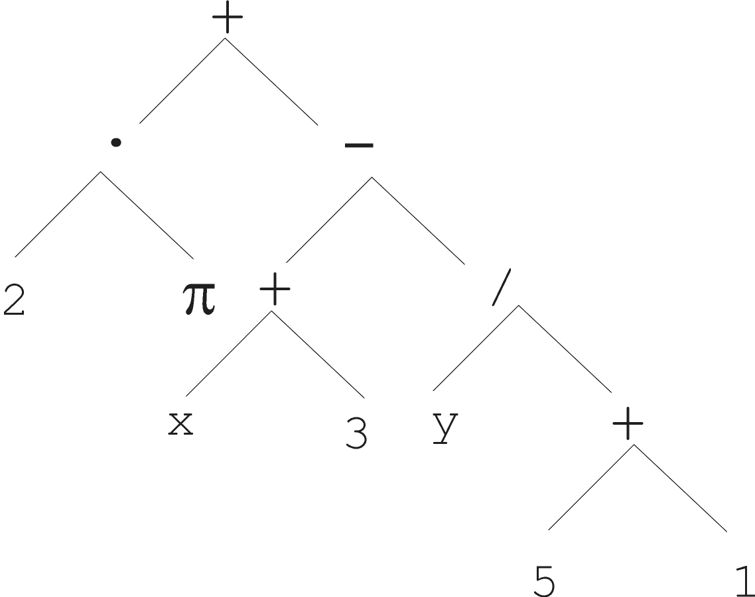
Tree based representation

Slide 34
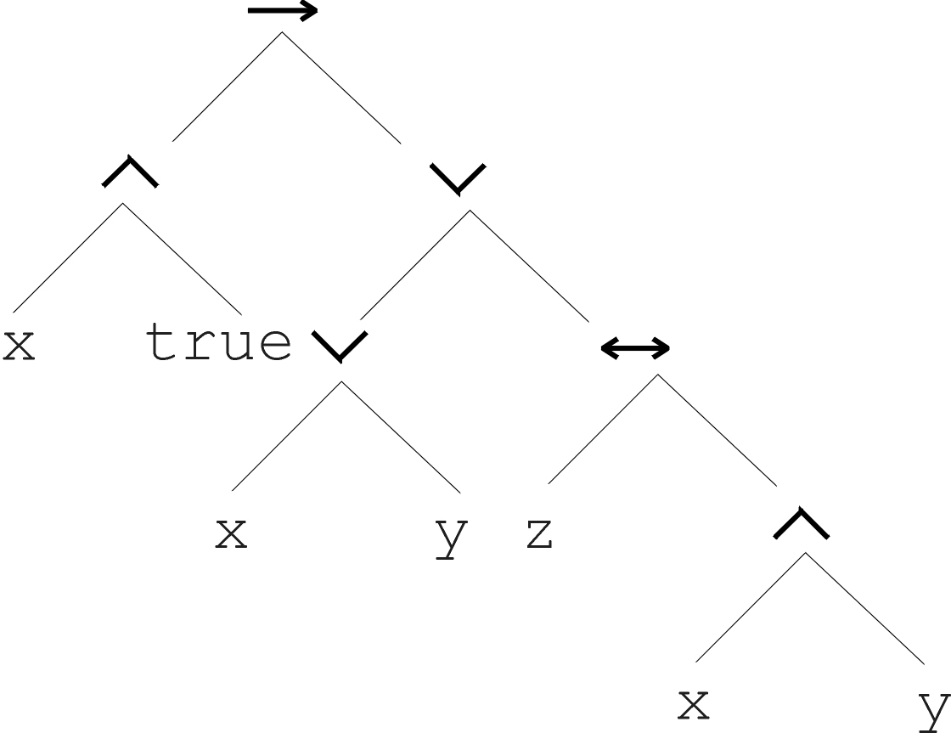
Tree based representation
(x ∧ true) → (( x ∨ y ) ∨ (z ↔ (x ∧ y)))

Slide 35
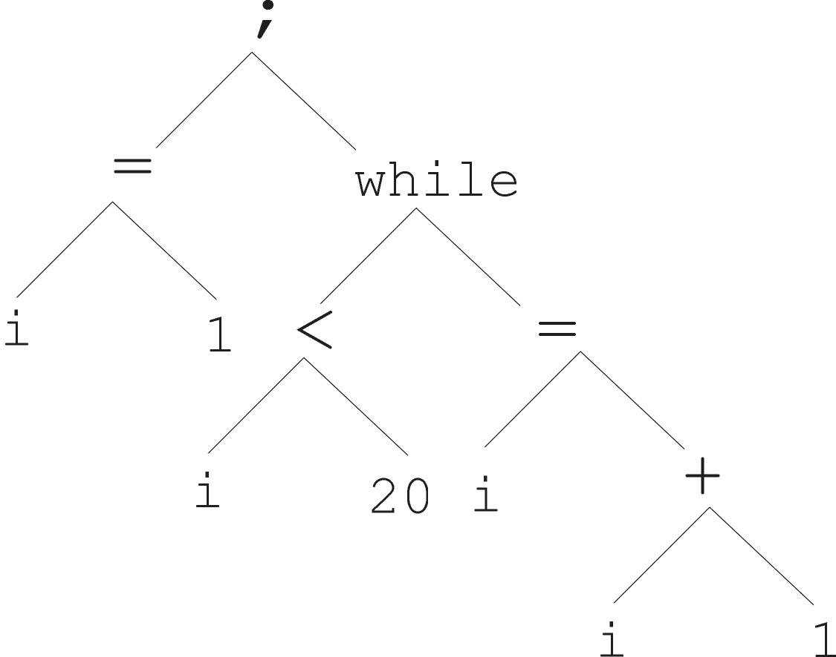
Tree based representation
i =1;
while (i < 20)
{
i = i +1
}

Slide 36
Tree based representation
In GA, ES, EP chromosomes are linear structures (bit strings, integer string, real-valued vectors, permutations)
Tree shaped chromosomes are non-linear structures.
In GA, ES, EP the size of the chromosomes is fixed.
Trees in GP may vary in depth and width.

Slide 37
Introductory example: credit scoring
Bank wants to distinguish good from bad loan applicants
Model needed that matches historical data
ID | No of children | Salary | Marital status | OK?
ID-1 | 2 | 45000 | Married | 0
ID-2 | 0 | 30000 | Single | 1
ID-3 | 1 | 40000 | Divorced | 1
…

Slide 38
Introductory example: credit scoring
A possible model:
IF (NOC = 2) AND (S > 80000) THEN good ELSE bad
In general:
IF formula THEN good ELSE bad
Only unknown is the right formula, hence
Our search space (phenotypes) is the set of formulas
Natural fitness of a formula: percentage of well classified cases of the model it stands for
Natural representation of formulas (genotypes) is: parse trees

Slide 39
Introductory example: credit scoring
IF (NOC = 2) AND (S > 80000) THEN good ELSE bad
can be represented by the following tree
AND
=
>
NOC
2
S
80000

Slide 40
Setting Up for a GP Run
The set of terminals
The set of functions
The fitness measure
The algorithm parameters
  population size, maximum number of generations
  crossover rate and mutation rate
  maximum depth of GP trees etc.
The method for designating a result and the criterion for terminating a run.

Slide 41
Crossover: Subtree Exchange
+
+
×
+
×
√
b
a
b
b
√
√
√
a
a
b
+
+
×
×
+
√
√
√
a
b
b
√
b
a
b
a

Slide 42
Mutation
+
+
/
×
/
+
b
√
a
b
b
√
√
-
a
a
b
b
a

Slide 43
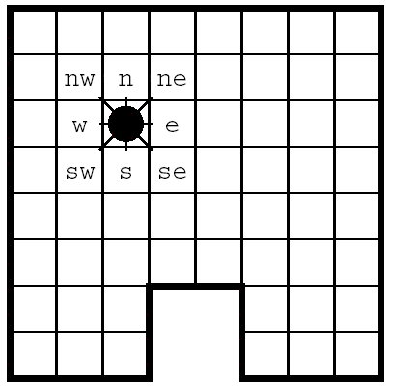
Example: Wall-Following Robot
Program Representation in GP
  Functions
    AND (x, y) = 0 if x = 0; else y
    OR (x, y) = 1 if x = 1; else y
    NOT (x) = 0 if x = 1; else 1
    IF (x, y, z) = y if x = 1; else z
  Terminals
    Actions: move the robot one cell to each direction {north, east, south, west}
    Sensory input: its value is 0 whenever the coressponding cell is free for the robot to occupy; otherwise, 1. {n, ne, e, se, s, sw, w, nw}

Slide 44
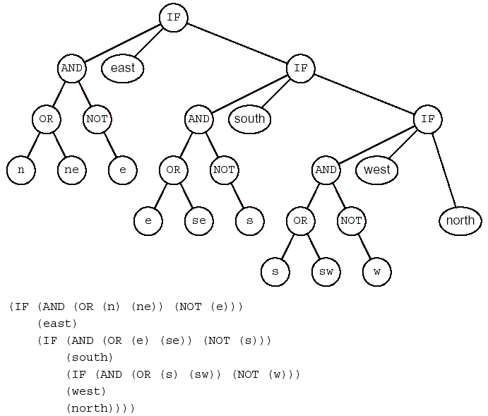
A Wall-Following Program

Slide 45
Evolving a Wall-Following Robot (1)
Experimental Setup
  Population size: 5,000
  Fitness measure: the number of cells next to the wall that are visited during 60 steps
    Perfect score (320)
      One Run (32) × 10 randomly chosen starting points
  Termination condition: found perfect solution
  Selection: tournament selection

Slide 46
Evolving a Wall-Following Robot (2)
Creating Next Generation
  500 programs (10%) are copied directly into next generation.
    Tournament selection
      7 programs are randomly selected from the population 5,000.
      The most fit of these 7 programs is chosen.
  4,500 programs (90%) are generated by crossover.
    A mother and a father are each chosen by tournament selection.
    A randomly chosen subtree from the father replaces a randomly selected subtree from the mother.
  In this example, mutation was not used.

Slide 47
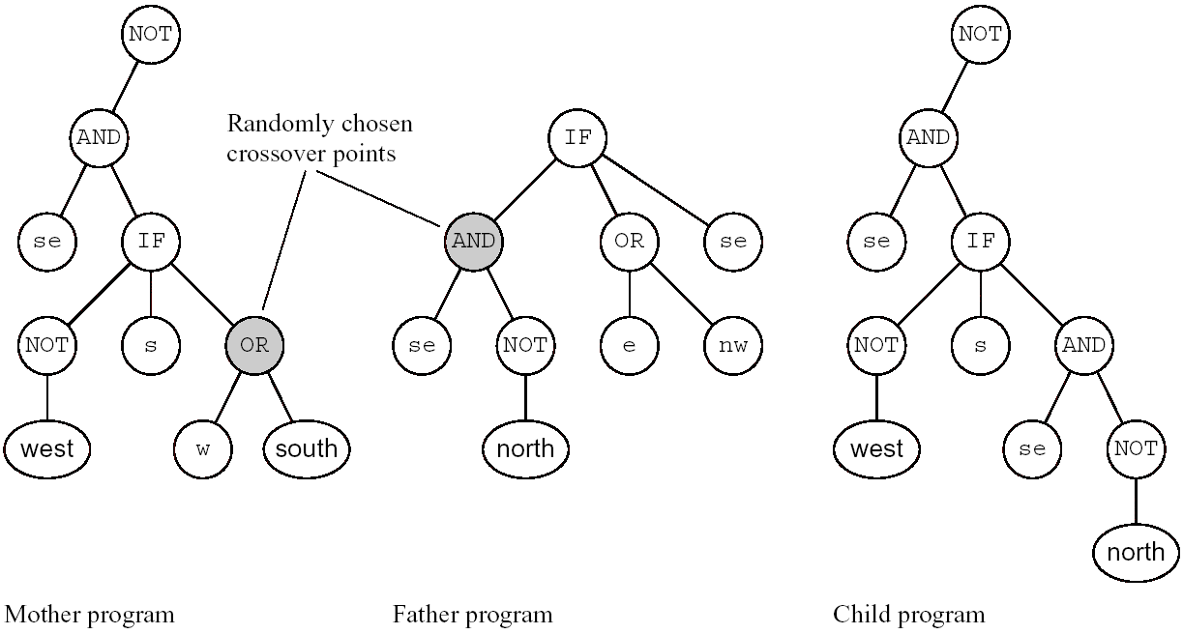
Two Parents Programs and Their Child

Slide 48
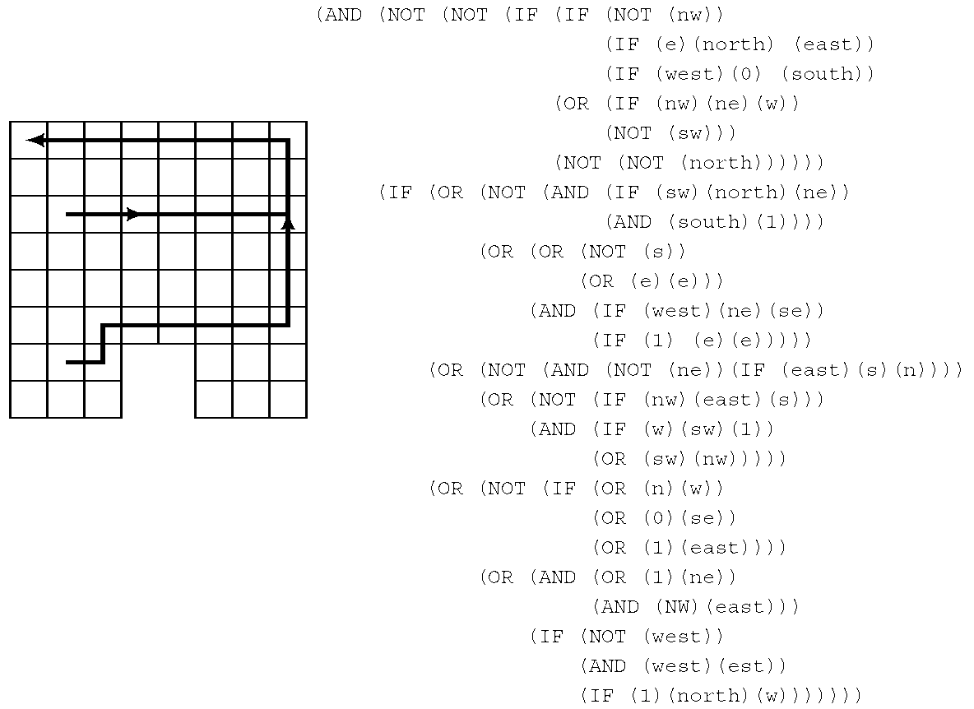
Result (1/5)
Generation 0
  The most fit program (fitness = 92)
    Starting in any cell, this program moves east until it reaches a cell next to the wall; then it moves north until it can move east again or it moves west and gets trapped in the upper-left cell.

Slide 49
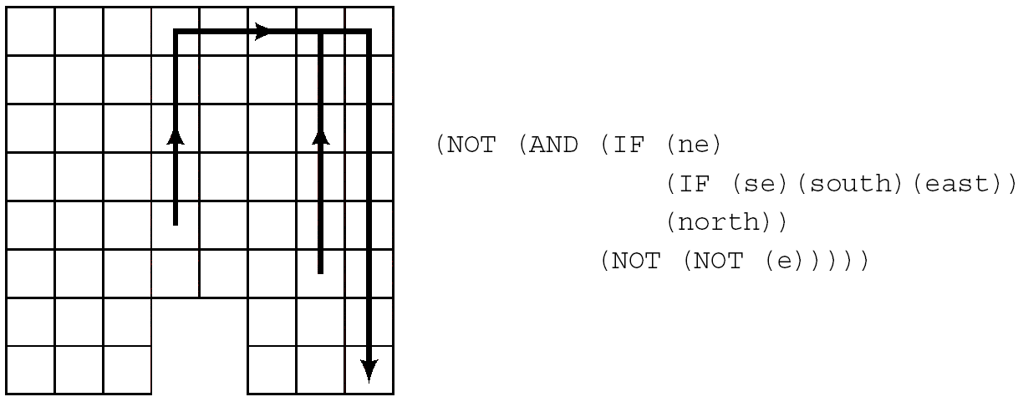
Result (2/5)
Generation 2
  The most fit program (fitness = 117)
    Smaller than the best one of generation 0, but it does get stuck in the lower-right corner.

Slide 50
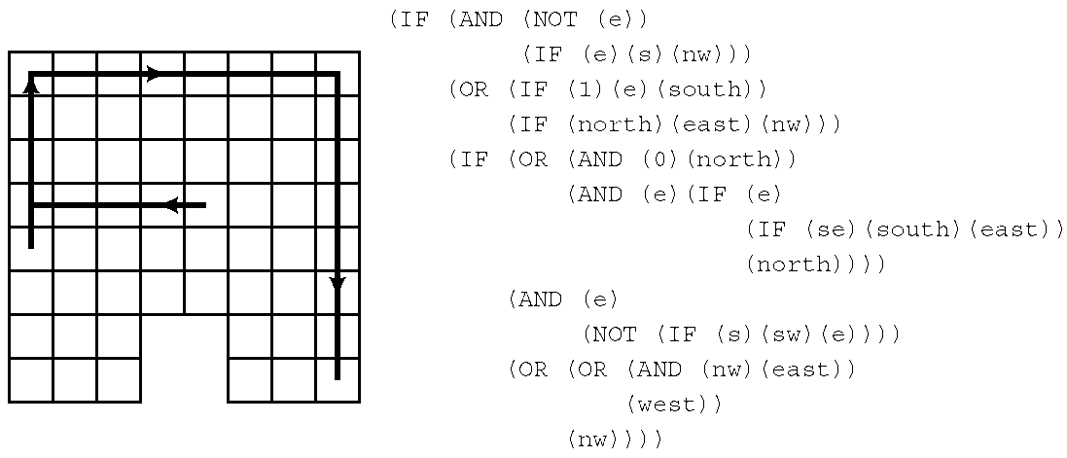
Result (3/5)
Generation 6
  The most fit program (fitness = 163)
    Following the wall perfectly but still gets stuck in the bottom-right corner.

Slide 51
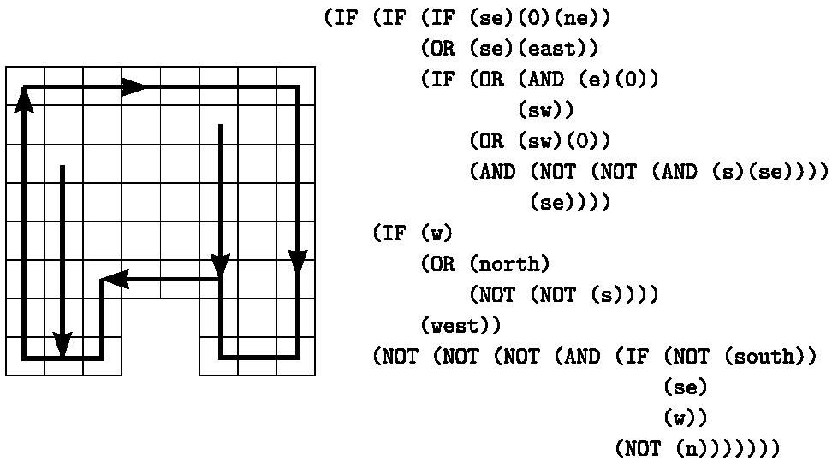
Result (4/5)
Generation 10
  The most fit program (fitness = 320)
    Following the wall around clockwise and moves south to the wall if it doesn’t start next to it.

Slide 52
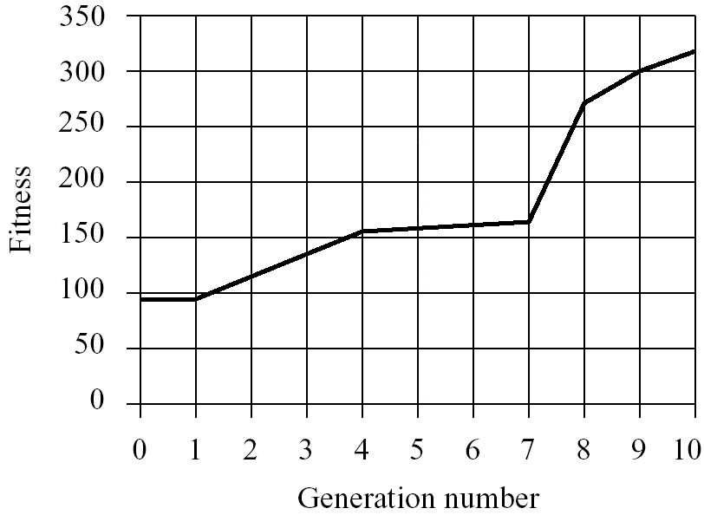
Result (5/5)
Fitness Curve
  Fitness as a function of generation number
    The progressive (but often small) improvement from generation to generation

Slide 53
Summary

Slide 54
Recapitulation of EA
EAs fall into the category of “generate and test” algorithms.
They are stochastic, population-based algorithms.
Variation operators (recombination and mutation) create the necessary diversity and thereby facilitate novelty.
Selection reduces diversity and acts as a force pushing quality.

Slide 55
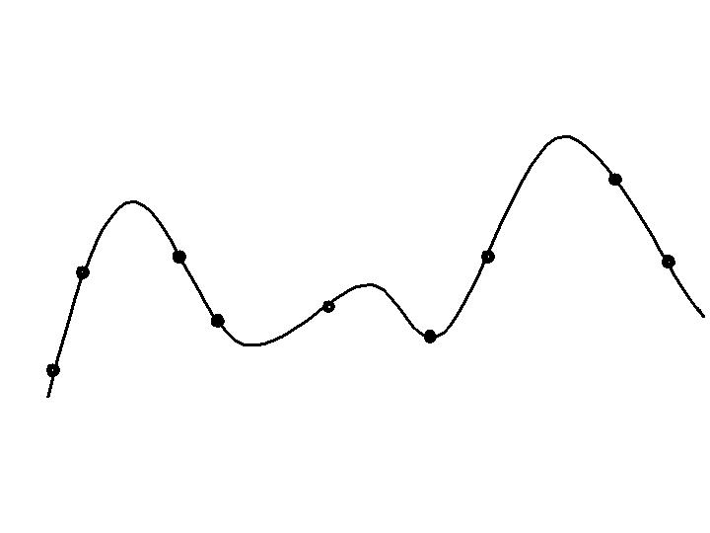
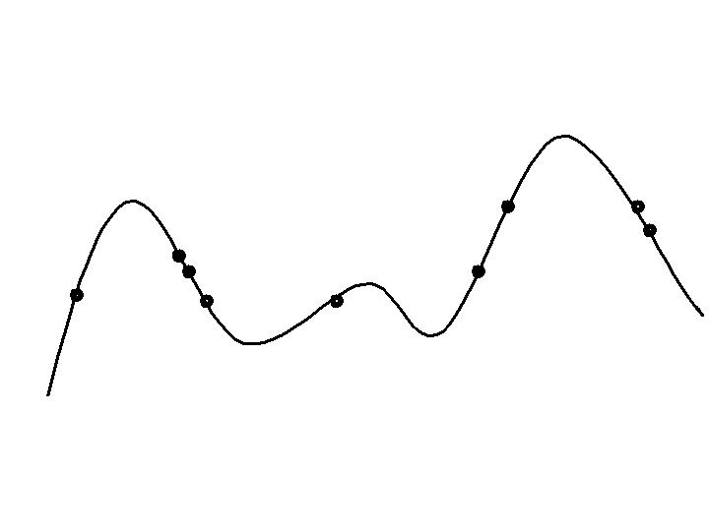
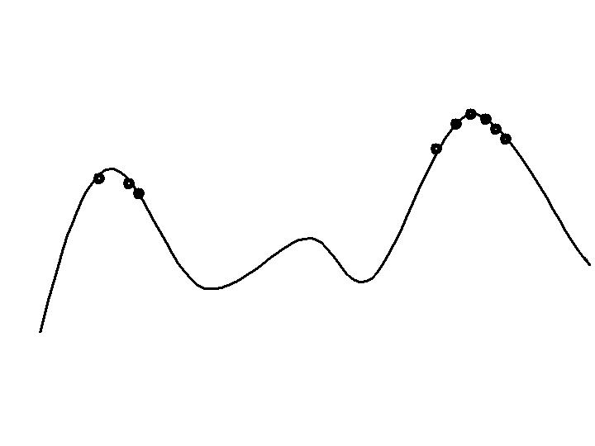
Typical behavior of an EA
Phases in optimizing on a 1-dimensional fitness landscape
Early phase:
quasi-random population distribution
Mid-phase:
population arranged around/on hills
Late phase:
population concentrated on high hills

Slide 56
Typical run: progression of fitness
Best fitness in population
Time (number of generations)
Typical run of an EA shows so-called “anytime behavior”

Slide 57
Are long runs beneficial?
Progress in 2nd half
Best fitness in population
Progress in 1st half
Time (number of generations)
Answer:
- it depends how much you want the last bit of progress
- it may be better to do more shorter runs

Slide 58
Evolutionary Algorithms in Context
There are many views on the use of EAs as robust problem solving tools
For most problems a problem-specific tool may:
  perform better than a generic search algorithm on most instances,
  have limited utility,
  not do well on all instances
Goal is to provide robust tools that provide:
  evenly good performance
  over a range of problems and instances

Slide 59
EAs as problem solvers:
Goldberg’s 1989 view
Special, problem tailored method
Evolutionary algorithm
Performance of methods on problems
Random search
Scale of “all” problems

Slide 60
Applications of EC
Numerical, Combinatorial Optimization
System Modeling and Identification
Planning and Control
Engineering Design
Data Mining
Machine Learning
Artificial Life

Slide 61
Advantages of EC
No presumptions w.r.t. problem space
Widely applicable
Low development & application costs
Easy to incorporate other methods
Solutions are interpretable (unlike NN)
Can be run interactively, accommodate user proposed solutions
Provide many alternative solutions

Slide 62
Disadvantages of EC
No guarantee for optimal solution within finite time
Weak theoretical basis
May need parameter tuning
Often computationally expensive, i.e. slow

Slide 63
Further Information on EC
Conferences
  IEEE Congress on Evolutionary Computation (CEC)
  Genetic and Evolutionary Computation Conference (GECCO)
  Parallel Problem Solving from Nature (PPSN)
  Foundation of Genetic Algorithms (FOGA)
  EuroGP, EvoCOP, and EvoWorkshops
  Int. Conf. on Simulated Evolution and Learning (SEAL)
Journals
  IEEE Transactions on Evolutionary Computation
  Evolutionary Computation
  Genetic Programming and Evolvable Machines

Slide 64
References
Main Text
  Chapter 4
Introduction to Evolutionary Computing
  A. E. Eiben and J. E Smith, Springer, 2003
Web sites
  http://evonet.lri.fr/
  http://www.isgec.org/
  http://www.genetic-programming.org/

