Slide 1
Version Space의 실험적 고찰 ii
2002.1.25
장해만

Slide 2
Introduction
Version space
Sequencing ; methods , price , etc
Pyrosequencing methods
discussion

Slide 3
Encoding.2(2)
Edge
cs-T’ | faculty-H’
Graph for All Hypothesis
cs-T’ | staff-H’
cs-T’ | five-H’
Vertex
cs
ee
cs-T’ | four-H’
cs-H | cs-T
ee-T’ | faculty-H’
ee-H | ee-T
ee-T’ | staff-H’
four
faculty-H | faculty-T
ee-T’ | five-H’
faculty
staff-H | staff-T
ee-T’ | four-H’
four-H | four-T
faculty-T’ | four-H’
five-H | five-T
faculty-T’ | five-H’
staff
five
staff-T’ | four-H’
+ Dummy strand for blunt end?
staff-T’ | five-H’

Slide 4
Version Space
available method 1
1. vertex 와 edge(PNA)를 이용, 가능한 모든 pool 합성
2. positive seq. 제작
3. hybridization in pool
4. PAGE로 위치확인
5. gel elution
6. PCR , 적정농도의 pool 형성 ---1st generalize
7. 2~6 반복 ( 단, positive일 경우)
negative example ???
DNA breaks down in gel elution

Slide 5
Detection
Implementation of ‘∩’ operation
  최초의 Tube1(0)는 앞서 encoding.2 에서 제안한대로 생성한다.(single strand)
  이후의 example에 대해 생성되는 모든 Tube2는 tube1(0)과 encoding을 complementary하게한다.
  (single strand)
  Tube2를 Tube1에 넣어 hybridization시켜 서로 완전히 결합한 double strand만을 뽑아낸다.
  (전기영동)
  앞의 결과물을 denature시켜 최초의 Tube1(0)과 같은 방향으로 encoding된 한쪽 single strand만을 다시 추출해낸다.

Slide 6
Commercial DNA sequencing serives.
Single - Primer Sequencing Services
Dye Labeled Primer Sequencing Method
Dye Primer DNA Sequencing Method
Direct Sequencing of PCR Product
Pyrosequencing services

Slide 7
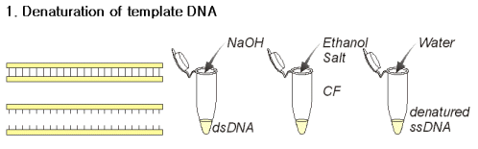
Primer DNA Sequencing Method

Slide 8
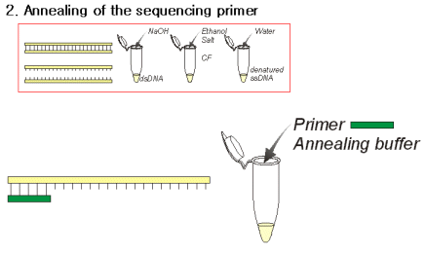
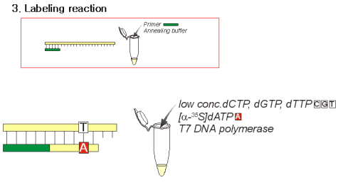

Slide 9
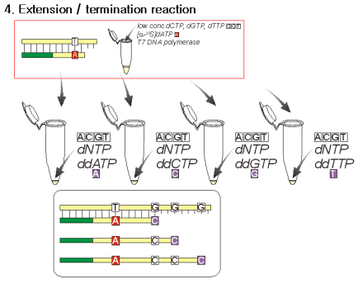

Slide 10
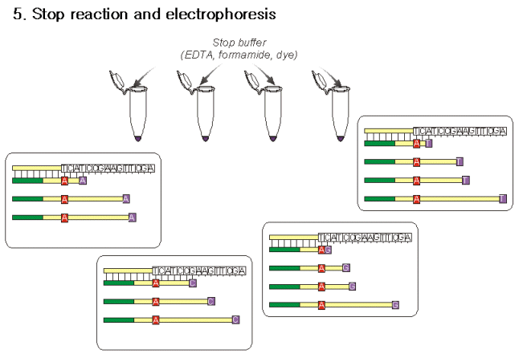

Slide 11
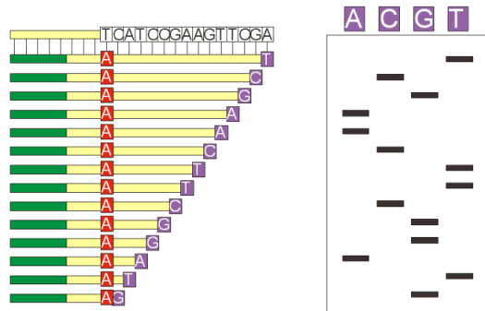

Slide 12
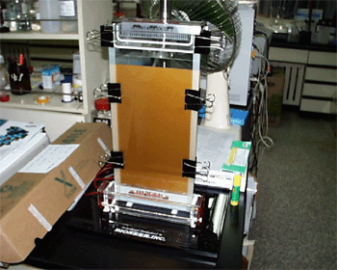

Slide 13
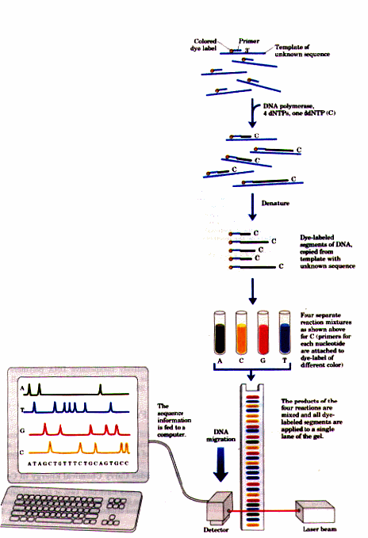

Slide 14
sequencing services.(국내)
First 400bp 19,000원
up to 1kb 40원/bp
primer size 19 ~ 25bp
delivery 통상4일
(결과분석 ▷ 분석가격통보 ▷ 분석료입금 ▷ Seq 결과발송)
필요 시료량 최소0.2 ㎍/㎕

Slide 15
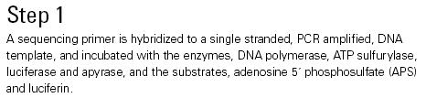
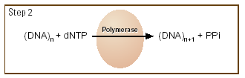
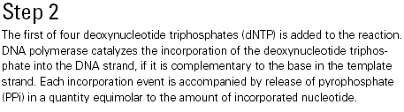
Pyrosequencing

Slide 16
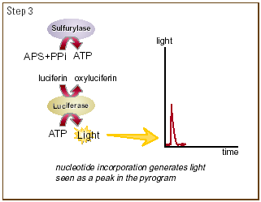
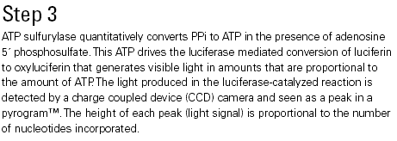

Slide 17


