Slide 1
PD Program
Park, Ji-Yoon
2002. 3. 8

Slide 2
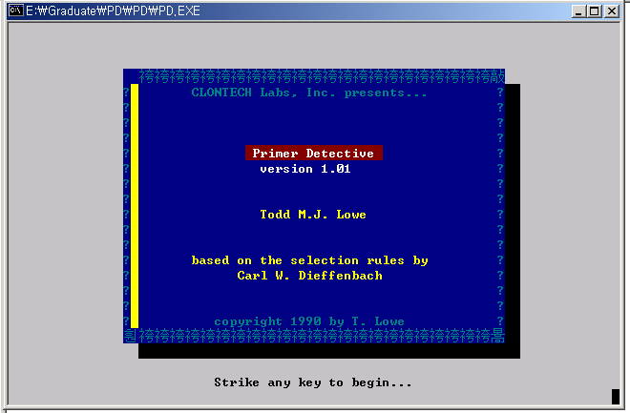

Slide 3
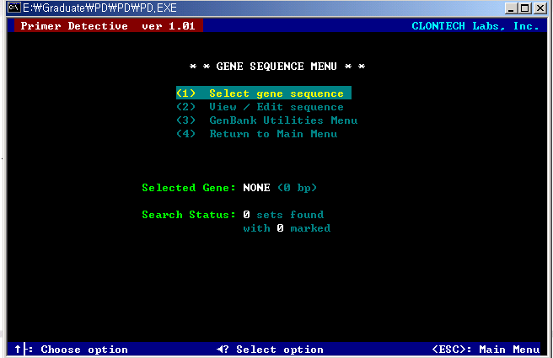

Slide 4
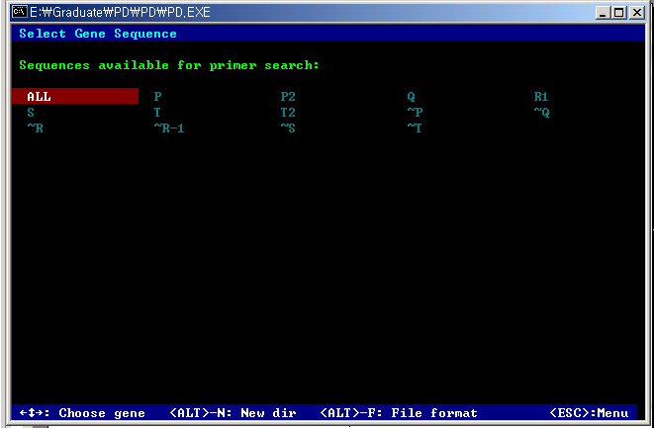

Slide 5
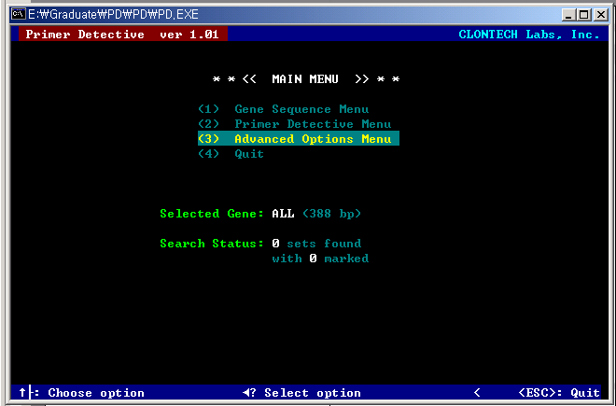

Slide 6
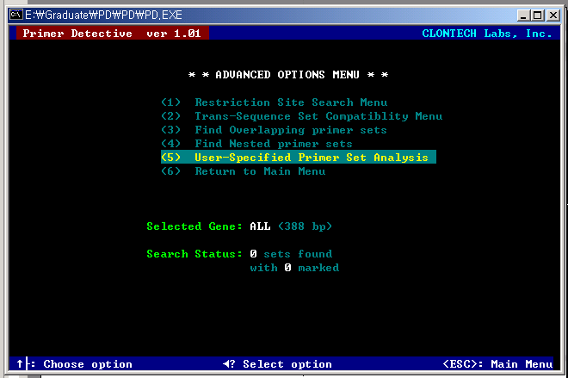

Slide 7
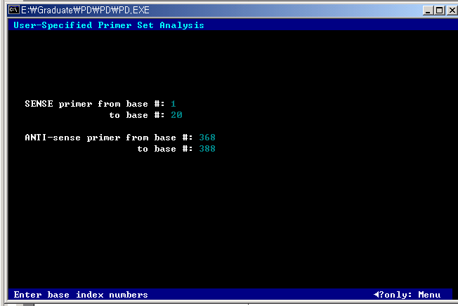

Slide 8
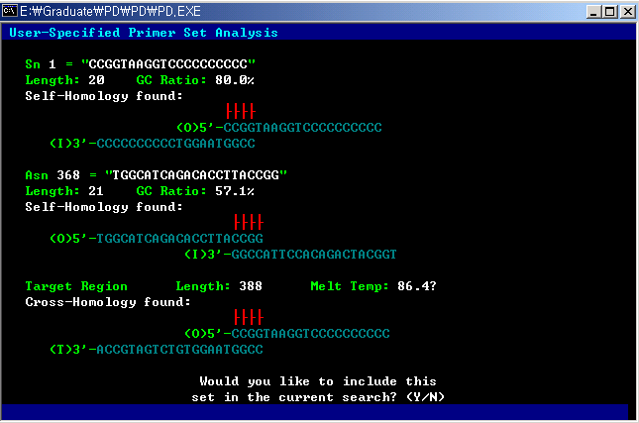
~R
R

Slide 9
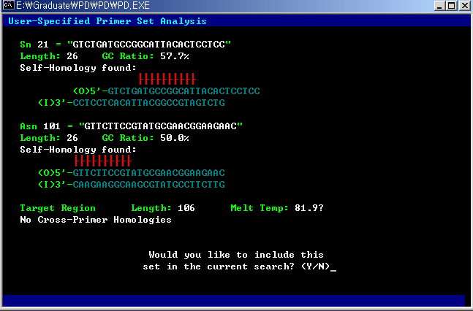
~Q
T

Slide 10
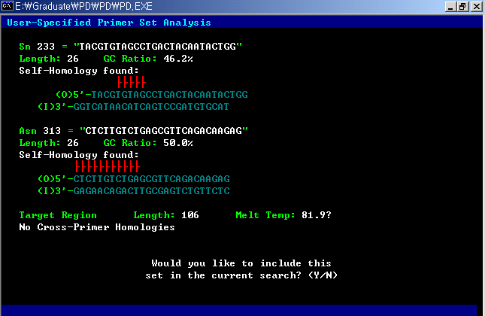
Q
P

Slide 11
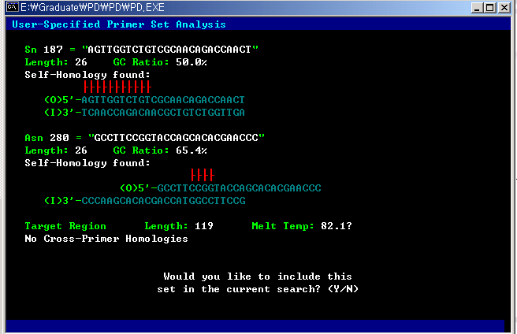
S
~P

Slide 12
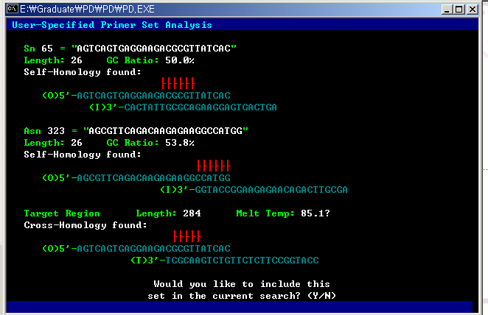
~T
P

Slide 13












5’
3’
CTCTTGTCTGAGCGTTCAGACAAGAGAAGGCCATGG
AGTTGGTCTGTCGCAACAGACCAACTAATCACAAGG
GTTCTTCCGTATGCGAACGGAAGAACGTGATAACGC
GTGTAATGCCTTCCGGTACCAGCACACGAA
GTCTGATGCCGGCATTACACTCCTCCAGTA
TCGTGTGCTTGGCATCAGACACCTTACCGG
TACGTGTAGCCTGACTACAATACTGGAGGA
GTCTTCCTCAGCTACACGTACCTTGTGATT
TTGTAGTCAGTGAGGAAGACGCGTTATCAC
CCGGTAAGGT
모두 5’에서 3’ 방향
(=화살표 방향): 그림, 서열 모두에서 …
* Expected PCR product: 298 bp
6
10
10
71.8°C
62.8°C
10
20
10
70.7°C
74.5°C
10
10
20
68.8°C
10
10
10
20
6
6
10
10
20
10
74.5°C
10
62.1°C
10
10
20
20
64.3°C
17.7°C
73.3°C
10
3’
5’

Slide 14
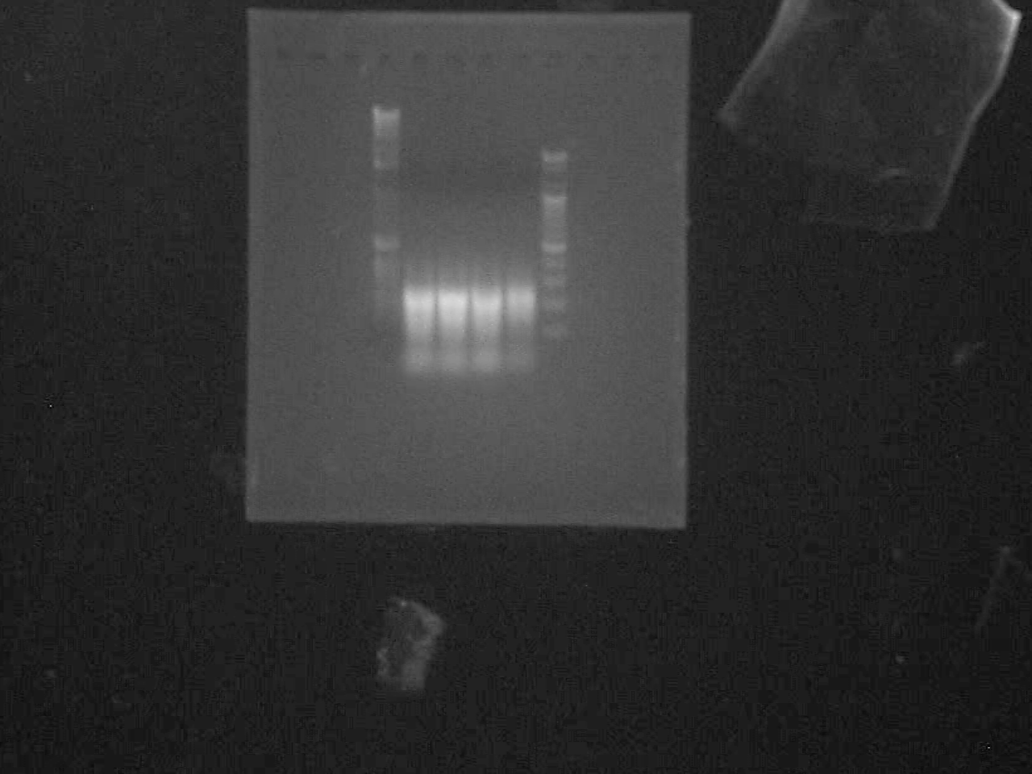
Result ( I )
Lane 1: DNA ladder(BMS)
Lane 2,5: Ligation mixture(100pmol)
Lane 3: Ligation mixture(200pmol)
Lane 4: Ligation mixture(400pmol)
Lane 6: 100bp DNA ladder(Bioneer)
250bp
300bp
200bp
100bp
Fig 1. Ligation mixture

Slide 15
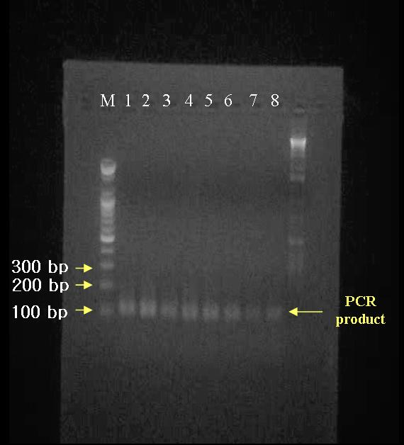
Result ( II )
Fig 2. Secondary PCR product

Slide 16
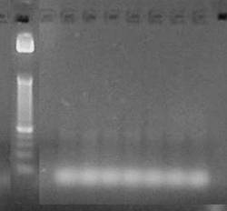
Result ( III)
25 bp
PCR product
Fig 3. Hairpin PCR product

Slide 17
Discussion
Mismatch Hairpin structure
  Shorter stem region
  Hairpin Tm range condition
  ; Annealing temp( 65°C ) < Tm < Extension temp( 72°C )
3’
5’
3’
5’

Slide 18
Discussion
Another detection method
- SSCP
- R.E cleavage size

