Slide 1
The Nuclease

Slide 2
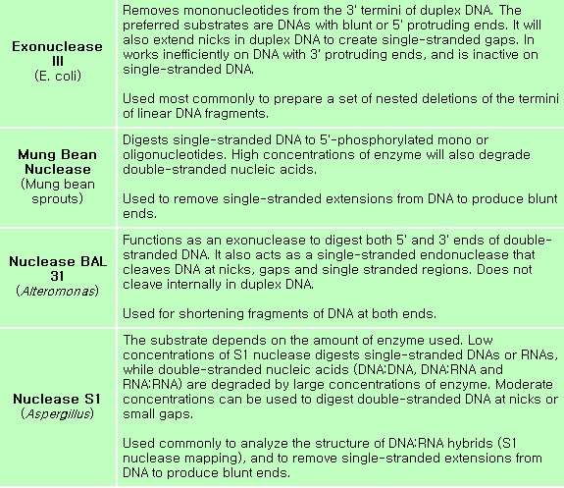


Slide 3
BAL 31 Nuclease(Alteromonas espejiana BAL 31); (1-2)
Activity: Exonuclease/endonuclease
Substrate: ds DNA sequentially from both termini
Reaction:
5’
3’
3’
5’
Ca²+
(rapid reaction)
BAL31
(2-3 units/ml
[high concentration])
5’
3’
3’
5’
Ca²+
(slow reaction)
5’
5’
3’
Blunt ends(~10-20%)
3’
5’
5’
3’
Single stranded tails about 5 nucleotides long(~80-90%)
3’
5’

Slide 4
BAL31 Nuclease(1)
Activity: Exonuclease(shortens ss DNA)
Substrate: ss DNA with 3’-hydroxyl termini
Reaction
5’
3’
Ca²+
BAL31
5’
3’

Slide 5
BAL31 Nuclease(2)
Activity: Endonuclease
Substrate: ss DNA; supercoiled DNA; DNA with B-DNA, Z-DNA
junctions and other non-B DNA Conformations
Reaction:
ss DNA
BAL31
Mononucleotides
Ca²⁺
ds linear DNA
BAL31
Superhelical ds DNA
Ca²⁺

Slide 6
Nuclease S1
Activity: single strand specific nuclease
Substrate: ss DNA or RNA/ more active on DNA than on RNA
Reaction: ss DNA or RNA → ^{5’}_{p}dN or ^{5’}_{p}rN
Nicked ds DNA
Zn ²⁺
(pH 4.5)
Nuclease S1
(moderate amounts)
+

Slide 7
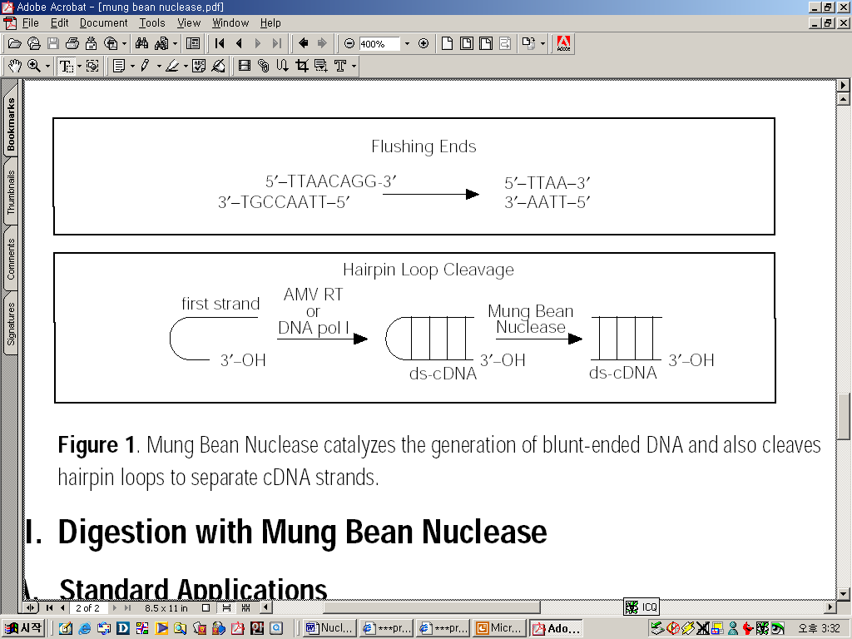
Mung Bean Nuclease (Mung bean sprouts)
Mung Bean Nuclease belongs to a class of enzymes that demonstrate a preference for single-stranded nucleic acids, lack sugar specificity and hydrolyze single-stranded substrates to products with 5’-phosphoryl and 3’-hydroxyl termini.

Slide 8
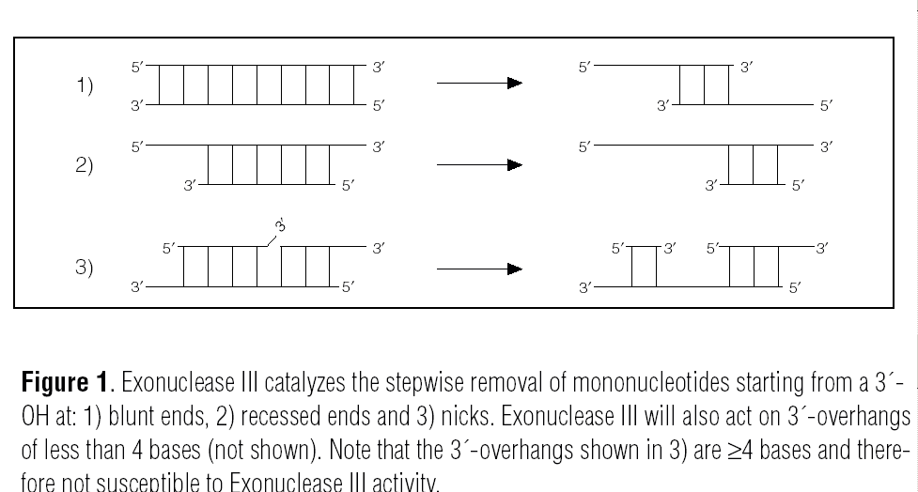
Exonuclease III (E.coli) (1-2)
A double-strand specific, nonprocessive 3´→5´ exodeoxyribonuclease activity; however, 3´-overhangs of ≥4 bases are protected from Exo III activity (1).

Slide 9
Exonuclease III (E.coli) (1)
Activity: 3’ Exonuclease
Substrate:
- active on 3’-hydroxyl termino of ds DNA with blunt ends or
with ends containing unpaired 5’-termini and recessed 3’-termini.
- 3’-hydroxyol termini at nicks in ds DNA
- The DNA must contain phosphodiester bonds; thioester are not
cleaved
Reaction:
5’ P
OH 3’
3’ HO
P 5’
5’ P
OH 3’
+ 5’ pN_{OH}
3’ HO
P 5’

Slide 10
Exonuclease III (E.coli) (2)
Activity: 3’ phosphatase
Substrate: ds or ss DNA with a 3’-phospate terminus; internal
phosphodiester bonds are not cleaved.
Reaction:
5’
P 3’
5’
OH 3’
Exo III
P 3’
5’
3’ OH
5’

Slide 11
Bacteriophage λ Exonuclease
(Bacteriophage λ-infected E.coli)
Activity: 5’ Exonuclease
Substrate: ds DNA with 5’-phosphate termini or with protruding
5’-termini
Reaction:
5’
OH 3’
3’
5’
Mg²⁺
Bacteriophage λ Exonuclease
5’
OH 3’
3’
5’
+ 5’ pG_{OH} + 5’ pC_{OH} + 5’pT_{OH} + 5’pA_{OH}

