Slide 1
Tutorial on DNA Computing and Graph Transformation – Computational Nature of Gene Assembly in Ciliates
T. Harju, I. Petre, and G. Rozenberg
ICGT2002, LNCS 2505, pp. 430-434, 2002.
Cho, Dong-Yeon

Slide 2
Introduction
Two Streams
  DNA computing in vitro
    Building (specialized) DNA-based computers in test tubes
  DNA computing in vivo
    Implementing some computational components in living cells
    Studying the computational processes taking place in the living cells
Gene Assembly
  A very intricate DNA processing taking place in single cell organisms called ciliates
  The role of graph transformations in modeling and studying gene assembly process
  The gene assembly process inspires a new computing paradigm; computing by folding and recombination.

Slide 3

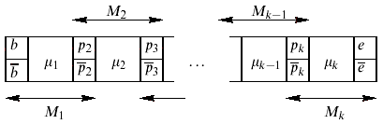
Nuclear Dualism of Ciliates (1/2)
Two Kinds of Nuclei
  Micronucleus
    The genes are placed in very long continuous DNA molecule interrupted by noncoding space DNA.
  Macronucleus
    The DNA is present in short, gene-size molecule, on average two thousand base pairs long.
MDS
(Macronuclear Destined Segment)
IES
(Internal Eliminated Segment)

Slide 4
Nuclear Dualism of Ciliates (2/2)
Gene Assembly
  At some stage in the sexual reproduction process, ciliates convert the micronuclear genome into the macronuclear genome, eliminating all the noncoding DNA, and transferring the micronuclear form of each gene into its macronuclear form.
  Ex) actin I gene of O. nova
    M₃I₁M₄I₂M₆I₃M₅I₄M₇I₅M₉I₆M₂I₇M₁I₈M₈
    M₁M₂M₃M₄M₅M₆M₇M₈M₉

Slide 5
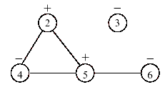
Formalisms: Legal Strings and Overlap Graphs
Assembly Strategies
  How micronuclear genes are translated to macronuclear conuterparts
Formalism
  Example
    M₁I₁M₆I₂M₅I₃M₃I₄M₂I₅M₄ ⇒ 2 6 5 6 4 3 3 2 5 4
  Legal string
    Exactly tow occurrences from {p, p}
  A pointer p in a legal string is negative, if δ₁pδ₂pδ₃
  A pointer p in a legal string is positive, if δ₁pδ₂pδ₃
  Two pointers p, q are said to be overlap in a legal string, δ₁p₁δ₂q₁δ₃p₂δ₄q₂δ₅, where p₁, p₂∈{p, p} and q₁, q₂∈{q, q}

Slide 6
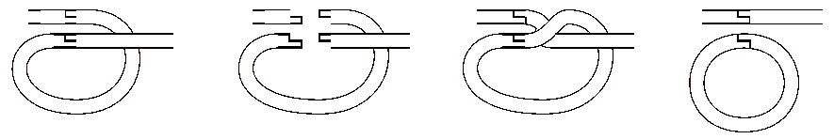
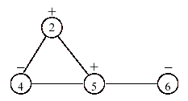
The Operations for Assembly (1/3)
Gene assembly is accomplished through the following three molecular operations.
  The ld-operation: δ₁ppδ₂ ⇒ δ₁δ₂
    The operation excises the part of the molecule that lies between the occurrences of this pointer.
    This part forms a debris circular molecule, and should not contain any MDSs.
    Removing a negative isolated vertex p⁻
2 6 5 6 4 3 3 2 5 4 ⇒ 2 6 5 6 4 2 5 4

Slide 7
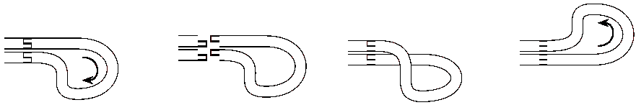
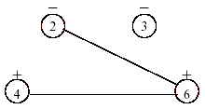
The Operations for Assembly (2/3)
  The hi-operation: δ₁pδ₂pδ₃ ⇒ δ₁δ₂δ₃
    It reverses the part of the molecule that lies between the two occurrences of the pointer.
    Removing a positive vertex p⁺ and complementing the neighborhood of p
2 6 5 6 4 3 3 2 5 4 ⇒ 2 6 6 4 3 3 2 4

Slide 8
The Operations for Assembly (3/3)
  The dlad-operation: δ₁pδ₂qδ₃pδ₄qδ₅ ⇒ δ₁δ₄δ₃δ₂δ₅
    It results in a molecule, where the intermediate parts are transposed.
    Removing two adjacent negative vertices p⁻ and q⁻, and complementing the edge set between the neighborhoods N(p) and N(q)/N(p), and N(q) and N(p)/N(q)
Every overlap graph reduces to the empty graph by a finite number of these 3 graph theoretic operations.
Such a sequence of operations describes how an micronuclear gene can be transformed to its macronuclear counter part.

