Slide 1
A DNA computing readout operation based on structure-specific cleavage
Liman Wang, Jeff G. Hall, Manchun Lu, Qinghua Liu1, and Lloyd M. Smith
2001, Vol 19, Nature Biotechnology

Slide 2
Introduction
The READOUT step identifies the DNA molecules present at the end of the computational process.
Problems in PCR-based readout
The specificity of the sequence detection used here derives from the sequence specificity of DNA hybridization coupled with the structure specificity of the enzymatic cleavage.

Slide 3
Previous work,
4-variable/3-satisfiability (SAT) problem (Nature, 2000)
5′-FFFFvvvvvvvvFFFF-3′
Four operations: MARK, DESTROY, UNMARK, and READOUT.
READOUT step
  Identifies the DNA molecules that encode the solutions to the computational problem.
READOUT step based on PCR
  Problems: false-positive signals, nonuniform amplification from mixtures of DNA targets

Slide 5
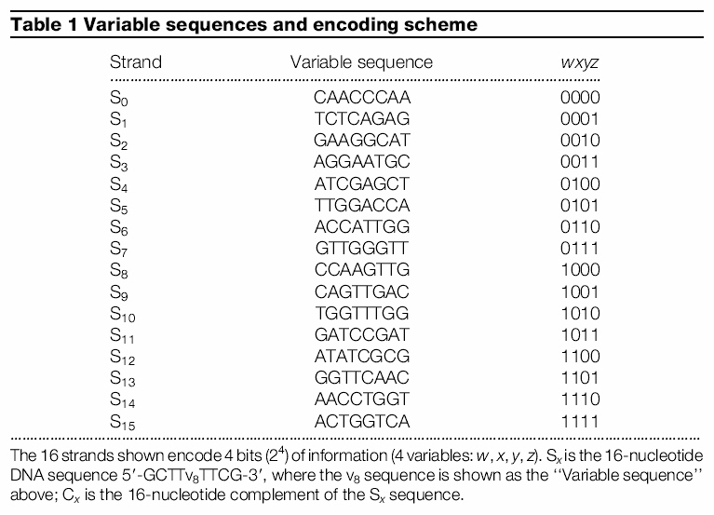

Slide 6
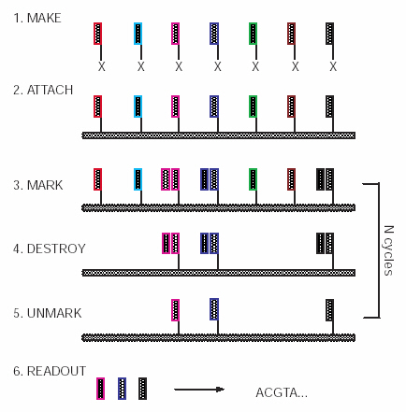

Slide 7
In this work,
An alternative READOUT approach
  Based on a recently developed structure-specific cleavage reaction, which addresses several of the problems encountered with PCR-based READOUT.

Slide 8
The structure-specific cleavage reaction
Developed for the quantitative detection of nucleic acids and the discrimination of single-nucleotide polymorphisms (SNPs)
Reaction
  Involves the hybridization of two sequence-specific oligonucleotides, an upstream oligonucleotide and a probe oligonucleotide, to a nucleic acid target of interest
Invasive cleavage
  Occurs at the position defined by the 3′-end of the upstream oligonucleotide, releasing the 5′-arm and the base-paired region of the probe oligonucleotide overlapped by the upstream oligonucleotide (usually one base)

Slide 9
The hybridized region of the probe sequence
  Designed to have a melting temperature near the temperature of the reaction.
  This allows for rapid turnover of the probe oligonucleotides, thereby amplifying the signal (many cleaved probes are produced per target DNA molecule).
  Typically, ~1,000 probe oligonucleotides are cleaved per target molecule in 30 min.

Slide 10
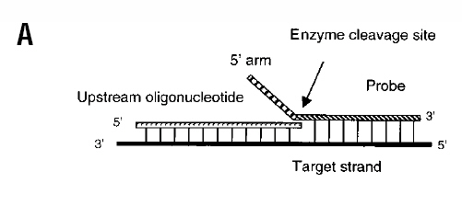
Analyte-specific region
→ forms a duplex with the target
Noncomplementary 5′-arm region
overlaps at least one nucleotide
Schematic representations of the invasive cleavage reaction
and structure of the overlapping substrate
  The upstream oligonucleotide and probe are bound with the target strand so that the
  3′-terminal nucleotide of the upstream oligonucleotide overlaps with the
  terminus of the duplex formed between the probe and the target. The
  arrow indicates the site of cleavage, which generates a cleaved 5′-arm.

Slide 11
A secondary cleavage reaction
For cases in which this level of signal amplification is insufficient.
  The cleaved arm from the primary reaction serves as the upstream oligonucleotide in a secondary cleavage reaction directed against a target–probe complex that is introduced into the reaction mix, producing secondary cleavage products (signal molecules) that are then detected.
  The arm sequences cycle in a fashion similar to the probe oligonucleotide in the primary reaction, permitting a limiting number of arms to drive multiple cleavage events.
Fluorescence resonance energy transfer (FRET) may be employed for homogeneous detection

Slide 12
The use of two sequential stages of cleavage reactions
  approximately squares the amount of amplification of cleavage products compared with a single-stage invasive cleavage reaction.

Slide 13
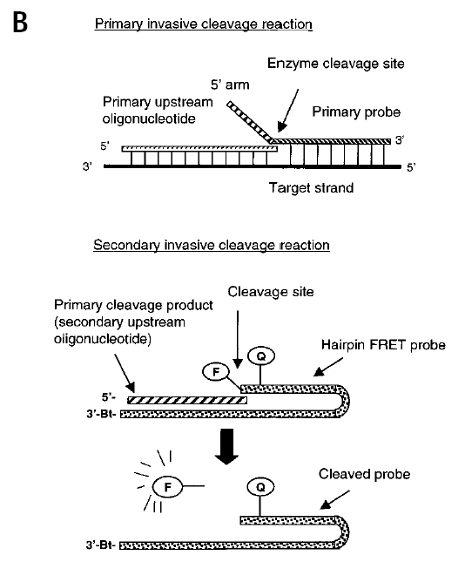
The two-step invasive cleavage reaction
The oligonucleotide cleavage product generated
from a primary reaction serves as an upstream
oligonucleotide in a secondary invasive cleavage
reaction, producing signal molecules that can be
detected by fluorescence resonance energy
transfer (FRET).
The fluorophore donor (F) is placed on the
opposite side of the cleavage site on a hairpin
oligonucleotide, and will be separated from the
fluorescence acceptor (Q) during the cleavage
event, resulting in an increase in fluorescence.

Slide 14
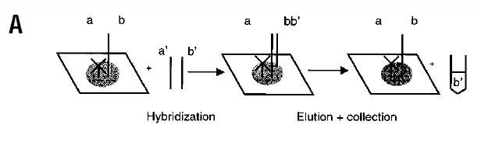

Slide 15
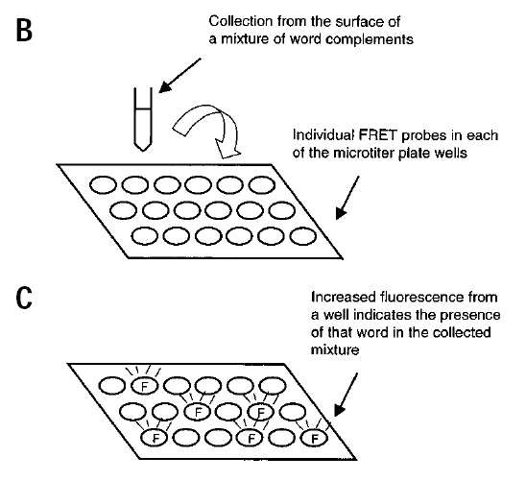

Slide 16
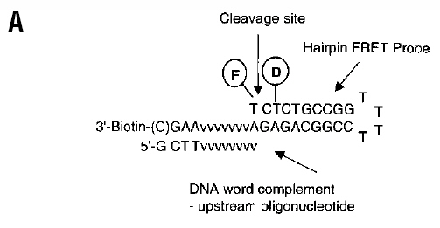
Results an Discussion
Structure of hairpin FRET probes employed for single-word DNA computing
  The hairpin-structured probe–target complex is labeled with fluorescein
  (fluorescence donor, F) and dabcyl (fluorescence acceptor, Q), forming a
  FRET pair.

Slide 17
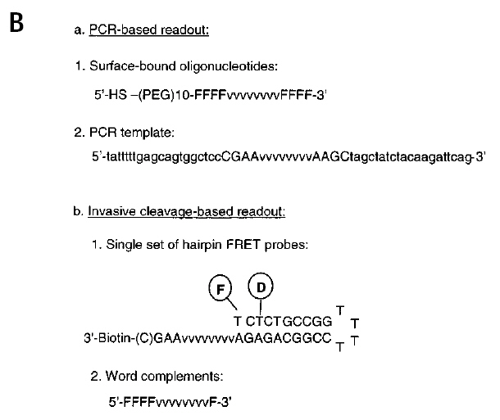
In the PCR-based READOUT
  two sets of DNA
  oligonucleotides are required for each word employed in a multiple-word
  DNA computation. The first set consists of each individual word
  sequence, synthesized with a long spacer and a functional group for
  surface attachment. The second set consists of the complements to each
  word sequence, along with contiguous sequences for subsequent PCR
  amplification.

Slide 18
In contrast, the invasive cleavage–based READOUT operation
  requires only a single set of hairpin FRET probes, each
  35–36 nucleotides in length and containing two dyes and a biotin group,
  to read out all the DNA words; a second set of word complements,
  13 nucleotides in length and unmodified, is needed for each word
  employed in a multiple-word DNA computation.

Slide 19
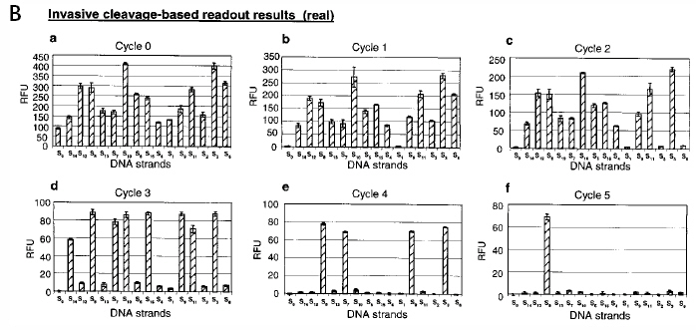
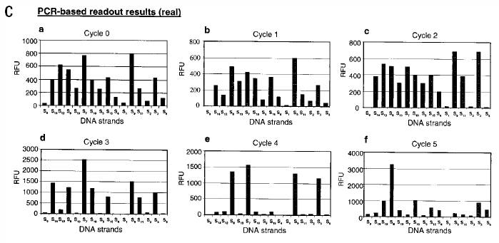

Slide 20
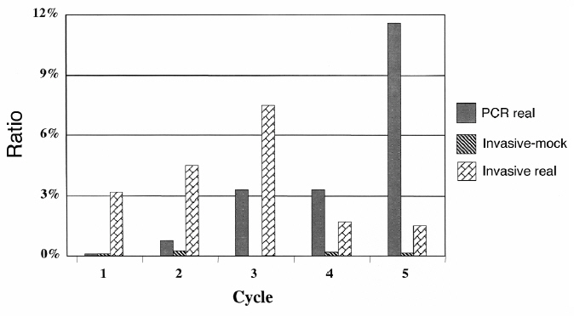

Slide 21
