Slide 1
Gene expression profiling diagnosis through DNA molecular computation
Allen P. Mills, Jr.
TRENDS in Biotechnology, vol 20 No.4 (2002) 137-140
MEC Seminar
Su Dong Kim
2003. 1. 9.

Slide 2
Introduction
Gene expression profiling ; (mRNA : cDNA)
DNA microarray
Adleman DNA self-assembly computer
DNA neural network
Expression profiling should be feasible
using a DNA neural network acting directly on cDNA

Slide 3
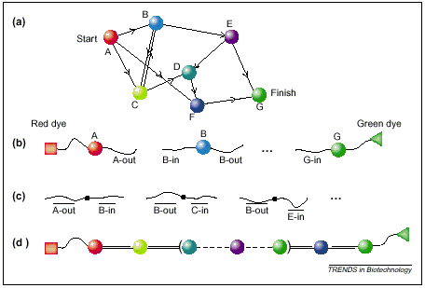
DNA computation
Adleman’s in vitro DNA solution of HPP (1994)

Slide 4
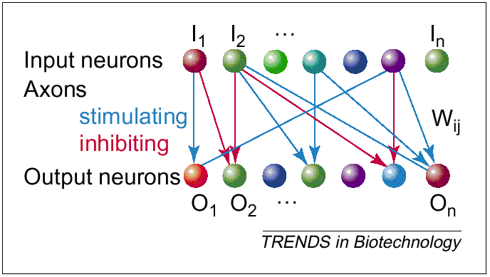
Perceptron

Slide 5
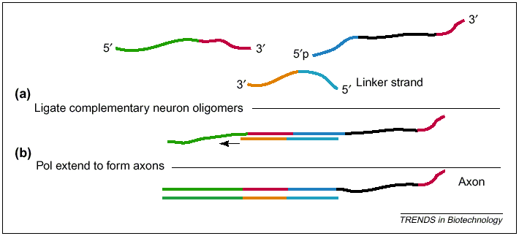
DNA Neural Networks (1)
Steps in forming an axon

Slide 6
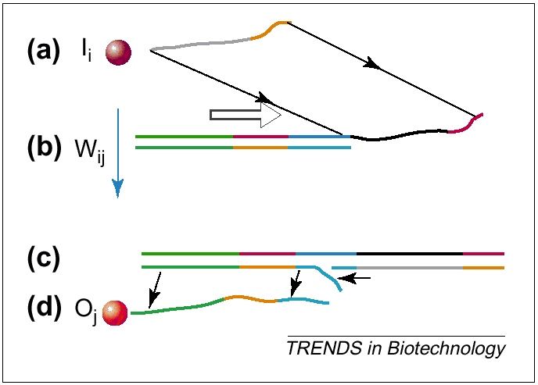
DNA Neural Networks (2)
Single layer DNA Neural Network represented by DNA

Slide 7
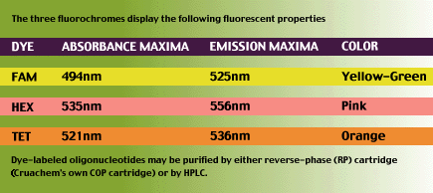
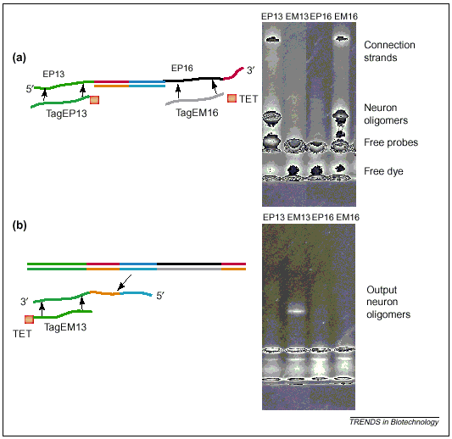
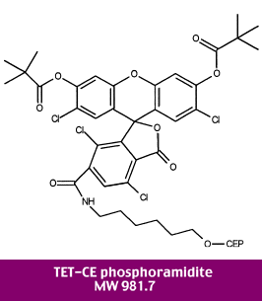
Experimental Results

Slide 8
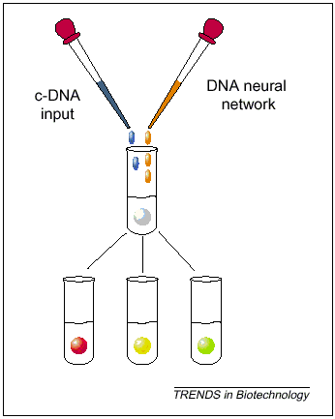
Expression Profiling Neural Network

