Slide 1

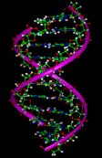
The 3rd Research on Theorem Proving
MEC Meeting
Hanyang University
Proteome Research Lab
2003. 1. 16
Park, Ji-Yoon

Slide 2
The 1st Year Research
- Linear Implementation

Slide 3
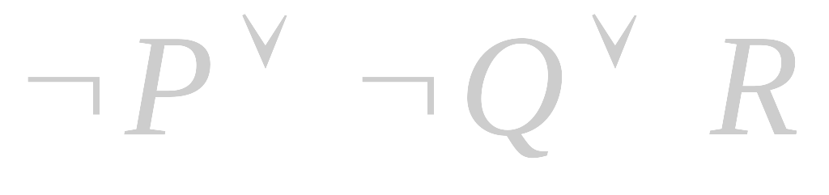





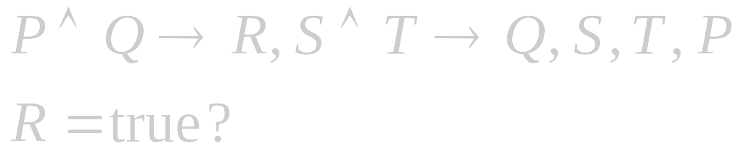






Theorem Proving using Resolution Refutation
, add R as
Nil

Slide 4
The Sequence for Linear Implementation
Primer | Sequence | Length | Modification | GC Content ( % )
ST¬Q | 5’ - AAG CAG TAG CGA CCA ATT GAC GCA AAT TGA CGT ACG TAC GCT GAA - 3’ | 45 mer | None | 46.7
¬RPQ | 5’- CAT ACA ATG AAC GCA GTC AAC GCA AGG CAG TTC AGC GTA CGT ACG - 3’ | 45 mer | None | 51.1
¬P | 5’- CTG CCT TGC GTT GAC - 3’ | 15 mer | 5’-phosphate | 60.0
R | 5’- TGC GTT CAT TGT ATG – 3’ | 15 mer | 5’-phosphate | 40.0
¬S | 5’ - TGG TCG CTA CTT –3’ | 15 mer | 5’-phosphate | 53.3
¬T | 5’ - TCA ATT TGC GTC AAT-3’ | 15 mer | 5’-phosphate | 33.3

Slide 5
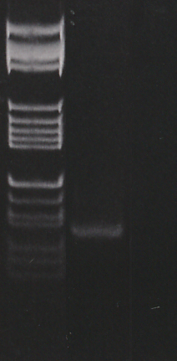
The Amplification of Linear Molecule
587
540
504
458
434
M
1
2
267
234
213
192
184
Fig 1. The amplification of linear
molecule in 3% agarose gel
electrophoresis
Lane 1: PCR product with S and ¬R
Lane 2: PCR products with ¬ S and R
Lane M is a 25 bp molecular DNA ladder
124/123
104
89/80
75 bp
64/57/51/
21/18/11/8

Slide 6
The 2nd Year Research
- Hairpin Implementation

Slide 7

Sequence for Hairpin Implementation
5mer
¬P
¬Q
P
6 mer
Q
5mer

Slide 8
The Sequence for Hairpin Implementation
Primer | Sequence(5’ → 3’) | Length | Modification | GC Content ( % )
P | TATTAAGACTTCTTGTAGTCT | 21 mer | 5’-Phosphate | 28.5
Q | TCATGTTCCT | 10 mer | 5’-Phosphate | 40.0
¬P | TAATAAGGAA | 10 mer | 5’-Phosphate | 20.0
¬Q | CATGA | 5 mer | 5’-phosphate | 40.0
¬R | TCATGTTCCT | 10 mer | 5’-phosphate | 33.3

Slide 9
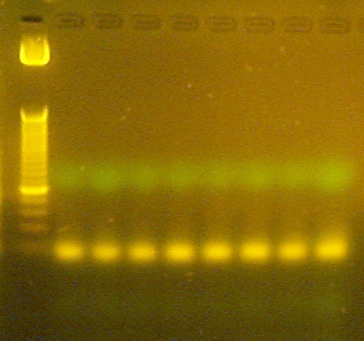
The Amplification of Hairpin Molecule
50 bp
25 bp
Fig 2. The amplification of hairpin molecule in 3%
agarose gel electrophoresis

Slide 10
The 3rd Year Plan

Slide 11
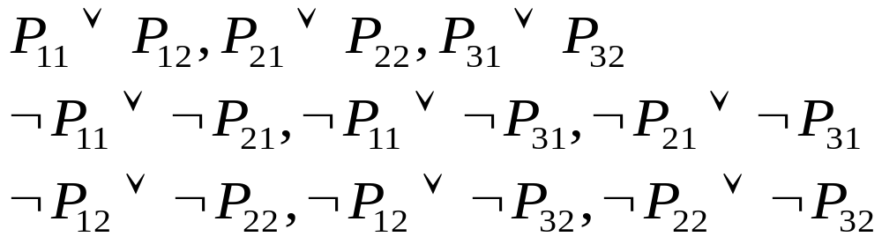
Design of Problem
6 variables, 9 clauses

Slide 12
One of Proof Trees
P₁₁∨P₁₂
~P₁₂∨~P₂₂
P₁₁∨~P₂₂
P₂₁∨P₂₂
P₁₁∨ P₂₁
~P₂₁∨~P₃₁
~P₁₁∨~P₂₁
P₂₁∨P₂₂
P₁₁∨~P₃₁
P₃₁∨P₃₂
~P₂₂∨~P₃₂
~P₁₁∨ P₂₂
P₁₁∨ P₃₂
~P₁₂∨~P₃₂
P₃₁∨P₃₂
~P₁₁∨ ~P₃₂
20~30
P₁₁∨~P₁₂
P₁₁∨P₁₂
~P₁₁∨~P₃₁
~P₁₁∨ P₃₁
20~30
P₁₁
~P₁₁
nil

Slide 13
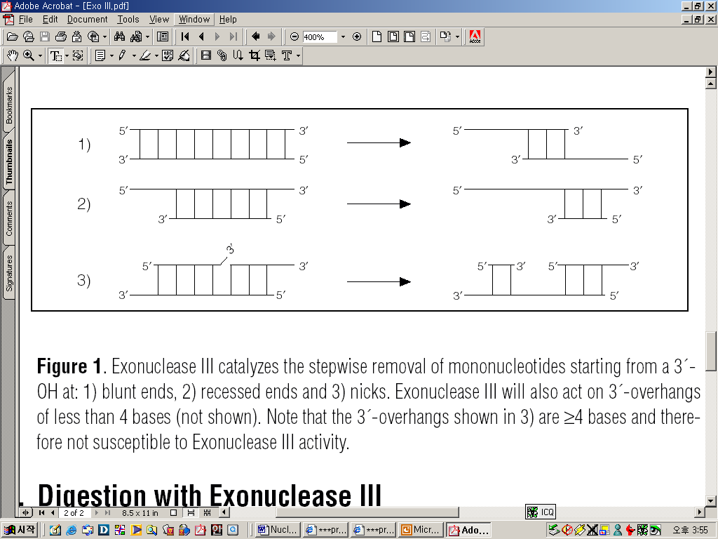
Experimental Procedure
Step VI
Step I
The Problem
(6var, 9clau)
Exonuclease III
(remove partial
solution)
* No Self-Homology
* No Cross-Homology
Step V
Step IV
Ligation
(T4 DNA Ligase: 16°C
Step II
Design of Oligo Sequence
Step VII
Hybridization
(95°C→16°C cooling down)
Gel Electrophoresis
Synthesis & Modification
(5’-Phosphate)
Step III
Step VIII
The Final Solution

Slide 14
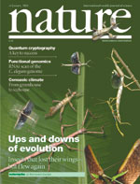


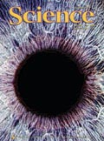

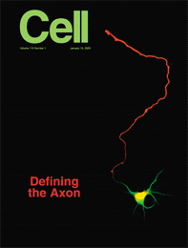
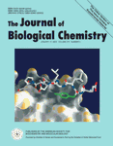
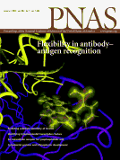

Forward Direction
29.491
24.595
DNA9 Conference
  Abstract Submission(2/15)
  Experimental Work
Journal Version
  Biochemical Journal
  Biological Computing
4.493
5.545
3.161
36.242
7.666
6.373
10.896

Slide 15

Expected Result
Fragments of linear DNA migrate through agarose gels with a mobility that is inversely proportional to the log₁₀ of their molecular weight
Circular forms of DNA migrate in agarose distinctly differently from linear DNAs of the same mass.

Slide 16
Discussion

