Slide 1
Error Correction in DNA Computing: Misclassification and Strand Loss
Kevin Chen and Erik Winfree
DNA5, 1999.
Summarized by In-Hee Lee

Slide 2
Model of Computation
Three primitives: extract, combine, detect.
  Optionally, detect step.
Linear running time, exponential amount of DNA.

Slide 3
Error Model
Assumption
  Errors are occurred in extraction step only.
  An algorithm has E extract steps.
Two sources of error
  Classification error
    P_{correct} : the probability that a strand is correctly processed by the entire algorithm
  Strand loss
    P_{survival} : the probability of at least one copy of a strand survive to the end of the computation

Slide 4
P_{correct}
Compound extract
  Repeat the same simple extract n times.
P_{correct} can be given by the tail of binomial distribution.
P_{e} : probability of error due to compound extract.

Slide 5
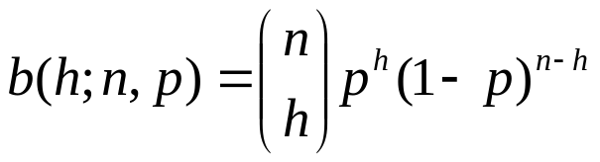
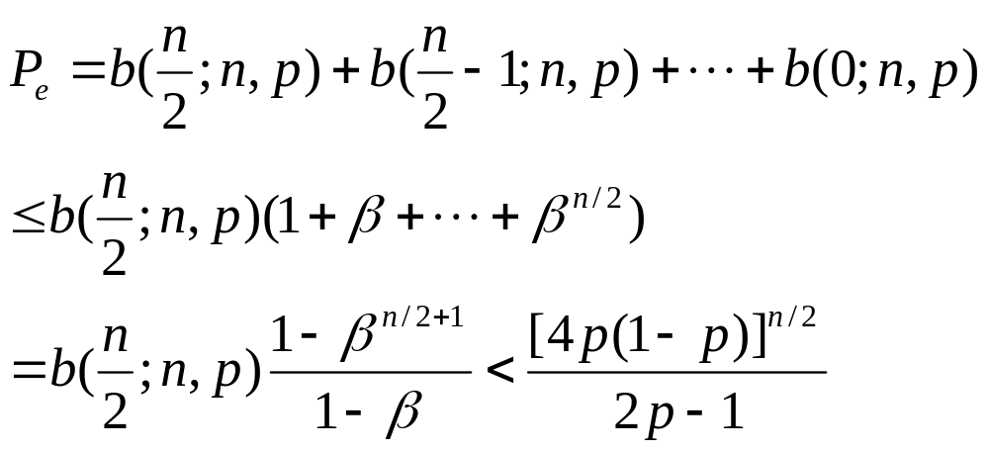
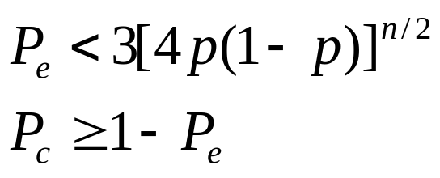
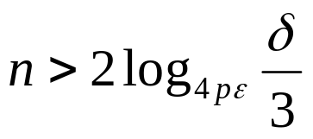
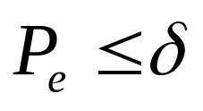
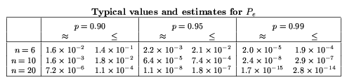
Upper Bound Analysis
Using ensures that

Slide 6

P_{survival}
Assumption
  Constant strand loss => apply PCR every k steps.
    An algorithm with E steps has generations.
Definitions
  P_{s} : probability that at least one copy survives the computation
  Z_{m} : number of strands in the m^{th} generation
  P_{m,i} : P(Z_{m}=i)

Slide 7




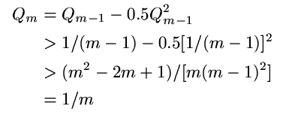

Bound Analysis
…
…
…
…

Slide 8


Combining P_{survival} and P_{correct}
If
Then
  P_{correct} > 0.95
  P_{survival} > 0.95
  There is probability that no more than one bad strand in the tube.

