Slide 1
Chemical Reaction-Diffusion Implementation of Finding the Shortest Paths in a Labyrinth
N. G. Rambidi and D. Yakovenchuk
Physical Review E, vol. 63, no. 2, 2001.
Cho, Dong-Yeon

Slide 2
Introduction
Nonlinear Reaction-Diffusion Media
  Some of the more promising embodiments of parallel and distributed computing
  Highly parallel multiprocessing system
  Light-sensitive reaction-diffusion media of Belousov-Zhabotinsky type

Slide 3
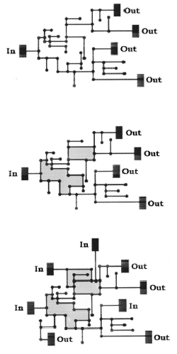
Several Remarks on the Problem of Finding the Shortest Paths in a Labyrinth
This paper is an attempt to show the followings.
  Known light-sensitive reaction-diffusion media of Belousov-Zhabotinsky type can be effectively used nowadays to solve at least simple labyrinth problems.
  The effective technique could be applied to finding the shorted path in a labyrinth on the basis of information on consecutive steps of wave spreading through the labyrinth.

Slide 4
Fundamentals of the Approach (1/2)
Three principal points were assumed.
  Hybrid type
    A combination of reaction-diffusion medium with a universal digital computer
  Storing a labyrinth of arbitrary structure in the reaction-diffusion medium for further processing
  How to organize a wave process capable of spreading in a parallel mode through all possible paths of a labyrinth
    Trigger waves – the velocity is very low.
    Phase waves

Slide 5
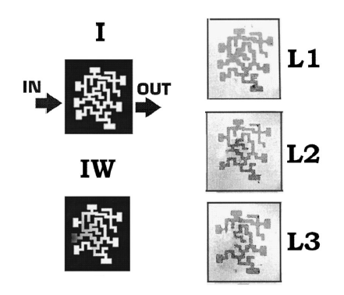
Fundamentals of the Approach (2/2)
Dynamic of the Belousov-Zhabotinsky Reaction
  Concentration of Br⁻
  Nonuniform background
  Self-oscillating mode of the Ru-based Belousov-Zhabotinsky reaction
    I: initial labyrinth image
    IW: a nonuniform background superimposed on the initial labyrinth image
    L1-L3: negative image

Slide 6
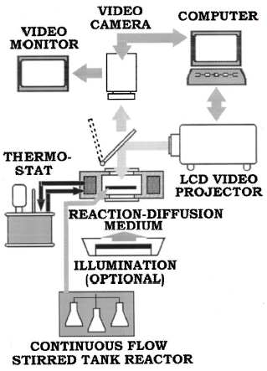
Experimental Technique
Principal Setup Scheme

Slide 7
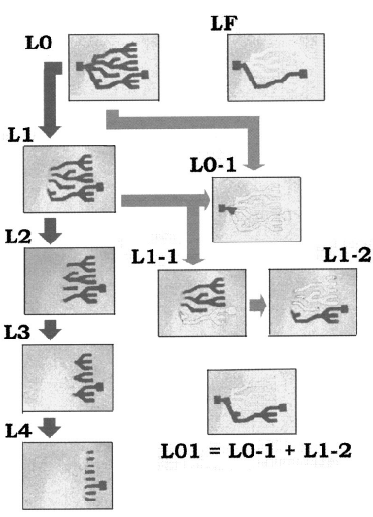
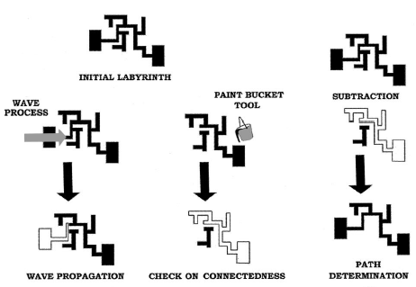
Procedure for Finding the Shortest Paths in a Labyrinth (1/2)
Paint-bucket operation
Simple tree-type labyrinth

Slide 8
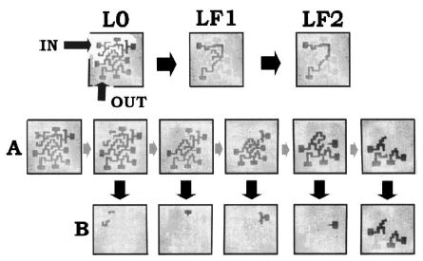
Procedure for Finding the Shortest Paths in a Labyrinth (2/2)
Arbitrary labyrinth

