Slide 1
A Software Tool for Generating Non-Crosshybridizing libraries of DNA Oligonucleotides
Russell Deaton, junghuei Chen, hong Bi, and John A. Rose
Summerized by Ji-Eun, Yun

Slide 2
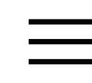
Abstract(1)
The problem of
finding a library of
non-crosshybridizing
DNA oligonucleotides
Finding an
independent set of
vertices in a graph.
Vertices : Individual oligonucleotides or Watson-Crick pairs
Edge : Indicating a hybridization

Slide 3
Abstract(2)
The minimum free energy of hybridization, according to the nearest-neighbor model of duplex thermal stability ,is less than some threshold value.
Using this equivalence, an algorithm is implemented to find maximal libraries.

Slide 4
Introduction(1)
DNAC key operation : the template-matching hybridization reaction.
Unplanned hybridization can occur Several negative effects.
DWD several requirements.
  The selected oligonucleotides should hybridize only as designed.
  The set of words, or library, should be large enough to represent the problem and implement a solution.
  Most of previous work : small collections of oligonucleotides.

Slide 5
Introduction(2)
The ongoing work goal
  To use computer simulation to study the characteristics of very large collections of many different DNA oligonucleotides.
  A DWD tool was implemented
    1. Ability to simulate and generate large sets of non-crosshybridizing oligonucleotides
    basis in nearest-neighbor model of DNA thermal stability,
    capability to check sequences and their reverse complements
    Options for different reaction conditions
    (temperature, salt starand concentrations , output of free energies of hybridization , melting temperatures and alignments of most energetically stable duplex.)

Slide 6
Outline
The equivalence of the DWD problem and the ISET
A software tool is described that implements the suggested algorithms.
The method and result are discussed, and conclusionts given.

Slide 7





DWD Equivalence to ISET(1)
The DNA word design problem ( the problem of finding a maimum-sized library of non-crosshybidizing DNA word) may be expressed as follows:
Difinition 1(DWD)
  Given a set of DNA oligonucleotides , an hybridization energy
  a positive integer , and a threshold , does T contain a subset such that

Slide 8




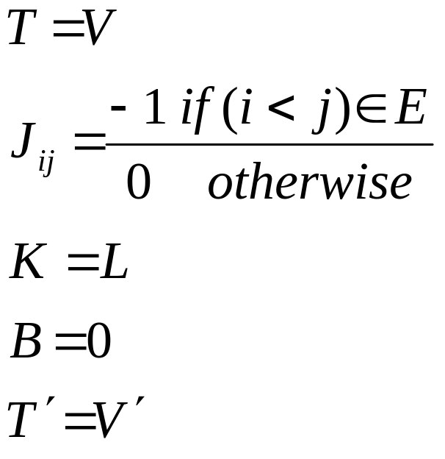
DWD Equivalence to ISET(2)
Definition 2(ISET)
  Given a graph G = (V,E) and a positive integer
  , dose G contain a subset such that , and such that no two vertice in are joined by an edge in E

Slide 9
DWD Equivalence to ISET(3)
Greedy Algorithm
  Let T' represent the noncrosshybridizing library, and N(T') indicate all those oligonucleotide.
  The algorithm for an initial set of oligonucleotides of size m is shown
Begin
T '← 0
for i = 1 to m do if i∈N( T ')then T '← T '∪{i}
end

Slide 10
DWD Equivalence to ISET(4)
In the Implementation
  Large random sets of oligonucleotides and their Watson-Crick complements are generated.
  Oligonucleotide are chosen in order and added to the library if they are still available.
  All oligonucleotides that have an minimum energy of hybridization with the added sequence, or its complement, that are less than threshold.
By repeating this process, a non-crosshybridizing library can be selected from the original random population

Slide 11
Thermodynamic Calculations(1)
The pgm uses the nearest-neighbor model of duplex thermal stability to determine gybridization evergies between oligonucleotides.
Hybridization are determined between two oligonucleotides if their minimum free energy of formation is less than a user-defined threshold.

Slide 12
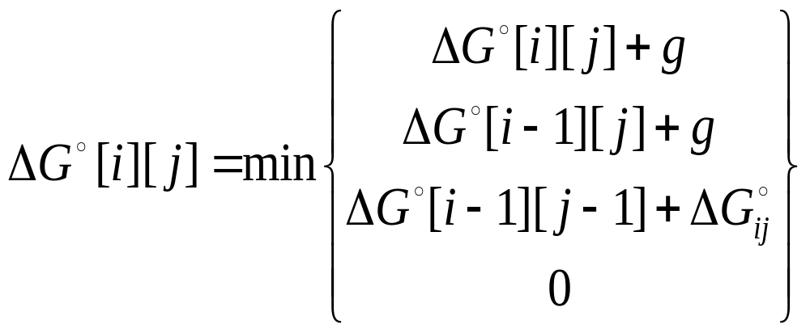
Thermodynamic Calculations(2)
The minimum free energy of hybridization is computed using a variant of the Smith-Waterman dynamic programming for finding local alignments.
The scoring function

Slide 13
Thermodynamic Calculations(4)
Value of enthalpy are recorded for melting temperature calculations

Slide 14
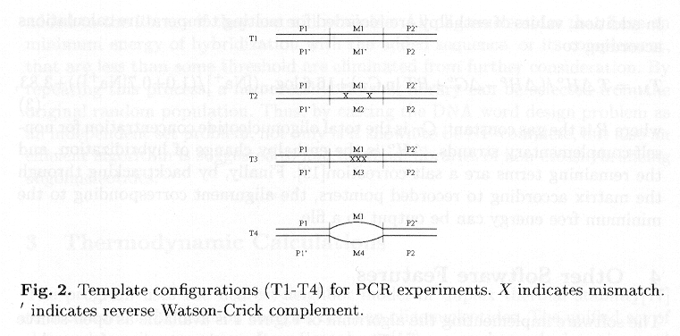
Results(1)
1. A set of template molecules to test a PCR protocol to select maximally mismatched DNA oligonucleotieds

Slide 15
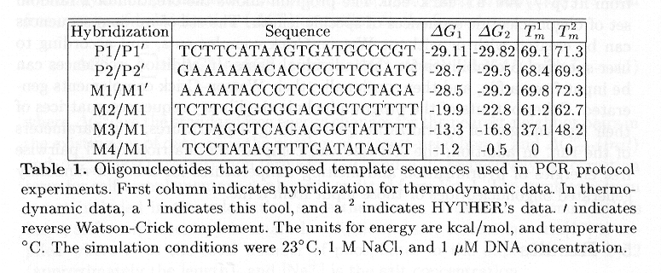
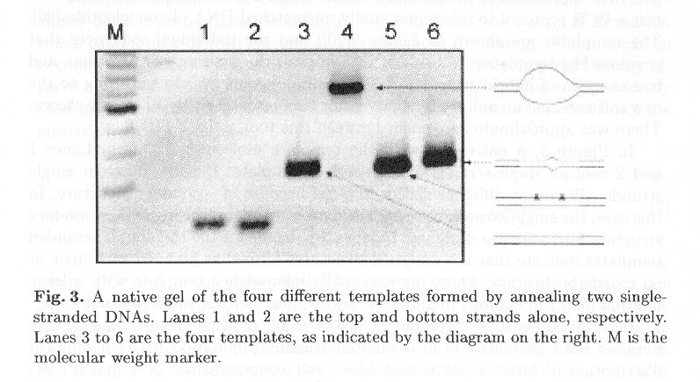
Results(2)

Slide 16
Discussion(1)
A maximal non-crosshybridizing library, not the largest possible.
The algorithm is fairly efficient and has generated a library of 3953 non-crosshybridizing Watson-Crick pairs of length 20bp.
In the thermodynamics, only the minimum free energy of hybridization is computed between two oligonucleotides.
  Minimum free energy was sufficiently small -> p(h) also be small
  many binding modes of approximately equal energy -> significant p(cross h)

Slide 17
Discussion(2)
The threshold for hybridization is set by the user
  Because, the size of the library generated is highly dependent on the threshold.
The duplexes generated by the tool were consistent with a modified staggered zipper model.
(local dynamic pgmming method produced single duplex region that contained very few error.)
The goal of the tool is not a complete thermodynamic simulator, but to supply a speedy design tool for large libraries of DNA words for computation.

Slide 18
Conclusion(1)
A software tool for generating non-crosshybridizing oligonucleotides has been developed and tested.
The minimum free energy for duplex formation between two given oligonucleotide is calculated using a unified set of nearest-neighbor thermodynamic parameters
A dynamic pgmming algorithm that calculates the minimum energy over all possible local alignment of two oligonucleotides.

Slide 19
Conclusion(2)
The libraries are selected from a initial random population by applying a greedy algorithm.
The tool was also used to generate non-crosshybridizing libraries for 10-mer and 20-mer.

