Slide 1
A PNA-mediated whiplash PCR-based program for in vitro protein evolution
2002.8.16
Eun-jeong Lee

Slide 2
Abstract
The directed evolution of proteins
  Using in vitro domainal shuffling strategy
  Based on POA
  Inefficient (‘cause backhybridization during POA), too coarse ( ‘cause domainal level)
In this work,
  Compact structural unit, or module & associated pseudo-module are adopted
In vitro method
  PWPCR, RNA-protein fusion, and restriction-based recombination (for a given selection motif)

Slide 3
Introduction (1)
Shuffled dsDNA libraries by Dnase I digestion & POA (I.e., DNA shuffling)
  unlikely to be capable of evolving substantially novel protein folds, and the non-homologous swapping of folded structures
Key for optimizing the search of protein sequence space
Domains

Slide 4
Introduction (2)
Domains
  string of nonoverlapping, independently folding elements
  30-300 residues in length
Protein evolution by in vitro domainal shuffling
  polynucleotide species encoding for each domain+set of chimeric oligonucleotide each of which encoding domain-domain boundary (in solution)
  iterated annealing, polymerase extension, dissociation of this strand set
  =>production of library of domain-shuffled dsDNAs
  -has many problems
Notes:
Problem-Dnase I에 의한 digestion으로 domainal integrity가 손상을 입고, POA를 하는 동안 back hybridization이 안정적으로 형성되고,
Expression을 위한 in vitro system을 위해서는 prometer나 ribosomal binding site 등을 인코드하는 dsDNAs가 높은 비율로 있도록 디자인되어야하는데 이점이 확실치 않다.

Slide 5
Introduction (3)
PWPCR is combined w/ RNA-protein fusion
  to implement a high-efficiency exon shuffling operation
  ‘module’ rather than the domain, is adopted as the basic element of protein structure
module
  compact structural unit
each shuffled protein
    : a walk on a predefined graph
each vertex
    : a pseudo-module contained in an initial protein set of interest

Slide 6
The Module Picture of Protein Architecture (1)
The frequent occurance of introns within domains
  belies the view that each exon encodes a domain
  suggests the decomposition of domains into a set of smaller, modules
modules
  corresponds roughly to an exon
  by exploiting
    (1) the tendency for module junctions to be buried
    (2) the tendency of modules to form a locally compact unit

Slide 7
The Module Picture of Protein Architecture (2)
basic module structure
  unit-turn-unit
  a length is correlated w/ the radius of the protein (10-25 residues : about half the mean exon length)
pseudo-module
  the element bt’n the approximate midpoints of adjacent modules
  coil-unit-coil structure
  a basic structural element of proteins

Slide 8
The Pseudo-module Generating Graph
P (prtein)
  decomposed into N to C-terminal sequence of q+1 pseudo-modules
  modeled as a q step tour of the digraph, Gp(V,E)
composition of Gp(V,E)
  V={V_{i}:i=1,…,q+1}, Vi : i^{th} pseudo-module from P’s N-terminus
  E={E_{i,i+1}:i=1,…,q}, E_{s,t} : directed edge bt’n source and target vertices
Pseudomodule graph representation
  facilitates a discussion of the generation problem for sets of proteins derived from P by various forms of pseudo-module sampling

Slide 9
The Pseudo-module Generating Graph
shuffling
  the protein set generated by the random sampling of q+1 pseudo-modules from P
  corresponds to the set of q-step walks on Gp(V,E⁺) ( ; fully interconnected graph).
Pseudo-module shuffling
  shuffling within specific regions of P (other regions remain unshuffled)
  Gp(V,E_{s}) ; pseudo-module graph

Slide 10
An in vitro Genetic Program for Protein Evolution
An in vitro method is presented for evolving sets of proteins w/ high affinity for a predifined seletion motif
subject to a specified pseudo-module graph, Gp(V′,E ′)
begin w/ initialization and followed by iterated application of 3 step cycle

Slide 11
Three step cycle
genotype generation
  by PWPCR followed by parallel strand conversion to
  dsDNA
fitness evaluation and selection
  by the generation of a set of RNA-protein fusions,
  followed by selection based on affinity to an
  immobilized selection motif
recombination
  using a restriction enzyme-based crossover
  operation

Slide 12
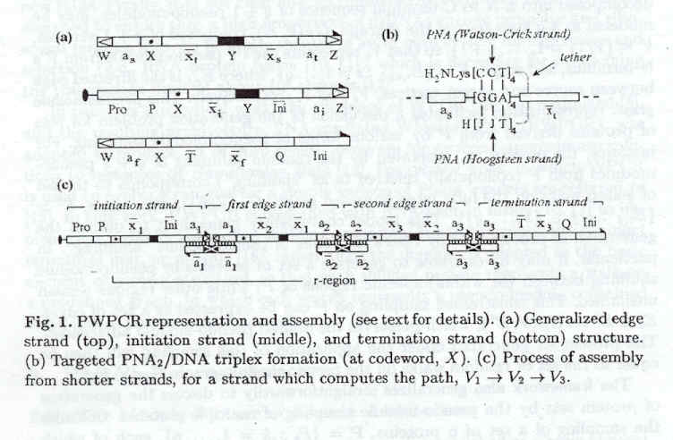
Initialization
edge
initiation
X : target site for triplex
termination
splinting
strand
x_{s}, x_{t}, a_{s}, a_{t} : edge specific / s:source, t:target / W,Z : halves of re.en site
/ X,x_{s},Y,x_{t} : implement the transition, V_{s} -> V_{t} / Pro : T7 promoter seq.
/ P : primer annealing / a_{i} : initial vertex / Q : primer annealing
/ Ini : Shine-Dalgarno seq.

Slide 13
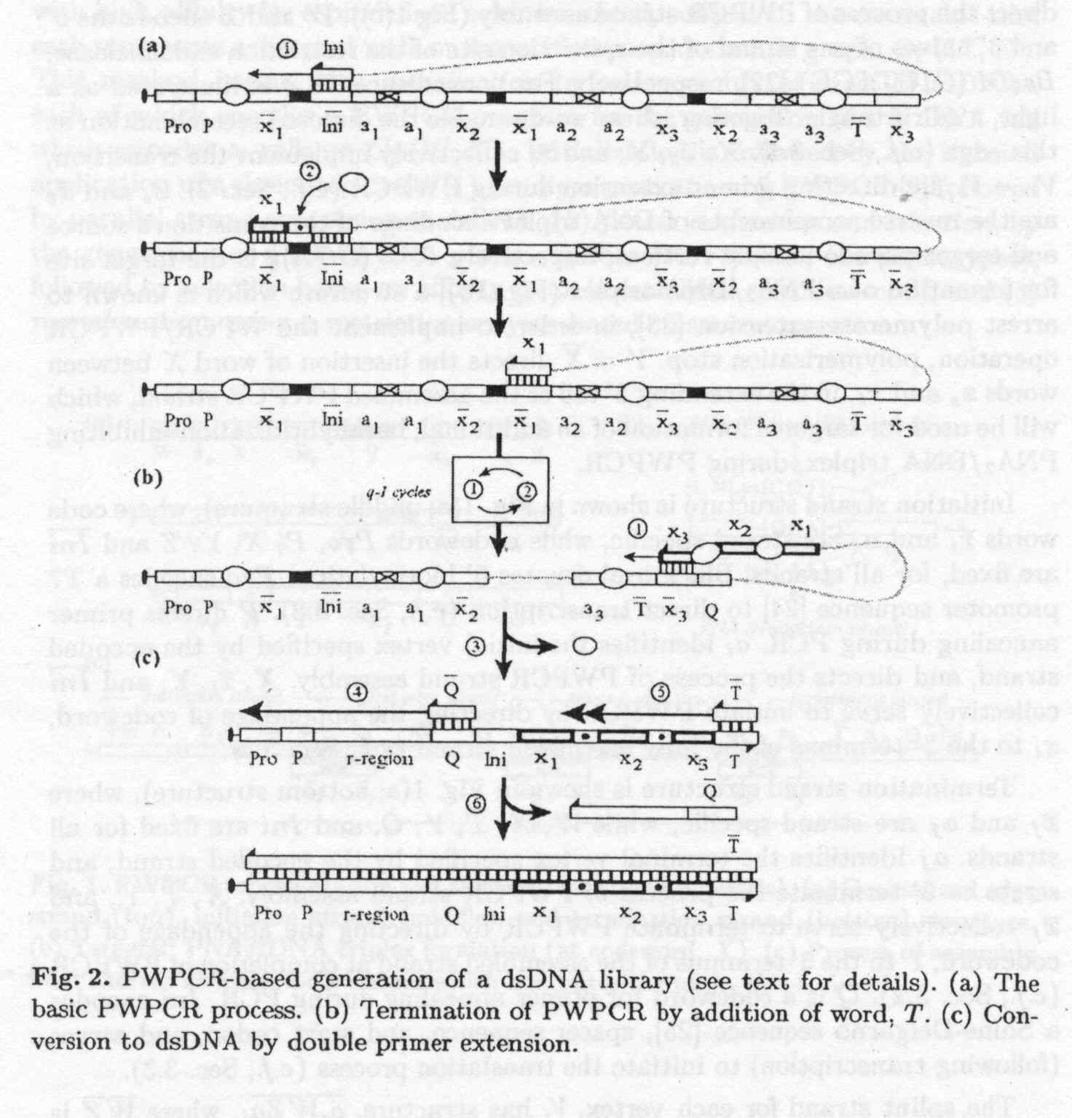
PWPCR-based Generation of a dsDNA Library

Slide 14
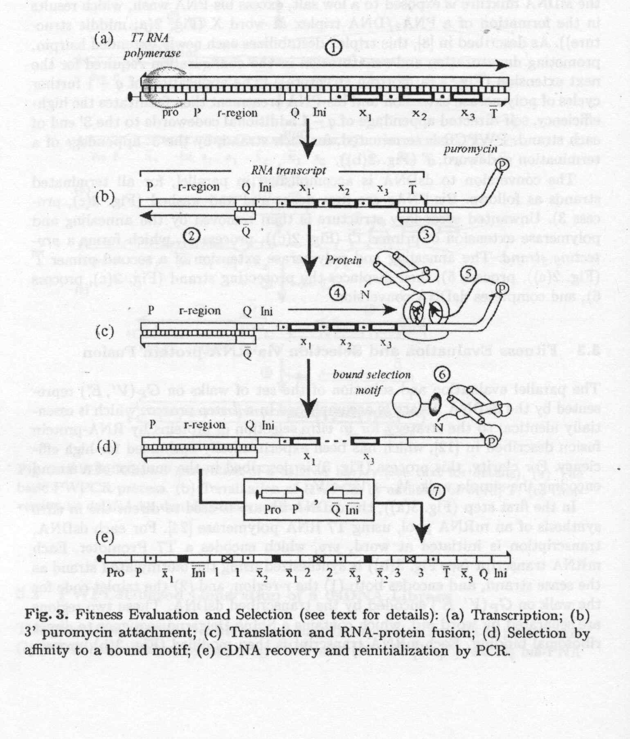
Fitness Evaluation and
Selection via
RNA-protein Fusion

Slide 15
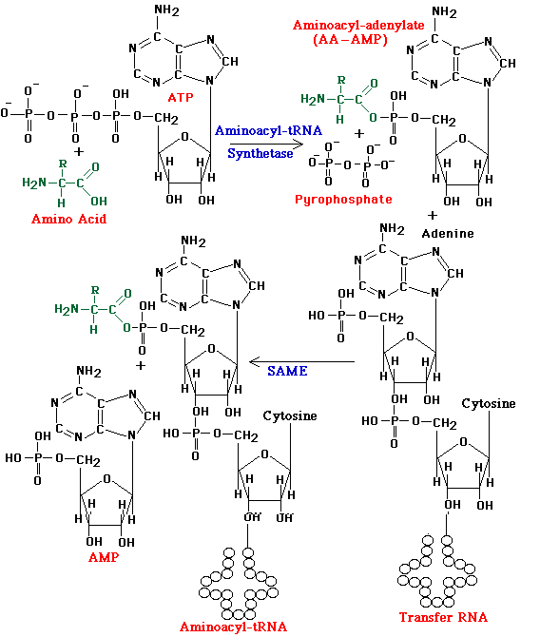
tRNA

Slide 16
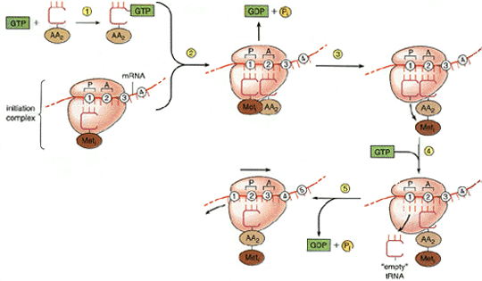
structure of ribosome
and elongation

Slide 17
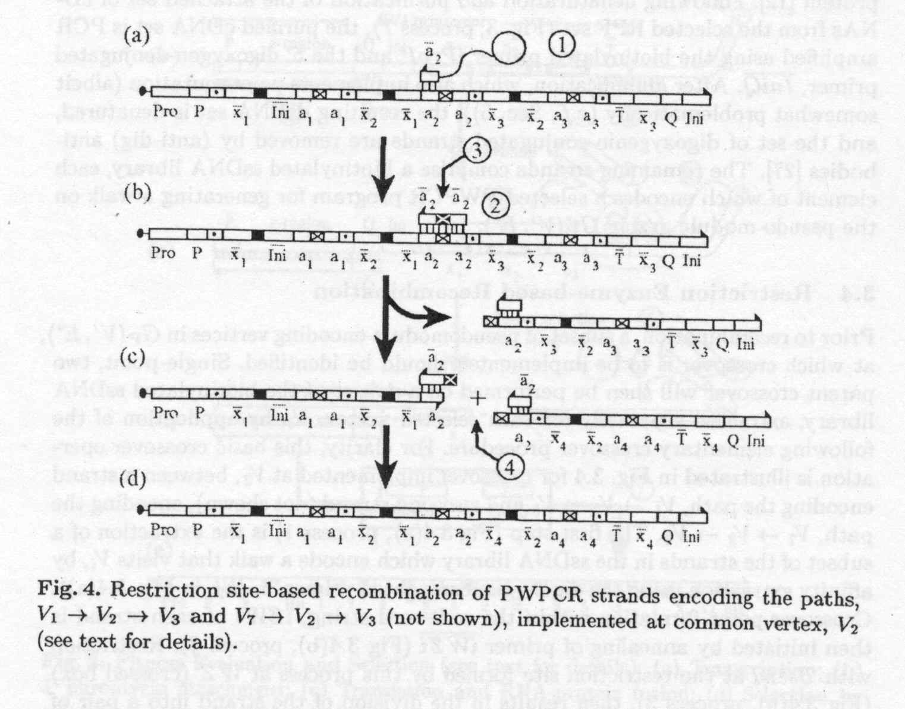
Restriction Enzyme-based
Recombination

